Slide 1

Practical Advice for parenting in the digital age
By
Denise Lisi DeRosa
Notes:
Technology is neutral. How we use it determines if it is a good thing or a bad thing. Think of technology as a tool, like a hammer….hang a picture, build a house or break a window. Technology is so woven in to our lives that it is necessary for us to understand and control our relationship to tech in order to live a healthy and balanced life.
****It’s not the technology that gets us in trouble, but how we use it. Let’s teach our kids to use it wisely. *****

Slide 2
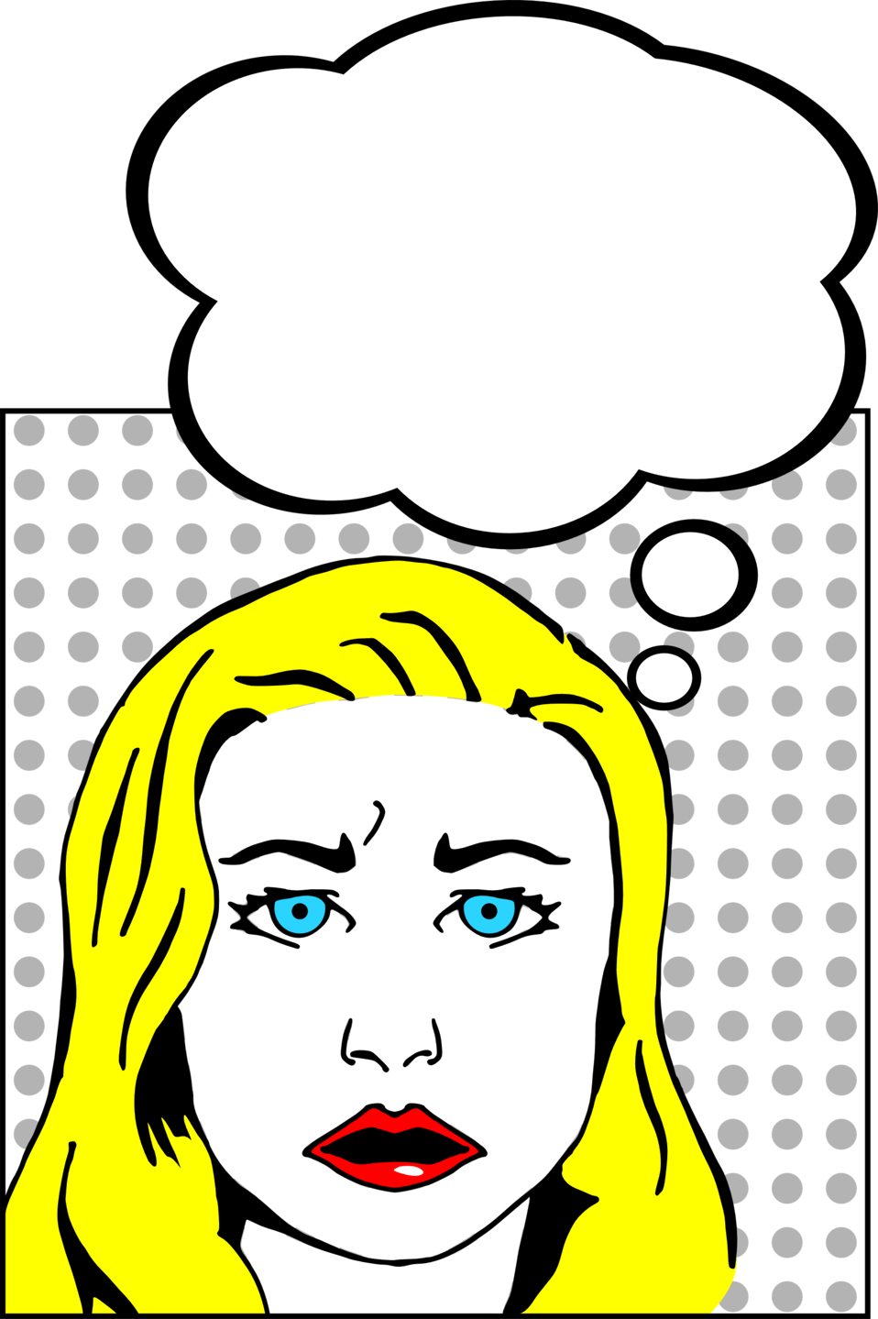
parent concerns
Screen Time / Over Use
  What are they missing because of screen use?
Content
  Ineffective filters, misinformation, urban legends
Connections
  Who are their ‘friends’ online?
Lack of Privacy
  What and how much are they sharing?
Notes:
What are your biggest concerns? And I chose this image because she looks worried but she doesn't know what she's worried about. I think that is the problem sometimes. We know we are worried about what our kids are doing online... but we can't say exactly what or why? But here are a top few I hear regularly.

Slide 3

Common Missteps
Overshare
Too Many Friends or Followers
Relative to What is Shared
Ignore Privacy & Safety Tools
Impulse Control
Over-Gaming, Bullying, Partying, Constant Distraction, Sexting
Notes:
We get in to the most trouble when we use tech mindlessly. It is more about learning to use tech with intention and not relying on it to stave boredom, or distract us from the real world.

Slide 4

Digital wellness
Using technology productively and with purpose while avoiding distraction and information overload
-Tools and strategies to flourish in the digital age
-Solutions for living in harmony with technology
Notes:
There are however things we can do to find tech balance. Healthy tech use is becoming an important part of our overall wellbeing. This movement includes people within the tech communities, psychologists and wellness professionals. The Digital Wellness Collective is a global organization leading the way.
there are some research backed tools and strategies that can be taught to improve productivity and reduce tech distraction - For us and our children.

Slide 5
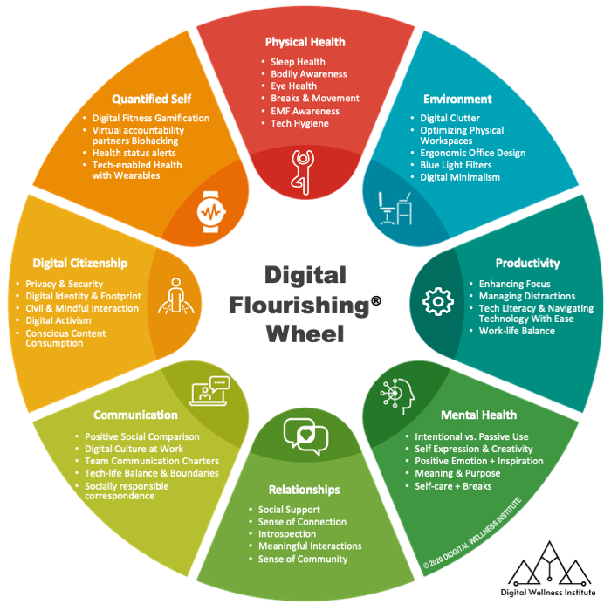
Notes:
DWC has taken in to consideration the 8 Pillars of Wellbeing: Intellectual, Career, Physical, Social, Spiritual, Financial, Environmental, and Emotional and applied the principles of wellbeing to establish the Digital Flourishing Wheel. This is an assessment tool to help people find the right digital balance and wellness for themselves and their families. Today, I want to focus on how the areas shown above apply to us and what we can do ensure a healthy relationship with technology. (Go through wheel)
PRODUCTIVTY: How do notifications and digital distractions effect your ability to focus?
DIGCIT: Do you know and understand how to stay safe online? Does your behavior online reflect your family values? Can you determine good from bad information sources.
WELLBEING: What kind of ENVIRONMENT are you encountering in online spaces through gaming and social media? Do these connections effect them positively or negatively? Do you have a COMMUNICATIONS Have you set boundaries for so being in constant contact, constantly interrupted, constantly distracted is not part of a normal day? Set DND, pause notifications.
MENTAL HEALTH: Are you effected by the bombardment of bad news and misinformation? Do you feel good about yourself as compared to the highlight reel of others on Instagram, etc. ? Are you overwhelmed with incoming texts / emails? Do you take time to recharge?
PHYSICAL HEALTH: Are you exercising and sleeping enough? Ware you taking time away from screens to re-set, recharge, digest? What is your office set up?
These answers will be different for every family and every child – and that is okay. Find what works for you and your home.

Slide 6

Over-Connected?
50% feel addicted to their devices
57% admit SM is a distraction from schoolwork
72% think tech manipulates them to stay on longer
78% check devices hourly
72% feel the need to respond immediately to texts, SM message and notifications.
66% Parents feel their teens spend too much time on devices, 52% of teens agree.
Studies show these distractions harm ability to focus and weed out irrelevant information.
BUT….
Majority feel SM has a positive impact on their lives
  Technology Addiction 2016 and Social Media, Social Life 2017 studies by Common Sense Media

Slide 7
Teen Views on Technology
Common Culture
Not addicted to tech, addicted to friends
Feel Positive about Social Media
But say it negatively impacts others
Admit to a hard time identifying accurate information
Provide Evidence Based Research about Tech Use
Encourage Short Breaks
Vs. Digital Detox
Model Healthy Tech Habits
Be a good digital role model
Digital and media literacy needed
They want input in finding digital balance

Slide 8
Brain Drain Effect
and
The Multitasking Myth
Interruption Up to 23 min to return
Attention Residue
Behavior: Self-Interruption
Always-On Culture
Digital Distractions:
Why we're exhausted
Mere Presence
Study
Source: Common Sense Media
Notes:
In 2020 300% Increase in searches for how to get brain to focus
Muscle memory of being distracted
Multitasking is really task switching which slows you down, reduces IQ and impacts short term memory.
Attention Residue: inability to fully transition from one task to next.
We are becoming conditioned to these distractions and to continuous input.
Up to 50% of distraction is imagined – the phone / notifications did not beep, we are just conditioned to check every so often.
For every time we check notification it can take up to 21 minutes to re-engage fully in deep work / learning
Where problematic is in thinking we can multitask or be constantly connected and responsive.
These tech distractions are harmful to learning. While kids may think they can text and pay attention in class, the research says otherwise. It is actually not possible to do 2 cognitive tasks at once. You can not fully listen and check your phone.
Additionally, research studies found that the ‘mere presence’ of a phone in view – even on silent and turned face down, is a distraction that limits cognitive retention and concentration. So we need to urge our kids to put the phones away – in a back pack or in another room while in the class room (or class Zoom) or while studying.
Technology Addiction 2016 and Social Media, Social Life 2017 studies by Common Sense Media

Slide 9

Attention economics
Data Driven Economy
Attention is the currency
Tech Brain Power
Persuasive Design / Hidden Manipulation Techniques
Variable Rewards
The Internet Never Ends
Content Continually Updated & Delivered
Non-stop Notifications
Remind Yourself to Stop
Gamifying Goals
Most friends, likes, followers, and Attention
Valuable and scarce commodity
Behavioral Changes
Fitness trackers
Notes:
Our teens are drawn to their phones as a way to connect with their friends but there are a lot of other forces behind the scenes keeping them attached to their devices.
Technology is driven by the accumulation and selling of our data. The companies who are able to gather the most data can make the most money. How do they acquire our personal information? By grabbing and keeping our attention. Netflix is in competition with Facebook, Fortnite, Amazon, Google, etc. for our attention. With every click, share, scroll, like and query we are giving away a little insight in to our thinking. Every morsel of information is added to get a clearer and clearer picture of what we like, buy, think, feel and want. So, these companies are competing for our attention – and they do this in several ways – with millions of dollars invested in learning how to get and keep our eyeballs on the screen.
Intermittent reinforcement is one trick the social media companies use in their algorithms. Sometimes when I post a photo I’ll get 100 views and 50 likes. Next time 25 views and 5 likes. But its not because of what or how I shared, a good portion of the feedback is due to these hidden techniques – that’s what keeps us interested to keep trying, posting, scrolling – to get more rewards (likes, followers) because we looking for that next post to get us to 200 views and 150 likes.
Another way is the continual update in our feeds or the auto-play on YouTube or streaming services – there is never an end or a definable stopping point. In the past media companies has to clamor for our attention and remind us to check back in, use ‘cliffhangers’ to get us to come back next week for the next episode, now everything is streamed right into our homes, hands, and laptops on a continual loop so we have to remind ourselves to stop.
Finally, gamifying of relationships. Online friendships are defined in quantities, not quality – it’s a numbers game for the most likes, followers, engagement and attention. Just like in games, you want to rack up points, accumulate rewards, get to the next level – and kids/teens are particularly susceptible to this feedback loop.
So, can we really blame or shame our kids for being overconnected? It’s time to parents to understand the forces behind what is drawing our kids to their screens and then we can help them to put virtual friendships and unrelenting notifications in their proper place – reinforce your values to help our kids manage their online time.
We need to expect more from technology – from popularity contests to meaningful connections, from shouting to discussing, from more quantity to more quality, from selfies to collaboration

Slide 10

Communication
Talk Early and Often About Tech
Be Open Minded in Discussions
  Have empathy!
  Be honest about your concerns.
  Think about parallels to your teen years.
  Help them find solutions to digital drama.
Notes:
When you set expectations of behavior for your kids: be kind and respectful, honest and fair – all of those qualities are expected of you online as well. When you talk about bullying, talk about cyberbullying, when you teach your kids not to steal, talk about illegal downloads, piracy and plagiarism.
Ask your kids about their favorite online activities – games, social media, apps, and ask why. Don’t be dismissive, this is their reality, the world they are growing up in is increasingly connected. There are positives and negatives to this changing landscape so teach them to be mindful.
****It’s not the technology that gets us in trouble, but how we use it. Let’s learn to use it wisely. *****

Slide 11

parenting Checklist
Discuss Standards of Online Behavior
    Digital Tattoos
    Tech Etiquette
    ’Friends’
Use Privacy and Safety Settings
Get on Social Media
Choose Content Wisely
Watch / Listen / Play Together
Be a Positive Digital Role Model
Set Tech-free Times / Zones
Notes:
We want to encourage kids to keep their online friends / connections to their friends in real life. When in doubt, they should know they can come to you – and that your immediate reaction will NOT be to remove the privilege, but to help them find a solution.
I spoke with your kids about Digital Tattoos and reminded them that what they post online is public and permanent.

Slide 12

Digital Wellness
Tools to Help Us Help Ourselves!
Wellbeing.Google
Facebook.com/safety/wellbeing
Wellbeing.instagram.com
Apple.com/families/
Support.snapchat.com
Microsoft.com/en-us/family
Verizon Smart Family
Notes:
Technology should improve your life, not distract you from it.

Slide 13
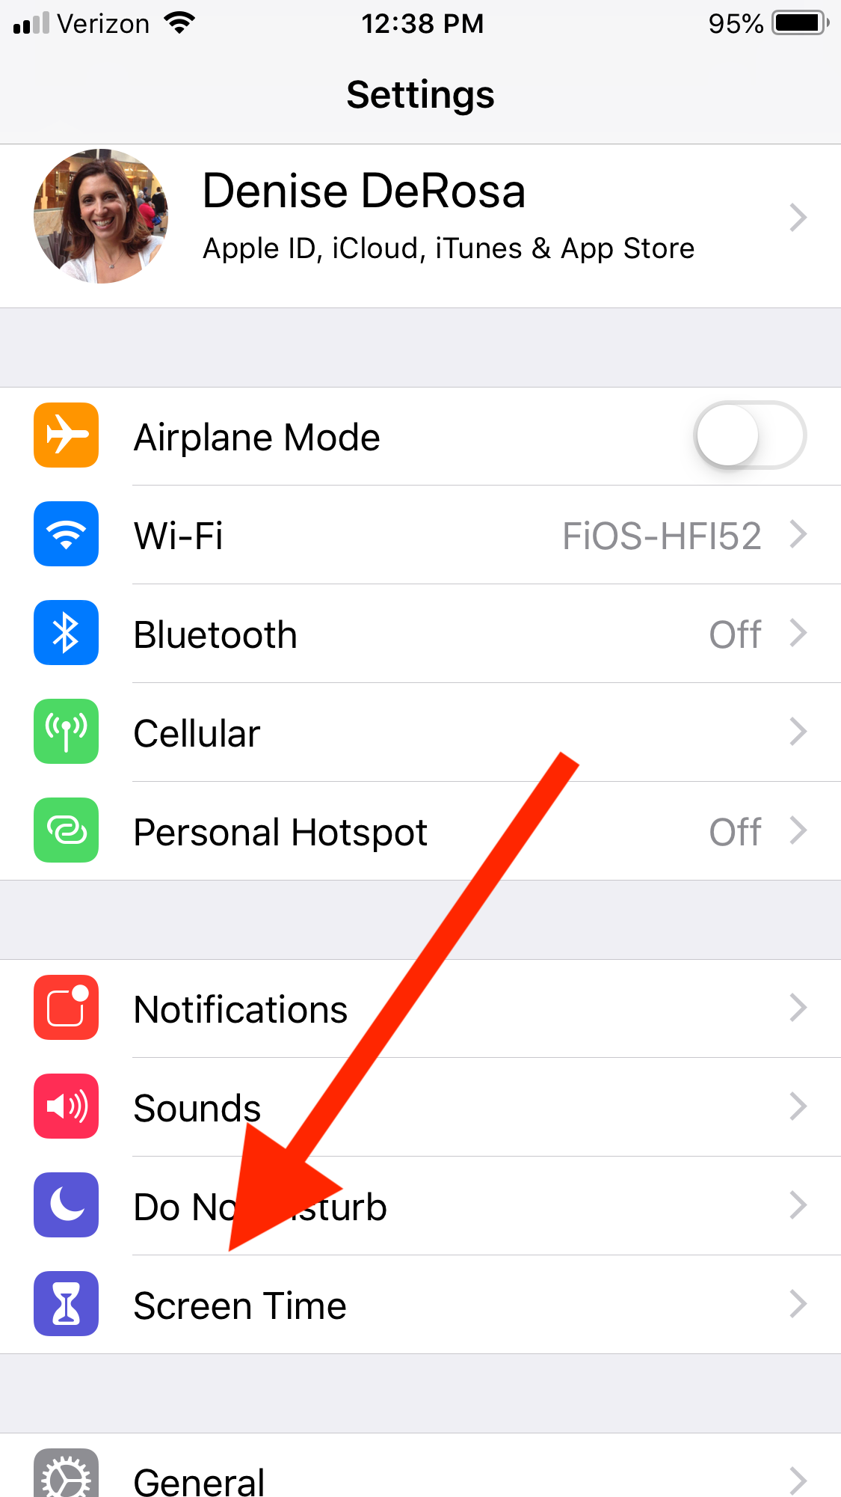
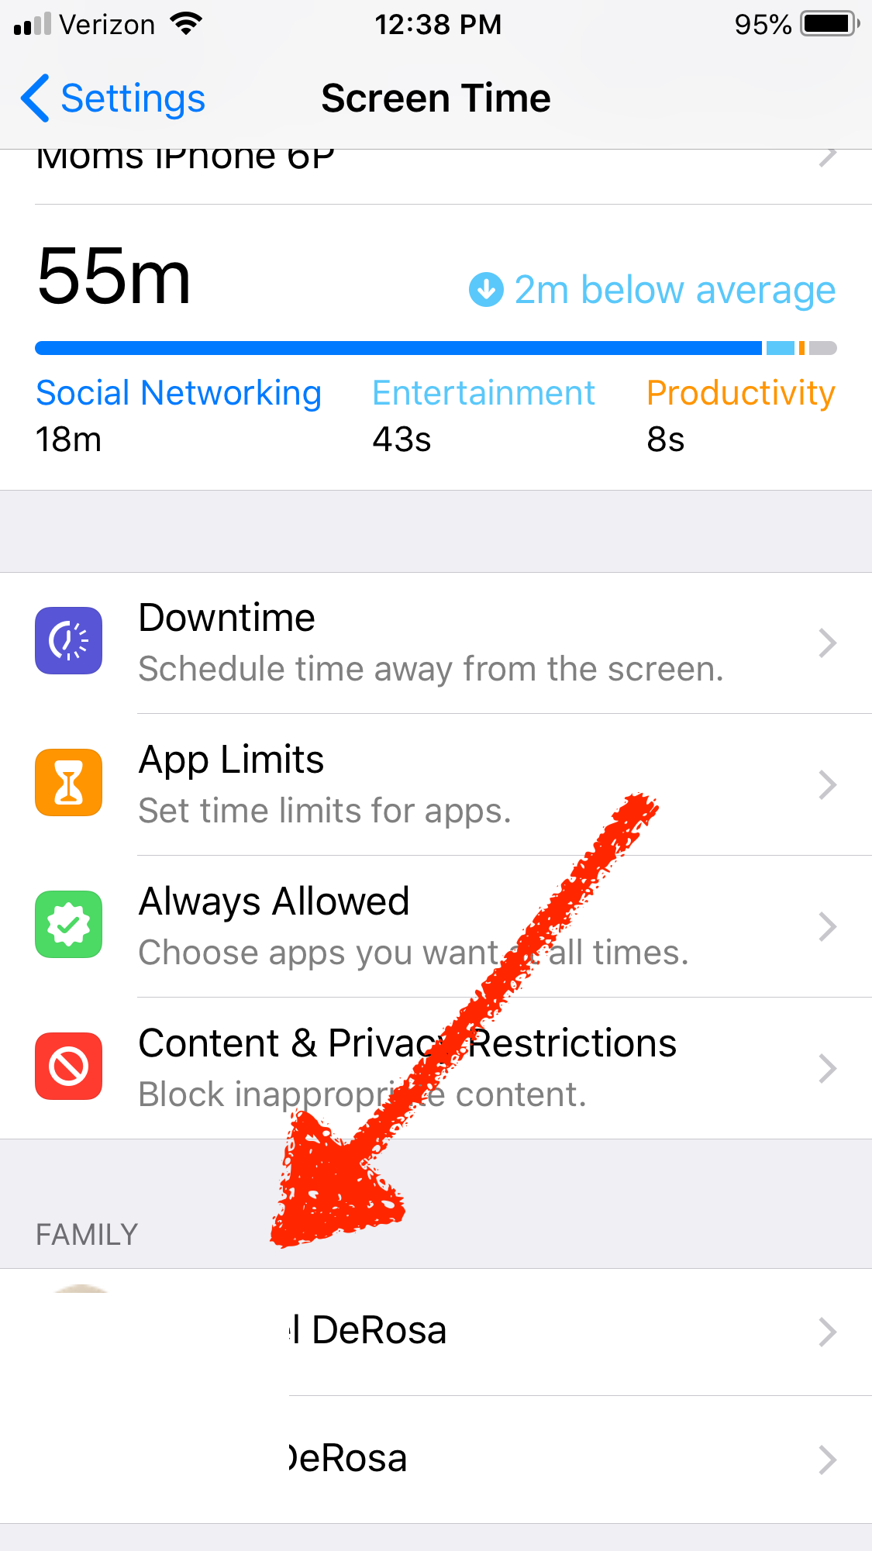
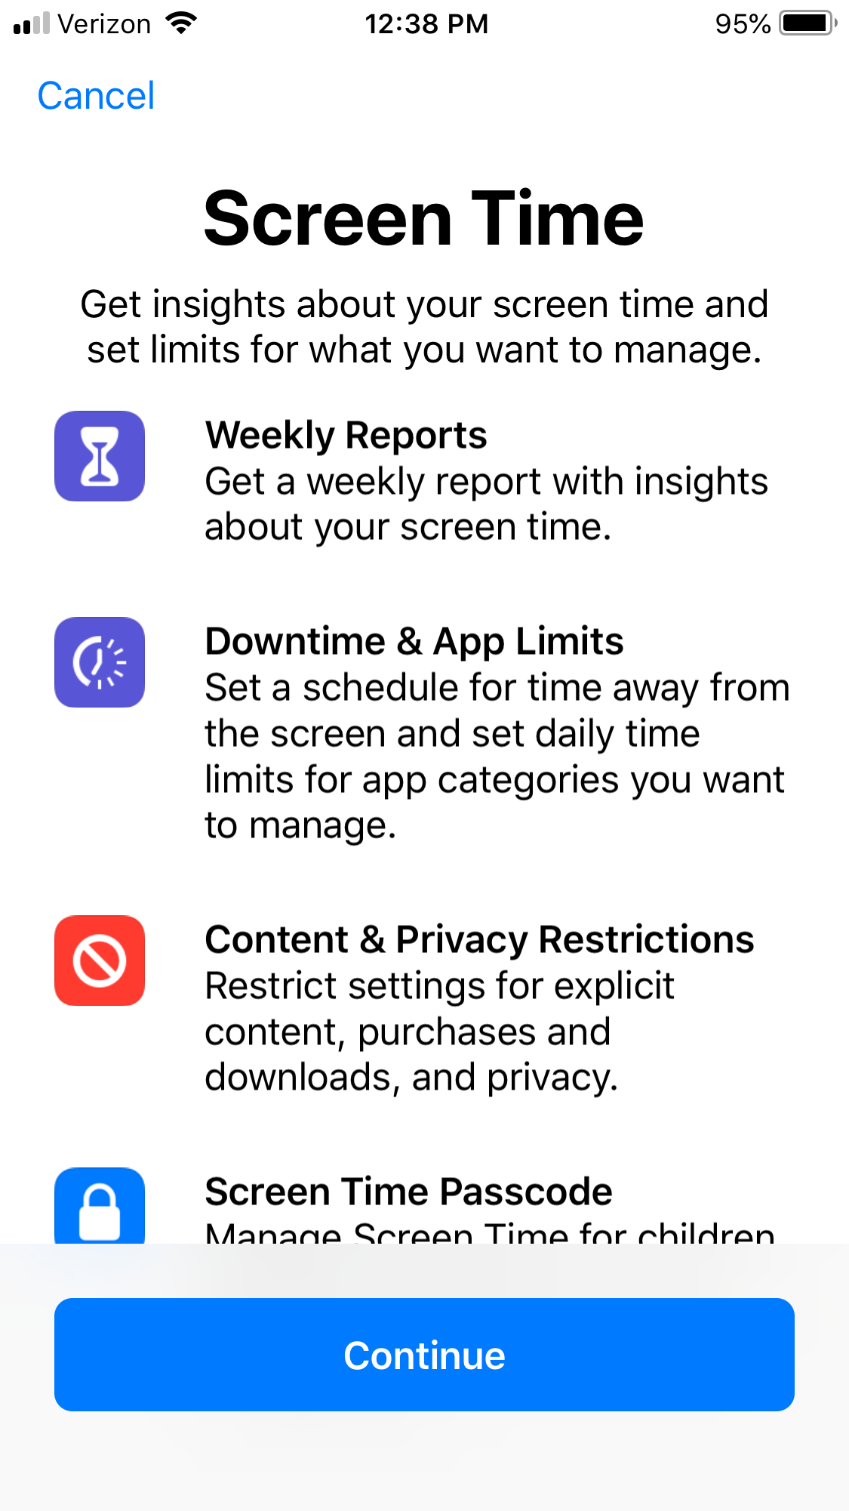
iPhone Screen Time

Slide 14
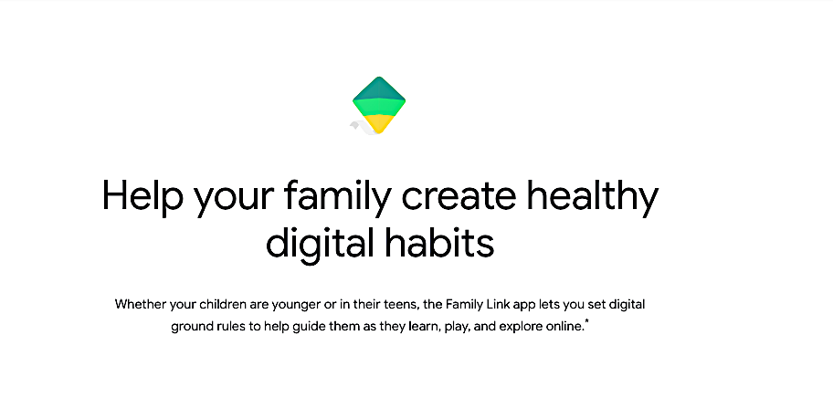
Google’s Digital Wellness
Family Link helps you set ‘Digital Ground Rules’.
Primarily for Kids Under 13 Years Old.
Includes: Content Filters, Screen Time Management, Bed Time and Manage App Access.
Search, Chrome and YouTube have filtering or restricted mode settings

Slide 15
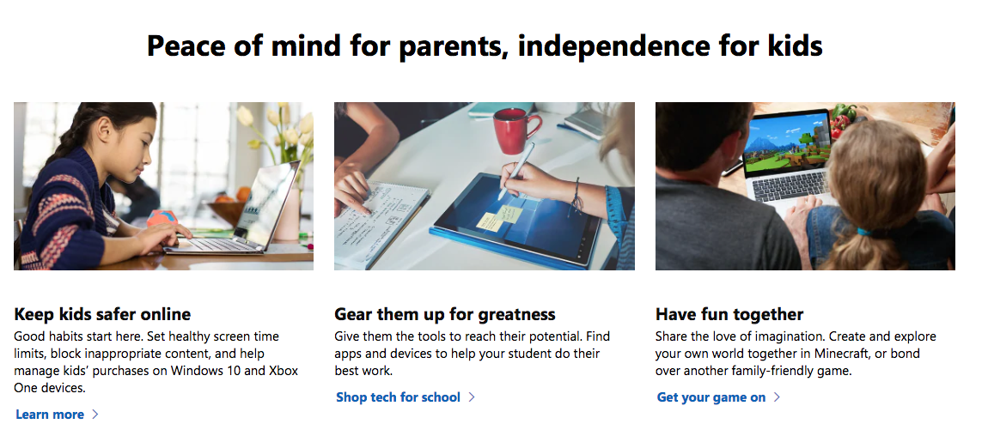
Microsoft Family
Notes:
Microsoft Family launched a family safety center to manage content, access and time limits at home.

Slide 16

Privacy and Safety Settings
Operating Systems, Apps, Browsers, Games, Devices
Teach Your Teen to Be in Control!
  Go through the options. Make sure they are not sharing more than they need.
  Proficient in protecting themselves and reputation online.
  Keep passwords private!
  Not everything needs to be recorded.
Notes:
The best way to maintain a positive digital reputation is to take control of it.
iPads, iPhones, Kindles, Laptops, Gaming platforms, have safety and privacy settings. Learn how to employ these as a way to protect yourself online. Privacy and safety settings can be adjusted at any time. Understand why and how safety and privacy settings work.
Adjust the settings based on your comfort level. But again, understand that while they are helpful, there remains some amount of risk at any safety level so connect and share with care online. A few simple habits they should shed now:
Don’t share your passwords with GF, BF, BFF
Another simple step, check which apps have requested access to your social media accounts data. These can be denied by you.
3. Limit your audience / be smart about who you allow in to your circle.

Slide 17
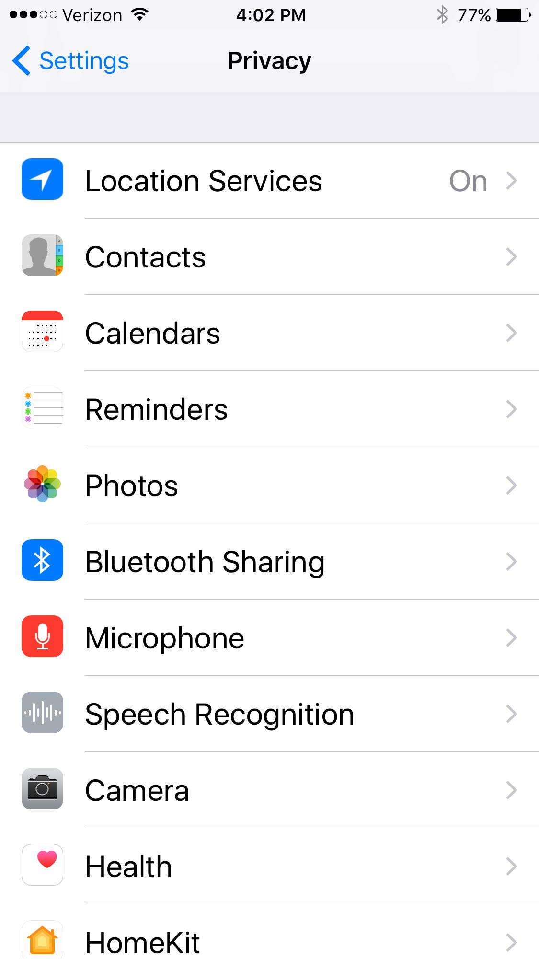
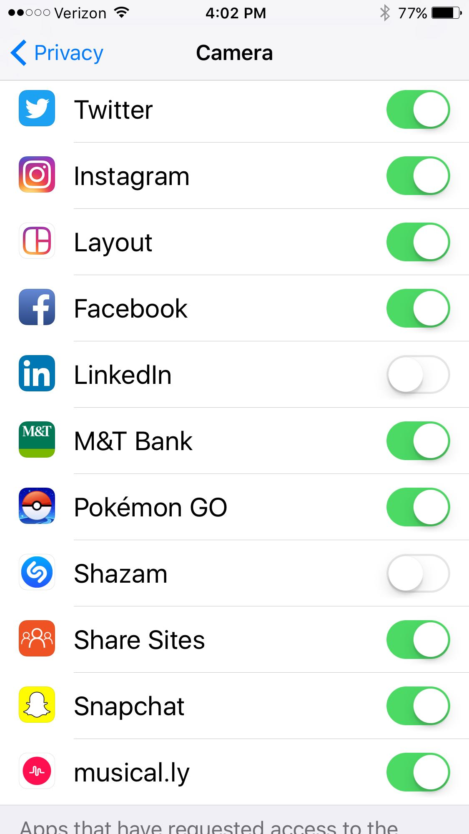
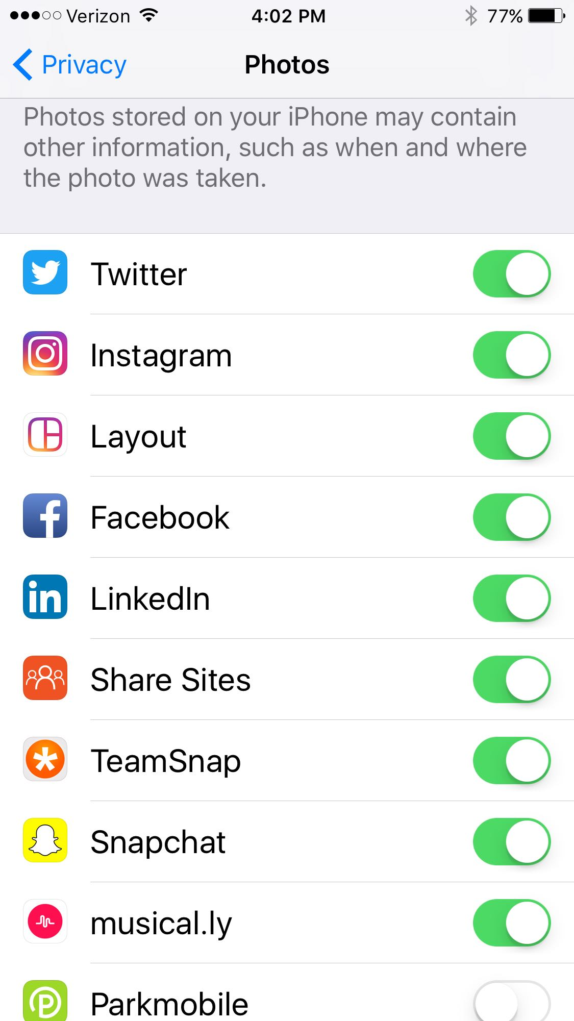
Adjusting location sharing
Notes:
To adjust geotagging on your camera and photos go to SETTINGS: PRIVACY: LOCATION SERVICES then open your CAMERA and / or your PHOTOS.
On most ANDROID phones you click on the CAMERA: SETTINGS, scroll until you see “GEOTAGS” and disable. To remove from old photos you may need to download an App called GEO-BYEBYE

Slide 18
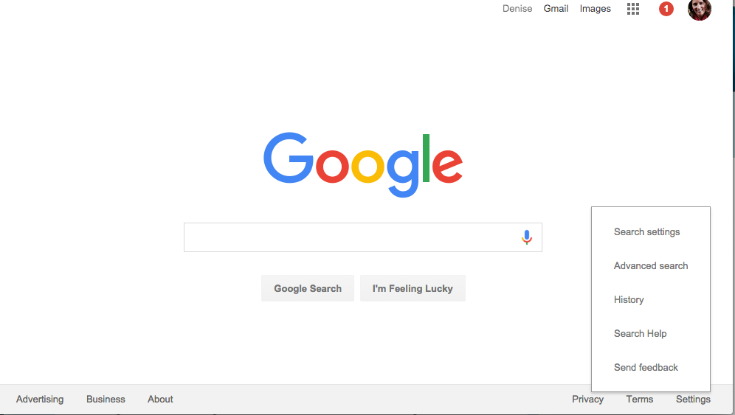
Google Safe Search
Notes:
Google does offer a safe search option but you need to check with the school on their preferences for the school devices. This sometimes does restrict access to legitimate research materials.
For your personal home devices, you can set the safety settings fairly easily, but be prepared for an imperfect system.
Screen shot of Google Safe Search
Search engines do provide some safe searching options. Use them to block the most offensive material. But be aware, they are not full-proof. Plus, they generally err on the side of free speech.

Slide 19
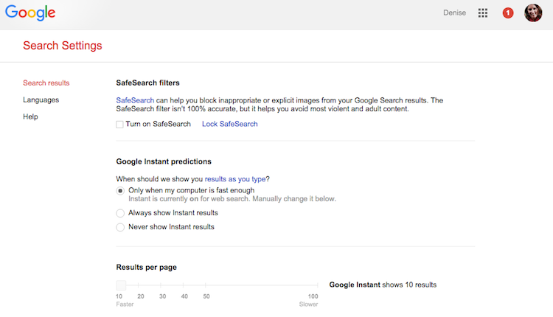
Set Google SafeSearch Filters
Notes:
Go to Google.com. Go to the bottom right hand corner. Click on the Settings menu. Click on Search Settings. Note: This is browser based. If you have more than one browser on your computer such as Safari, Chrome or IE, you will need to set this for up for each one. These settings are available on other search engines as well. On Yahoo you can set different SafeSearch preferences for each family member with a Yahoo! Account. You go to the gear icon in the upper rights and click preferences.
Also note: Google owns YouTube so the settings are similar. Open YouTube on your browser, scroll to the bottom of the page and turn restricted mode ON. This can be done on the App as well.

Slide 20








Popular Social Apps
Due to COPPA must be 13YO
Use the Privacy and Safety Functions
Understand Pros & Cons of each
Notes:
Due to COPPA Laws users must be 13 years old to use social media.
The large social media platforms have quality privacy settings, safety check-ins, block functionalities, teen help centers and reporting options.
Use the privacy and safety settings to protect yourself. Update and check often. It is up to you to control your visibility and protect yourself online.
Don’t over-share. Limit what and how often you post for the world to see.
How many of you are already using some social media? What do you use?
Think about how you want to connect with friends and family. Use social media for added ways to interact and share but don’t use as your only way to communicate. Keep your friends online limited to those you know offline. Be wary of unknown ‘friend’ requests. Limit your visibility, adjust your audience for different posts, keep it clean.
As you get older, use social media to network with potential employers, colleges, interest groups. (Linkedin)
Be creative. Use fun apps like Music.ly, Tumblr to express yourself but be mindful of your audience and limit some of what you share.

Slide 21

Digital Tattoos
What you share online is Public and Permanent.
What you post and how you interact with others online is part of your Reputation.
Once you’ve shared something digitally, you no longer Control it.
Every Data Point is added to the picture
First Impressions Online
Notes:
Your online profile is the first impression most people will get. You don’t get a second chance to make a first impression, so use technology wisely.
Your digital tattoo is your online reputation, so it is important for you to understand that nothing online is private. Even when you share a photo on Snapchat. Do you know how a snapchat photo can become part of your permanent online profile.
40% of College Admissions Officers do a Google Search of their applicants.
Ever wonder why there are laws preventing minors from getting tattoos? It’s because it is permanent! The laws are designed to protect you from yourself! Can you think of something you’d want tattooed on your body today? How do you think you would feel about it in 5 years, 10, 30 years?
If you are posting even silly moments, are they something you want to be permanently tattooed to your body? Just think about the permanence for all of it before you decide.
Have you ever said or done something you wish you could take back? That’s why it is important to really think about what you are sharing online. Be mindful of how things can be misinterpreted, received by those who don’t know you, and even by those who do!
Express yourself online, be creative and fun but think about all those who will receive it.
What does your online presence say about you? How do you want to present yourself to the world?
Do a search of yourself online. Is what you find a good example of who you are as a person? If not, what can you do to improve your online profile?
Colleges and employers will be googling you.
There are services such as Social Assurity and Cornerstone Reputation what help with online reputation building.

Slide 22
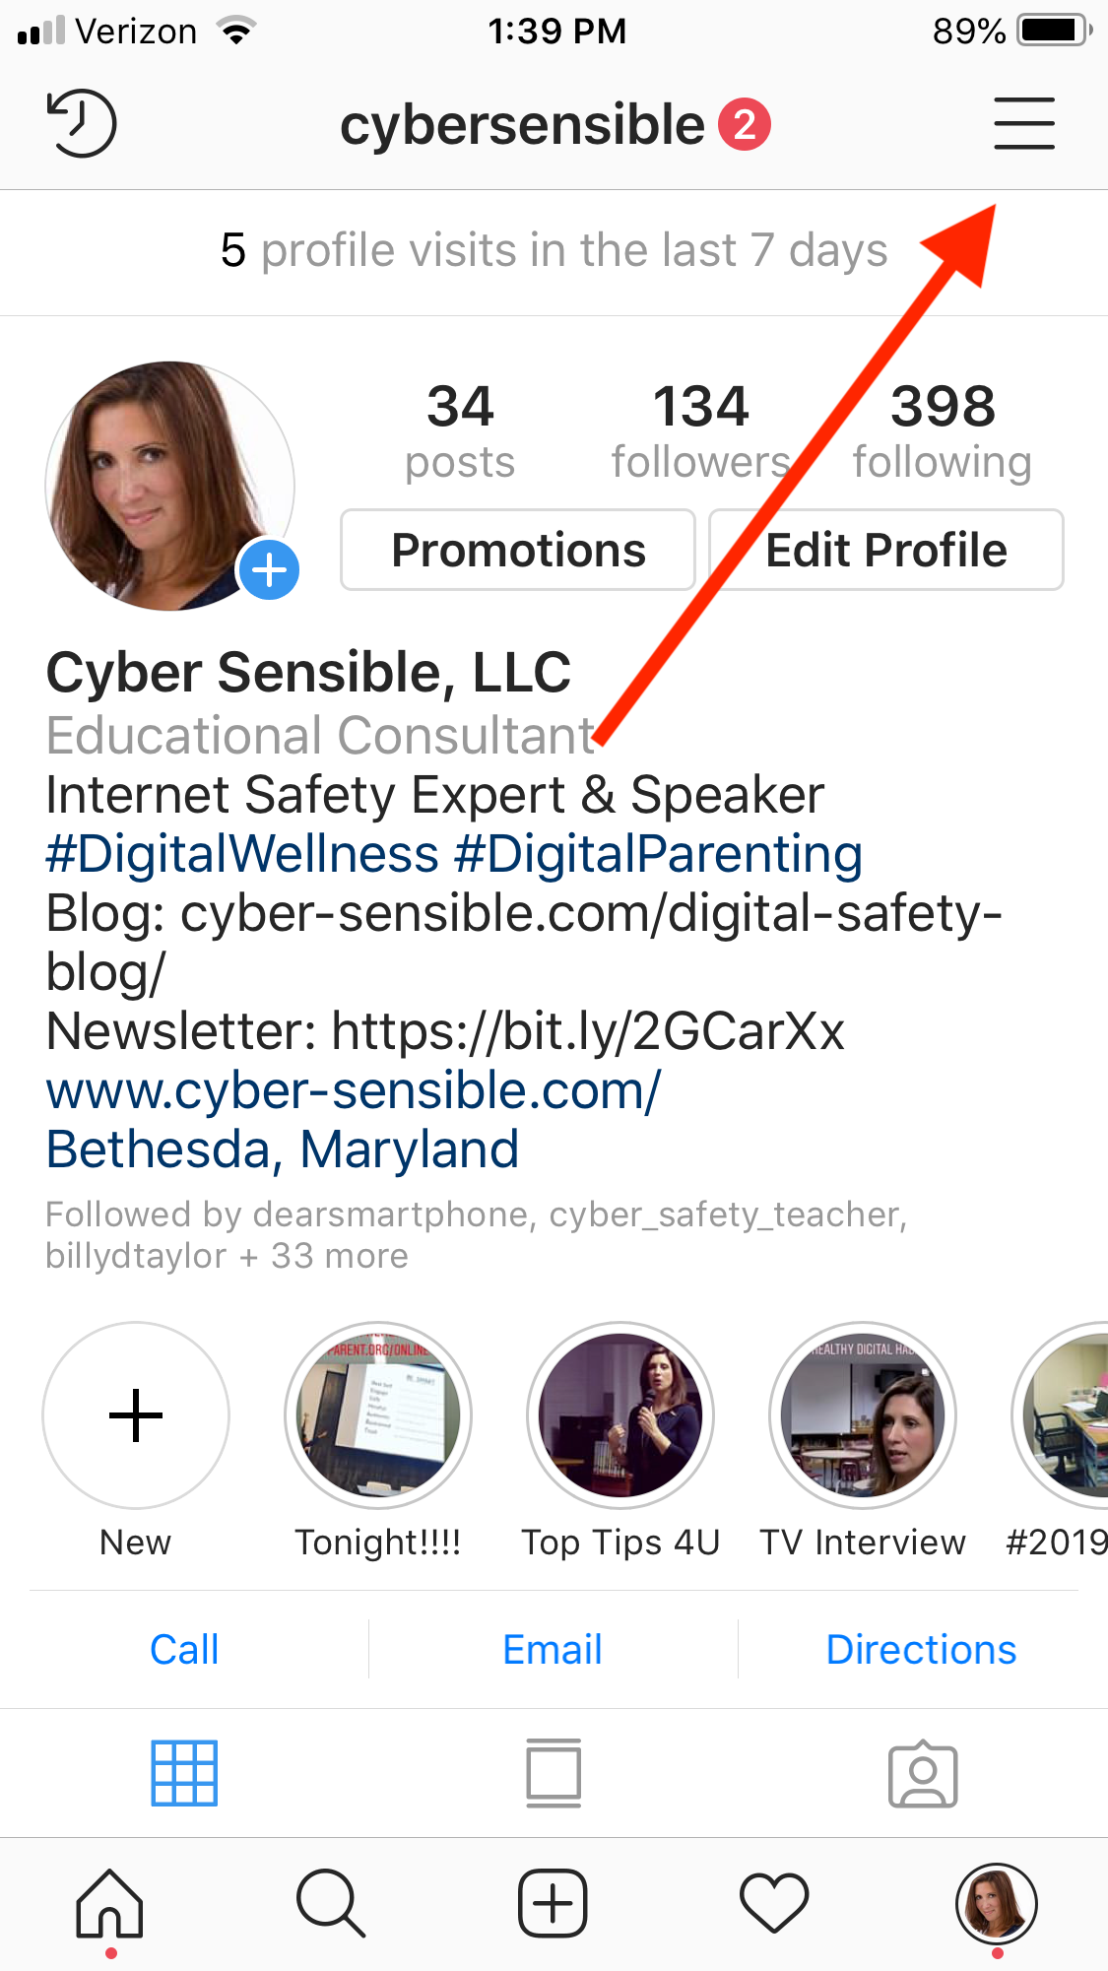
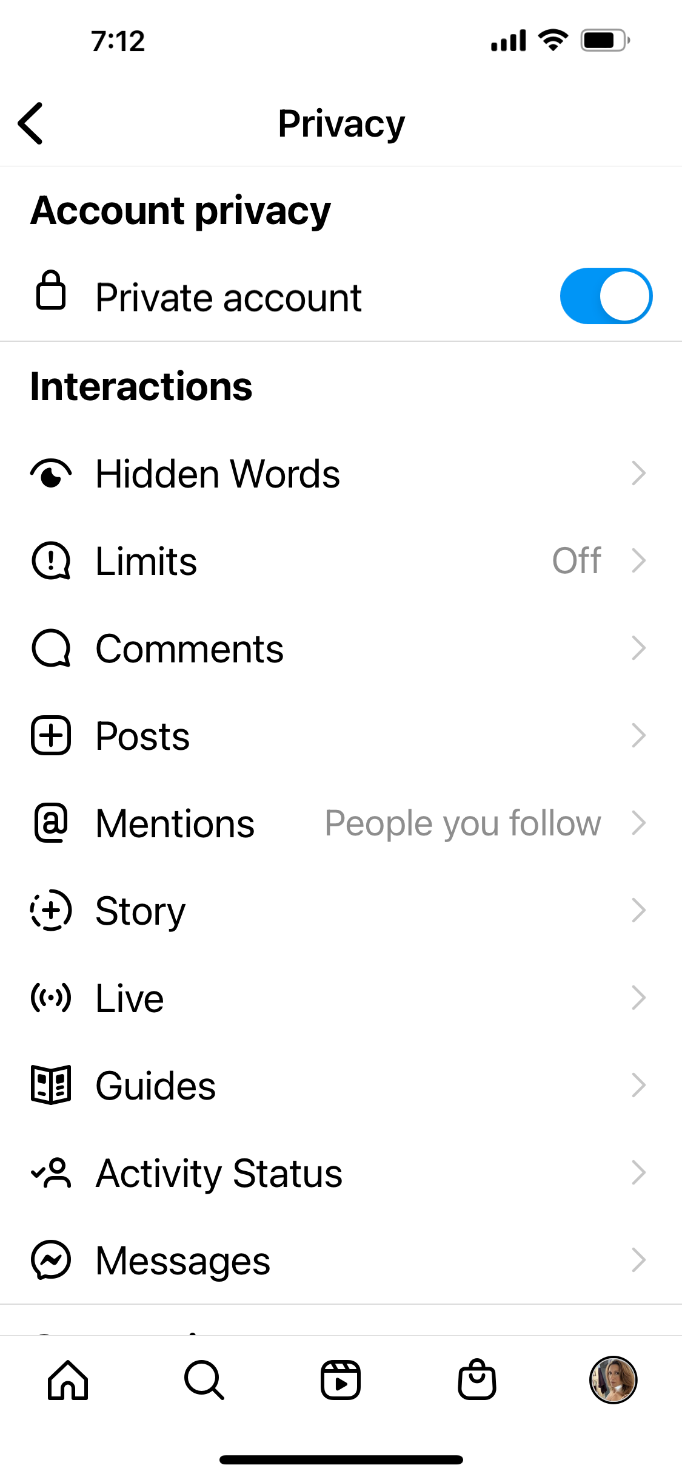
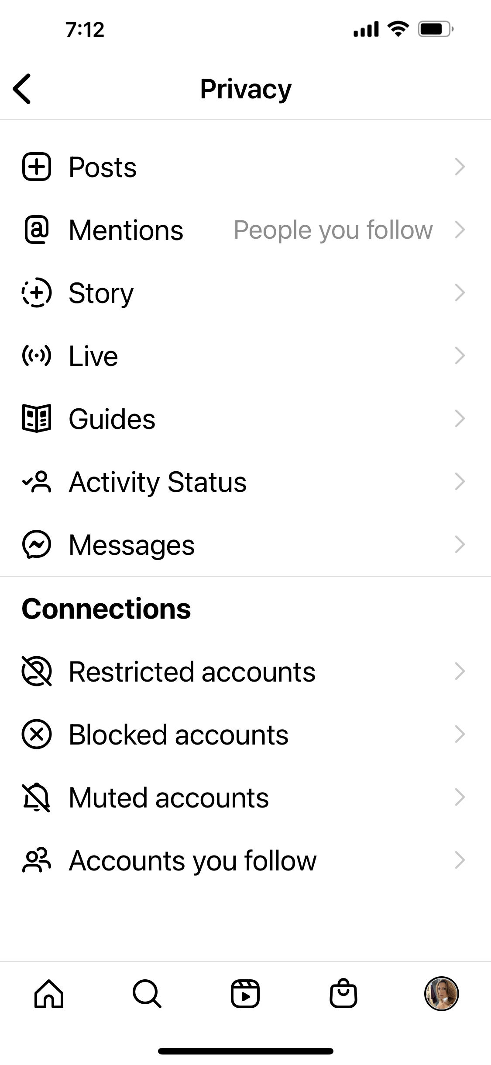
Instagram PRIVACY
Notes:
Instagram, owned by Facebook, has similar visibility options. When You log on to your Instagram account, Click on the Gear on the Upper Right to Bring Up the Options.
Do you want to control your followers or allow anybody to follow you? You now have the ability to hide hurtful comments. Use it! You can block unwanted comments by going to PROFILE: OPTIONS: COMMENTS
There are also mechanisms for protecting the photos you share from being searchable on Google. I would not depend 100% on something shared being protected, so it is always best to keep questionable content off your digital profile.

Slide 23
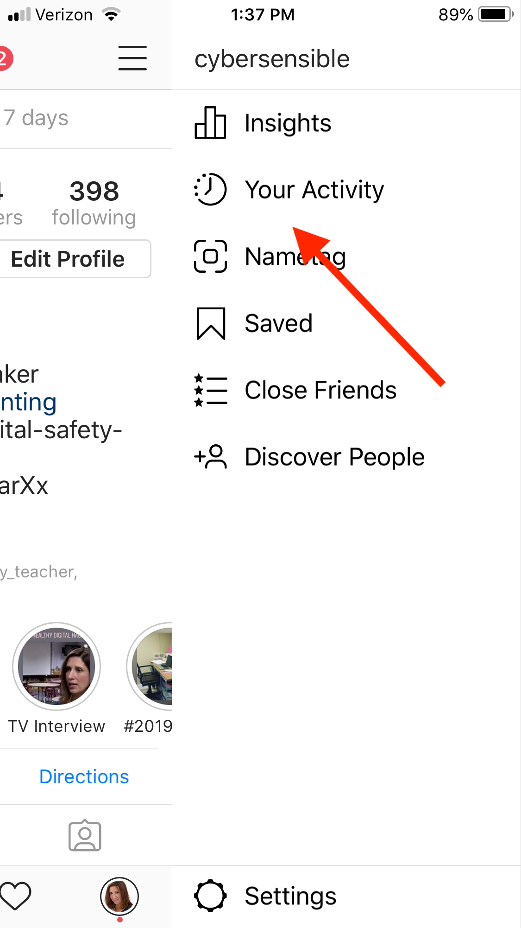
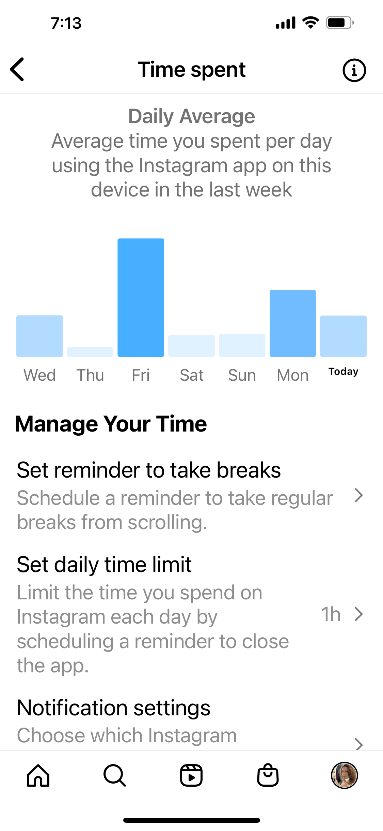
Ig: manage your time
Notes:
Instagram, owned by Facebook, has similar visibility options. When You log on to your InstaGram account, Click on the Gear on the Upper Right to Bring Up the Options.
Do you want to control your followers or allow anybody to follow you? You now have the ability to hide hurtful comments. Use it! You can block unwanted comments by going to PROFILE: OPTIONS: COMMENTS
There are also mechanisms for protecting the photos you share from being searchable on Google. I would not depend 100% on something shared being protected, so it is always best to keep questionable content off your digital profile.

Slide 24
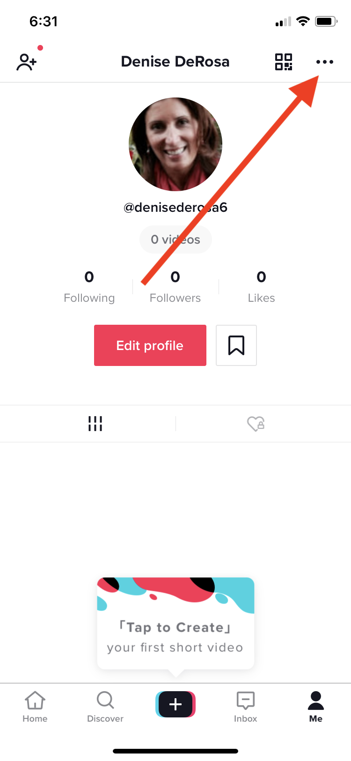
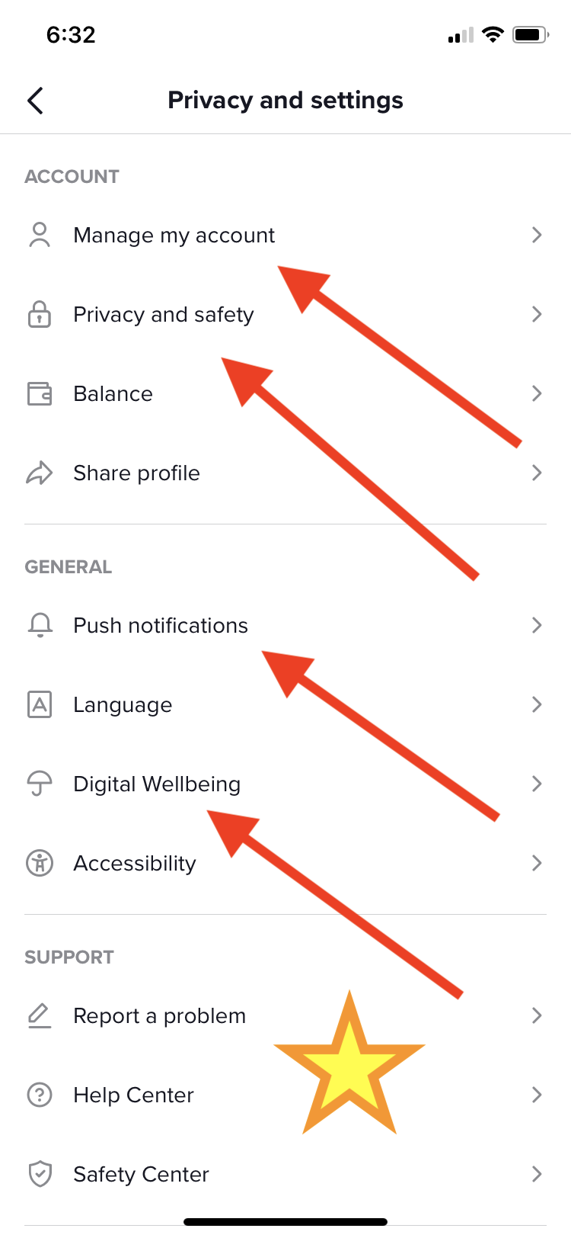
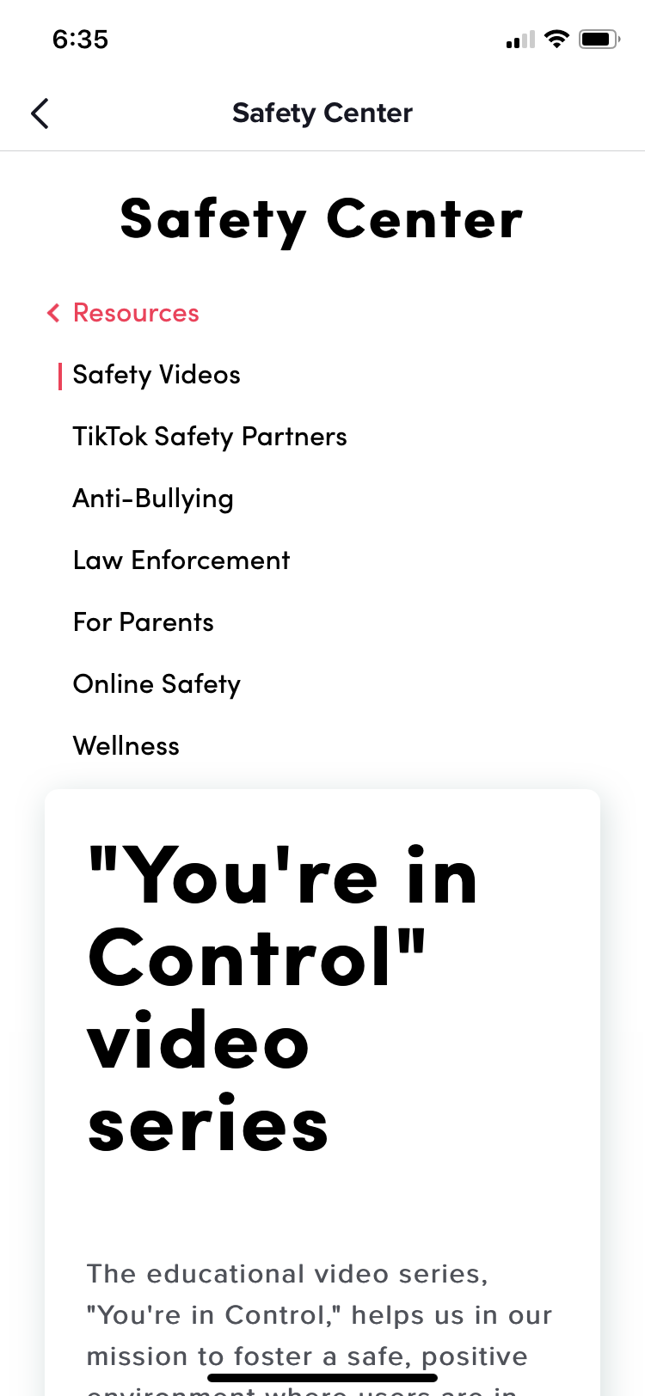
TikTok

Slide 25
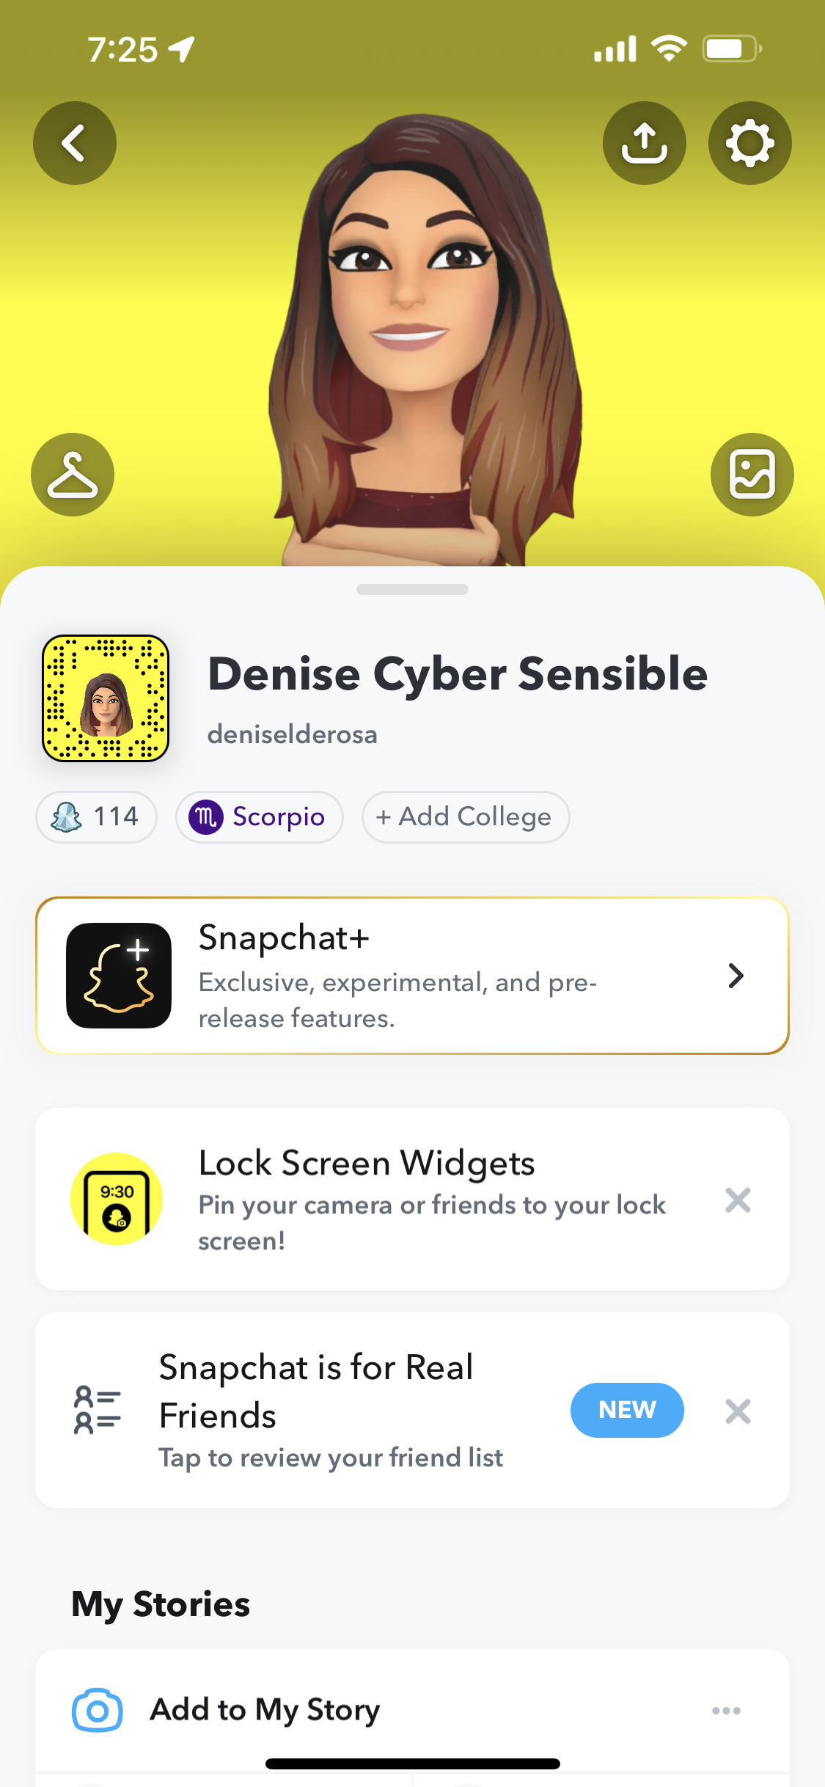
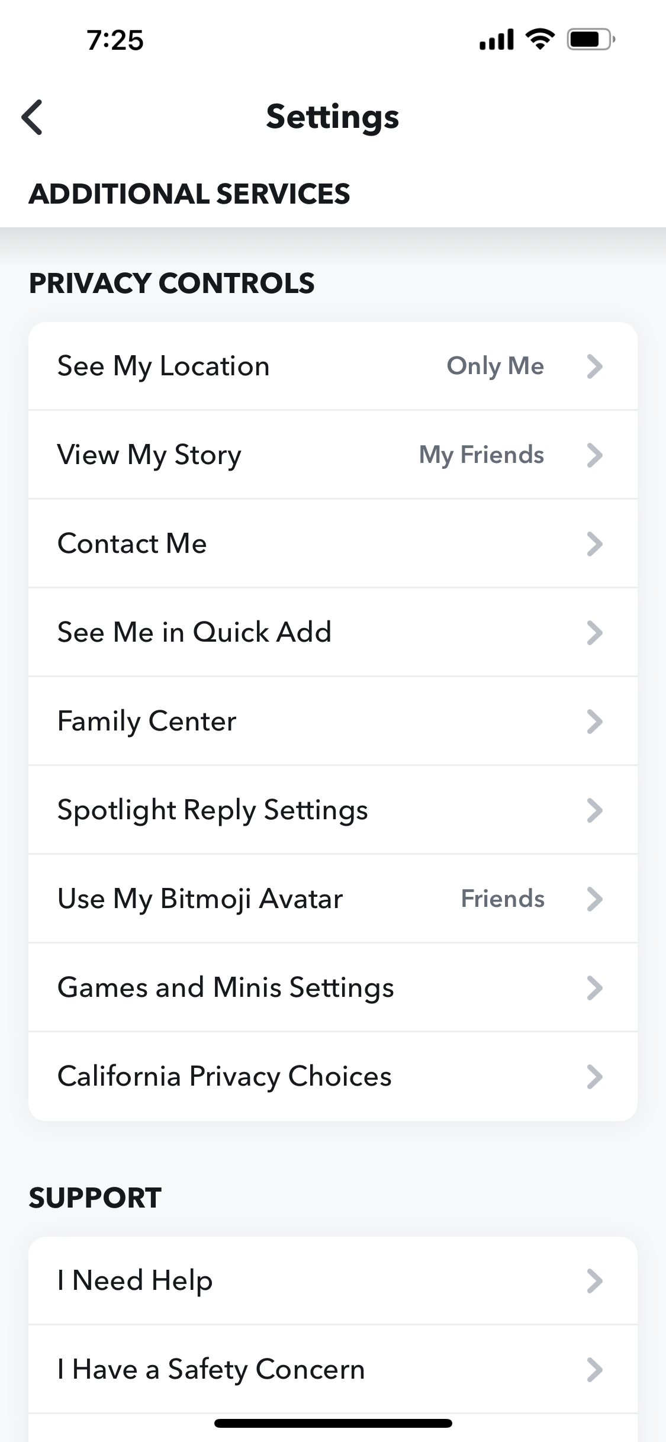
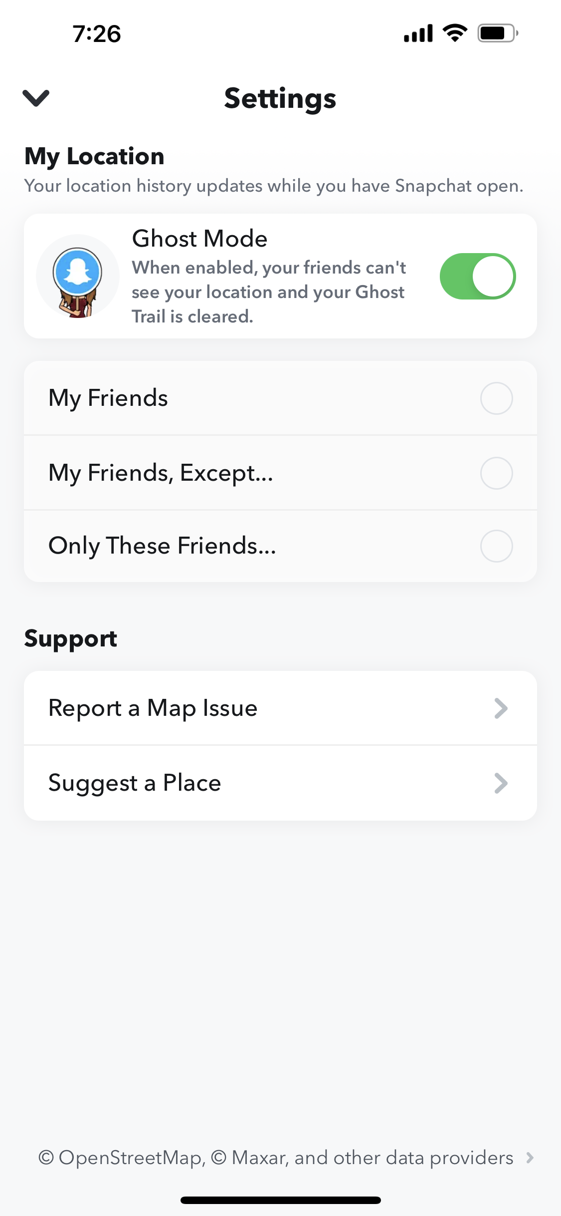
SNAPCHAT

Slide 26
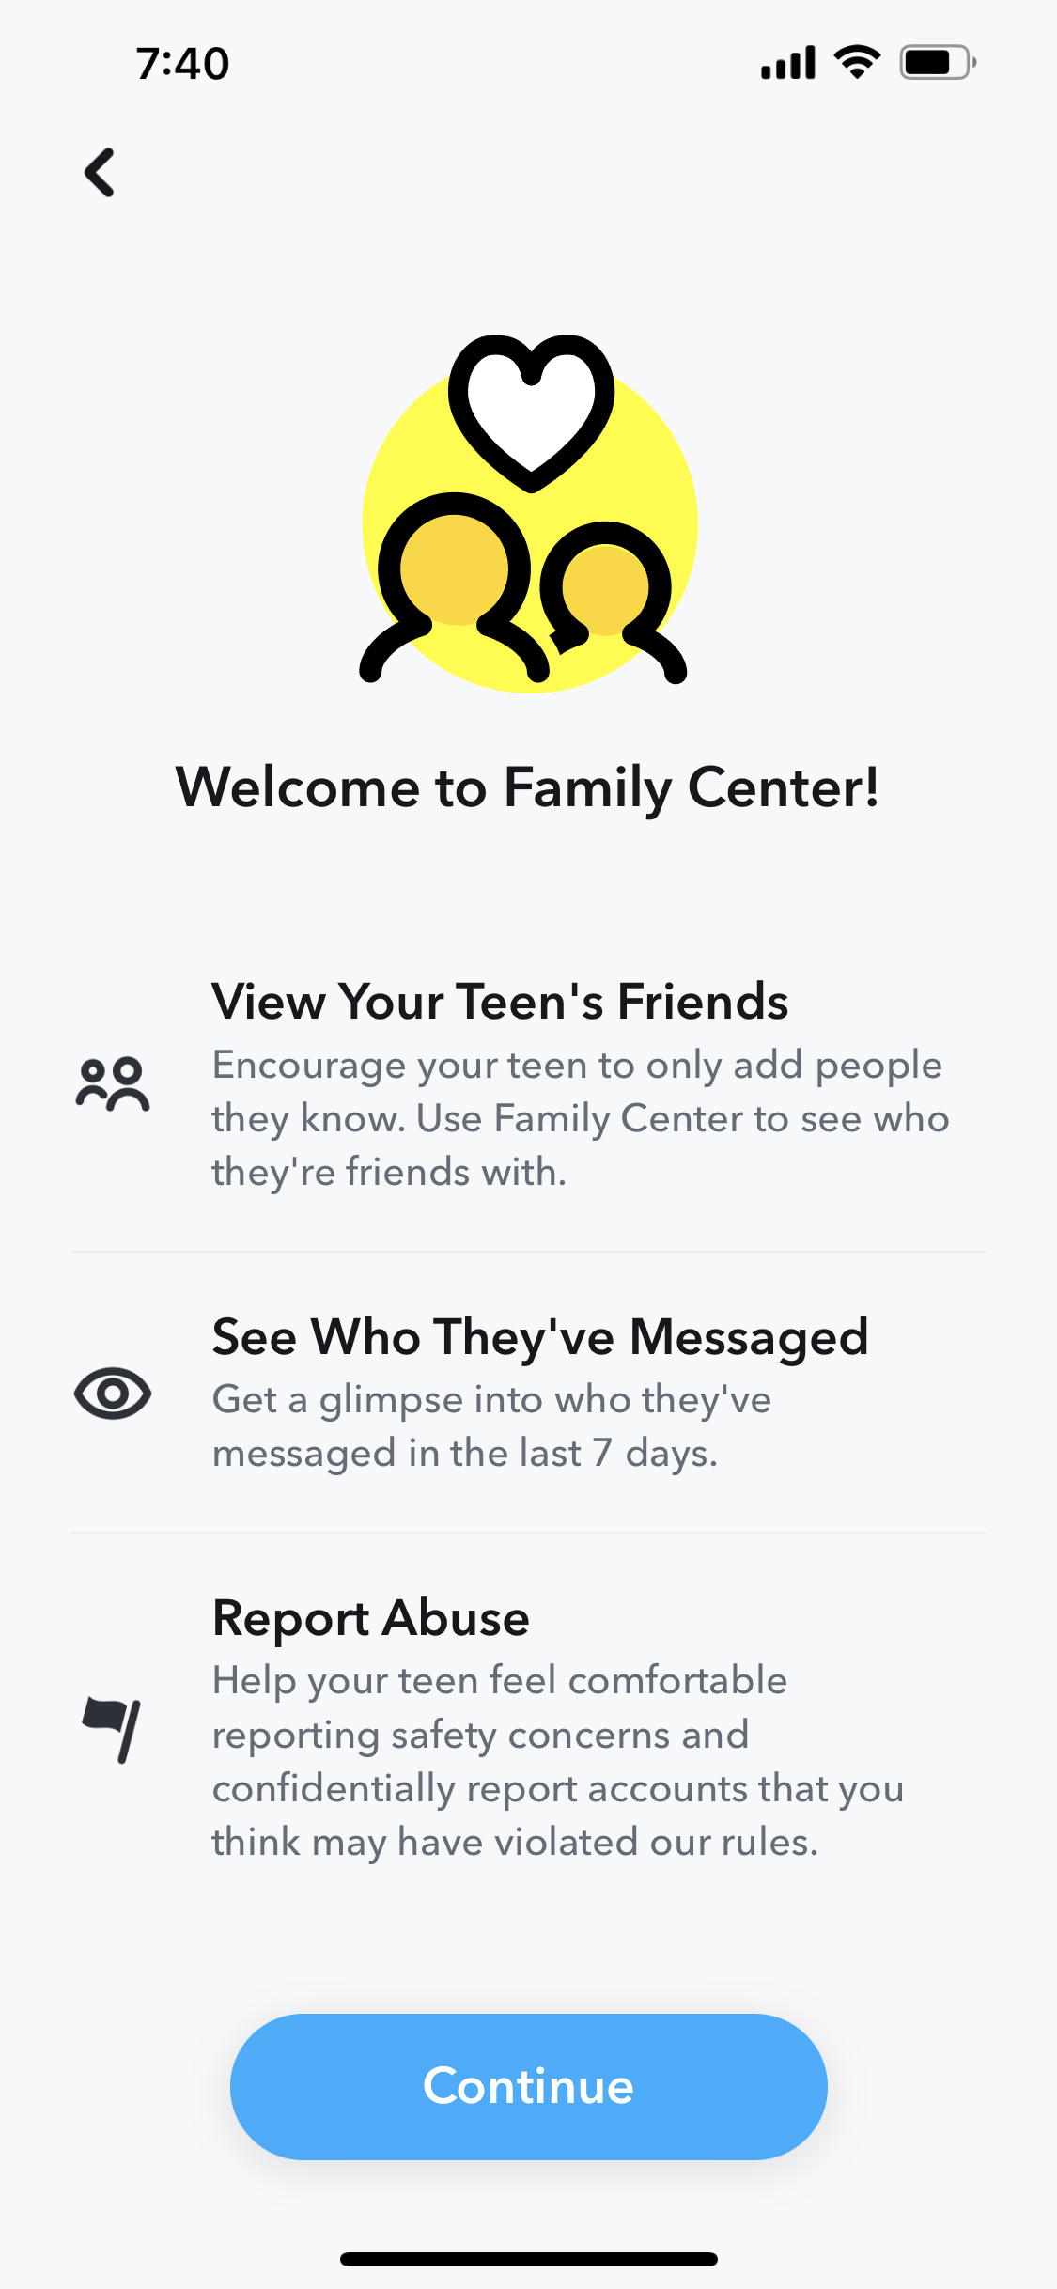
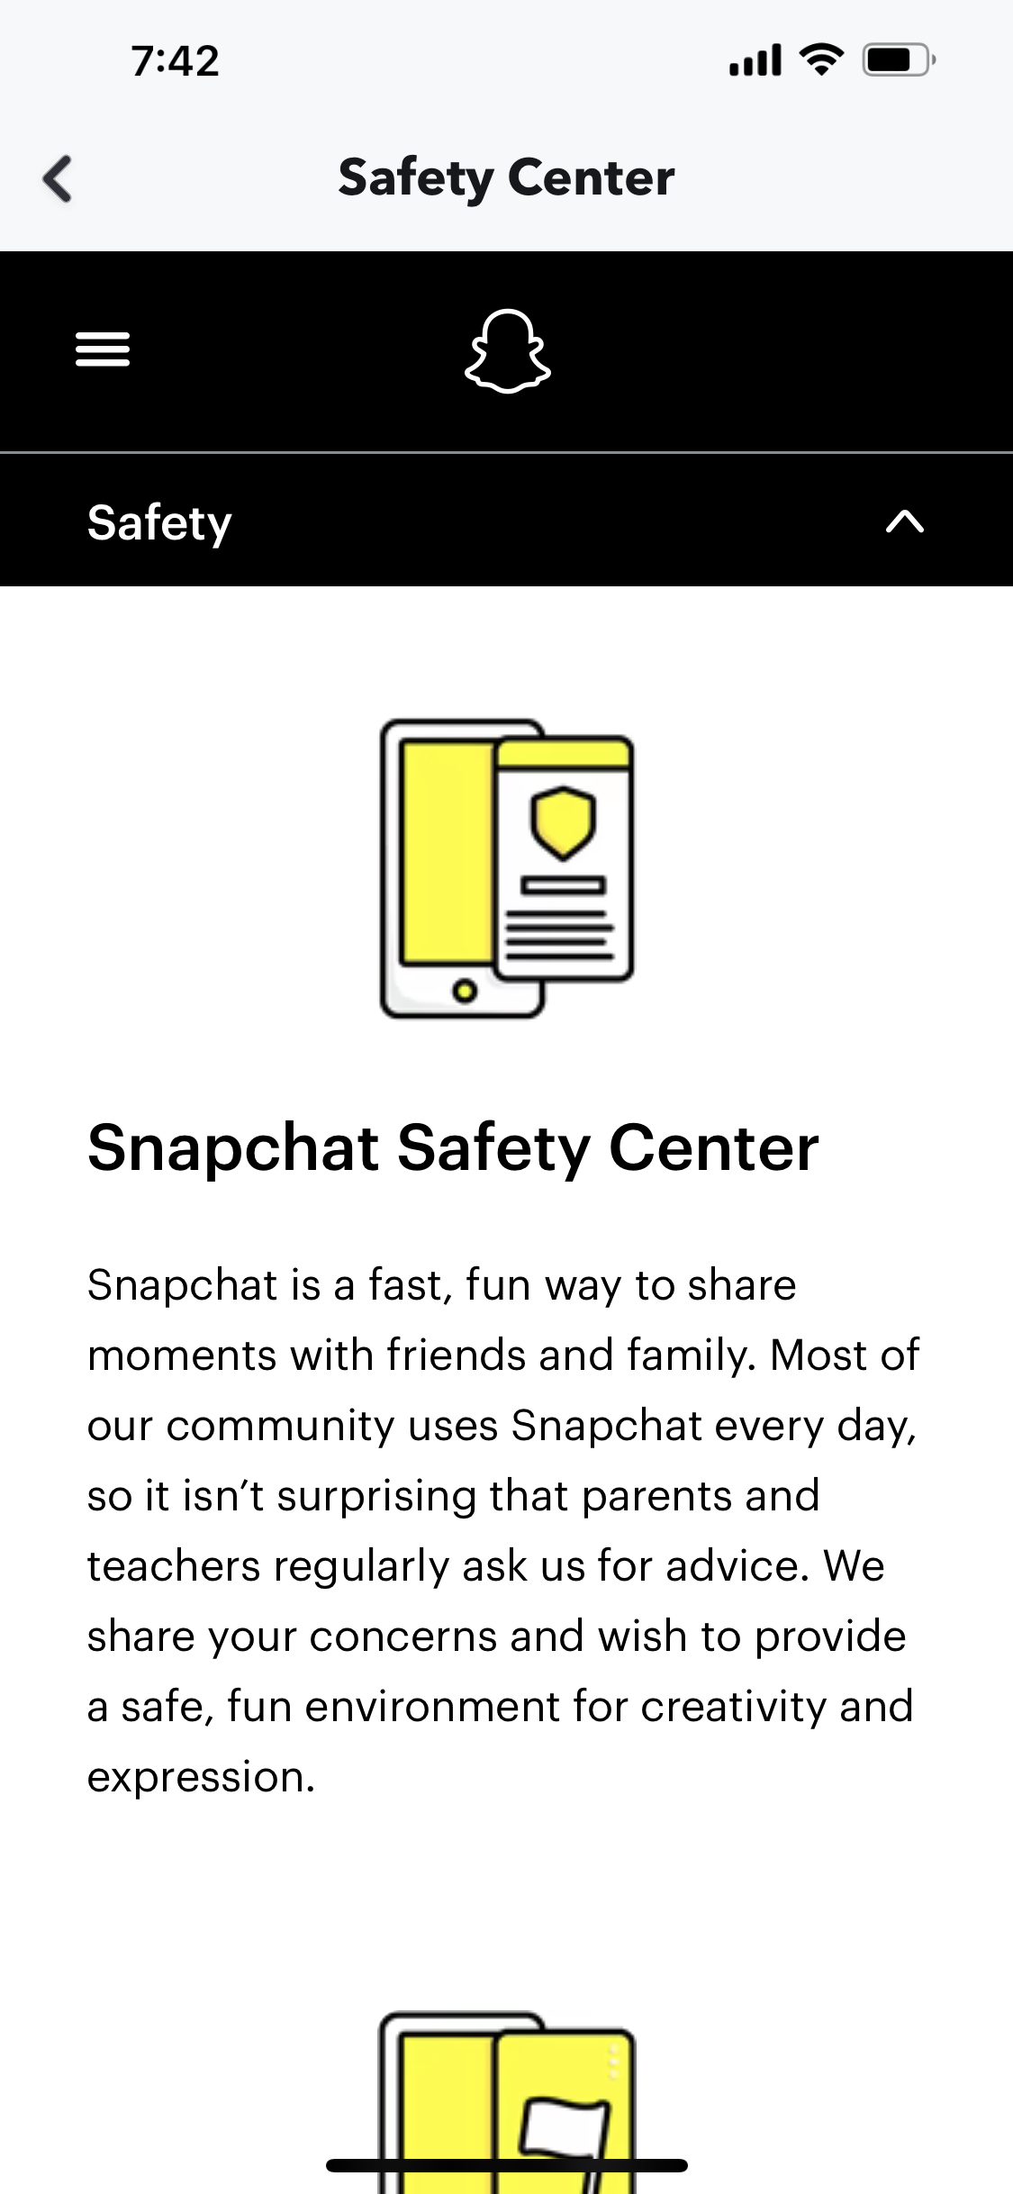

Slide 27
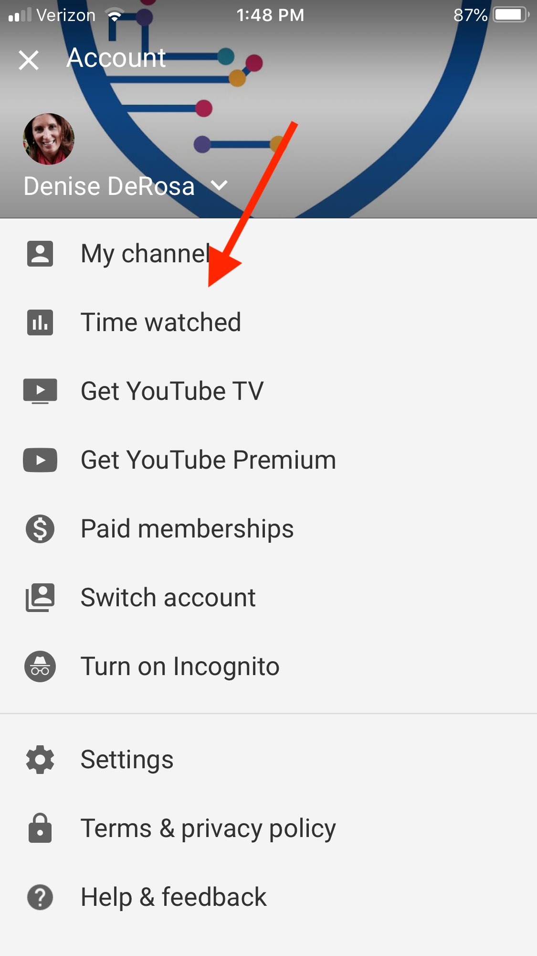
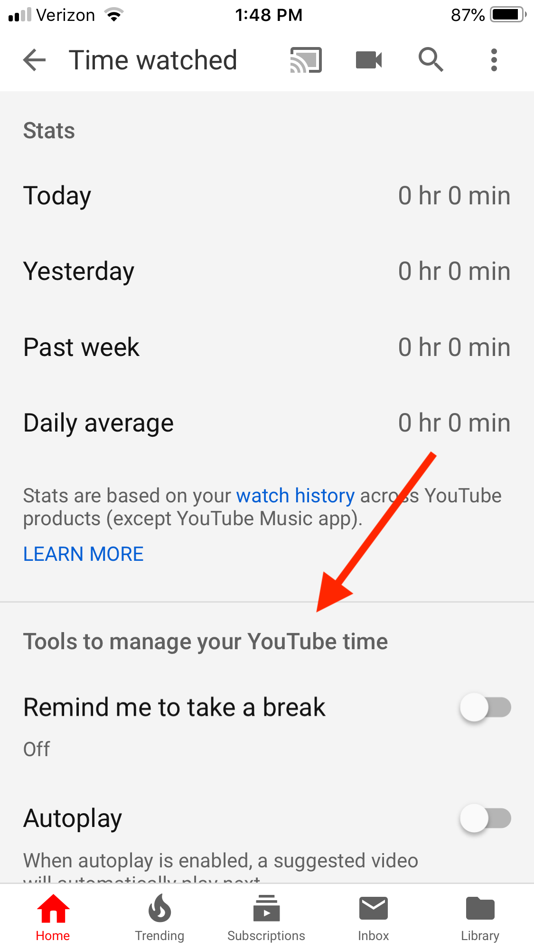
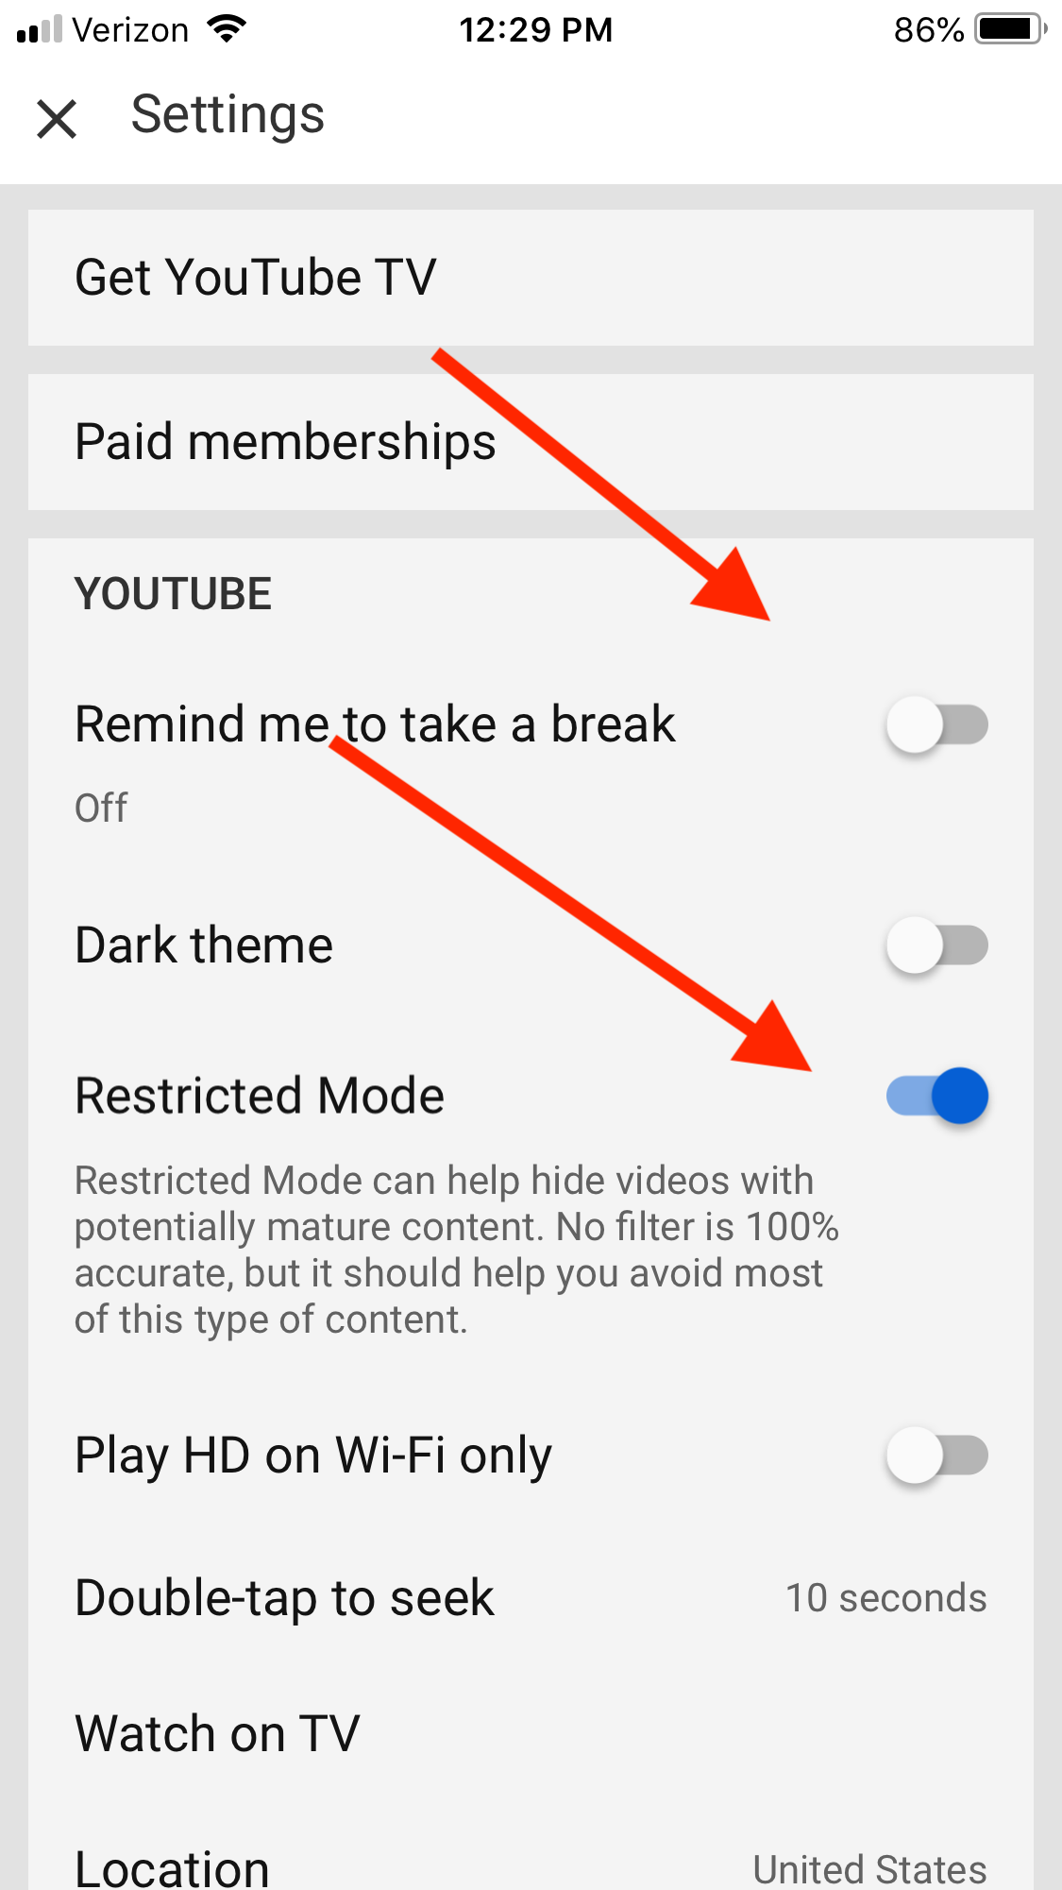
YouTube

Slide 28

Gaming
Can Be Important Part of Socialization
Choose Wisely: Use ESRB Ratings System
  ESRB.ORG
Set Ground Rules -- content and connections
Set Parental Controls –content and connections
  PARENTALTOOLS.ORG
Play with Your Kids
Notes:
Encourage your kids to interact positively when gaming as well as when on social media. These platforms are designed for some of the best features to be accessed only when using the online interaction functions.
DON’T TAKE AWAY, TEACH THEM HOW TO BE SAFE

Slide 29
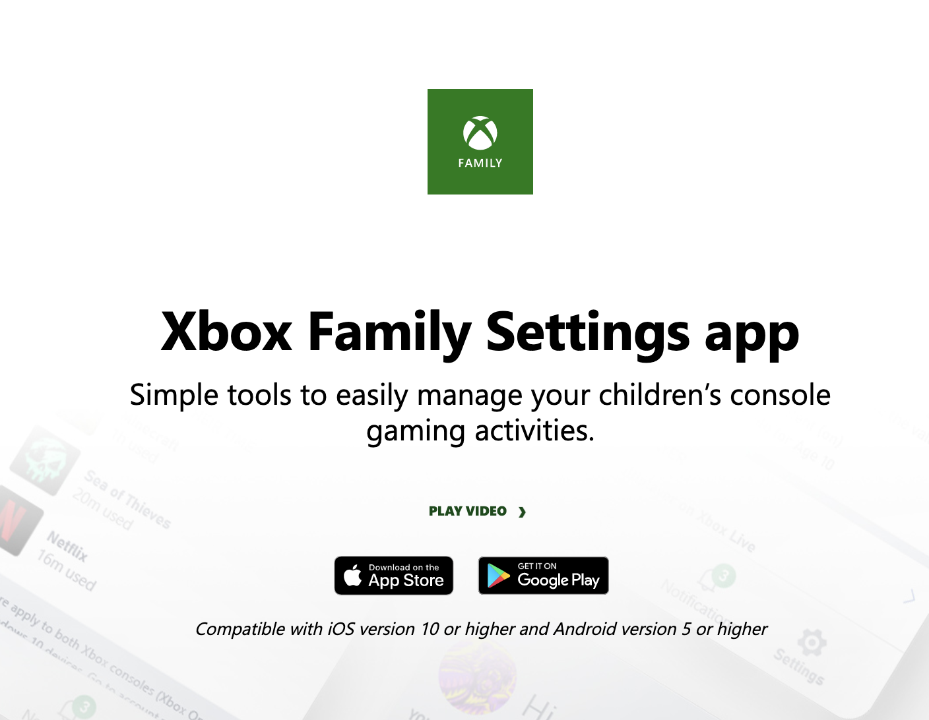
Xbox Family settings app
Notes:
Settings for screen time, content, spending, notifications and online friends and interactions.

Slide 30
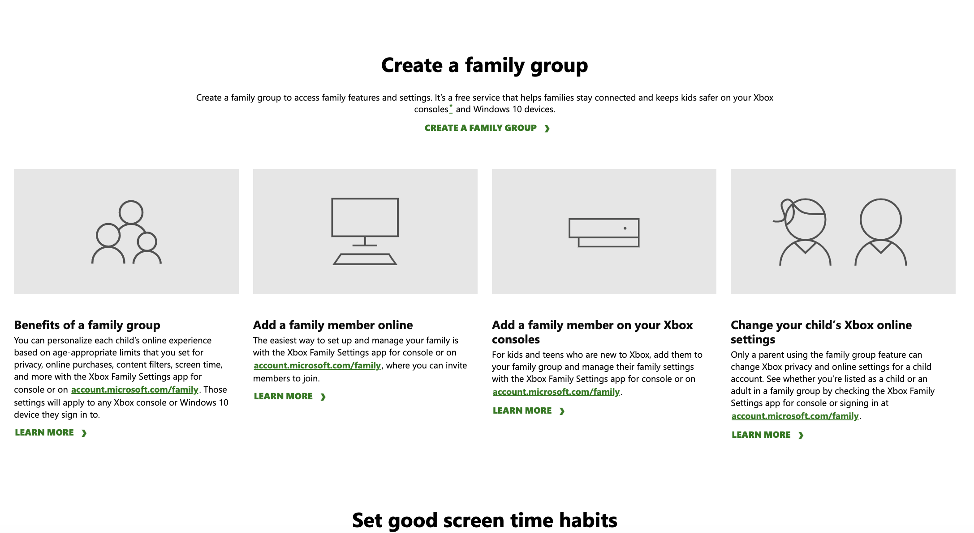
Xbox settings

Slide 31
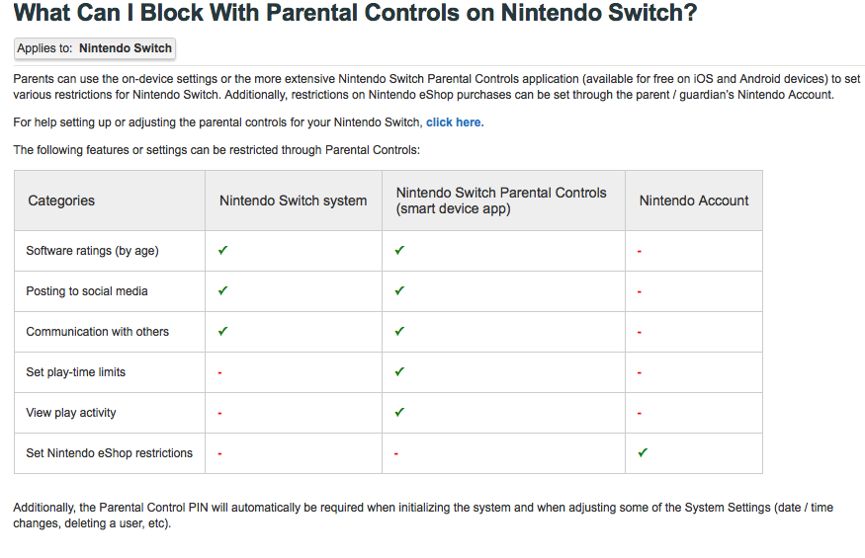
Nintendo Switch
Parental Controls App

Slide 32
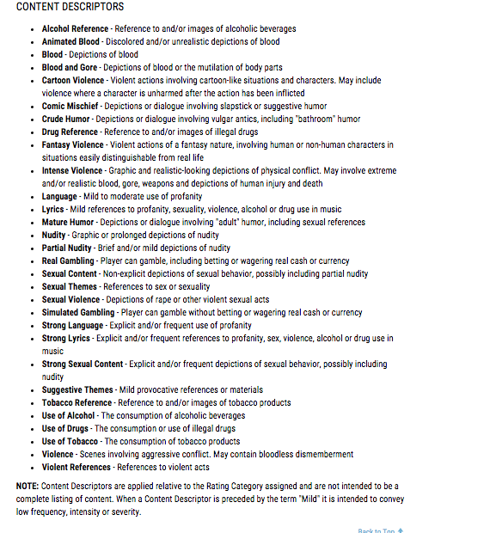
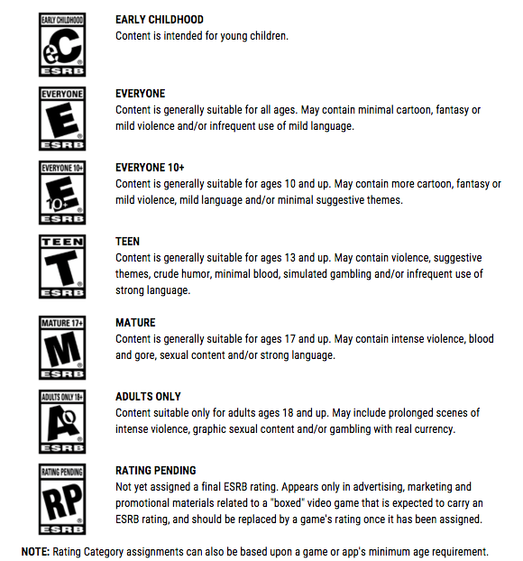
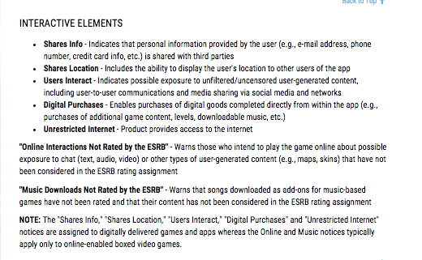
ESRB Ratings
Notes:
Ratings for games, online games and they are starting to review mobile games. ESRB rates games based on content and interactive elements. These ratings can be in conflict with ‘suggest age’ in the App Store and Google Play. Best to look at ESRB ratings.

Slide 33
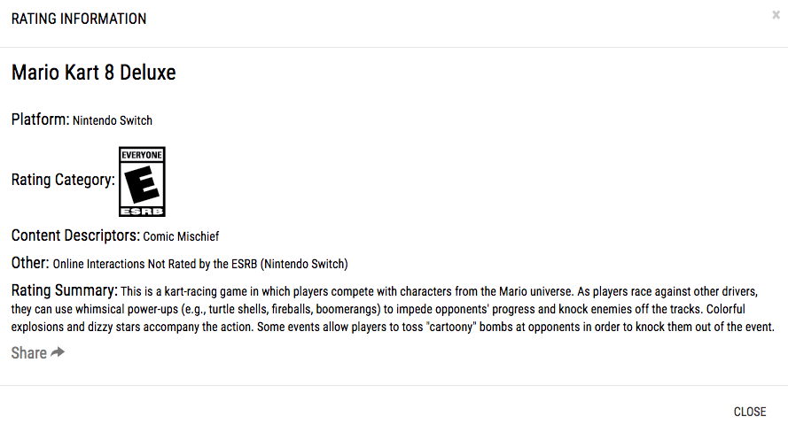
ESRB Rating Example

Slide 34

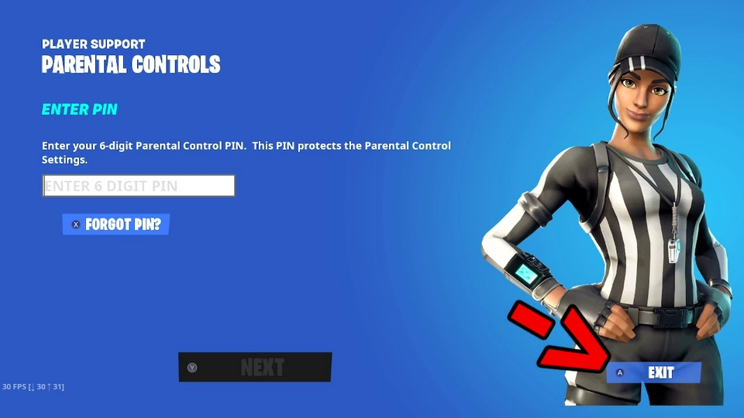

Slide 35
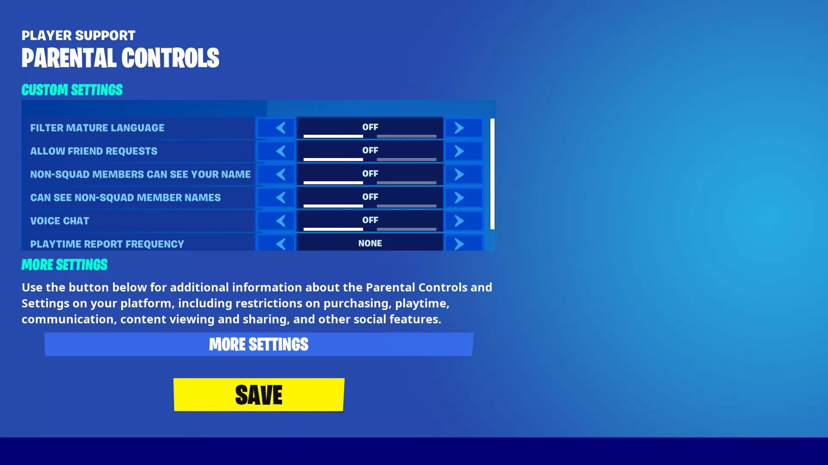

Slide 36

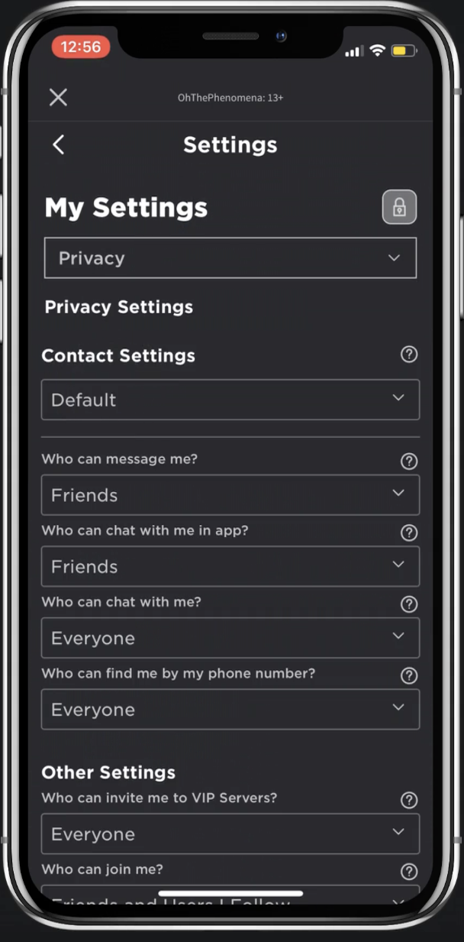
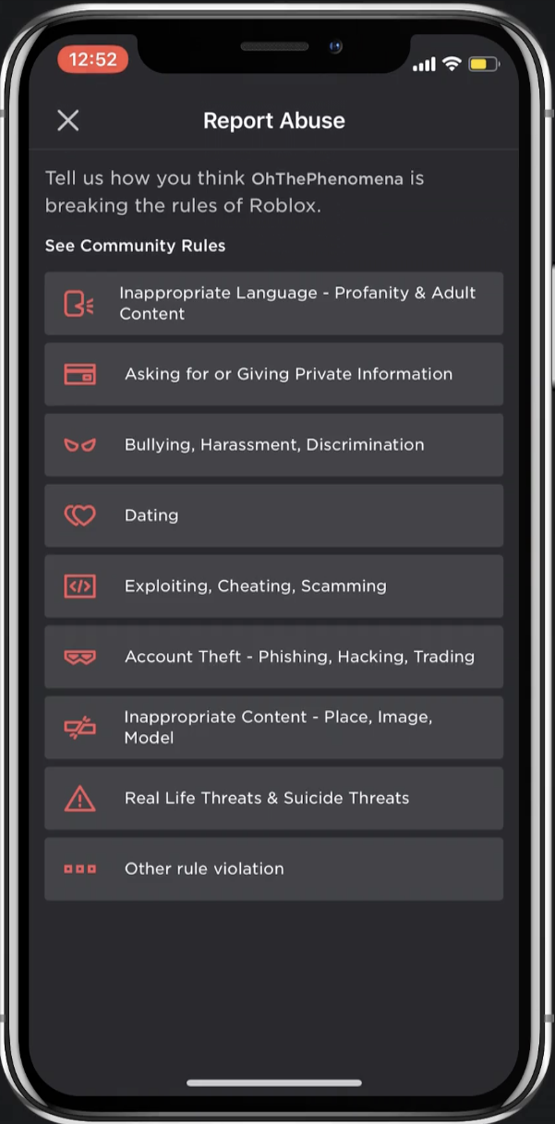
Avatar Creation
Report Abuse System
Chat Filters

Slide 37

Tech Etiquette
Modern (Digital) Manners
Limit Tech Distractions
Ask Before You Share News / Photos of Others
Don’t Say Anything Online You Wouldn’t in Person
Keyboard Courage
Use Best Medium for a Message
Notes:
Netiquette is really just modern digital manners. Apply your values, your guide on how to interact with others, how to treat friends, acquaintances, teachers.
Also, no Phubbing! – ignoring people in front of you for what is on your phone. Be present with the people in front of you!

Slide 38

Healthy Digital Diet
Mindful: Go for Good Stuff, Limit the Junk
  Not all screen time is equal
  Self-Regulate: Know when to unplug.
  When does tech enhance or detract from an activity?
  Purpose: What are you Doing Online & Why?
    Is it active or passive? Are you consuming or creating? Are you connecting or isolating?
Notes:
It’s important to think about where technology fits in to your life. How can you achieve a balance? When does technology add or enhance what you are doing. When does it detract from experiences?
There's a lot of garbage online, but there are also great opportunities for learning, exploring, collaborating, connecting and creative expression. Approach technology like nutrition; Use the majority of your screen time for healthy endeavors and limit the junk. In the end, I want you to learn how to manage your limits on your own. Think about how tech can enhance your life, and when it detracts from your emotional wellness. How do you feel after spending an entire afternoon playing video games instead of heading to the park with friends?
It’s perfectly ok to enjoy and share silly videos and harmless fun, but don’t let the tech consume and control you. You should be mindful of when technology is getting to be too much.
When does tech make you feel connected? When do you feel disengaged?
The goal is for you to be self-motivated, able to self-monitor and independently make good decisions in all aspects of your lives, including your digital health. Understand what you are doing and why: learning or escaping? Connecting or disengaging? Creating or consuming? Think about this to influence your time limits. Content and context is key. So much of your lives is online that you want to make sure that you recognize it as a part of your whole life, you want to achieve balance.

Slide 39
Digital nutrition
Screen Time with Purpose
Mindless or Mindful
Connecting or Scrolling?
Notes:
Go for healthy tech, limit the junk.

Slide 40

You Are The Parent!
No ‘Parenting App’
Rely on Mentoring over Monitoring
Be practical, not perfect.
Goal: Raise kids who are safe, self-reliant and responsible users of tech.
Notes:
I just think we need to come at the screen time issue from a different angle. We should not be condescending when addressing their screen use – devices are built in to their social fabric – instead we need to remember what it is like to be a teenager and add the complexity of digital devices to the equation. We can still help our teens to navigate social minefields, we just need to recognize that a large portion of it happens on screens they’ve been conditioned to depend upon.
If you don’t feel 100% comfortable with tech, think of yourself as the manager of tech. You are going to lead your family to integrate technology responsibly in your lives. Set the tone. Be reasonable with your expectations. Tech is woven in to all parts of our lives now, there’s bound to be some tension. House rules are the same for their real lives and their virtual lives.
Your child’s ability to navigate the technology does not make them good digital citizens. Yes, we want them to be savvy and knowledgeable with the tech, but your role as a parent is to guide them to use it appropriately, to apply the golden rule to tech, to achieve balance, maintain a positive online footprint, etc.

Slide 41
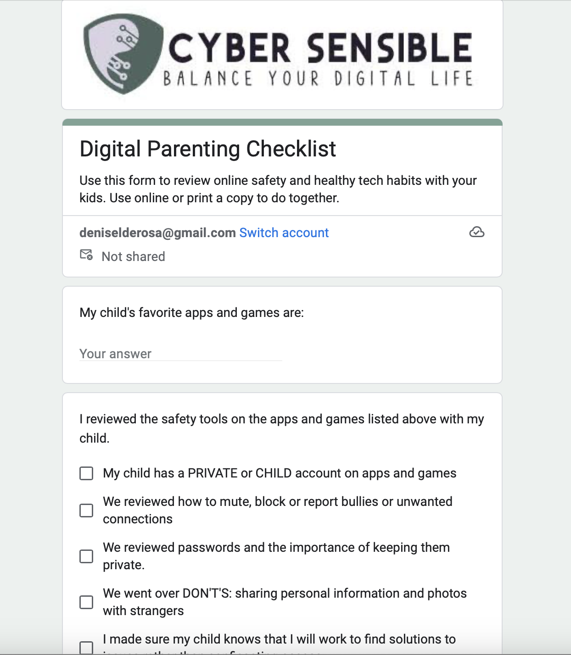

Slide 42

Tips for Digital parents
Know the Apps They Use
Use Privacy and Safety Settings
Agree to Online Standards of Behavior
Review Tech Etiquette
Model Good Digital Habits

Slide 43
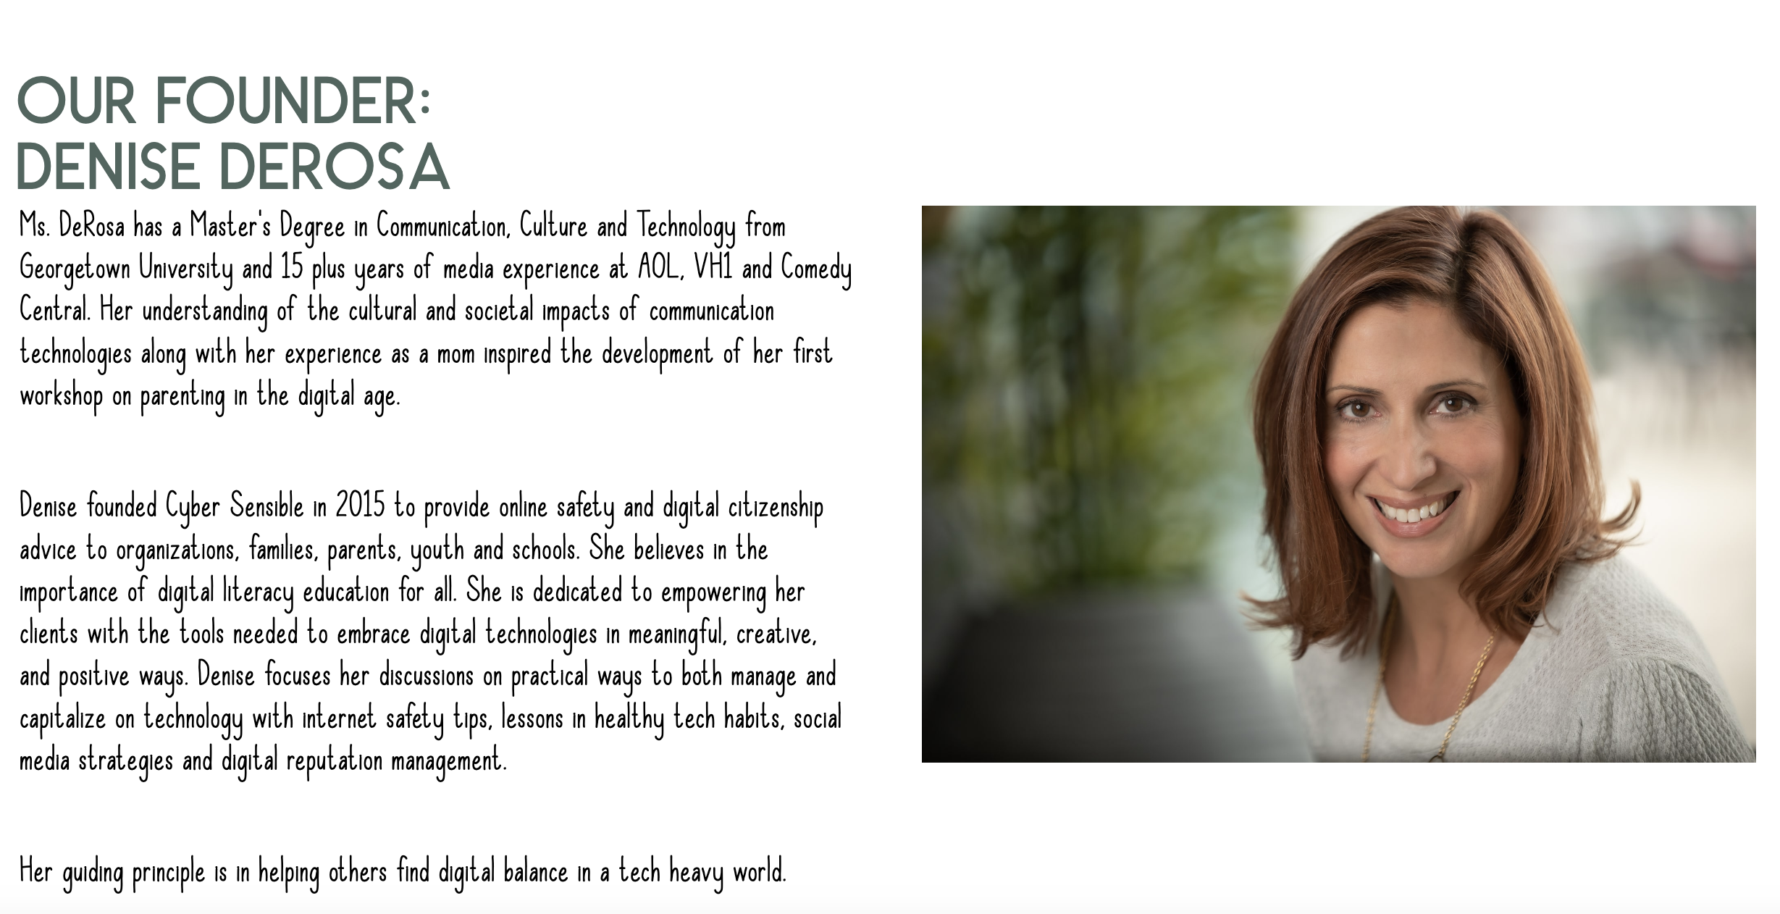
Balance Your Digital Life
Thank you! Please visit Cyber-Sensible.com for more advice. FB & IG: CyberSensible
Twitter: @DeniseLisi23
Notes:
Please visit Cyber-Sensible.com for more advice! Follow Cyber Sensible on Facebook and Twitter.

Slide 44
Your Window
“Think of the Internet less as a screen and more of a window – what do you want to see when you look out and what do you want others to see about you when they look in? Then take steps to make the online environment and your digital profile reflect your answer. ”
–Denise,
Cyber Sensible Founder

