Slide 1


2026 Safety First Grant Program

Slide 2
Before we get started,
at the end of this presentation, I will open for
questions feel free to write them down as we go along and ask them at the end.

Slide 3
2026 Safety First Grant Program Guidelines
Purpose
The Safety-First Grant Program provides financial assistance to parishes, missions, and schools that demonstrate a commitment to safety and loss prevention. The Safety-First grant program helps fund projects that protect people and property by reducing exposure to risk. The focus of the program is to assist locations to undertake projects that might otherwise not be affordable or considered, while keeping in mind that projects considered maintenance, or general upkeep will not be funded by the program.

Slide 4
Eligibility criteria
Each parish, school, mission, or other location insured under the Archdiocesan Insurance Program may apply for a Safety-First matching grant(s).
The grant will match funds up to $10,000.00 for each insured location for one to three approved safety and loss prevention projects. The grant will be funded on a reimbursement basis so locations must be able to fund the total cost of the project.
Accounts receivable with the Archdiocese must be current.
Applications must include supporting documentation outlining the detailed scope of the project, the description and purpose of item(s) to be purchased and must include cost estimates from a vendor/contractor for any projects requiring services.

Slide 5
Eligibility criteria cont.
If you are requesting funds from another source, please provide detailed information on the application.
Photographs should be submitted whenever applicable.
Applications must include the Pastor’s signature and if a school, that of the Principal/President. The signatures affirm the Pastor and Principal’s support of the grant application and the grantee’s ability to fund total cost of the project(s). Further financial information may be requested.

Slide 6
Procedures
Application forms will be available for download from the Property and Risk Management page at archdpdx.org. When completed, submit them with the estimate or proposals any time after January 1, and before March 13, 2026.
It is a best practice to submit your application before the last day of the submission period and to consult with the Risk Management Office ahead of time if you have questions about the eligibility of your project. Applications must be submitted to the Risk Management Office by March 13, 2026. REMEMBER no extensions will be offered.
Applicants will be notified if the project has been approved or not by April 14, 2026. We will do our best to contact you as soon as possible if your project does not qualify so that you might possibly submit another project for consideration before the deadline date.

Slide 7
Application tips….
The very last day to submit all the required information for the grant is March 13th end of day.
Pull the application directly from the Risk Management page - https://www.archdpdx.org/property-and-risk-management. Do not save the forms to your PC. We slightly change the forms as needed please make sure the form you are using is the current application. 2026 Safety-First Grant Application.
Add the highest estimate of the cost or the highest bid. This is significant since the data provided to Risk Management in the project application serves as the foundation for our SFG budget. This does not obligate you to utilize the estimate that you provided. This does imply that we will not raise the amount for you if you submit the lowest-cost offer and later choose to utilize a higher-cost bid. The amount can be decreased but never increased.
You can submit up to three projects total. You may use one form if you like or multiple. It’s up to you.

Slide 8

Application tips continued…
5. RM should be able to communicate with just one person at the parish/school. You will note on the application there is a line to fill in that asks for the point of contact. In the past, three to four people have contacted me at different times about the same project at the same parish. If 200 locations or 20 locations do this, my workload will increase significantly.
6. Direct purchases. This means you have purchased something you can install without assistance. For example, non-slip mats, & Fire extinguishers. These are direct purchases and do not require a contractor to install.
7. You will know the project has been approved because I will send an approval letter via email to the contact person. If the contact person for the parish/ school does not prefer email I can mail a paper copy as well. All the following steps are outlined in the letter. Read it.

Slide 9
When submitting any information / documentation to Risk Management
PLEASE DO NOT SUBMIT INCOMPLETE DOCUMENTS. Feel free to wait until you have everything you need. I cannot partially approve any projects, contracts, insurance, or payments until I have everything completed. Preferably in one email. There are approximately 200 locations each of them have the ability to participate and a lot of locations do participate, which means I have a large number of documents to review.
When I receive an email with documents I automatically start reviewing as soon as possible. If it is incomplete, I will email the sender and let them know to resend all documents entirely which starts my process all over again.
Email Submissions- Please use the subject line in the following format, Name and location of parish, SFG, Document name.
For example, Pastoral Center-Portland SFG Application
If every submission says Safety First Grant Application, I can not search for a specific location using standard search tools.

Slide 10
After the project has been approved
IMPORTANT: For ALL approved projects for contracted services $10,000 and over, locations must submit completed contract and insurance documents for review and approval by the Risk Manager before the start of the project. For projects with contracted services under this threshold, contract and insurance documents are required; however, they do not need to be submitted. Locations must maintain these documents, and the Risk Management office may request them for review at any time.
REMINDER: Any projects with contracts $10,000 or higher completed without Risk Management approval will be in violation. Any locations found not to have contracts or insurance in place will not be eligible for the next Safety-First Grant cycle.

Slide 11
Payment for Direct Purchases
Upon purchase of the item(s) approved for matching funds, submit a SAFETY-FIRST Grant Payment Request Form and documentation of all payment(s) to the Risk Management Office. Documentation should include any/all paid invoices and a copy of payment check(s) or receipt(s). Matching grant funds cannot be disbursed without this payment documentation.
Within fourteen (14) days of receipt of the payment documentation, matching grant funds will be mailed to you.

Slide 12
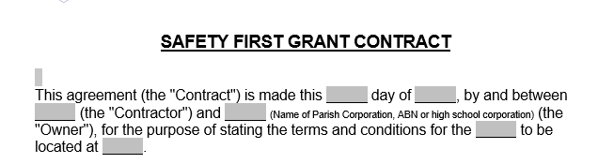
Completing The Contract – Never Change or Alter the Contract
1. Use the parish/school's legal name. You can find the info or double check the information on the Secretary of State website. https://sos.oregon.gov/business/Pages/find.aspx. I will not approve the contract if the DBA is used.
2. Purpose of stating the terms section top of page 1. This is a brief description of the project and the location of the project. (See below) Example, for the purpose of stating the terms and conditions for the ADA doors to be located at your parish/school's name.

Slide 13
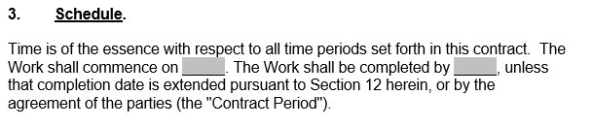
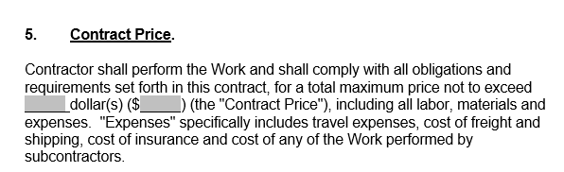
Completing The Contract Continued
Section 3. Schedule – the schedule needs to list a start and finish date. In date format for example March 1st, 2026. Please be specific “fall” to “Summer” will not be accepted.
Section 5. – Contract price you will see two fillable sections this is to avoid error and should be completed as follows; the first fillable box is used to spell out the price for example one hundred dollars the second box is for numerals 100.

Slide 14
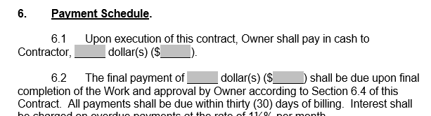
Completing The Contract Continued
Section 6. Payment Schedule – 6.1 should read ZERO /0 unless you have agreed to put a down payment on the work.
Section 6.2 the first fillable box is again asking for the amount to be spelled out before the numerical section. For example, the final payment of six thousand dollars $6,000 shall be due upon final completion of the Work.

Slide 15
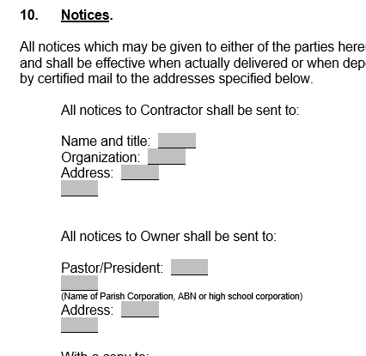
Completing The Contract Continued
10. Notices – contractor on top name and title for example
Clifton Smith - Owner
A Waterproofing & Drainage Co.
Address
The lower section is parish information and should look like this.
Fr. David Jaspers
Ascension Catholic Church Portland Oregon
address

Slide 16
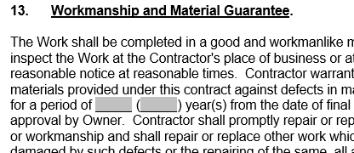
Completing The Contract Continued
13. Workmanship and Material Guarantee – you will find two fillable boxes. The first box you will spell out the number for example two following 2. It is not required to say 2 this is just an example. Commonly one (1) is used.

Slide 17
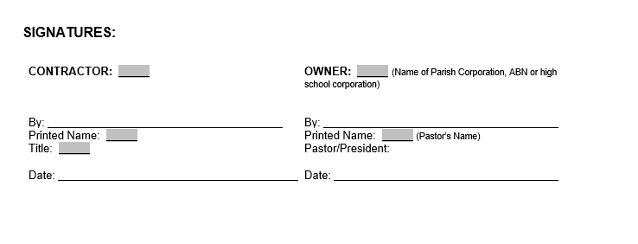
Completing The Contract Continued
Signature page - on the left, contractor, first box is the business name following the signature of the signer with the printed name below that and lastly the date.
On the right is the parish side the first box is the legal name of the parish then the signature of pastor, printed name and lastly date.

Slide 18
Please keep in mind…….
If I have requested an edit and the parties have already signed….
Both parties need to initial the edit or resign and date. A contract should never be altered once it has been signed and not resigned.
It seems tedious but this is a legally binding contract, and we must be diligent.

Slide 19
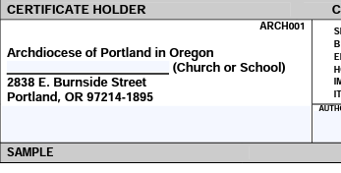
Insurance Tips
You can find a sample certificate on our department webpage that highlight some key factors for approval. I will list common mistakes below. Also, we know many of you are not insurance experts we do not expect you to know and understand all the lingo, but we do expect you to get help if you are unsure. Risk Management is here to guide you and help you when needed.
1. Legal name of parish and Archdiocese must be named additional insured on certificate and endorsement.

Slide 20
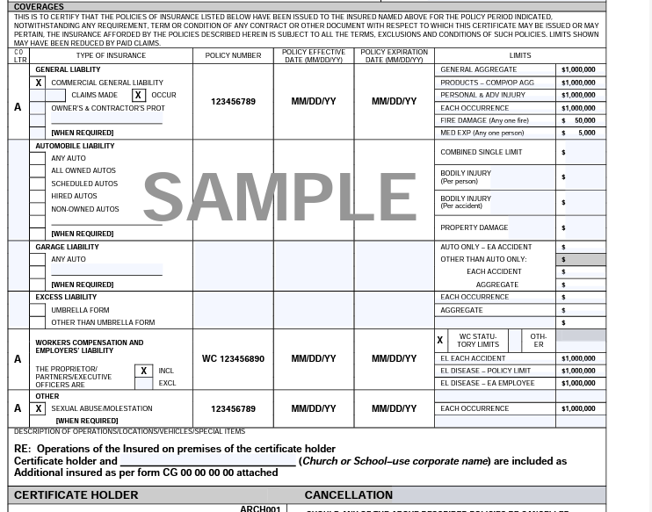
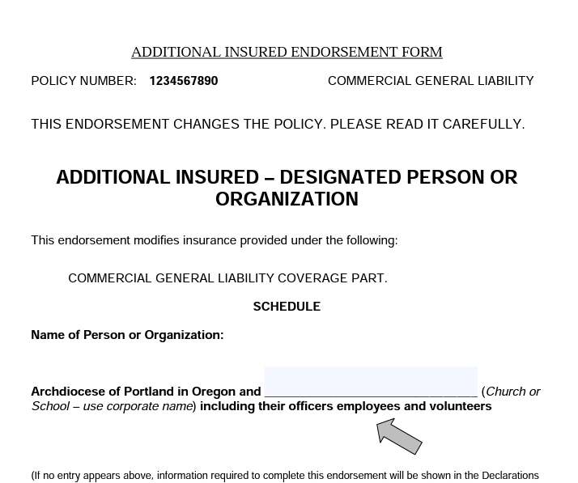










Insurance Tips Continued
The policy number should be listed and current. They must have Workers Comp coverage. It’s possibly on another certificate if they use another provider for that coverage. (totally okay) For WC coverage we request that they have 1 million however I will and have accepted 500k. This only applies to SFG and workers comp. coverage.
The additional insured endorsement must have “primary” language, the policy number and list both the parish / school as additional insured

Slide 21
Pro tip……
Insurance certs will never be one page
Ever…

Slide 22
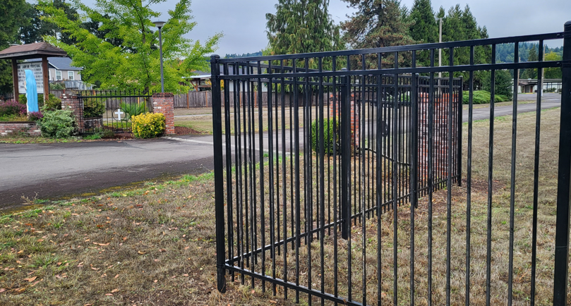
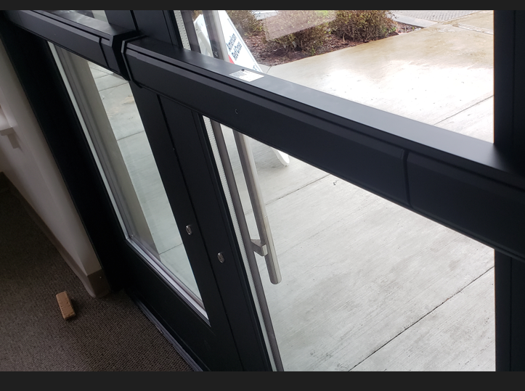
Once your contract and insurance is approved you will receive an approval letter from me. At that point you can start the project.
Once your project is finished, submit the payment request form along with invoices, and proof of payment to the Risk Management email.
Riskmanagement@archdpdx.org
Please include a photo. We love to see the completed work.

Slide 23
Common mistakes of 2025… Missing Information
Contracts were not turned in and or approved.
2.Payment Request forms were missing the processed checks or the form in general. (I need to see the money leaving the bank account or credit card) Paid invoices are not acceptable proof of payment.
3. Contracts, contracts, contracts….
4. Incomplete insurance certificates.

Slide 24
2026 Safety First Grant Program Guidelines
Common Projects/Examples
Security cameras
Parking lot repaving
Security lighting
ADA accommodations
Sidewalk repair
Shatter resistant glass
AEDs
Slip resistant mats/rugs
Security system installation (but not monthly fees)
Fire system upgrades
Electric upgrades to meet code
Fencing/gate projects

Slide 25
2026 Safety First Grant Program Guidelines
Ineligible Projects
Projects that are already started
Playground equipment
New furniture, kitchen equipment, etc.
Lawn/landscaping projects
Tree removal
Maintenance projects
New construction projects
Asbestos removal (if not part of a larger project)
Primarily cosmetic projects
Personalized items (slip mats with logs, etc.)

Slide 26
Let’s have a quick timeline review…
Grant announcement
January 1st, 2026
Applications must be submitted by
March 13th, 2026
Applicants will be notified if project was approved or not by
April 14th , 2026
Friendly Reminder:
All approved projects must be completed, and payment documentation submitted to the Risk Management Office, by December 1, 2026, No exceptions will be granted. One check will be issued per location.

Slide 27
Rolling Over…
If your project is not completed by the December 1st, 2026, deadline you can roll over into the next year. Please communicate this with Risk Management. It’s good to keep us in the loop.
If you rollover into the next cycle, you will not be eligible to apply for a new grant in 2027. You many resume in the 2028 Safety-First Grant cycle.
If you have rolled over into the next cycle but have not communicated with or updated Risk Management, the progress of the project we might cancel it prior to the following year. We will reach out for an update prior to cancellation.

Slide 28
Tips to know that you have followed the guidelines …….
You have a Project Approval Letter from Risk Management. (Approval #1)
You have a Contract Approval Letter from Risk Management. (If your project is under 10K you do not need approval unless you prefer to have it.) We will not send one unless both contract and insurance is approved. (Approval #2)
You did not start the projects without the approval letters.
You have signed documents (by Risk Management) for example a copy of your application was sent back to you signed by Risk Management.
(Approval #3) will be the Payment Request Form Approval.
Create a SFG folder for each year either paper or digital whichever you prefer and save all the correspondence, documents, and receipts in the folder for easy retrieval.

Slide 29
Very Important Information
If the parish / school does not follow the SFG guidelines. You will not participate the following year. We historically have held funds or partial funds depending on the nature of the situation. I do not like math, nor do I want to withhold expected funds from a parish or school. I will, however, give you a timeout. ☺
Please follow the guidelines they are simple, and the information is available and posted year around.
Use a checklist (we made one) it can be found with all other docs.

Slide 30
Important key points of this program
You will receive 3 approvals from me if the project is over 10K and you are following the guidelines.
Insurance Certificates are never one page.
Submit whole and complete documents no bits and pieces.
I need the proof – processed checks, bank or credit card statements.
Don’t be afraid to email me. I’m here all year around and can help guide you through the process if you have questions.
Utilize the subject line of the emails to me. Please include the location and city name. Several locations have the same name different city.
One project manager please.

Slide 31

Open
for
Questions

