Slide 1

Preventative Maintenance

Slide 2
Safety Committee
To have a preventative maintenance plan, you should have a Safety Committee.
Everyone has a role.
Designate persons involved with day to day operations and grounds control.
Meet regularly to discuss the Parish/School needs to reduce risks on the property.
Establish a plan to address these risks.
Don’t wait for something to happen. It is all about prevention! By being proactive vs. reactive you are reducing your loss exposure and saving money.

Slide 3
Preventative Maintenance
The following statements are no secret to facility managers:
Preventative maintenance funding is usually the first thing that is cut from the budget when looking to save funds.
Unfortunately, that can actually cost more money in the long run.
It also creates two problems:
Increased repair costs for equipment break down
Increased exposure to liability and property losses
Sometimes it is the little things that can hurt the most.

Slide 4
Preventative Maintenance:
What are some examples of the most overlooked or deferred maintenance items?
Emergency Lights and Exit Lights
HVAC Systems
Interior stairs and landings
Roofs and gutters
Flooring
Sidewalks, exterior stairs, other walkways
Exterior security lighting
Exit doors
Electrical systems
Building security
Playgrounds

Slide 5
Preventative Maintenance:
What are some of the most overlooked items?
Exit Doors
Doors need to open and close easily and smoothly
Doors with automatic closures should be checked for proper operation
Door latching devices should unlock to open the doors easily and latch smoothly when closed
(No more than 15 pounds of pressure against latch to open the door)

Slide 6
Preventative Maintenance:
What are some of the most overlooked items?
Building Security
Do you have a good key control policy?
Do you check your outside lights regularly?
Do you prohibit outside doors from being blocked open?
Do you keep landscaping trimmed away from doors and windows?

Slide 7
Preventative Maintenance:
What are some of the most overlooked items?
Playgrounds and equipment should meet Consumer Product Safety Commission Standards (CPSC)
Regularly check all bolts and connection points
Adequate Cushioning Material (Minimum 9”-12”)
Age appropriate equipment
Adequate “use zones”
Adequate Supervision
NO HOMEMADE PLAYGROUND EQUIPMENT!
Regularly check the condition of the athletic fields for adverse condition

Slide 8
Preventative Maintenance:
What are some of the most overlooked items?
Housekeeping
Following proper housekeeping practices is the cheapest preventative maintenance effort we can make.
A place for everything and everything in its place. It may sound simple, but it works!
If you haven’t used it in a while, dispose of it.
While clutter may not start a fire, it gives the fire a place to start and contributes to the spread and severity of a fire. It also can cause trip and fall injuries.
Excessive items will increase the potential for rodents, insects and other pests.

Slide 9
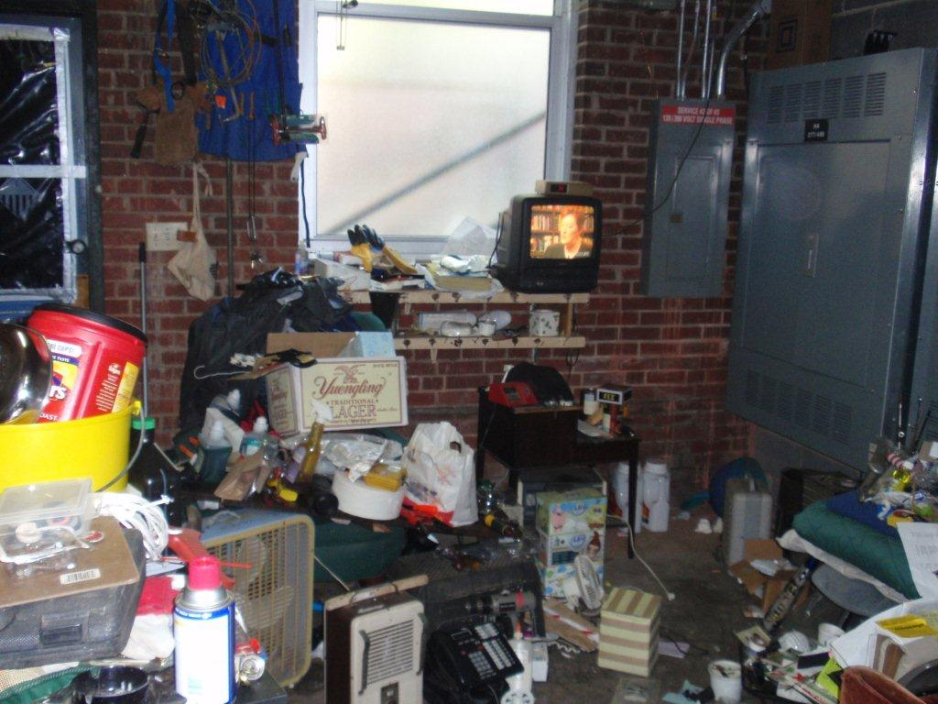
Good housekeeping?

Slide 10
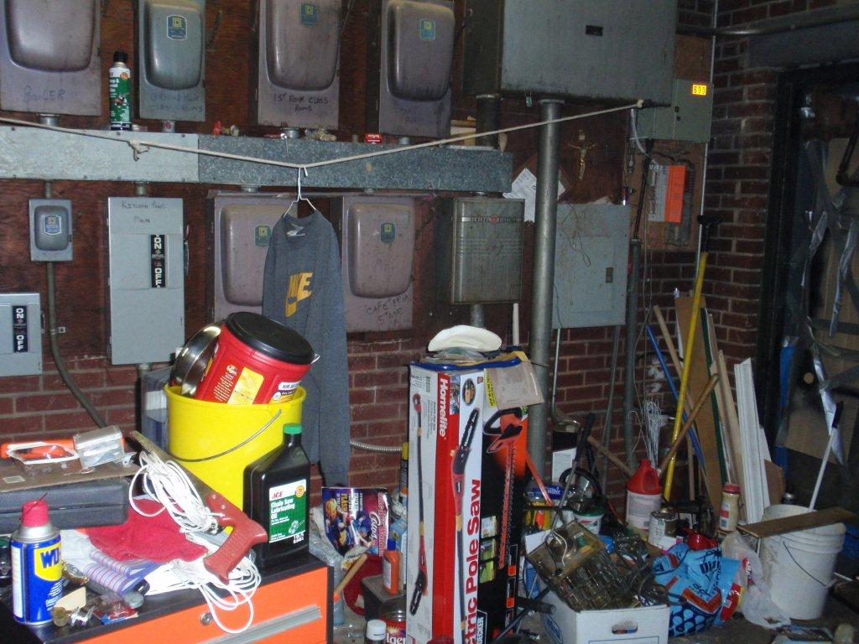

Slide 11
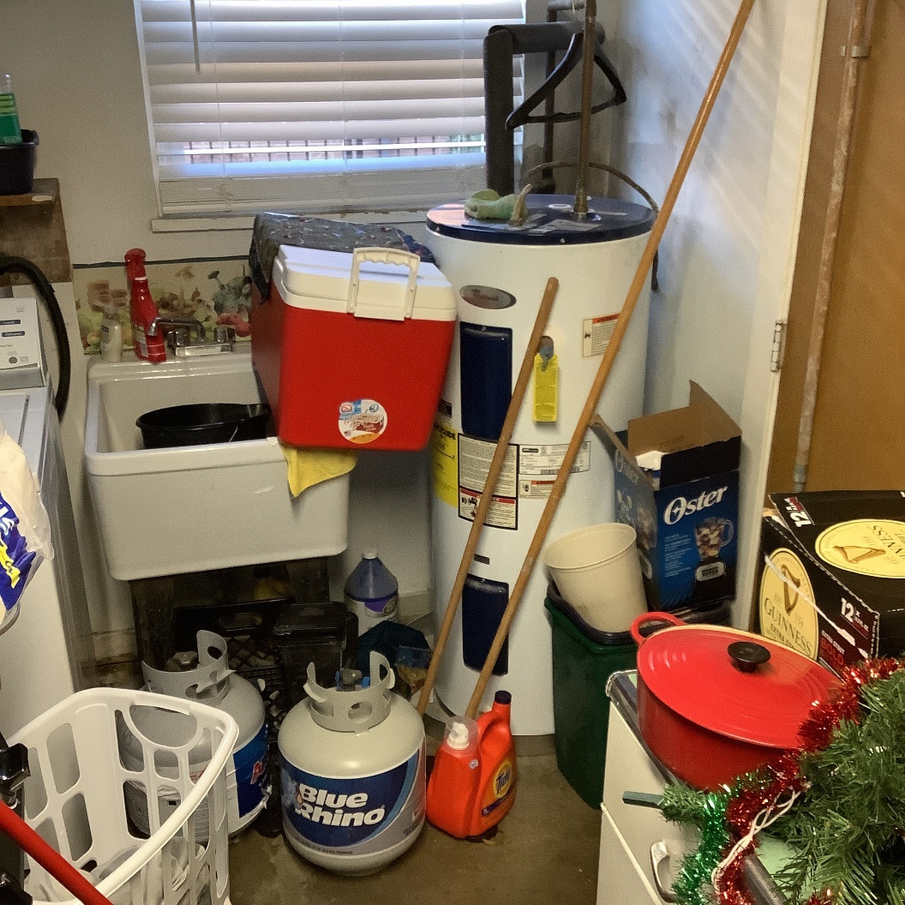

Slide 12
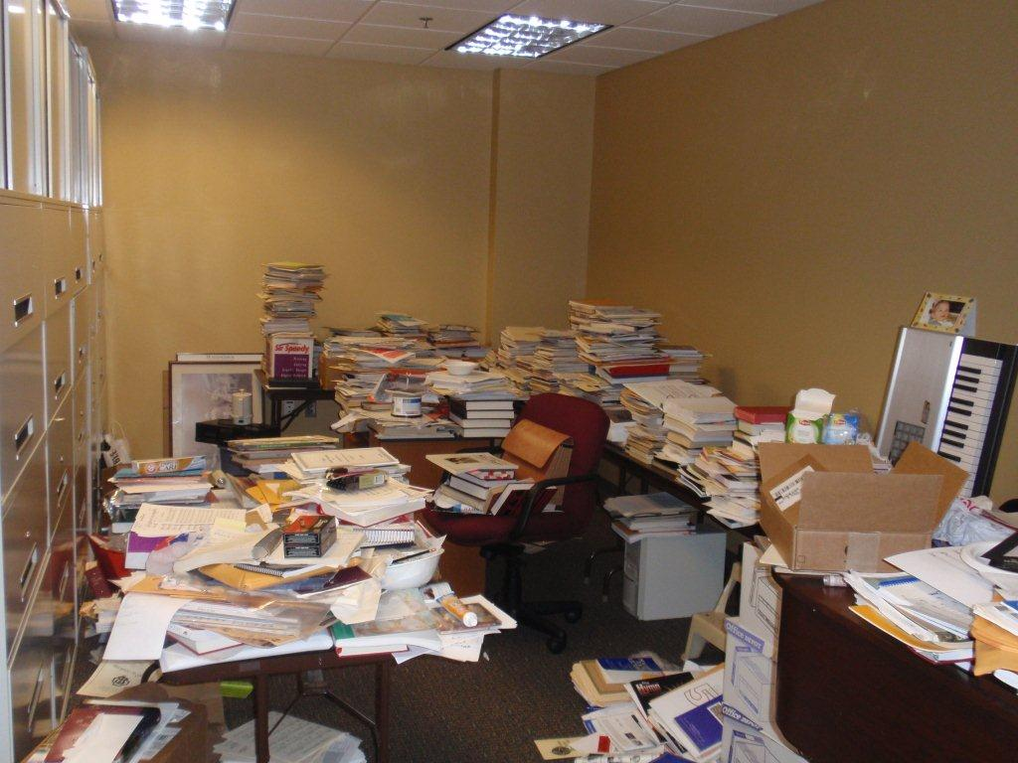

Slide 13
After The Storm: Facility Management
In many parts of the country, tornados and severe thunderstorms can cause extensive damage to our properties. As soon as it is deemed safe to examine the property, you'll want to do so.
Watch for downed power lines. If found, discontinue your examination until you are advised it is safe to walk your grounds.
If you have above-ground electrical service, make a visual check of the electrical connection outside of building. Do not attempt to make repairs or touch any wiring. Contact a qualified electrician to examine the issue if you suspect damages or have concerns.

Slide 14
After The Storm: Facility Management
A quick survey should be made to identify the types of items that need to be secured and whether any trees or branches pose a direct threat to your property. Most of the damage from storms comes from fallen trees or branches.
Examine the exterior of building for obvious signs of damage that could turn into a bigger problem. Make temporary repairs to protect from further damage.
Check roof for damage such as missing shingles, torn metal, or extensive pooling of rain water on flat roofs. Look for leaks and broken vent pipes.

Slide 15
After The Storm: Facility Management
The evidence for wind damage can range from missing shingles, which can be seen from the ground, to lifted shingles with broken glue seals. Asphalt shingles adhere to one another utilizing a strip of adhesive called a glue strip or sealant strip. When high winds break this seal, debris and dirt are blown into this glue area.
Lightning damage is not always visible or obvious. It can range from structural damage to damage to a portion or the entire electrical system to the building(s).
Examine the interior of every room and look for water staining or leaks. If you see water on the floor along the wall but no moisture on the wall itself, this would be indicative of interior water migration.

Slide 16
After The Storm: Facility Management
Almost every church and school depends on volunteers for necessary maintenance and minor repair work. However, it is not recommended to have volunteers examine your property for storm damage. This should be handled by professionals who are trained to identify specific damages and are aware of potential hazardous situations.

Slide 17
Preventative Maintenance Checklist
Daily
Wet or snowy days:
  Clean up water around entrances and on steps right after school starts, just before lunch, and just before dismissal.
Check all stoves, hood filters, and cooking areas to insure they are properly cleaned to remove grease and inflammable waste.
Check exit lights.
Check all outside lights.
Vacuum carpets (in heavy traffic areas, classrooms, offices, etc.).
Pick up all trash around buildings.
Clean up around dumpster.

Slide 18
Preventative Maintenance Checklist
Daily
Cold Weather Precautions:
  If heat is left on, check to see that it is still on.
  Pipes under sinks are usually on the outside walls.
  Open the cabinet doors so heat can get to these pipes.
  Use salt and shovel to clean a path on each set of steps when there is ice on the ground.
  Path should be next to the hand rail.

Slide 19
Preventative Maintenance Checklist
Weekly
Check smoke detectors.
Drain water from air compressor.
Check plumbing in all restrooms.
Check all sinks for leaks.
Pour water in bathroom floor drains.

Slide 20
Preventative Maintenance Checklist
Monthly
Check all window frames and glass for cracks.
Check caulking on windows.
Check hardware on all doors.
Check all storage areas to insure they are clean, shelves are not overloaded, and heavy objects are stored on lower shelves.
Check all trees for dead branches.
Check all playground equipment.
Check and clean out outside drains.
Check gauge on fire extinguishers.
Check all fences.
Trim shrubs.

Slide 21
Preventative Maintenance Checklist
Every 3 months
Change oil in air compressor.
Clean heating & air conditioning coils.
Clean filters.
Lubricate bearings and shaft.
Leave heat on in vacant buildings, or turn off the water and drain the pipes.
Check fuses/breakers.
Check motors/connections.

Slide 22
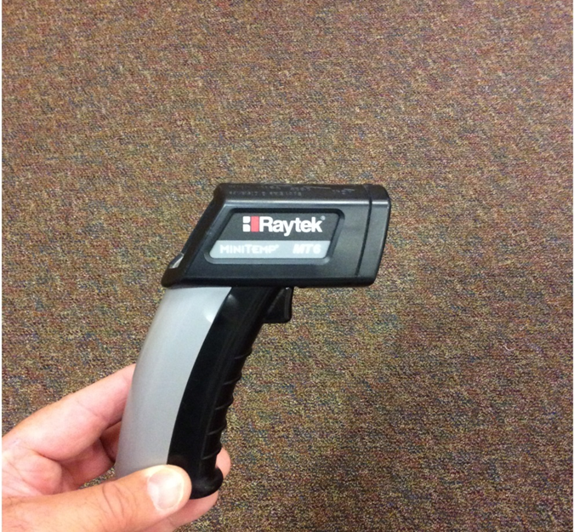
Preventative Maintenance Checklist
Scan breakers with thermometer
Temperatures will vary depending on circuits
The temperature of the breaker(s) should not exceed more than 18 degrees of the ambient temperature
Example: If most breakers are running around 85 degrees and you have one or more breakers 103 degrees or higher, we recommend contacting a qualified electrician to determine the cause
Do not wait to make the call, it may cost you

Slide 23
Preventative Maintenance Checklist
The cause of the elevated temperature could be as simple as the breaker needs to be tightened from several years of use or, it could indicate an appliance on that circuit is ready to fail
You would not know if something is ready to fail unless you check these breakers regularly
By inspecting your breakers, you are performing a fire prevention method which may in fact prevent a fire from occurring at your location

Slide 24
Preventative Maintenance Checklist
Every 6 months
Oil fan motor
Remove and clean out P-traps
Inspect roof
Clean out gutters
Check weather stripping on doors and windows

Slide 25
Preventative Maintenance Checklist
Yearly
Check roof drains.
Tuckpointing.
Termite inspection/treatment (outside contractor).
Fire extinguishers serviced/inspected (outside contractor).
Clean entire heating/air condition unit.
Check receptacles.

Slide 26
Taking Shortcuts
How often do you wait until tomorrow to repair an issue?
Have you ever used improper tools for a job because you didn’t have the budget to purchase the correct equipment?
Wait another year to replace the roof or parking lot?
Stood on a chair instead of a proper ladder?
Do you allow non-qualified people to make your repairs to save costs (electrical/plumbing/roof)?

Slide 27
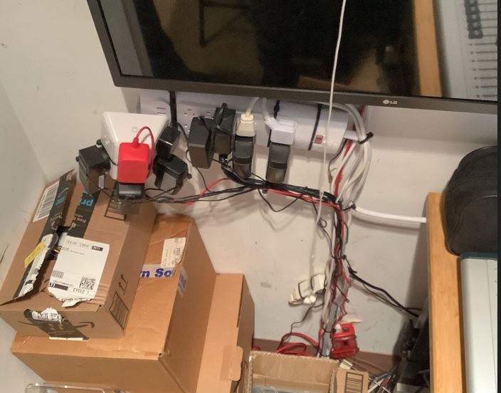
Would you take chances like this?

Slide 28
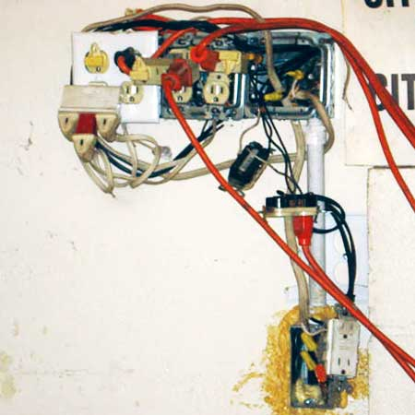

Slide 29
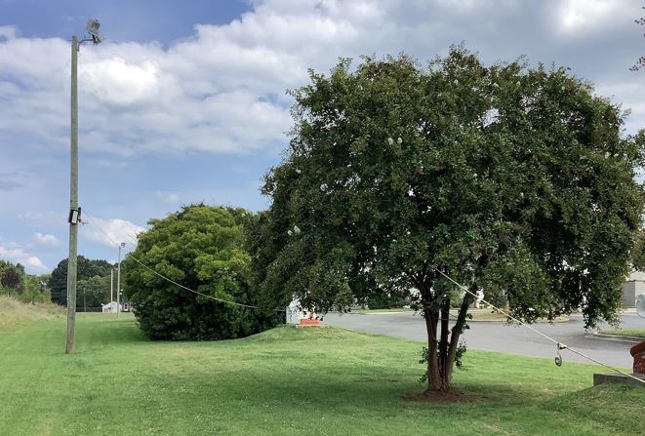

Slide 30
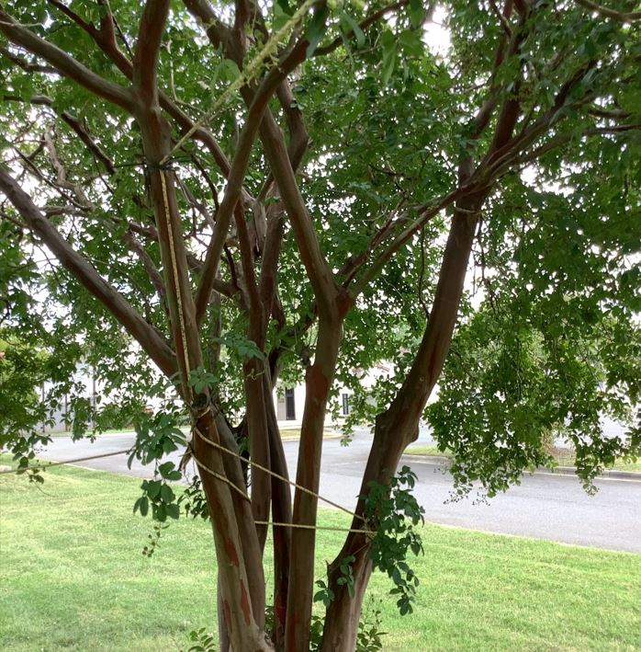

Slide 31
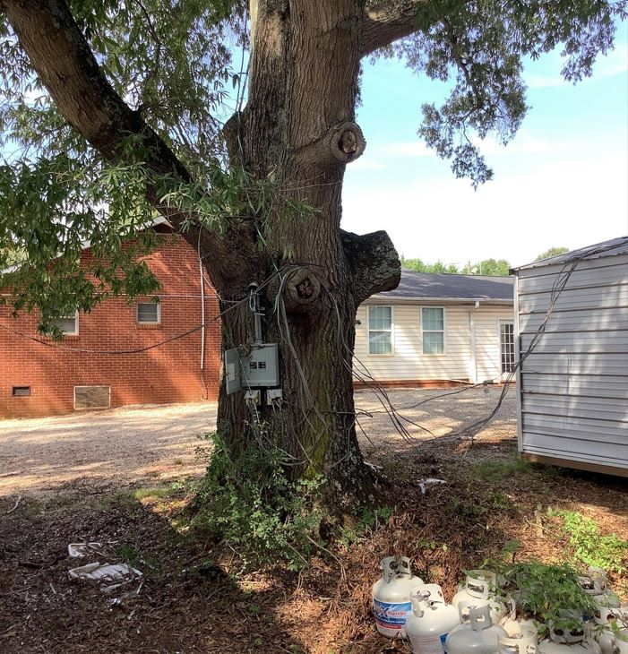

Slide 32
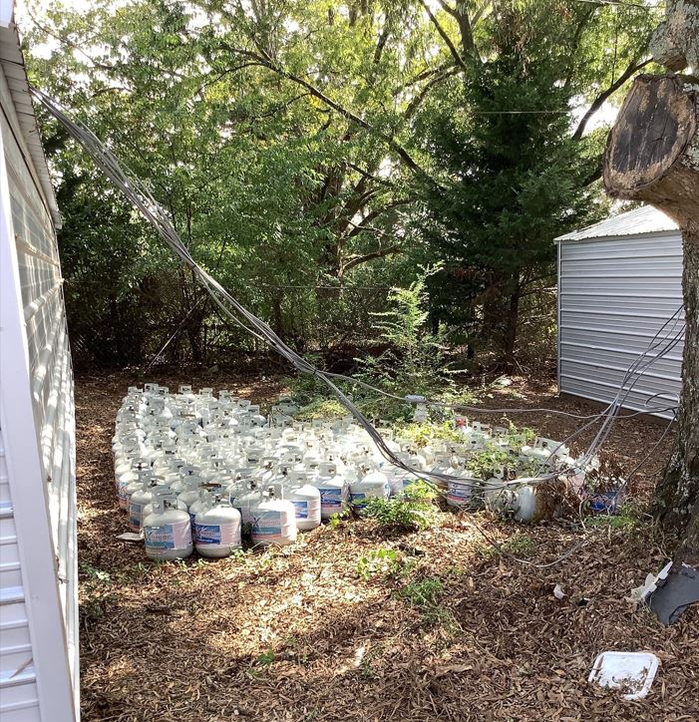

Slide 33
What If We Don’t Have The Staff?
This is where we need to use outside vendors to assist in caring for our building and grounds. We are very sensitive with the current state of the church.

Slide 34
Deferred Maintenance
By deferring preventative maintenance, you are taking chances.
Increasing your risks for losses.
Increasing your risks for injuries.
Increasing your chance of litigation.

Slide 35
TIPS FOR WINTERIZING PROPERTY
Replace furnace filters. This should also be done at least every two months throughout the winter for maximum efficiency. The furnace should be serviced by a professional every year. Check the thermostat to ensure it is working properly.
Examine the water heater for leaks and make repairs as needed.
Clean and vacuum vents, ducts and baseboard heaters.
Clean and inspect your chimney for blockages. Check flashing around the chimney or where the roof meets the walls; caulk and seal any open joints. Also, ensure that the flue is open and fireplace doors seal tightly.

Slide 36
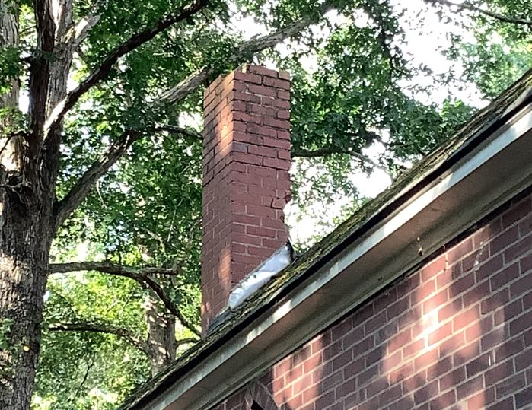

Slide 37
TIPS FOR WINTERIZING PROPERTY
Check your roof for leaks or damaged, loose or missing roof shingles. Ensure necessary repairs are made to reduce the chance of water damage.
Check and repair exterior walls that have peeling paint or missing or loose siding.
Drain water from the sprinkler system. Drain and remove garden hoses. Insulate exterior faucets by wrapping them with a blanket, bubble wrap or insulation tape.

Slide 38
TIPS FOR WINTERIZING PROPERTY
Ensure all outdoor lights, switches, timers and bulbs are working properly. Ensure the timers are reset to compensate for earlier nightfall.
Clean gutters and storm drains. Ensure that downspouts carry water at least 6’ away from the house.
Check for low spots around the exterior of the house where drainage might be a problem. Fill trouble areas so the ground slopes away from the house.

Slide 39
PROTECT YOUR PROPERTY FROM FREEZE DAMAGE
INSPECTION OF PROPERTY
Fall is the time to perform pre-winter maintenance at each building. A good winterizing program prepares properties for both expected and unexpected cold weather hazards, and begins with a thorough inspection of all property. This program should include servicing of furnaces and boilers by a qualified inspector to guarantee adequate heat sources for the winter. All piping should be identified and treated, as necessary. Pipes in concealed spaces or in areas with limited heat service, especially those pipes which are located outdoors above ground (common in warm climate regions), warrant special attention. Windows, doors, and ventilation openings should also be examined for gaps or cracks where cold air may enter. Minor gaps can be eliminated by caulking; however, major gaps may require replacement.

Slide 40
PROTECT YOUR PROPERTY FROM FREEZE DAMAGE
INSULATION AND INSPECTION OF PIPING
Pipes identified as being potentially subject to freezing should be properly insulated. Heat tape or heat cables can be used, but caution should be exercised. The U.S. Consumer Product Safety Commission states that “heat tapes or cables contribute to 3,300 residential fires each year,” and advises that heat tapes and cables be inspected yearly for cracks or damage to the plastic coverings, bare wires or char marks. If damage is found, the tapes or cables should be replaced. Be aware of asbestos!
Incorrect application of heat tape also poses a fire hazard. Use only one layer of heat tape. This will sufficiently protect pipes from freezing without presenting a risk of fire.

Slide 41
PROTECT YOUR PROPERTY FROM FREEZE DAMAGE
Many people also use heat tape in gutters, downspouts, and drains to prevent water from freezing in these areas and from backing up under roof materials, causing extensive roof damage and water leaks. However, it is important that the heat tape used is approved by a recognized testing lab for this type of application and that it be installed in accordance with manufacturer’s recommendations. Misuse of heat tape in these cases creates an electrical hazard and a possible fire ignition source.

Slide 42
PROTECT YOUR PROPERTY FROM FREEZE DAMAGE
As winter arrives, a designated person should routinely inspect the property in order to limit damage if a water pipe has frozen. Mission churches, parish halls, schools, and other occupancies that are used on a limited basis should also be checked. These buildings can sustain extensive water damage before the problem is discovered. During holidays and weekends, when buildings are unoccupied (such as schools) or have minimum staff on hand, substantial losses can be incurred before it can be determined that a water pipe has frozen and burst. During periods of extreme cold, inspections performed every three or four hours would not be excessive.

Slide 43
Self Inspection Report
Locations that do not receive an Onsite Inspection will receive a SIR.
Why are the SIR’s so important?
Who should fill out the SIR?

Slide 44
Self Inspection Report
Do you have a security emergency response plan in place?
Are practice drills regularly conducted?
Do you have key control policy in place?
Do you maintain an inventory list of furnishings & equipment?
Do you have an Automatic External Defibrillator (AED)?

Slide 45
CMG Resources Available
CMG Connect
Catholic Mutual CARES documents
Emergency Response Procedures phone app

Slide 46
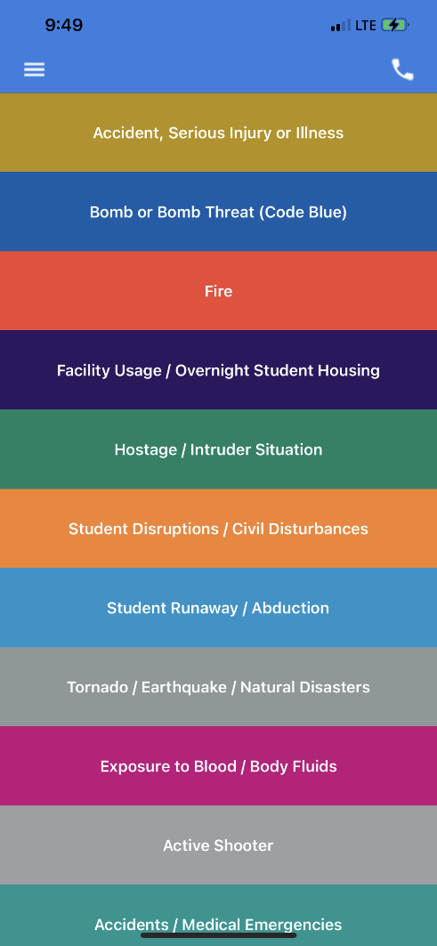
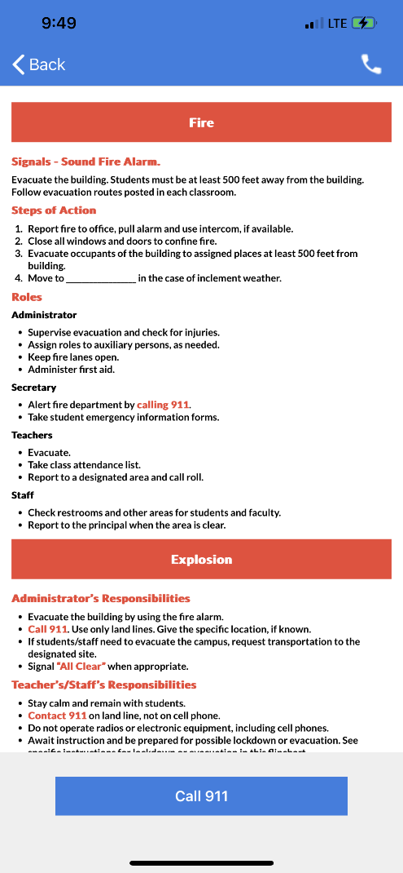
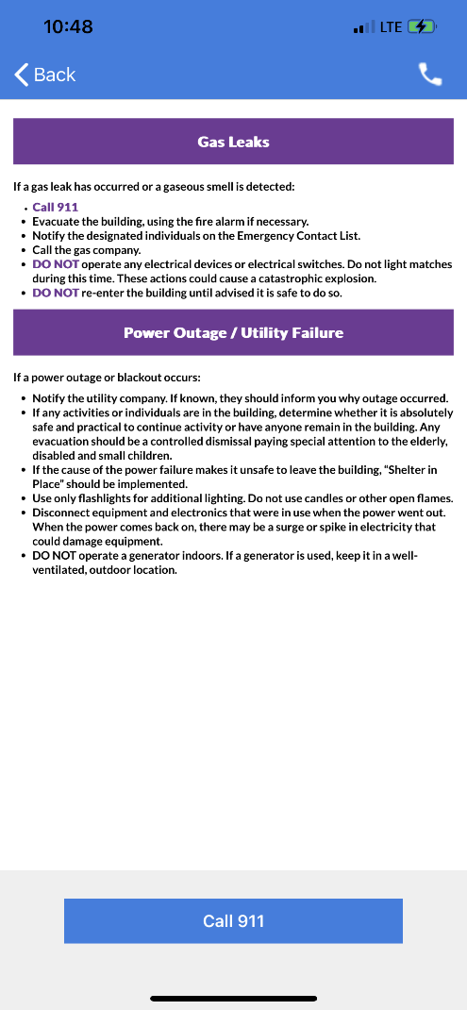
Emergency Response Procedures phone app

Slide 47
Any Questions?
Thanks for joining us!

