Slide 1
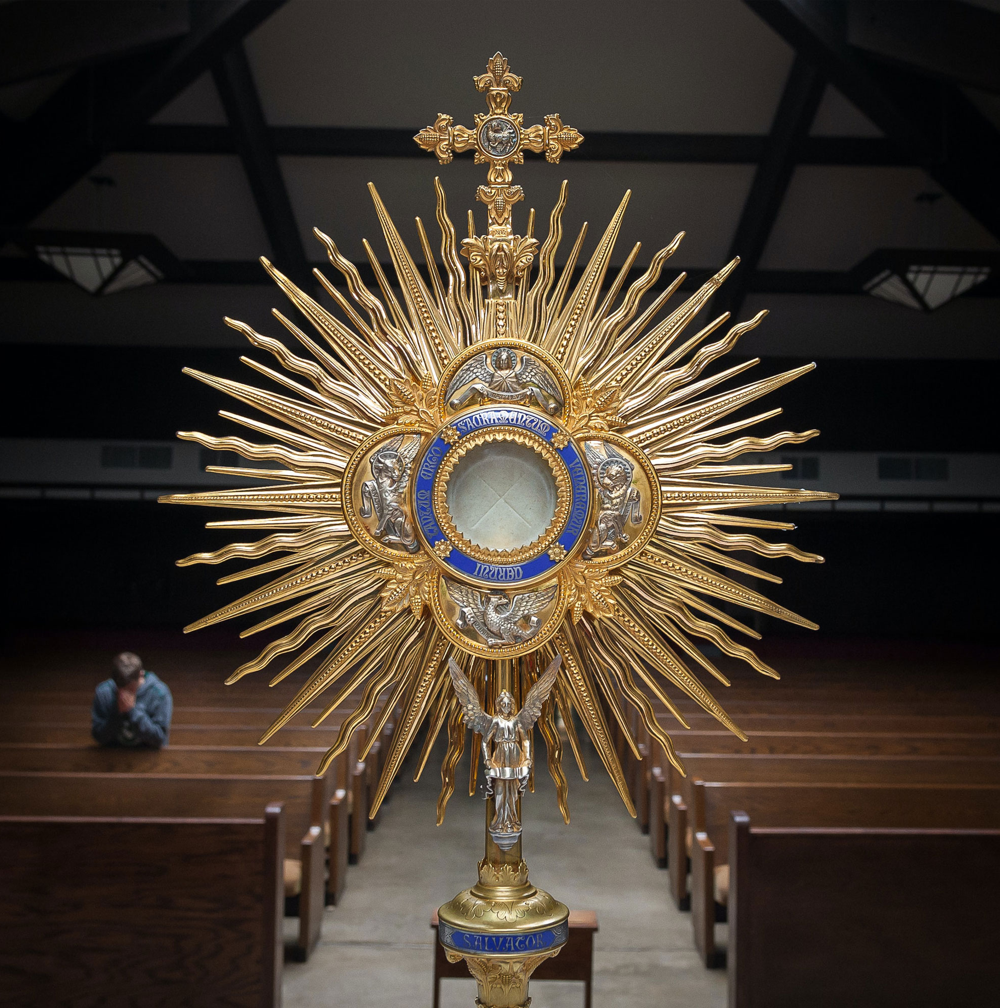
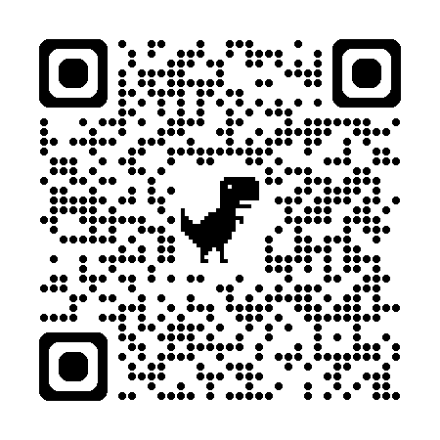

Florida Catholic Conference
Accreditation Program
Early Education Program
Governance & Leadership
and
Operational Vitality
Benchmarks
Slide deck (recording available after the webinar)
https://eas-ed.org/presentation-recordings-and-powerpoints

Slide 2
Agenda
Opening Prayer
General Benchmark Information
Governance & Leadership Domain
Q & A
Operational Vitality Domain
Q & A
Closing Prayer
Any Final/Individual Questions

Slide 3
Opening Prayer
Come, Holy Spirit, fill the hearts of your faithful
and kindle in them the fire of your love.
Send forth your Spirit and they shall be created,
and you shall renew the face of the earth.
O God, who have taught the hearts of the faithful
by the light of the Holy Spirit, grant that in the same Spirit we may be truly wise and ever rejoice in his consolation.
Through Christ our Lord. Amen.

Slide 4
Benchmarks
EEP Standards
  Full standards for stand-alone centers
  School standards for programs connected to schools
    “Missing” benchmarks are covered in the regular school standards and benchmarks in the ARCA (PK must be following these). More of the benchmarks are now included for programs within schools in order to ensure PK focus. (*centers only)
Met-Not Met
Word document with descriptions: EEP Standards and Benchmarks on www.eas-ed.org.
Director – maybe fulfilled by director, principal, or anyone from the leadership team

Slide 5
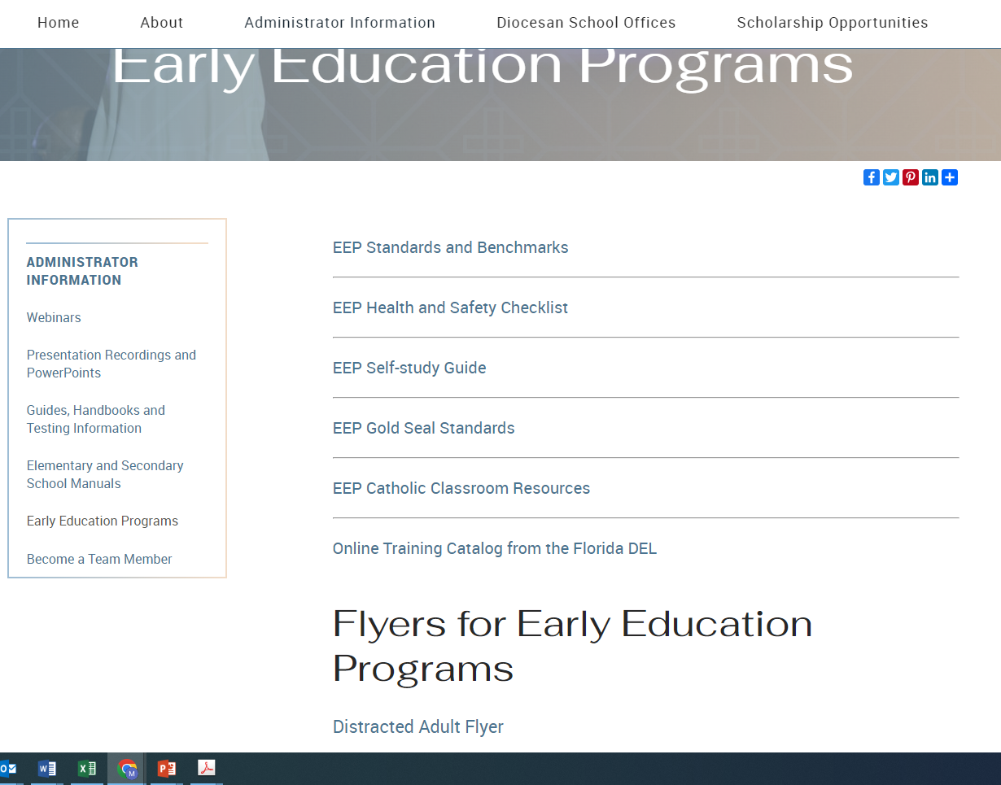


Slide 6
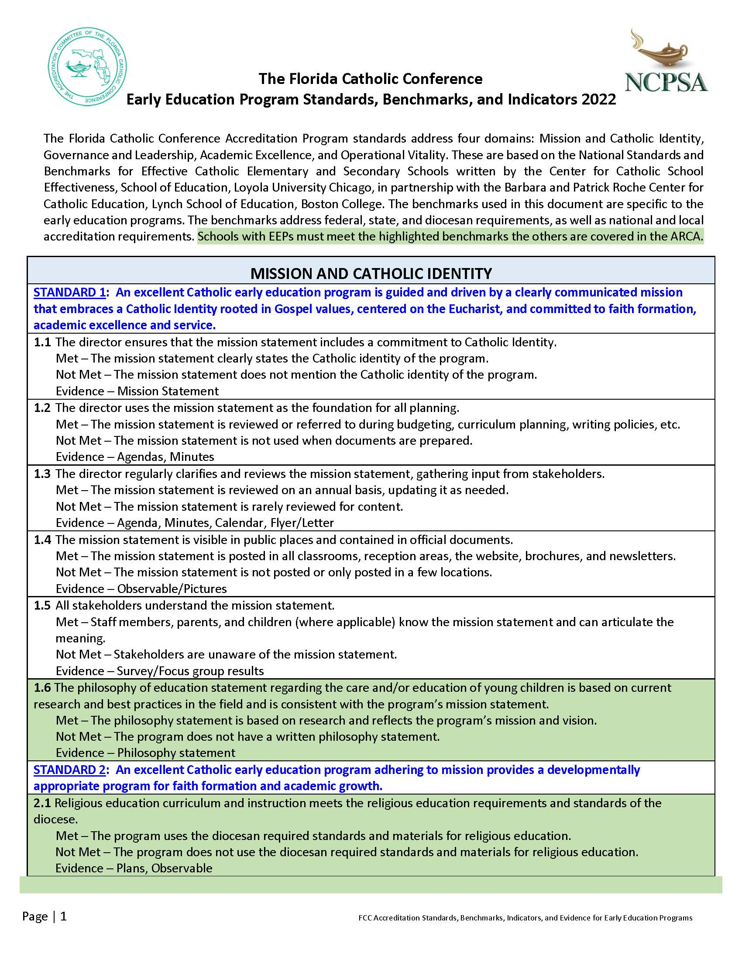

Slide 7
Preparing for a site visit or review
Use the comment boxes
  Brief description of what this looks like at your school/center
  Tell your story – what do you want reviewers to know
Attach necessary evidence
  More does not equal better
  Make sure it is related to the benchmark
  Don’t overwhelm or underwhelm your reviewers
  Every benchmark must have evidence (if physical – write that in the comments and explain where to find the evidence)

Slide 8

Early Education Program
Governance and Leadership Benchmarks

Slide 9
5.1 The program has a clearly defined governance structure, complete with job descriptions. (Schools with EEPs must include responsibilities of the director versus the principal, if the job is divided.)
Met – Job descriptions or other documents include the chain of command and indicate the decision makers.
Not Met – The governance structure is understood, but not documented.
Evidence – Handbook, job descriptions, chart
Governance flow chart
Job descriptions
  If connected to a school - detail director’s job vs. principal’s job (if there is a separate director)

Slide 10
*5.2 The director systematizes the policies of the early education program’s operations to ensure fidelity to mission, and continuity and sustainability through leadership successions.
Met – The program has well defined and up to date written policies in all areas and a written succession plan.
Not Met – The program only has some policies and handbooks written.
Evidence – Handbooks, files, website, written plan
Handbook reviewed, updated, and in use
What kind of leadership succession plan(s) is available – what happens if the director has to be out for several weeks?

Slide 11
*5.3 The director maintains a constructive and beneficial relationship with the bishop and the superintendent that is marked by mutual trust, close cooperation, and continuing dialogue.
Met – The director attends meetings with the superintendent and education office personnel. The director follows the directives of the bishop.
Not Met – The director does not participate in diocesan meetings on a regular basis.
Evidence – Calendar, agendas, conversations
In addition to attending meetings and collaborating with the superintendent, the initiatives and messages from the bishop are shared with parents/staff

Slide 12
*5.4 The director maintains a constructive and beneficial relationship with the pastor and the school principal, if the parish has a school, that is marked by mutual trust, close cooperation, and continuing dialogue.
Met – The director meets with the pastor and principal if the parish has a school.
Not Met – The director does not meet with the pastor and/or the principal on a regular basis.
Evidence – Calendar, agendas, conversations
What is the relationship/connection with the pastor?
What is the relationship to the school, if connected to one or to nearby Catholic elementary schools?

Slide 13
5.5 The pastor (or school principal or superintendent, where applicable) ensures an annual evaluation of the early education program’s director is completed.
Met – An evaluation form used to annually evaluate the director is evident.
Not Met – Evidence of an annual evaluation is not available.
Evidence – Completed evaluation
How often is the director evaluated? By whom?

Slide 14
6.1 The Director meets state and diocesan requirements for early education program leadership preparation and licensing.
The Director:
Is a minimum of 21 years age
Holds a director’s credential from Florida DCF or an FLDOE administrator’s certificate
In a stand alone center – must be met.
In a school – director and principal can both be used to meet all of these requirements (director meets some, principal meets some) – except 6.1.a – both must be at least 21

Slide 15
6.1 The Director meets state and diocesan requirements for early education program leadership preparation and licensing. The Director:
Has obtained a minimum of 9 credit hours of college course work in administration, leadership or management
Has obtained a minimum of 24 credit hours of specialized college course work in early education, child development, elementary education or special education.
Has experience working directly with children whose ages are represented in the early education program for which the director has oversight.
6.1.c & d – college transcript showing the hours in any of these areas
6.1.e – resume, job experience documented through observations, evaluations

Slide 16
6.2 The director assumes responsibility of the day to day operations of the program, maintains program policies, and monitors the program’s compliance with applicable requirements, including health and safety, consulting with the diocese and experts.
Met – A current job description for the director delineates the above-mentioned responsibilities of the director.
Not Met – The job description for the director does not mention these items.
Evidence – Written job description, schedule, compliance reports
Job description
Latest DCF report or letter for religious exemption
Local inspection reports

Slide 17
6.3 The director takes responsibility for the development and oversight of personnel, including hiring, professional growth, faith formation and formal assessment of staff in compliance with diocesan policy. The formal assessment takes place annually. The director assists the teachers in creating individual professional development plans.
Met – A current job description for the director delineates the above-mentioned responsibilities of the director; director documents regular meetings with teachers.
Not Met – The job description for the director does not mention these items.
Evidence – Written job description, schedule
What professional development is offered to staff?
How often do observations take place? Are these reviewed and discussed?
How are evaluations completed?
Do teachers have professional development plans?

Slide 18
6.4 The director has plans in place for the use of qualified substitute teachers to ensure the integrity of the program.
Met – A current and sufficient list of qualified substitutes is available, and evidence is clear that the integrity of the program is maintained during teacher absences.
Not Met – A plan to obtain substitutes is not in place, and a list of qualified substitutes is not available.
Evidence – List of substitutes with qualifications
The substitute list should include details – degree/credentials, background screening

Slide 19
6.4.a. In the case of a VPK program, the director has an additional teacher or substitute with the VPK endorsement who could fill in long term (two weeks or more), if needed.
Met – Another teacher, in addition to the VPK teacher(s), has the VPK endorsement or a substitute has the VPK endorsement.
Not Met – The program does not have another teacher or substitute with the VPK endorsement.
Not Applicable – The program does not have VPK.
Evidence – DCF certificates
The goal is to have at least two VPK credentialed teachers on staff

Slide 20
6.5 The director designates a qualified person to assume leadership and responsibility of the early education program in the event of the Director’s absence. The person shall be at least 21 years of age.
Met – A qualified person is the designated leader in the absence of the director.
Not Met – There is no specific person designated to assume the responsibilities of the director when the director is absent.
Evidence – Written policy, personnel file
Should be part of the job descriptions/chain of command
Who fills in for the director?

Slide 21
6.5. a. In the case of a VPK program, a second person on staff has a VPK director credential.
Met – In addition to the director, another staff member has the VPK director credential. In the case of a school, a second person has a professional Florida educator certificate in educational leadership.
No Met – The program does not have a second staff member with the VPK director credential or Florida educator certificate.
Not Applicable – The program does not have VPK.
Evidence – DCF and/or FLDOE certificates
The goal is to have at least two people with the VPK director credential (or administrator certificate)

Slide 22
6.6 The director holds regular staff meetings to support the professional development plan, to build strong relationships, to promote communication, and for the operational vitality of the program.
Met – The calendar indicates the dates of regular staff meetings and agendas are kept.
Not Met – The program does not schedule regular staff meetings.
Evidence – Calendar, agenda
Minutes/sign in sheets from staff meetings
In a school, these can be full faculty meetings
Should have a program-wide professional development plan, in addition to IPDPs

Slide 23
6.7 The director engages in ongoing training and self-evaluation to ensure the continued execution of his or her responsibilities.
Obtains a minimum of 45 clock hours during the first year of employment, especially as it relates to Florida requirements.
Obtains an additional 10 clock hours per year of continuing professional development, provided by a qualified entity in such areas as approved by the diocese.
Met – The director has a professional development plan that includes goals; classes, workshops, or webinars; and self-evaluations.
Not Met – The director does not have a plan for professional development.
Evidence – Professional development plan, course certificate
Director/Principal’s evidence from ongoing PD
Director/Principal’s self-evaluation
Individual Professional Development Plan

Slide 24

Questions on EEP Governance & Leadership Benchmarks?

Slide 25

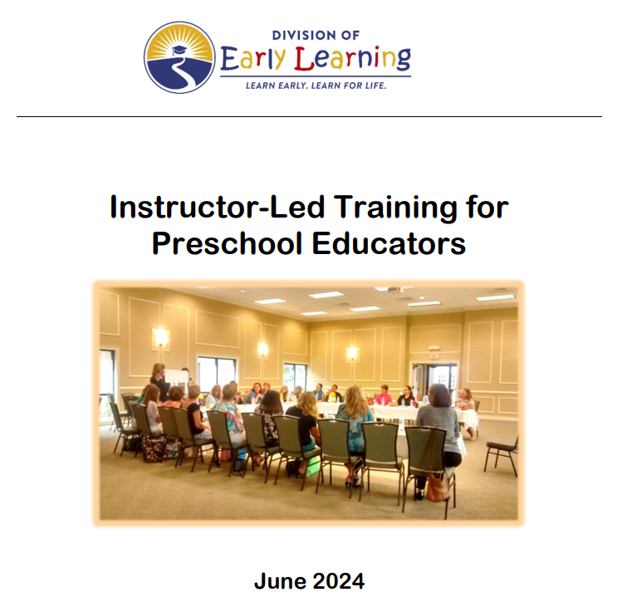



Resources
www.eas-ed.org (administrator information page – early education programs)
https://www.fldoe.org/schools/early-learning/providers/pro-learning.stml

Slide 26

Early Education Program
Operational Vitality Benchmarks

Slide 27
*10.1 The director, in collaboration with the pastor or superintendent (and the principal, where applicable), ensures that appropriately developed financial plans and budgets are implemented using current and effective business practices, as approved by the diocese, as a means of providing good stewardship of resources and program stability. The finance committee reviews the financial plans in parish early education programs.
Met – There are protocols in place for budgeting and financial planning. The finance committee or diocesan approved person reviews the financial plans on a regular basis.
Not Met – There are no protocols in place for budgeting or financial planning.
Evidence – Description of the financial planning process, financial statements, meeting minutes
What is the financial planning/budgeting process?

Slide 28
*10.2 Financial plans include the delineation of costs for key target areas such as instruction, administration, professional development, facilities, equipment, technology, program enhancement, benchmarked compensation/salary scales, and other health benefits and retirement costs, and other planned projects. The financial plans are projected out 3 to 5 years.
Met – The budget contains the appropriate line items. The full financial plan is for 3 to 5 years.
Not Met – The budget does not delineate appropriate line items or the financial plan is for less than 3 years.
Evidence – Budget, financial plan
Does the pastor, principal, or director consult with the diocese regarding finances?
Are reports sent, as requested?

Slide 29
*10.3 Current and projected budgets include a statement of the actual and projected revenue sources and a statement of actual and projected expenditures including the actual cost per child. The budget to actual is reviewed on a monthly basis.
Met – Financial documents include projected versus actual. Cost per child is determined. Budget and actual expenditures are reviewed each month.
Not Met – Financial documents do not include projected versus actual or cost per child is not determined or the budget and actual spending are not reviewed monthly.
Evidence: Budget and financial documents, meeting minutes
The full budget for the EEP is needed. It can be reviewed onsite.

Slide 30
*10.4 Annually published financial reports include information on the operation of the early education program.
Met – Parents receive information about the tuition, fees, and the cost to run the program. Financial reports are published in some manner, such as in parish bulletins or in annual reports.
Not Met – Parents only receive information about the tuition and fees or financial reports are not made public.
Evidence – Fee schedule, tuition forms, registration forms, published financial reports.
What financial information is published?
At least basic financial information must be published – parish bulletin, annual report, etc.

Slide 31
*10.5 The director provides families access to information about appropriate state and local programs that assist parents with early education costs.
Met – Parents receive information from any state agencies or local organizations that offer assistance.
Not Met – The director does not provide tuition or fees assistance information to parents.
Evidence – Tuition or fees assistance paperwork
Is tuition assistance offered? Other sources of assistance?

Slide 32
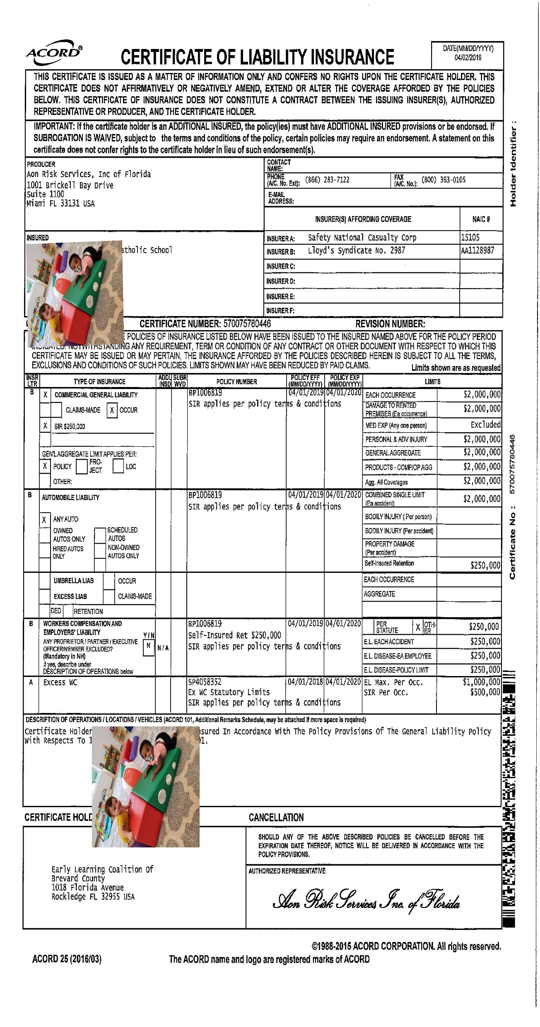
10.6 The parish maintains adequate liability and accident insurance including insurance on any vehicle that transports children.
Met – The program is covered under liability and accident insurance.
Not Met – The program does not have insurance.
Evidence – Proof of insurance
Insurance form from the diocese

Slide 33
*11.1 The director ensures that the early education program is in compliance with the diocesan human resources policies and the DCF policies regarding appropriate staffing.
Met – The human resources and staffing requirements are in the handbook and implemented.
Not Met – The program is not implementing all of the human resources policies and staffing requirements.
Evidence - Handbook
Each diocese has HR personnel and policies; need evidence that the center is following it

Slide 34
*11.2 The early education program complies with diocesan human resource standards for position descriptions including staff responsibilities and qualifications; hiring; compensation; and benefits, as well as standards for professional development, accountability, succession planning and retirement.
Met – Written job descriptions are in place; as well as policies related to hiring and compensation, professional development, accountability, succession planning, and retirement.
Not Met – The program does not have these written policies in place
Evidence – Job descriptions and policies
Job descriptions should be reviewed and acknowledged
What succession planning is happening?
What is the professional development expectation and compensation?

Slide 35
*11.3 The early education program complies with diocesan human resource standards and ensures that competitive and just salaries, benefits, and professional growth opportunities are provided for all staff.
Met – Salaries and benefits meet diocesan standards. PD opportunities are provided.
Not Met – Salaries and / or benefits do not meet diocesan standards and/or PD opportunities are not provided.
Evidence – Salary and benefit information; PD flyers or information
Benchmarked compensation; benefits package; PD

Slide 36
11.4 The director maintains a confidential file on each employee according to diocesan and DCF policies. A master file checklist is used.
Met – Personnel files are maintained in a secure location.
Not Met – The program does not have personnel files.
Evidence – Personnel files
Well organized staff files – cover sheet/master file checklist
Sections/pockets/folders for different areas
Background screening; Reference checks; Transcripts; DCF training & certificates; Annual list of PD; Observations & Evaluations

Slide 37
11.5 All staff members receive a copy of the employee handbook and written policies. Receipt of these by staff members has been documented. The staff members are instructed at least annually on employee policies. New staff members are provided with an orientation.
Met – Staff members have a handbook and written policies and have reviewed the them.
Not Met – Staff members do not have a handbook.
Evidence – Handbook, receipts, agenda
Handbook receipt
Minutes from orientation meetings

Slide 38
12.1 The early education program’s facilities, equipment, and technology management plan includes objectives to support the delivery of the educational program of the early education program and accessibility for all children.
a. The physical environment of the program provides sufficient lighting, good ventilation, and a comfortable temperature.
b. Classrooms are suitable for the age and activities of the children in the program. For programs built after 1992, floor space meets or exceeds a minimum thirty-five square feet of usable space per child.
Observable
Include maps with capacity numbers

Slide 39
12.1 Continued
c. Children are provided with individual spaces, such as cubbies, in which they can store their work and personal belongings.
*d. The facilities include appropriate office space, area for staff meetings, and suitable storage space.
e. To accommodate the children’s various play activities, the outdoor physical environment includes seventy-five square feet per child on the playground at any given time. Playground equipment is varied and sufficient for the number of children on the playground at the same time. The playground is designed and equipped to provide optimal learning experiences for children.
Observable/Pictures

Slide 40
*12.2 The early education program’s budget supports facilities, equipment, and technology management with specific funds for capital improvements, depreciation, and replacement.
Met – The budget contains line items for the maintenance and improvement of facilities, equipment, technology, and capital improvements.
Not Met – The budget does not allow for the upkeep of the facility and equipment.
Evidence – Budget
Budget line items and facilities management documents

Slide 41
*12.3 The early education program’s purchasing, and physical and technological improvements are, by design, done in alignment with the mission and the early education program’s planning and curricular goals, and consistent with environmental stewardship.
Met – A written plan is developed and followed in the purchasing of equipment and technology.
Not Met – Items are purchased in a reactionary way.
Evidence – Purchasing plan
Basic plan with goals and budget

Slide 42
*13.1 The communications/marketing plan includes the implementation of contemporary marketing strategies designed to reach targeted audiences.
Met – The program implements its written marketing plan.
Not Met – The program has a list of activities, but not a plan.
Evidence – Marketing plan
Written marketing plan; evidence of implementation

Slide 43
*13.2 The director reviews and analyzes the enrollment management plan annually. This includes currently enrolled children, children who have left the program, and possible attendees.
Met – The program implements its written enrollment management plan.
Not Met – The program has a list of activities, but not a plan.
Evidence – Enrollment plan
Written enrollment management plan; evidence of implementation

Slide 44
13.3 Parents of the children in the program receive a parent handbook that includes but is not limited to (1) the philosophy statement regarding the care and education of young children attending the program, including what discipline techniques will be used (2) policies regarding holidays, illnesses, hours of operation, fees, refunds, enrollment, and termination procedures; and (3) an explanation of the program’s day-to-day functioning. Parents/guardian sign a statement acknowledging that they understand and support the program’s policies as outlined in the parent handbook.
Met – The program distributes a well written handbook each year.
Not Met – The handbook does not include everything mentioned in this benchmark.
Evidence – Handbook, signed parental acknowledgements
Ensure the handbook includes items described in this benchmark

Slide 45
13.4 Clear enrollment policies and procedures are stated in writing.
Met – Written enrollment policies indicate who is eligible for enrollment, how acceptance into the program happens, waiting list procedures, etc.
Not Met – The enrollment policy is not evident.
Evidence – Enrollment policy
In handbook, enrollment package, and/or tuition rate information

Slide 46
13.5 Policies regarding the enrollment and termination of enrollment protect children’s rights (as outlined in the Americans with Disabilities Act).
Met – The program follows accepted protocols when enrolling and dismissing children.
Not Met – The program does not have a protocol in place to dismiss children from the program.
Evidence – Written procedures for enrollment and dismissal
Is there any reason why a student would be unenrolled? Must be included in handbook

Slide 47
14.1.a. The early education program has a written safety and security plan which shall include a section on emergency procedures to address such matters as natural disasters, environmental hazards, dangerous weather, violent incidents, and evidence of evacuation drills (a minimum of monthly fire drills, regular tornado drills, and regular safety/lockdown/evacuation drills). Emergency evacuation route maps are prominently posted in the same place in each room.
Met – The program has a formal written safety and security plan.
Not Met – The program’s plan is not written.
Evidence – Safety and security plan; drill logs
Safety plan; evacuation log; prominent exit maps at student level

Slide 48
14.1.b. The early education program is in compliance with provincial and diocesan safe environmental policies. All volunteers and staff members undergo Level II background screening, fingerprinting and training. Both VECHS, completed for the diocese, and the DCF Clearing house are used for background screening. References are checked prior to hiring. Volunteers work under the supervision of qualified staff members.
Met – Evidence of screening, fingerprinting, and training is in each staff member’s file.
Not Met – Not all pieces of evidence are in the files.
Evidence – Personnel files, lists of training.
Files and handbooks

Slide 49
14.1.c. The early education program is in compliance with the Florida Catholic Conference Health and Safety Checklist.
The Health and Safety Checklist is a separate tile on the Accreditrac website
Anytime standard 14 must be completed, the Health & Safety Checklist must be completed with evidence
Monday’s session will focus on it

Slide 50
14.1 d. The early education program has a written policy that complies with the requirements of civil authorities for administering and storing medications. It has been distributed to the parents of the children in the program. A detailed medical log is maintained that includes a record of all medications given to children, the time the medication was given, and the person administering the medication.
Met – The program has a written policy and keeps a detailed log of any administration of medication.
Not Met – The program does not have a written policy or has not given it to parents or does not keep a log.
Evidence – Handbook, policy, medication log
Medication forms
Medication log
In staff handbook – storage and administration

Slide 51
14.1.e. At least one credentialed staff member per 20 children is present at all times.
Met – Credentialed staff members are present at all times.
Not Met – Credentialed staff members are not always present.
Evidence – Rosters, staff list of assignments
Ensure this ratio is met at all times, paying particular attention to the beginning and the end of the day

Slide 52
14.1 Continued
f. The minimum staff student ratio is maintained at all times:
i. Under 12 months – 1:4; group size maximum of 8
ii. 12 months to 23 months – 1:6; group size maximum of 12
iii. 24 months to 35 months – 1:11; group size maximum of 22
iv. 36 months to 47 months – 1:15; group size maximum of 30
v. 48 months to 59 months – 1:20; group size maximum of 30
(VPK 1:11; Group size maximum of 20)
g. When mixed age groups of infants (under 12 months)and toddlers (12 months to 23 months) are in the same room, the child-staff ratio is maintained according to the youngest child in the room.
Rosters with birth dates; staff assignments
If the school/center does not have children that age, mark Not Applicable

Slide 53
14.2 The early education program maintains health records that include immunization data, any screenings, and early education program-entry medical examinations in accordance with the policies of the State of Florida, the diocese, and DCF. Current emergency information is maintained for each child enrolled in the program, including expected attendance, parent contact information, people authorized to take the child off the premises, allergies, and other important health information.
Met – The program has both health records and emergency information for each child.
Not Met – The program does not have health records or does not have emergency records for each child.
Evidence – Health files, emergency forms
Forms are current; emergency contact information – in files
App information

Slide 54
14.3 The early education program shall publish, implement, and display statements of nondiscrimination of children and personnel in accordance with federal law and regulations.
Met – Nondiscrimination statements are displayed in the facility and in the handbook.
Not Met – Nondiscrimination statements do not exist or are not displayed.
Evidence – Handbook, observable/pictures
Nondiscrimination statement posted

Slide 55
14.4 The early education program shall develop an academic calendar and supporting attendance policies that are sufficient to the operation of a quality instructional program where applicable.
Met – An academic calendar / schedule is used by the program and given to parents.
Not Met – An academic calendar or schedule is not used.
Evidence – Academic calendar / schedule
Calendar – progress reports, conferences; VPK information

Slide 56
14.5 The age of the child is the primary appropriate entrance requirement for prekindergarten 3 and 4. The child must be age 3 or 4, respectively, on or before September 1 of the entering school year.
Met – Children meet with prekindergarten 3 and 4 age requirement.
Not Met – Children do not meet the age requirement.
Evidence – Copies of birth certificates
VPK students must meet the age requirement

Slide 57
14.6 The early education program shall maintain records for children containing information, procedures, and confidentiality as required by law and as necessary for the operation of a quality educational program. (Closed early education programs will follow diocesan procedures regarding these records.)
Met – Children’s confidential records are maintained in a secure area of the office.
Not Met – The program does not have records. Or the confidential records are not secured.
Evidence – Secure area, files
Well organized student files with coversheets/checklists

Slide 58
14.7 The program has an open-door policy regarding visits by parents on the program’s premises including in their child’s classroom. Policies concerning parent involvement (e.g., visiting, observing, and volunteering) are in place to ensure the partnership between home and program is maintained. Visitation must be in compliance with diocesan security policies for schools.
Met – Parents follow sign in procedures (in accord with diocesan policy) and visit classrooms, volunteer, or meet with staff members as they request.
Not Met – Parents are rarely, if at all involved in the program.
Evidence – Sign in documents, volunteer rosters, pictures, survey results
Handbook should include visiting protocols
How can parents be involved?

Slide 59
14.8 The director is familiar with community services and resources regarding children with specific needs and provides this information to parents. The director and staff work collaboratively with community agencies in providing information as needed.
Met – Parents receive information regarding services and resources available to assist their child with special needs.
Not Met – Information regarding these services is not given to the parents.
Evidence – Letters, brochures
List of resources shared with parents

Slide 60
Questions on EEP Operational Vitality Benchmarks?

Slide 61

Resources
www.eas-ed.org (administrator information page – early education programs)
https://www.fldoe.org/schools/early-learning/providers/pro-learning.stml (Division of Early Learning professional learning)
https://www.myflfamilies.com/service-programs/child-care/training.shtml (DCF training and credentialing)

Slide 62
Closing Prayer
We give Thee thanks for all Thy benefits, almighty God, who live and reign forever. Amen.
Glory be to the Father and to the Son and to the Holy Spirit. As it was in the beginning, is now,
and ever shall be world without end. Amen.

Slide 63

Contact
Allison Clow
Accreditation & Education Specialist
aclow@flacathconf.org
850-205-6822
Mary Camp
Associate Director for Accreditation
mcamp@flacathconf.org
850-224-7906

