Slide 1
Accreditation Visitation Summary
2025

Slide 2
Opening Prayer
2
Good and Gracious God, we thank You and praise You for the gift of our Catholic faith. We ask You to bless and assist all Catholic schools in their important work of teaching the faith and educating young people. Please help all Catholic schools to flourish in every way, and we particularly ask your blessings on <<Insert School Name>> today. Amen.

Slide 3
Accreditation Visitation Team
Team Member Names and Dioceses

Slide 4
School Name
School Mission Statement
Notes:
Comments from the team regarding the Mission, Vision, and Philosophy Statements

Slide 5
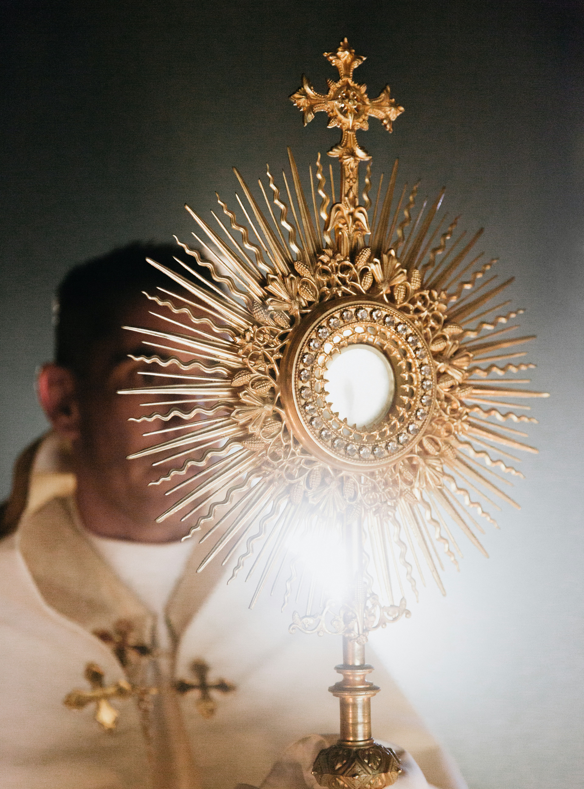
One Word
Listing of words collected from all stakeholders

Slide 6
Key Phrases
Insert 3 to 5 Key Phrases (What did the team witness, read, hear, see, experience at this school? In the work on Accreditrac? Through observations and conversations?)

Slide 7
Mission, Vision, and Philosophy Statements
Validations recommendations, comments

Slide 8
Classroom Observations
8
Comments and Feedback

Slide 9
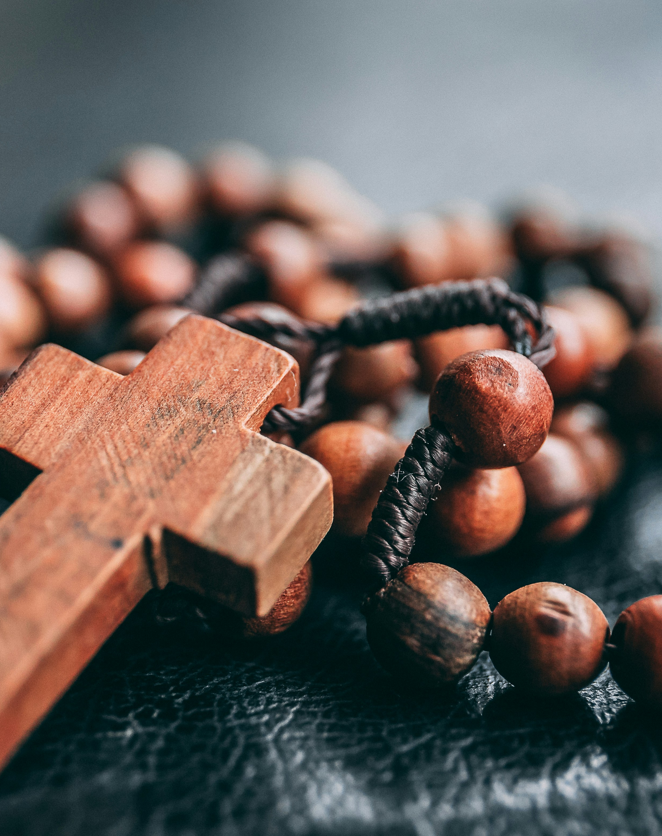
Validated Strengths
List

Slide 10
Benchmarks with a Different Rating
10
List (and explain why, either on the slide or in the presentation

Slide 11
Action Plan
Any comments or suggestions

Slide 12
Recommendations
Immediate Attention
  List safety and/or scholarship compliance issues that must be addressed this school year
Recommendations
  List practices and/or procedures the school should consider in the next few years
Opportunities for Growth
  List any practices and/or procedures the school might want to consider as a lower priority

Slide 13
Favorite Things
13
List a few of the favorite things students, parents, and staff mentioned

Slide 14
Next Steps
All the Continuous Improvement Process for Accreditation work and the Visitation Team work will be reviewed by the FCCAP staff and the superintendents.
Accreditation status will be determined.
New accreditation certificate will be sent and access to the website will be given.

Slide 15
Thank you for the generous hospitality!!

Slide 16
Closing Prayer
16
We give Thee thanks for all Thy benefits, almighty God, who live and reign forever. Glory be to the Father and to the Son and to the Holy Spirit. As it was in the beginning is now and ever shall be world without end. Amen.

Slide 17
Congratulations on completing this part of the accreditation process!

