Slide 1

Accreditation Visitation Team Orientation
2025

Slide 2
Agenda
Prayer
CIPA Stages
Pre-Visit Work
Overall Impressions
First Team Meeting
On-site Work
Observations and Conversations
Benchmark Ratings
Recommendations
Team Orientations
Questions
Prayer

Slide 3
Opening Prayer
3
Good and Gracious God, we thank You and praise You for the gift of our Catholic faith. We ask You to bless and assist all Catholic schools in their important work of teaching the faith and educating young people. Please help all Catholic schools to flourish in every way, and we particularly ask your blessings on our FCC Accreditation Program and our site visit teams. Amen.

Slide 4
CIPA – has three stages
Stage I: Purgative/Reflective: focus on MVP and domains in general; anchor charts
Stage II: Illuminate/Examine: focus on the rubrics; domain summaries
Stage III: Unitive/Plan: creating an action plan

Slide 5
CIPA and Visitation
CIPA Process: more reflective, building to a unified plan. Who/What is the school, what are they currently doing, where do they want to go, what is the plan to get there?
Visitation Work: a little more reflective and all encompassing, instead of benchmark detail focused

Slide 6
Accreditation Visitations
Heart of the Accreditation Process – Site Visit by a Team of Peers
  Validate the work and strengths; determine areas for growth; reflect back to the staff the findings (hopefully it’s a mirror)
  Determine if process was followed and staff was involved
  Provide feedback to the FCCAP
  Continuous Improvement (not a checklist or a one and done)

Slide 7
Pre-visitation Work: Team
Review School Forms & Complete Key Take Away Form
Domain Review Work & Complete Form – assign domain(s)
Action Plan Review & Complete Form
Getting an overall sense of the school

Slide 8
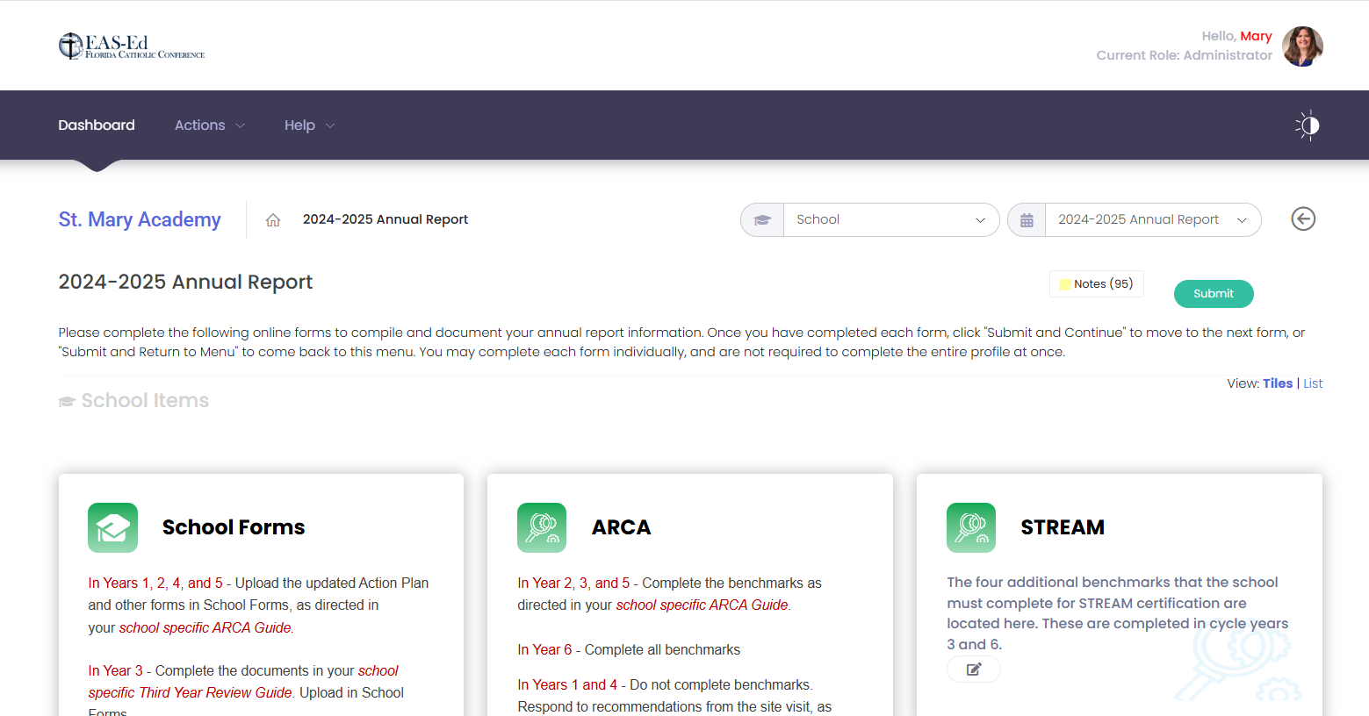
Pre-visitation Work: School Forms
Login to Accreditrac
Site Visits
Review School – School Forms (on Annual Report Page) – 2024-2025

Slide 9
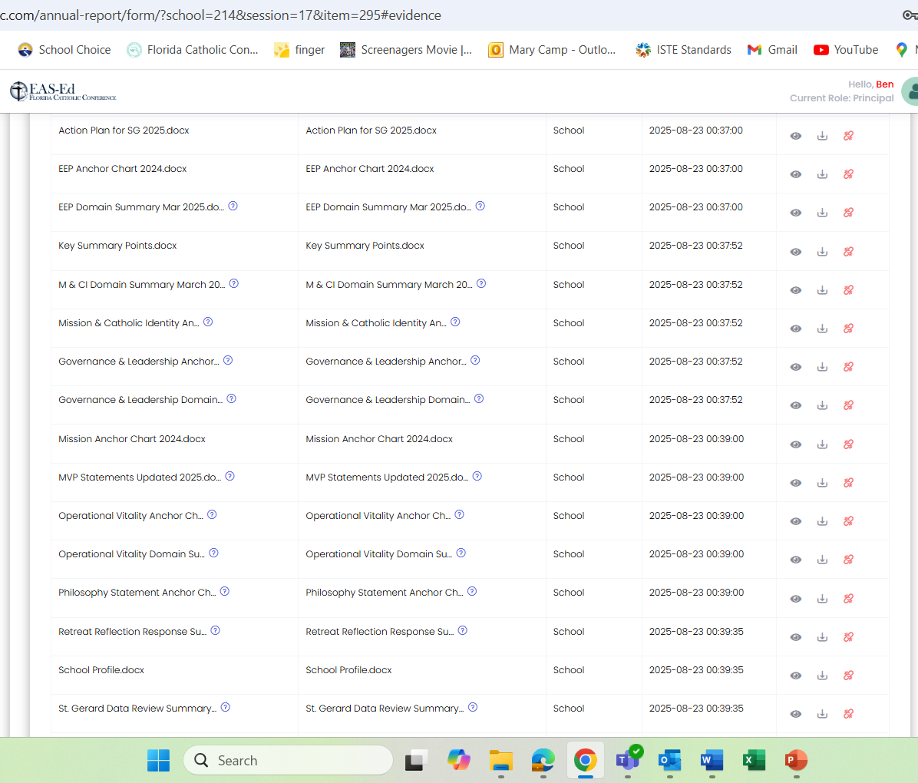
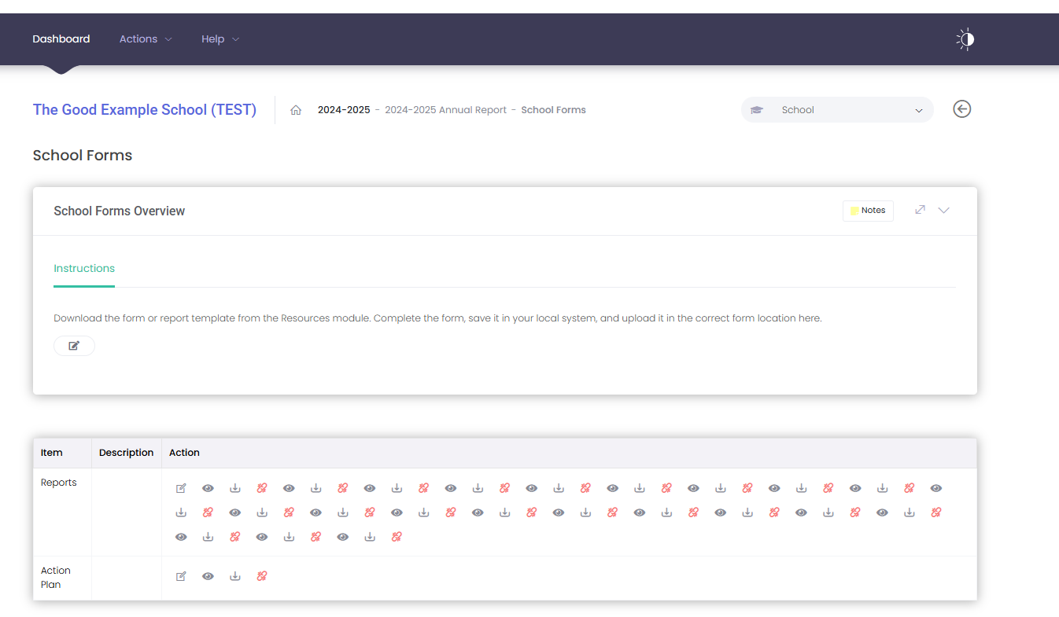
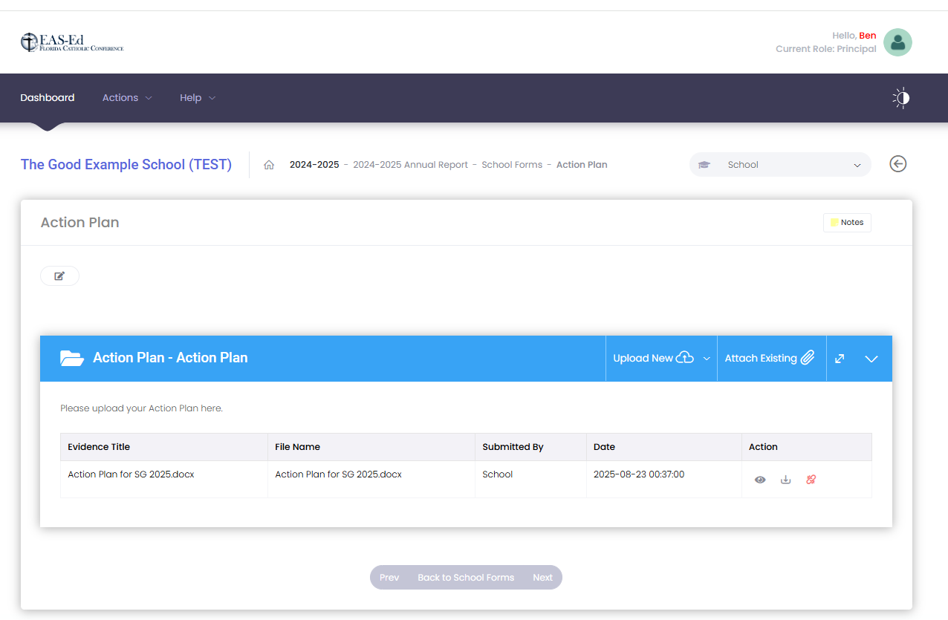

Slide 10
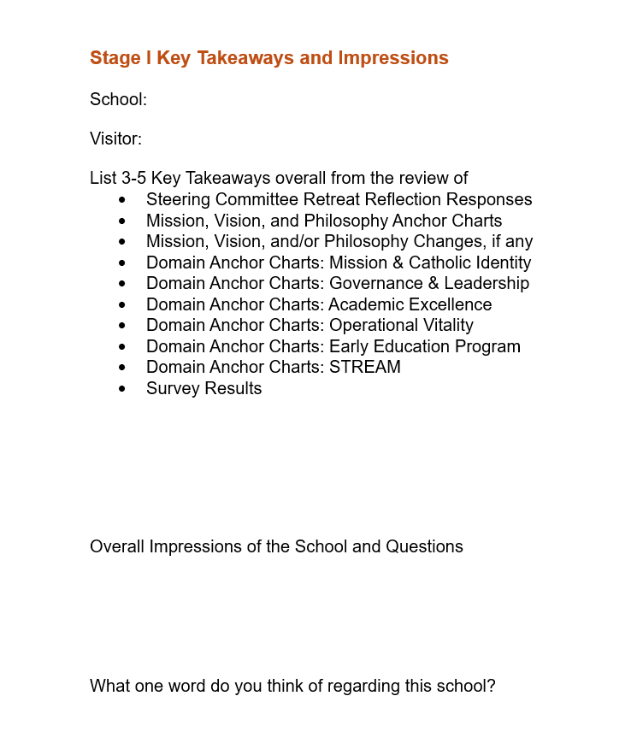

Slide 11
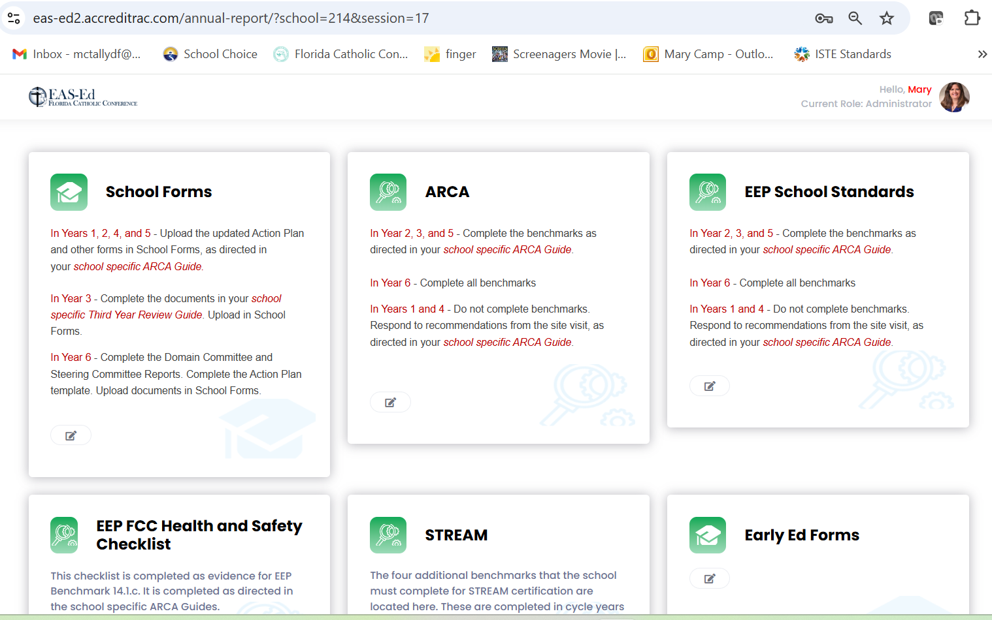
Pre-visitation Work: Domain Review
Login to Accreditrac
Site Visits
Review School – ARCA/EEP/Health & Safety Checklist/STREAM (on Annual Report Page) – 2024-2025

Slide 12
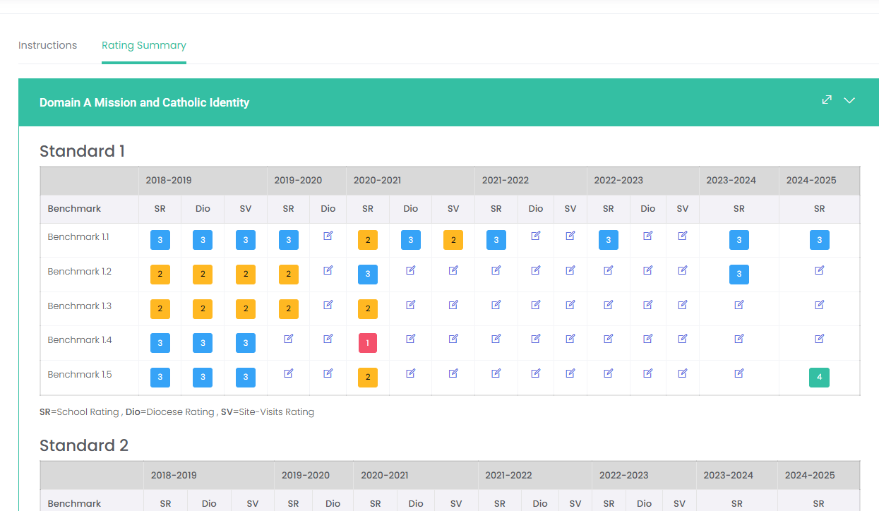
Start with the Rating Summary of the ARCA, EEP Standards, EEP Health & Safety Checklist, and STREAM

Slide 13
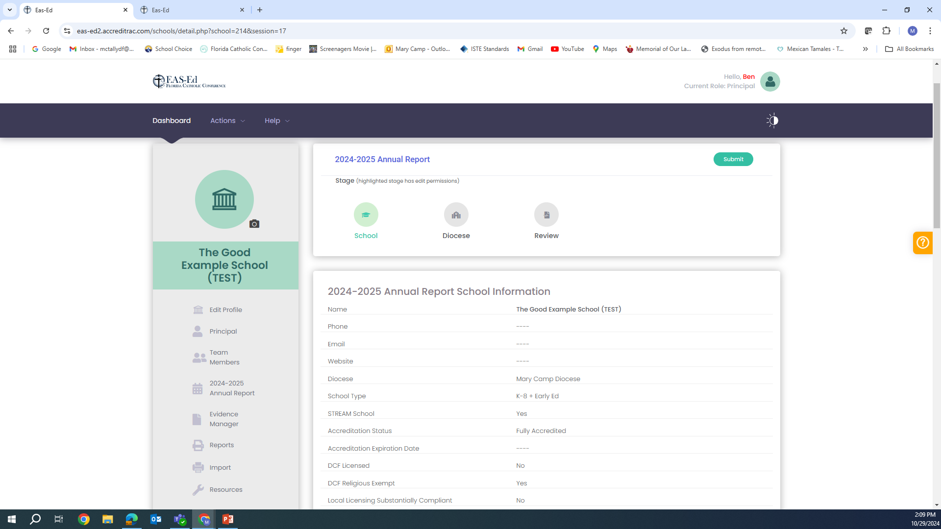
Download the Report of Everything in a Word Document
Profile Page

Slide 14
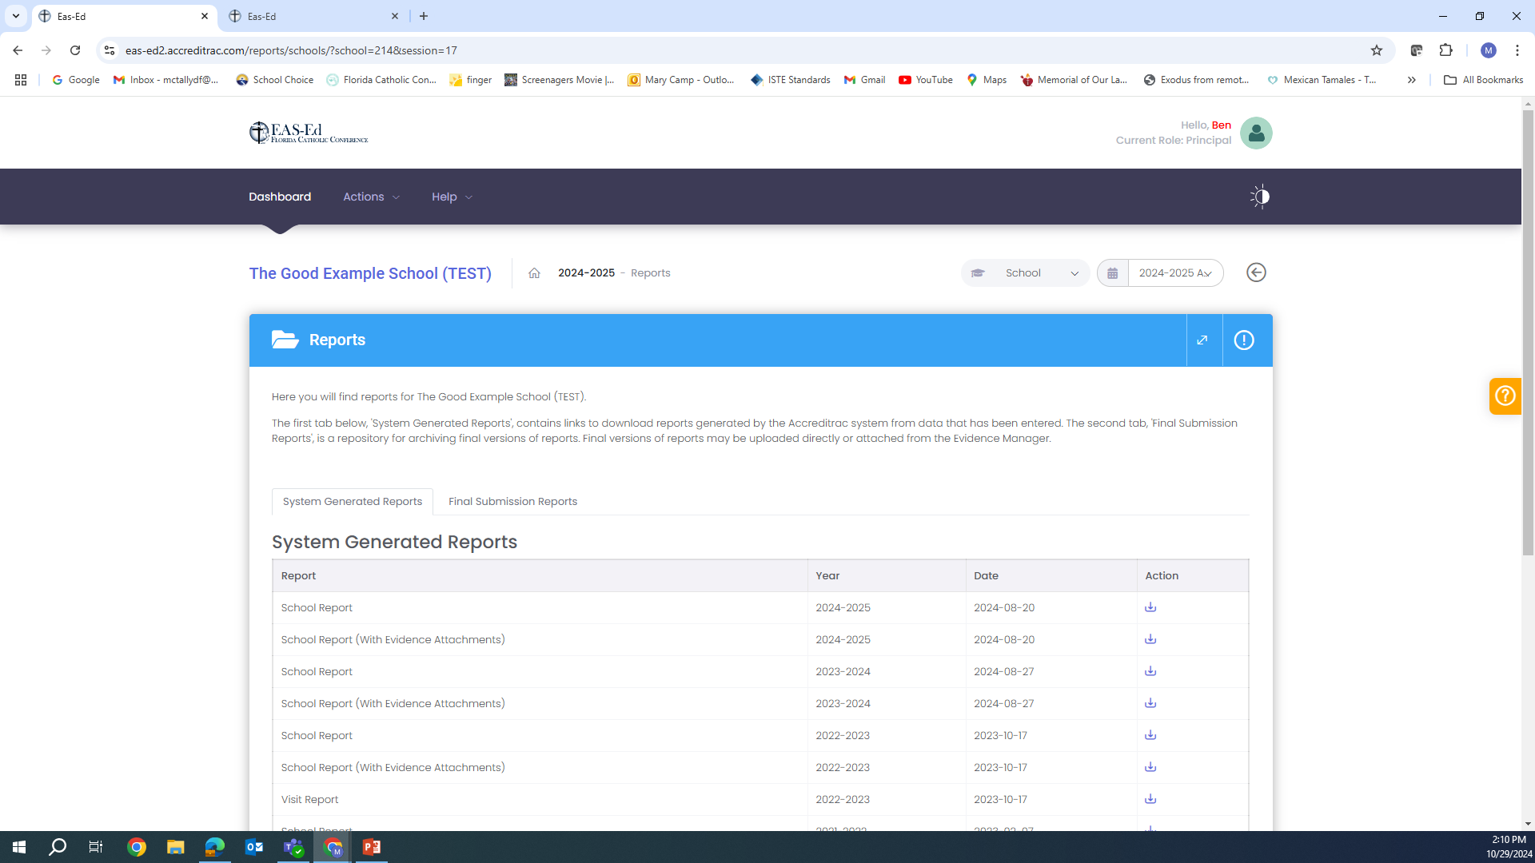

Slide 15
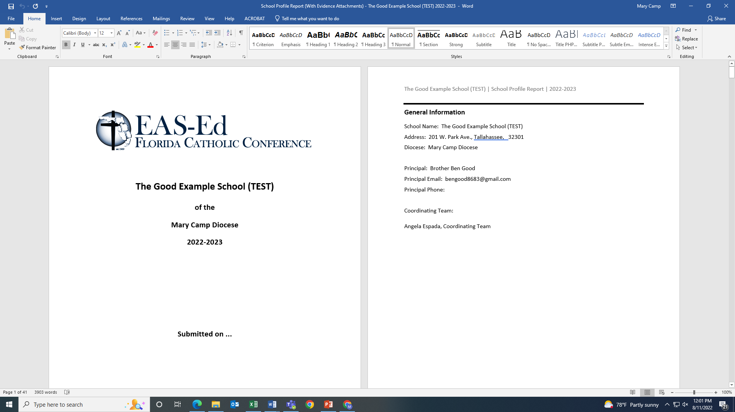

Slide 16
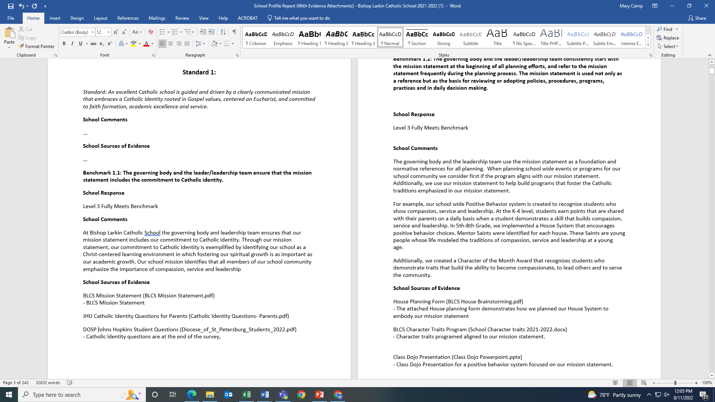

Slide 17
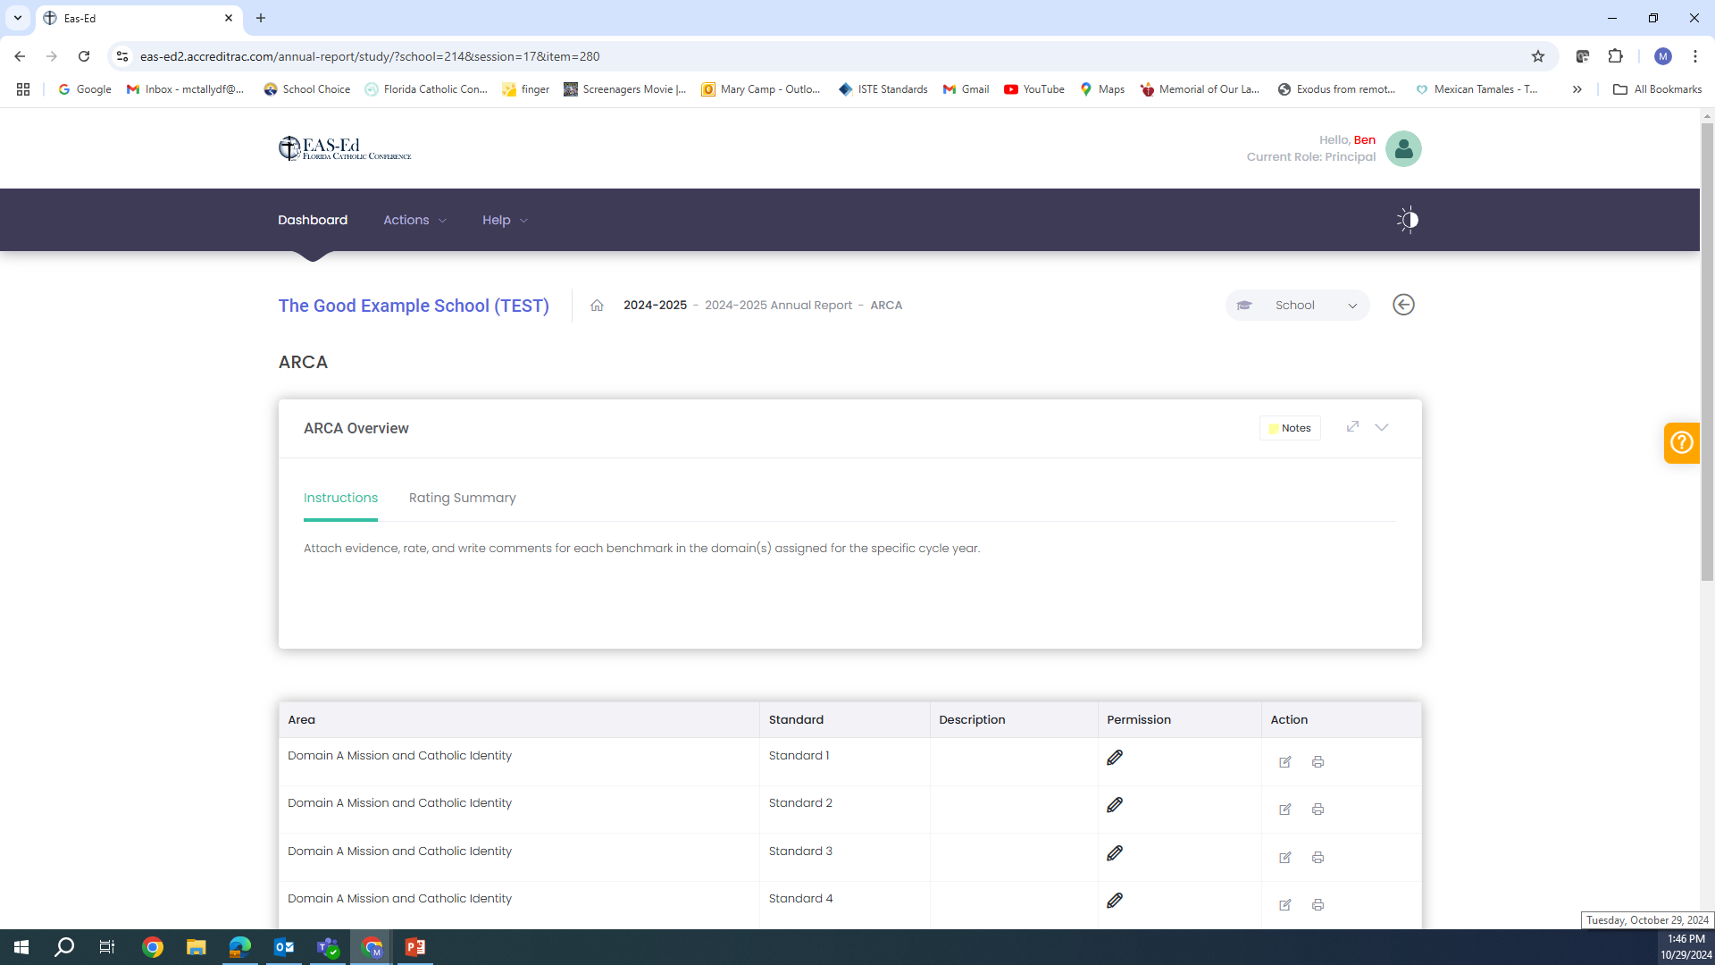

Slide 18
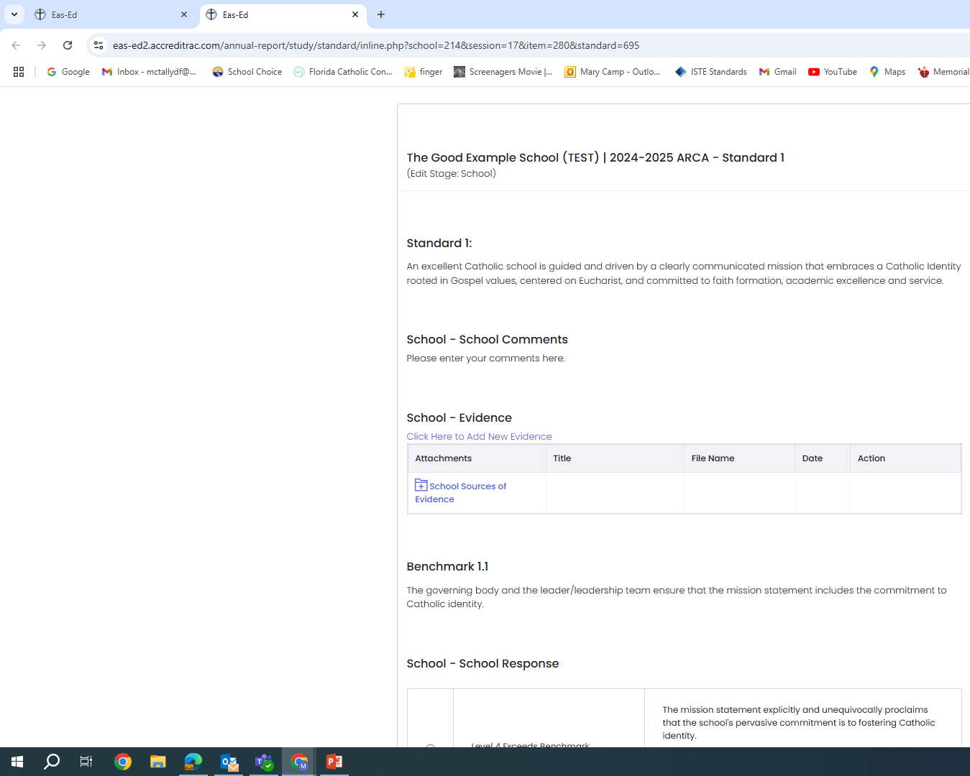
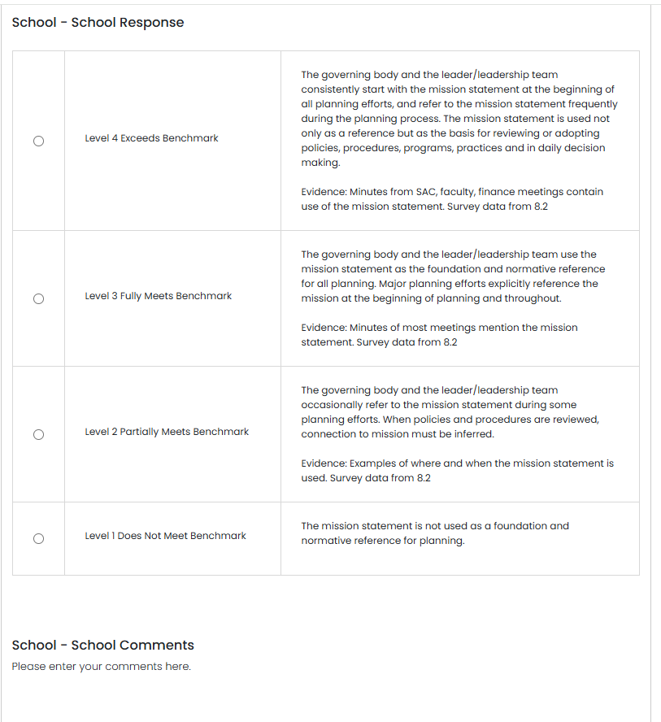
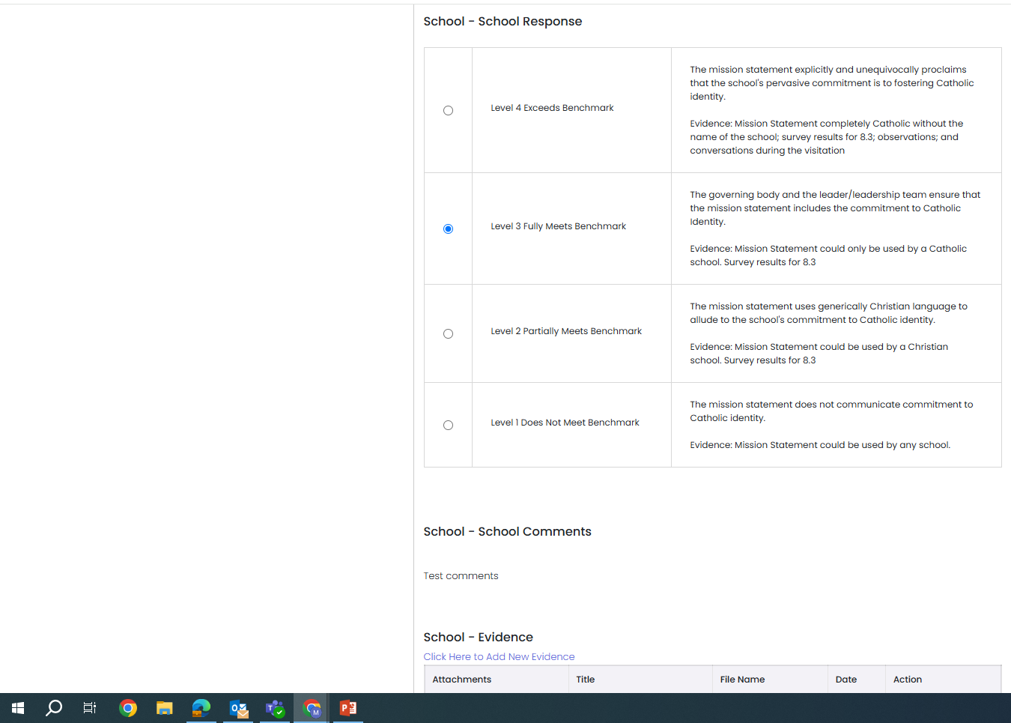
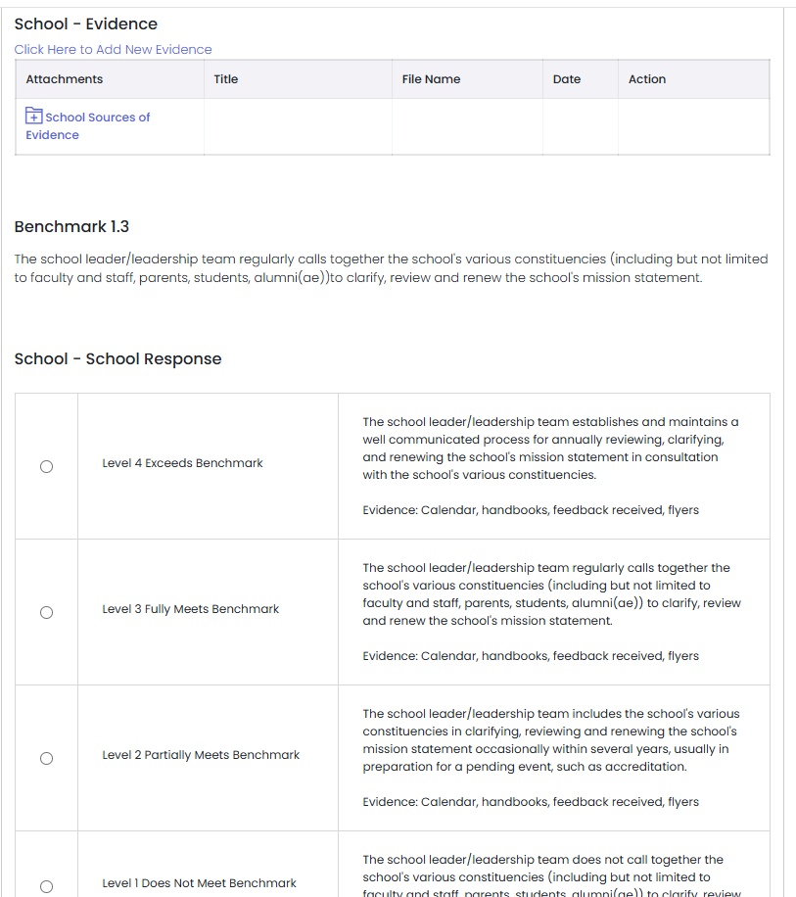
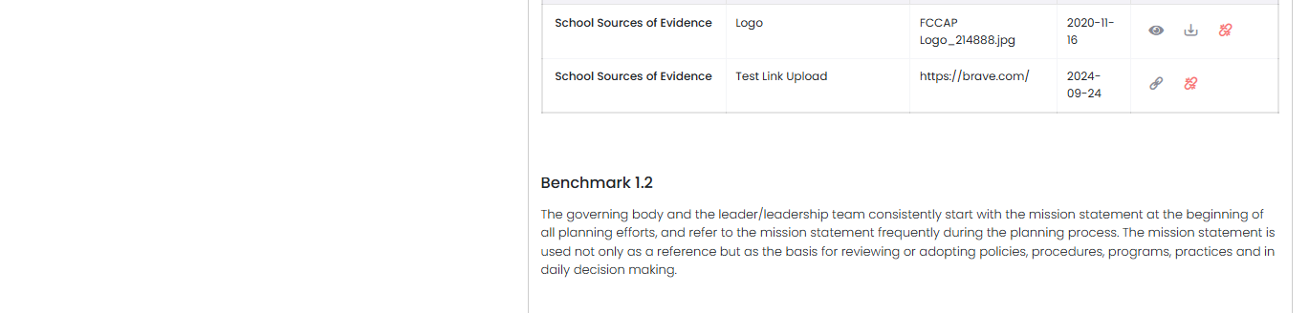

Slide 19
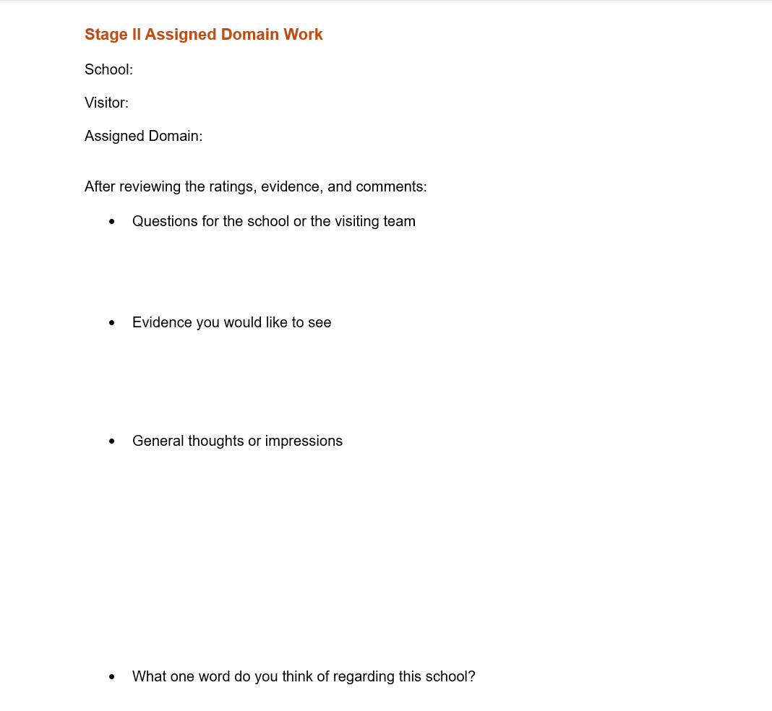

Slide 20
Pre-visitation Work: Action Plan Review
School Forms (on Annual Report Page) – 2024-2025
Action Plan

Slide 22
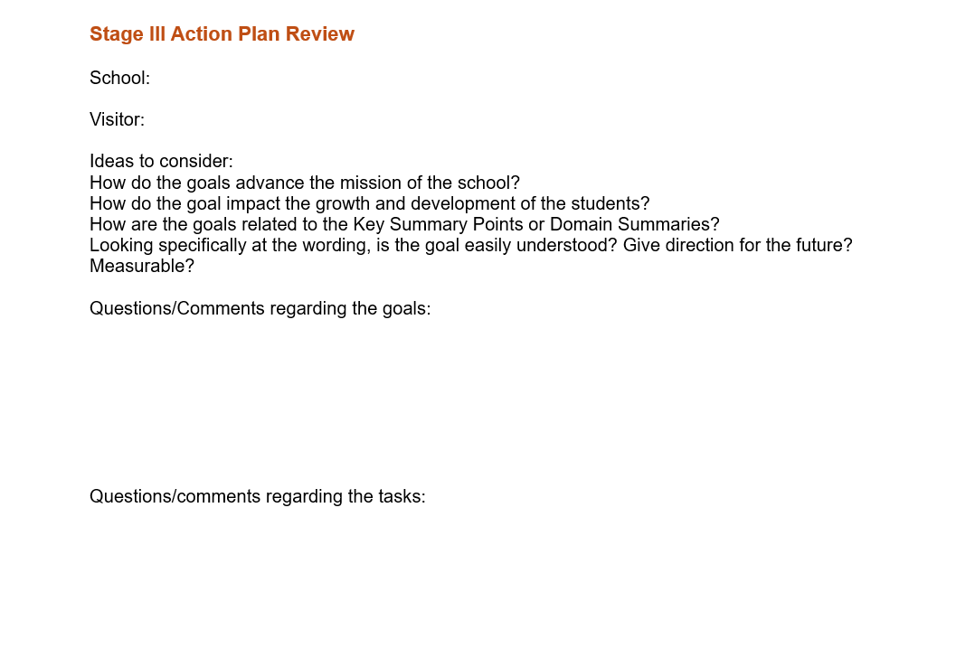

Slide 23
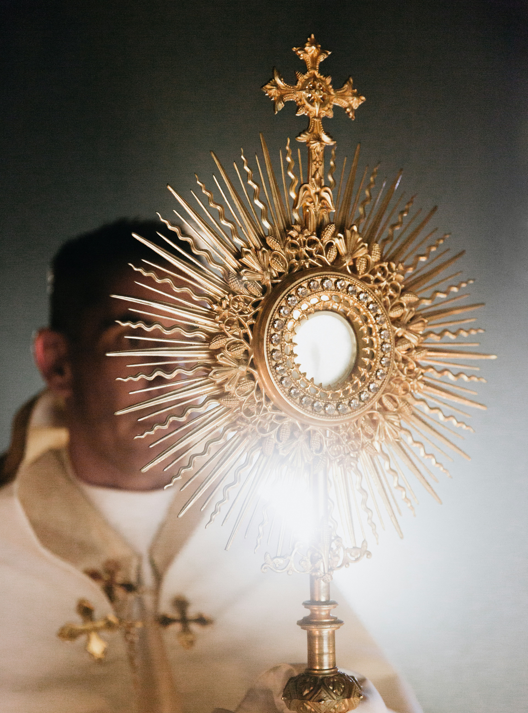
First Team Meeting
Afternoon/Evening before site visit
Review the completed forms for MVP, retreat, domains
Begin considering the validations, recommendations, and comments on the MVP
Discuss the domains overall, talk about ratings, comments, and evidence: what do you want to see while on site, what questions do you want to ask
Begin discussing the school’s strengths
Review schedule for the visit and assignments

Slide 24
During the Visit
24
Meet with staff briefly the first morning – prayer and introductions of team
Observe in all classrooms; provide feedback
Meet with selected parents and students; all staff; pastor; leadership; random students and staff
Review all benchmark ratings, comments, and evidence
  If rating is different, ask for specific evidence – don’t spend lots of time on this
Review the action plan
Provide feedback: exit report on site, summary report at conclusion

Slide 25
One Word
Listing of words collected from all stakeholders
Begins with the pre-visit work
Has its own slide at the exit report

Slide 26
Key Phrases
Reflecting back to the staff
What did the team witness, read, hear, see, experience at this school?
In the work on Accreditrac?
Through observations and conversations?
Overall impressions

Slide 27
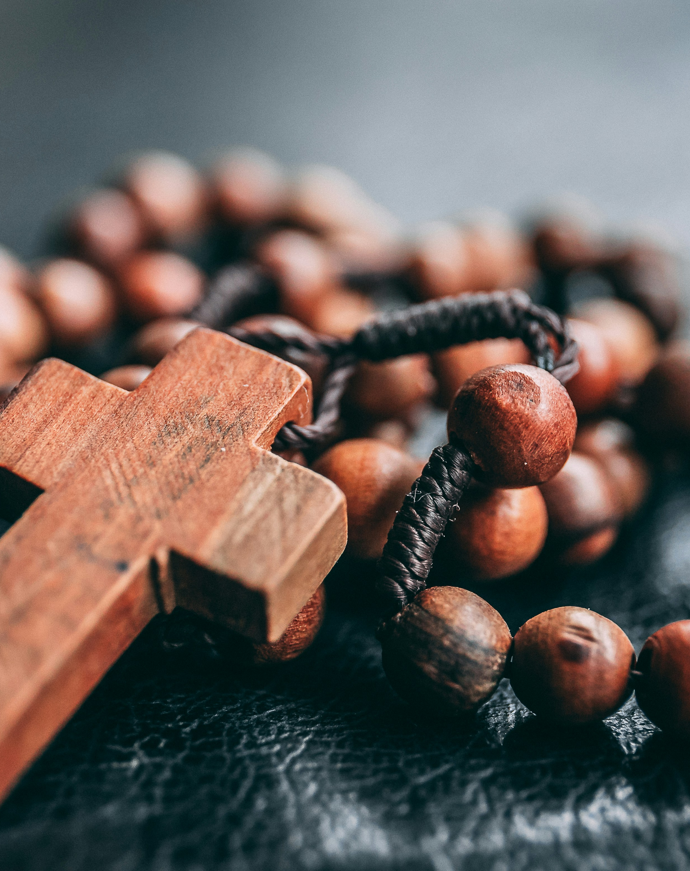
Classroom Observations
Use the observation tool
Results sent
Summary and feedback slide

Slide 28
Validated Strengths
Based on observations, conversations, benchmark work, anchor charts, summaries
5 to 10 strengths

Slide 29
Reviewing the Benchmarks
29
Consensus building and benchmark rating: use resources
List each benchmark the team rates differently from the school and explain why, either on the slide or in the presentation
Do NOT nitpick and do NOT give the benefit of the doubt: balance in between
Ask questions, ask for specific evidence, explain why you need it
Use all of your conversations and observations as evidence
Explain any different ratings in the comment boxes

Slide 30
Action Plan Review
Any comments or suggestions
Goals make sense, specific, measurable, time-bound
Plan flows from the self-study
Anything else they should consider based on your review

Slide 31
Recommendations
Immediate Attention
  List safety and/or scholarship compliance issues that must be addressed this school year
Recommendations
  List practices and/or procedures the school should consider in the next few years
Opportunities for Growth
  List any practices and/or procedures the school might want to consider as a lower priority

Slide 32
Accreditrac Work and Reports
Ensure all benchmarks are rated: ARCA, EEP, Health & Safety Checklist, STREAM; comments written, as needed
Complete the slide deck for the meeting after school on day 2 and send to accreditation@flacathconf.org in PowerPoint format.
Complete the written report and send to accreditation@flacathconf.org within two weeks of the visit in a Word Document.

Slide 33
Exit Report
33
All team members participate
All staff members attend
Balanced Reporting

Slide 34
Don’ts
Do’s
Focus on your school and how things are done there
Try to find something wrong
Give an easy A
Spend too much time on one item or on things not related to the work
Struggle with issues/questions on your own.
Focus on validating the self-study work and rating all benchmarks
Be professional in attire, attitude, and actions
Smile and be affirming
Note key takeaways to share at your school
Contact FCC with questions
Have fun and enjoy the visit!!

Slide 35
Questions?

Slide 36
Thank you for generously giving of your time to participate in FCC accreditation visitations!!

Slide 37
Closing Prayer
37
We give Thee thanks for all Thy benefits, almighty God, who live and reign forever. Glory be to the Father and to the Son and to the Holy Spirit. As it was in the beginning is now and ever shall be world without end. Amen.

