Slide 1
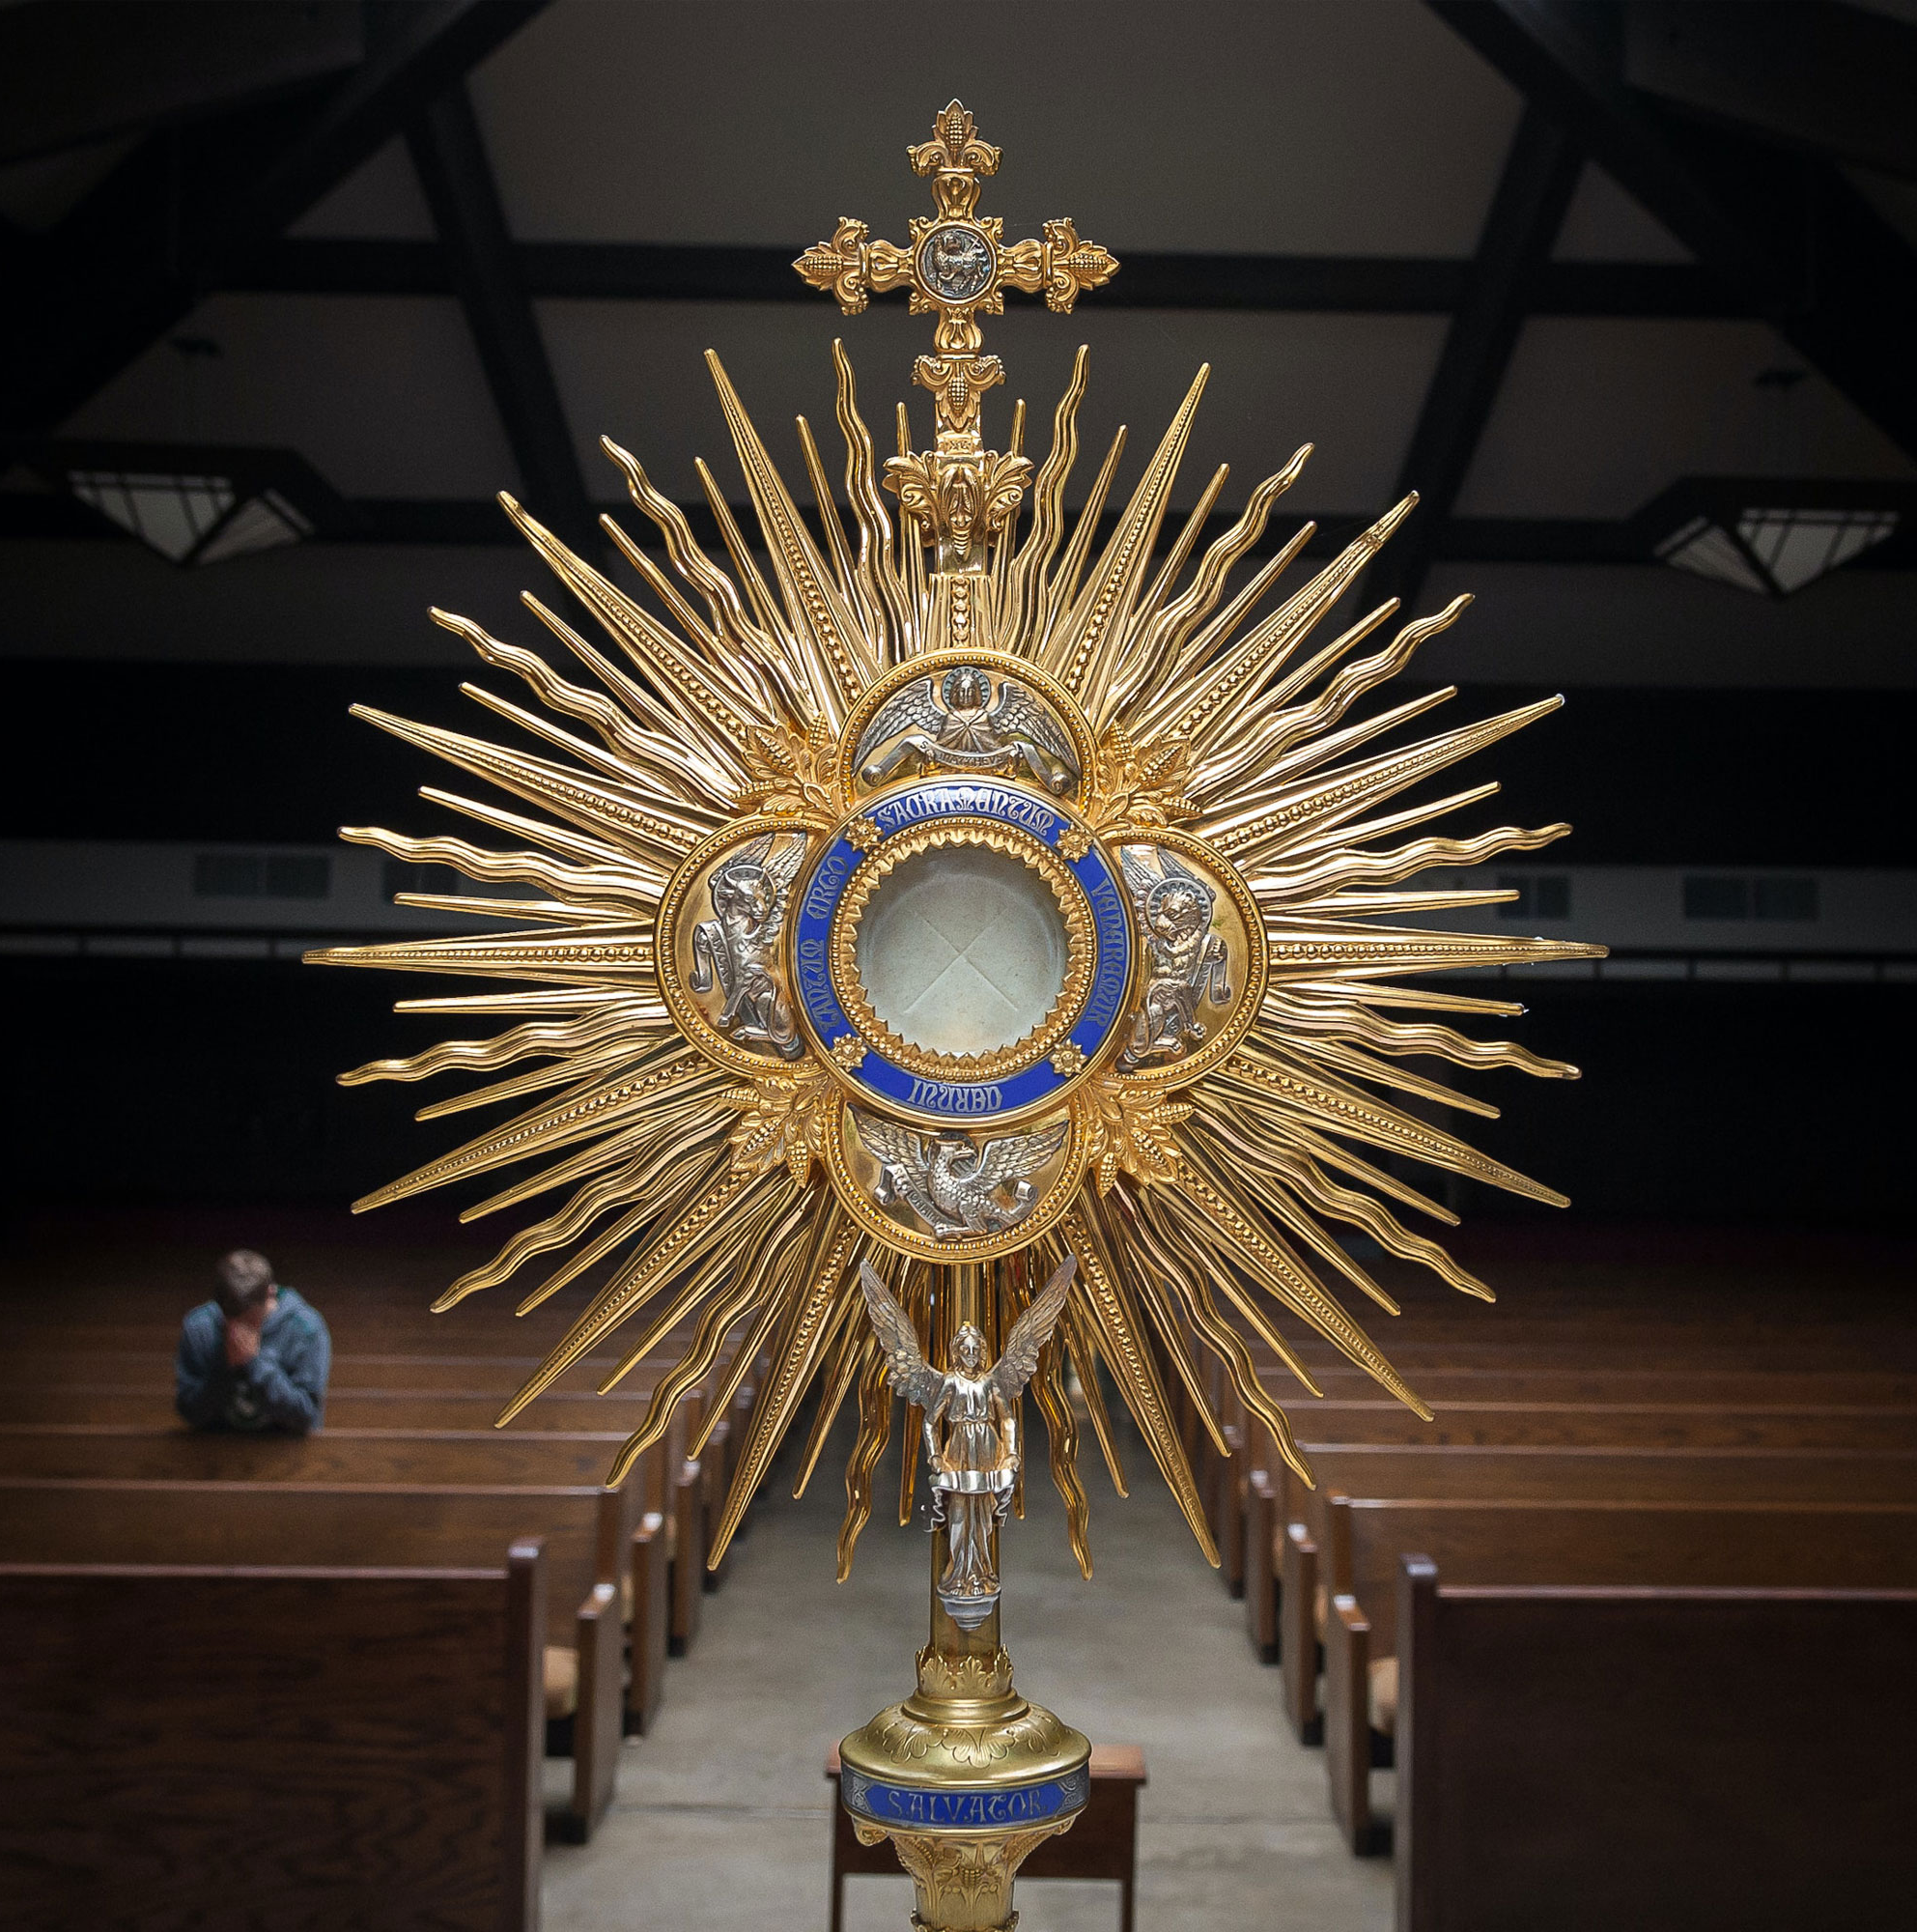
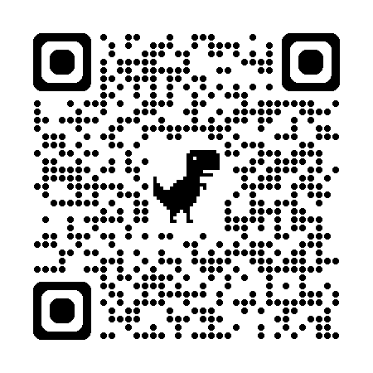

Florida Catholic Conference
Accreditation Program
Academic Excellence Domain
2025
Slide deck (recording available after the webinar)
https://eas-ed.org/presentation-recordings-and-powerpoints

Slide 2
Agenda
Opening prayer
Each standard 7-9
Questions
Closing prayer

Slide 3
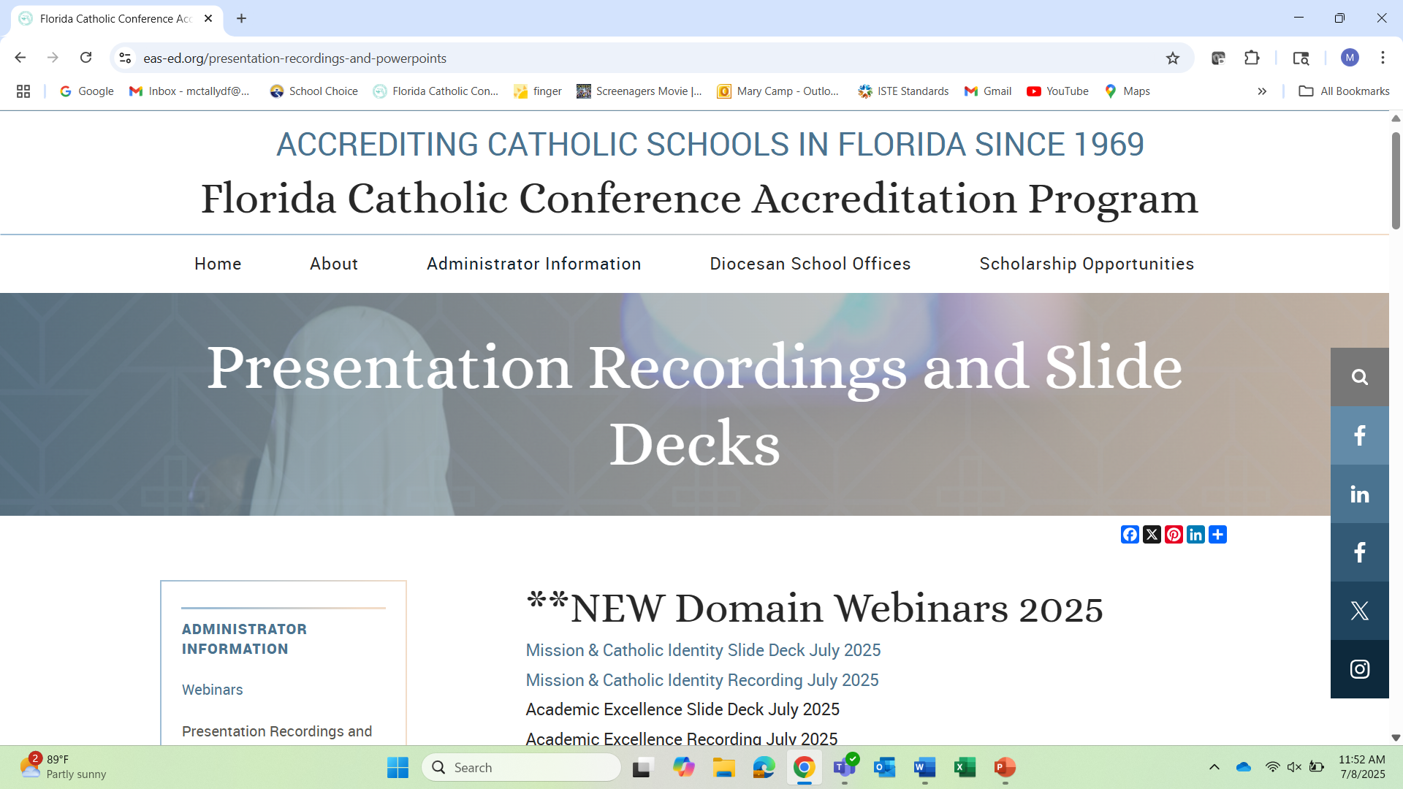




Slide 4
Opening Prayer
Come, Holy Spirit, fill the hearts of your faithful and kindle in them the fire of your love.
Send forth your Spirit and they shall be created, and you shall renew the face of the earth.
O God, who have taught the hearts of the faithful by the light of the Holy Spirit, grant that in the same Spirit we may be truly wise and ever rejoice in his consolation. Through Christ our Lord. Amen.

Slide 5
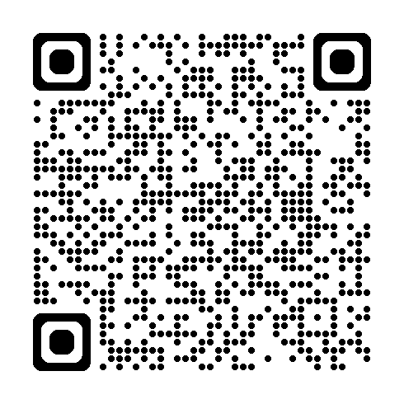

In General
Using Level 3: Fully Meets the Benchmark
Many changes to the rubrics; most schools – partially meets level
Glossary: https://ncea.org/NSBECS (Resources-Glossary)
Reflection questions

Slide 6
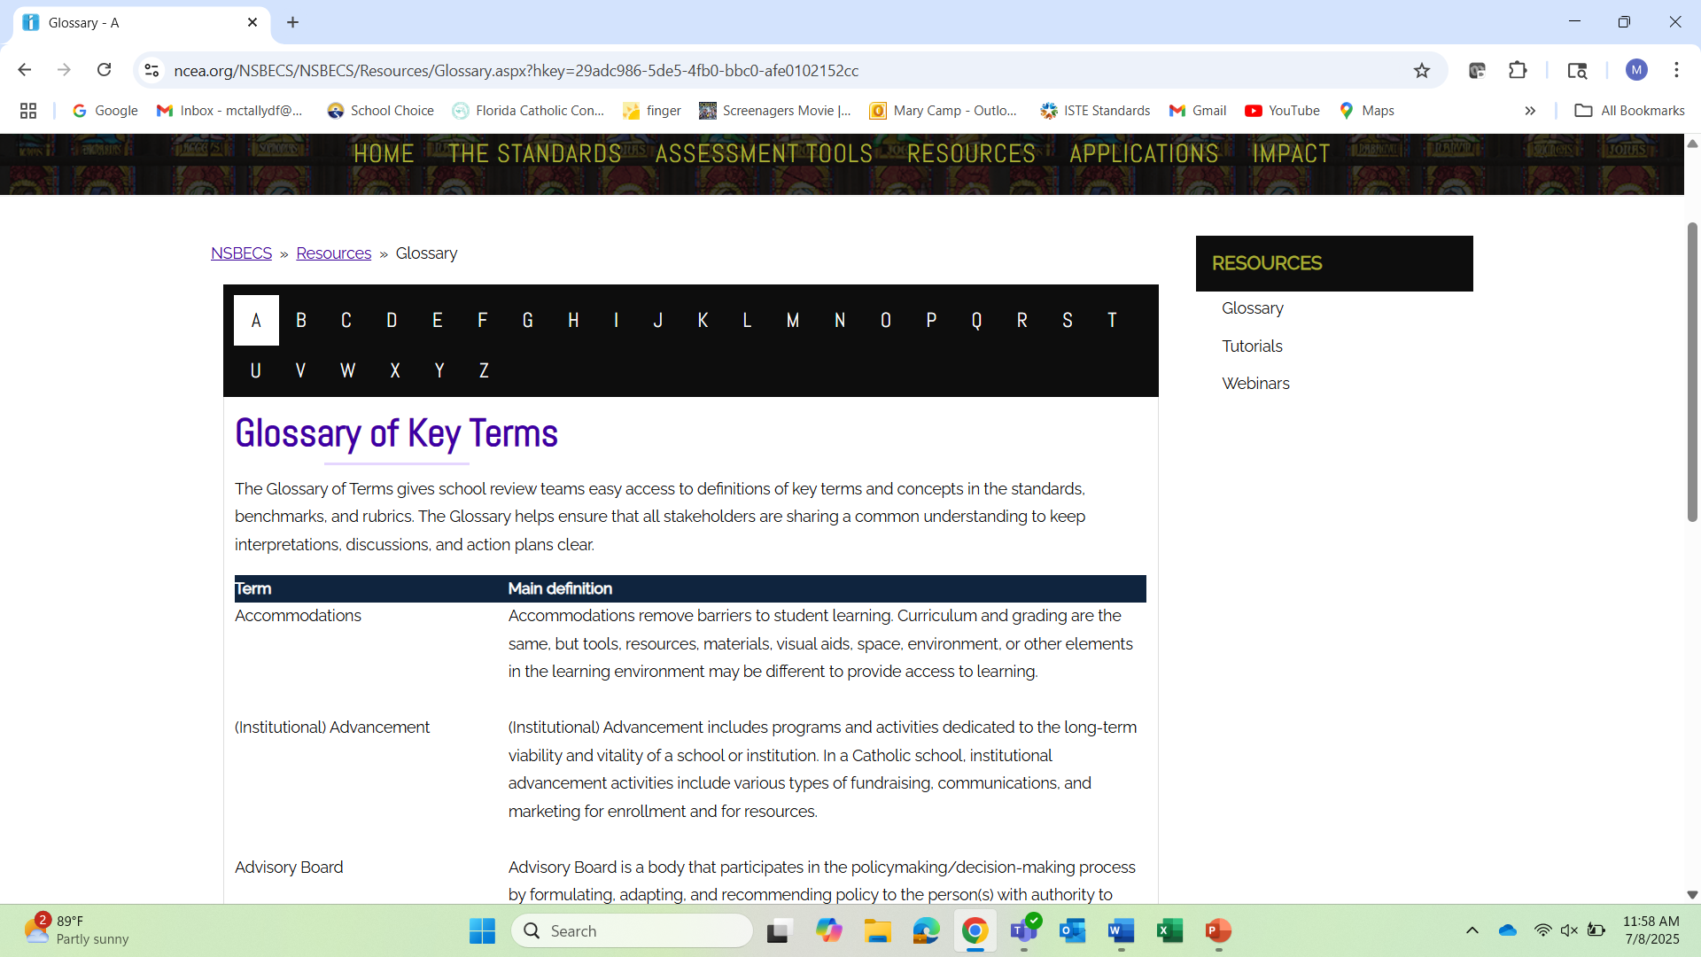




Slide 7
Standard 7
Curriculum and instruction

Slide 8
7.1 Aligned curriculum standards
The curriculum adheres to appropriate, delineated curriculum standards in every subject area, and is vertically and horizontally aligned to ensure that each student successfully completes a rigorous and coherent sequence of academic courses based on the curriculum standards.
How does the school ensure the curriculum standards are aligned?
How does the school ensure the standards are used?

Slide 9
7.2 Curriculum with Catholic dimensions
The curriculum integrates the Catholic worldview, spiritual, moral, and ethical dimensions of learning in all subjects.
Evidence shows that these curricula are used to drive instruction that is integrated with the Catholic dimensions of learning.
How are Catholic dimensions integrated into the curriculum and instruction?

Slide 10
7.3 Instruction actively engages
Classroom instruction actively engages and motivates each student to learn. Classroom instruction is:
Student-centered.
Varied among whole group, small-group, partner work, and individual work.
Students have the tools to work independently including specific and explicit instruction on how to work in small groups, in partners, and independently.
Expectations about classwork, homework, and projects are clear, provided from the start, and retaught as needed.
Students are provided with choices about work product, work style, seating, and/or tools.
Level 2: Classroom instruction shows little evidence of student-centered, varied instruction and student choice.

Slide 11
7.3 Instruction actively engages
What does instruction and learning look like, sound like in the school?
How often does instruction vary between whole-group, small-group, partner, and individual?
How do students know what to do in groups or individual activities?
When are expectations explained and/or modeled?
What type of choice do students have in each classroom?

Slide 12
7.4 Instruction provides skills to communicate, collaborate, think critically
Curriculum and instruction provide students with the knowledge, experience, understanding, and skills to communicate, collaborate, and think critically and creatively for the common good. Consistently throughout the school:
Teachers directly and explicitly teach students how to communicate, collaborate, think critically, and think creatively.
Curriculum maps show that there is a plan for this instruction.
Daily and long-term assignments show evidence of rigor: wrestling with challenging topics or skills with scaffolding from the teacher.
Daily instruction includes students collaborating.
Daily instruction shows evidence of learning that requires more than one answer or way to solve a problem or look at a situation.
Teachers share that the knowledge, experience, understanding, and skills to communicate, collaborate, and think critically and creatively are all focused on the goal of respect for each member of society, for the common good

Slide 13
7.4 Instruction provides skills to communicate, collaborate, think critically (Level 2)
Level 2: Curriculum and instruction provide students with some knowledge, experience, understanding, and skills to communicate, collaborate, and think critically and creatively for the common good.
This happens sporadically:
Teachers teach students how to communicate, collaborate, think critically, and think creatively but not directly and explicitly and not in all subject areas.
Teachers occasionally share (indirectly rather than explicitly) that the knowledge, experience, understanding, and skills to communicate, collaborate, and think critically and creatively are all focused on the goal of respect for each member of society, for the common good

Slide 14
7.4 Instruction provides skills to communicate, collaborate, think critically
When do students learn how to communicate, collaborate, think critically, think creatively?
Are these skills included in curriculum standards or maps?
How does instruction and learning in the school demonstrate rigor?
How often do students have the opportunity to collaborate?
Where in the curriculum standards and instructional practices is the focus on having more than one way to answer or solve a problem?

Slide 15
7.5 Authentic use of technology
Curriculum and instruction empower students to responsibly use and evaluate technology for research, computation, innovation, communication, and collaboration. Consistently throughout the school:
Classroom instruction teaches responsible, moral, and ethical use of technology that directly aligns to the Catholic worldview and Catholic social teaching.
Classroom instruction teaches students how to evaluate what tools might work best for a task.
Teachers use technology in meaningful and thoughtful ways to promote higher-order thinking and transfer of knowledge and skills.
Students use technology not only as a substitution (e.g., an online textbook or completing a worksheet) but to make meaning and transfer knowledge and skills to new and novel situations.
Technology is used to improve and empower student research, computation, and innovation.
Technology is used to improve and increase communication and collaboration

Slide 16
7.5 Authentic use of technology (level 2)
Use of technology is present and classroom instruction may teach responsible use of technology; however, technology is seldom used meaningfully or thoughtfully to engage students in higher-order thinking and transfer of knowledge and skills. (e.g., technology is mostly used as a substitution like projecting a worksheet or using a SmartBoard as a whiteboard instead of for meaning-making and/or transfer of knowledge and skills.)
Students primarily use technology independently.

Slide 17
7.5 Authentic use of technology
How are teachers and students using technology?
How does the school ensure that students are taught the responsible, moral, and ethical use of technology?
Do students have choice in what technology they use?
How is technology used to promote higher-order thinking?
Is technology used as a substitution? Only as a substitution?
Is technology used to make meaning or transfer knowledge/skills to a new situation?
Do students use technology for research, computation, and innovation?
Do students use technology for communication and collaboration?
Do students use technology independently? And primarily independently?
Do teachers use technology more than the students?

Slide 18
7.6 Instruction addresses affective dimensions of learning
Classroom instruction is designed to intentionally address the affective dimensions of learning, such as Catholic virtue, intellectual and social-emotional dispositions, relationship and community building, and skills of executive function. Written curriculum documents and classroom instruction intentionally do the following:
Teach and practice Catholic virtues.
Teach and practice intellectual and social-emotional dispositions including but not limited to identifying, understanding, and responding to emotions, responding to anxiety and anger, seeing good and God in all things, developing trusting relationships, forgiveness, and reconciliation.
Teach and practice relationship and community building including but not limited to how to make and keep friends, how to be trustworthy and how to trust, what respect means and what it looks and feels like, respecting the dignity of each person, classroom behavior expectations, and celebration.
Teach and practice the skills of executive function including but not limited to sustaining effort and persistence, adaptable thinking, self-regulation, goal-setting, planning, organization, time management, self-assessment, and reflection.

Slide 19
7.6 Instruction addresses affective dimensions of learning (level 2 and level 1)
Level 2: Classroom instruction sometimes addresses the affective dimensions of learning, such as Catholic virtue, intellectual and social-emotional dispositions, relationship and community building, and skills of executive function; however, these dimensions are not documented, consistent, and/or explicitly taught.
Level 1: Classroom instruction shows little or no evidence of addressing the affective dimensions of learning, such as Catholic virtue, intellectual and social-emotional dispositions, relationship and community building, and skills of executive function.
Instruction is mostly teacher-centered. Positive reinforcements are rarely used. Evidence exists that students are not sure what to do or what the expectations are.

Slide 20
7.6 Instruction addresses affective dimensions of learning
Where in the curriculum are the Catholic virtues? How and when are these taught and practiced?
Where in the curriculum are the intellectual and social-emotional dispositions ? How and when are these taught and practiced?
Where in the curriculum are relationship and community building? How and when are these taught and practiced?
Where in the curriculum are the skills of executive function? How and when are these taught and practiced?

Slide 21
7.7 Meeting all students needs
Classroom instruction is designed to engage and motivate all students, addressing the diverse needs and capabilities of each student and accommodating students with special needs as fully as possible.
A universal screener / interim assessment is administered to all students.
Unit and/or lesson plans give evidence of differentiation based on the results from the screener / interim assessment.
Students entering the school with IEPs or 504 Plans are transitioned to Student Support Plans (or the school's equivalent). These plans are reviewed and updated annually, using the Students Support Team approach.
Interventions, accommodations, and/or modifications are provided, documented, and reviewed for effectiveness and student progress.

Slide 22
7.7 Meeting all students needs
What screener or interim assessment is used? What happens with the results?
How does differentiation happen in the classrooms? How is it noted in lesson and unit plans?
How often does the student support team meet? When are SSPs reviewed and updated?
What is the expectation for teachers to implement the SSPs and provide accommodations?

Slide 23
7.8 PLCs to improve effectiveness
Faculty collaborate in professional learning communities to develop, implement and continuously improve the effectiveness of the curriculum and instruction to result in high levels of student achievement, engagement, and well-being. Consistently throughout the school:
Members of the professional learning communities (PLCs) use current best practice to analyze data including but not be limited to standardized achievement tests, individualized skill tests, classroom teacher made assessments, and behavior assessments/social-emotional assessments.
PLCs may be within a school or among schools and may be face‐to-face gatherings or virtual opportunities.
  Are all faculty members involved in at least one PLC?
  Does the school have PLCs focused on improving the effectiveness of curriculum, instruction, student achievement, student well-being, and student engagement?
  How are agendas and topics determined? Work monitored?

Slide 24
7.9 Certified teachers and staff
The faculty and professional support staff meet (arch)diocesan, state, and/or national requirements for academic preparation and licensing to ensure their capacity to provide effective curriculum and instruction for each student.
Compliance with these requirements is factored into all employment decisions.
Professional development is provided to support continuous improvement.
Are teachers certified or on a diocesan approved plan?

Slide 25
7.10 Pedagogical growth
For effective instruction, faculty and professional support staff demonstrate and continuously improve knowledge of culturally responsive pedagogy that aligns to Catholic social teaching that supports the full dignity of each student.
Annual goal setting includes plans for continuous improvement in effective and culturally responsive pedagogy that supports the full dignity of each student.

Slide 26
7.10 Pedagogical growth
From the NSBECS Glossary: Culturally Responsive or Sustaining Pedagogy: an educator’s ability to recognize students’ cultural displays of learning and meaning, making and responding positively and constructively with teaching moves that use cultural knowledge as a scaffold to connect what the student knows to new concepts and content to promote effective information processing. All the while, the educator understands the importance of being in a relationship and having a social-emotional connection to the student in order to create a safe space for learning. No less than other schools, does the Catholic school pursue cultural goals and the human formation of youth.
Notes:
Example of assignment: write a paragraph explaining the steps to build a snowman.

Slide 27
7.10 Pedagogical growth
Do teachers’ individual professional development plans (IPDPs) include a goal related to pedagogy?
Do classroom observations document the use of effective and culturally responsive pedagogy?

Slide 28
7.11 Professional development
Faculty and staff engage in high-quality and research-based professional development, including religious formation, and are accountable for implementation that supports student learning and well-being.
Faculty set goals for improvement and select professional development for growth. The effectiveness of professional development is measured by student learning growth and well-being.
How are faculty held accountable for implementation of professional development?
Do the IPDPs include a goal for improvement in subject matter? A goal for religious formation?
What are the expectations around professional development?

Slide 29
Questions on Standard 7

Slide 30
Standard 8 assessment

Slide 31
8.1 Use of data
School-wide and student data are regularly used to inform, review, and evaluate the curriculum, co-curricular programs, ancillary services, sustained student growth, and faculty performance.
Who is analyzing school-wide and student data?
How is the analysis used?

Slide 32
8.2 Normed data shared
School-wide and aggregated student data are normed to appropriate populations and are shared with all stakeholders.
Elementary: How are results of the Terra Nova shared with all stakeholders?
Secondary: How are results of the ACT, CLT, PSAT, or SAT shared with all stakeholders?
This is more than with individual students and parents; does not have to be entire results

Slide 33
8.3 Use of a variety curriculum-based assessments & results
Faculty use a variety of curriculum-based assessments aligned with learning outcomes and instructional practices to assess student learning and plan for continued and sustained student growth.
These assessments include but are not limited to formative, summative, authentic performance, and student self-assessment.
Faculty adjust instructional practices based on data from assessments. For example, when many students struggle on an assessment, the teacher reteaches, provides small-group instruction, or provides appropriate differentiation.
What types of assessments are used?
How are teachers adjusting instruction based on results? How is this documented?

Slide 34
8.4 Criteria used to evaluate students
Criteria used to evaluate student work and the reporting mechanisms are valid, consistent, transparent, equitable, and justly administered.
Faculty collaborate to develop school‐wide criteria for valid and equitable assessment of students.
Criteria are based on evidence-based best practices and discipline-based professional standards (e.g., NCTM, NCTE, etc.).
Parents and students understand the criteria and have equitable, transparent access to criteria (for example, in-home language, offered via paper and electronically, etc.) at the outset of the assignment.
Who determines criteria used for evaluation?
How/Where/When is this information shared?

Slide 35
8.5 Use of data in PLCs
Faculty use student data to inform the work of their professional learning communities; such data are collected and used to monitor individual and class-wide student learning and to set goals for the professional learning community which meets regularly.
PLCs use student data to revise and adjust curriculum and instruction.
Does the school have PLCs focused on analyzing and using student data, both individual and class-wide?
How are goals for these PLCs determined? Monitored?

Slide 36
7.8 & 8.5 PLCs
7.8
Focus: Improving Curriculum & Instruction; Improving student engagement, achievement, and well-being; More whole-class and school-wide
8.5
Focus: Academic growth – individual & whole class
Analyzing &
Using Data

Slide 37
Questions on Standard 8

Slide 38
Standard 9 programs and services

Slide 39
9.1 Programs for parents
School-wide programs for parents provide opportunities for parents to partner with school leaders, faculty, and other parents to enhance the educational experiences for the school community.
These opportunities are accessible to all school families (e.g., in terms of time of day, language, childcare, etc.).
How does the school partner with parents?
What programs are provided for parents?

Slide 40
9.2 Student services
Guidance services, wellness programs, behavior management programs, and other services offer appropriate, mission-aligned support focused on the spiritual, social, emotional, academic, and physical well-being of students and their families.
Communications are in place for students and parents to learn about and make use of these resources. Support for how to access them is readily available. Services are accessible to all: day and time, language, etc.
Outcomes for these services are aligned with students’ spiritual, social, emotional, academic, and physical well-being.
What mission-aligned support is offered to students for their spiritual, social, emotional, academic, and physical well-being? To families?
How do students and families know about these?

Slide 41
9.3 Co-curricular and extra-curricular activities
Co-curricular and extra-curricular activities provide opportunities outside the classroom for students to further identify and develop their gifts and talents and to enhance their creative, aesthetic, social/emotional, physical, and spiritual capabilities.
Activities are accessible to all students and families.
Communications with students and families regarding these activities are clear and consistent.
What co-curricular activities are available to all students? Extra-curricular?
How do students and families know about them?

Slide 42
Questions on Standard 9

Slide 43
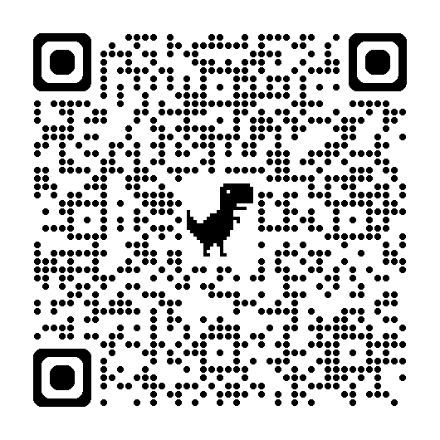
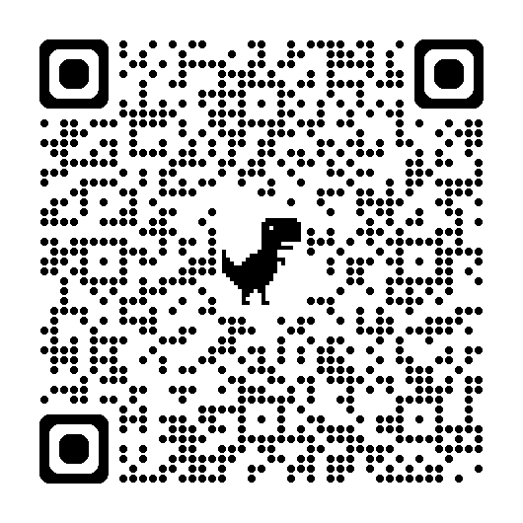
New Rubrics
https://eas-ed.org/elementary-and-secondary-school-manuals
Standards and Benchmarks:
Rubrics:

Slide 44
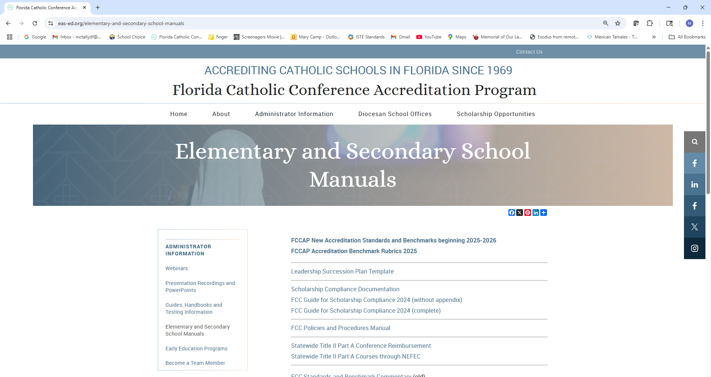







Slide 45
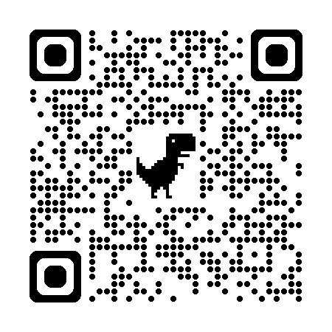
Questions?
Mary Camp
Director of Accreditation
mcamp@flacathconf.org
850-224-7906
Shelley Bosko
Associate for Accreditation
sbosko@flacathconf.org
407-404-0766
Slide deck (recording available after the webinar)
https://eas-ed.org/presentation-recordings-and-powerpoints

Slide 46
Closing Prayer
We give Thee thanks for all Thy benefits, almighty God, who live and reign forever. Glory be to the Father and to the Son and to the Holy Spirit. As it was in the beginning is now and ever shall be world without end. Amen.

