Slide 1
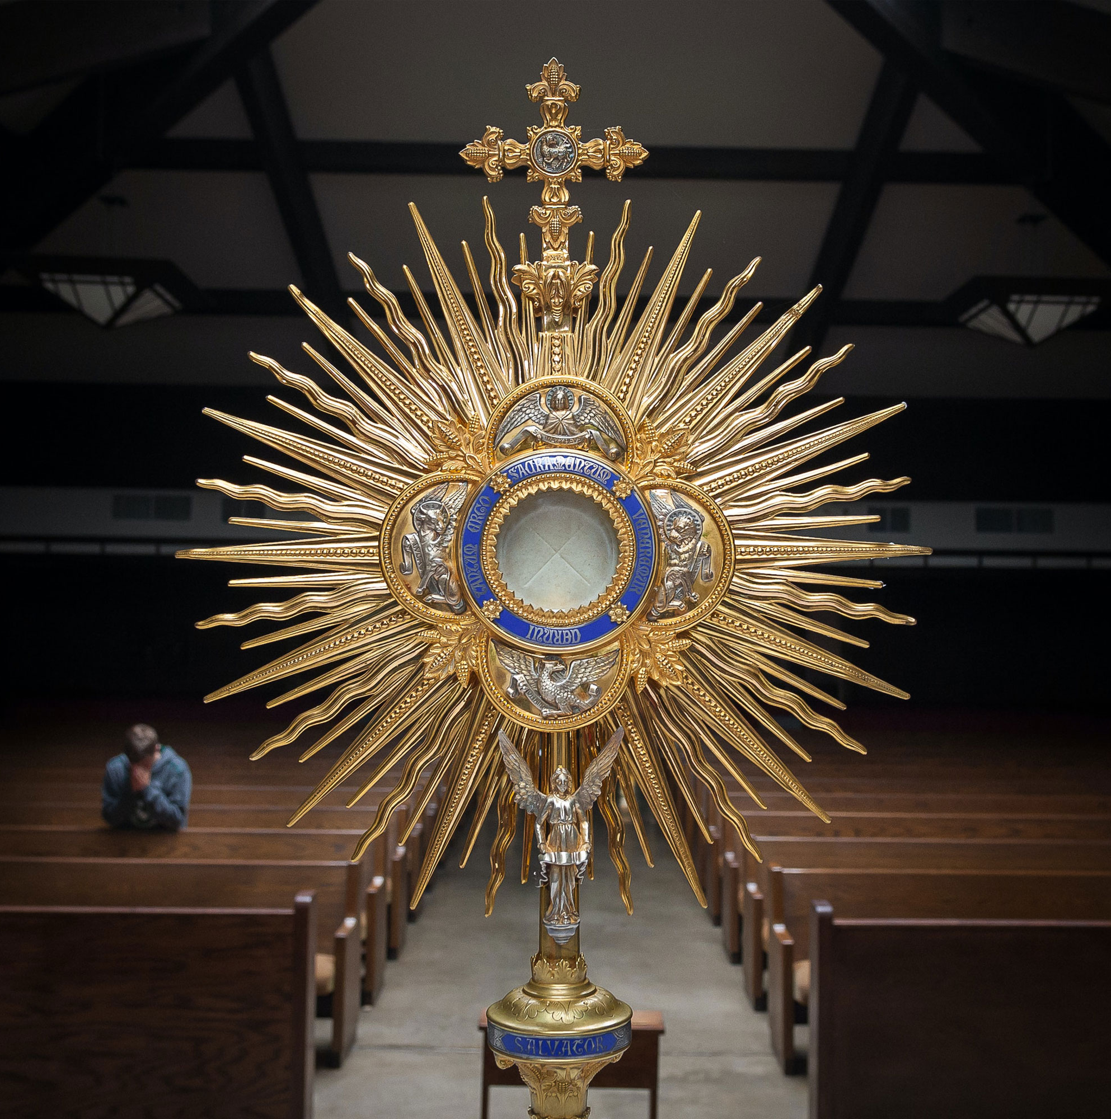
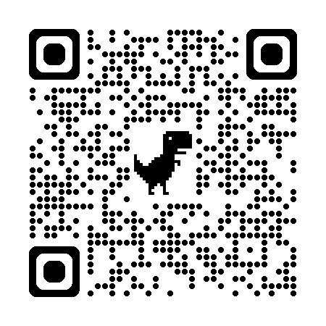

Florida Catholic Conference
Accreditation Program
Continuous Improvement
Process for Accreditation
for Early Education Programs
2025-2026
Cohort Meeting
January 2026
Slide Deck

Slide 2
Agenda
Opening Prayer
CIPA Stage II
CIPA Stage III
Questions
Closing Prayer

Slide 3
Opening Prayer
Come, Holy Spirit, fill the hearts of your faithful and kindle in them the fire of your love.
Send forth your Spirit and they shall be created, and you shall renew the face of the earth.
O God, who have taught the hearts of the faithful by the light of the Holy Spirit, grant that in the same Spirit we may be truly wise and ever rejoice in his consolation. Through Christ our Lord. Amen.

Slide 4
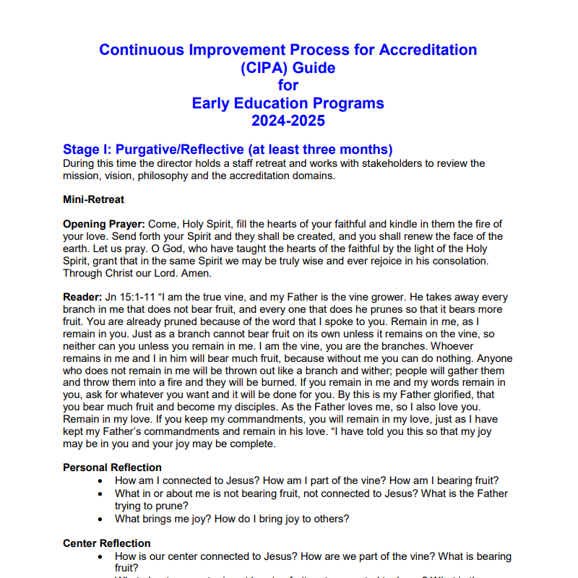
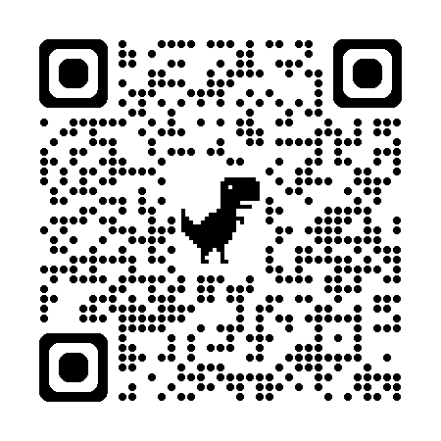
CIPA Stages
Stage I: Purgative/Reflective
Stage II: Illuminate/Examine (4 mos.)
Stage III: Unitive/Plan
CIPA Guide for Early Education Programs 2024

Slide 5
Stage II: Illuminate/Examine
  Committees Should Be Working
  Teachers
    Mission & Catholic Identity; Academic
Excellence
  Administration
    Governance & Leadership; Operational Vitality; Health & Safety Checklist

Slide 6
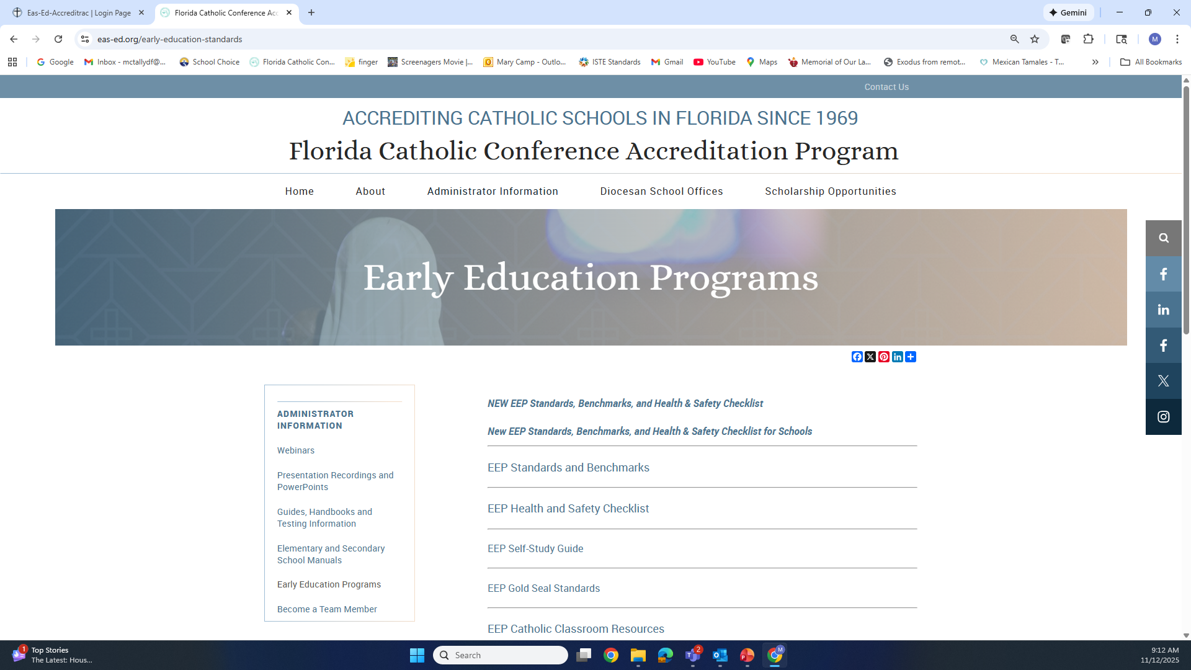
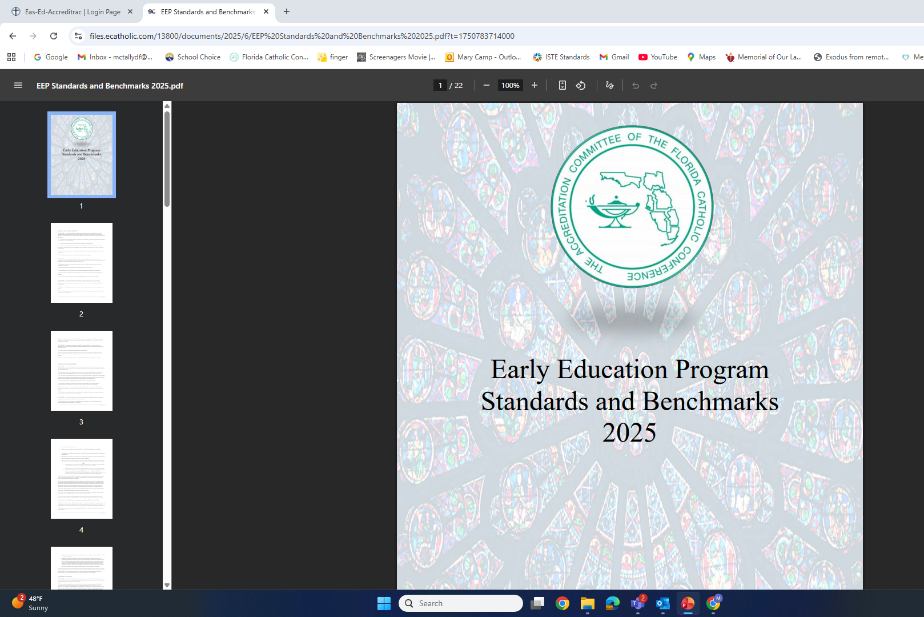
Benchmark Work
https://eas-ed.org/

Slide 7
Benchmark Work
Webinars
Collect evidence
Write comments
Rate

Slide 8
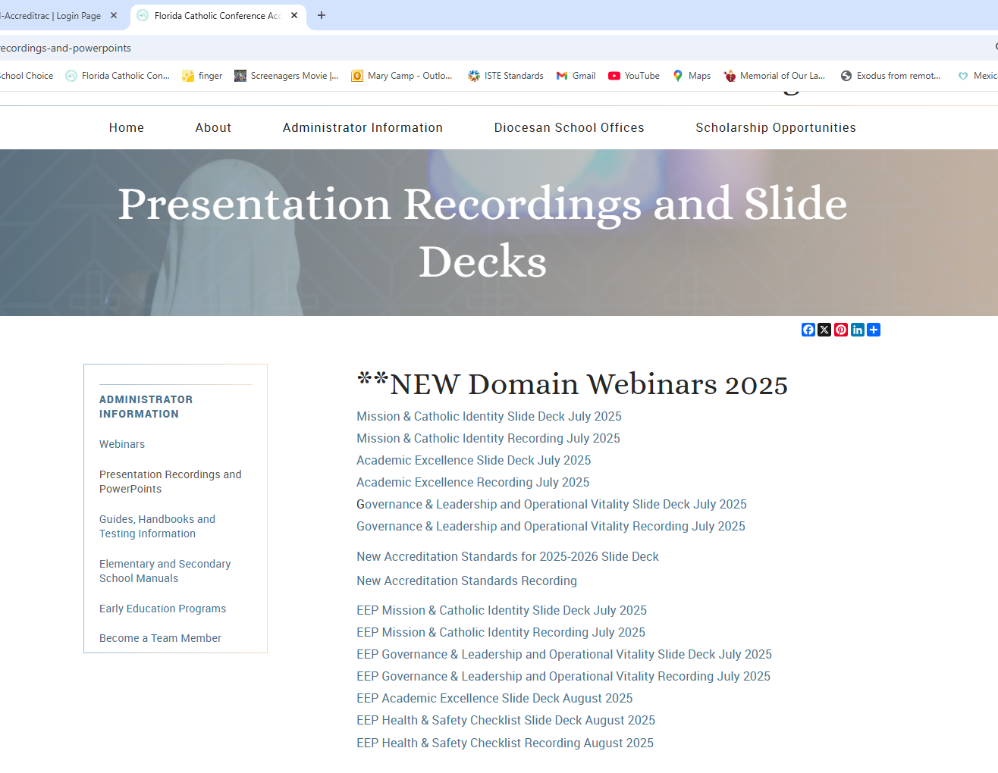
Webinars
Early Education Program Domains (All Cycle Years)
Tuesday, January 20, 2026 | Accreditation Mtg | EEP Mission & Catholic Identity Domain | 3:30 p.m., Eastern
Thursday, January 22, 2026 | Accreditation Mtg | EEP Governance & Leadership and Operational Vitality Domains | 3:30 p.m., Eastern
Wednesday, February 4, 2026 | Accreditation Mtg | EEP Academic Excellence Domain | 3:30 p.m., Eastern
Thursday, February 5, 2026 | Accreditation Mtg | EEP Health &Safety Checklist | 3:30 p.m., Eastern
https://eas-ed.org/

Slide 9
Collect Evidence
Every benchmark must have evidence.
Attach easily read documents
Pictures must have description/explanation
If evidence is observable, explain that in the comments (e.g., in H10, the first aid kit: “Each classroom has a basic first aid kit located in the locked cupboard in the bathrooms and a full kit is in the cupboard in the clinic. All of the necessary items can be seen during the visit.”)

Slide 10
Write Comments
Use comment boxes
Explain how the benchmark is met (e.g., for 5.3 the comment could be, “The director attends diocesan meetings. The associate superintendent visits the center several times a year. The flyer for the diocesan day of reflection was shared with staff and parents, inviting them to attend.” Then attach agendas, pictures, and email to demonstrate this.)
Explain why the benchmark is not met (e.g., for 7.1.b the comment could be, “Some of our teachers are still using more worksheets than activities. The team might see this during observations.”)

Slide 11
Rate
Mark as met or not met
If it isn’t fully met, mark not met and explain in the comments
Only mark not applicable if the center does not have that age of child or that program (VPK)

Slide 12
Stage III: Unitive/Plan (2 months)
  Complete Accreditrac Work
  Domain Summaries
  Action Plan
  Review

Slide 13
Stage III: Unitive/Plan (2 months)
  Domain Summaries – complete once benchmarks are rated, compare to anchor chart
  Action Plan – 2 to 3 smart goals for the next three years
  Review – meet with diocesan accreditation coordinator

Slide 14
Next Meeting
CIPA EEP Cohort (Centers Cycle Year 6)
Wednesday, March 18, 2026 | Accreditation Mtg | 10 a.m., Eastern

Slide 15
Questions?
Mary Camp
Associate Director for Accreditation
mcamp@flacathconf.org
850-224-7906
Shelley Bosko
Associate for Accreditation
sbosko@flacathconf.org
407-404-0766
CIPA Guide for EEPs
Slide Deck

Slide 16
Closing Prayer
We give Thee thanks for all Thy benefits, almighty God, who live and reign forever. Amen. Glory be to the Father and to the Son and to the Holy Spirit. As it was in the beginning, is now, and ever shall be world without end. Amen.

