Slide 1
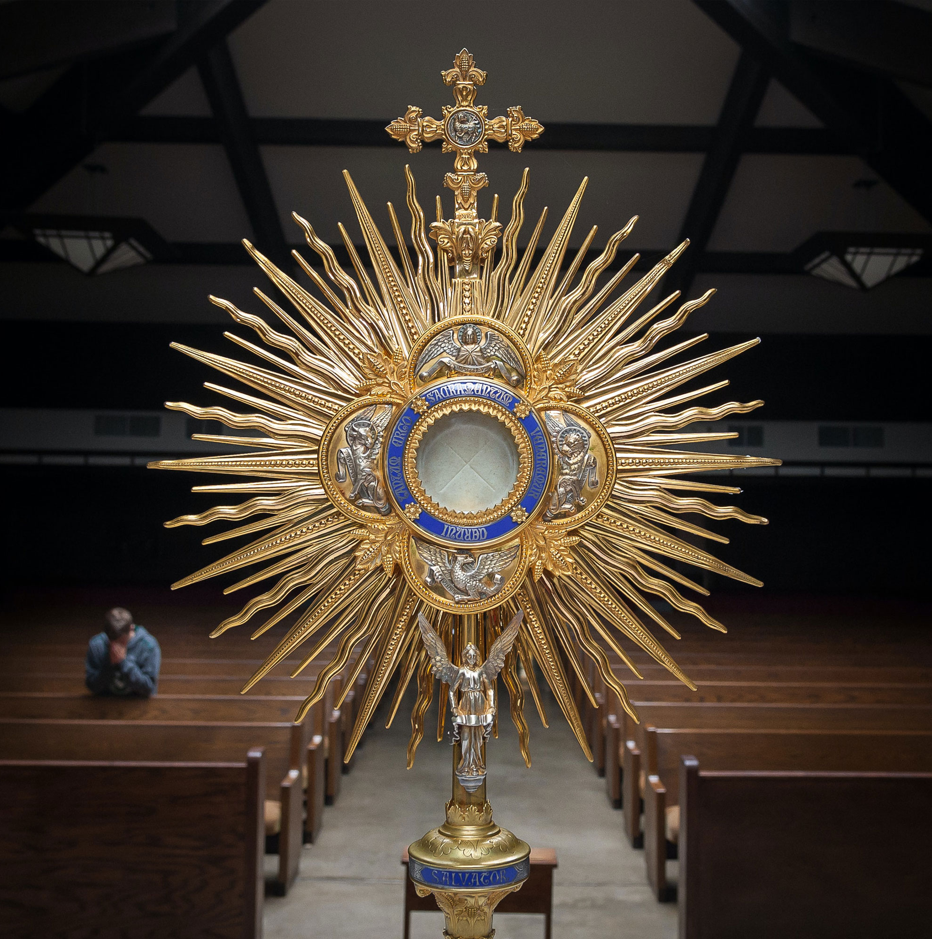


Florida Catholic Conference
Accreditation Program
Fall CIPA Cohort
January 15, 2026
Slide deck (recording available after the webinar)
https://eas-ed.org/presentation-recordings-and-powerpoints

Slide 2

Agenda
Prayer
By Now
Stage II Work
Next Steps
Questions
Prayer
CIPA Guide
https://eas-ed.org/guides-and-handbooks

Slide 3
Opening Prayer
Come, Holy Spirit, fill the hearts of your faithful and kindle in them the fire of your love.
Send forth your Spirit and they shall be created, and you shall renew the face of the earth.
O God, who have taught the hearts of the faithful by the light of the Holy Spirit, grant that in the same Spirit we may be truly wise and ever rejoice in his consolation. Through Christ our Lord. Amen.

Slide 4
By Now
Stage I complete; documents uploaded in Schools Forms
Surveys completed and analyzed, details shared with domain committees
Implementing Stage II

Slide 5
Uploaded in School Forms
Survey Results
Retreat Reflection Response Summary
Mission Vision and Philosophy Anchor Charts
Mission Vision and Philosophy Statements
Domain Anchor Charts

Slide 6
Stage II: Illuminate/Examine – 4 months
Data Review (achievement, attendance, participation, etc.)
Survey Stakeholders/Focus Groups
Domain Committee Work (all faculty on at least one committee)
  Review and use all resources
  Collect evidence, write stories, comments, or explanations
  Rate benchmarks
  Compare with Anchor Chart; create summary

Slide 7
Stage II: Data Review (page 33)
Reflective questions
Possible data to review
Create a Data Review Summary with the insights of each review; upload into School Forms

Slide 8
Stage II: Survey Stakeholders (if not completed)
All parents (goal – 40%)
All staff (100%)
All students in grades five through twelve (100%)
See page 31 of CIPA Guide

Slide 9
Stage II: Domain Committee Work
All faculty on at least one committee
Review and use all resources
  Access to the rubrics
  Webinars and slide decks
Collect evidence for each benchmark
  Collect artifacts from all grade levels, subject areas, offices, departments
  Conversations and review; cull – select best pieces
Write brief stories, comments, or explanations
Rate benchmarks based on evidence and current practice
Compare with Anchor Chart; create summary

Slide 10
Review Written Plans
“Plans” in the benchmarks means implementing robust written plans
Assessment and Data Usage, Communications/Marketing, Development/Advancement, Enrollment Management, Facilities Management, Individual Professional Development Plans, Leadership Succession, Safety, School-wide Professional Development, Technology Plan

Slide 11

Resources on EAS-Ed
CIPA Guide: https://eas-ed.org/guides-and-handbooks
New Rubrics: https://eas-ed.org/elementary-and-secondary-school-manuals
Slide Decks and Recordings: https://eas-ed.org/presentation-recordings-and-powerpoints

Slide 12
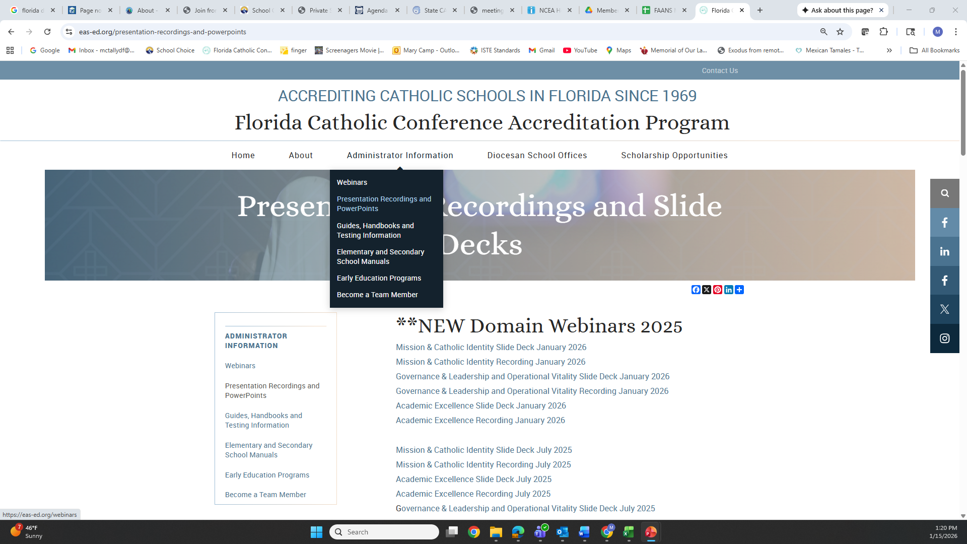





Resources on EAS-Ed

Slide 13
Next Steps
Continue Stage II
Plan for Stage III
Notes:
Very Important Stage! Time to Get an Overall Picture of the School. Get Everyone on the Same Page. Review and Renew the Mission Vision and Philosophy. The Mission Statement should drive all that happens in the school. Stage I sets the tone for the rest of the process.

Slide 14

Cohort Meetings
Wednesday, March 18, 2026 | Accreditation Mtg | Fall CIPA Cohort
https://eas-ed.org/webinars

Slide 15
Domain Webinars (for Stage II)
Domain Webinars
Tuesday, January 6, 2026 | Accreditation Mtg | Mission & Catholic Identity Domain
Wednesday, January 7, 2026 | Accreditation Mtg | Governance & Leadership and Operational Vitality Domains
Thursday, January 8, 2026 | Accreditation Mtg | Academic Excellence Domain
Early Education Program Domain Webinars
Tuesday, January 20, 2026 | Accreditation Mtg | EEP Mission & Catholic Identity Domain
Thursday, January 22, 2026 | Accreditation Mtg | EEP Governance & Leadership and Operational Vitality Domains
Wednesday, February 4, 2026 | Accreditation Mtg | EEP Academic Excellence Domain
Thursday, February 5, 2026 | Accreditation Mtg | EEP Health &Safety Checklist
https://eas-ed.org/presentation-recordings-and-powerpoints
https://eas-ed.org/webinars

Slide 16

Questions?
Mary Camp
Director of Accreditation
mcamp@flacathconf.org
850-224-7906
Shelley Bosko
Associate for Accreditation
sbosko@flacathconf.org
407-404-0766
Slide deck (recording available after the webinar)
https://eas-ed.org/presentation-recordings-and-powerpoints

Slide 17
Closing Prayer
We give Thee thanks for all Thy benefits, almighty God, who live and reign forever. Glory be to the Father and to the Son and to the Holy Spirit. As it was in the beginning is now and ever shall be world without end. Amen.

