Slide 1
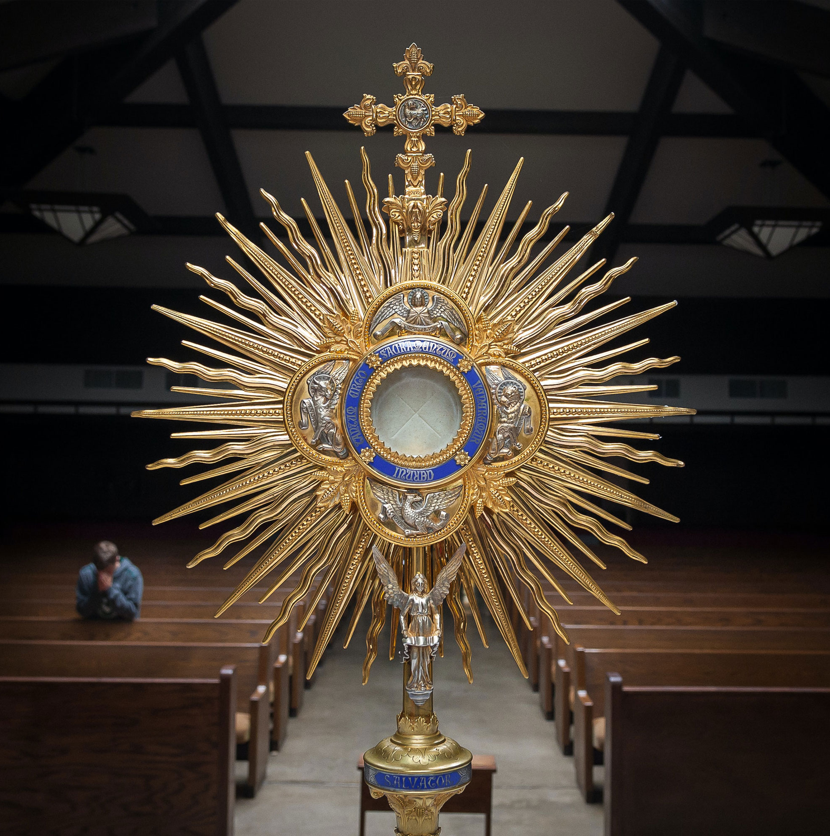
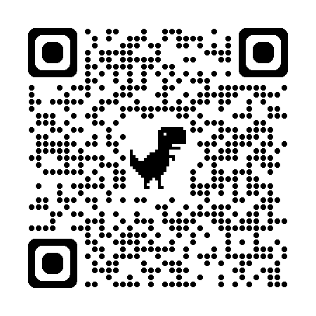

Florida Catholic Conference
Accreditation Program
Governance & Leadership Domain
And
Operational Vitality
Domain
2026
Slide deck (recording available after the webinar)
https://eas-ed.org/presentation-recordings-and-powerpoints

Slide 2
Agenda
Opening prayer
Each standard 10-14
Questions
Closing prayer

Slide 3
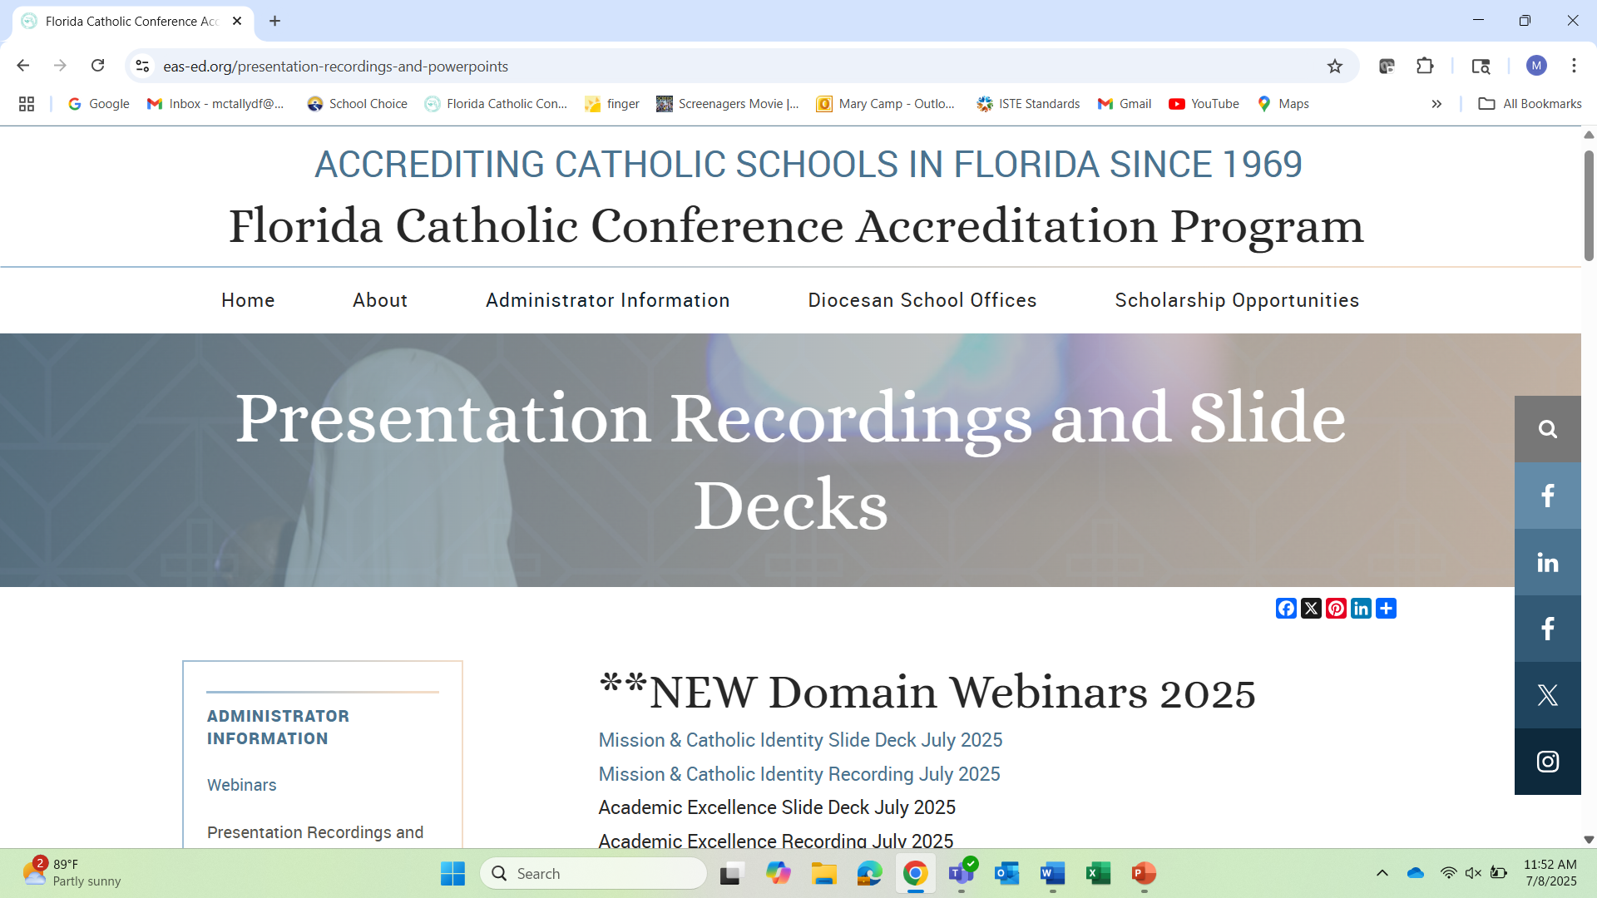




Slide 4
Opening Prayer
Come, Holy Spirit, fill the hearts of your faithful and kindle in them the fire of your love.
Send forth your Spirit and they shall be created, and you shall renew the face of the earth.
O God, who have taught the hearts of the faithful by the light of the Holy Spirit, grant that in the same Spirit we may be truly wise and ever rejoice in his consolation. Through Christ our Lord. Amen.

Slide 5


In General
Using Level 3: Fully Meets the Benchmark
Many changes to the rubrics; most schools – partially meets level
Glossary: https://ncea.org/NSBECS (Resources-Glossary)
Reflection questions

Slide 6
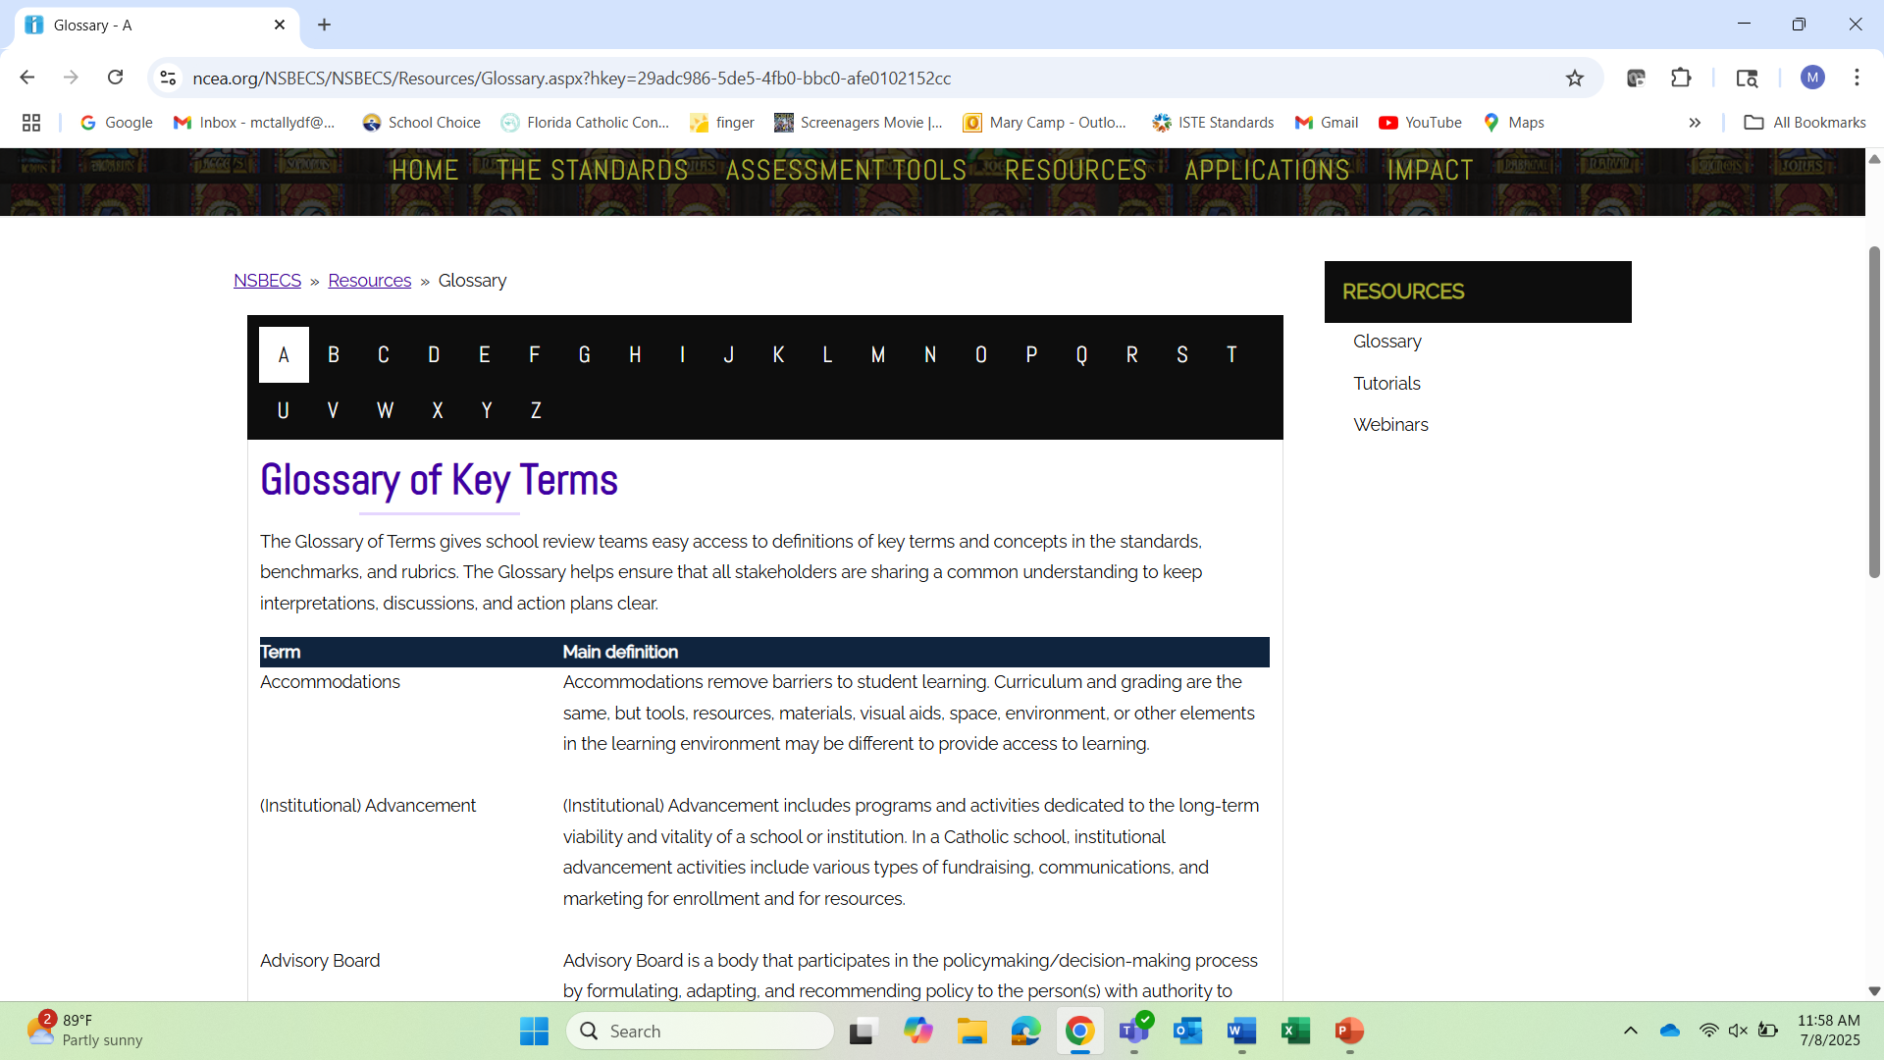




Slide 7
Governance & Leadership
Standard 5
Governing body

Slide 8
Governing body and Leadership Team
Governing body: Pastor (Bishop’s designee), (President), Principal, and School Advisory Council (SAC). Group focused on policy.
Leadership team: Principal, assistant principal, and any leads/directors/deans of the principal’s choice. Group focused on implementing policy.

Slide 9
Plans
Plans: If a benchmark mentions a plan, the school must be implementing a robust written plan in order to fully meet the benchmark.

Slide 10
5.1 Governing body membership
The governing body represents the diversity of stakeholders and the larger community.
How does the membership of the school advisory council represent the members of the school community?
Is it diverse in race, sex, skill sets, etc.?
Level 2: The governing body attempts to represent the diversity of stakeholders and the larger community, but has not yet attracted such diversity.

Slide 11
5.2 By-laws
The governing body functions according to its approved constitution and by-laws.
Both constitution and by-laws are current and accessible to the school community.
When are the by-laws reviewed?
What information is available on the school website? Bylaws, membership, meeting summaries, etc.?

Slide 12
5.3 Systematize policies & succession plans
The governing body with the leader/leadership team systematizes the policies of the school’s operations, to ensure fidelity to mission, and continuity and sustainability through leadership successions.
There are systems in place that ensure the ability of the school to operationalize the policies. Leadership succession plans are up to date.
How often are policies, handbooks, and website reviewed? Organized and easily accessible?
How does the school ensure compliance with diocesan policy?
Is a robust succession plan in place? How often is it updated?

Slide 13
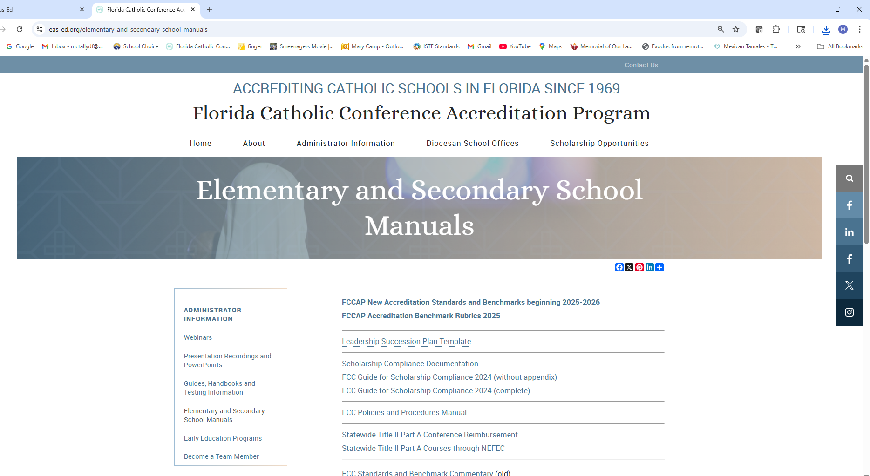
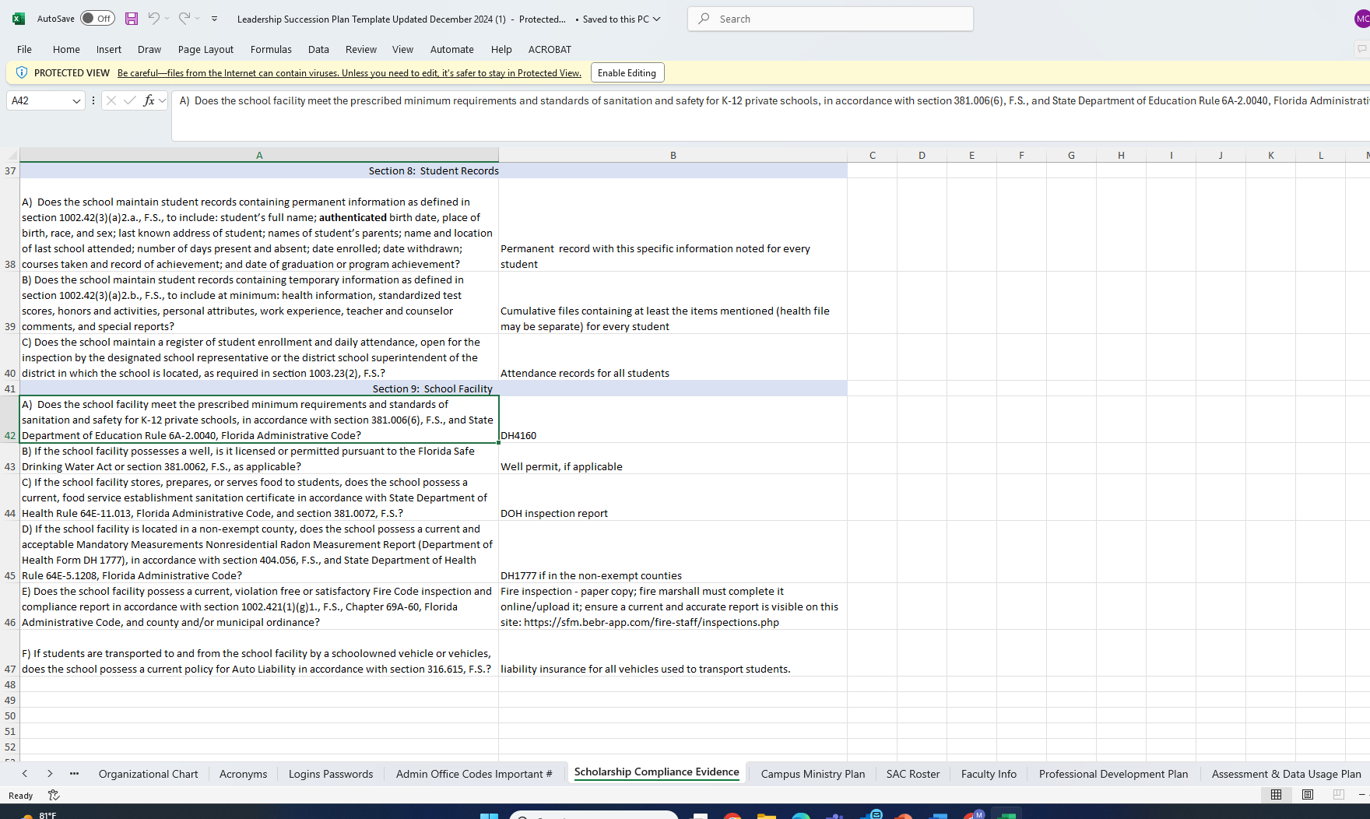





Leadership Succession Plan Template

Slide 14
5.4 Relationship with the Bishop (local ordinary)
The governing body, in collaboration with or through the actions of the leader/leadership team, maintains a relationship with the Local Ordinary marked by mutual trust, close cooperation, continuing dialogue, and respect for the Local Ordinary’s legitimate authority.
How do stakeholders know the school is part of the diocese?
How does the school try to develop a relationship with the bishop? Is he invited to activities?
How does the school participate in diocesan activities?

Slide 15
5.5 Relationship with the superintendent
The governing body, in collaboration with or through the actions of the leader/leadership team, maintains a constructive and beneficial relationship with the (arch)diocesan Education Office consistent with (arch) diocesan policy pertaining to the recognition of Catholic schools by the Local Ordinary.
How does the school develop the relationship with the superintendent and/or associates? Are they invited to the school?
What meetings are attended? Are there committees?
Does leadership consult with superintendent?

Slide 16
5.6 Relationship with the pastor
The governing body, working within their defined roles and responsibilities and in collaboration with the leader/leadership team in collaboration with the leader/leadership team, maintains a relationship with the designated ecclesial authority according to their school’s governance model, marked by mutual trust, close cooperation and continuing dialogue.
How is the pastor (designated ecclesial authority) involved with the SAC?
How and when do the principal and pastor meet?
How is the pastor involved with the school? Invitations?

Slide 17
5.7 Governing body formation & evaluation
The governing body engages in effective board governance practices, including ongoing formation and self-evaluation to ensure the faithful execution of their responsibilities and continuous improvement.
The governing body regularly implements accountability measures, follow-up strategies, and/or plans for improvement related to carrying out the faithful execution of their responsibilities and ensuring continuous improvement.
What formation is in place for SAC?
How does the SAC evaluate itself?
How are the roles and expectations defined, in alignment with the by-laws?

Slide 18
5.8 Leadership formation and evaluation
The governing body holds the leadership team accountable for ongoing formation, professional development, and self-evaluation to ensure the faithful execution of their responsibilities and continuous improvement.
Formation, professional development, and self-evaluation occur in all areas of leadership responsibility.
Who evaluates the principal? How often?
How does the principal complete a self-evaluation?
Does the principal have an individual professional development plan (IPDP)? What is the expectation for formation?
How is he or she held accountable?

Slide 19
Questions on Standard 5

Slide 20
Standard 6
Leadership team

Slide 21
6.1 Leadership certification & PD
The leader/leadership team meets national, state and/or (arch)diocesan requirements for school leadership preparation and licensing to serve as the faith and instructional leader(s) of the school.
Relevant knowledge and skills are kept up to date through professional development and evaluation.
Do leadership team members hold current Florida educator certificates with educational leadership on them? Or is there a diocesan approved written plan?
How often are the leadership team’s IPDPs updated?
Who completes evaluations and when?

Slide 22
6.2 Leadership’s mission & vision
The leader/leadership team articulates a clear mission and vision for the school consistent with its Catholic identity and engages the school community to ensure a school culture that embodies the mission and vision.
The Catholic mission, vision, and identity are routinely part of the leadership team’s interaction with the school community.
What is the principal’s mission and vision for the school?
How is this articulated to all stakeholders?
Does everyone know the priorities? Is everyone on board?

Slide 23
6.3 Development & oversight of personnel
The leader/leadership team takes full responsibility for the development and oversight of personnel, including recruitment, professional growth, faith formation, and formal assessment of faculty and staff in compliance with (arch)diocesan policies and/or religious congregation sponsorship policies.
The leader/leadership team implements established policies and procedures in all areas of personnel development and oversight and regularly reviews effectiveness. Measurable levels of compliance exist and are consistently and uniformly applied in the adoption and implementation of personnel policies. Formal assessment procedures are in place. Professional development includes a plan for professional growth and faith formation.

Slide 24
6.3 Development & oversight of personnel
What does teacher and staff recruitment look like at the school?
How does the leadership team support faculty and staff in their professional growth, faith formation, and goal setting?
How is oversight and formal assessment handled? Is this in alignment with diocesan policies?
How and when are observations completed?
When do teachers meet with leadership 1:1?
Are instructional coaches used? Leadership coaches?

Slide 25
6.4 Networks of collaboration
The leader/leadership team establishes and supports networks of collaboration at all levels within the school community to advance excellence.
These networks are established and supported with designated times and places (including online opportunities) for the work of the networks. Support for the growth and sustainability of networks is expected and clearly evident. With support from the leader/leadership team, networks contribute to a culture of community and collaboration.
What does collaboration look like at the school?
What is the expectation? What supports are in place?
How are all stakeholder groups included in collaboration?

Slide 26
6.5 Continuous improvement of Catholic identity and faith formation
The leader/leadership team directs the development and continuous improvement of Catholic identity and faith formation and uses school-wide evidence to plan for continued and sustained growth in these areas.
The development and continuous improvement of Catholic identity and faith formation is a priority for the leader/leadership team and sufficient time and resources are given to setting school-wide expectations for and creating programs to support growth and improvement in these areas.
What school-wide evidence is available regarding Catholic identity and faith formation?
Who focuses on this aspect? Are there any PLCs?
Does the school have goals and plans in this area?

Slide 27
6.6 Assessment and data usage
The leader/leadership team directs the development and continuous improvement of curriculum and instruction and utilizes school-wide data to plan for continued and sustained academic excellence and growth.
The leader/leadership team works with the faculty to adjust the curriculum and instruction on the basis of ongoing assessment data to address the needs of the students.
There is a formal, documented plan for work with the faculty to adjust the curriculum and instruction on the basis of assessment data to address the needs of the students.
A school-wide assessment procedure is implemented, making useful school-wide data available.
Faculty receive training for use of the data to plan for continued and sustained academic excellence and growth.

Slide 28
6.6 Assessment and data usage
How and when are the implementation of curriculum standards evaluated? What school-wide data is used to evaluate the successful implementation? Are standards tracked?
What does the assessment and data usage plan look like? Who oversees it?
How are classroom teachers involved in the analysis of data?
How is the analysis applied to the entire school? Individual classes? Individual students? Individual teachers?
How is data informing instruction, support, resources, and decision making?
What professional development and training is provided for teachers in this area?
What are the expectations for the use of data throughout the school year?

Slide 29
6.7 Infrastructure for operational vitality
The leader/leadership team works in collaboration with the governing body to provide an infrastructure of programs and services that ensures the operational vitality of the school and upholds the dignity of the whole child.
The infrastructure provides sufficient resources and personnel to implement processes, programs, and services to support enrollment management, personnel decisions, budgeting, finance and development.
Plans for facilities, budgeting, advancement, and development are in place to ensure operational vitality and uphold the dignity of the whole child.
Does the school have a robust infrastructure to ensure operational vitality?
Are strong financial plans and strategic plans in place and implemented?
Are there enough personnel and programs to enrich the life of the school?

Slide 30
6.8 Communicating new initiatives
The leader/leadership team assumes responsibility for communicating new initiatives and/or changes to school programs to all constituents.
A variety of credible and reliable communication methods, including electronic, in-person, multiple languages, etc., are developed and used to reach all members of the school community.
How does the school communicate with all stakeholders, including parishioners?
Does the leadership team lead and/or oversee communications?

Slide 31
6.9 Building leadership capacity
The leader/leadership team assumes responsibility for building leadership capacity and creating shared leadership within the faculty to ensure the long-term sustainability of the school’s mission and vision.
Policies and procedures are in place that delineate opportunities for and expectations of faculty participating in shared leadership, and faculty are invited and encouraged to engage in professional development to build leadership skills in multiple areas.
What does shared leadership look like in the school?
What professional development is provided?
How is this included in the succession planning?

Slide 32
Questions on Standard 6

Slide 33
Operational vitality
Standard 10 financial plans

Slide 34
10.1 Financial planning process
The governing body and leader/leadership team conduct a financial planning process and consult with available experts in nonprofit management and funding.
The financial planning process is clearly delineated, documented, and followed.
What is the process for your school?
Who is involved?
What parish committee reviews and approves?

Slide 35
10.2 Investments in the 3-5 year financial plan
Financial plans include agreed-upon levels of financial investment determined by the partners involved including parishes, dioceses, religious sponsor, educational foundations, the larger Catholic community, and responsible board.
The three-to five-year financial plan identifies all partner funding sources and their agreed-upon level of financial investment.
Does the school have a long-term financial plan (projected budget)?
What financial investments are included? (tuition and scholarships are revenue, not investments)

Slide 36
10.3 Revenue in the 3-5 year financial plan
Financial plans clearly define all revenue sources including tuition, subsidies, fundraising, and other identified categories.
Revenue sources are analyzed and reviewed to maintain and strengthen the diversity of funding sources in the three-to-five-year financial plans.
What revenue sources does the school have?
How do these change over time?

Slide 37
10.4 Costs included in financial plans
Financial plans, including current and projected budgets, delineate all costs for key target areas including salaries, instructional programs, equipment and facilities, capital projects, and other identified categories.
The categories are clear in the three- to five-plan and allow for effective cost monitoring and control. School leadership has full visibility into financial costs.
How is the principal involved in the budgeting?
Does the budget and long-term financial plan include line items for all expenses?

Slide 38
10.5 Budgets use cost per child
Current and projected budgets include a statement of all actual and projected revenue, by source, and a statement of all projected expenditures, by category, identifying the cost per child while showing appropriate balance.
The calculation includes all sources of cost, including allocations for shared costs and budgeted amounts for non-recurring costs (capital improvements, facilities maintenance, etc.).
How and when is budget to actual reviewed?
How and when is cost per child determined? How is this information used?

Slide 39
10.6 Published cost per child
The governing body and leader/leadership team annually communicate an explanation to stakeholders of the total cost per child and how that cost is met by identifying the percentage of cost that is paid for by tuition and the remaining amount of cost that is supported by other sources of revenue.
The cost per child information is published via multiple channels, and in multiple languages, if necessary, to ensure that the information is accessible to every member of the community.
How and when is the cost per child information published?
What does the publication look like – how much detail is shared?

Slide 40
10.6 Published cost per child (levels 2 & 1)
Level 2: The governing body and leader/leadership team share information with the stakeholders that only partially explains the cost per child and how that cost is met. OR The information is not accessible to all stakeholders.
Level 1: The governing body and leader/leadership team fail to communicate and distribute cost per child information and how that cost is met to stakeholders.

Slide 41
10.7 Tuition assistance
The governing body and leader/leadership team provide families equitable access to information about tuition assistance and long-term planning for tuition and Catholic school expenses.
The governing body and leader/leadership team keep current about tuition assistance opportunities and initiate communication with families about tuition assistance information and Catholic school expenses.
How does the school communicate the scholarship information and other tuition assistance information?

Slide 42
10.8 Use of effective business practices
The governing body and leader/leadership team ensure that appropriately developed financial plans and budgets are implemented using current and effective business practices.
What software is used for finances?
What training takes place?
How does the school implement diocesan protocols related to finances?

Slide 43
Questions on Standard 10

Slide 44
Standard 11 human resources

Slide 45
11.1 HR staffing
Human resource programs are professionally staffed at the appropriate level (i.e. central office, school office) and ensure full compliance with human resource policies.
A trained professional assists the school leadership team with personnel management.
How does the school collaborate with the diocese to implement HR policies?

Slide 46
11.2 HR policies
Human resource policies delineate standards for position descriptions including staff responsibilities and qualifications, hiring, compensation, and benefits, as well as standards for professional development, accountability, succession planning, and retirement.
The human resource standards are sufficient to enable effective management of personnel and other human resource issues.
What diocesan policies are implemented regarding job descriptions, qualifications, and responsibilities?
What diocesan policies are implemented regarding hiring, compensation, retirement, and benefits?
What diocesan policies are implemented regarding PD and accountability?
What succession planning is in place?

Slide 47
11.3 Benchmarked compensation
Human resource policies ensure that benchmarked compensation is applied fairly and equitably to salaries and benefits for all staff.
Does the school implement a salary scale or some sort of fair and equitable benchmarked compensation?
Level 2: There are human resource policies and they are used in the school to guide decisions regarding compensation about salary and benefits; however, the policies are only partially benchmarked.

Slide 48
11.4 HR benefits
Human resource policies ensure that institutional planning includes benefits such as investment in professional growth opportunities, health care, and retirement.
How are these included in the financial planning annually and long-term?

Slide 49
Questions on Standard 11

Slide 50
Standard 12
Facilities management

Slide 51
12.1 Facilities, equipment, and technology management plan(s)
The school’s facilities, equipment, and technology management plan includes measurable objectives to support the school’s mission, the delivery of the educational program of the school, and accessibility for all students.
Objectives in these areas are aligned to the mission of the school and Catholic social teaching. This plan could be a single document or three interrelated documents.
What are the objectives of the school’s plan(s)?
How current are the plans? Who is responsible for them?

Slide 52
12.2 Budget supports plans
The school’s budget supports facilities, equipment, and technology management with specific funds for maintenance, capital improvements, depreciation, and replacement.
Budgets provide for unexpected costs and costs aligned to specific capital improvements and other expected replacement costs.
Plans are aligned with the school’s mission and Catholic social teaching.
Are these line items in the budget?
Does the budget align with the plan(s)?

Slide 53
12.3 Planned improvements
The school’s purchasing, physical, and technological improvements are, by design, done in alignment with the mission, with budget funds and appropriate external revenue sources.
Decisions made are consistent with environmental stewardship.
Are decisions made in alignment with the plan(s) and the budget?
How often are the plan(s) reviewed and updated?

Slide 54
Questions on Standard 12

Slide 55
Standard 13
Institutional advancement

Slide 56
13.1 Communications/marketing plan
The communications/marketing plan requires the school leader/ leadership team and staff person(s) to ensure the implementation of contemporary strategies to reach targeted audiences, maintain communication outlets, serve all stakeholders, and provide data analysis.
The school makes use of multiple information technologies to reach targeted audiences and ensure accessibility.
The school establishes reliable and secure databases ensuring accountability to stakeholders.
When was the communications/marketing plan last reviewed and updated?
Does it contain objectives and steps that are in alignment with the mission and vision of the school?

Slide 57
13.2 Enrollment management plan
The enrollment management plan requires the governing body to review and the school leader/leadership team to supervise annual and continuous measurement and analysis of recruitment, enrollment, and retention data for all student groups.
The measurement and analysis actually take place, according to plan, and the information is used to direct decision-making related to tuition, marketing, communications, and other aspects of school operations that are linked to overall enrollment.
Who analyzes the recruitment, enrollment, and retention data?
Does the enrollment management plan contain objectives and steps that are in alignment with the mission and vision of the school?

Slide 58
13.3 Development/advancement plan
The development/advancement plan requires the school leader/leadership team, in collaboration with the governing body, to ensure that key strategies and metrics are in place to identify, cultivate, analyze, and maintain significant funding sources. School leaders act on the plan.
The plan includes forward-looking strategies to expand the set or grow the current funding sources and means of monitoring success.
When was the development/advancement plan last reviewed and updated?
Does it contain objectives and steps that are in alignment with the mission and vision of the school and will ensure the operational vitality of the school long-term?

Slide 59
Questions on Standard 13

Slide 60
Standard 14
Health, safety, & scholarship compliance

Slide 61
Standard 14: Health & Safety, Florida requirements
An excellent Catholic school operates in compliance with all diocesan and applicable state, and local policies.
All benchmarks in standard 14 must be met and required evidence must be attached (or available on site for a few of them)

Slide 62
The school shall develop a written plan for mandated diocesan, county, and state health procedures; provide a safe environment to prevent illness and accidents; deal with emergencies should they occur; and educate students concerning safe and healthy practices.
14.1 Health & Safety
Clinic; sick student protocols
Cleaning and sanitizing protocols
Injury protocols
Health education

Slide 63
The school shall maintain health records that include immunization data, hearing and vision screening, scoliosis screening, and school-entry medical examinations. This includes completed DH3040 and DH680 forms for each student, documentation of scoliosis screening in 6th grade, and DH684 report for kindergarten and grade 7.
14.2 Health Records
Student health files (can be all in one)
  DH3040 – school entry health form (HS, too)
  DH680 - immunization
  6th grade scoliosis screening results
  Hearing and vision screening results
School DH684 report (for grs K & 7)

Slide 64
The school shall be in compliance with diocesan and applicable state and county requirements regarding protection, health, sanitation, and safety. The school shall have completed Florida Department of Health forms, as applicable. This includes DH 1777 for Radon, DH 4160 for sanitation, DH 4023 for food service, and a completed fire code inspection and compliance report.
14.3 Building/Facility requirements
DH1777 (Radon Measurement Report) – see next slide;
DH4160 (proof of compliance with sanitation standards for K-12 private schools)
Fire department, smoke & fire detector, and kitchen inspections

Slide 65
The following counties are currently exempt from mandatory radon testing: Baker Bay Bradford Clay Collier Escambia Flagler Franklin Glades Hendry Lafayette Lake Lee Monroe Okeechobee Orange Santa Rosa Wakulla Washington. If the school/center is in a county on this list, radon testing is not required. If the school/center is in a county not on this list, then radon testing is required at the time of the build and five years later. If the second test is clear, then nothing further is needed unless changes are made to the building structure.
(These two test results are the documentation used for scholarship compliance.)
14.3 Building/Facility requirements

Slide 66
The school shall develop and make available a written safety and security plan which shall include a section on emergency procedures to address such matters as natural disasters, environmental hazards, dangerous weather, violent incidents, and evidence of evacuation drills.
14.4 Safety & Security
Safety & security plans
Evidence of evacuation, tornado, and lock-down drills (logs)
Highly visible exit maps in all classrooms; Safety posters
Building entrance procedures

Slide 67
The school shall be in compliance with provincial and diocesan safe environment policies, including training, background screening, and history checks with previous employers. The school shall post a diocesan approved staff code of ethics which includes training and the requirement to report abuse. Abuse reporting posters shall be on display in the school.
14.5 Safe environment
Safe environment training certificates in files
Background screening results and history checks in files
Spreadsheet of staff members (catechetical, educator certificates, etc.)
Posted code of ethics
FLDOE approved abuse reporting posters – staff and student (11x17)

Slide 68



11x17 English and Spanish Posters – reporting abuse and misconduct for STUDENTS to see
http://www.fldoe.org/teaching/professional-practices/reporting-misconduct-abuse.stml

Slide 69
The school shall publish, implement, and display statements of nondiscrimination of students and personnel in accordance with federal law and regulations, under diocesan guidance.
14.6 Nondiscrimination
Statement in compliance with diocesan attorney recommendation
In handbooks, website

Slide 70
The school shall develop an academic calendar and supporting attendance policies and records that are sufficient to the operation of a quality instructional program with a minimum of 180 actual school days. The school year shall include a minimum of 540 net instructional hours for kindergarten, 720 net instructional hours for grades 1-3, and 900 net instructional hours for grades 4-12. High schools (and middle schools teaching a course for high school credit) shall ensure that one full credit includes a minimum of 135 instructional hours.
14.7 School calendar
School calendar with days noted
Class schedules with minutes tallied
High Schools – tally hours for full and half credit classes

Slide 71
The age of the student is the primary appropriate entrance requirement. Entry dates shall be in accordance with the following schedule:
Pre-Kindergarten 3 3 years of age on or before September 1
Pre-Kindergarten 4 4 years of age on or before September 1
Kindergarten 5 years of age on or before September 1
First Grade 6 years of age on or before Sept 1 & successful completion of Kindergarten
School personnel shall document meetings held with parents prior to acceptance to review the school’s academic programs and policies, customized educational programs, student code of conduct, and attendance polices.
14.8 Student age entry date and school entry
Copy of birth certificate in file
Handbook
Meeting log; documents

Slide 72
The school shall maintain records for students containing information, procedures, and confidentiality as required by law and as necessary for the operation of a quality educational program. These files shall include a copy of the birth certificate, parent data, attendance record, courses taken, and standardized testing results, at a minimum. Permanent records shall be kept with the summary of this information. (Closed schools will follow diocesan procedure regarding these records.)
14.9 Student records
Well organized student files with cover sheets
Checklist in the front
Permanent files
Handbook

Slide 73
The school shall maintain records for all personnel. These files shall include the employment application, employment history check, level 2 background screening documentation, college transcripts, Florida educator certificate, BEC-PASS documentation, Professional Practices Database of Disciplinary Actions documentation, Disqualification List documentation, catechist certification data, ethics training documentation, safe environment training certificate/documentation, and signed receipt of staff handbook, at a minimum. A spreadsheet or database of the specific information shall be maintained with current expiration dates.
14.10 Personnel records
Well organized personnel files, containing everything listed above
Checklist in the front
Up to date spreadsheet: name, date of hire, position, degree, background screening & expiration, certificate & expiration, catechetical certification

Slide 74
Questions on Standard 14

Slide 75


New Rubrics
https://eas-ed.org/elementary-and-secondary-school-manuals
Standards and Benchmarks:
Rubrics:

Slide 76
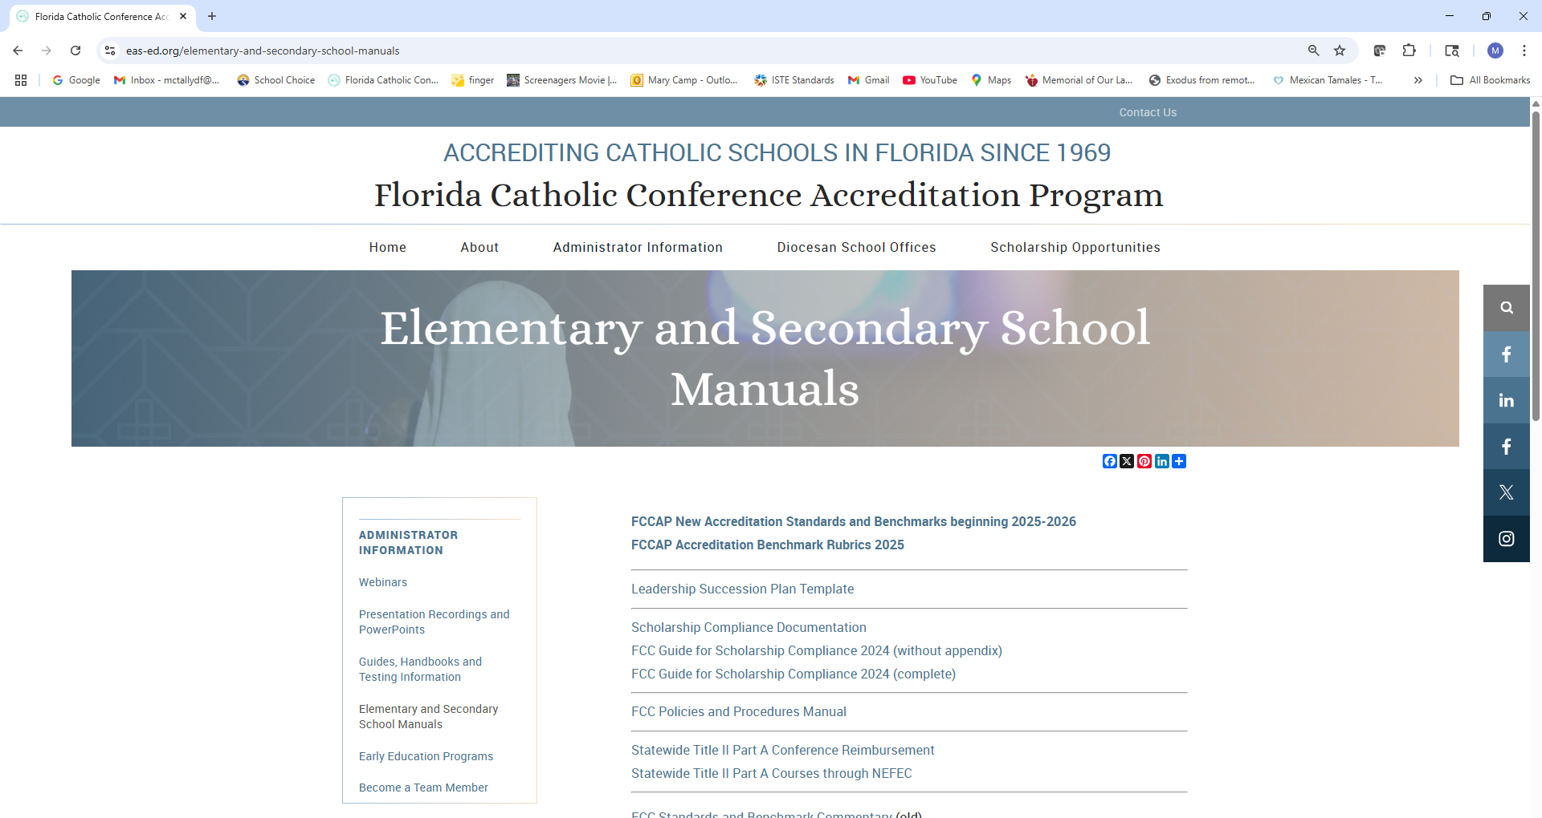







Slide 77

Questions?
Mary Camp
Director of Accreditation
mcamp@flacathconf.org
850-224-7906
Shelley Bosko
Associate for Accreditation
sbosko@flacathconf.org
407-404-0766
Slide deck (recording available after the webinar)
https://eas-ed.org/presentation-recordings-and-powerpoints

Slide 78
Closing Prayer
We give Thee thanks for all Thy benefits, almighty God, who live and reign forever. Glory be to the Father and to the Son and to the Holy Spirit. As it was in the beginning is now and ever shall be world without end. Amen.

