Slide 1
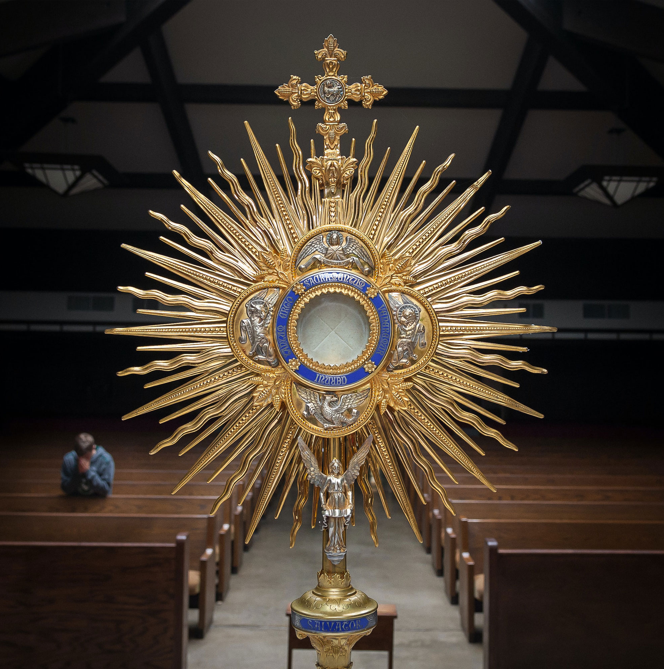
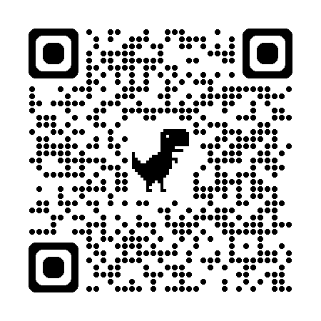

Florida Catholic Conference
Accreditation Program
Mission & Catholic Identity Domain
Slide deck (recording available after the webinar)
https://eas-ed.org/presentation-recordings-and-powerpoints

Slide 2
Agenda
Opening prayer
Each standard 1-4
Questions
Closing prayer

Slide 3
Opening Prayer
Come, Holy Spirit, fill the hearts of your faithful and kindle in them the fire of your love.
Send forth your Spirit and they shall be created, and you shall renew the face of the earth.
O God, who have taught the hearts of the faithful by the light of the Holy Spirit, grant that in the same Spirit we may be truly wise and ever rejoice in his consolation. Through Christ our Lord. Amen.

Slide 4
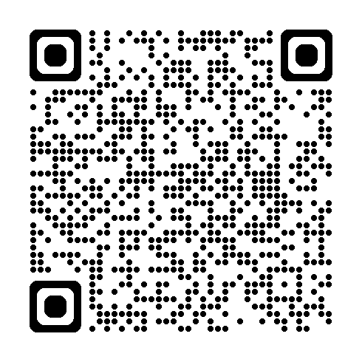
In General
Using Level 3: Fully Meets the Benchmark
Many changes to the rubrics; most schools – partially meets level
Glossary: https://ncea.org/NSBECS (Resources-Glossary)
Reflection questions

Slide 5
Standard 1
Mission statement and its use

Slide 6
1.1 Catholic mission statement with school charism
The governing body and the leader/leadership team ensure that the mission statement identifies the school as Catholic and references the school’s unique religious character or charism.
  Without the name of the school, what in the statement makes it Catholic?
  What is the school’s charism?
  What words or phrases make the statement unique to the school?
From NSBECS Glossary: Charism is a spiritually inspired core value to distinguish and advance the school’s evangelizing and educational mission

Slide 7
1.2 Using the mission statement in planning
The governing body and the leader/leadership team use the mission statement as the foundation and normative reference for most planning.
Major planning efforts explicitly reference the mission at the beginning of planning and throughout.
Throughout planning cycles, key components of the mission statement guide the direction and the communication of the initiatives.
How is the mission statement used?
When is it referenced?
What is the decision making process?

Slide 8
1.3 Regular mission statement review
The school leader/leadership team regularly calls together the school’s various stakeholders [including but not limited to faculty and staff, parents, students, alumni(ae)] to review, clarify, and renew the school’s mission statement.
When and how is the mission statement reviewed?
Should guide all that happens, reviewed and renewed at least annually

Slide 9
1.4 Mission statement visible
The mission statement is visible in public places and contained in official documents including but not limited to handbooks and website.
Where is the mission statement seen?
Best practice: same place in all classrooms, easily seen

Slide 10
1.5 Stakeholders understand the mission statement
All stakeholders know and understand the school’s mission.
School leaders work to ensure that every group of stakeholders can articulate and explain the mission.
How is mission statement taught?
How is it used with staff? Parents?

Slide 11
1.6 Supplemental statements
Supplemental statements such as the school’s motto, beliefs, philosophy, core values, charism, and/or graduate profile are aligned with the school’s mission statement and are inspired by the school’s Catholic identity.
When have these been reviewed?
How are they used?
At a minimum: mission statement, vision statement, philosophy of education statement
MS: defines who/what the school is; VS: ideal; Philosophy: specifically how to get there

Slide 12
Questions on Standard 1

Slide 13
Standard 2 religious curriculum

Slide 14
2.1 Curriculum Instruction Encounter
Religious education curriculum and instruction facilitates an encounter with Jesus Christ that evangelizes and meets the religious education requirements and standards of the (arch)diocese.
The requirements for knowledge and faith formation are evidenced in course expectations, grade level expectations, and course content throughout the school.
How is encounter built into instruction?
Using diocesan religion standards?
What are the expectations?

Slide 15
2.2 Religion classes integral part
Religion classes are an integral part of the academic program in the assignment of teachers, amount of class time, and the selection of texts and other curricular materials.
When are religion classes?
What texts are used?
USCCB Conformity Listing: https://www.usccb.org/resources/conformity-review-list.pdf

Slide 16
2.3 Catechetical certification
Faculty who teach religion meet (arch)diocesan requirements for academic and catechetical preparation and certification to provide effective religion curriculum and instruction.
Following diocesan protocol for all staff?
How are teachers held accountable?

Slide 17
2.4 Catholic identity requires excellence
The school’s Catholic identity requires excellence in academic and intellectual formation in all subjects including religious education.
In keeping with its Catholic identity, the school sets articulated standards for and expectations of academic and intellectual excellence in all subjects, including religious education.
How is excellence required?
How is this articulated?

Slide 18
2.5 Lenses of scripture and CIT
Faculty use the lenses of scripture and the Catholic intellectual tradition in all subjects to help students think critically and ethically about the world around them.
The faculty is knowledgeable in scripture and Catholic intellectual tradition, infusing it into the academic culture.
How is scripture and CIT used?
How are teachers supported in their knowledge and understanding of scripture and CIT?

Slide 19
2.5 Lenses of scripture and CIT
Glossary: Catholic Intellectual Tradition is the product of a continuous dialogue between faith and cultures that reflects two essential characteristics of the Christian, and especially the Catholic, understanding of human experience: faith necessarily seeks understanding, and all intellectual inquiry leads eventually to questions of an ultimate nature that invite faith responses. For the Catholic, thinking is part of believing, and the Catholic view sees no conflict among faith, knowledge, and reason; it looks to how they illuminate one another.

Slide 20
2.6 Catholic culture
Catholic culture and faith are expressed in the school through multiple and diverse forms of visual and performing arts, music, and architecture, as well as all extra-curricular and co-curricular activities.
Any visitor to the school can readily identify signs and symbols of Catholic culture and faith.
What makes the school Catholic?
What is seen, felt, heard?
Take a Catholic culture walk

Slide 21
2.7 Church’s social teachings
The theory and practice of the Church’s social teachings are essential elements of the curriculum.
Every student receives planned instruction in the themes from the Church’s social teaching.
When are the 7 themes of CST taught and used?
Many resources: USCCB, CRS, textbook companies, YouTube

Slide 22
Questions on Standard 2

Slide 23
Standard 3 student faith formation

Slide 24
3.1 Opportunities to grow closer to Christ
Every student is offered timely and regular opportunities to grow closer to Christ through prayer, the Eucharist, and liturgy.
Students are involved in the design of prayer services/liturgical services.
Students regularly serve in a variety of roles in the Eucharistic liturgy.
Eucharist is celebrated regularly as a school or class community.
Students can articulate how they are growing closer to Christ.
When is Mass?
How are students involved in the design of any prayer?
Do students talk about their relationship with Jesus?

Slide 25
3.2 Retreats and spiritual experiences
Every student is offered timely, regular, and age-appropriate opportunities to reflect on their life experiences and faith through retreats and/or other spiritual experiences that prioritize both personal reflection and interpersonal encounter.
Retreat experiences (on or off-site) are part of student life at all grade levels.
When age-appropriate, students have the opportunity to participate in the planning of retreats or other spiritual events.
Students are given regular opportunities to participate in guided reflection on their life experiences and faith that prioritize both personal reflection and interpersonal encounter.
  How are retreats and reflection incorporated into the life of the school?
  How are students involved in the planning?

Slide 26
3.3 Authentic Christian service program
Every student participates in authentic Christian service programs to promote the lived reality of action in service of social justice.
Christian service opportunities provide specific means for students to clearly make connections between the gospel, the teachings of the Catholic faith, service, and social justice.
The Christian service programs are rooted in the gospel mandate to serve as Jesus served and intentionally are tied to the mission and the academic programs of the school.
What is the school’s Christian service program? What makes it authentic?
How are connections made to gospel, mission, etc.?

Slide 27
3.4 Role models of faith and service
Every student experiences role models of faith and service for social justice among the administrators, faculty, and staff.
Being a role model for faith and service is a consideration in hiring. This is an expectation of the school.
When is role modeling discussed?
How do staff members know the expectations?

Slide 28
Questions on Standard 3

Slide 29
Standard 4 adult faith formation

Slide 30
4.1 Staff spiritual experiences
The leader/leadership team provides engaging spiritual formation experiences that prioritize both personal reflection and interpersonal encounter for the faculty and staff on a regular and timely basis.
The leader/leadership team involves faculty and staff in the planning and implementation of spiritual formation experiences.
What type of spiritual formation and reflection experiences are provided for the staff as a whole? When do these happen?
How are staff involved in the planning?

Slide 31
4.2 Assist parents
The leader/leadership team and faculty assist parents in their role as the primary educators of their children in faith, making clear to families the appropriate supportive role of the school as it relates to parish and home.
Programs and support are intentional and consistent throughout a child’s school career.
The role of the school as a support to the parish and families is clearly communicated to all in the school community.
How does the school support the parents?
How is this communicated?
Are programs offered? How are parents invited?

Slide 32
4.3 Parent faith formation
The leader/leadership team collaborates with other institutions (for example, the parish(es), Catholic Charities, Catholic higher education, or one or more religious congregations) to provide opportunities for parents to grow in the knowledge and practice of the faith.
Family input and feedback are respectfully included in collaborations with other institutions.
What opportunities are provided to parents? How are they invited to participate?
With which institutions does the school collaborate?
Does the school request parental input?

Slide 33
4.4 Adults participate in Christian service program
All adults in the school community are invited to participate in authentic Christian service programs to promote the lived reality of action in service of social justice.
Participation is expected, encouraged, and embraced by adults in the school.
How are adults included in the Christian service program?

Slide 34
4.5 Staff support faith life
Every administrator, faculty, and staff member visibly supports the faith life of the school community.
This is a clear expectation for every administrator, faculty and staff member.
How are staff members expected to support the faith life of the school?
How is this communicated?

Slide 35
4.6 Individual staff member spiritual formation
The leader/leadership team attends to the unique formative needs of all faculty and staff so that all faculty and staff are equipped to support an authentic and vibrant Catholic school faith community.
The leader/leadership team identifies the spiritual formation needs of all faculty and staff and offers opportunities for each member to increase and deepen their understanding of the Catholic faith and their own spiritual journey to increase their ability to support and participate in the vibrant Catholic school faith community.
How are unique staff needs determined?
What is offered to assist in spiritual journeys?

Slide 36
Questions on Standard 4

Slide 37
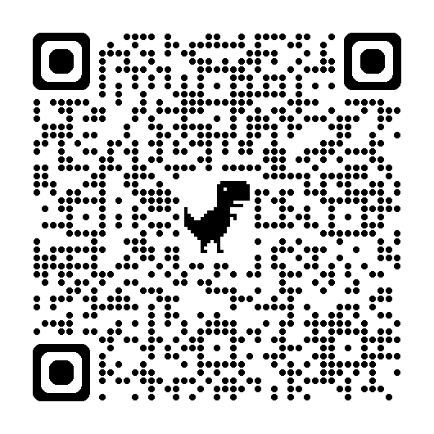
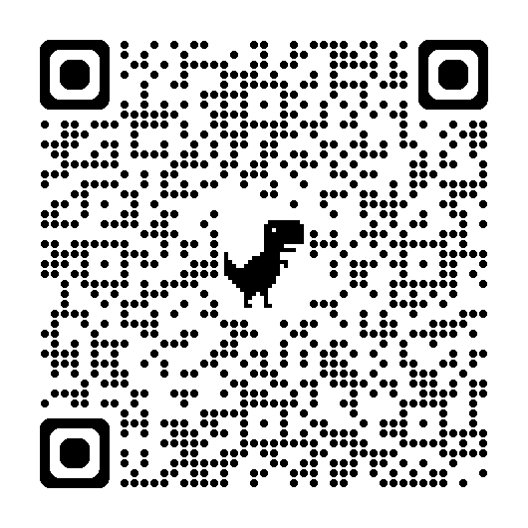
New Rubrics
https://eas-ed.org/elementary-and-secondary-school-manuals
Standards and Benchmarks:
Rubrics:

Slide 38
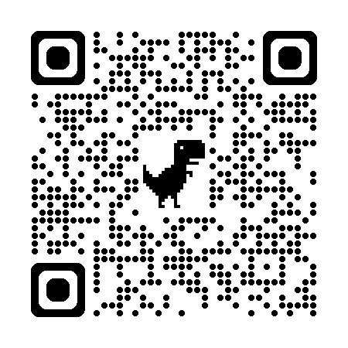
Questions?
Mary Camp
Director of Accreditation
mcamp@flacathconf.org
850-224-7906
Shelley Bosko
Associate for Accreditation
sbosko@flacathconf.org
407-404-0766
Slide deck (recording available after the webinar)
https://eas-ed.org/presentation-recordings-and-powerpoints

Slide 39
Closing Prayer
We give Thee thanks for all Thy benefits, almighty God, who live and reign forever. Glory be to the Father and to the Son and to the Holy Spirit. As it was in the beginning is now and ever shall be world without end. Amen.

