Slide 1
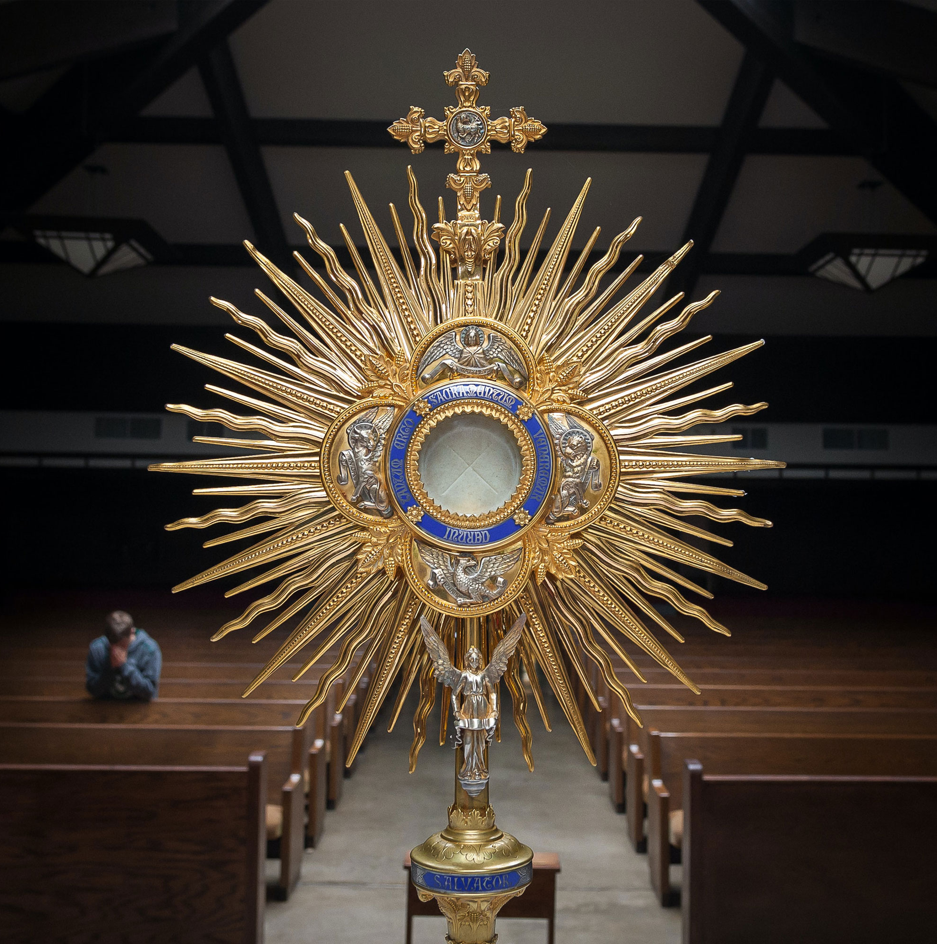


Florida Catholic Conference
Accreditation Program
Spring CIPA Cohort
March 2026
Slide deck (recording available after the webinar)
https://eas-ed.org/presentation-recordings-and-powerpoints

Slide 2

Agenda
Prayer
By Now
Resources
Next Steps
Cohort Meetings
Questions
Prayer
CIPA Guide
https://eas-ed.org/guides-and-handbooks

Slide 3
Opening Prayer
Come, Holy Spirit, fill the hearts of your faithful and kindle in them the fire of your love.
Send forth your Spirit and they shall be created, and you shall renew the face of the earth.
O God, who have taught the hearts of the faithful by the light of the Holy Spirit, grant that in the same Spirit we may be truly wise and ever rejoice in his consolation. Through Christ our Lord. Amen.

Slide 4
By Now
Finishing Stage I
Uploading documents from Stage I
  Retreat Reflection Response Summary (page 16)
  MVP Anchor Charts (pages 19-21)
  MVP Statements
  Domain Anchor Charts (includes EEP, STREAM) (page 30)
  Survey Results

Slide 5
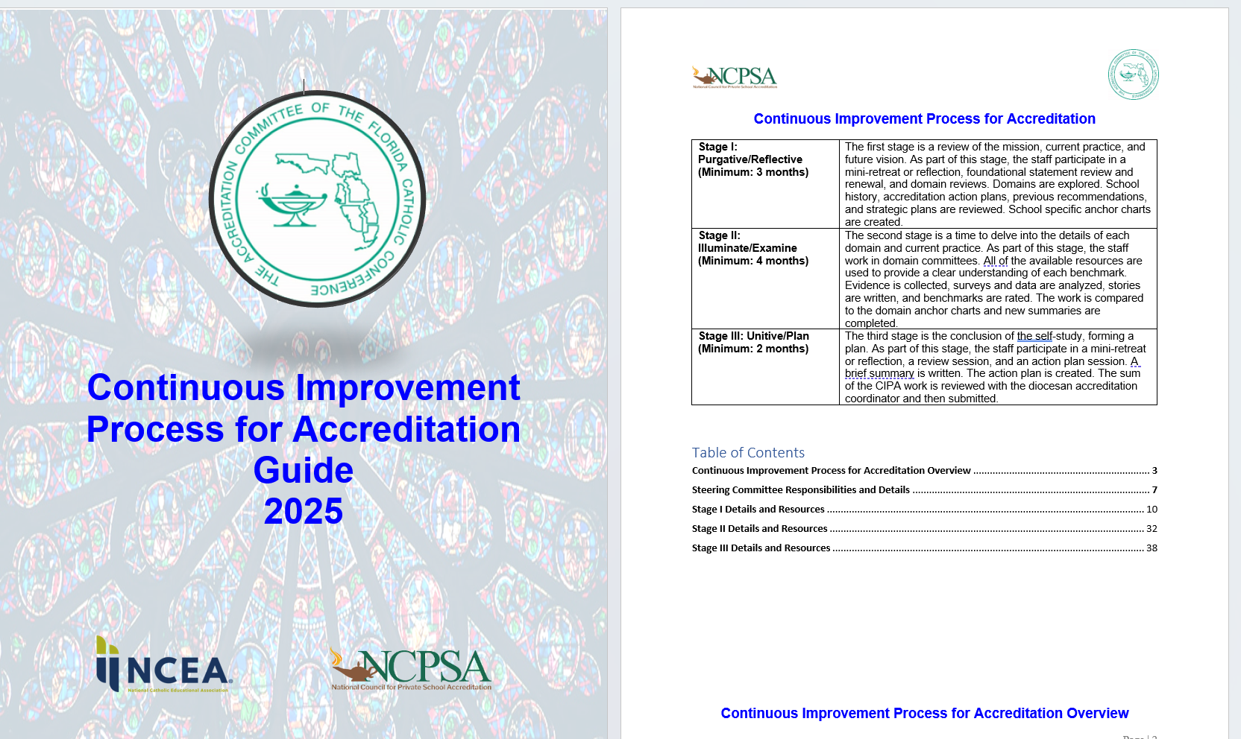
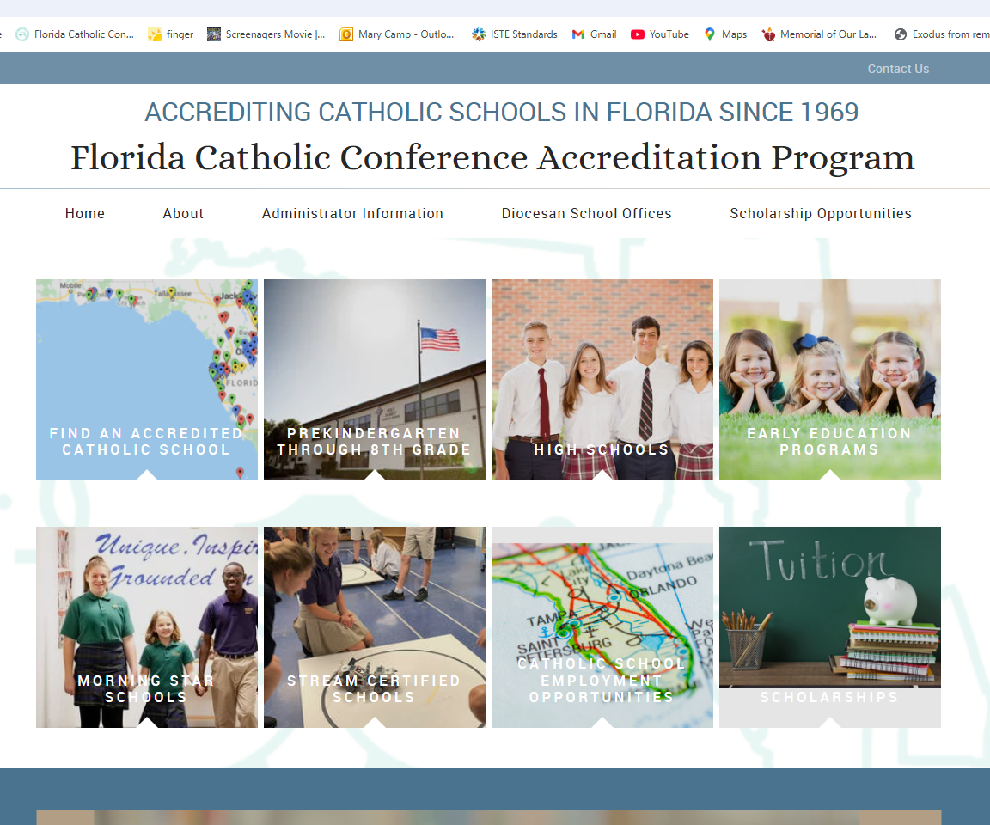

Resources
CIPA Guide
Slide Decks and Recordings
https://eas-ed.org/

Slide 6
Stage II: Illuminate/Examine – 4 months
Data Review (achievement, attendance, participation, etc.)
Survey Stakeholders/Focus Groups
Domain Committee Work (all faculty on at least one committee)
  Review and use all resources
  Collect evidence, write stories, comments, or explanations
  Rate benchmarks
  Compare with Anchor Chart; create summary

Slide 7
Stage II: Data Review (page 33)
Reflective questions
Possible data to review
Create a Data Review Summary with the insights of each review; upload into School Forms

Slide 8
Survey Stakeholders
Miami & Orlando: Contact Diocesan Office
All others: Contact FCC Accreditation Office
All parents (goal – 40%)
All staff (100%)
All students in grades five through twelve (100%)
See page 31 of CIPA Guide

Slide 9
Stage II: Domain Committee Work
All faculty on at least one committee
Review and use all resources (www.eas-ed.org)
  Access to the rubrics
  Webinars and slide decks
Collect evidence for each benchmark
  Collect artifacts from all grade levels, subject areas, offices, departments
  Conversations and review; cull – select best pieces
Write brief stories, comments, or explanations
Rate benchmarks based on evidence and current practice
Compare with Domain Anchor Chart; complete summary

Slide 10
Review Written Plans – Administration (page 34)
“Plans” in the benchmarks means implementing robust written plans
Assessment and Data Usage, Communications/Marketing, Development/Advancement, Enrollment Management, Facilities Management, Individual Professional Development Plans, Leadership Succession, Safety, School-wide Professional Development, Technology Plan

Slide 11

Resources on EAS-Ed
CIPA Guide: https://eas-ed.org/guides-and-handbooks
New Rubrics: https://eas-ed.org/elementary-and-secondary-school-manuals
Slide Decks and Recordings: https://eas-ed.org/presentation-recordings-and-powerpoints

Slide 12
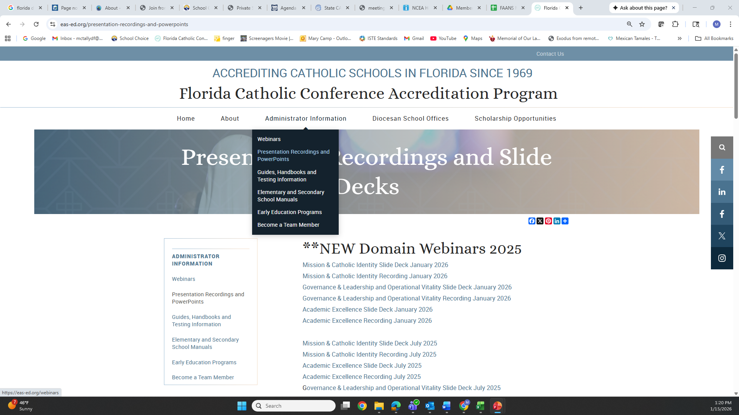





Resources on EAS-Ed

Slide 13
Next Steps
Continue Stage II (finish in early fall)
Plan for Stage III (finish 6 weeks prior to visit)
Notes:
Very Important Stage! Time to Get an Overall Picture of the School. Get Everyone on the Same Page. Review and Renew the Mission Vision and Philosophy. The Mission Statement should drive all that happens in the school. Stage I sets the tone for the rest of the process.

Slide 14
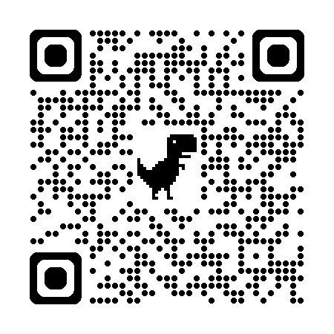
Cohort Meetings – 3:30 p.m., Eastern
Thursday, July 30 at 11 a.m., Eastern | Accreditation Mtg
Wednesday, Oct. 28 at 3:30 p.m., Eastern | Accreditation Mtg
https://eas-ed.org/webinars

Slide 15
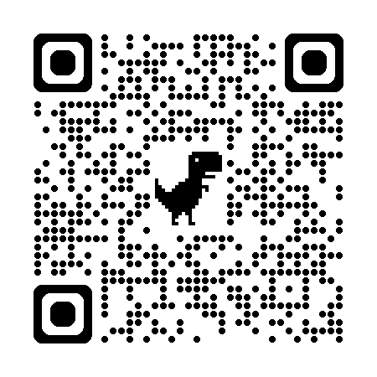
Questions?
Mary Camp
Director of Accreditation
mcamp@flacathconf.org
850-728-4272
Shelley Bosko
Associate for Accreditation
sbosko@flacathconf.org
407-404-0766
Slide deck (recording available after the webinar)
https://eas-ed.org/presentation-recordings-and-powerpoints

Slide 16
Closing Prayer
We give Thee thanks for all Thy benefits, almighty God, who live and reign forever. Glory be to the Father and to the Son and to the Holy Spirit. As it was in the beginning is now and ever shall be world without end. Amen.

