Slide 1
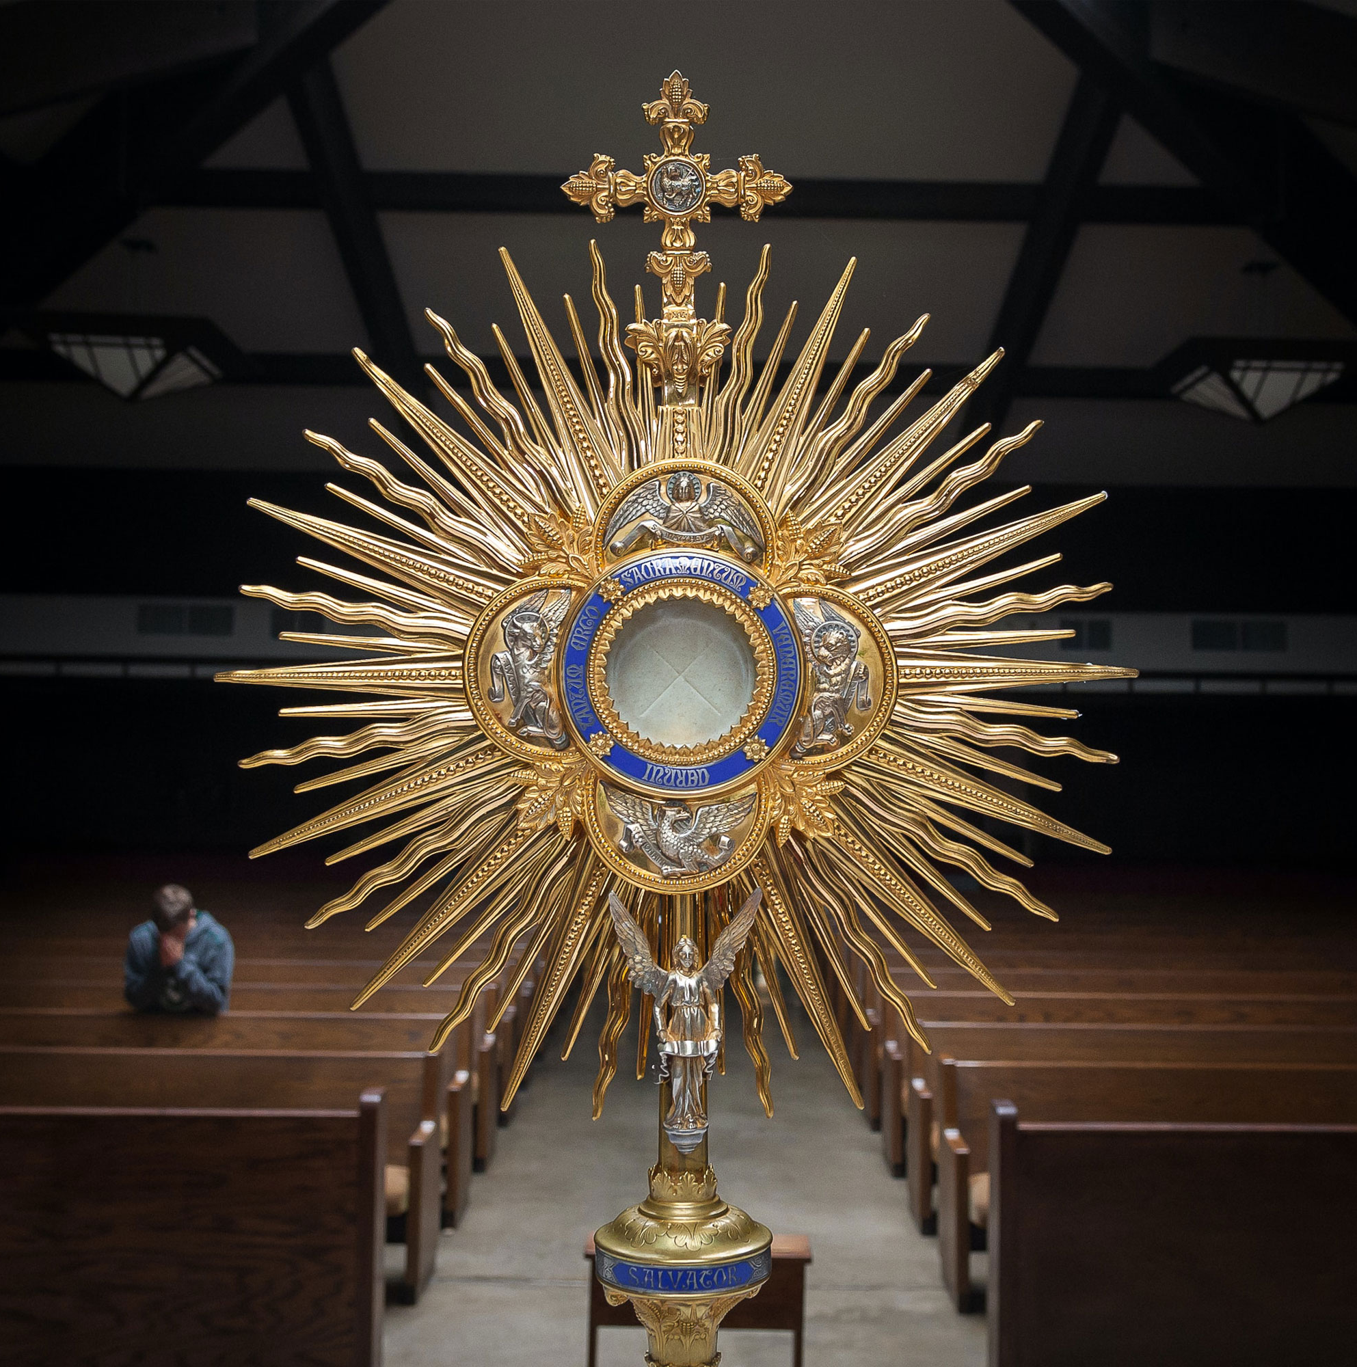
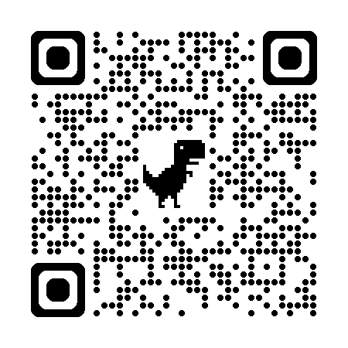

Florida Catholic Conference
Accreditation Program
Continuous
Improvement
Process for
Accreditation
2026
(Arrival Activity)

Slide 2
Agenda
Prayer
CIPA Stages
Retreat & MVP Work
Domain Review
Domain Committee Work
Action Plan
Concluding Retreat & Review

Slide 3
Opening Prayer
Come, Holy Spirit, fill the hearts of your faithful and kindle in them the fire of your love. Send forth your Spirit and they shall be created, and you shall renew the face of the earth. Let us pray. O God, who have taught the hearts of the faithful by the light of the Holy Spirit, grant that in the same Spirit we may be truly wise and ever rejoice in his consolation. Through Christ our Lord. Amen.

Slide 4
CIPA Stages
Stage I
Stage II
Stage III
Purgative/ Reflective
(3 months)
Foundational Work
Illuminate/ Examine
(4 months)
Detailed status review
Unitive/Plan
(2 months)
Road Map

Slide 5
Stage I: Purgative/Reflective
Mini-Retreat / Reflection
Mission, Vision, and Philosophy Work
Domain Description Review

Slide 6
MVP – Mission Vision & Philosophy Work
Retreat/Reflection
Review of current statements
Review of history and action plan
Statement determination
MVP Anchor Chart
John 15:1-11
Reflection Questions: Personal and School
Connected? Bearing fruit?
Not bearing fruit? Needs to be pruned?
Joy?
Share School Reflection Responses

Slide 7
MVP – Mission Vision & Philosophy
Retreat/Reflection
Review of current statements
Review of history and action plan
Statement determination
MVP Anchor Chart
MVP Review
Reflection Questions
How does this statement or these statements connect us to Jesus and his Church?
Highlight 3 to 5 key words/phrases

Slide 8
MVP – Mission Vision & Philosophy
Retreat/Reflection
Review of current statements
Review of history and action plan
Statement determination
MVP Anchor Chart
MVP Review
Defining Characteristics Reflection

Slide 9
Defining Characteristics
Centered on the Person of Jesus Christ
Contributing to the Evangelizing Mission of the Church
Distinguished by Excellence
Committed to Educate the Whole Child
Steeped in a Catholic Worldview
Sustained by Gospel Witness
Shaped by Communion and Community
Accessible to All Students
Established by the Expressed Authority of the Bishop
How is this seen, felt, heard in our school? Is any of this explicitly stated in our foundational statements?

Slide 10
MVP – Mission Vision & Philosophy
Retreat/Reflection
Review of current statements
Review of history and action plan
Statement determination
MVP Anchor Chart
MVP Review
Reflection Questions
Who are we and where do we want to be in 7 years?
Does anything need to be pruned?
Non-negotiables: Name 3 to 5

Slide 11
MVP – Mission Vision & Philosophy
Retreat/Reflection
Review of current statements
Review of history and action plan
Statement determination
MVP Anchor Chart
School History
Accreditation Action Plan
Recommendations from Third Year Review

Slide 12
MVP – Mission Vision & Philosophy
Retreat/Reflection
Review of current statements
Review of history and action plan
Statement determination
MVP Anchor Chart
Do any of the statements need changes or major revision?
If they do, make these changes during the self-study year

Slide 13
MVP – Mission Vision & Philosophy
Retreat/Reflection
Review of current statements
Review of history and action plan
Statement determination
MVP Anchor Chart
Create a Mission, a Vision, & a Philosophy Anchor Chart for your school

Slide 14
Domain Work
Key Words and Phrases
School Initiatives/Efforts/Accomplishments
Things we are planning to do or considering
Wish Lists/What we would like to be doing

Slide 15
Domains – Mission & Catholic Identity
The Church’s teaching mission includes inviting young people into a relationship with Jesus Christ or deepening an existing relationship with Jesus, welcoming young people into the life of the Church, and assisting young people to see and understand the role of faith in one’s daily life and in the larger society. “This unique Catholic identity makes our Catholic elementary and secondary schools ‘schools for the human person’ and allows them to fill a critical role in the future life of our Church, our country and our world” (The Catholic School on the Threshold of the Third Millennium, 1997). The following standards address Catholic identity and culture as vital to the mission of Catholic schools in the United States.

Slide 16
Domains – Governance & Leadership
Central to the mission of the Church is the work of Catholic school education. The success of this mission depends on the key components of effective governance, which provides direction or authority, and leadership, which ensures effective operations. Catholic school governance and leadership can be seen as a ministry that promotes and protects the responsibilities and rights of the school community. Governance and leadership based on the principles and practices of excellence are essential to ensuring faith formation and Catholic identity, academic excellence, and operational vitality of the school. Although governance models vary based on the sponsorship of the school, those who serve on the governing body or leadership team in Catholic schools provide for an environment for the teaching of doctrine and Sacred Scripture, the building and experiencing of community, the serving of others, and the opportunity for worship.

Slide 17
Domains – Academic Excellence
The United States Conference of Catholic Bishops (USCCB) affirms the message of the Congregation on Catholic Education that intellectual development of the person and growth as a Christian go forward hand in hand. Rooted in the mission of the Church, the Catholic school brings faith, culture, and life together in harmony. In 2005, the bishops noted that “young people of the third millennium must be a source of energy and leadership in our Church and our nation. And, therefore, we must provide young people with an academically rigorous and doctrinally sound program of education” (Renewing Our Commitment to Catholic Elementary and Secondary School is in the Third Millennium, 2005).
Essential elements of “an academically rigorous and doctrinally sound program” mandate curricular experiences – including co-curricular and extra-curricular activities – which are rigorous, relevant, research-based, inclusive, global, and rooted in Catholic faith and traditions (Fratelli Tutti, 2020).
In the words of the Vatican Congregation for Catholic Education, “It is an education – at the same time – that is sound and open, that pulls down the walls of exclusivity, promoting the richness and diversity of individual talents and extending the classroom to embrace every corner of social experience in which education can generate solidarity, sharing and communion” (“Educating to fraternal humanism: Building a ‘civilization of love’ 50 years after Populorum Progressio” 2017).

Slide 18
Domains – Operational Vitality
Catholic schools are temporal organizations committed to the Church and the mission of Catholic education including a commitment to a culture of excellence and rigor. These schools face constant socioeconomic challenges, prompting the need for sustainable financial planning, human resource/ personnel management, professional formation, facilities maintenance and enhancement, institutional advancement, and contemporary communication. Catholic schools must adopt and maintain standards for operational vitality in these areas and define the norms and expectations for fundamental procedures to support and ensure viability and sustainability. When a school does not maintain standards for operational vitality, the continuation of academic excellence is in grave jeopardy. Over time, even an academically rigorous school with strong Catholic identity will not survive without operational vitality.
Standards for operational vitality focus on the “operation” of the school - how it works and how it is supported - in four key areas: finances, human resources/personnel, facilities, and institutional advancement. The leader/leadership team must manage each area and be subject to the direct oversight of the governing body in these matters.

Slide 19
Domain Review
Key Words and Phrases
School Initiatives/Efforts/Accomplishments
Things we are planning to do or considering
Wish Lists/What we would like to be doing
Compare with the recommendations from the third-year review and the current action plan
Any Pruning Needed?
Domain Anchor Chart

Slide 20
Stage I: Purgative/Reflective – 3 months
Form steering committee
  Draft Calendar
  Organize and schedule time for the entire faculty: Retreat and MVP Work; Domain Review
  Complete summaries for Stage I
  Set up Domain Committees for Stage II

Slide 21
Stage II: Illuminate/Examine – 4 months
Data Review (achievement, attendance, participation, etc.)
Survey Stakeholders/Focus Groups
Domain Committee Work (all faculty on at least one committee)
  Review and use all resources
  Collect evidence, write stories, comments, or explanations
  Rate benchmarks
  Compare with Anchor Chart; create summary

Slide 22
Domain Committee Work
  Review and use all resources
    Webinars (live; recording; slide deck)
    Rubric PDF
  Collect evidence from all classrooms and offices
    Select best artifacts to upload
  Write stories, comments, or explanations
  Rate benchmarks

Slide 23
Domain Committee Work Examples
  Examples 3.1 and 7.4
  Using the rubric,
    Discuss what this benchmark means.
    Talk about the evidence you want to collect.
    What does this benchmark mean in your school?
    Review the Anchor Chart for this Domain
    What comments will you need to include for the visitation team?
    Which rating is the best fit?

Slide 24
Stage II: Illuminate/Examine – 4 months
Steering Committee schedules
Survey Stakeholders/Focus Groups
Data Review
Domain Committee Work (all faculty on at least one committee)
  Review and use all resources
  Collect evidence, write stories, comments, or explanations
  Rate benchmarks
  Compare with Anchor Chart; Create Summary

Slide 25
Stage III: Unitive/Plan – 2 months
Work entered on Accreditrac (if it hasn’t been)
All faculty: retreat and review work; action plan session
Action plan for next three years
Review all work; meet with diocesan accreditation coordinator
Click Submit 6 weeks prior to site visit

Slide 26
Stage III: Unitive/Plan
Concluding Retreat & Review Session
  Retreat, review MVP Anchor Chart, review MVP statements, review Domain Anchor Charts and Summaries
  Determine Key Summary Points
Action Plan Session
Action Plan Finalized

Slide 27
Action Plan
For the next three years – use the template
Draft three goal statements in SMART format
  Specific
  Measurable
  Achievable
  Relevant
  Time-bound
Initiatives / Steps / Details

Slide 28
Stage III: Unitive/Plan – 2 months
Steering Committee schedules
All faculty retreat and review work session
All faculty action plan session
Steering Committee
Completes action plan template
Ensures Accreditrac is complete
Plans for visitation
Leadership
Reviews all work; meets with diocesan accreditation coordinator
Clicks Submit 6 weeks prior to site visit

Slide 29
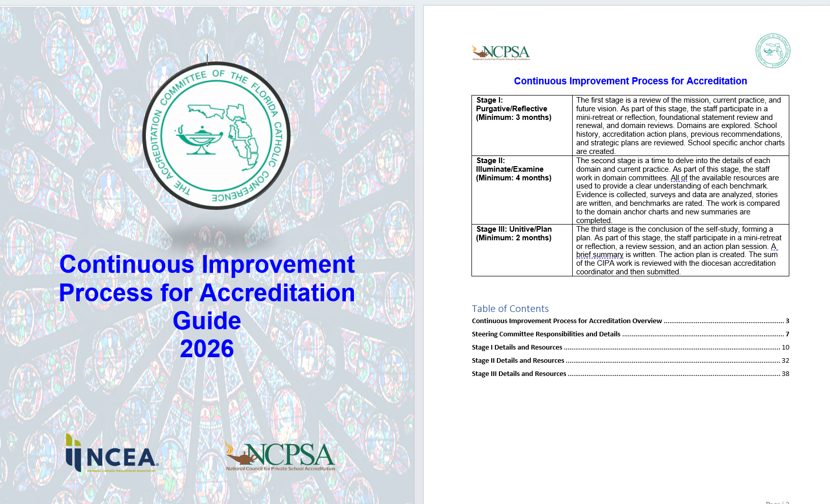
Resources
CIPA Guide 2026
Webinars for each Stage; Domain
Province-wide Cohort Meetings
https://eas-ed.org/guides-and-handbooks

Slide 30
Province-wide Cohort Meetings
FALL CIPA COHORT
Basilica School of St. Mary Star of the Sea
Epiphany Catholic School
Marian Center School & Services
St. Rose of Lima School
St. Malachy
Blessed Trinity School
Father Lopez Catholic HS
St. Joseph Catholic School, Palm Bay
Cathedral Parish School
St. Matthew School
Mother Teresa of Calcutta Catholic School
St. Patrick Catholic School
St. Elizabeth Ann Seton
SPRING CIPA COHORT
Annunciation School
St. Ambrose Catholic School
St. Anthony Catholic School
St. John the Apostle Catholic School
St. Mary's Cathedral School
Good Shepherd Catholic School
St. Margaret Mary Catholic School
St. Peter Catholic School
John Carroll Catholic HS
St. Anastasia Catholic School
Little Flower Catholic School
St. John Catholic Academy
Epiphany Catholic School
San Juan del Rio Catholic School
St. Paul Catholic School
Clearwater Central Catholic HS
St. Anthony Catholic School
St. Petersburg Catholic HS
Bishop Verot Catholic HS
Rhodora Donahue Academy at Ave Maria
St. Francis Xavier School
Spring CIPA Cohort first meeting: July 30 at 10 a.m., Eastern
Fall CIPA Cohort first meeting: July 29 at 10 a.m., Eastern

Slide 31
Next Steps
Review CIPA Guide
Select Steering Committee
Send Steering Committee Co-chairs information to Shelley Bosko: sbosko@flacathconf.org
Attend first Cohort meetings via Teams in July

Slide 32
Questions
Shelley Bosko
Associate for Accreditation
sbosko@flacathconf.org
407-404-0766
Mary Camp
Director of Accreditation
mcamp@flacathconf.org
850-224-7906

Slide 33
Closing Prayer (from the concluding retreat)
Eph 3:20-21: Now to him who is able to accomplish far more than all we ask or imagine, by the power at work within us, to him be glory in the church and in Christ Jesus to all generations, forever and ever. Amen.

