Slide 1
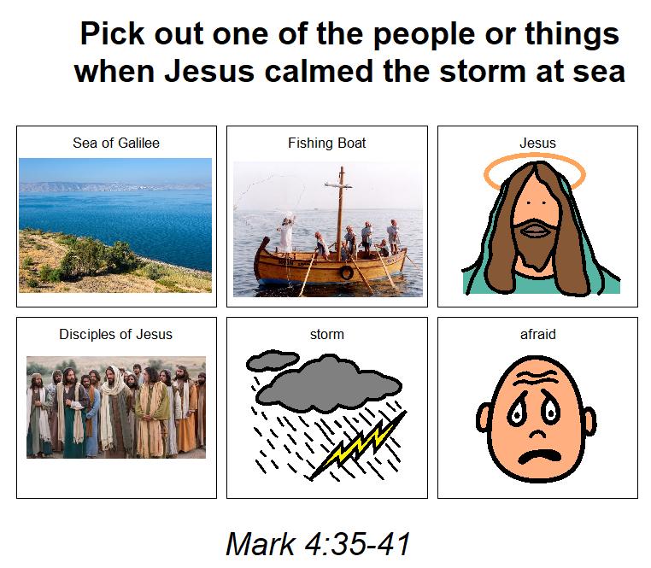

Slide 2
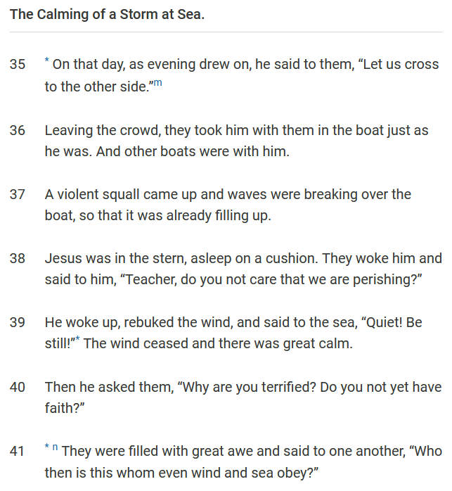
^{Psalm 107}
²³ Some of you made a living
by sailing the mighty sea,
²⁴ and you saw the miracles
the Lord performed there.
²⁵ At his command a storm arose,
and waves covered the sea.
²⁶ You were tossed to the sky
and to the ocean depths,
until things looked so bad
that you lost your courage.
²⁷ You staggered like drunkards
and gave up all hope.
²⁸ You were in serious trouble,
but you prayed to the Lord,
and he rescued you.
²⁹ He made the storm stop
and the sea be quiet.
³⁰ You were happy because of this,
and he brought you to the port
where you wanted to go.
³¹ You should praise the Lord
for his love
and for the wonderful things
he does for all of us.

