Slide 1

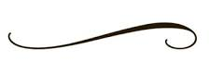
Welcome to 6th Grade ELA
Mrs. Satawa
satawa@stbenedictnj.org

Slide 2

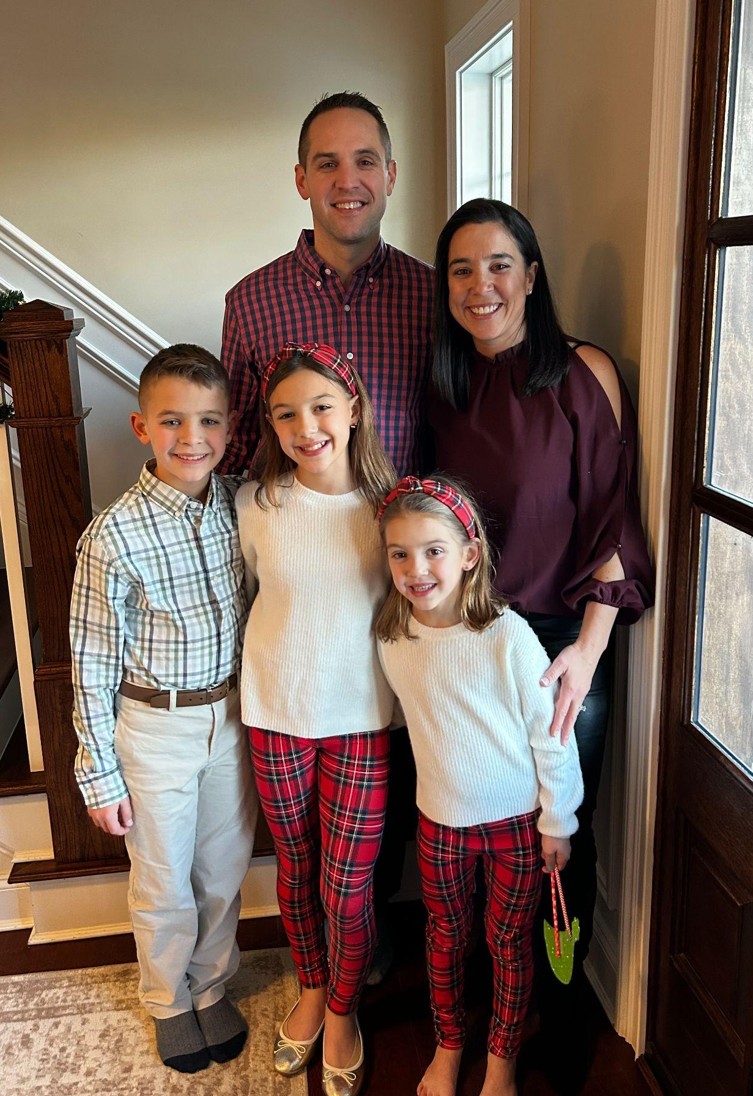
All About Me
- Graduated from Monmouth University with a degree in Elementary Education and a degree in English.
- I taught in the public schools for several years as a 5th grade teacher.
- I took some time off from teaching to raise my three children: Ava (12), Tyler (10), and Emma (6).

Slide 3





Books that we are going to explore this year:
Plus Book Clubs

Slide 4
Writing
Attention will be placed on usage, pronoun choice, thesis statements with supporting facts, sentence structure, subject/verb agreement, and self editing skills of various types of essays:
Personal Narrative
Research Paper
Argumentative
Persuasive
Compare & Contrast
Expository
Grammar is pulled from our online program IXL. We focus heavily on usage and MLA, but include Grammar and Mechanics as well. Skills taught change throughout the year based on what I see needs to be focused on in their writing.
Vocabulary book is Vocabulary Power Plus.
Journal Entries

Slide 5
Grading:
Middle School policy states we don’t accept late work.
If you are absent, you will have one day for each day you are absent to make up the work.
Homework is graded using check marks:
(✓+) = 100%
(✓) = 80%
(✓–) = 70%
Unit Assessments 30%
Writing 30%
Quizzes 25%
Homework/ Classwork 15%

Slide 6
Thank you for all your support!
Important Reminder
Grades are posted on Genesis
Assignments are posted on GCR and Teacher Webpage
Please feel free to reach out to me anytime with any questions or concerns!

