Slide 1

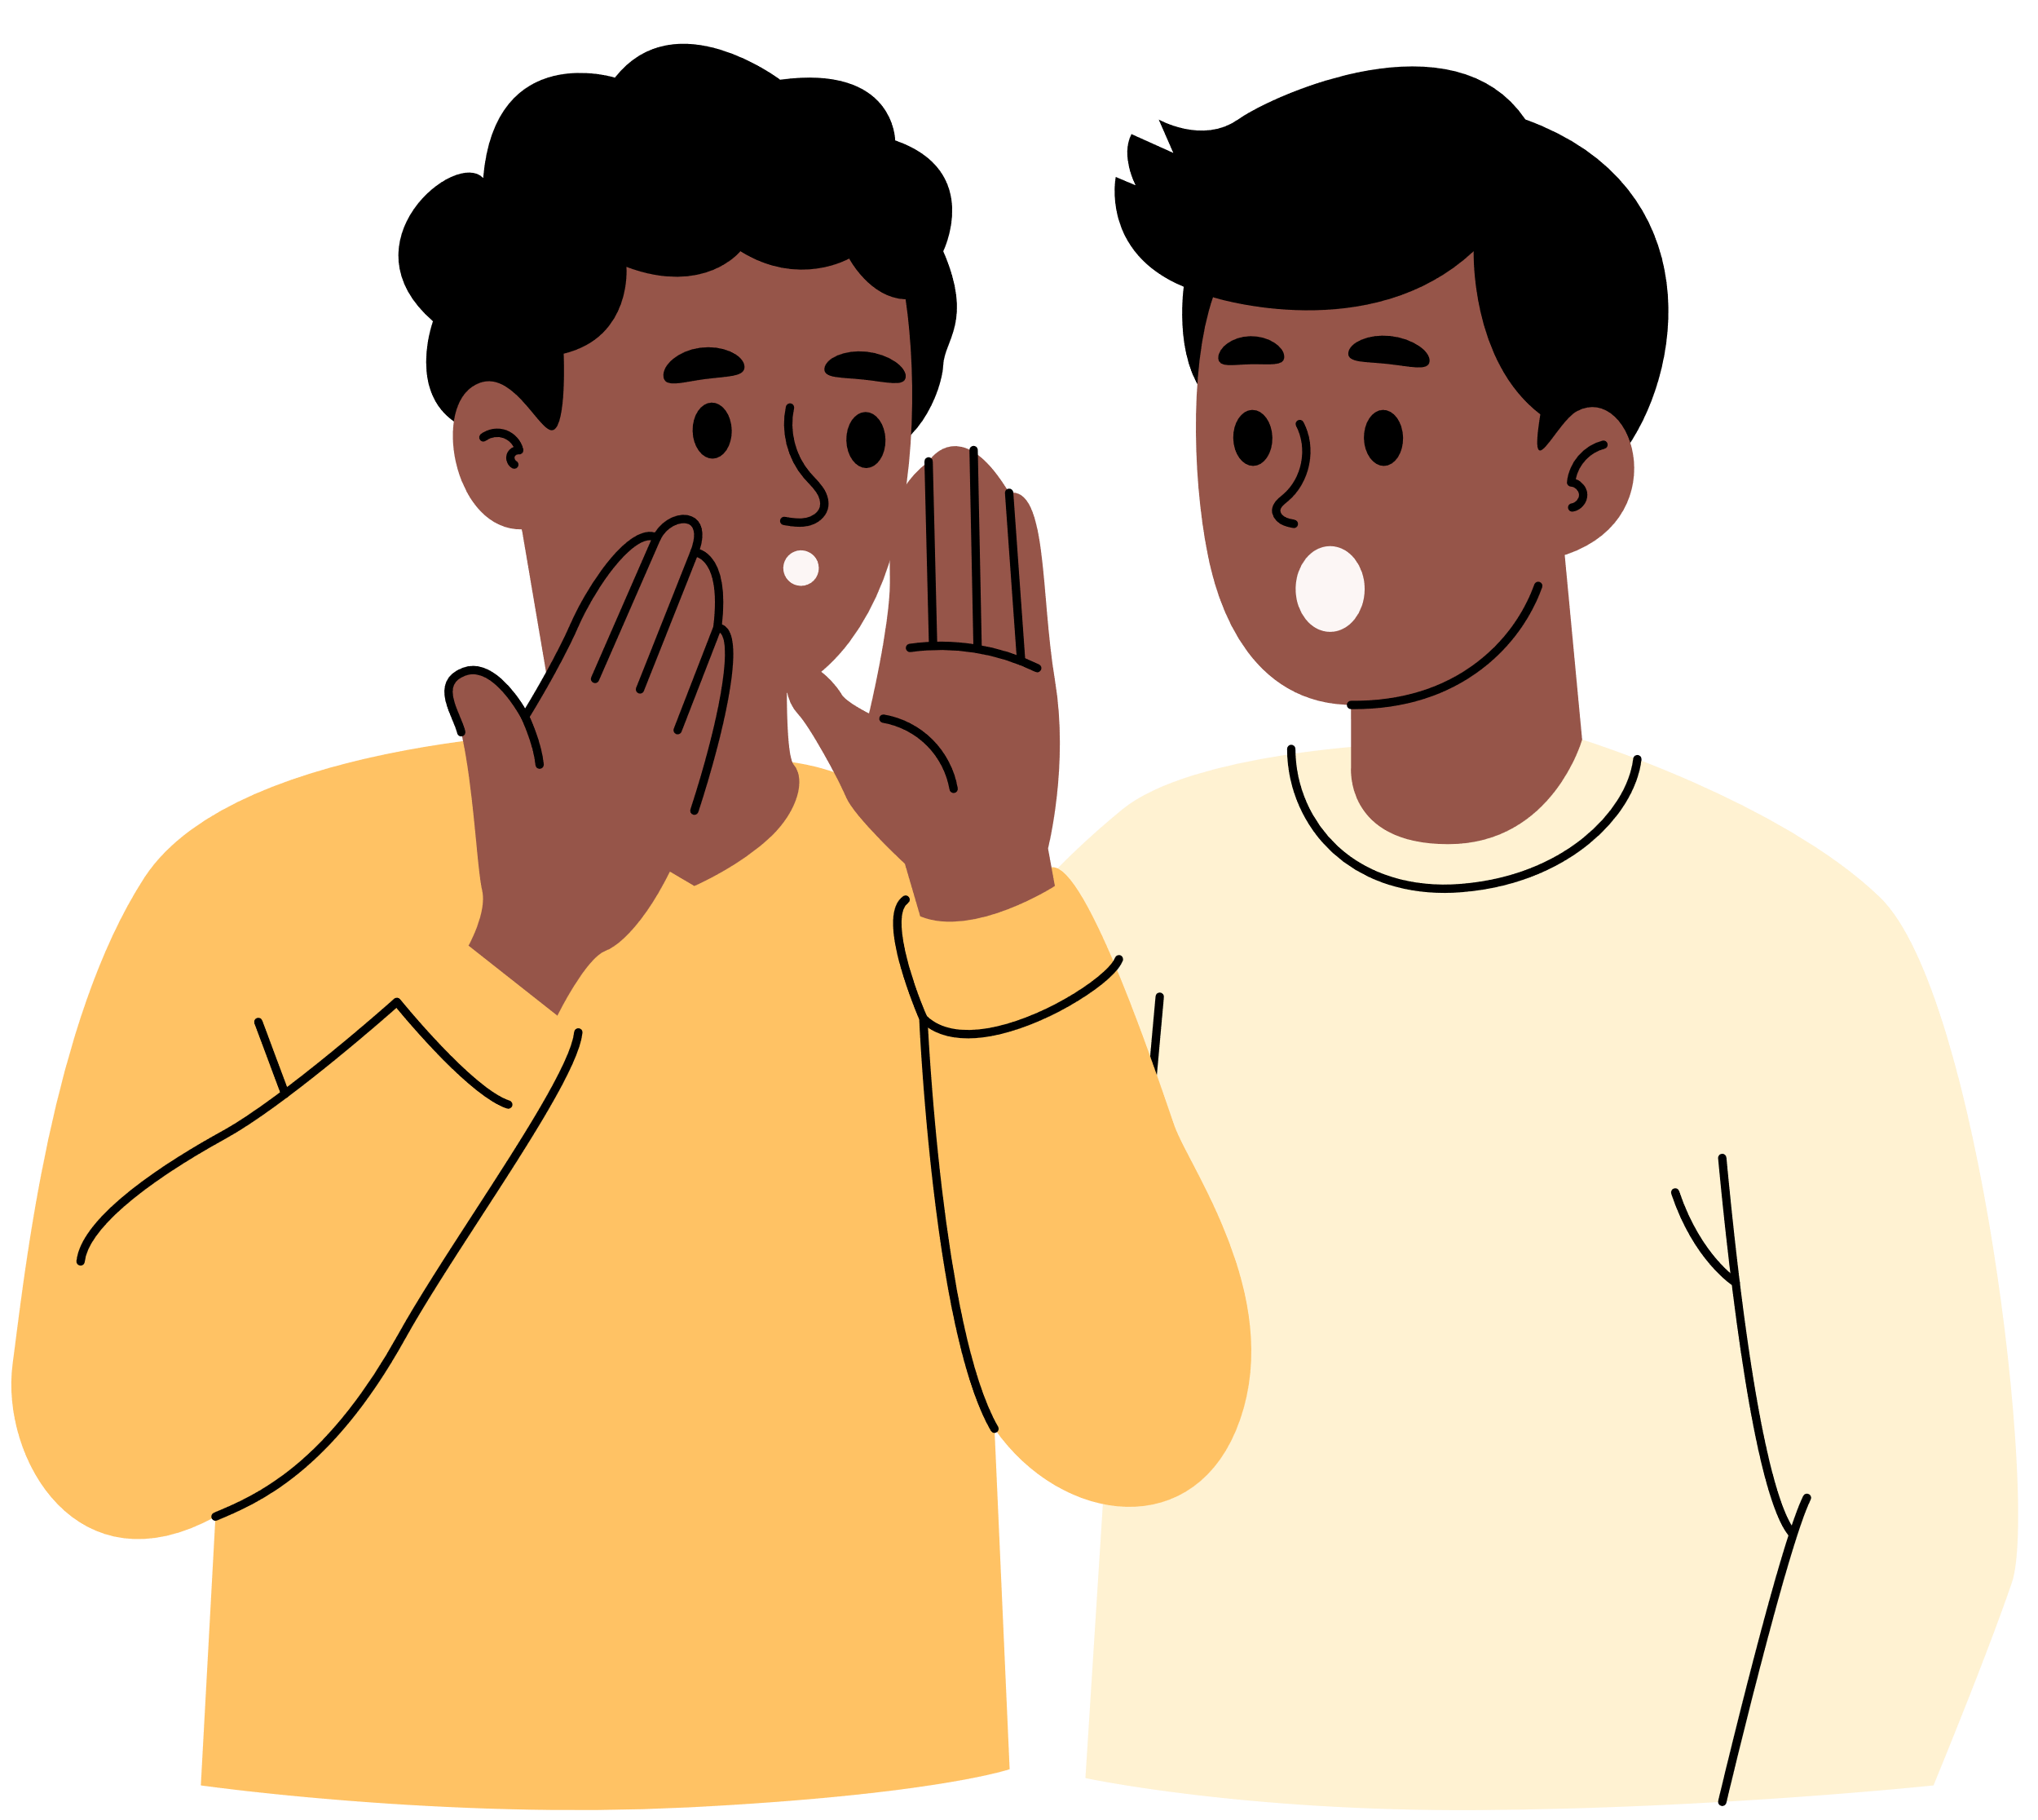
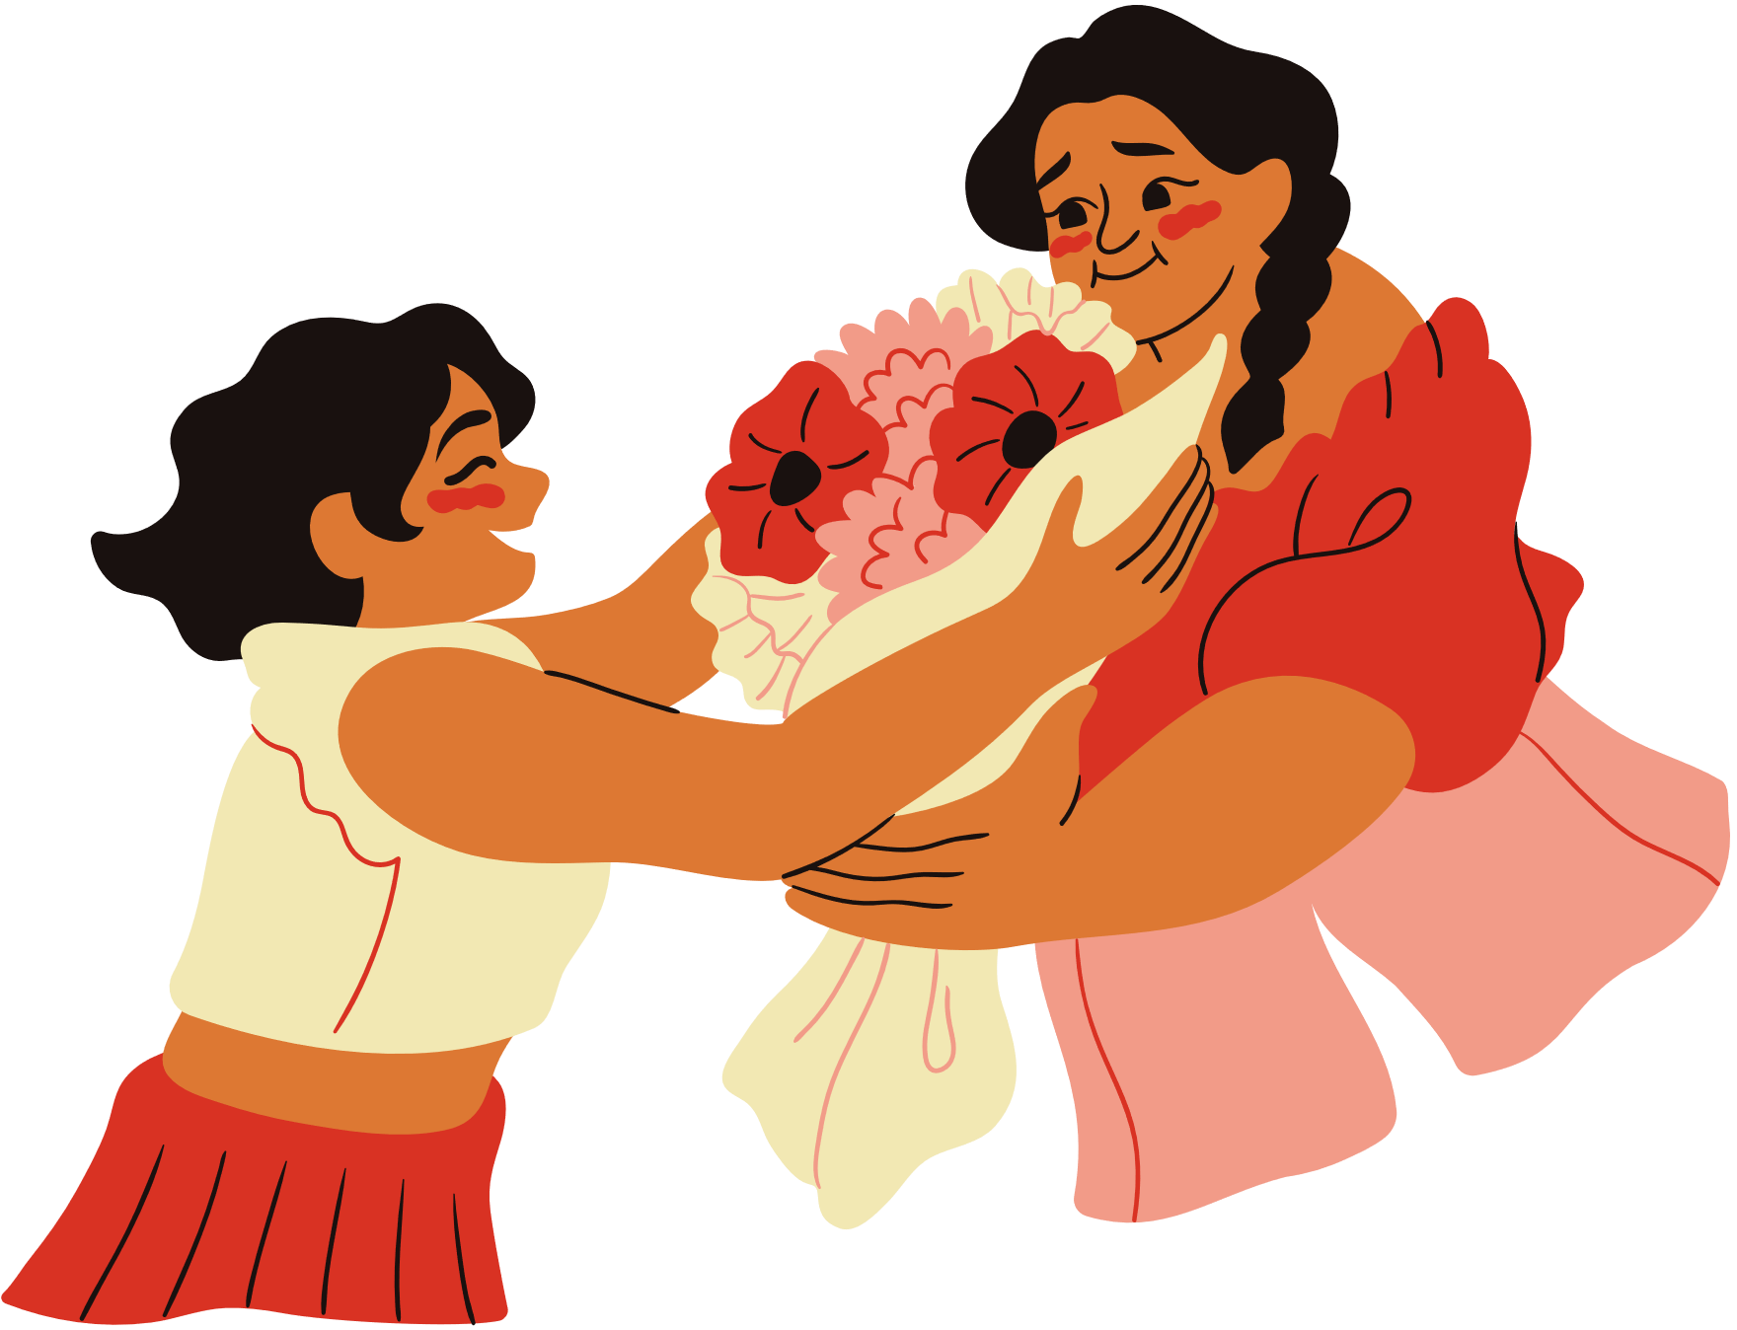
Secrets, Surprises, & Promises
Empowering God’s Children, Lesson 4

Slide 2
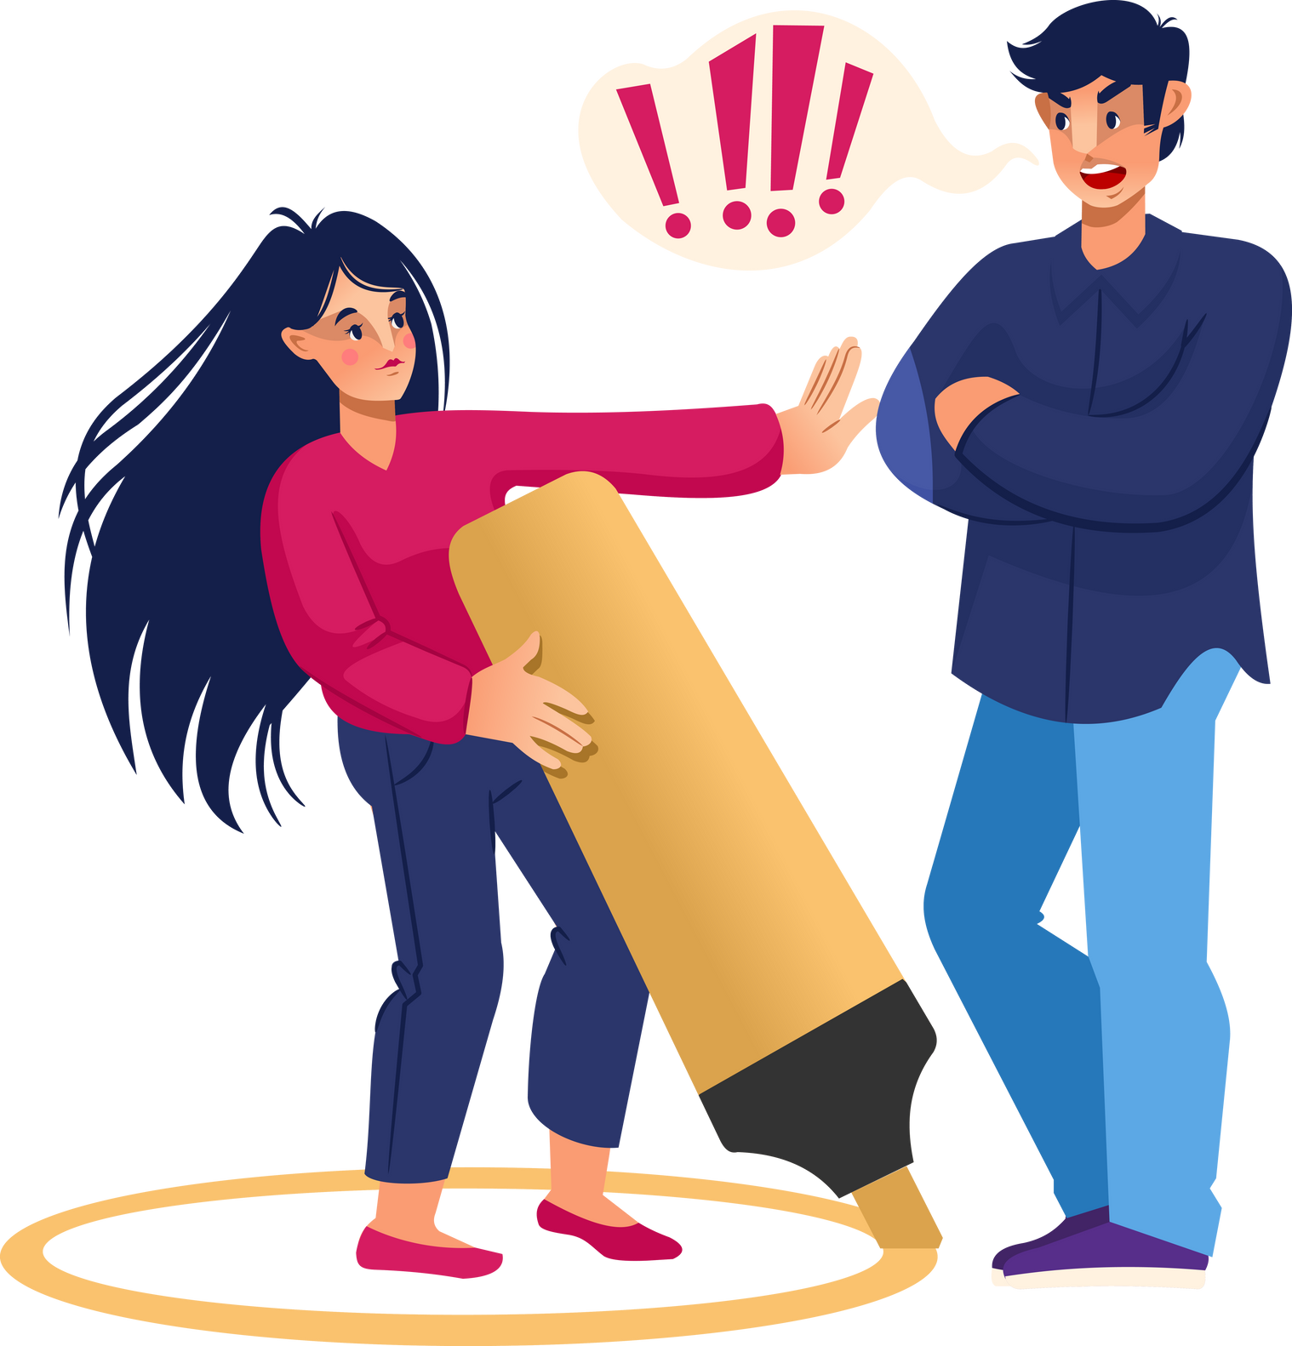
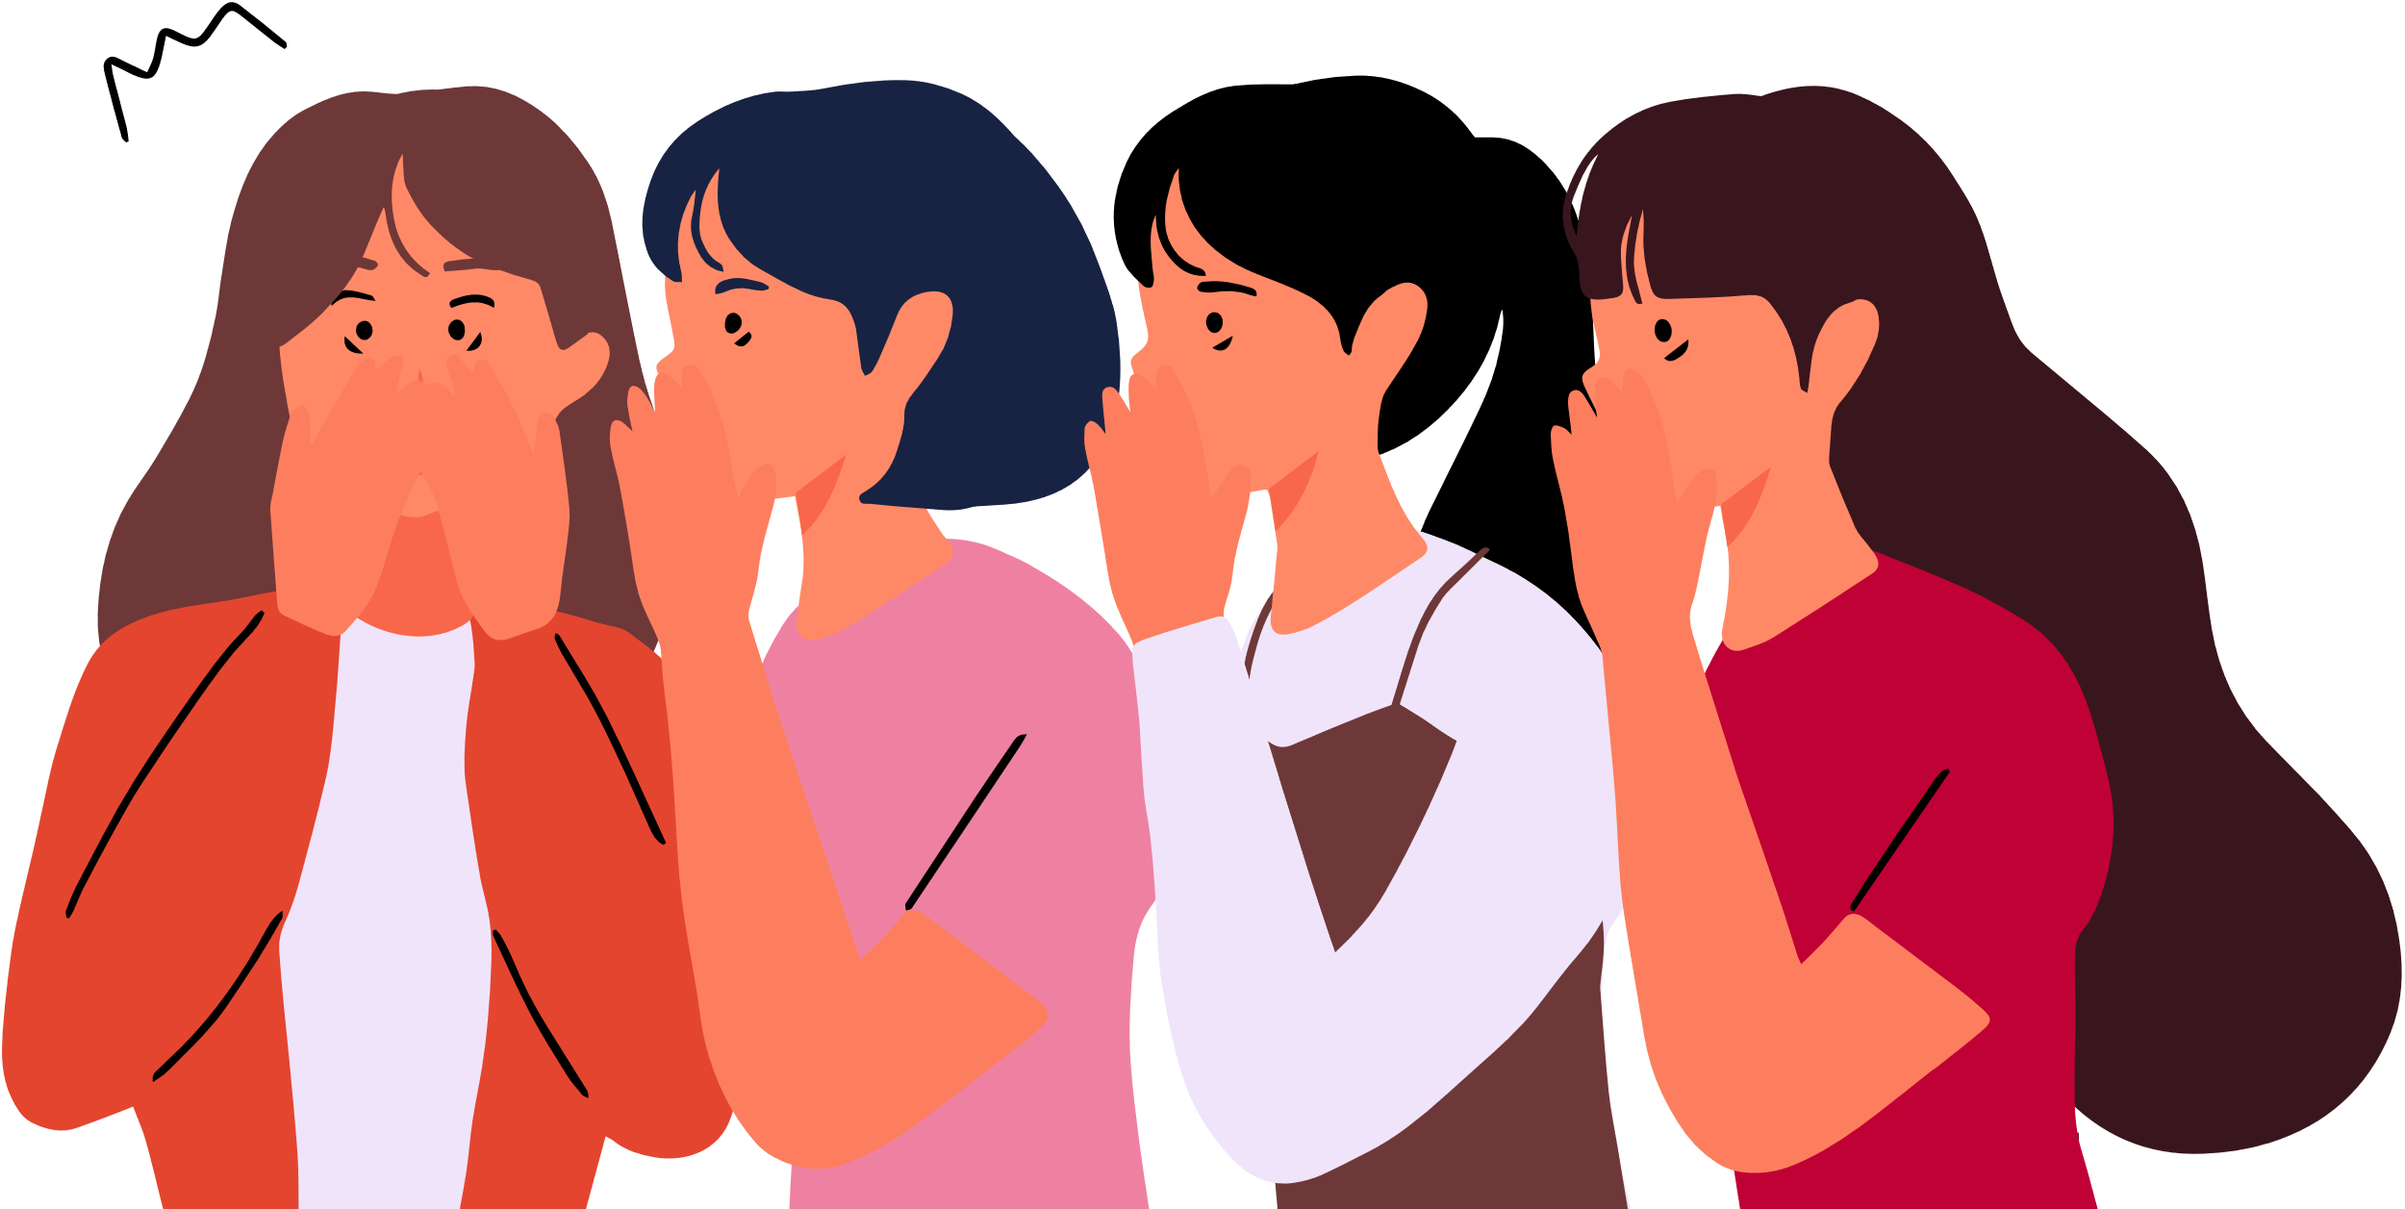
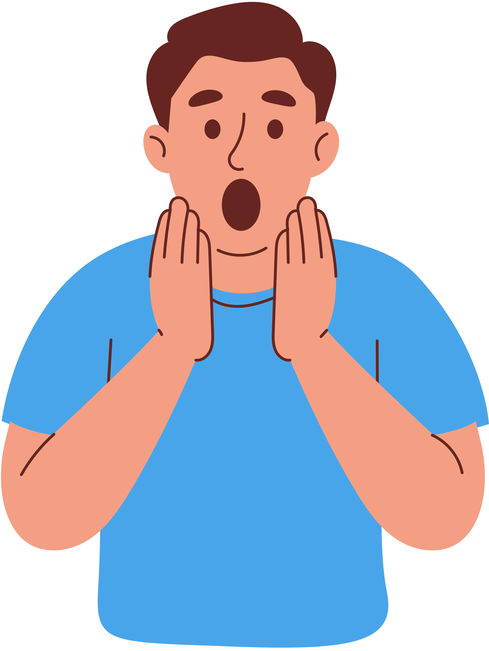
Private Body Parts, Rules, & Boundaries
Safety Rules
Secrets, Surprises, & Problems

Slide 3

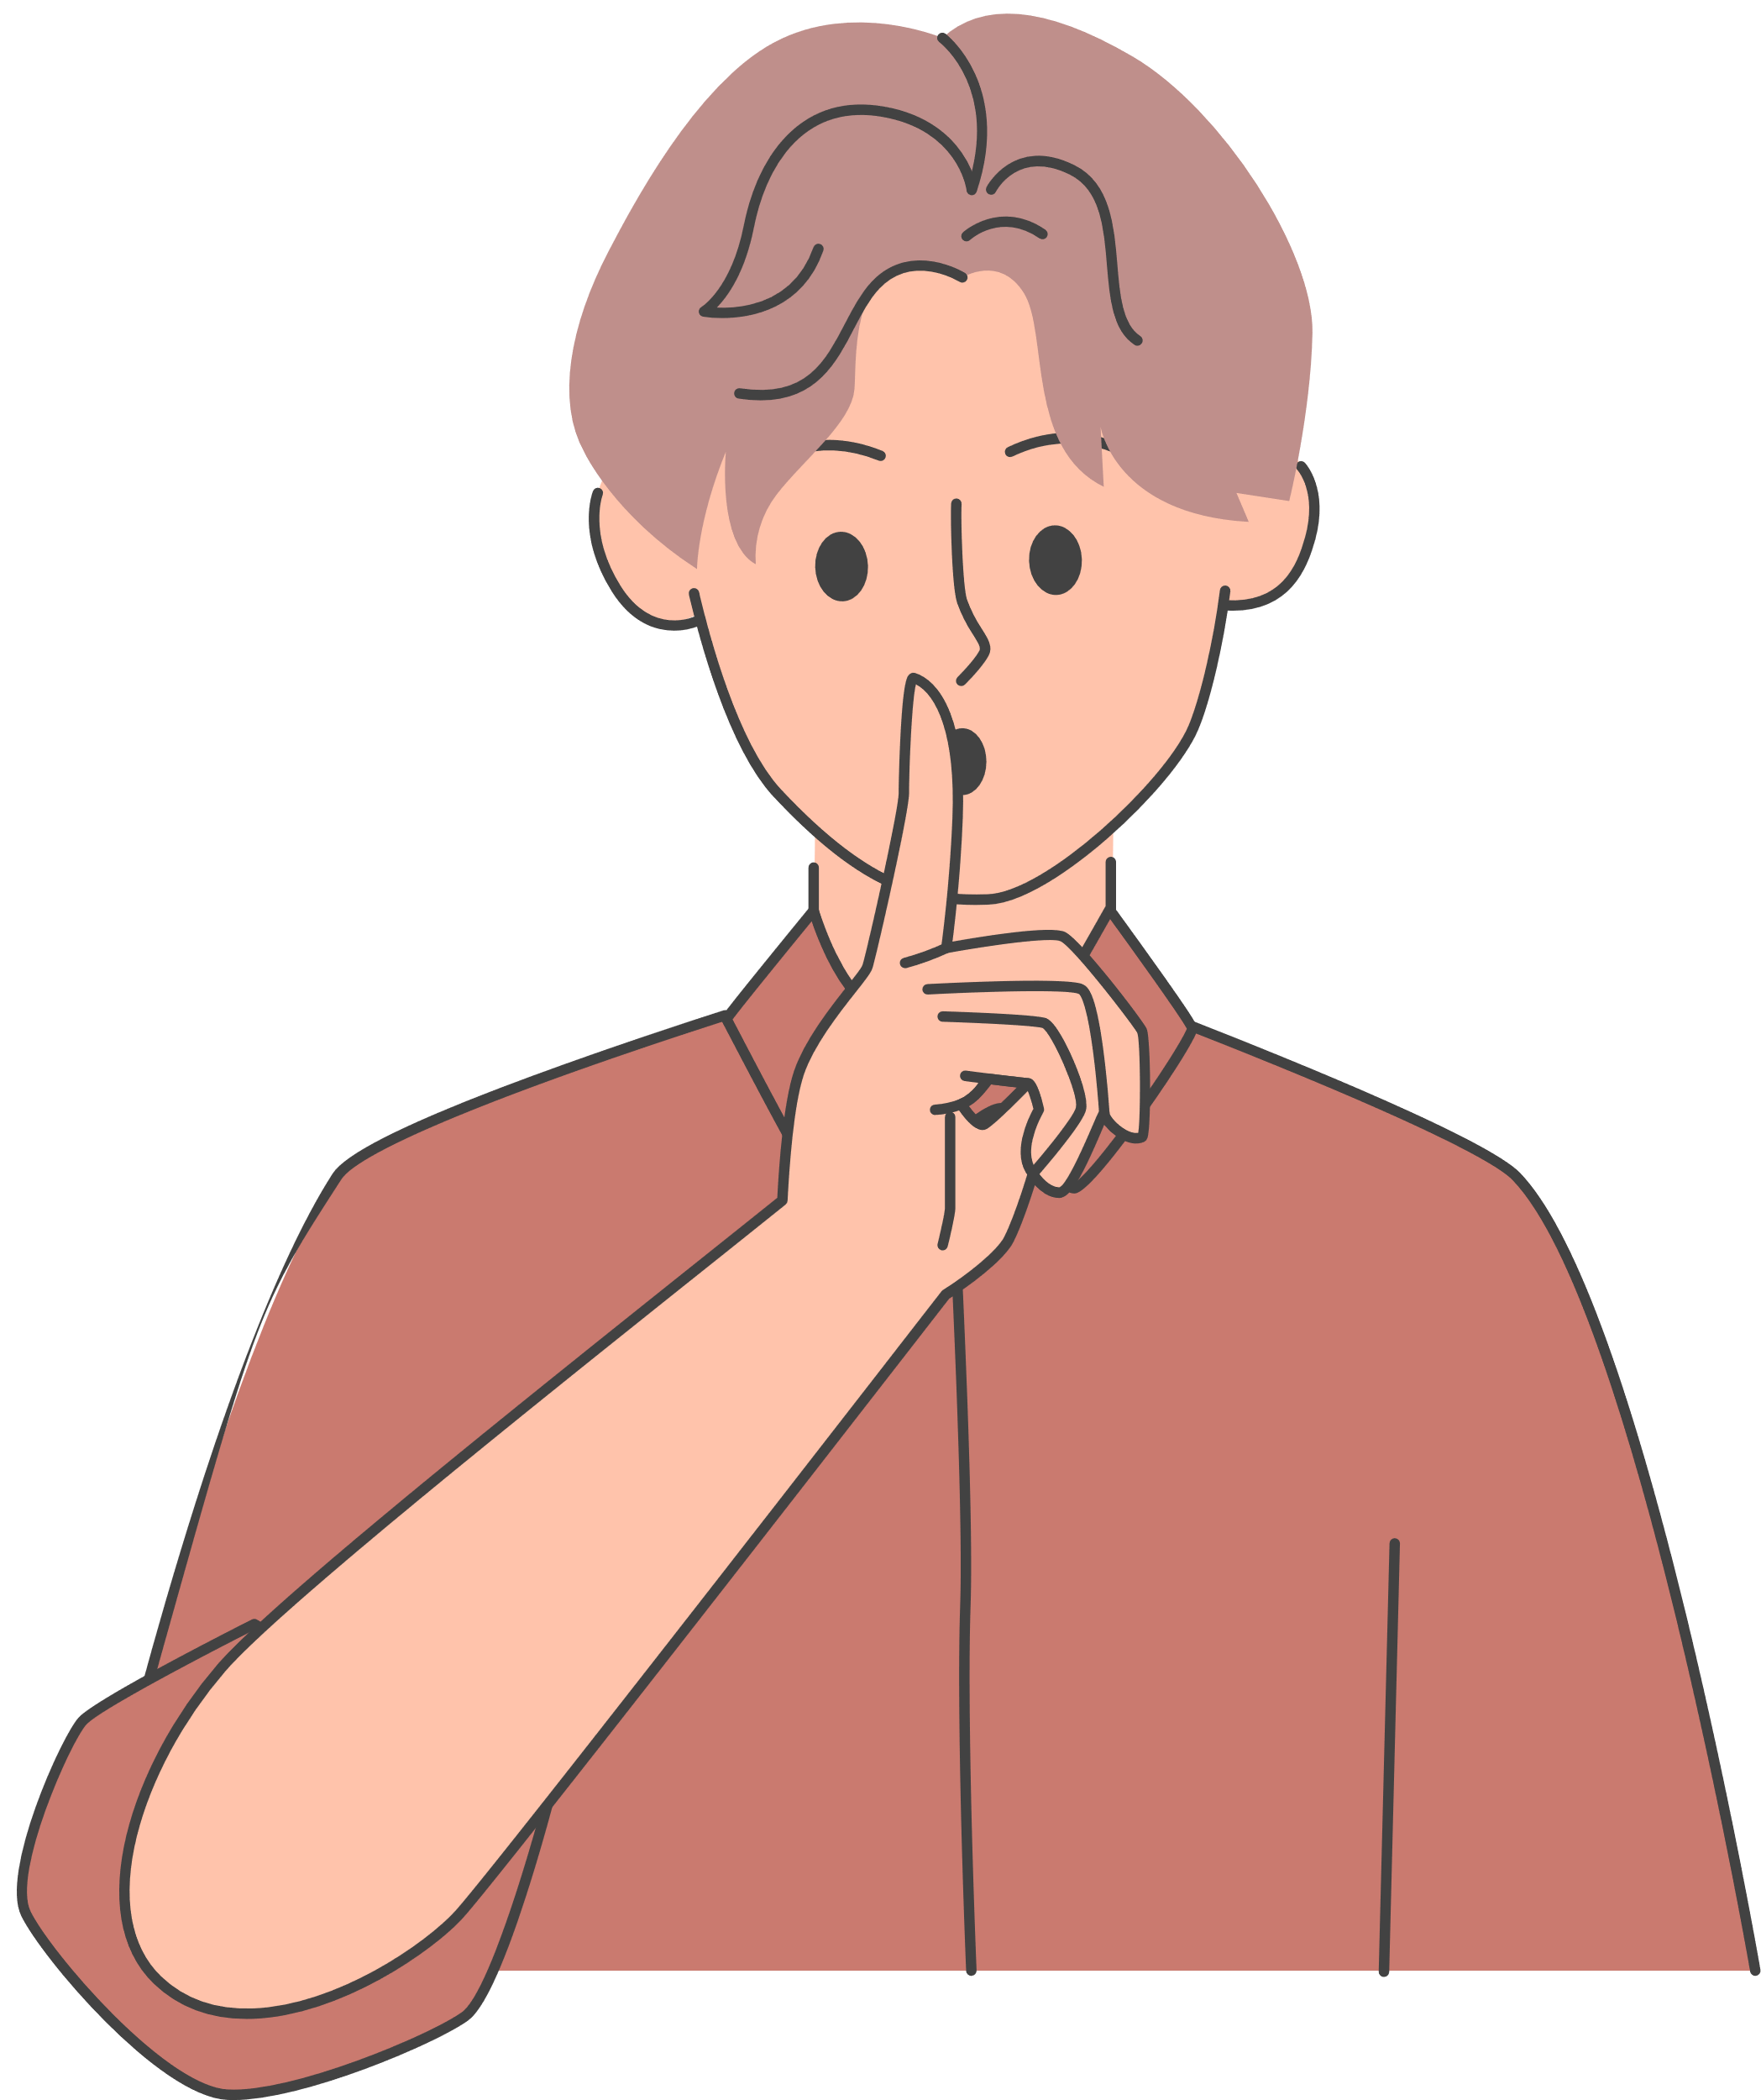
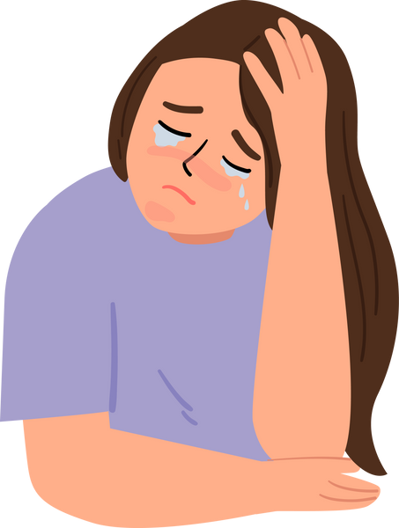
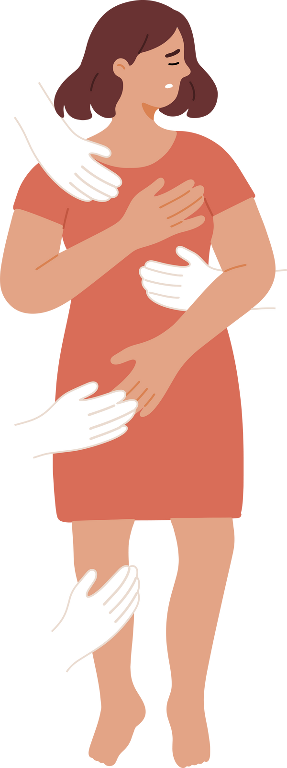
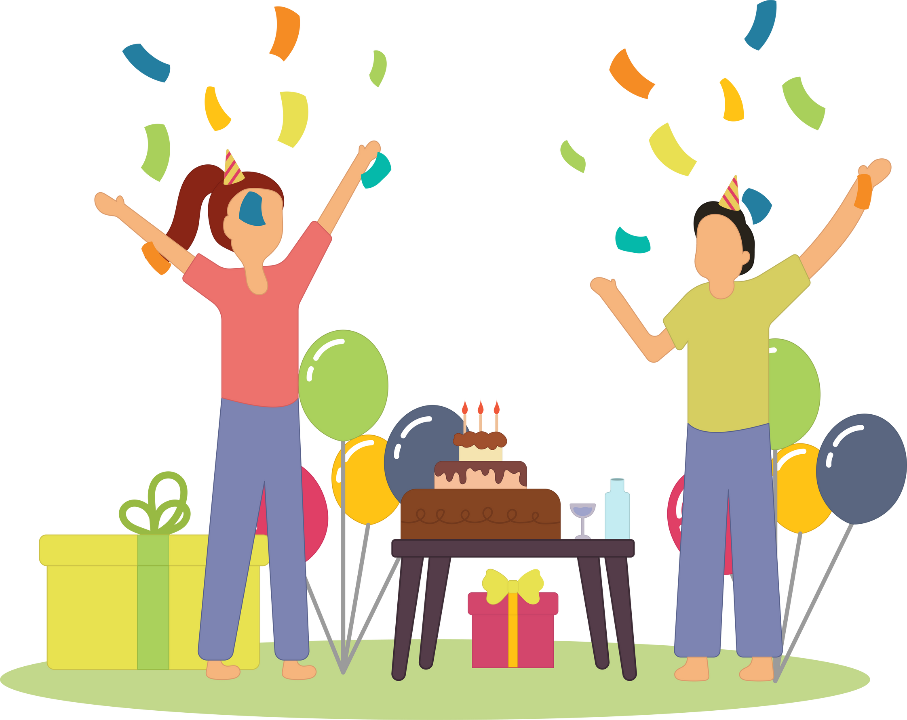
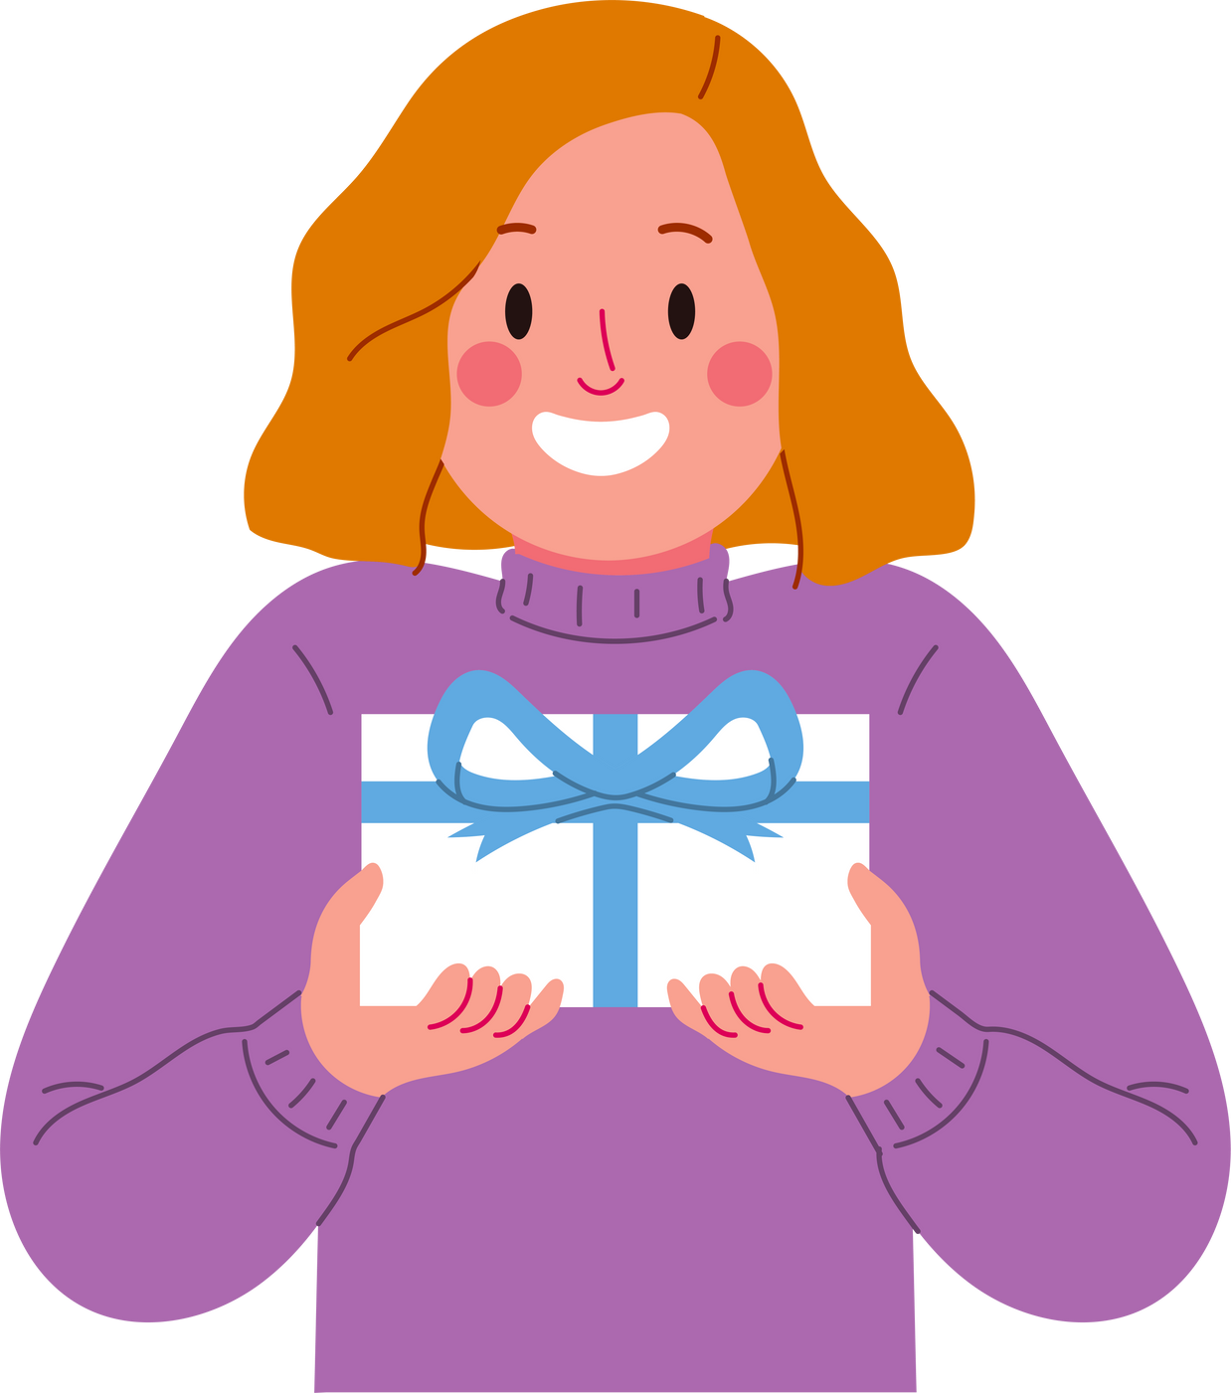
Secrets are never meant to be shared. They can exclude or put people at risk.
Secrets v. Surprises
Learning more about the differences between secrets & surprises
Surprises are meant to be shared. They are meant to show our appreciation towards other people.

Slide 4
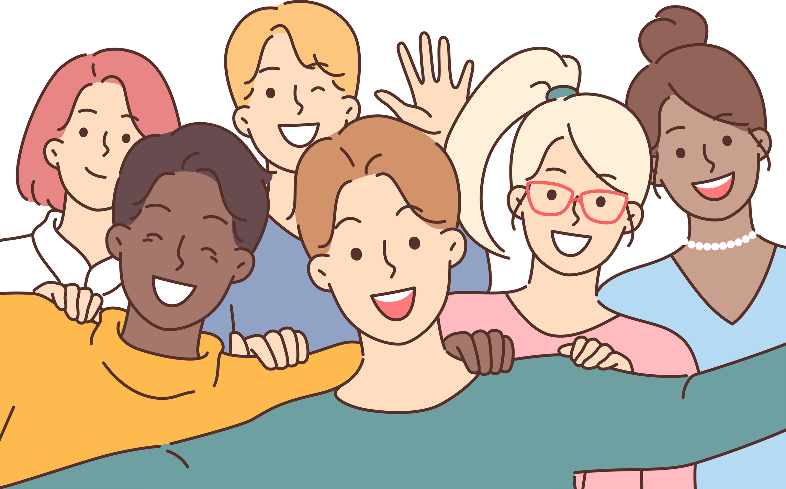
Closing Prayer
Dear God, thank you for making each of us unique and special in your image. Thank you for also giving us similarities, like our right to dignity and worthiness of respect. Help me to live in peace in times of confusion. Help me to remember to respect myself and others, as I would like others to respect me. Help me keep strong boundaries, and thank you for placing trusted adults in my life. Please give me the courage and confidence to speak up for myself and others if I see anything that does not seem right. Amen.

