Slide 1


Secrets, Surprises, & Promises
Empowering God’s Children Lesson 4

Slide 2

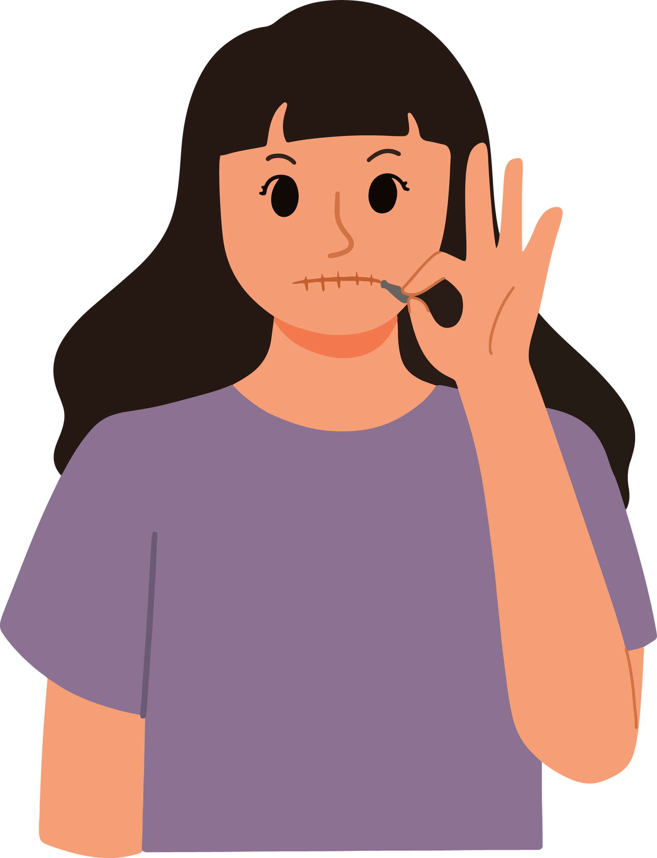

  SAYING “NO”
  SAFE FRIENDS & SAFE ADULTS
  UNSAFE FRIENDS & UNSAFE ADULTS
  PRIVATE BODY PARTS
  RULES
  BOUNDARIES
  THREAT
  PROMISE
  SECRET
  SURPRISE
  PROBLEM

Slide 3



SECRETS V. SURPRISES
BOUNDARY & SAFETY RULES BADGE
LET’S TALK MORE ABOUT THE DIFFERENCES BETWEEN SURPRISES AND SECRETS
COLORING ACTIVITY

Slide 4



CLOSING PRAYER
Dear God, thank you for making each of us unique and special in your image. Thank you for also giving us similarities, like our right to dignity and worthiness of respect. Help me to live in peace in times of confusion. Help me to remember to respect myself and others, as I would like others to respect me. Help me keep strong boundaries, and thank you for placing trusted adults in my life. Please give me the courage and confidence to speak up for myself and others if I see anything that does not seem right. Amen.

