Slide 1

2025 – 2026
CATHOLIC SERVICES APPEAL (CSA)

Slide 2
CSA PRAYER
Lord, Jesus, we thank you for calling us together as Church.
In you we are one.
Enlighten us, that we may know how we are called
to foster your Kingdom on Earth
through the generous sharing of our time,
talent and treasure.
Bless our efforts and help us grow
into a strong and vibrant community.
Give us the grace to support generously
the Catholic Services Appeal
so that we may, with your blessing,
strengthen the Catholic Church
in Central Texas.
Amen.
CSA PRAYER

Slide 3

GET YOUR PHONES OUT, SCAN THE QR CODE AND GET READY TO PLAY CSA KAHOOT!
KAHOOT

Slide 4
PARTICIPATION
MATTERS!
PARTCIPATION

Slide 5
2024-2025 HIGHLIGHTS – NO STOPPING THE CSA!
$6,600,000
GOAL
7%
PLEDGED
$6,900,000
CHALLENGE GOAL
10%
PAID
$8,300,000
PLEDGED
Average Gift
$442
125%
GOAL
13%
13%
FAMILIES
120%
CHALLENGE GOAL
-2%
YOY Increase
Participation Rate
2024 – 2025 HIGHLIGHTS

Slide 6
5-YEAR OVERVIEW – PARTICIPATION RATE
For the past five years, participation rate has been based on the number parishes report in the Directory. Starting in 2026 it will be based on the number of active families in Ministry Platform (MP). Clean up your data for the most accurate reporting!
5-YEAR OVERVIEW
4-YEAR OVERVIEW

Slide 7
TOP “20” PARISHES –PARTICIPATION RATE INCREASE YOY
Our Lady of Guadalupe Parish, Temple 166.67%
Santa Barbara Parish, Austin 148.90%
St. John the Evangelist Parish, San Marcos 130.77%
St. Mary of the Visitation Parish, Lockhart 108.54%
St. Margaret Parish, Giddings 106.98%
Holy Family Mission, Lexington 91.67%
St. John the Baptist Parish, Waco 80.95%
St. Philip Mission, China Spring 72.00%
St. Peter Mission, Goldthwaite 66.67%
Immaculate Heart of Mary Parish, Martindale 65.85%
St. Francis of Assisi Parish, Franklin 65.00%
St. Mary Catholic Center, College Station 63.86%
St. Mary of the Assumption Mission, String Prairie 61.90%
St. Mary Parish, Hearne 57.63%
St. John the Evangelist Parish, Luling 57.14%
St. Anthony Marie de Claret Parish, Kyle 55.03%
St. Mary of the Immaculate Conception Parish, Lampasas 54.05%
S. Joseph Parish, Manor 52.61%
St. Paul Parish, Smithville 47.19%
St. Albert the Great Parish, Austin 46.82%
2024 – 2025 PARTCIPATION RATE

Slide 8
PARTICIPATION RATE – BY PARISH SIZE
  0 – 299 FAMILIES
  Our Lady of San Juan Mission, Moody – 72.00%
  St. Mary Mission, Ellinger – 70.71%
  St. Peter Catholic Student Center, Waco – 58.67%
St. Mary of the Assumption Mission, String Prairie –54.40%
  St. Mary Mission, Pin Oak – 45.00%
500 – 1,499 FAMILIES
Holy Vietnamese Martyrs Parish, Austin – 66.84%
Sacred Heart Parish, Austin – 57.18%
Cristo Rey Parish, Austin – 50.85%
St. Paul Chong Hasang Parish, Harker Hghts. – 37.50%
Sacred Heart Parish, La Grange – 34.11%
300 – 499 FAMILIES
Santa Barbara Parish, Austin – 100.00%
St. John the Baptist Parish, Fayetteville – 67.64%
St. Julia Parish, Austin – 53.24%
St. Mary, Our Lady of the Lake Parish, Lago Vista – 36.03%
Sacred Heart Parish, Rockne – 35.00%
1,500 + FAMILIES
St. Vincent De Paul Parish, Austin – 31.55%
St. William Parish, Round Rock – 26.05%
Santa Teresa Parish, Bryan – 25.20%
St. Joseph Parish, Bryan – 23.11%
St. Anthone Marie de Claret Parish, Kyle – 22.78%
TOP PARISHES-PARTICIPATION RATE

Slide 9
CSA OVERAGE – HOW THE FUNDS WERE DISTRIBUTED
The CSA outperformed by $1.7M!
  Holy Trinity Catholic High School, Temple – subsidy
  Catholic Charities of Central Texas – financial support
  Our Lady of Wisdom Parish & St. Elizabeth Parish – parish support
OVERAGE DISTRIBUTION

Slide 10
PARTICIPATION
MATTERS!
PARTCIPATION

Slide 11
PARISH GRANT PROGRAM
Increase YOY
Participation Rate
Achieve 7 tickets – Earn $5,000!
Achieve CSA Goal
Achieve CSA
Challenge Goal
Deanery Achieves Goal
YOY Increase in
the Number of Gifts
A Priest Attends a CSA Training or the Priest Dinner (October 8)
Show the CSA Video
PARISH GRANT PROGRAM

Slide 12

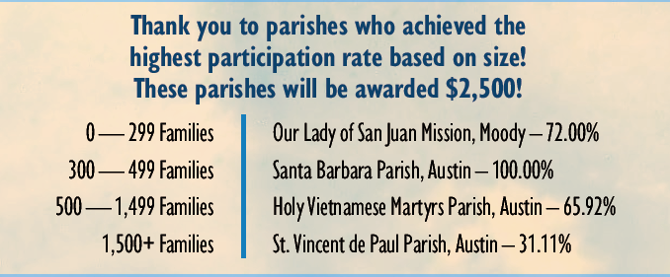
GRANT AWARDS RECEPTION
Oct. 18 at St. William Parish – 11 am to 1pm
$250,000 in grants will be awarded to parishes, schools and deanery
2024-2025 GRANT AWARDS3

Slide 13
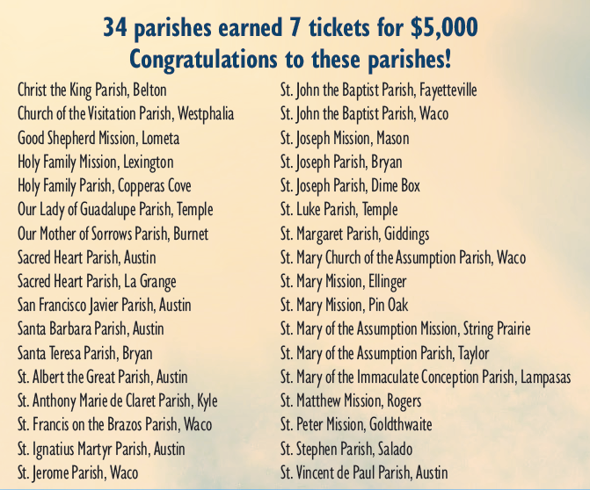
2024–2025 –GRANT AWARD RECIPENTS
2024-2025 GRANT AWARDS

Slide 14

CSA VIDEO
CSA VIDEO

Slide 15
PARTICIPATION
MATTERS!
PARTCIPATION

Slide 16
2025-2026 GOALS
GOAL
$7,000,000
(6% increase from last year)
CHALLENGE GOAL
$7,200,000
(4% increase from last year)
Parish Goals
  Based on 3-year historical data provided to you in your folder
  Tip to reach goal – Increase your participation rate
  You can earn a ticket if you achieve your goal and challenge goal
2025-2026 GOALS

Slide 17
FUND ALLOCATION
Why Give to the CSA!
Form our future priests – 52 seminarians in formation.
Teach our children - catechize children, youth, and adults in the truths of the Catholic faith, forming the next generation of disciples in wisdom and holiness.
Extend Christ’s mercy - the CSA reaches the most vulnerable among us and it is our responsibility to support the mission of the Church and help those in need.
FUND ALLOCATION

Slide 18
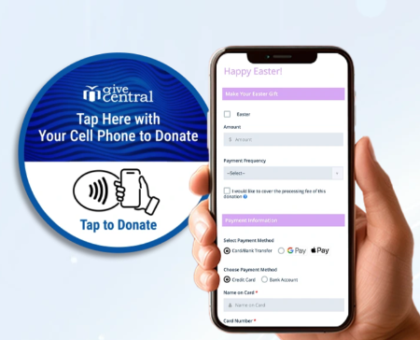
WHAT’S NEW – Material Reveal!
  CSA Banner – Bishop Danny launches the CSA
  Parish Goal Poster
  Parish Grant Poster
  Social Media – Coordinator Toolbox
  Priest Luncheon – NOW! Priest Dinner – Convocation/Oct. 8
  Digital Wallet Online Offerings - Apple Pay/Google Pay/Paze
  GiveCentral SmartStickers - allow donors to simply tap their smartphones and make a secure donation in seconds.
    Pilot testing – St. Vincent de Paul Parish & St. Margaret Mary Parish
WHAT’S NEW

Slide 19
CSA APPEAL TIMELINE
Sept. 23 | Father James letter, brochure and pledge card hits homes (GSS donors)
Oct. 1 - 4 | Father James letter, brochure and pledge card hits homes (non-GSS donors)
Oct. 8 | NEW! Priest Dinner (Convocation) – Italian Style
Oct. 11 – 12 | Awareness & Education Weekend – read Bishop letter at all Masses
Oct. 18 – 19 | Announcement Weekend – banners outside for 3 weeks
Oct. 25 – 26 | Commitment Weekend
Oct. 27 (Monday) | Batch CSA envelopes, fill out transmittal form and send to Letter Concepts in return mailer
Nov. 1 – 2 | Follow-up Weekend
Nov. 3 (Monday) | Mail second batch to Letter Concepts in return mailer
Nov. mid | Follow-up letter, from pastor to all families who have not made a gift
Jan. – April | Electronic marketing, seminarian & retired priest letters and targeting mailings to bridge gap if needed
CSA APPEAL TIMELINE

Slide 20
TIPS FOR SUCCESS
Utilize parish resource materials in Coordinator & Pastor Toolboxes online at www.austindiocese.org/
csa-parish-resources
Priest or Deacon gives personal homily or pulpit talk or
Priest uses pre-written homily in Pastor Toolbox online at
https://www.austindiocese.org/csa-parish-resources
Strong lay leadership is key to success – recruit help
Hand out pledge cards as parishioners enter the parish
Priest walks parish step-by-step in filling out pledge card
Show the video
Place QR code placards in pews
Place CSA banner out in front of Church – 3 weeks
Encourage online safe/securing giving
Strive for 100% participation
Utilize social media – share diocesan posts to parish platforms and utilize graphics
TIPS FOR SUCCESS

Slide 21
PLEDGE CARD DISTRIBUTION/
COLLECTION SUGGESTIONS
Distribution
  Hand out pledge cards as parishioners enter parish or
  Place pledge cards/pens in the pews prior to Mass
  Have hospitality ministers pass out pledge cards during the Mass
Collection
  Place baskets at the altar and have parishioners come up and place their card in the basket
  Have hospitality ministers collect the pledge cards pew-by-pew
  Have hospitality ministers stand at the back of the church with baskets as Mass ends
Keep your Sunday collection separate from the CSA
Do not leave pledge cards at the back of the church and tell parishioners to pick one up on the way out. The pledge cards are to be filled out during Mass
Encourage paperless, safe and secure online giving
PLEDGE CARD DISTRIBUTION/COLLECTION SUGGESTIONS

Slide 22
PARTICIPATION
MATTERS!
PARTCIPATION

Slide 23
RETURN PROCEDURES
7-Step Easy Process – Completing the Transmittal Form
Count all sealed pledge envelopes and place them in the Return Mailer envelope.
DO NOT OPEN THEM!
Count the number of loose checks and place them in the Return Mailer envelope.
Collect all loose cash and change and put it into one pledge envelope. Write “Anonymous” on the envelope and place it in the Return Mailer. This counts as one (1) pledge envelope.
Total the number of pledge envelopes, the number of loose checks, and the anonymous cash envelope, and write this number on the line “Total # of Envelopes.”
Mail first two batches to the processing center. Send remaining batches to the Stewardship & Development Office at the Diocese of Austin. OBTAIN A TRACKING #.
Include and mail the completed Transmittal Form in the Return Mailer envelope.
Keep one copy of this form for your records and email/mail one copy to the Diocese.
RETURN PROCEDURES

Slide 24
COMPLETED EXAMPLE
RETURN PROCEDURES- COMPLETED EXAMPLE

Slide 25
CATHOLIC SERVICES APPEAL WEBSITE
www.austindiocese.org/csa
CATHOLIC SERVICES APPEAL WEBSITE

Slide 26
PARTICIPATION
MATTERS!
PARTCIPATION

