Slide 1


Site Administrator Meeting
2026 Open Enrollment

Slide 2

Agenda
What’s changing for 2026?
Planning for Open Enrollment
Health Plan Options and FAQ’s
Tax Free Savings Accounts – H.S.A and F.S.A and Dependent Care
Reminders for Site Administrators
Additional Support
Today’s presentation will be shared via email following the meeting.

Slide 3
What’s Changing for 2026?

Slide 4
What’s changing for 2026?
Overall Goal:
  Minimize costs while continuing to offer comprehensive coverage that meets the needs of our dedicated staff
Overview of Changes:
New Plan Premiums: The Archdiocese has increased premium by plan and tier by 4%. This is well below the national trend increase of 10%.
Suggested Employee Premiums: The Archdiocese is recommending to hold employee premiums flat for 2026.
Health Plans with UMR: No change.
Health Savings Account and Flexible Spending Account with Voya: IRS updated maximums which will be reflected in guide and benefitsCONNECT. Employees choosing these are REQUIRED to re-enroll each year.
Ancillary Plans with UMR: No change.

Slide 5
Planning for Open Enrollment

Slide 6
Open Enrollment
Open Enrollment opens to employees Monday, November 10 – Friday, November 21
Educational Support offered to Employees:
  Benefit guide with plan comparison details
  Videos to watch and share with family members
  Webinars
How Should Staff Enroll:
All staff are encouraged to review their current elections in benefitsCONNECT online or by calling the Benefit Advocate Center.
Employees waiving health coverage should log into benefitsCONNECT and waive each year, as required by the IRS.
Those enrolled in a health savings account or flexible spending account are required to re-enroll each year.
We are asking Staff to assure all employees primary email addresses are available (personal emails, if arch-no isn’t available)
State Continuation Members:
For those sites who have continuation members, we will customize a guide with the new premiums and mail to their homes.

Slide 7

How To Enroll?
benefitsCONNECT Website: https://enroll.benefitsconnect.net/archofno
Username: the first 6 letters of your last name (or your entire last name if six letters or less), the first letter of your first name, followed by the last 4 of your SSN (social security number).
Example: John Johnson, xxx-xx-1234
Username would be johnsoj1234
Password: the first time you log in, the password will be your SSN (no spaces or dashes). You will be given the opportunity to change your password after you log in the first time.
Benefit Advocate Center:
Call 1-833-857-0755
You can call between 7 AM – 6 PM CST
You may also email them at bac.anobenefits@ajg.com
Calls recorded for quality assurance

Slide 8
Health Plan Options for 2026

Slide 9
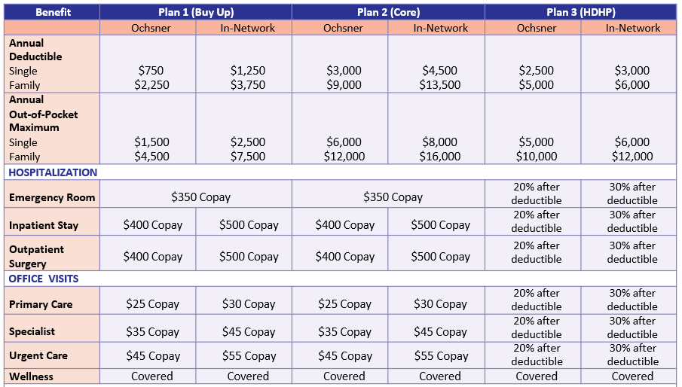
Health Plans – Plan Design
Reminders:
All Plans have PPO national network
Traditional deductible plans
Core and Buy Up offer Copays for Dr Visits
Wellness visits covered in full for all plans
High Deductible health plan requires members to pay for services first dollar- until deductible is met. Allows for lower premium. Can be used in conjunction with Health Savings Account

Slide 10
Health Plans – FAQ’s
What type of services will track toward the deductible of the Core and Buy Up plans?
Copays apply for office visits, surgeries, hospital stays and prescriptions.
Deductible applies for ambulance, durable medical equipment, outpatient lab/x-ray, outpatient hospital services such as CT, MRI, PET, etc.
Do copays track toward deductible?
No, while copays do NOT track toward deductible, they DO track toward out-of-pocket maximum.
Do all plans cover preventive at 100%
Yes, all plans, including the high-deductible plan cover preventive visits at 100%. This includes immunizations, well visits, preventive tests such as pap smears, mammograms, prostate screenings, colonoscopies.
I was charged for my mammogram / colonoscopy, why?
If you are charged for a mammogram, it’s likely not preventive meaning they found a concern in the past and every mammogram following is considered diagnostic. For colonoscopies, if they are preventive, you may still have some charges for anesthesia.
Will employees receive new UMR ID cards?
No, employees will not receive new ID cards, unless they make a change.

Slide 11
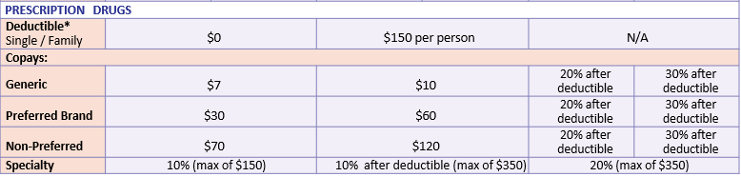
Pharmacy – Plan Design

Slide 12
Education – Which Plan is Right for Me?
Buy-Up | Core | HDHP
This plan may be good for you and your family if you want the consistency of copays and a low deductible. This plan is also a good option if you anticipate having surgery or expensive prescriptions. Predictable Costs: Fixed copays for doctor visits, prescriptions, and emergency room visits simplify budgeting. Premiums: Higher premiums than both plans, in exchange for copays and the lowest deductible. Flexible Spending Account (FSA): You can open an FSA to save pre-tax money for medical expenses, reducing taxable income and having funds ready for healthcare costs. | This plan may be good for you and your family if you want the consistency of copays, but don’t think you’ll need to worry about hitting your deductible. Predictable Costs: Fixed copays for doctor visits, prescriptions, and emergency room visits simplify budgeting. Premiums: Higher premiums than HDHP but lower than Buy-Up, offering copays and a lower deductible than the HDHP. Pharmacy Deductible: Includes a $150 deductible per person for prescriptions, leading to lower premiums compared to the Buy-Up Plan. Flexible Spending Account (FSA): You can open an FSA to save pre-tax money for medical expenses, reducing taxable income and having funds ready for healthcare costs. | This plan may be good for you and your family if you want coverage, but don’t go to the doctor often or have numerous or expensive prescriptions. Deductible: In an aggregate HDHP, all family members' medical expenses contribute to a single family deductible. Once this combined deductible is met, coinsurance begins. For example, with a $5,000 family deductible, you and your family will pay the full cost of services until you hit your deductible. Any combination of expenses from family members can add up to meet the deductible. This approach reduces financial burden by pooling healthcare expenses. Premiums: Premiums are lower than the copay plans, guaranteeing you save money each month. Health Savings Account (HSA): You can open an HSA to save pre-tax money for medical expenses, reducing taxable income and having funds ready for healthcare costs.

Slide 13
Tax Free Savings Accounts

Slide 14
Tax Savings Accounts for Health Plans
 | HSA (administered by Voya) | FSA (administered by Voya)
What is it? | It’s a personal bank account to help you save and pay for covered health care expenses | It’s an account to help you pay covered health care services and eligible medical expenses.
How do I get it? | You must sign up for the High deductible plan. You also must meet IRS guidelines to be eligible. You can learn about these at irs.gov | You can sign up for a health care FSA through the Archdiocese, if you elect the core or buy up plan.
Who owns it? | You do. | Archdiocese of New Orleans, but it’s your money.
Who puts the money in it? | You. | You.
How is the money put in it? | Archdiocese of New Orleans will take money out of each paycheck, before taxes, and put it into the account. It is treated like you would with other personal bank accounts. | Archdiocese of New Orleans will take money out of each paycheck, before taxes, and put it into the account.
IRS Limits | Single - $4,400 Family - $8,750 | $3,400 – Health care Employees can carry over up to $680 into 2026, but the rest is use it or lose it.

Slide 15
More on Health Savings Accounts (with HDHP)
What is an HSA?
An HSA lets you set aside a portion of your paycheck before taxes for healthcare expenses or retirement savings. It offers tax benefits that 401(k)s and IRAs don't, making it a powerful tool for diversifying your retirement portfolio.
Advantages of HSAs
Personal Savings: Your HSA is a personal savings account. Unspent money is yours to keep and can grow over time. Save for emergencies, invest for retirement, or spend on qualified expenses penalty-free. At age 65, you can withdraw funds without penalty for any purpose.
Triple-Tax Savings: Contributions, investment earnings, and withdrawals for eligible expenses are all tax-free.
Investment Options: Invest HSA funds in an interest-bearing account, mutual funds, or a Health Savings Brokerage Account with access to over 30 mutual funds, stocks, and bonds.
How Do I Sign Up?
Visit https://myhealthaccountsolutions.voya.com/ to register.
What Can I Use An HSA For?
You can use the money in the account to pay for qualified medical expenses for yourself, your Spouse, or your dependent children (even if they are not covered by your HDHP). There are thousands of eligible items. The list includes but is not limited to:
Doctor visits and surgeries
Prescription drugs
Birthing and Lamaze classes
Dental care and orthodontia
Vision expenses, such as frames, contacts, prescription sunglasses, etc.

Slide 16
Dependent Care Flexible Spending Accounts
Dependent Care Accounts (DCAP)
What is it? | A DCAP is a pre-taxed benefit account used to pay for eligible dependent care services, such as preschool, summer camp, before or after school programs, and child or adult day care.
How do I get it? | Anyone can enroll in a DCAP. This means that all benefit- eligible employees may participate in the Archdiocese of New Orleans DCAP.
Who owns it? | Any funds put into the DCAP belongs to the participant to use throughout the plan year; however, funds do not rollover and are not transferrable. This means any unused funs will go back to the employer.
How are funds accessed? | Funds are accessed using a debit card or through manual reimbursement through Voya
IRS Limits | $7,500 per family

Slide 17
Reminders for Site Administrators

Slide 18
Reminders
    Beneficiaries
    Update life insurance, retirement plans, or accidental death and dismemberment (AD&D) beneficiaries.
    Verify correct names, relationships, and contact details.
    Tax Forms & Payroll
    Review W-4 withholding and direct deposit details.
    Confirm bank account numbers and routing info are current.
    Emergency Contacts
    Make sure HR has up-to-date emergency contact information for safety and compliance.
    Name Changes
    If legal name has changed, employees should submit documentation (e.g., updated Social Security card) so HR/payroll systems match.
    Financial and Retirement Planning
    Review or adjust 401(k) contributions or other retirement plans.

Slide 19
Reminders
    New Hires for November and December
    If you are enrolling employees yourself for 11/1 or 12/1 effective dates, please be sure to elect the 2025 benefits AND 2026 benefits. If you don’t, current benefits for that employee will end on 12/31/2025
    Billing Updates
    Please review your bill closely each month, share any updates with Amy Jones with Gallagher, if you notice anything that should be changed.
    Key Areas Staff Should Review & Update
    Contact Information
    Home address
    Phone number (mobile and emergency contact)
    Personal email address (for post-employment communication or Health Continuation notices)
    Marital & Dependent Status
    Marriage, divorce, birth, or adoption
    Dependents’ Social Security numbers and birthdates (needed for health coverage and tax purposes)
    Employees on Leave
    If an employee's health-related absence exceeds 4 months, please reach out to HR

Slide 20
Additional Support

Slide 21
We are Here to Help
 | Benefit Advocate Center (BAC) | UMR | Guardian | Gallagher Team | Archdiocese HR
How Can They Help? | Enrollment Support Using benConnect Customer Service Understanding benefits Help with a claim | Rush enrollments Help with a claim Wellness Resources | Rush enrollments Help with a claim | Overall Support Coverage after Termination | Overall Support
Contacts | 1-833-857-0755 bac.anobenefits@ajg.com | Darlene Sens Sallie Campbell | Mary Krueger Carol Plant | Hayley Trahan Lindsey Kenny Kaylie Von Kanel Duncan Hope Amy Jones | Chalana Landry Pam Powers Galintha Thomas

Slide 22
Thank you for joining us today!

