Slide 1
Feast of
Our Lady of Guadalupe
Friday, December 12, 2025
Prayer for Life

Slide 2
Memorare of Our Lady of Guadalupe
Remember, O most gracious Virgin of Guadalupe,
that in your heavenly apparitions
on the mount of Tepeyac, you promised to show your compassion and pity towards all who, loving and trusting you, seek your help and call upon you in their necessities and afflictions. You promised to hear our supplications, to dry our tears, and to give us consolation and relief.

Slide 3
Never has it been known that anyone
who fled to your protection, implored your help,
or sought your intercession, was left unaided.
Inspired by this confidence, we fly to you,
O Mary, ever-Virgin Mother of the true God!
Though grieving under the weight of our sins,
we come to prostrate ourselves before you.
We fully trust that, standing beneath your shadow
and protection, nothing will trouble or afflict us,
nor do we need to fear illness or misfortune,
or any other sorrow.

Slide 4
O Virgin of Guadalupe, you want to remain with us through your admirable image, you who are our Mother, our health and our life.
Placing ourselves beneath your maternal gaze,
and having recourse to you in all our necessities,
we need do nothing more.
O Holy Mother of God, despise not our petitions,
but in your mercy hear and answer us.
Amen.

Slide 5
Prayer for Life - Our petition for the Novena
O Mary, bright dawn of the new world, Mother of the living, to you do we entrust the cause of life: Look down, O Mother, upon the vast numbers of babies not allowed to be born, of the poor whose lives are made difficult, of men and women who are victims of brutal violence, of the elderly and sick killed by indifference or out of misguided mercy. Grant that all who believe in your Son may proclaim the Gospel of life with honesty and love for the people of our time.

Slide 6
Obtain for them the grace to accept that Gospel as a gift ever new, the joy of celebrating it with gratitude throughout their lives and the courage to bear witness to it resolutely, in order to build, together with all people of good will, the civilization of truth and love, to the praise and glory of God, the Creator and Lover of life. Amen
St. John Paul II - Evangelium Vitae, 1995

Slide 7
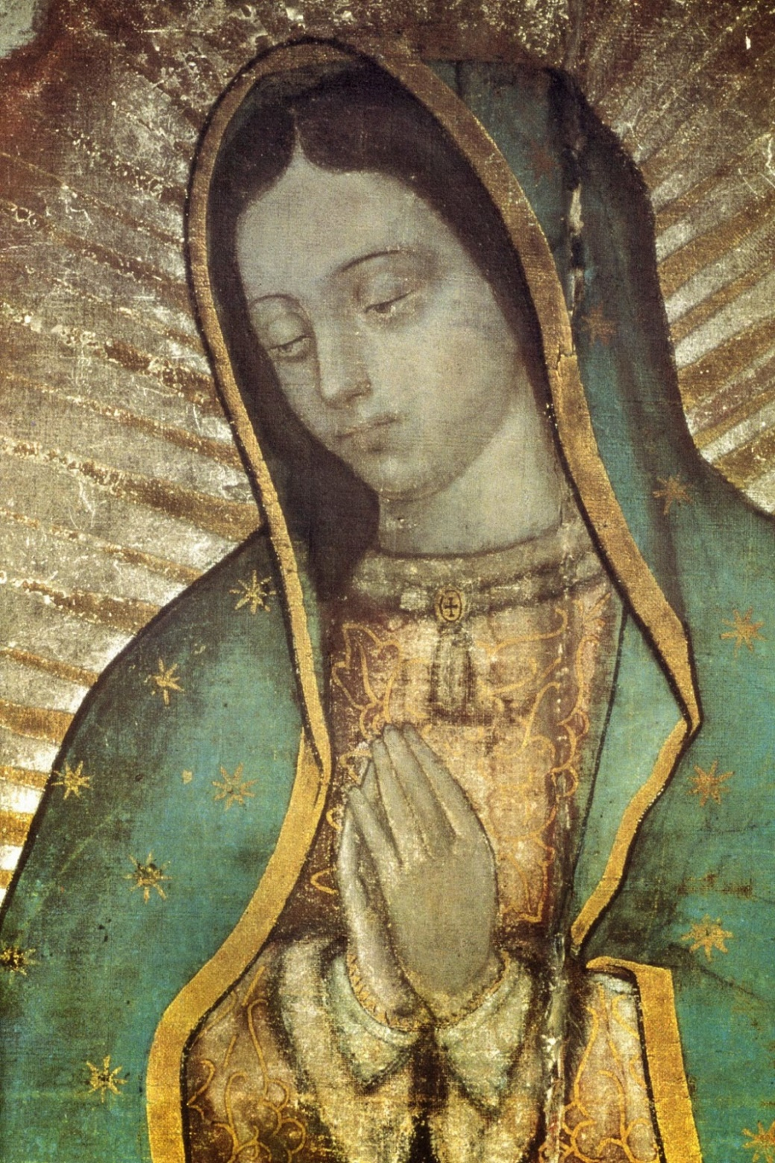

Slide 8
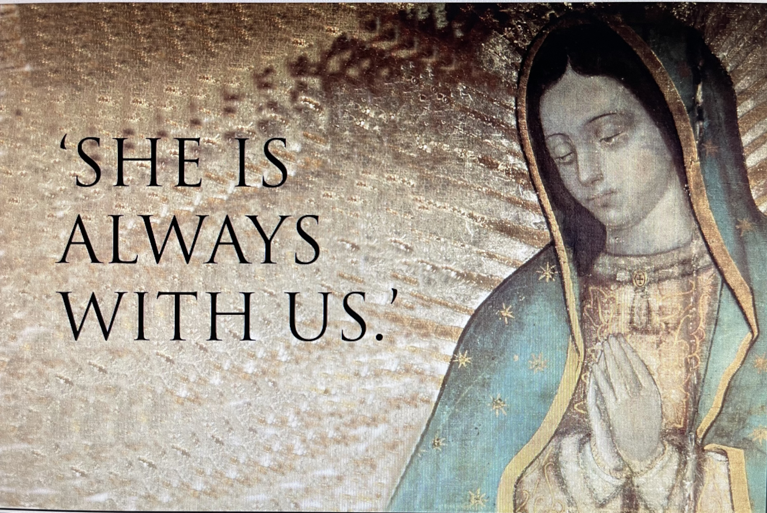

Slide 9
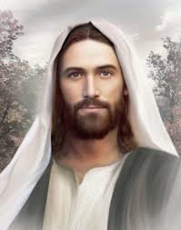

Slide 10
Our Lady of Guadalupe
Our Lady of Guadalupe

