Slide 1
Novena for life to
Our Lady of Guadalupe
Day 2
Thursday, December 5, 2024
The Luminous Mysteries of the Rosary

Slide 2
O Mary conceived without sin, we come to your throne of grace to share the fervent devotion of your faithful children who call upon you under the glorious title of Guadalupe. Obtain for us a lively faith to do your Son’s holy will always: May His will be done on earth as it is in heaven.

Slide 3
The Holy Rosary
To begin:
The Sign of the Cross
The Apostles’ Creed
The Lord’s Prayer
3 Hail Marys – for an increase in faith, hope and charity
Glory Be

Slide 4
I believe in God, the Father almighty,
Creator of heaven and earth,
and in Jesus Christ, His only Son, our Lord,
who was conceived by the Holy Spirit,
born of the Virgin Mary,
suffered under Pontius Pilate,
was crucified, died and was buried;
He descended into hell;
on the third day He rose again from the dead;

Slide 5
He ascended into heaven, and is seated at the right hand of God the Father Almighty;
from there He will come to judge the living and the dead.
I believe in the Holy Spirit,
the holy catholic Church,
the communion of saints,
the forgiveness of sins,
the resurrection of the body,
and life everlasting. Amen.

Slide 6
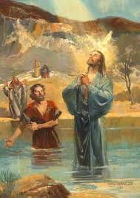
The 1st Luminous Mystery – The Baptism of Jesus
In those days Jesus came from Nazareth of Galilee and was baptized by John in the Jordan. And when he came up out of the water, immediately he saw the heavens opened and the Spirit descending upon him like a dove; and a voice came from heaven, “You are my beloved Son, with you I am well-pleased.
Mark 1, 9-11
Let us pray for pray for submission to God’s will

Slide 7

The Lord’s Prayer
10 Hail Marys
Glory Be
Fatima Prayer:
O my Jesus, forgive us our sins,
save us from the fires of hell.
Lead all souls to Heaven,
especially those in most need of Thy mercy.

Slide 8
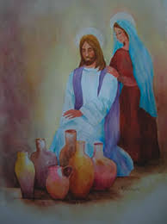
The 2nd Luminous Mystery – The Wedding Feast at Cana John 2, 1-5 & 11
On the third day there was a marriage at Cana in Galilee, and the mother of Jesus was there; Jesus also was invited to the marriage, with his disciples. When the wine failed, the mother of Jesus said to him, “They have no wine.” And Jesus said to her, “O woman, what have you to do with me? My hour has not yet come.” His mother said to the servants, “Do whatever he tells you” …This, the first of his signs, Jesus did at Cana in Galilee, and manifested his glory; and his disciples believed in him.
Let us pray for devotion to Mary

Slide 9

The Lord’s Prayer
10 Hail Marys
Glory Be
Fatima Prayer:
O my Jesus, forgive us our sins,
save us from the fires of hell.
Lead all souls to Heaven,
especially those in most
need of Thy mercy.

Slide 10
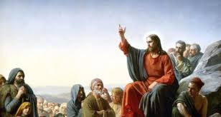
3rd Luminous Mystery – The Proclamation of the Kingdom
From that time Jesus began to preach, saying ‘Repent, for the kingdom of God is at hand”…And he went about all Galilee, teaching in their synagogues and preaching the gospel of the kingdom and healing every disease, and infirmity among the people.
...And great crowds followed him from Galilee and the Decapolis and Jerusalem and Judea and from beyond the Jordan.
Matt 4,17 & 23 & 25
Let us pray for the grace of conversion

Slide 11

The Lord’s Prayer
10 Hail Marys
Glory Be
Fatima Prayer:
O my Jesus, forgive us our sins,
save us from the fires of hell.
Lead all souls to Heaven,
especially those in most need
of Thy mercy.

Slide 12
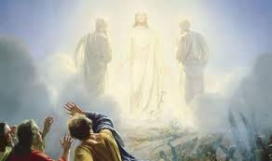
The 4th Luminous Mystery – The Transfiguration Matt. 17, 1-3
And after six days Jesus took with him Peter and James and John his brother, and led them up a high mountain apart. And he was transfigured before them, and his face shone like the sun, and his garments became as white as light. And behold, there appeared to them Moses and Elijah, talking with him.
Pray for the holy fear of God

Slide 13

The Lord’s Prayer
10 Hail Marys
Glory Be
Fatima Prayer:
O my Jesus, forgive us our sins,
save us from the fires of hell.
Lead all souls to Heaven,
especially those in most need of Thy mercy.

Slide 14
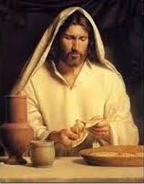
The 5th Luminous Mystery – Institution of the Eucharist
And when the hour came, he sat at table, and the apostles with him. And he said to them, “I have earnestly desired to eat this Passover with you before I suffer; for I tell you, I shall not eat it until it is fulfilled in the kingdom of God”. And he took bread, and when he had given thanks he broke it and gave it to them, saying, “This is my body which is given for you. Do this in remembrance of me.” And likewise the cup after supper, saying, “This cup which is poured out for you is the new covenant in my blood.” Luke 22, 14-16 & 19 - 21
Let us pray for Thanksgiving to God

Slide 15
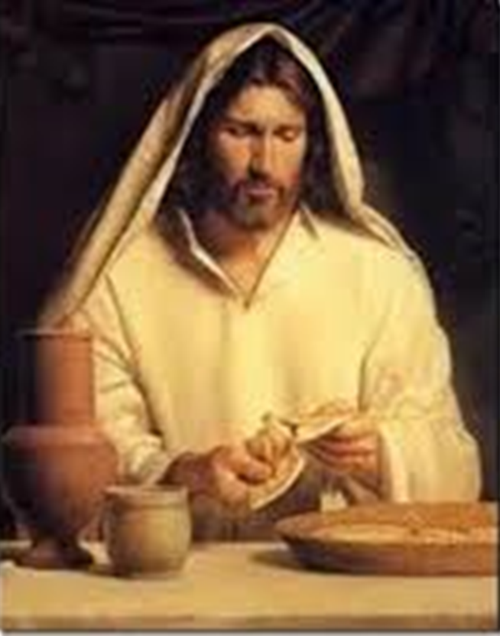
The Lord’s Prayer
10 Hail Marys
Glory Be
Fatima Prayer:
O my Jesus, forgive us our sins,
save us from the fires of hell.
Lead all souls to Heaven,
especially those in most need of Thy mercy.

Slide 16
Hail, Holy Queen
Hail, Holy Queen, Mother of mercy, our life, our sweetness, and our hope.
To thee do we cry, poor banished children of Eve.
To thee do we send up our sighs,
mourning and weeping in this valley of tears.
Turn then, most gracious advocate, thine eyes of mercy toward us; and after this our exile show unto us the blessed fruit of thy womb, Jesus.
O clement! O loving! O sweet Virgin Mary.
v - Pray for us O Holy Mother of God.
r - That we may be made worthy of the promises of Christ.

Slide 17
Let us pray
O God, whose only-begotten Son, by His life, death, and resurrection, has purchased for us the rewards of eternal salvation; grant we beseech Thee, that by meditating upon these mysteries of the most holy Rosary of the Blessed Virgin Mary, we may imitate what they contain and obtain what they promise. Through the same Christ our Lord. Amen.
V May the divine assistance remain always with us.
r Amen
V And may the souls of the faithful departed, through the mercy of God, rest in peace. r Amen

Slide 18
Memorare of Our Lady of Guadalupe
Remember, O most gracious Virgin of Guadalupe,
that in your heavenly apparitions
on the mount of Tepeyac, you promised to show your compassion and pity towards all who, loving and trusting you, seek your help and call upon you in their necessities and afflictions. You promised to hear our supplications, to dry our tears, and to give us consolation and relief.

Slide 19
Never has it been known that anyone
who fled to your protection, implored your help,
or sought your intercession, was left unaided.
Inspired by this confidence, we fly to you,
O Mary, ever-Virgin Mother of the true God!
Though grieving under the weight of our sins,
we come to prostrate ourselves before you.
We fully trust that, standing beneath your shadow
and protection, nothing will trouble or afflict us,
nor do we need to fear illness or misfortune,
or any other sorrow.

Slide 20
O Virgin of Guadalupe, you want to remain with us through your admirable image, you who are our Mother, our health and our life.
Placing ourselves beneath your maternal gaze,
and having recourse to you in all our necessities,
we need do nothing more.
O Holy Mother of God, despise not our petitions,
but in your mercy hear and answer us.
Amen.

Slide 21
