Slide 1
Novena for life to
Our Lady of Guadalupe
Day 3
Friday, Dec 6, 2025
The Sorrowful Mysteries of the Rosary

Slide 2
O Mary, most sorrowful, whose Immaculate Heart, was pierced by seven swords of grief, help us to walk valiantly amid the sharp thorns strewn across our pathways. Obtain for us the strength to be true imitators of you. This we ask you, our dearest Mother.

Slide 3
The Holy Rosary
To begin:
The Sign of the Cross
The Apostles’ Creed
The Lord’s Prayer
3 Hail Marys – for an increase in faith, hope and charity
Glory Be

Slide 4
I believe in God, the Father almighty,
Creator of heaven and earth,
and in Jesus Christ, His only Son, our Lord,
who was conceived by the Holy Spirit,
born of the Virgin Mary,
suffered under Pontius Pilate,
was crucified, died and was buried;
He descended into hell;
on the third day He rose again from the dead;

Slide 5
He ascended into heaven, and is seated at the right hand of God the Father almighty;
from there He will come to judge the living and the dead.
I believe in the Holy Spirit,
the holy catholic Church,
the communion of saints,
the forgiveness of sins,
the resurrection of the body,
and life everlasting. Amen.

Slide 6
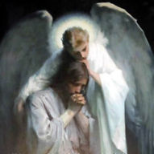
The 1st Sorrowful Mystery – The Agony in the Garden
And being in an agony he prayed more earnestly;
and his sweat became like great drops of blood falling down upon the ground.
Luke 22, 44
Let us pray for true repentance for our sins

Slide 7
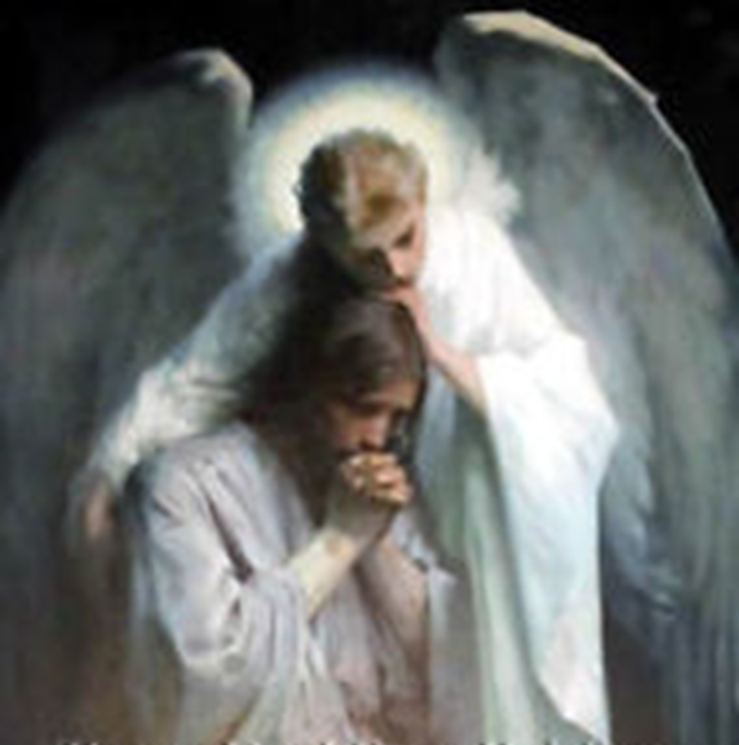
The Lord’s Prayer
10 Hail Marys
Glory Be
Fatima Prayer:
O my Jesus, forgive us our sins,
save us from the fires of hell.
Lead all souls to Heaven,
especially those in most need of Thy mercy.

Slide 8
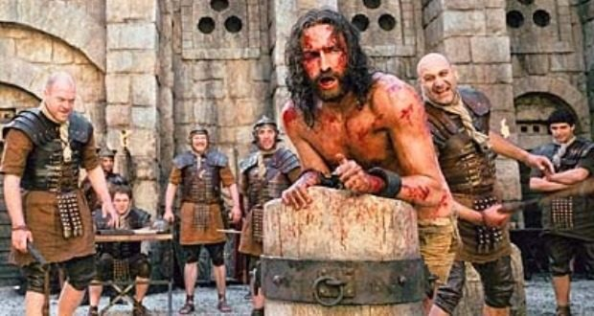
The 2nd Sorrowful Mystery – The Scourging at the Pillar
So Pilate, wishing to satisfy the crowd, released for them Barabbas,
and having scourged Jesus, he delivered him to be crucified.
Mark 15. 15
Let us pray for purity of mind
and body

Slide 9

The Lord’s Prayer
10 Hail Marys
Glory Be
Fatima Prayer:
O my Jesus, forgive us our sins,
save us from the fires of hell.
Lead all souls to Heaven,
especially those in most need of Thy mercy.

Slide 10
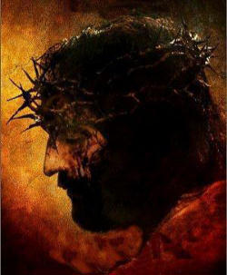
The 3rd Sorrowful Mystery – The Crowning with Thorns
And plaiting a crown of thorns, they put it on his head, and put a reed in his right hand. And kneeling before him they mocked him saying, “Hail, King of the Jews!”
And they spat upon him, and took the reed and struck him on the head.
Matthew 27, 29-30
Let us pray for moral strength and courage

Slide 11

The Lord’s Prayer
10 Hail Marys
Glory Be
Fatima Prayer:
O my Jesus, forgive us our sins,
save us from the fires of hell.
Lead all souls to Heaven,
especially those in most need of Thy mercy.

Slide 12
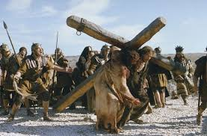
The 4th Sorrowful Mystery – The Carrying of the Cross
Then he handed him over to them to be crucified.
So they took Jesus, and he went out, bearing his own cross, to the place called the place of the skull, which is called in Hebrew, Gol’gotha.
John 19, 16-18
Let us pray for the virtue of patience

Slide 13

The Lord’s Prayer
10 Hail Marys
Glory Be
Fatima Prayer:
O my Jesus, forgive us our
sins,
save us from the fires of hell.
Lead all souls to Heaven,
especially those in most need of Thy mercy.

Slide 14
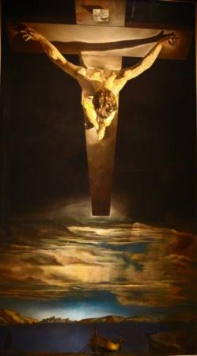
The 5th Sorrowful Mystery – The Crucifixion
When Jesus had received the vinegar, he said, “It is finished!”
and he bowed his head and gave up his spirit.
John 19, 30
Let us pray for final perseverance

Slide 15

The Lord’s Prayer
10 Hail Marys
Glory Be
Fatima Prayer:
O my Jesus, forgive us our sins,
save us from the fires of hell.
Lead all souls to Heaven,
especially those in most need of Thy mercy.

Slide 16
Hail, Holy Queen
Hail, Holy Queen, Mother of mercy, our life, our sweetness, and our hope.
To thee do we cry, poor banished children of Eve.
To thee do we send up our sighs, mourning and weeping in this valley of tears.
Turn then, most gracious advocate, thine eyes of mercy toward us; and after this our exile, show unto us the blessed fruit of thy womb, Jesus.
O clement! O loving! O sweet Virgin Mary.
v - Pray for us O Holy Mother of God.
r - That we may be made worthy of the promises of Christ.

Slide 17
Let us pray
O God, whose only-begotten Son, by His life, death, and resurrection, has purchased for us the rewards of eternal salvation; grant we beseech Thee, that by meditating upon these mysteries of the most holy Rosary of the Blessed Virgin Mary, we may imitate what they contain and obtain what they promise. Through the same Christ our Lord. Amen.
V May the divine assistance remain always with us.
r Amen
V And may the souls of the faithful departed, through the mercy of God, rest in peace. r Amen

Slide 18
Memorare of Our Lady of Guadalupe
Remember, O most gracious Virgin of Guadalupe,
that in your heavenly apparitions
on the mount of Tepeyac, you promised to show your compassion and pity towards all who, loving and trusting you, seek your help and call upon you in their necessities and afflictions. You promised to hear our supplications, to dry our tears, and to give us consolation and relief.

Slide 19
Never has it been known that anyone
who fled to your protection, implored your help,
or sought your intercession, was left unaided.
Inspired by this confidence, we fly to you,
O Mary, ever-Virgin Mother of the true God!
Though grieving under the weight of our sins,
we come to prostrate ourselves before you.
We fully trust that, standing beneath your shadow
and protection, nothing will trouble or afflict us,
nor do we need to fear illness or misfortune,
or any other sorrow.

Slide 20
O Virgin of Guadalupe, you want to remain with us through your admirable image, you who are our Mother, our health and our life.
Placing ourselves beneath your maternal gaze,
and having recourse to you in all our necessities,
we need do nothing more.
O Holy Mother of God, despise not our petitions,
but in your mercy hear and answer us.
Amen.

Slide 21
