Slide 1
9 Day Novena for life to
Our Lady of Guadalupe
Wednesday, Dec 10, 2025
Day 8
The Glorious Mysteries of the Rosary

Slide 2
O Lady of Guadalupe, with our hearts full of the most sincere veneration, we prostrate ourselves before you, O Mother, to ask you to obtain for us the grace to fulfill the duties of our state in life with faithfulness and constancy.

Slide 3
The Holy Rosary
To begin:
The Sign of the Cross
The Apostles’ Creed
The Lord’s Prayer
3 Hail Marys – for an increase in faith, hope and charity
Glory Be

Slide 4
I believe in God, the Father almighty,
Creator of heaven and earth,
and in Jesus Christ, his only Son, our Lord,
who was conceived by the Holy Spirit,
born of the Virgin Mary,
suffered under Pontius Pilate,
was crucified, died and was buried;
he descended into hell;
on the third day he rose again from the dead;

Slide 5
he ascended into heaven, and is seated at the right hand of God the Father Almighty;
from there he will come to judge the living and the dead.
I believe in the Holy Spirit,
the holy catholic Church,
the communion of saints,
the forgiveness of sins,
the resurrection of the body,
and life everlasting. Amen.

Slide 6
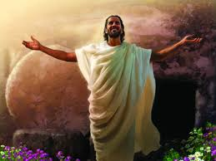
The 1st Glorious Mystery – The Resurrection
But the angel said to the women, “Do not be afraid; for I know that you seek Jesus, who was crucified.
He is not here, for he has risen, as he said. Come, see the place where he lay.
Matt. 28, 5-6
Let us pray for the virtue of faith

Slide 7
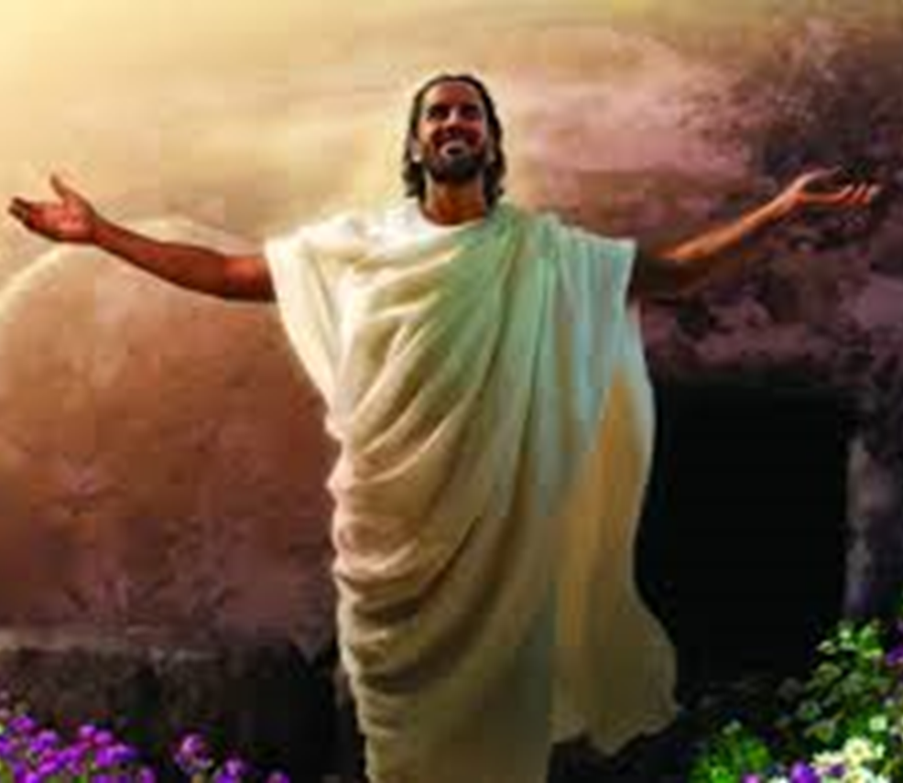
The Lord’s Prayer
10 Hail Marys
Glory Be
Fatima Prayer:
O my Jesus, forgive us our sins,
save us from the fires of hell.
Lead all souls to Heaven,
especially those in most need of Thy mercy.

Slide 8
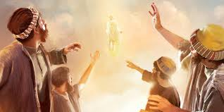
The 2nd Glorious Mystery – The Ascension into Heaven
So then the Lord Jesus, after he had spoken to them, was taken up into heaven, and sat down at the right hand of God.
Mark 16-19
Let us pray for hope and trust in God

Slide 9

The Lord’s Prayer
10 Hail Marys
Glory Be
Fatima Prayer:
O my Jesus, forgive us our sins,
save us from the fires of hell.
Lead all souls to Heaven,
especially those in most need of Thy mercy.

Slide 10
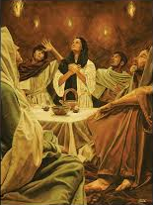
The 3rd Glorious Mystery – The Descent of the Holy Spirit
And there appeared to them tongues as of fire, distributed and resting on each one of them.
And they were all filled with the Holy Spirit and began to speak in other tongues, as the Spirit gave them utterance.
Acts 2, 3-4
Let us pray for the virtue of love

Slide 11
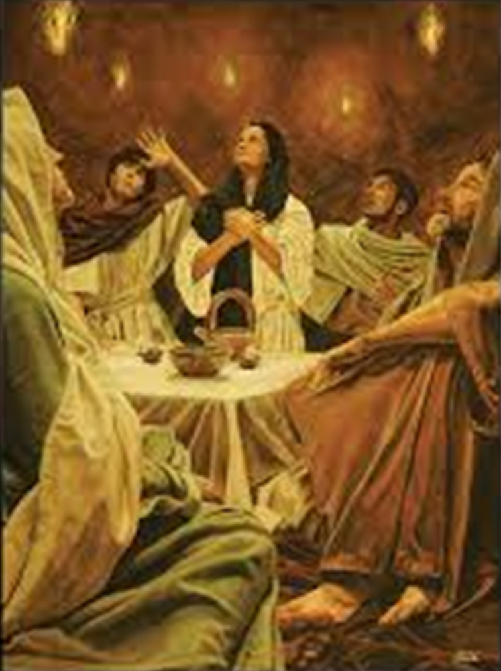
The Lord’s Prayer
10 Hail Marys
Glory Be
Fatima Prayer:
O my Jesus, forgive us our sins,
save us from the fires of hell.
Lead all souls to Heaven,
especially those in most need of Thy mercy.

Slide 12
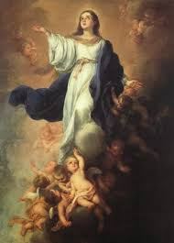
The 4th Glorious Mystery – The Assumption of Mary into Heaven
The Most Blessed Virgin Mary, when the course of her earthly life was completed, was taken up body and soul into the glory of heaven, where she already shares in the glory of her Son’s Resurrection, anticipating the resurrection of all members of his Body.
CCC 974
Let us pray for a happy death

Slide 13

The Lord’s Prayer
10 Hail Marys
Glory Be
Fatima Prayer:
O my Jesus, forgive us our sins,
save us from the fires of hell.
Lead all souls to Heaven,
especially those in most need of Thy mercy.

Slide 14
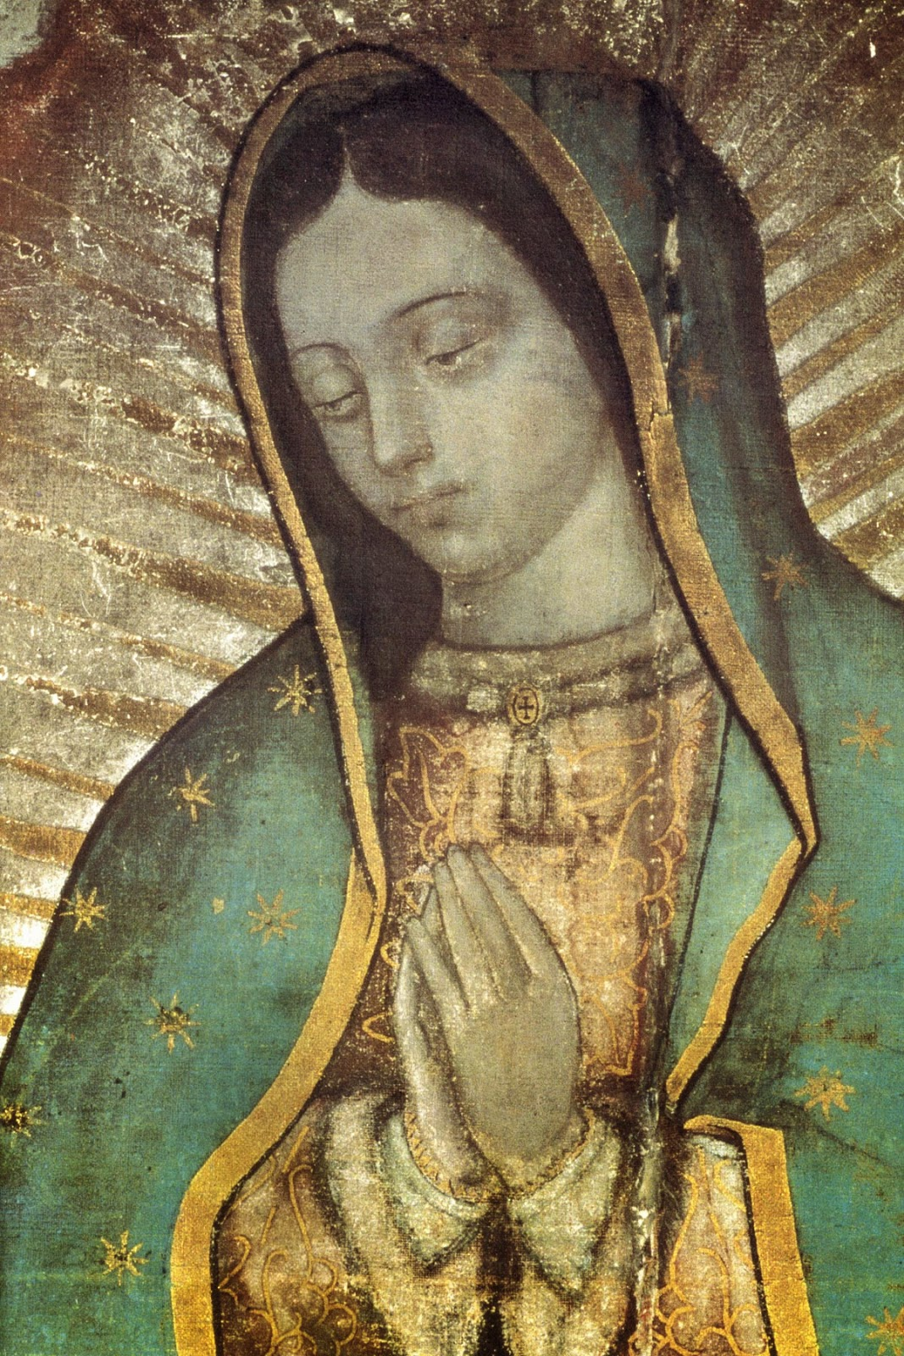
The 5th Glorious Mystery – The Crowning of Our Blessed Lady
And a great sign appeared in heaven, a woman clothed with the sun, with the moon under her feet, and on her head a crown of twelve stars;
Revelation 12, 1
Let us pray for eternal salvation

Slide 15
The Lord’s Prayer
10 Hail Marys
Glory Be
Fatima Prayer:
O my Jesus, forgive us our sins,
save us from the fires of hell.
Lead all souls to Heaven,
especially those in most need
of Thy mercy.

Slide 16
Hail, Holy Queen
Hail, Holy Queen, Mother of mercy, our life, our sweetness, and our hope.
To thee do we cry, poor banished children of Eve.
To thee do we send up our sighs,
mourning and weeping in this valley of tears.
Turn then, most gracious advocate, thine eyes of mercy toward us; and after this our exile show unto us the blessed fruit of thy womb, Jesus.
O clement! O loving! O sweet Virgin Mary.
v - Pray for us O Holy Mother of God.
r - That we may be made worthy of the promises of Christ.

Slide 17
Let us pray
O God, whose only-begotten Son, by His life, death, and resurrection, has purchased for us the rewards of eternal salvation; grant we beseech Thee, that by meditating upon these mysteries of the most holy Rosary of the Blessed Virgin Mary, we may imitate what they contain and obtain what they promise. Through the same Christ our Lord. Amen.
V May the divine assistance remain always with us.
r Amen
V And may the souls of the faithful departed, through the mercy of God, rest in peace. r Amen

Slide 18
Memorare of Our Lady of Guadalupe
Remember, O most gracious Virgin of Guadalupe,
that in your heavenly apparitions
on the mount of Tepeyac, you promised to show your compassion and pity towards all who, loving and trusting you, seek your help and call upon you in their necessities and afflictions. You promised to hear our supplications, to dry our tears, and to give us consolation and relief.

Slide 19
Never has it been known that anyone
who fled to your protection, implored your help,
or sought your intercession, was left unaided.
Inspired by this confidence, we fly to you,
O Mary, ever-Virgin Mother of the true God!
Though grieving under the weight of our sins,
we come to prostrate ourselves before you.
We fully trust that, standing beneath your shadow
and protection, nothing will trouble or afflict us,
nor do we need to fear illness or misfortune,
or any other sorrow.

Slide 20
O Virgin of Guadalupe, you want to remain with us through your admirable image, you who are our Mother, our health and our life.
Placing ourselves beneath your maternal gaze,
and having recourse to you in all our necessities,
we need do nothing more.
O Holy Mother of God, despise not our petitions,
but in your mercy hear and answer us.
Amen.

Slide 21
