Slide 1
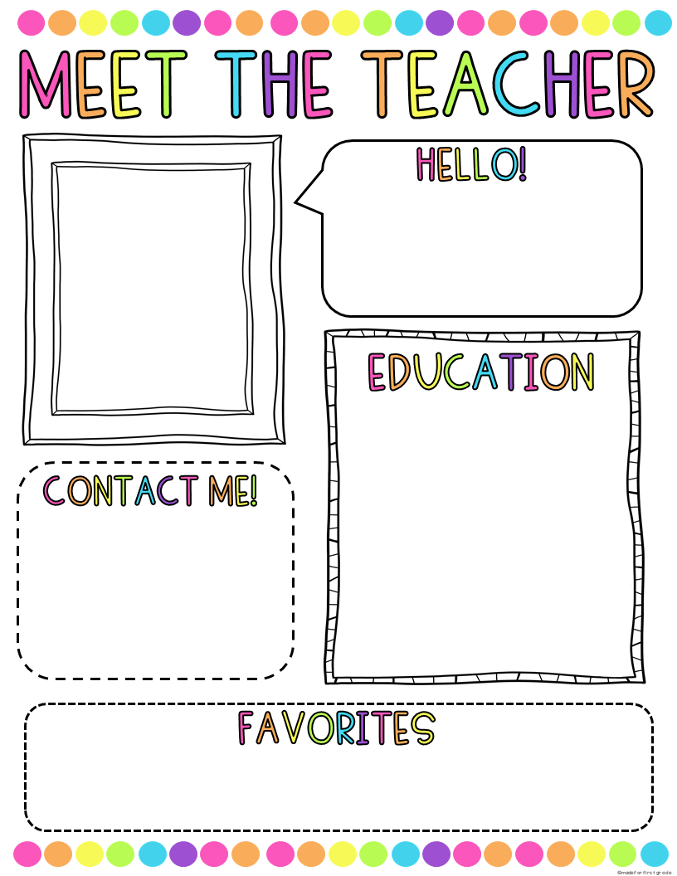
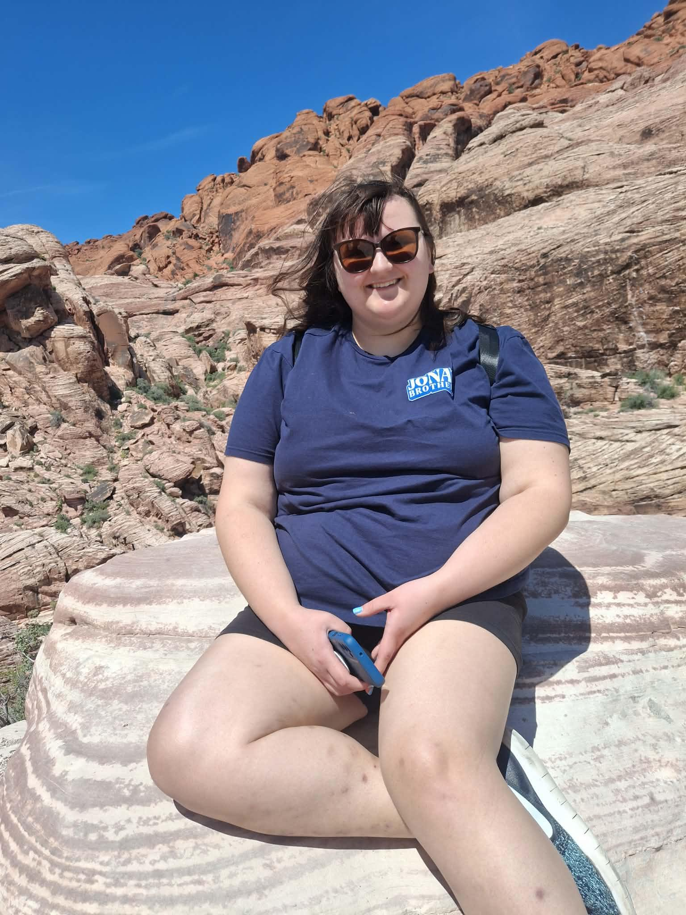
Welcome to 3rd Grade! My name is Ms. Koszyk. I am very excited to be your child’s 3rd grade teacher for the 2026-2027 school year! This will be my fifth year teaching at St. Anthony’s.
I graduated from Indiana University South Bend with a bachelor's degree in Elementary Education along with a concentration and minor in English. I was born and raised in South Bend, IN. In addition, I am a parishioner and alumni of St. Matthew Cathedral School and Parish. Outside of school, I love to read and spend time outside with my family, friends and my two miniature dachshunds, Lucy and Desi.
Please feel free to contact me about any questions or concerns at akoszyk@stasb.org.
Food: Tacos
Snack: Doritos/Cheez-Its
Drink: Coke Zero
Book: Number the Stars
Game: Uno
Movie: Tangled
Scent: Eucalyptus
Store: Target/Amazon
Color: Blue
Hobby: Reading and
Gardening.

