Slide 1
Saint Camillus Church
Bell Tower
Masonry Assessment
CPARL Review
12 September, 2025

Slide 2
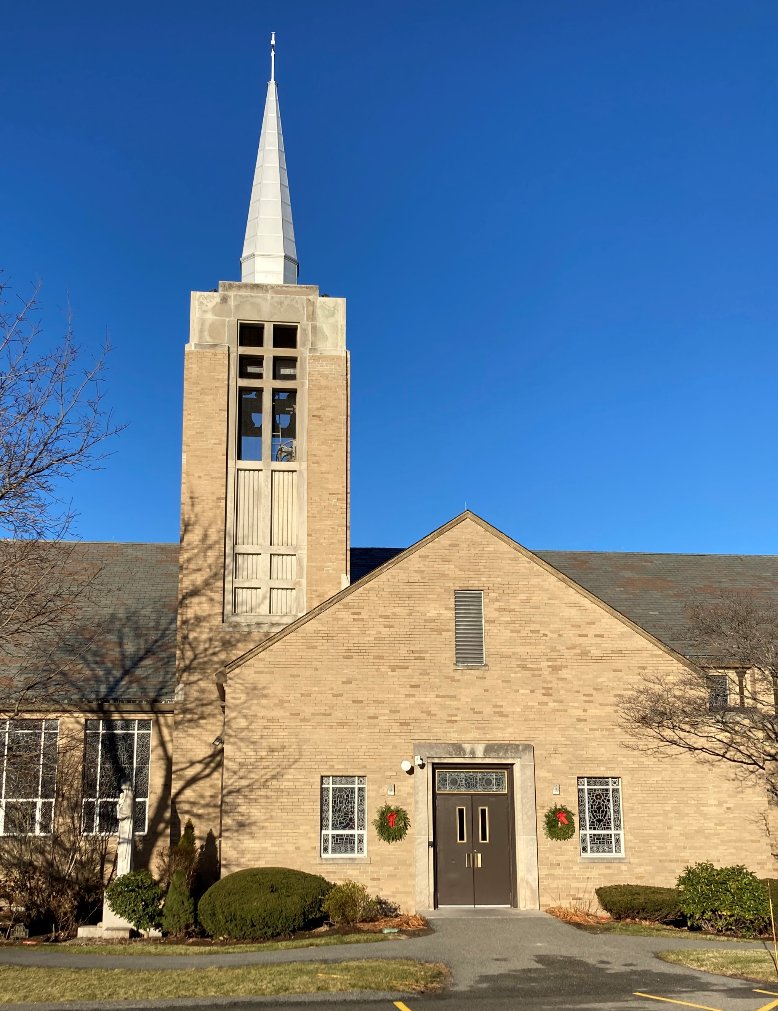
Saint Camillus Church Bell Tower Masonry Assessment
Overview
Emergency masonry repairs Fall 2023
Engineering review Spring 2024
Carillon shut down for safety Summer 2024
Scope of work developed and bid to contractors Summer 2024
Fundraising Fall 2024 - Present
CPARL Facilities Committee oversight Fall 2024 – Present
East facade

Slide 3
Saint Camillus Church Bell Tower Masonry Assessment
Emergency masonry repairs
Masonry repointing and anchoring, portions of south and east sides
Replace portions of damaged sealant, south and east sides

Slide 4
Saint Camillus Church Bell Tower Masonry Assessment
Engineering review
Exterior observations: cracked and spalled brick, failed sealants, efflorescence, failed interior mortar and structural wall ties, steeple roof repairs.
Interior observations: cracked and spalled brick, efflorescence, eroded mortar, concrete deck spalling and steel reinforcing erosion, failed sealants, deteriorated bird screen frames.

Slide 5
Saint Camillus Church Bell Tower Masonry Assessment
Carillon shutdown
Due to safety concerns regarding vibration, the carillon chiming mechanism was disabled.

Slide 6
Saint Camillus Church Bell Tower Masonry Assessment
Develop Scope of Work and Bidding
Scope of work was developed utilizing engineer’s recommendations.
Project bid to five qualified contractors, four bids received.
Low bid: Folan Waterproofing and Construction Co., Inc., September 2024
Assume four months construction

Slide 7
Saint Camillus Church Bell Tower Masonry Assessment
CPARL Facilities Committee Oversight
Monthly visual review from grade with binoculars
Access bell tower and exterior review 31 December 2024
Removal of masonry debris March 2025
Access bell tower and exterior review 9 May 2025
Access bell tower and exterior review 12 September 2025

Slide 8
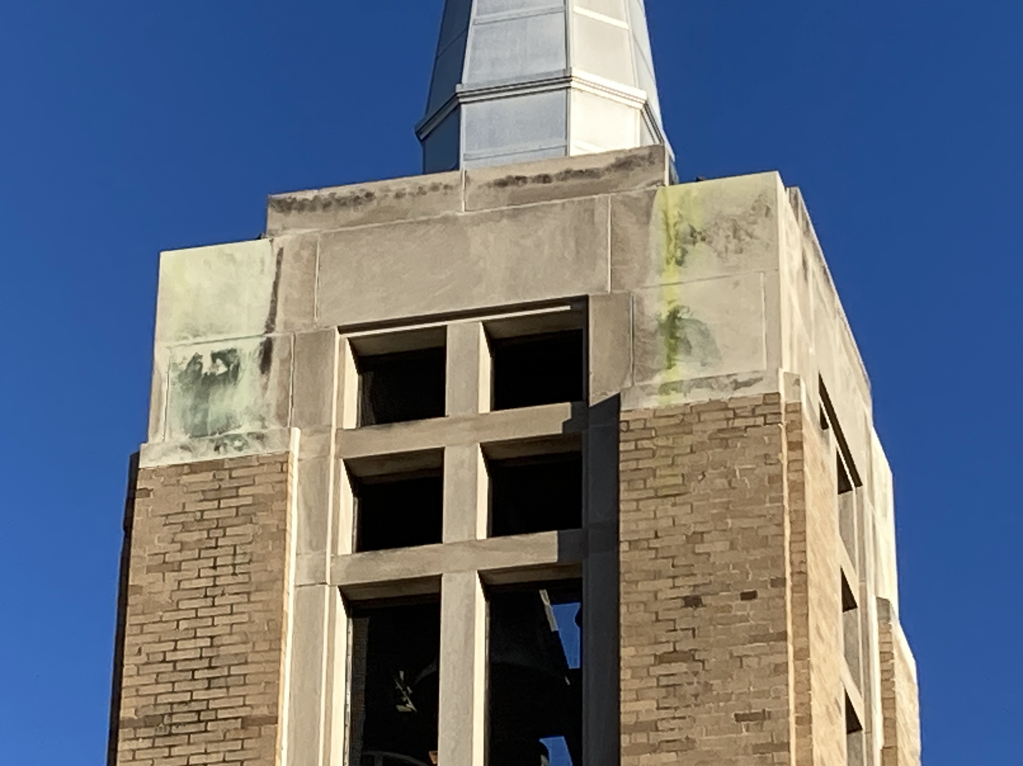
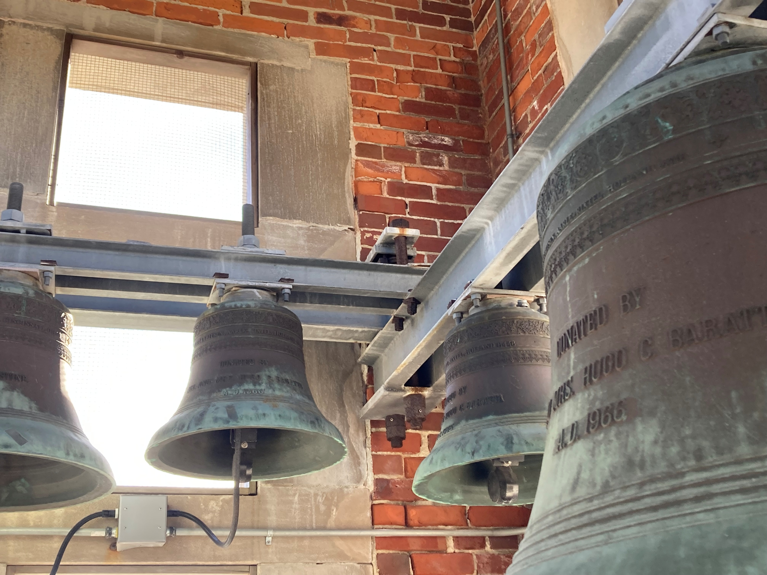
Saint Camillus Church Bell Tower Masonry Assessment
Photographic documentation
December 2024
Masonry degradation and staining, East side
Interior masonry spalling

Slide 9
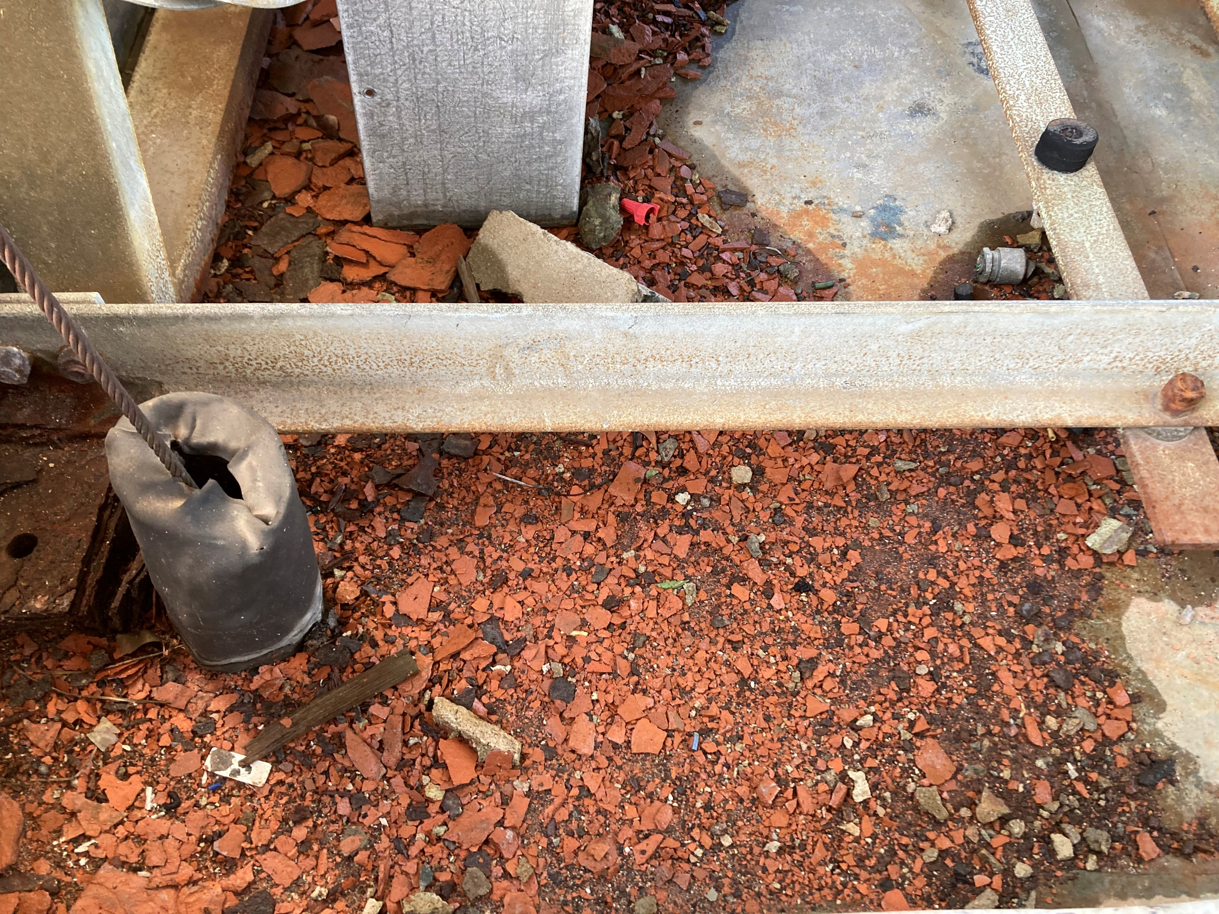
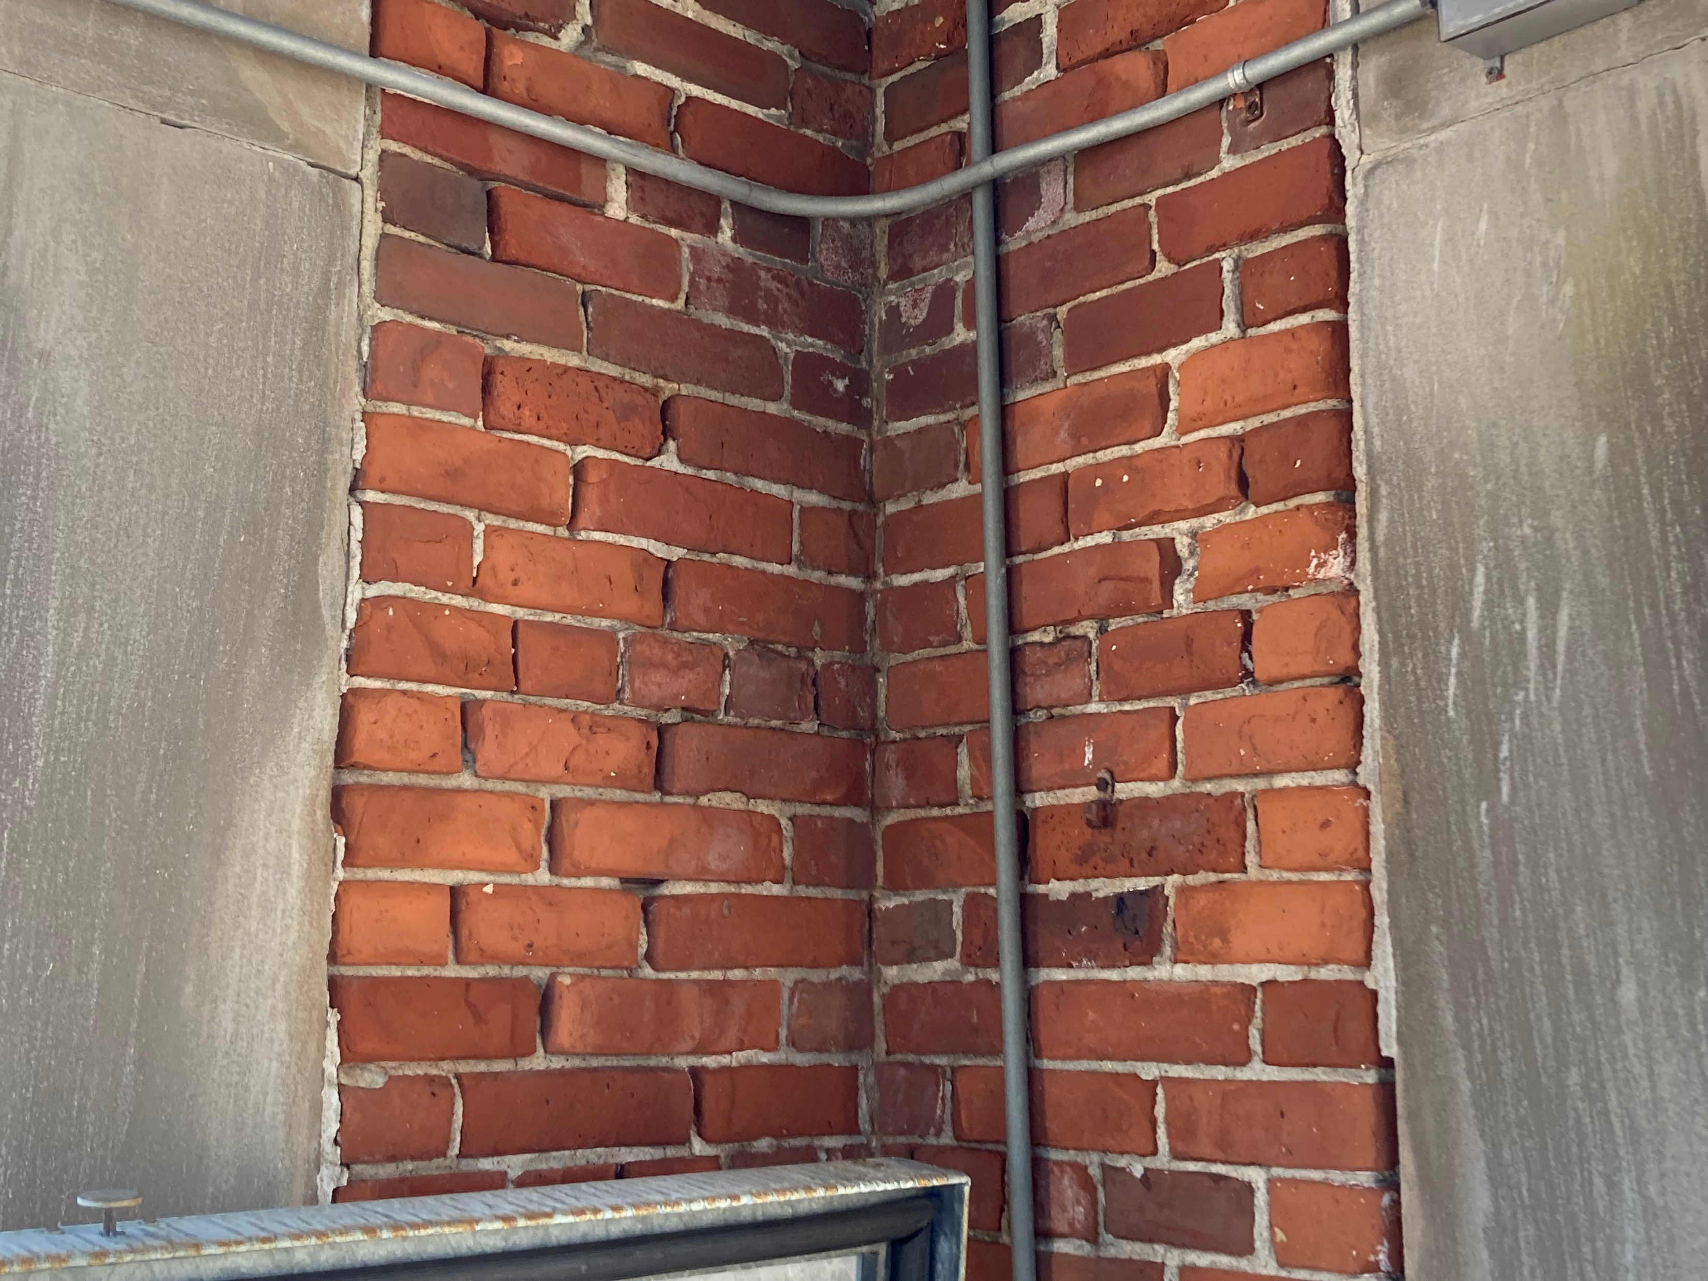
Saint Camillus Church Bell Tower Masonry Assessment
Photographic documentation
December 2024
Spalled interior masonry debris at bell tower level
Spalled interior masonry & eroded mortar, sealant failure

Slide 10
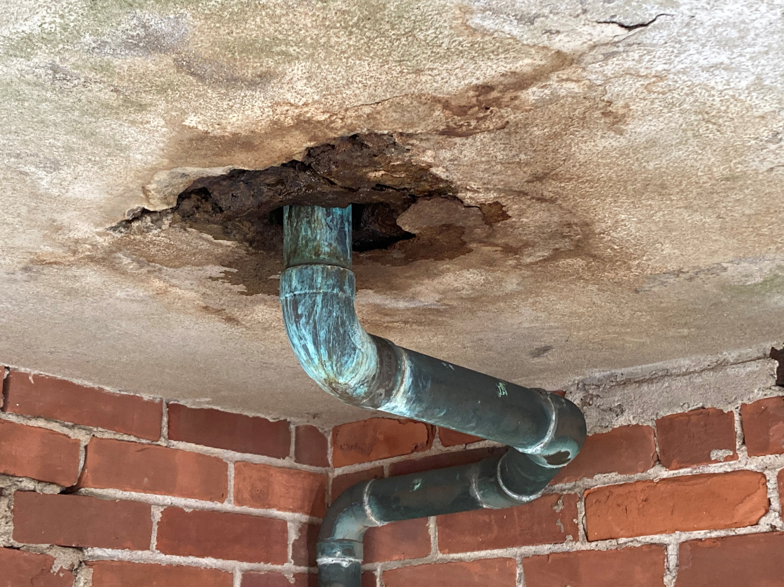
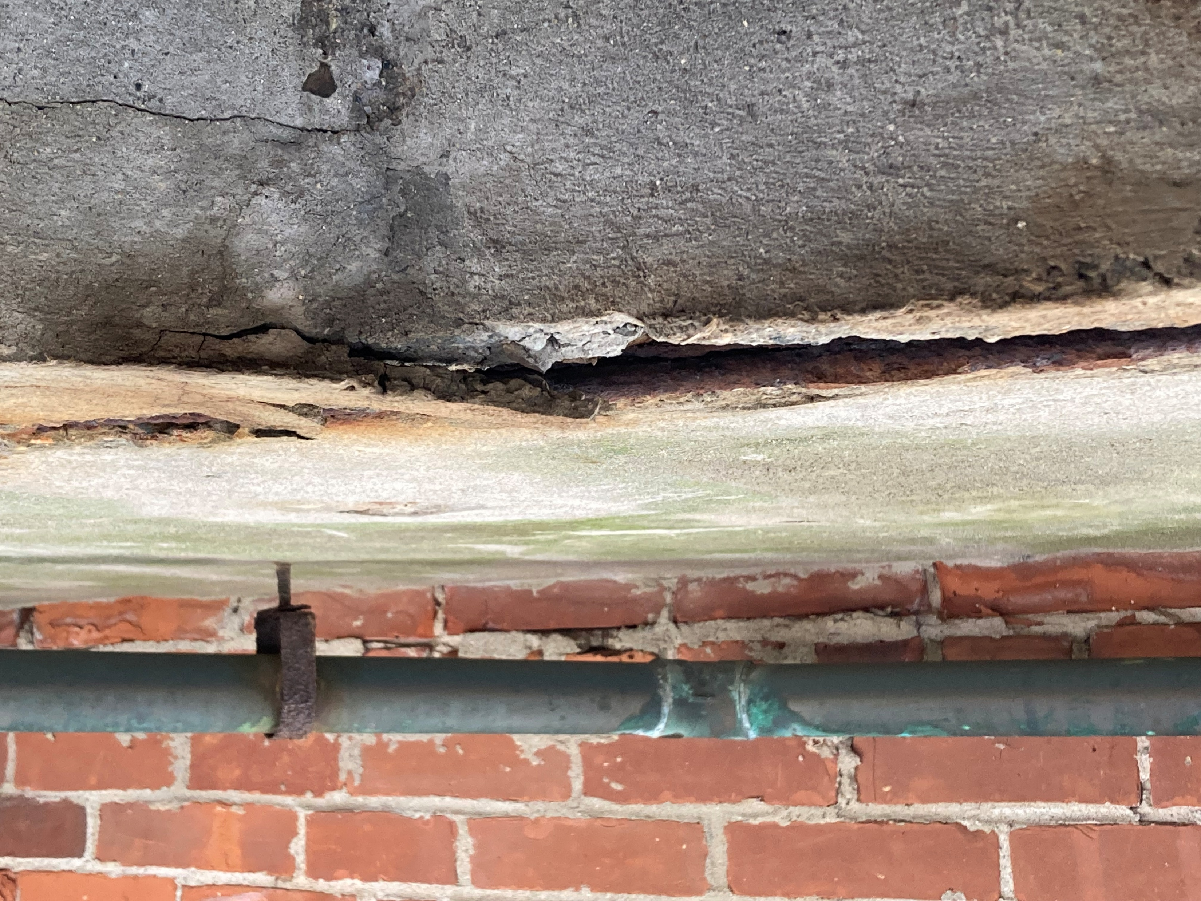
Saint Camillus Church Bell Tower Masonry Assessment
Photographic documentation
December 2024
Concrete deck deterioration below steeple
Rust jacking of concrete deck below steeple

Slide 11
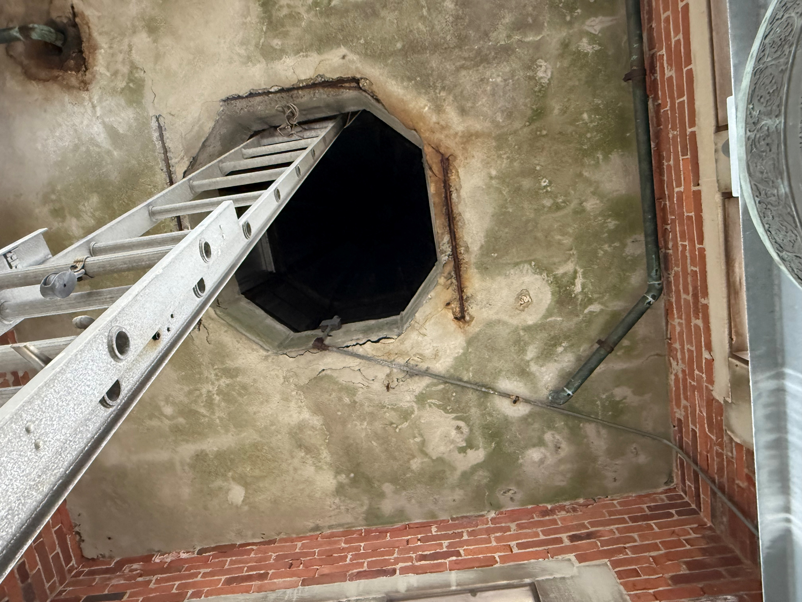
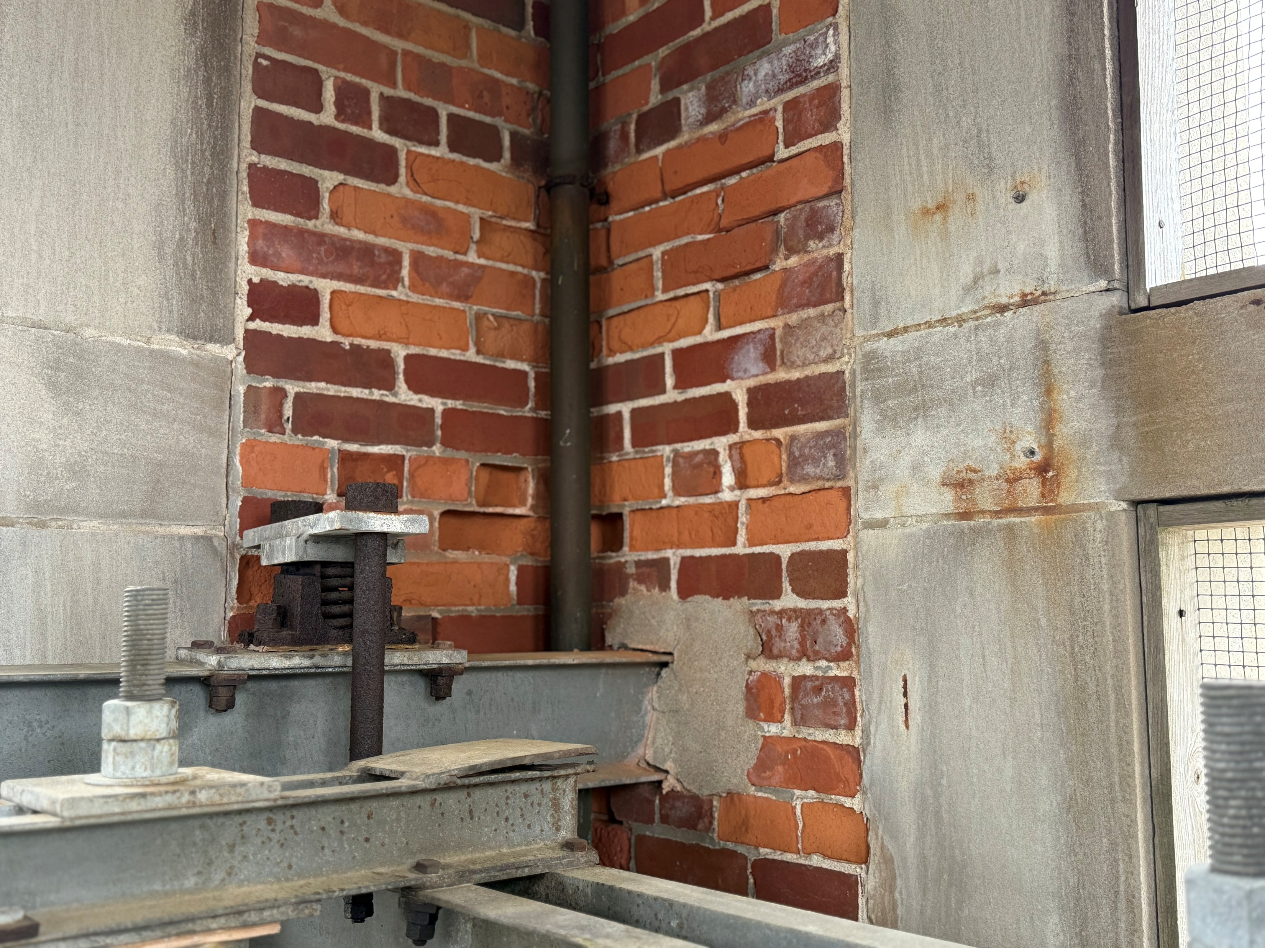
Saint Camillus Church Bell Tower Masonry Assessment
Photographic documentation
May 2025
Rust jacking of concrete deck and rebar deterioration below steeple
Masonry & sealant degradation at bell tower interior

Slide 12
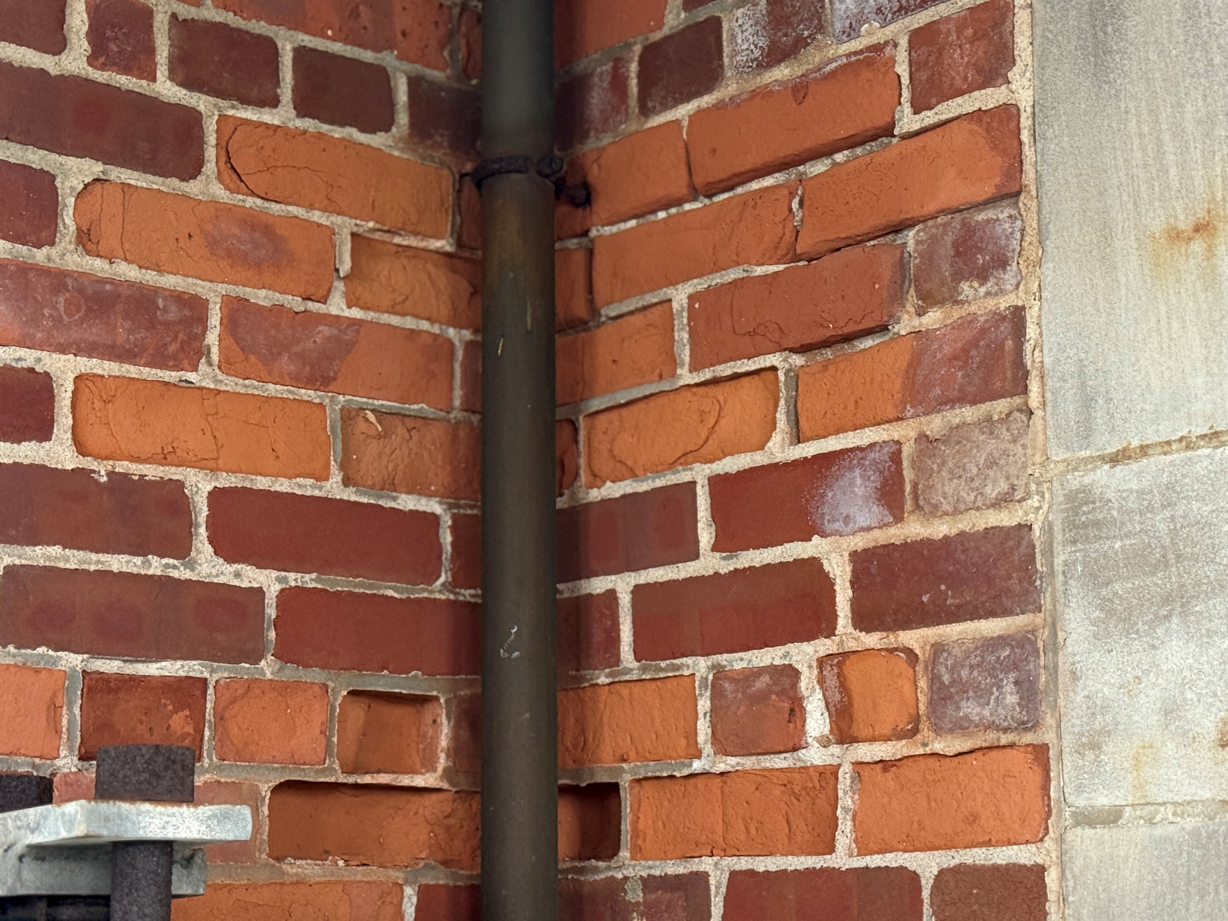
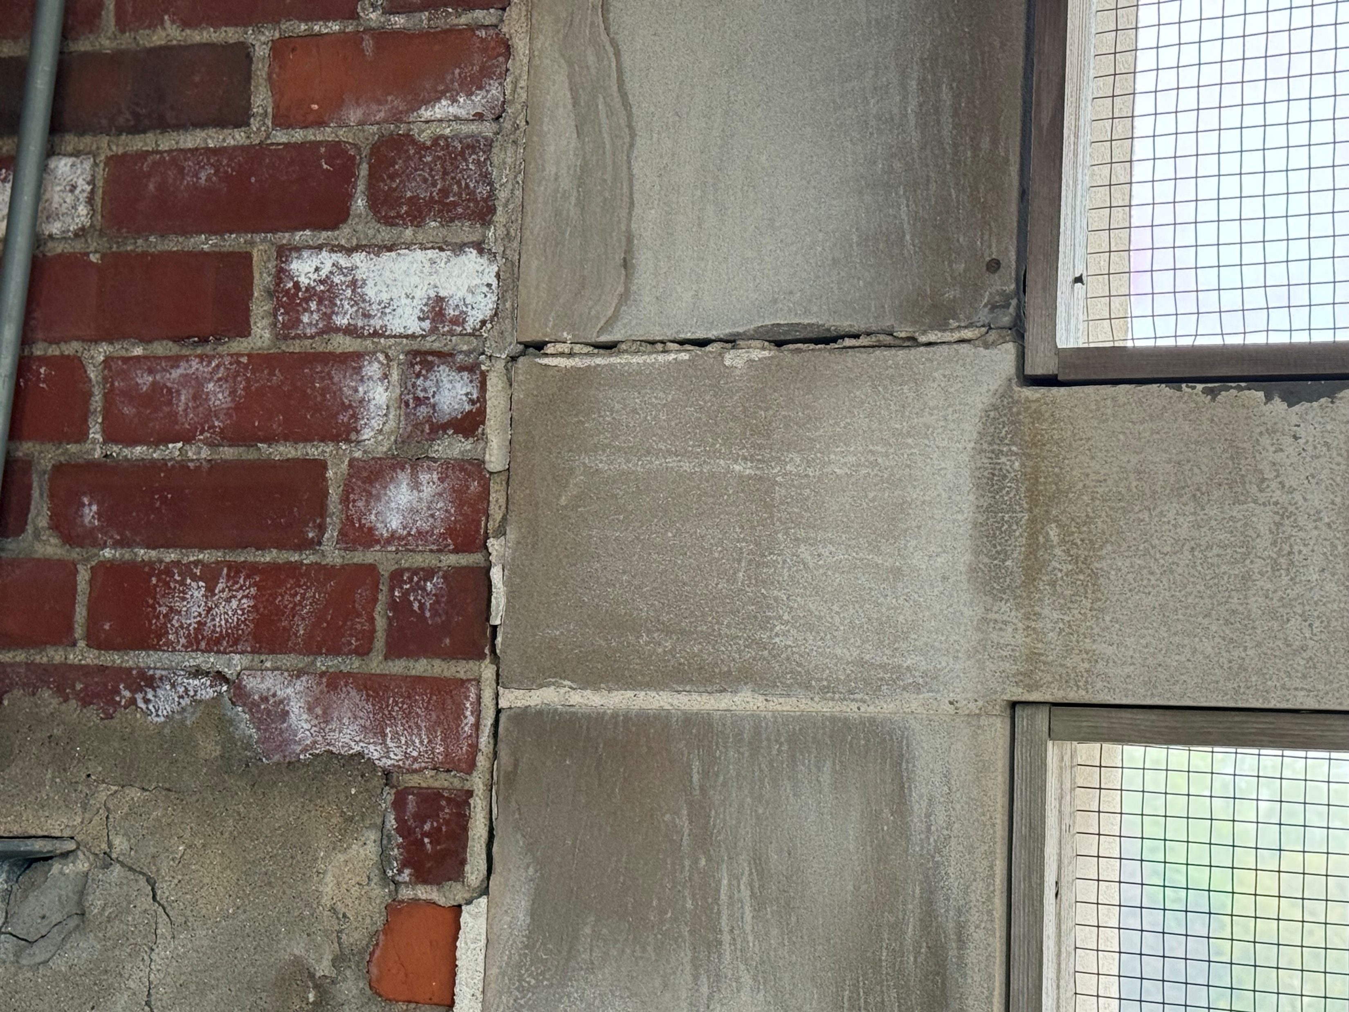
Saint Camillus Church Bell Tower Masonry Assessment
Photographic documentation
May 2025
Masonry degradation & eroded mortar at bell tower interior
Masonry and sealant degradation at bell tower interior

Slide 13
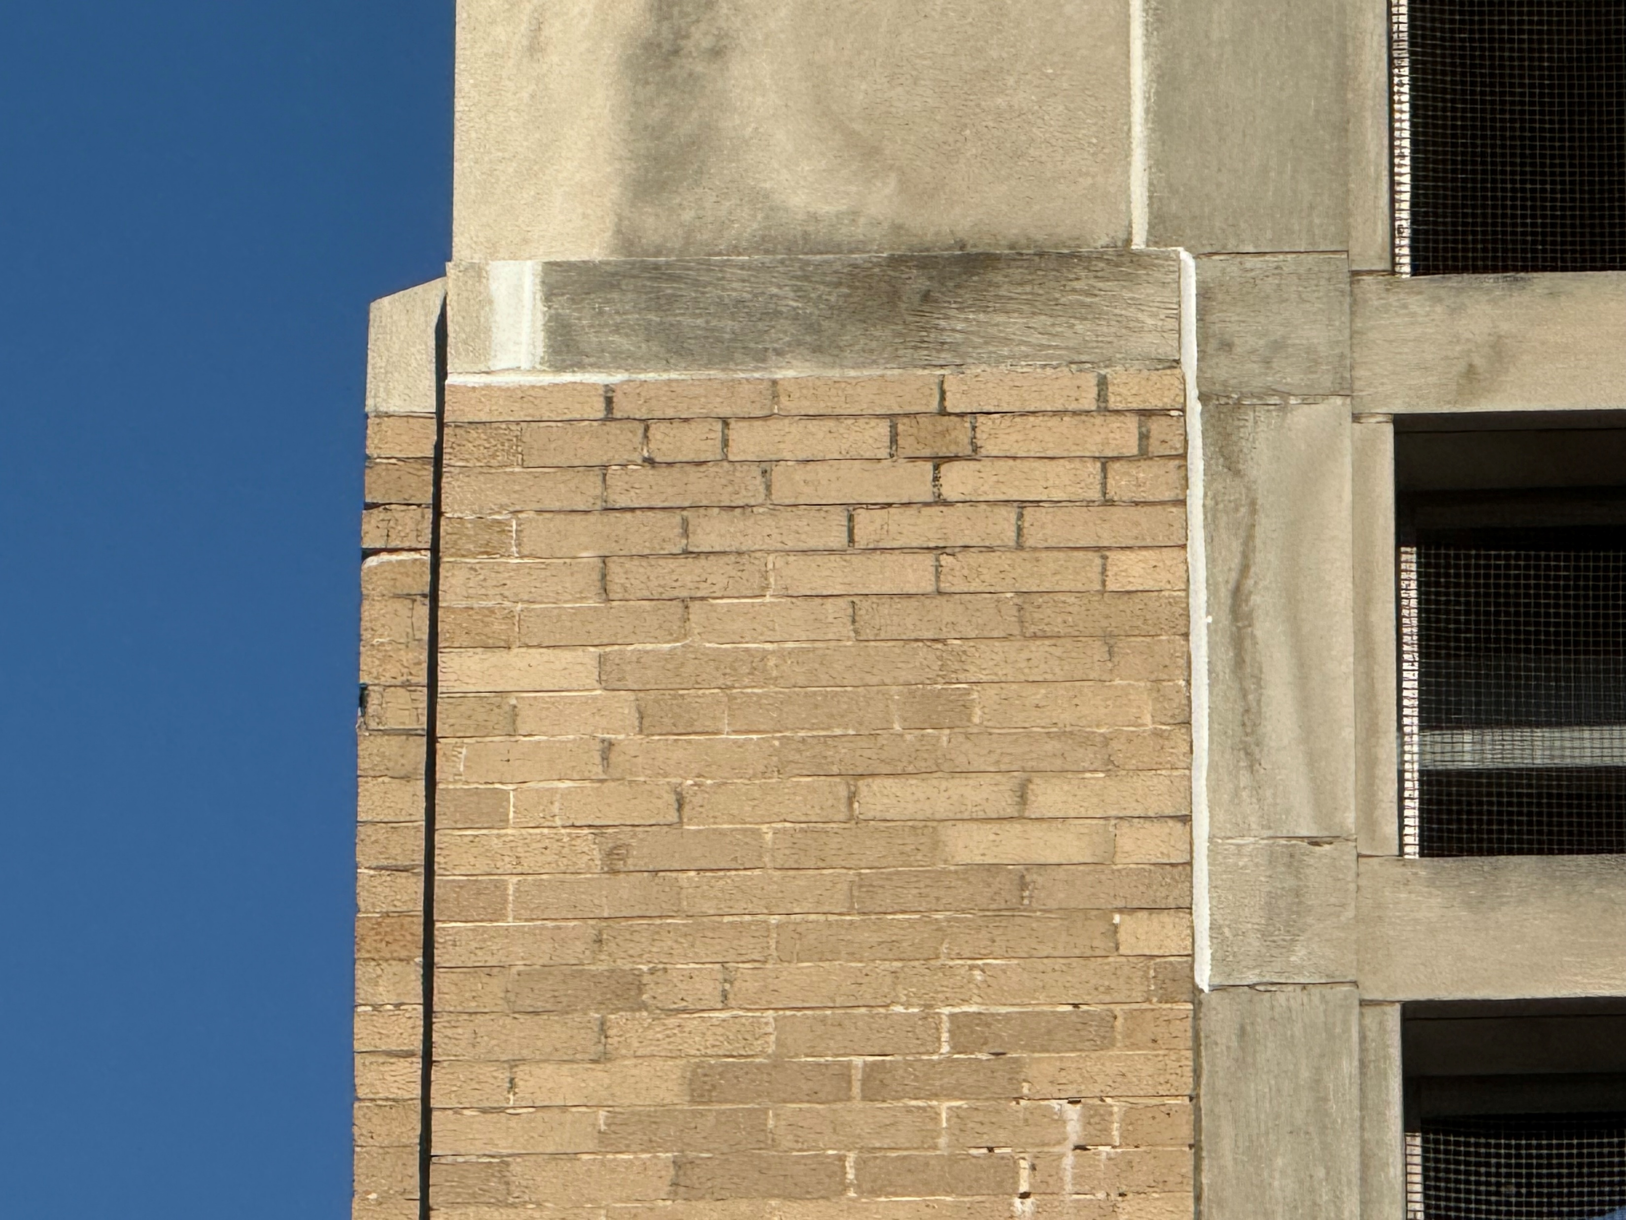
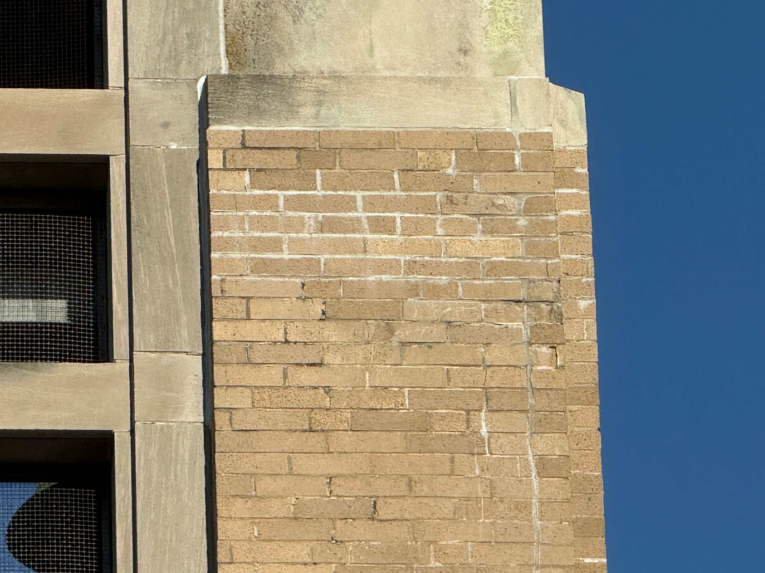
Saint Camillus Church Bell Tower Masonry Assessment
Photographic documentation
September 2025
Masonry and sealant degradation, atmospheric staining at bell tower exterior
Masonry degradation, atmospheric staining at bell tower exterior

Slide 14
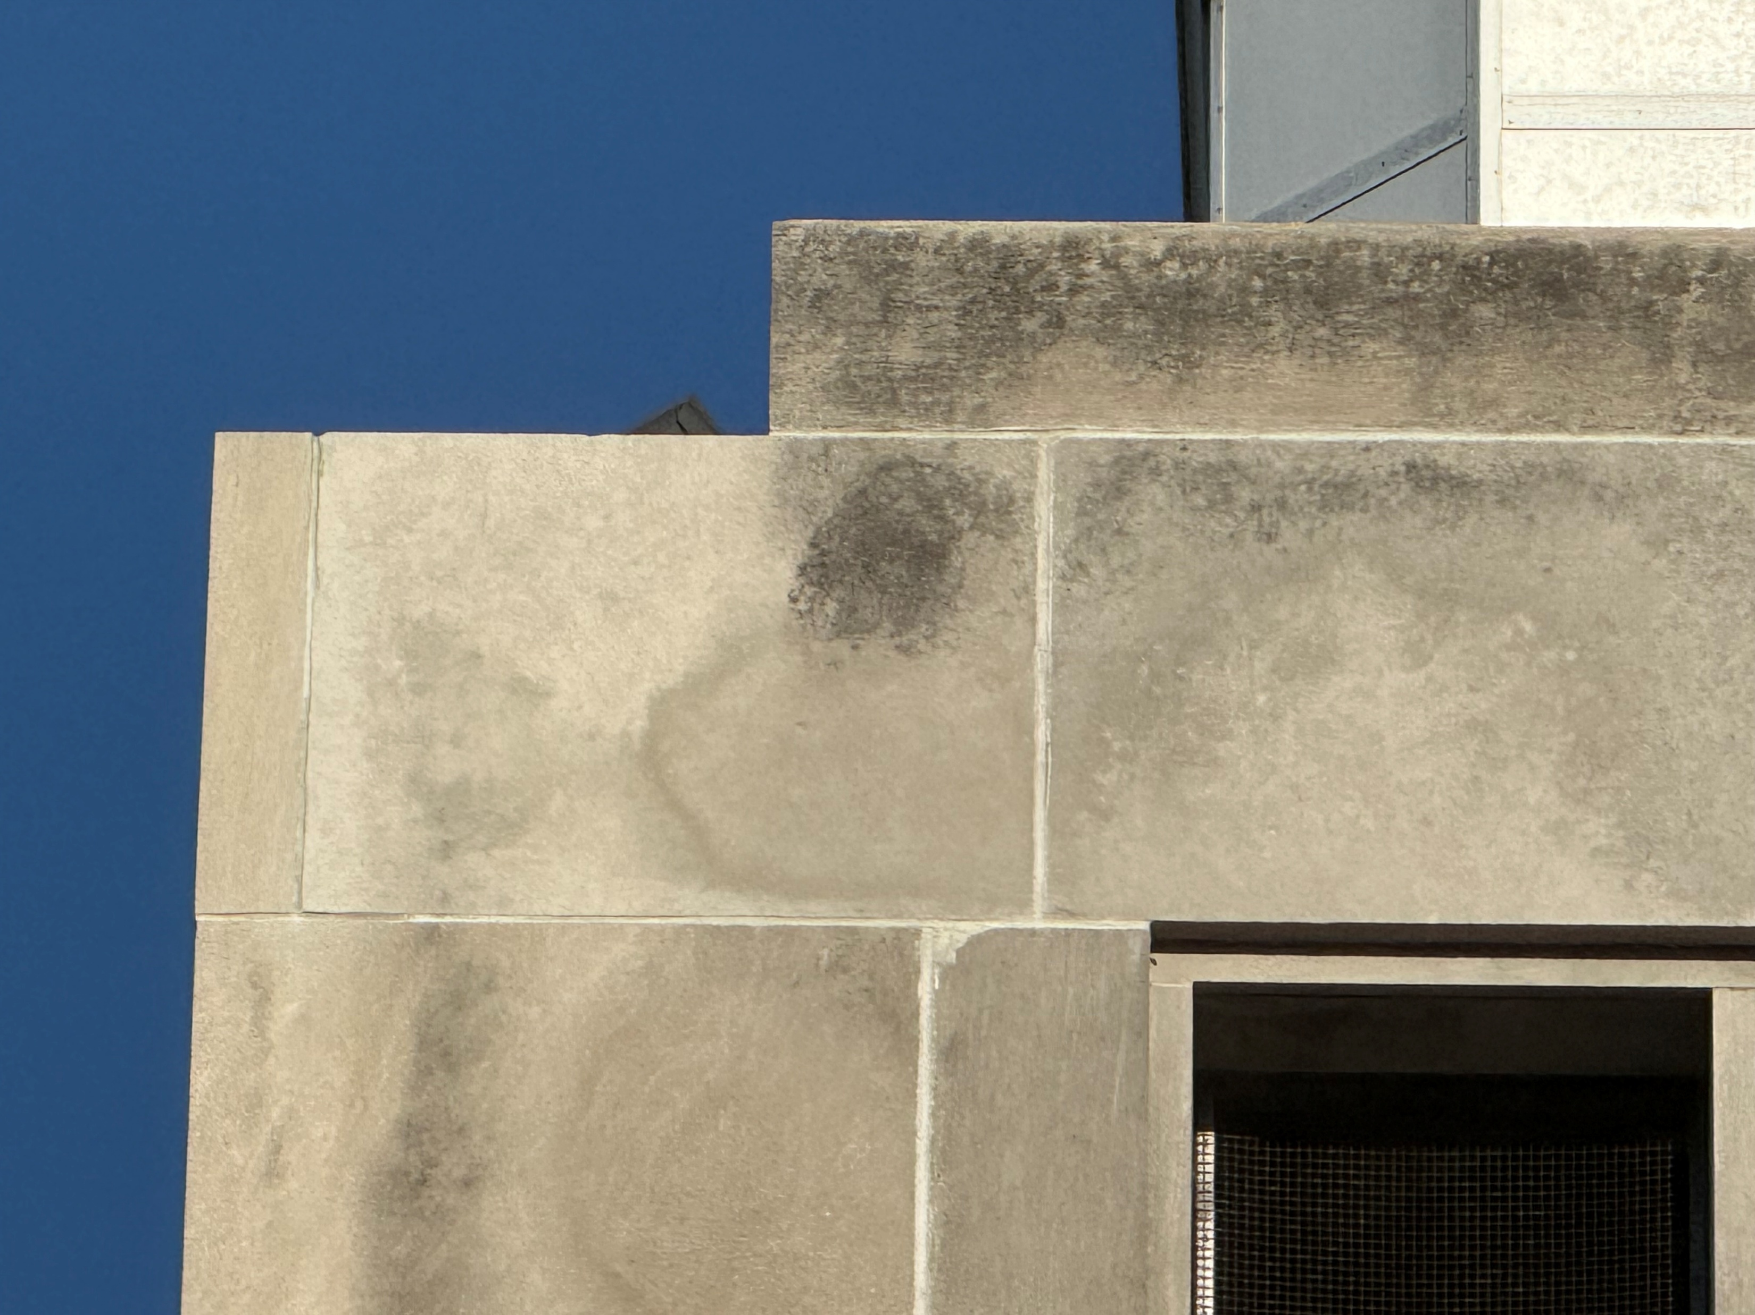
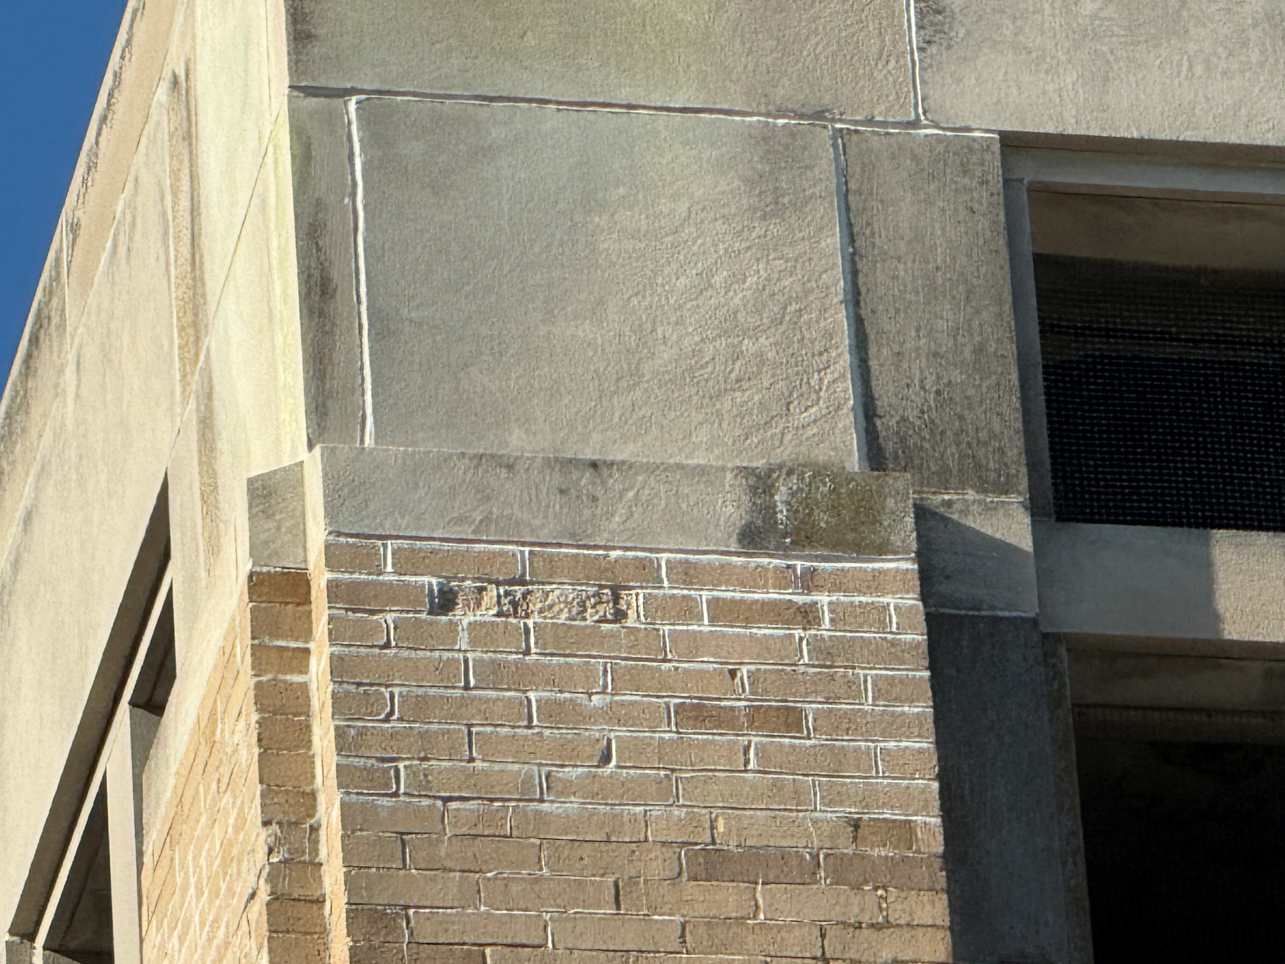
Saint Camillus Church Bell Tower Masonry Assessment
Photographic documentation
September 2025
Masonry staining and sealant degradation at bell tower exterior
Spalling masonry and mortar failure, atmospheric staining at bell tower exterior

Slide 15
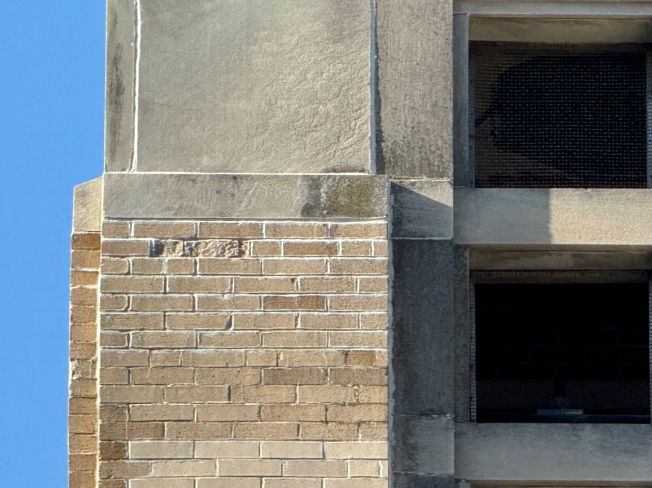
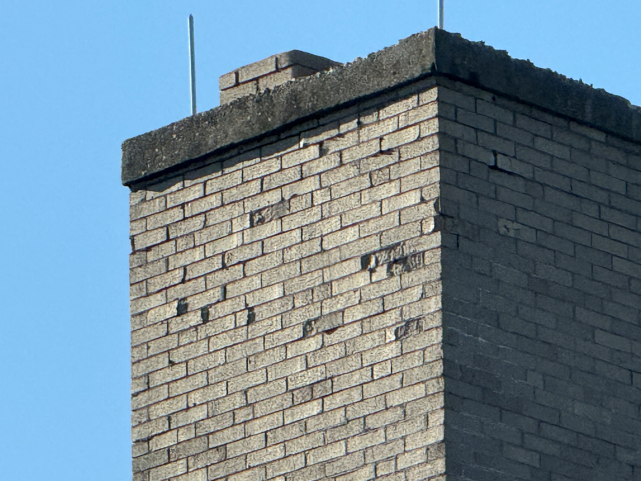
Saint Camillus Church Bell Tower Masonry Assessment
Photographic documentation
September 2025
Masonry spalling and mortar failure, atmospheric staining at bell tower exterior
Masonry spalling and mortar failure at north chimney facade

Slide 16
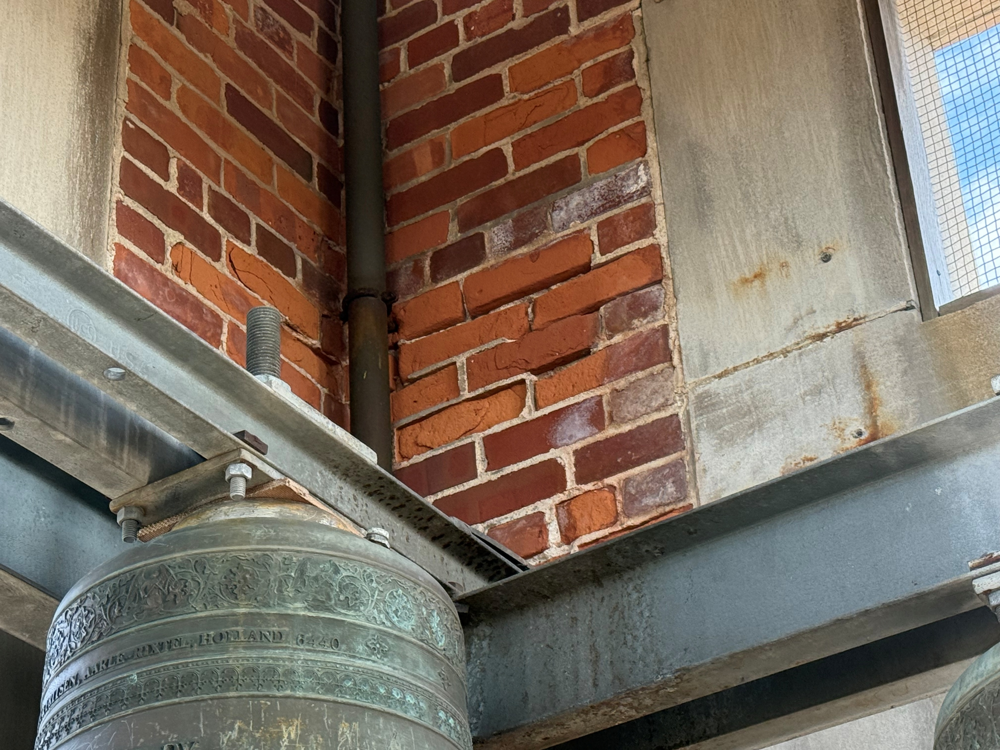
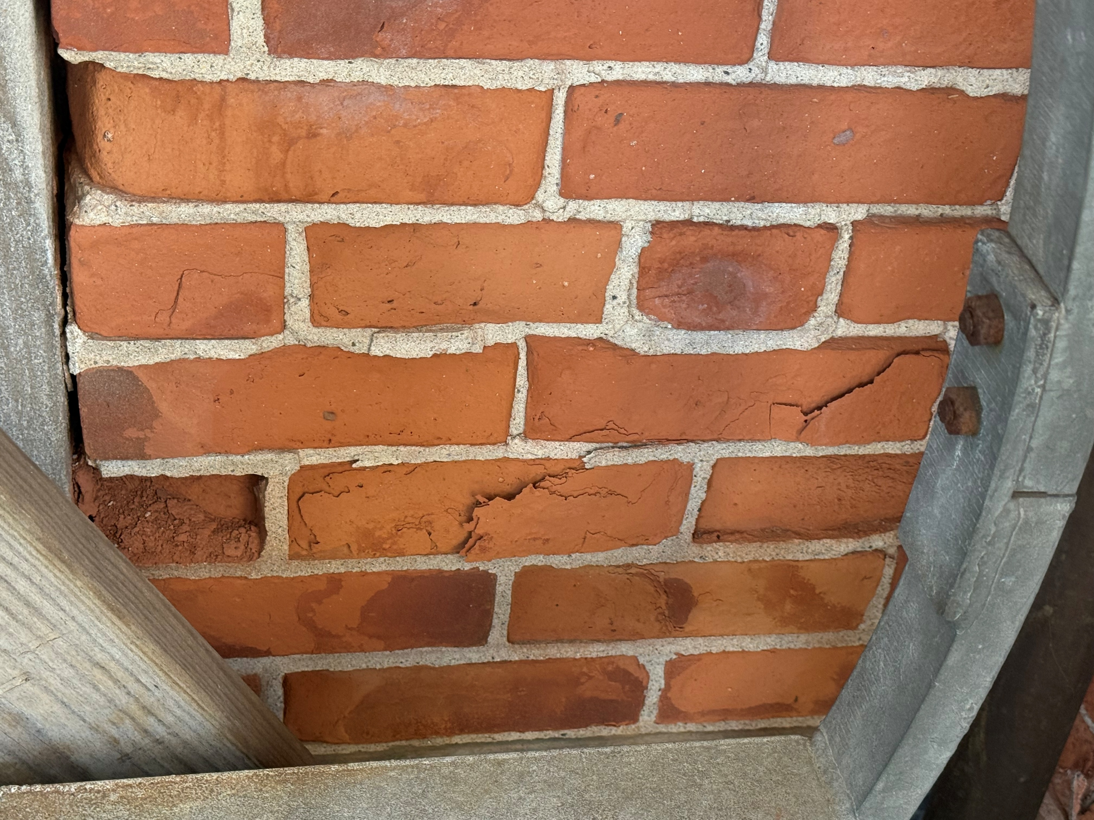
Saint Camillus Church Bell Tower Masonry Assessment
Photographic documentation
September 2025
Masonry and sealant degradation at bell tower interior
Masonry degradation at bell tower

Slide 17
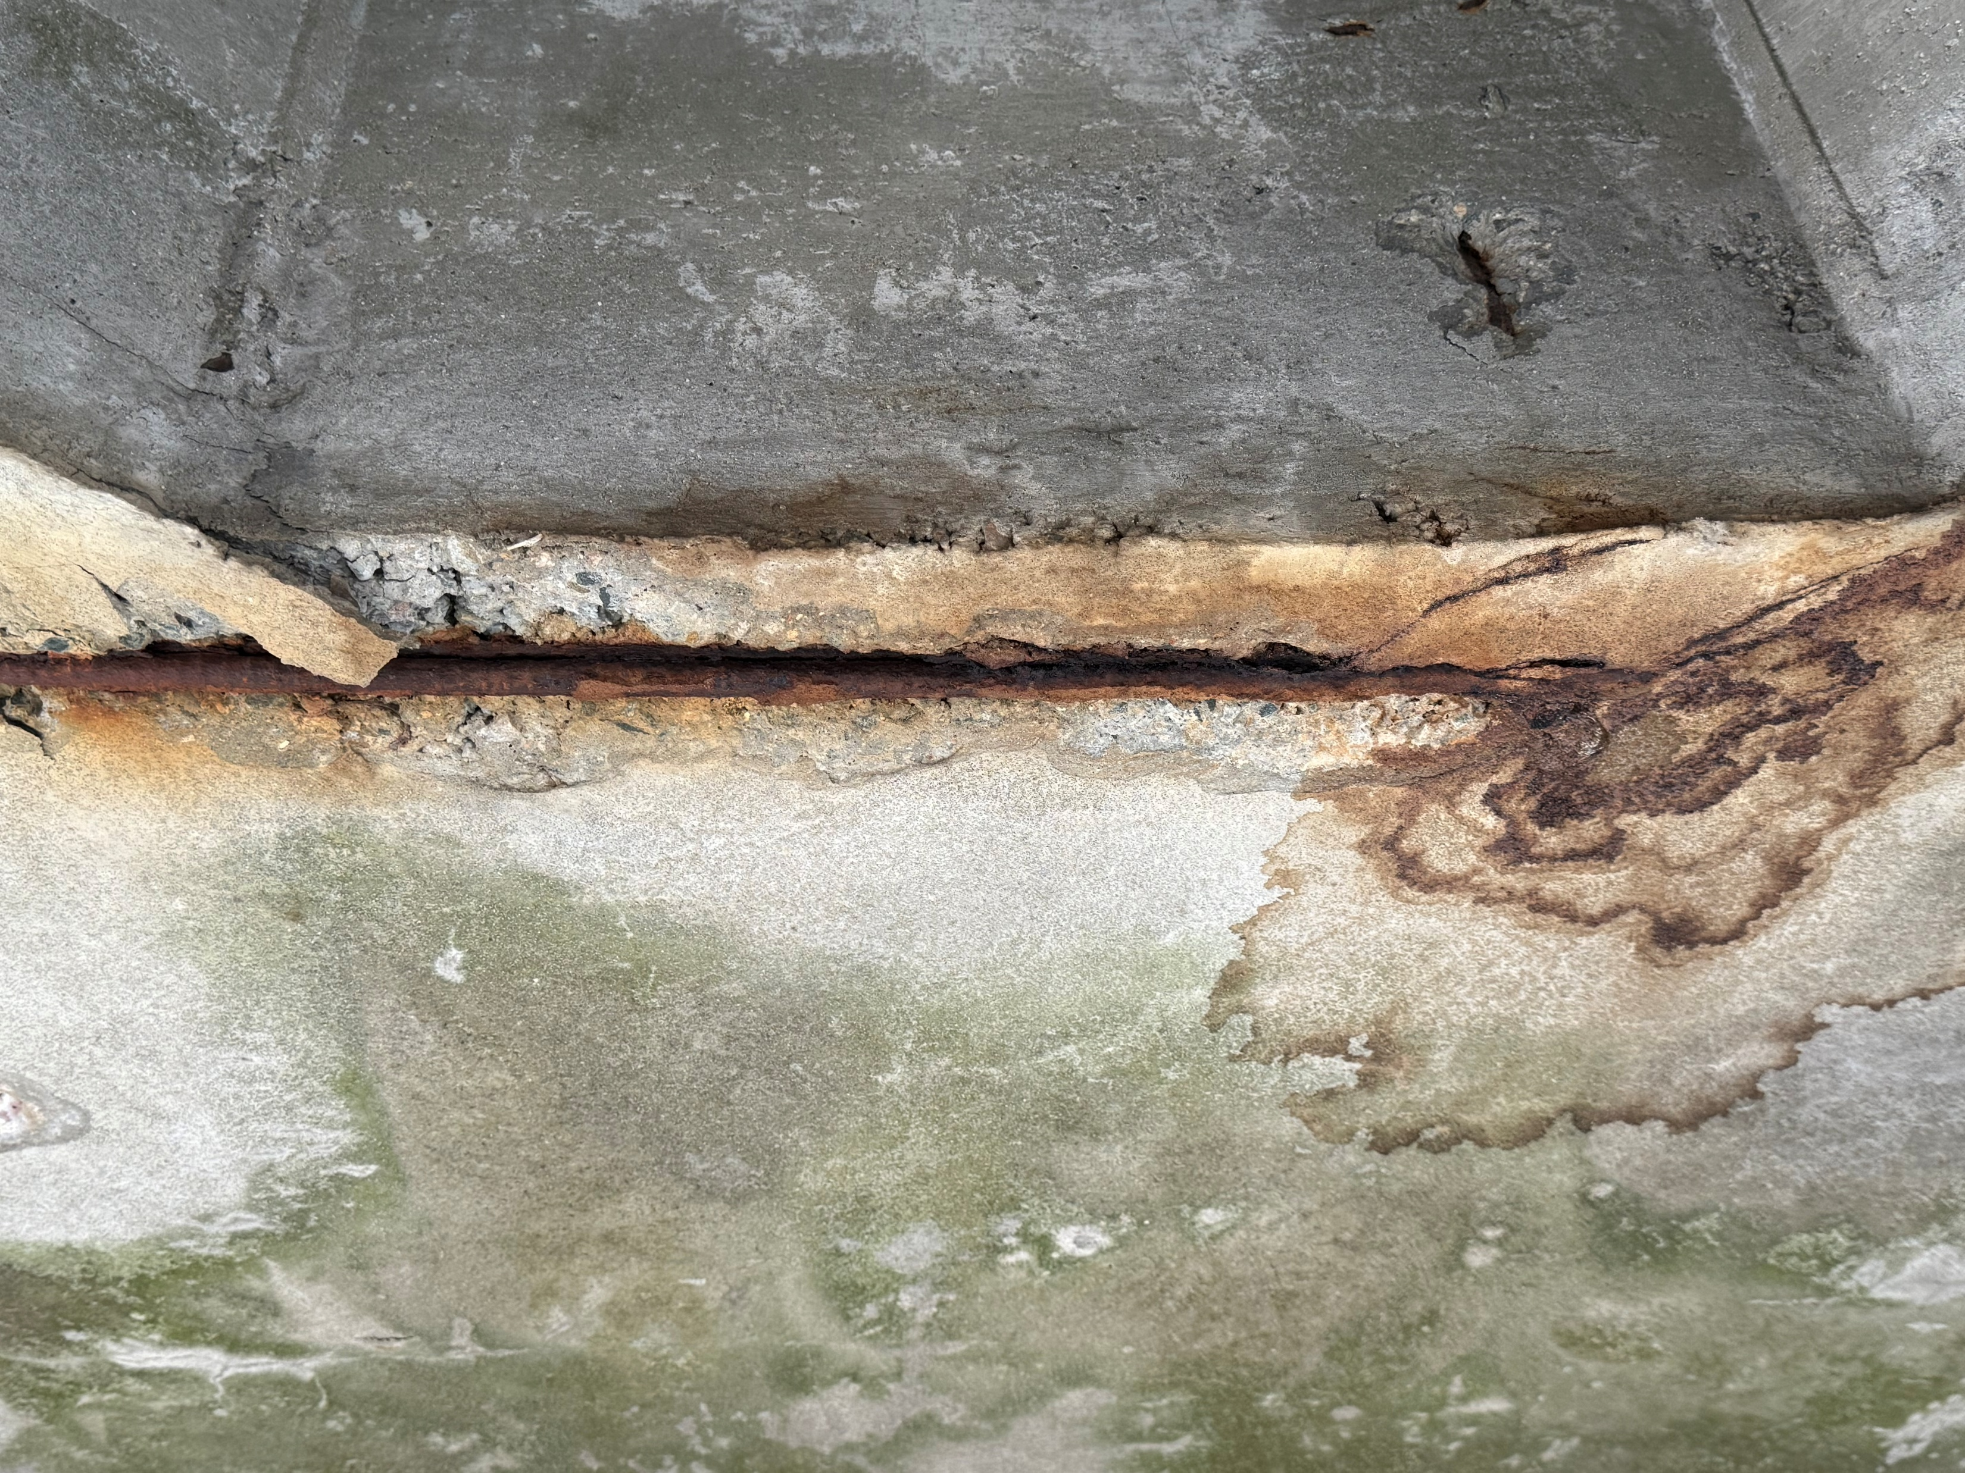
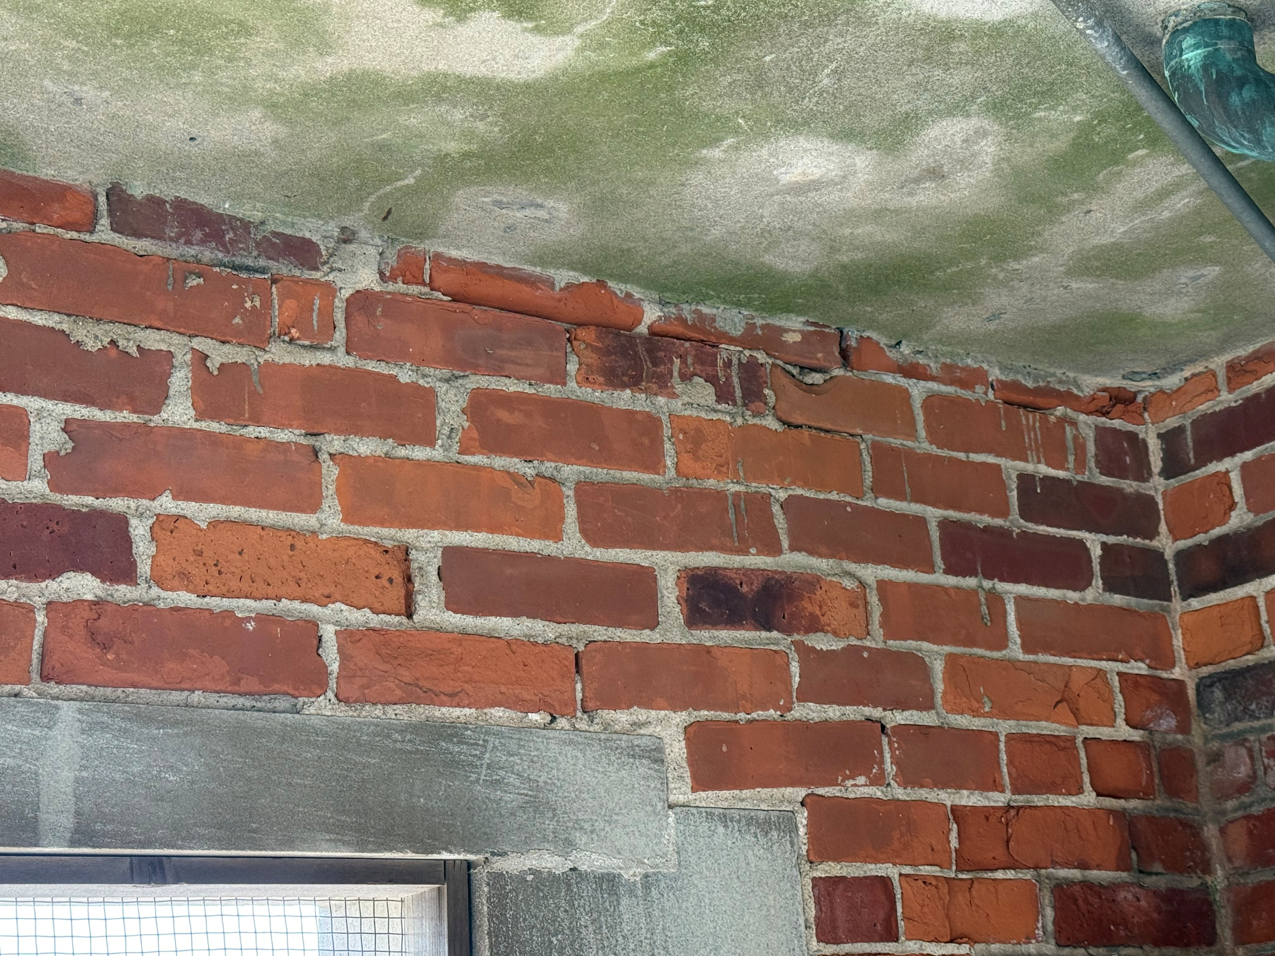
Saint Camillus Church Bell Tower Masonry Assessment
Photographic documentation
September 2025
Rust jacking of concrete deck and rebar deterioration below steeple
Masonry and sealant degradation at bell tower

