Slide 1
Le Puy, France
Notes:
October 2000, the French Federation of Sisters of St. Joseph hosted a celebration/symposium in honor of the 350th anniversary of our foundation. Representatives of the various Federations and International congregations were invited to attend. Included in these days was discussion on the charism and mission of the congregation in the light of the needs of the world today. The idea of undertaking a common project in the form of an International Centre in Le Puy-en-Velay surfaced at this gathering.

Slide 2
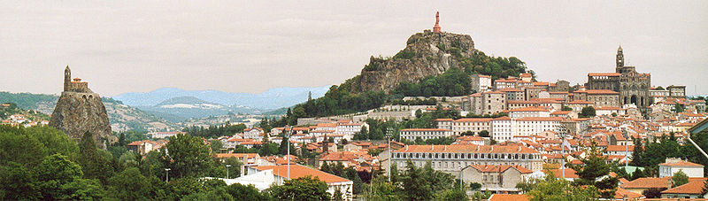
October 2000 Sisters worldwide gathered to celebrate the 350th anniversary of our foundation. At that time the idea of creating an International Centre in Le Puy emerged.

Slide 3
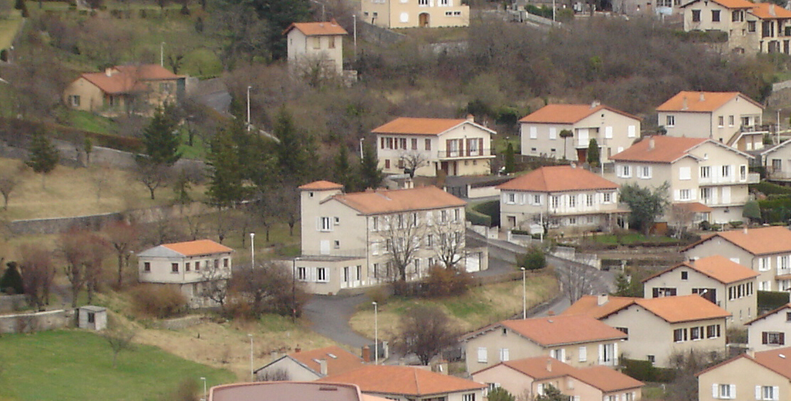
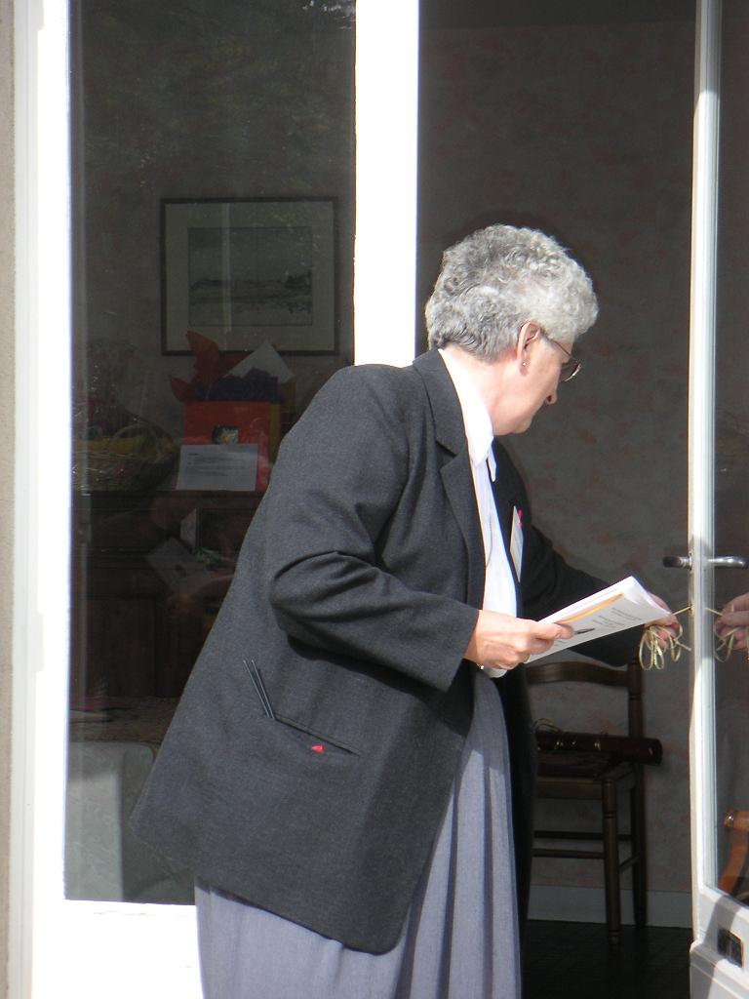
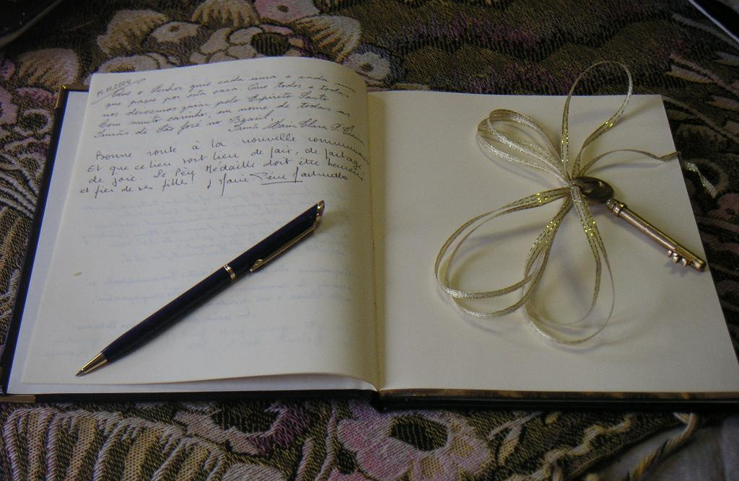
The Centre officially opened October 15, 2004
… in Aiguilhe, in a convent provided by Institute St. Joseph.

Slide 4
Mission Statement
Embracing the past, we will study and deepen our awareness of our history, tradition, and spirituality to ensure the preservation of our “story” for future generations.
Nurturing the present, we will engage Sisters of St. Joseph, associates, and lay partners in deepening their understanding of our mission and charism; we will do this within an international setting and with a global focus.
Creating a new future, we will interpret our charism in light of today’s world, and informed with this new understanding, help establish ways to incarnate the prayer “that all may be one,” particularly among the young and in areas in need of reconciliation.

Slide 5
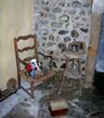
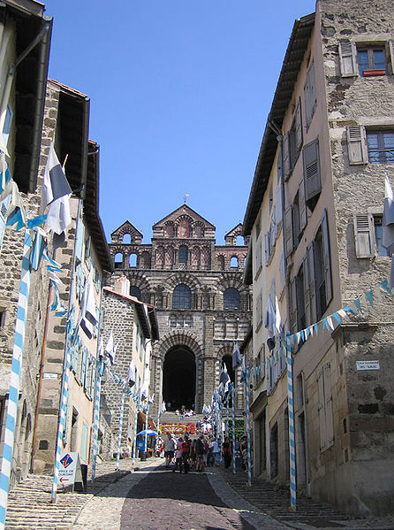
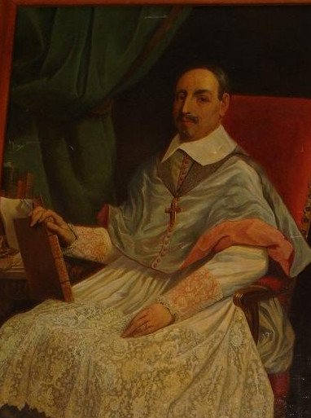
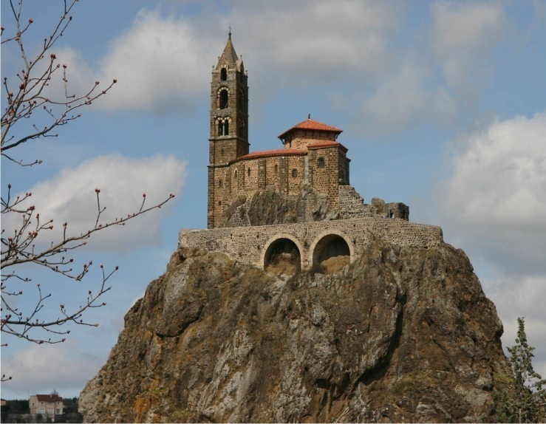
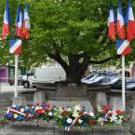
Embracing the past…
~ deepening awareness,
~ of history, tradition, spirituality,
~ study,
~ our story for future generations.
Notes:
Embracing the past, we will study and deepen our awareness of our history, tradition, and spirituality to ensure the preservation for our story for future generations.

Slide 6
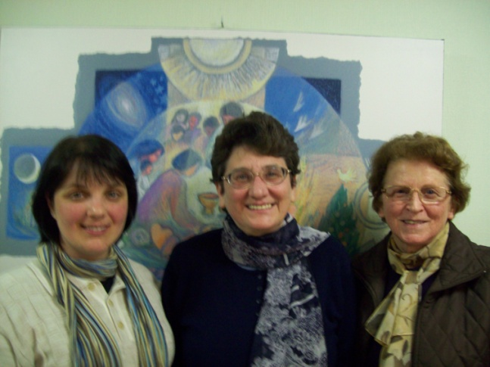
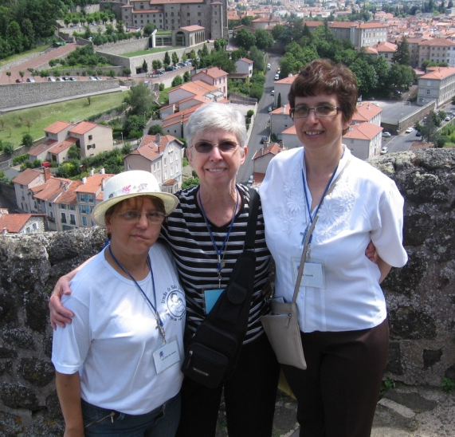
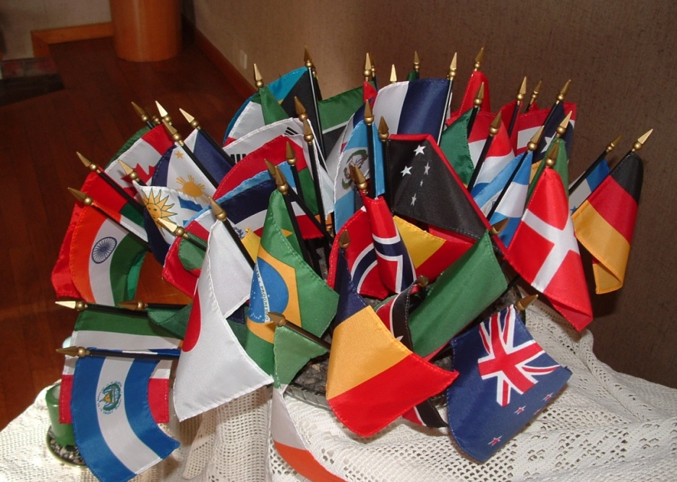
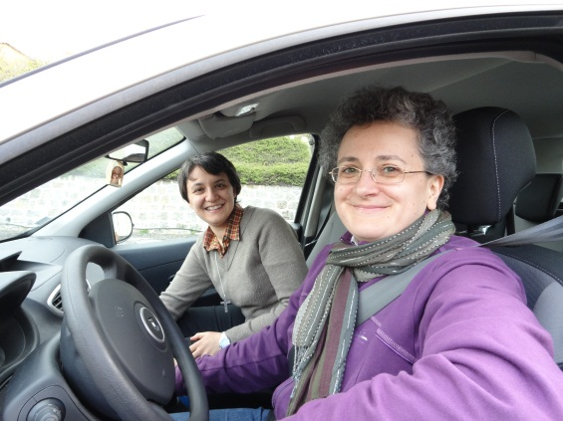
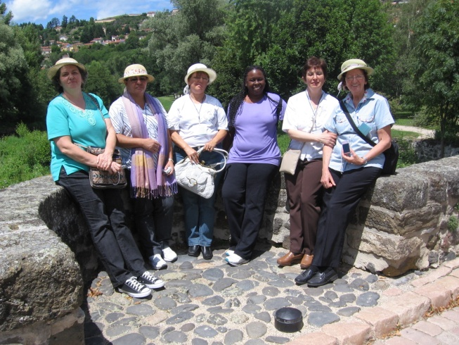
Nurturing the present…
Young Adults Program at the Centre
~ deeper understanding
of mission and charism
~ engaging
Sisters,
associates,
lay partners
~ international setting ~
with a global focus.
Notes:
Nurturing the present… by engaging Sisters of St. Joseph worldwide, associates and lay partners in deepening their understanding of our mission and charism… within an international setting and with a global focus.

Slide 7
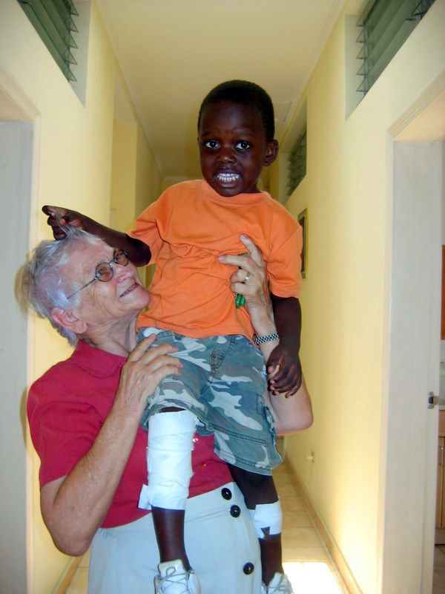
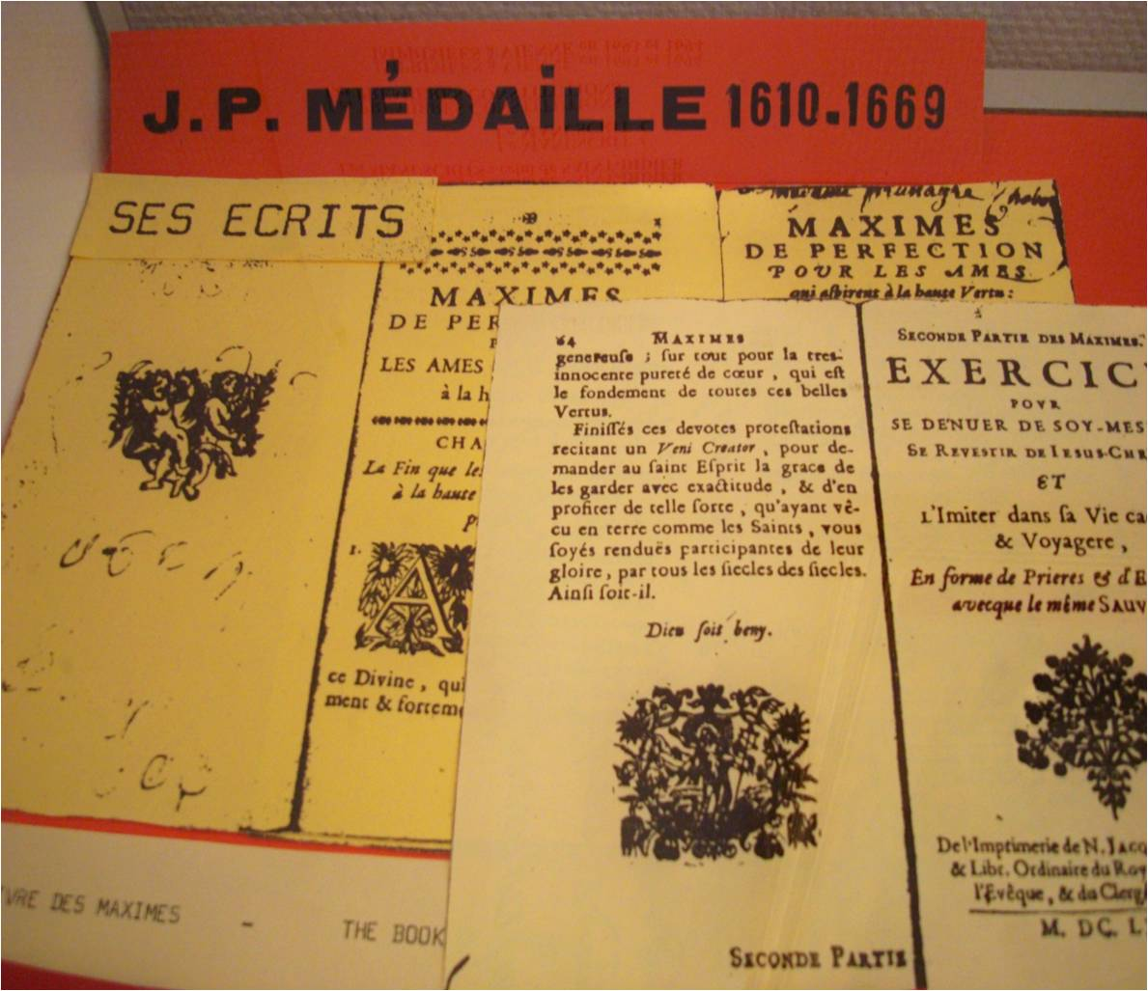
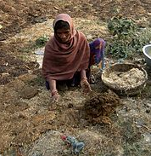

Creating a new future…
~ interpreting our charism in light of today’s world,
~ ways that ... “all may be one,” particularly among the young
and in areas in need of reconciliation.
Notes:
As we strive to … interpret our charism in light of today’s world, and informed with this new understanding, help establish ways to incarnate the prayer “that all may be one.” particularly among the young and in areas in need of reconciliation.

Slide 8
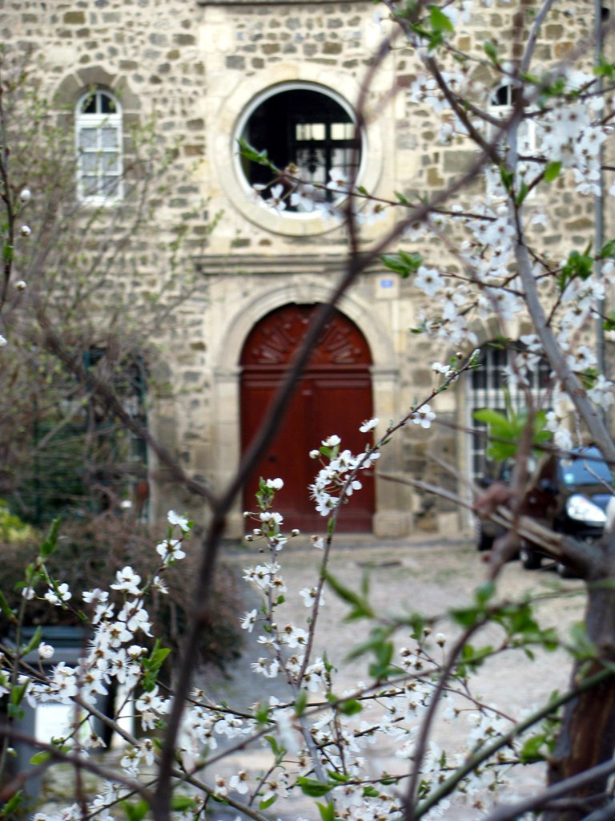
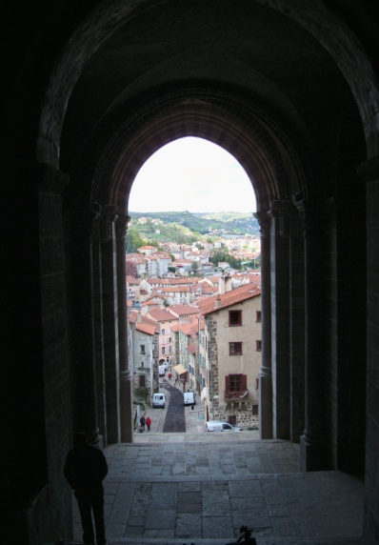
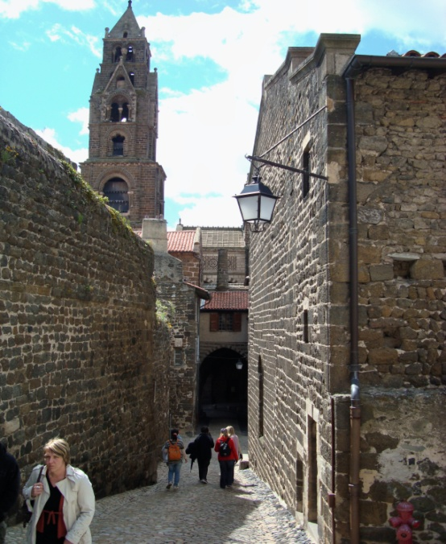
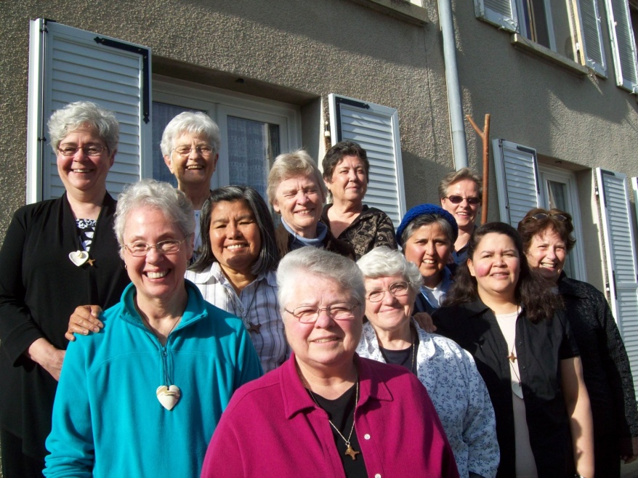
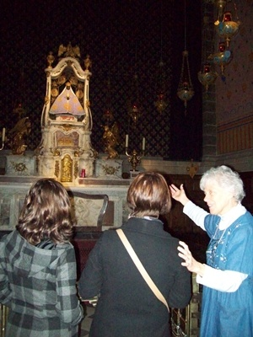
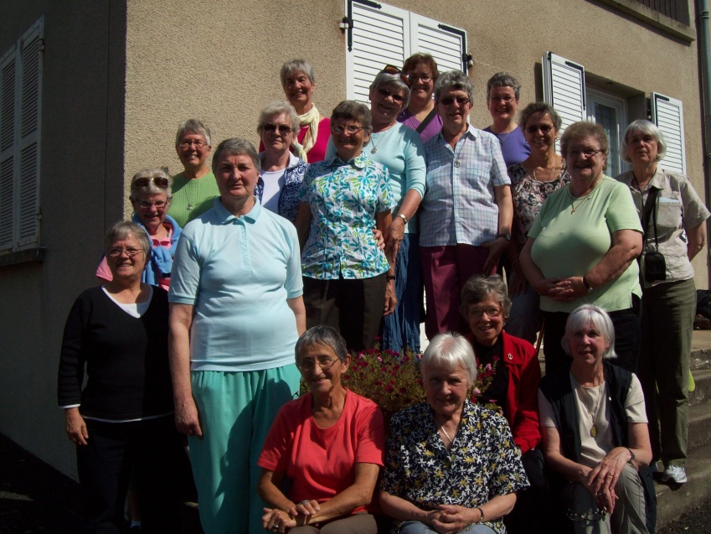
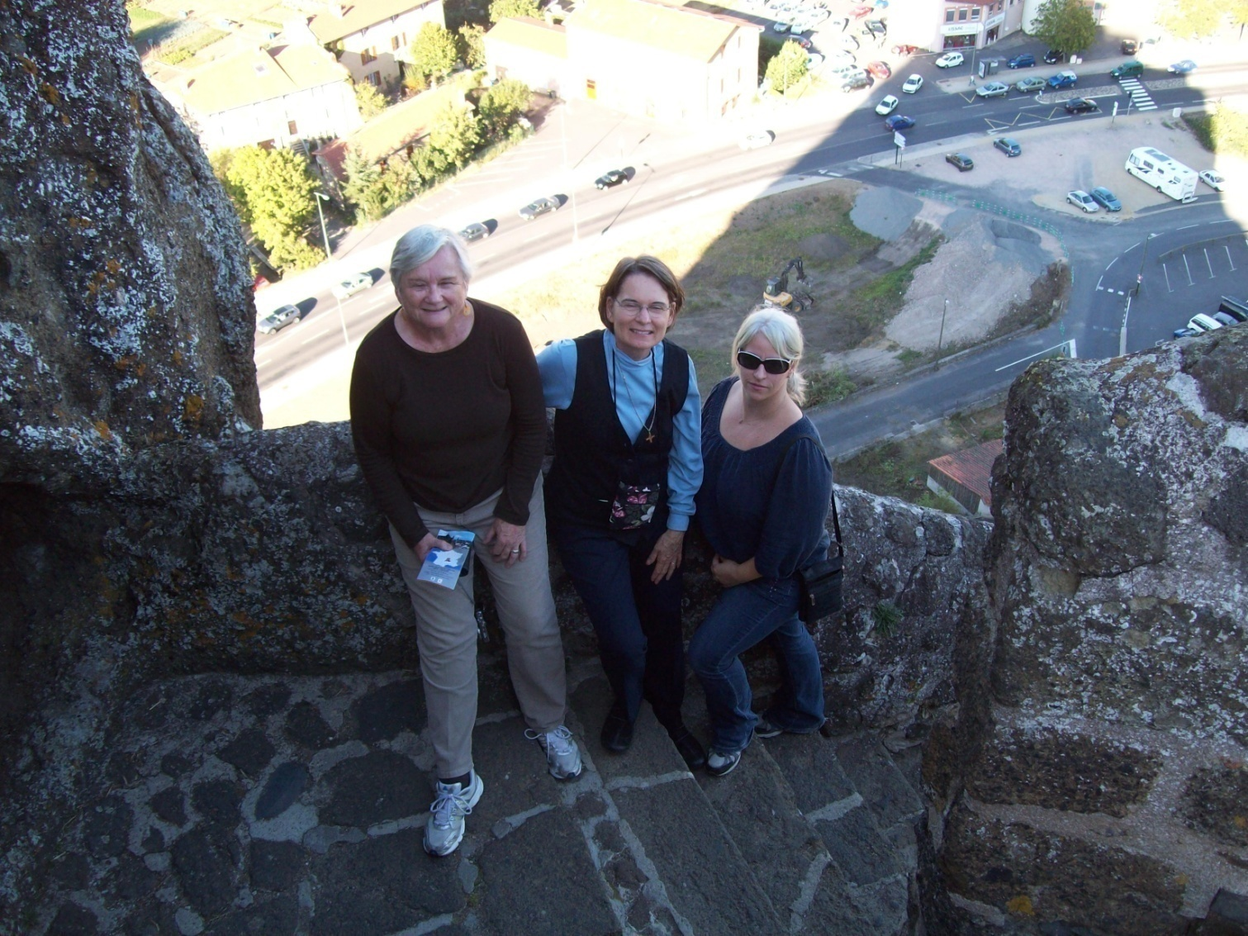
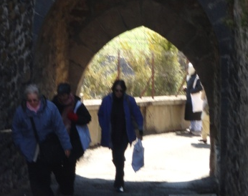
Sisters, associates and friends
experience our common touchstone.
“… Ask where the good road is, the godly paths you used to walk in, in the days of long ago. Travel there, and you will find rest for your souls.”
~ Jeremiah 6:16

Slide 9
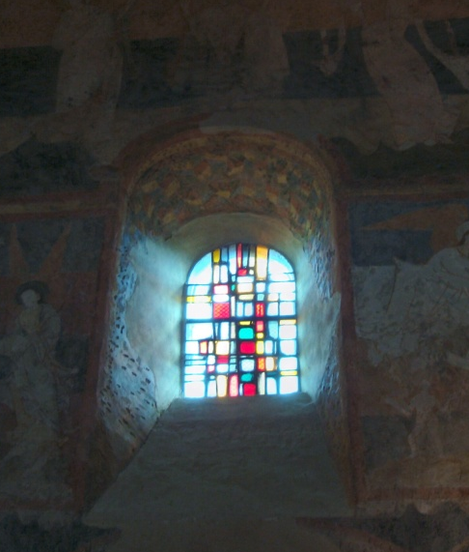
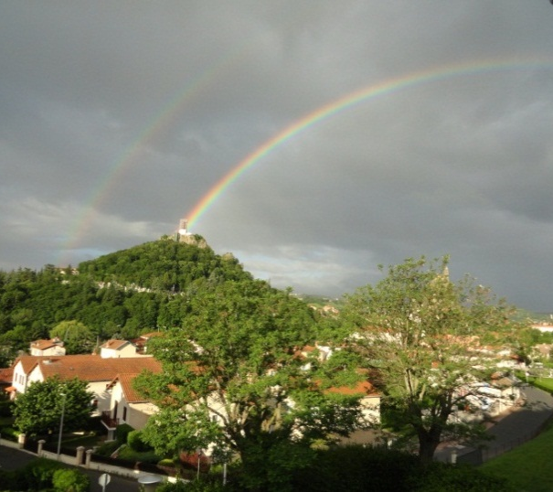
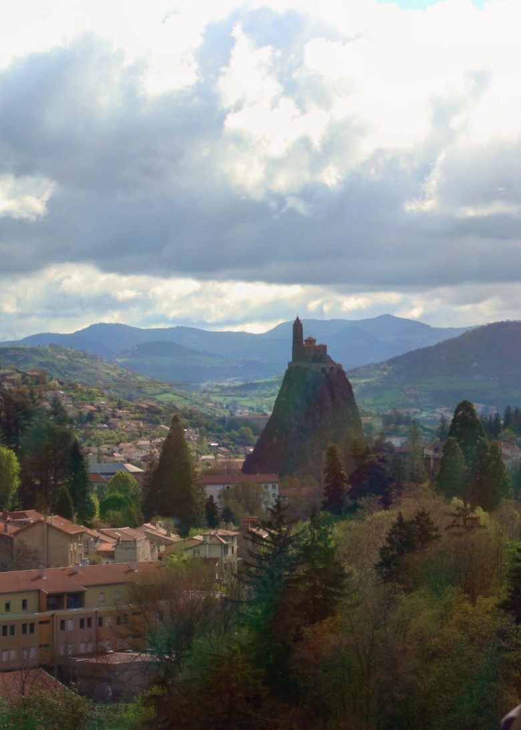
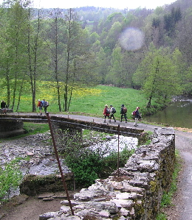
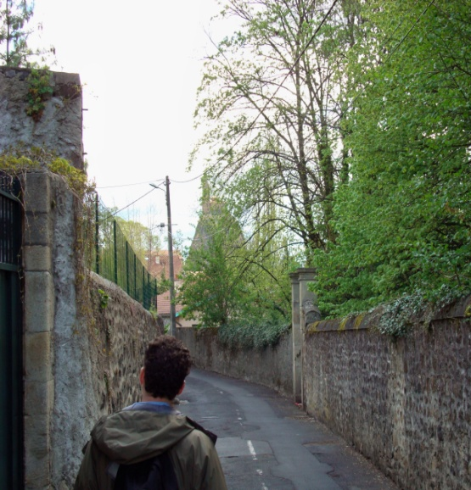
Some come … searching within…
The longest journey
Is the journey inwards
Of him who has chosen his destiny ~ Dag Hammarskjöld
Notes:
Pilgrimage- CSJ Orange California and Canadien Federation.

Slide 10
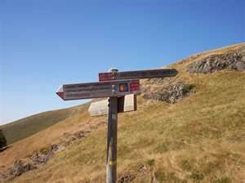
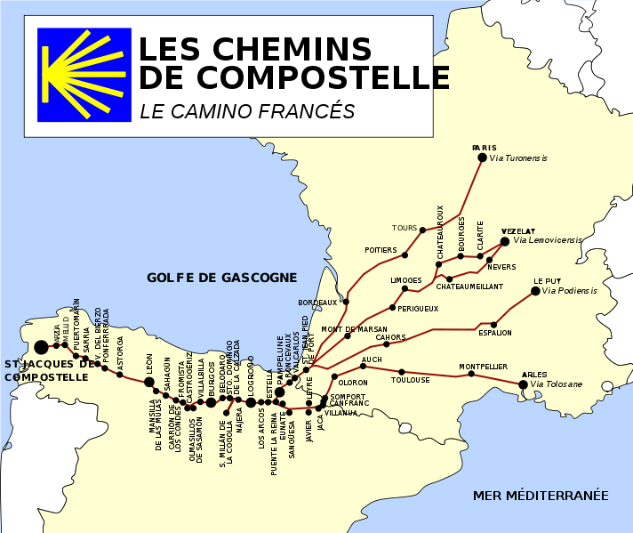

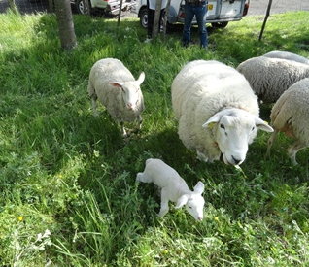
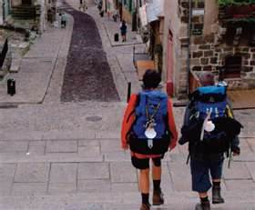
Others… to walk the camino Compostelle…
~
Solvitur ambulando. It is solved by walking.
~ St. Augustine

Slide 11
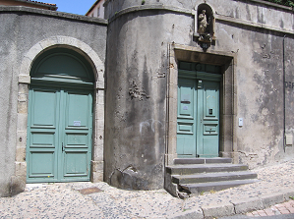
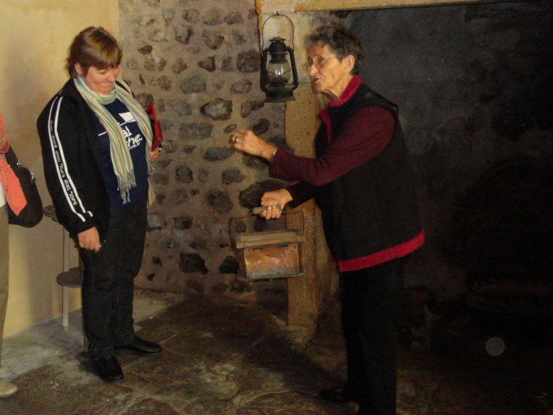
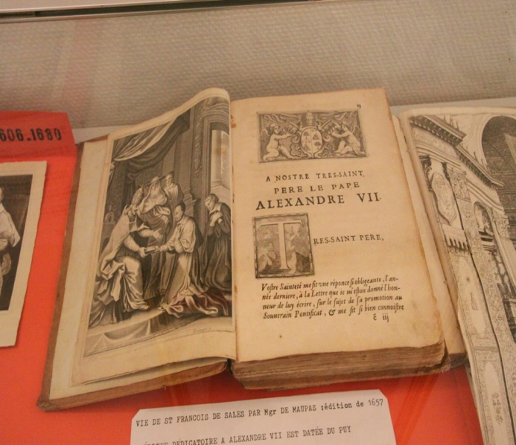
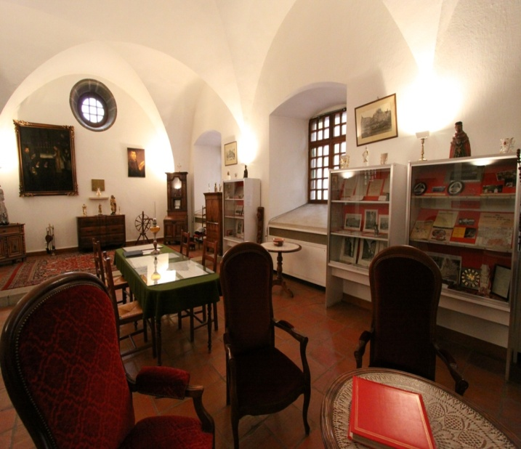
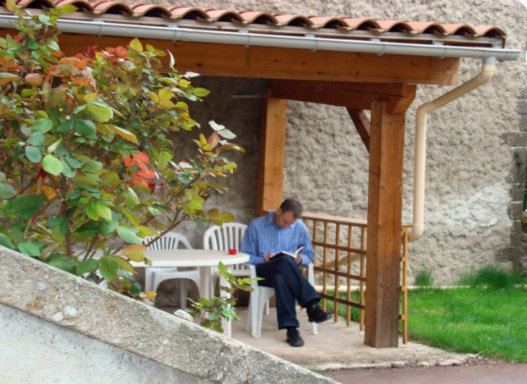
Others come to study our roots,
~ striving to interpret the charism …
in light of today’s reality.

Slide 12

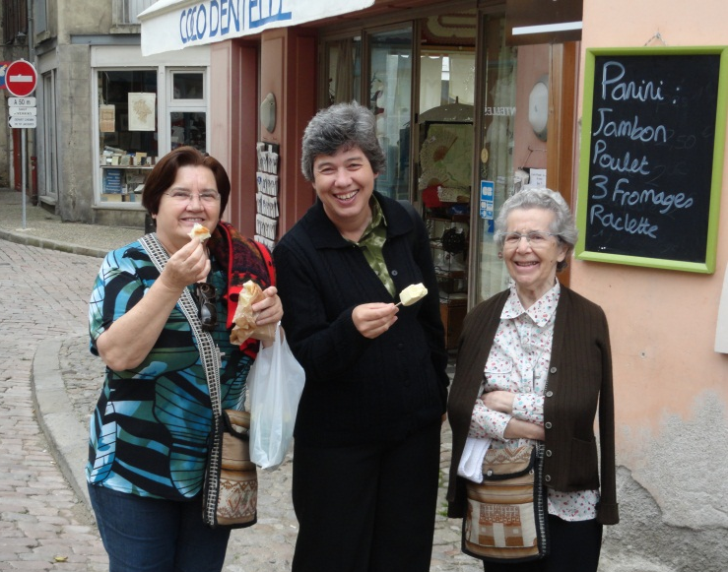
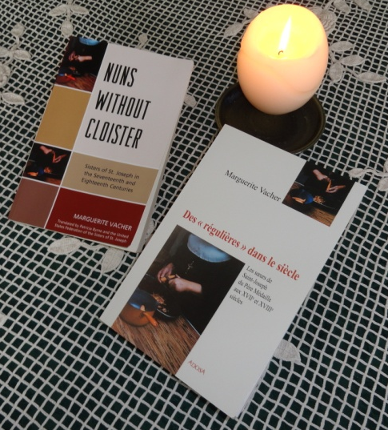
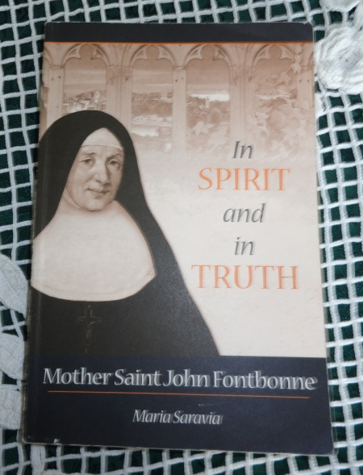
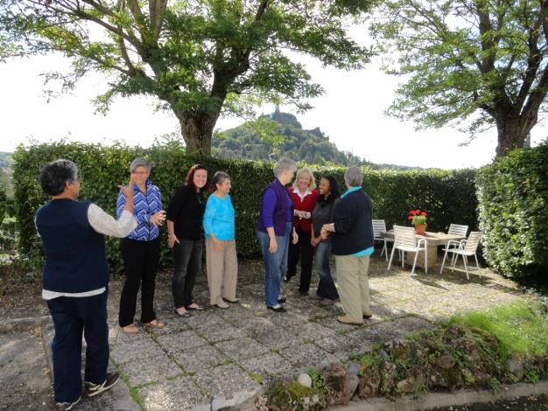
Centre International sponsors programs and pilgrimages…
History and Heritage
Mission
Effectiveness
Program

Slide 13
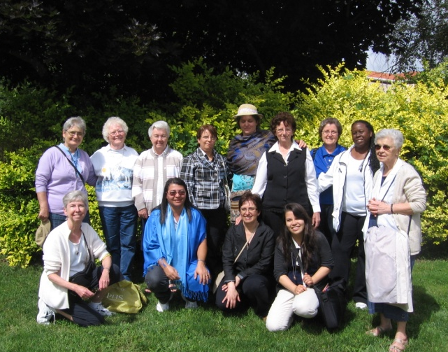
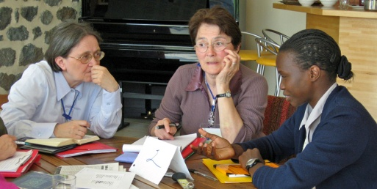
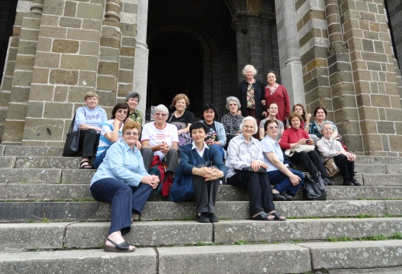
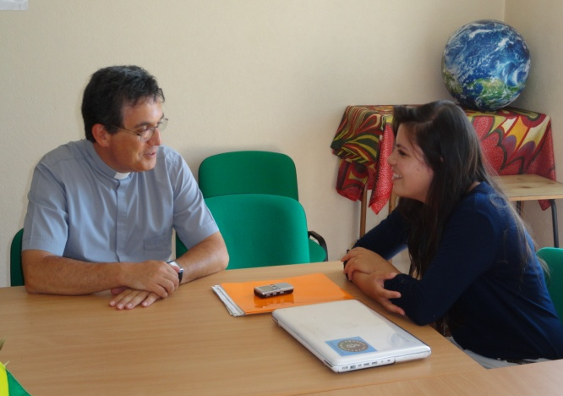
for Sisters of St. Joseph worldwide, associates and partners in mission.
Walking in the Footsteps of our Founders Program

Slide 14

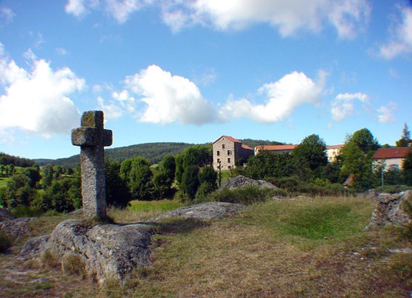
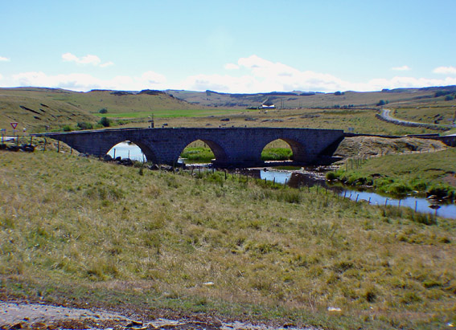

Throughout the year, the Centre offers individually designed retreats, visits.
~ personal renewal,
spiritual direction
~ walk at a different pace…
~ rest, reflect and renew.

Slide 15
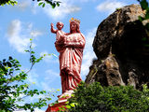




Notre Dame
May the stars light your way
and may you find the interior road.
Forward!
~ traditional Irish farewell
St. Michel
Typical private room at Centre International, facing Le Puy.

Slide 16

To contact Centre International:
centre.international@wanadoo.fr
To learn more about Centre International:
www.centreinternationalssj.org

