Slide 1
Modern Church/America
1900-2000

Slide 2
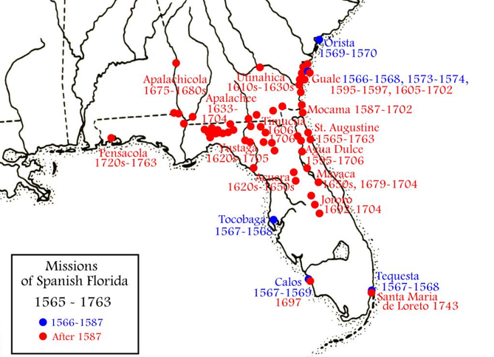
Spanish Florida

Slide 3
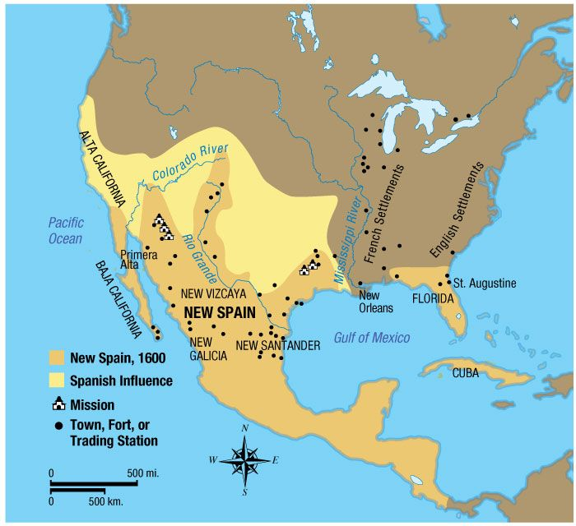
New Spain

Slide 4
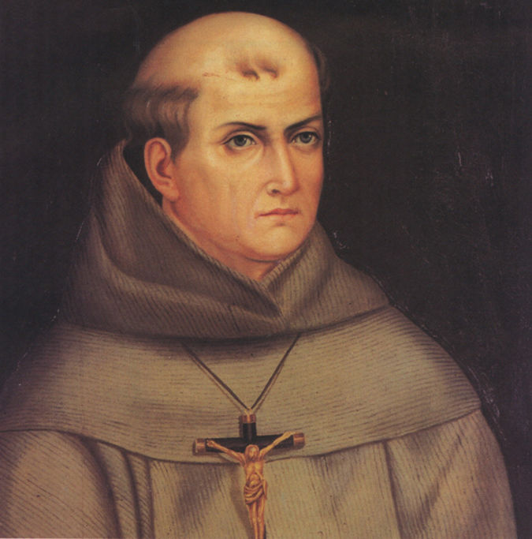
St. Junipero Serra (1713-1784)

Slide 5
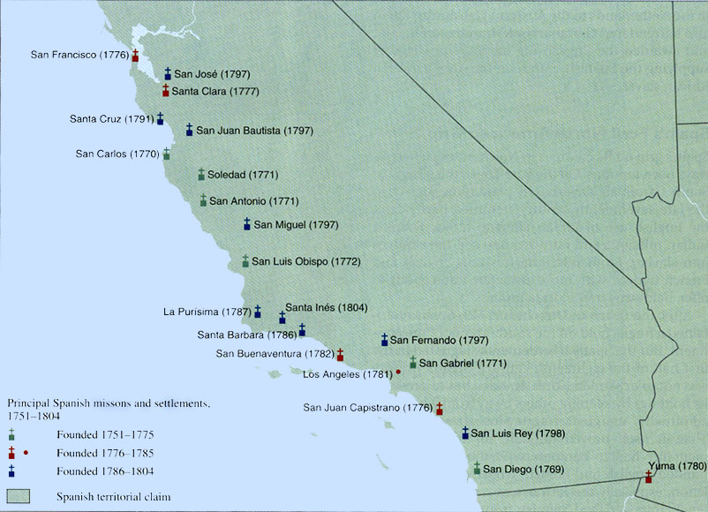
California Missions

Slide 6
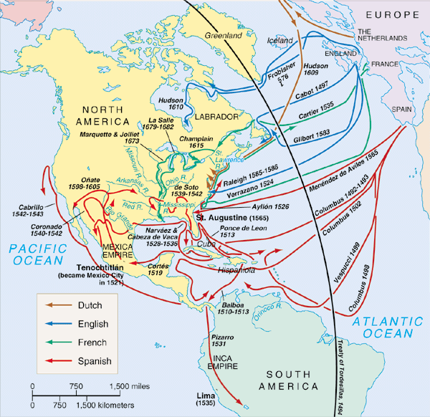
Northwest Passage

Slide 7
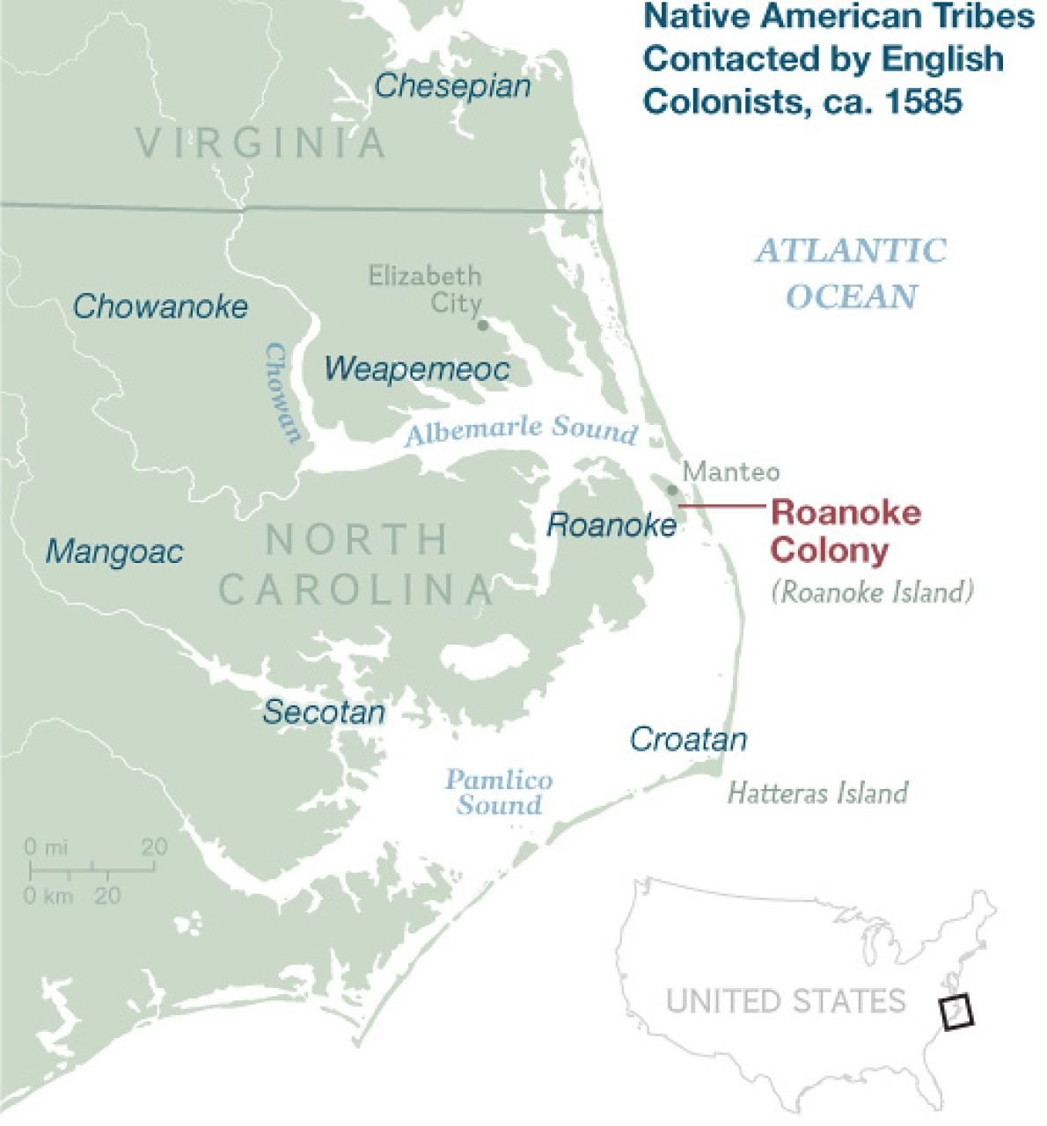
Roanoke Island (1585-1590)

Slide 8
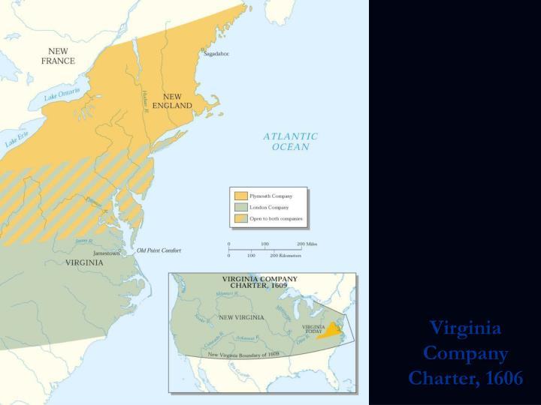
Virginia Company 1606

Slide 9
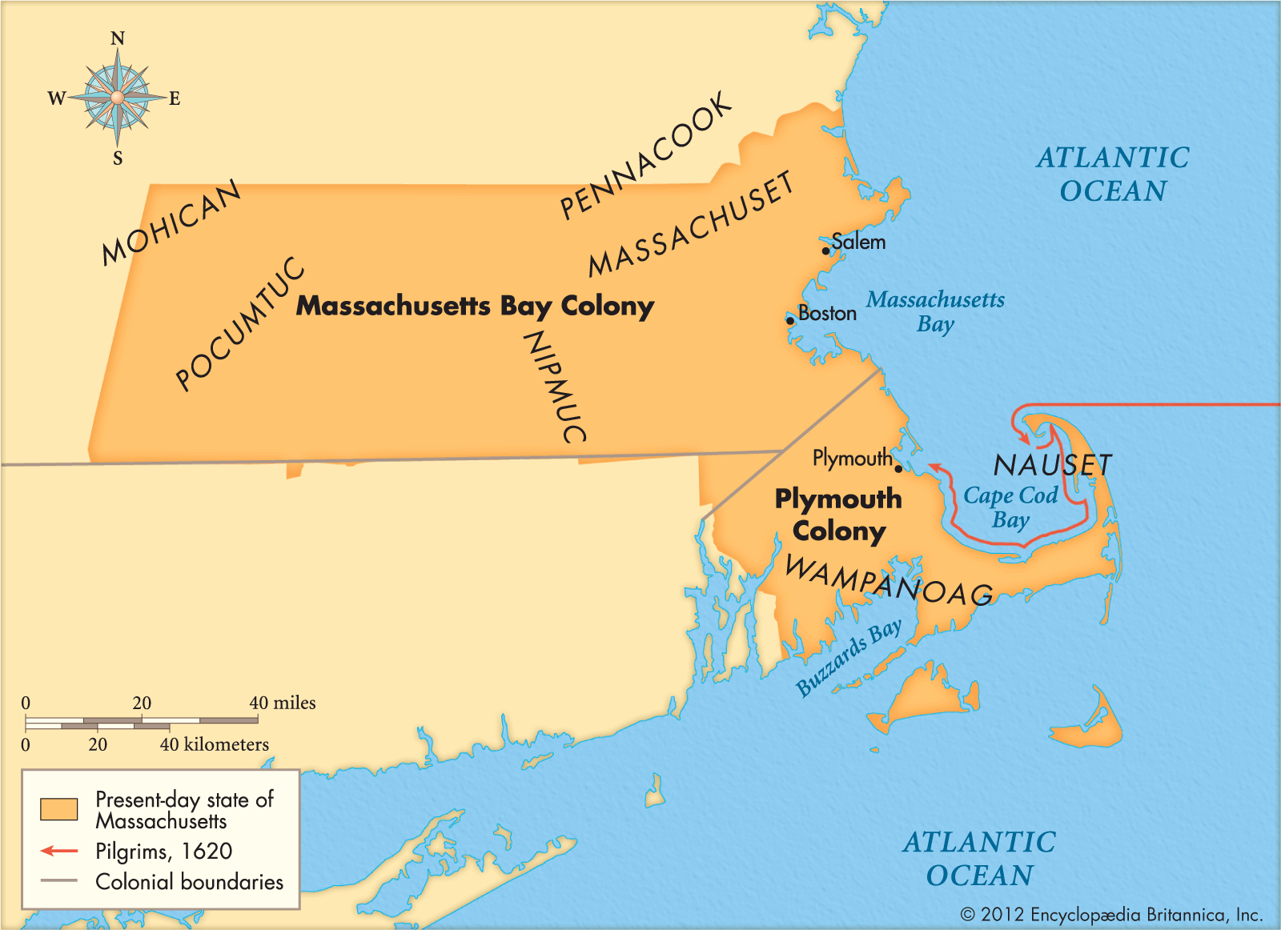
Plymouth and Massachusetts Bay Company

Slide 10
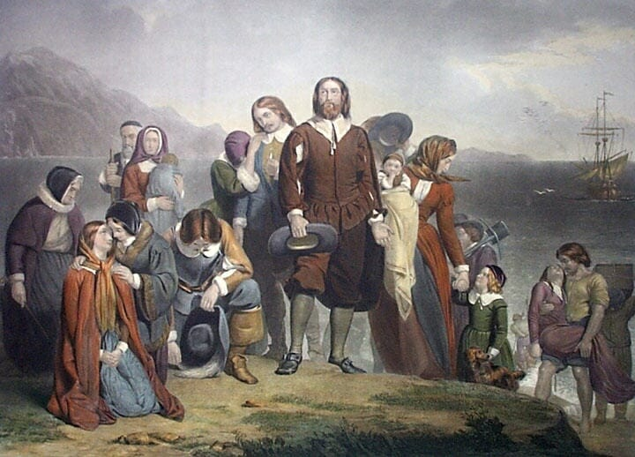
Puritans

Slide 11
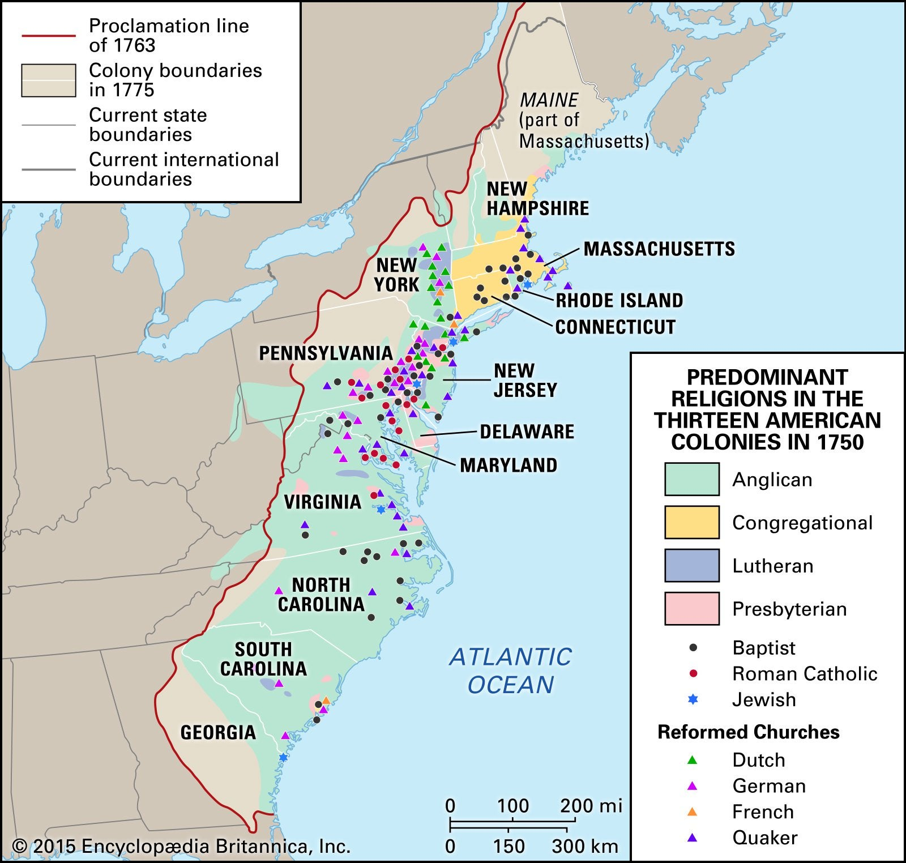
Colonies

Slide 12
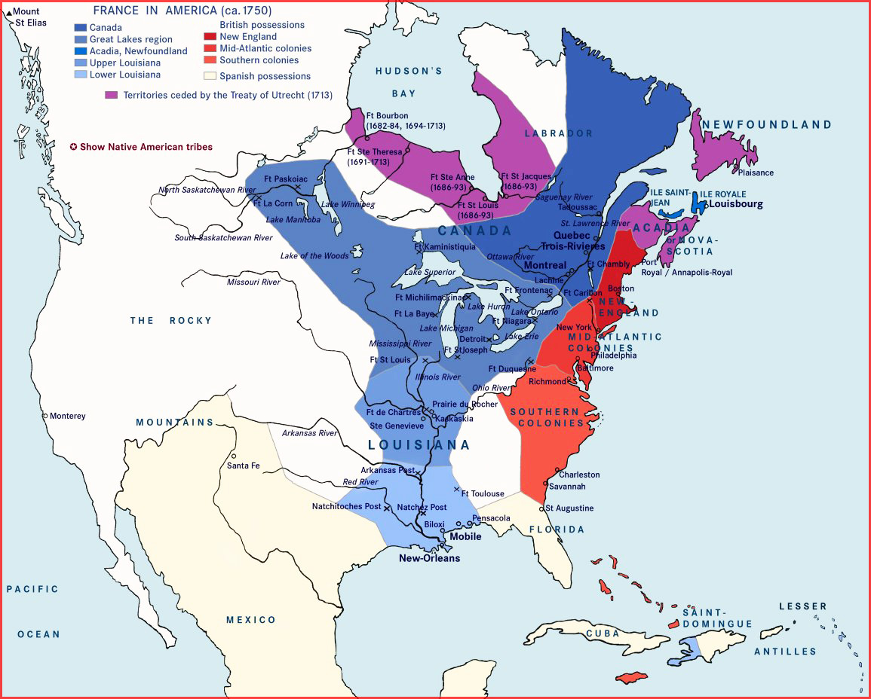
French Colonies

Slide 13
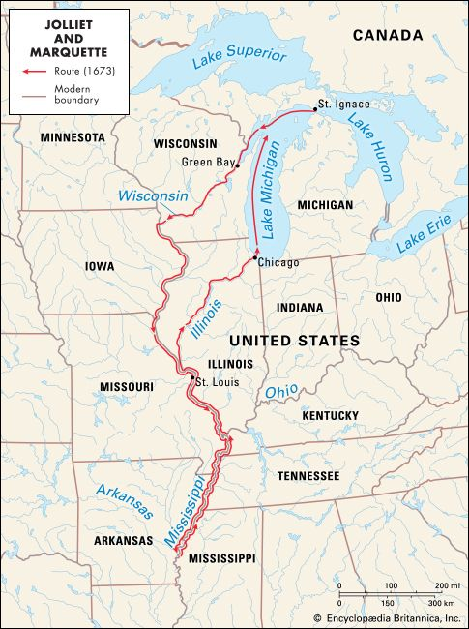
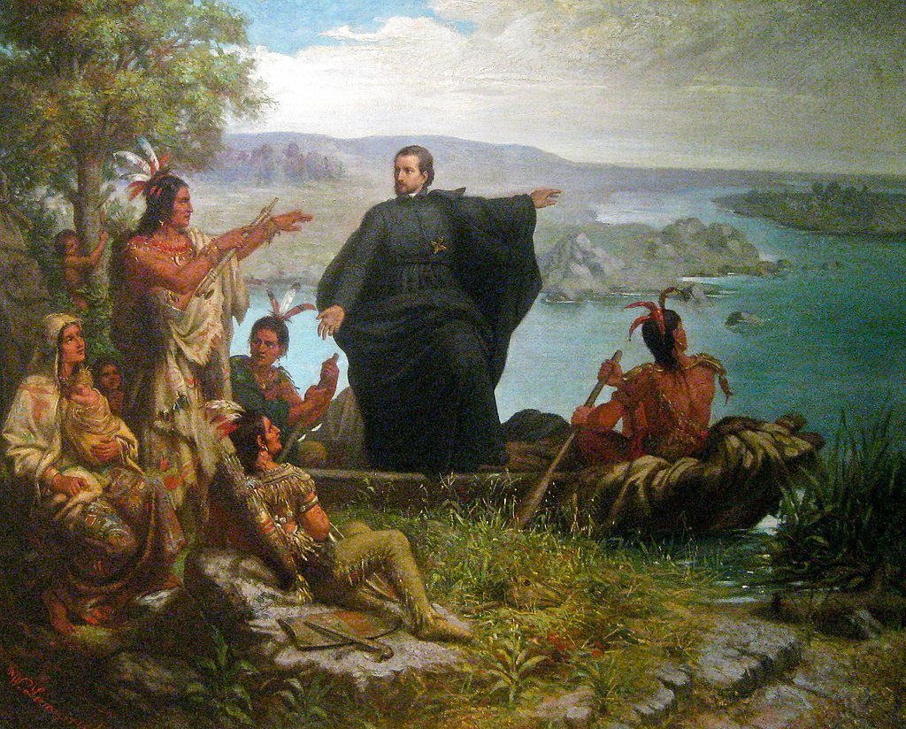
Jacques Marquette (1637-1675)

Slide 14
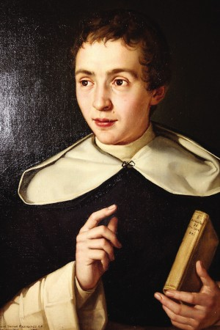
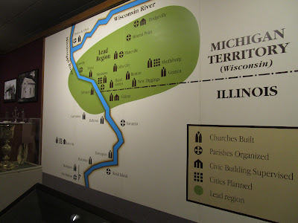
Samuel Mazzuchelli (1800-1864)

Slide 15
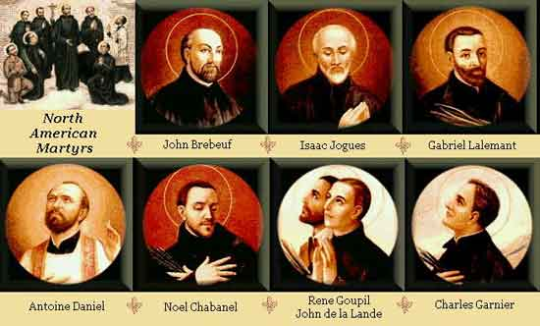
North American Martyrs

Slide 16
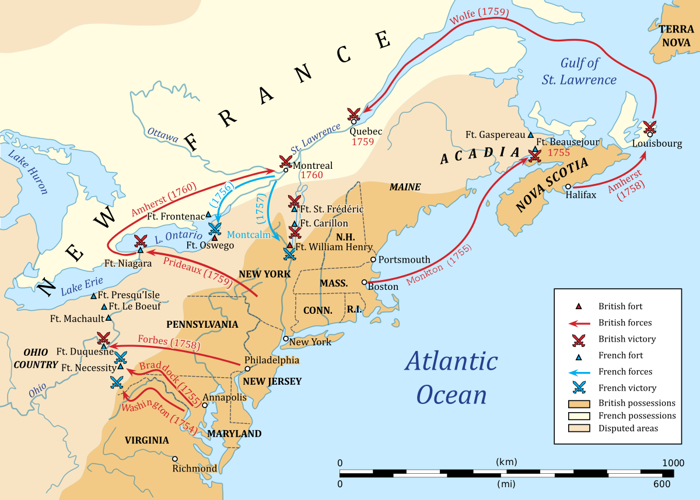
French and Indian War (1754-1763)

Slide 17
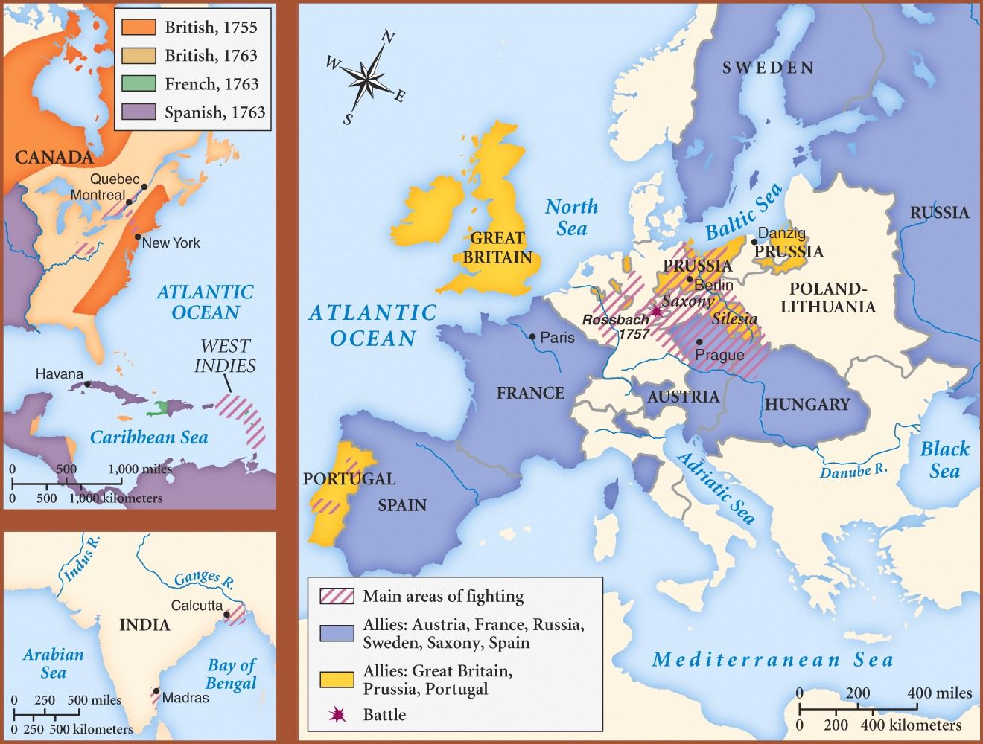
Seven Years’ War (1756-1763)

Slide 18
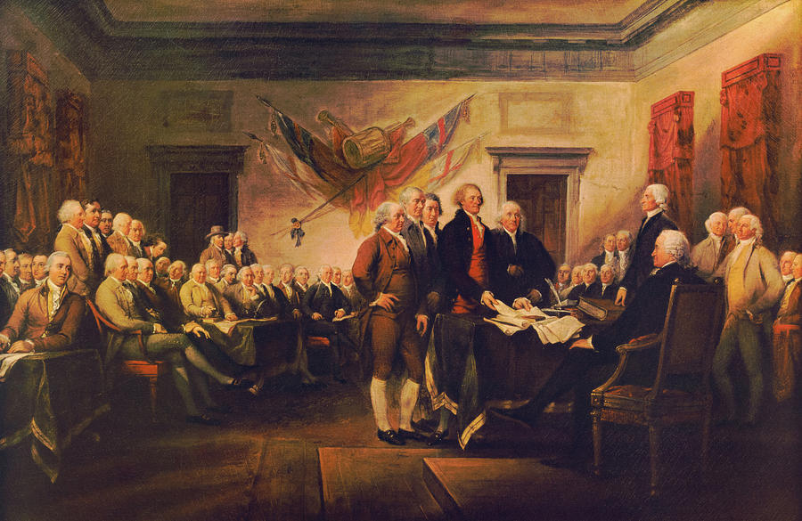
Declaration of Independence

Slide 19
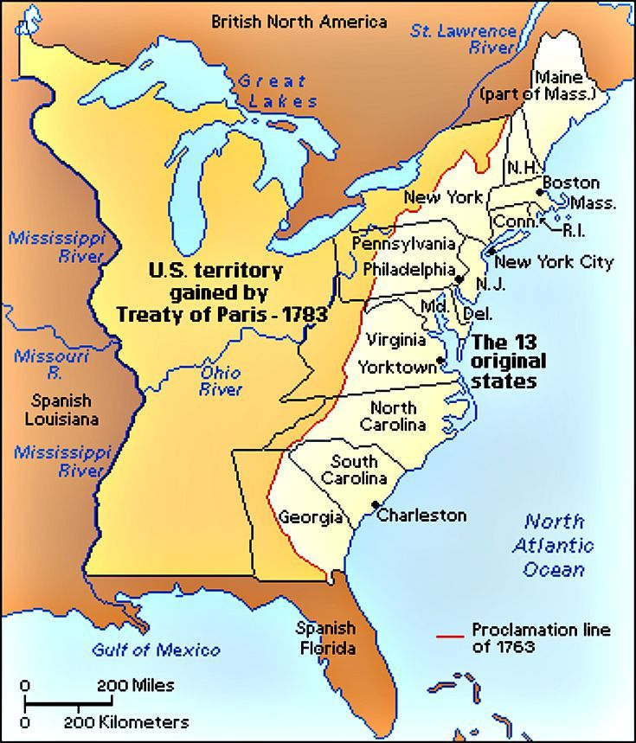
Treaty of Paris 1783

Slide 20
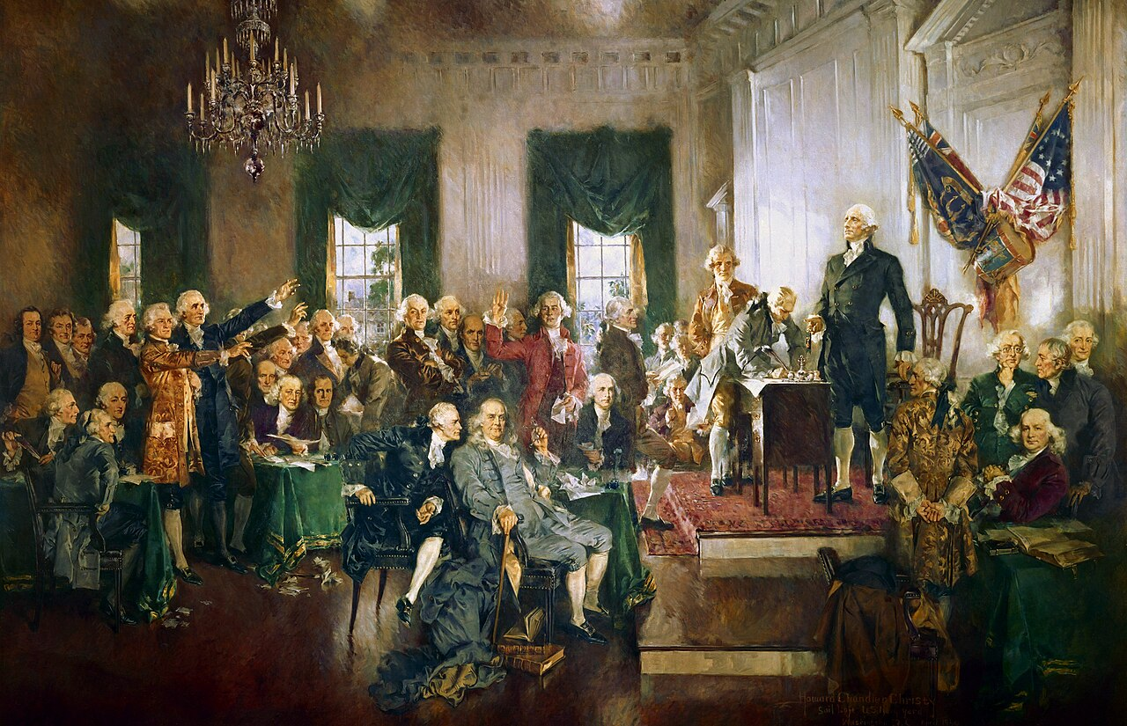
Constitutional Convention 1787

Slide 21
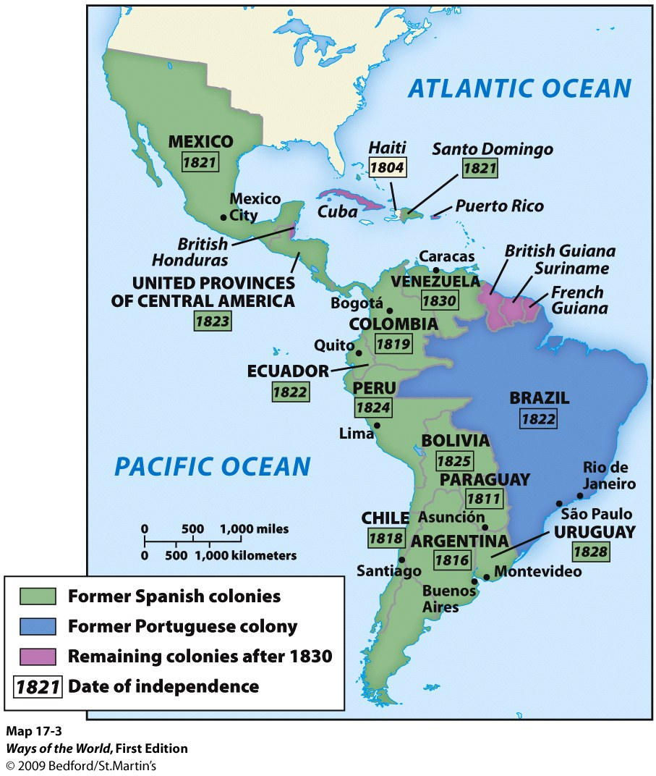
Latin America

Slide 22
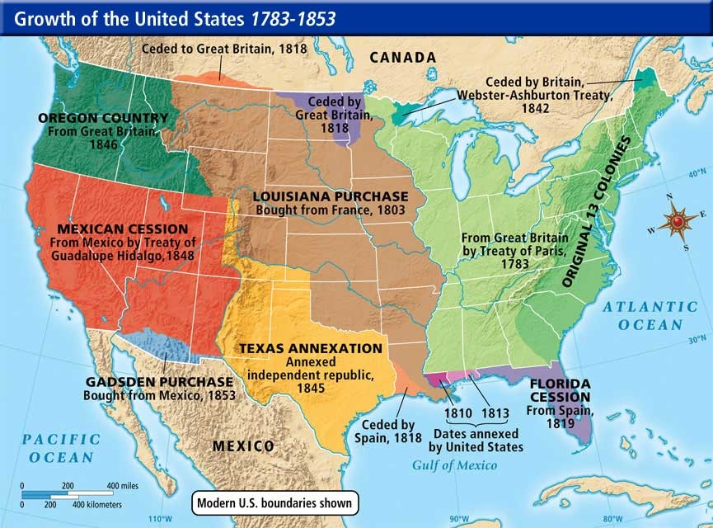
Manifest Destiny

Slide 23
Catholics in the United States
Nativism
4 million Irish 1820-1920
1 million German Catholics 1870s
Ethnic churches

Slide 24
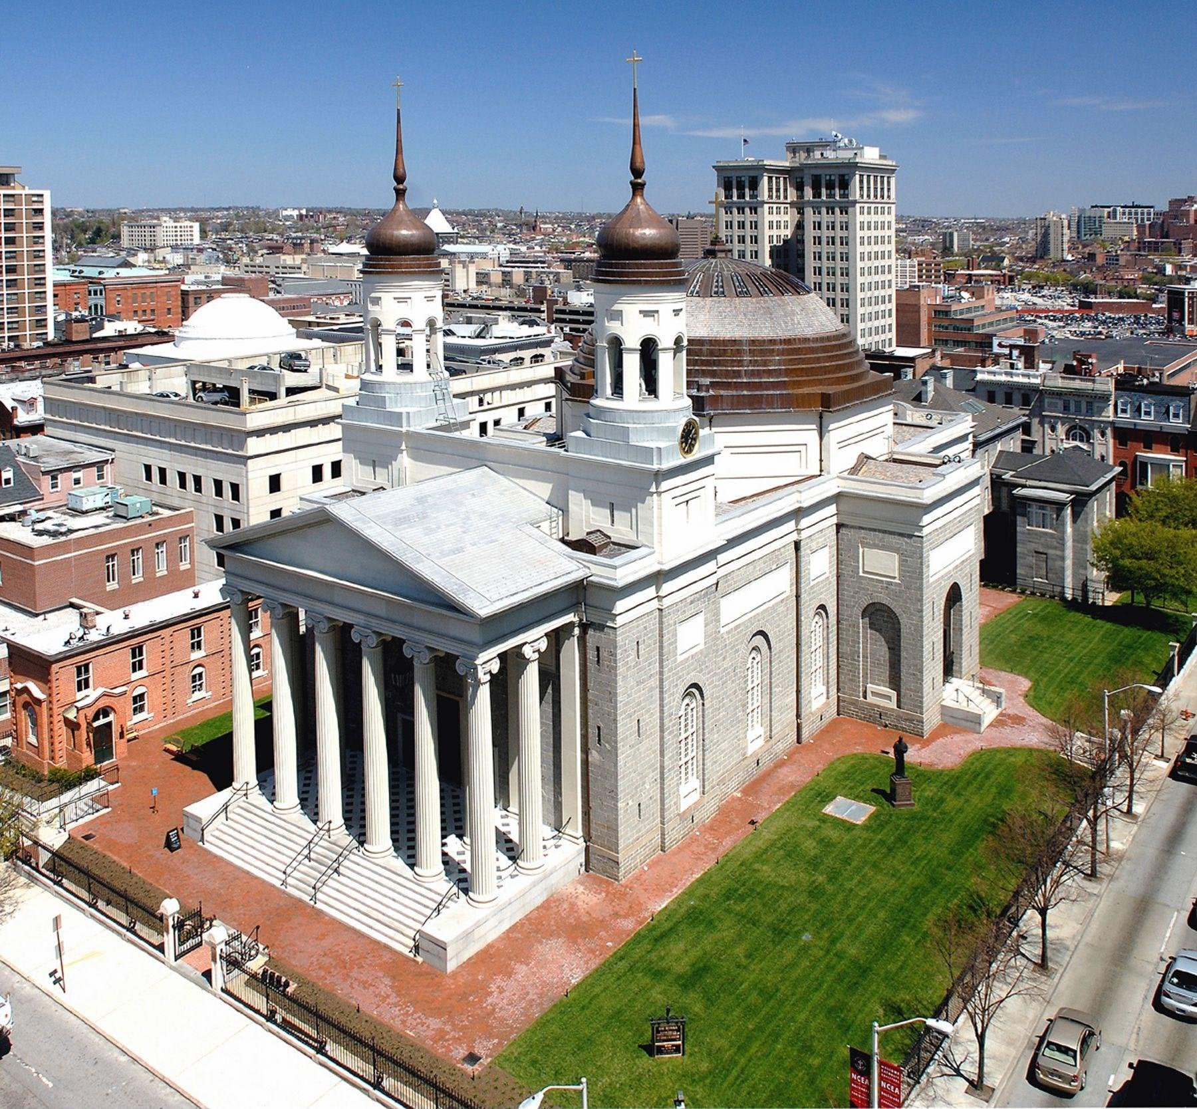
Baltimore

Slide 25
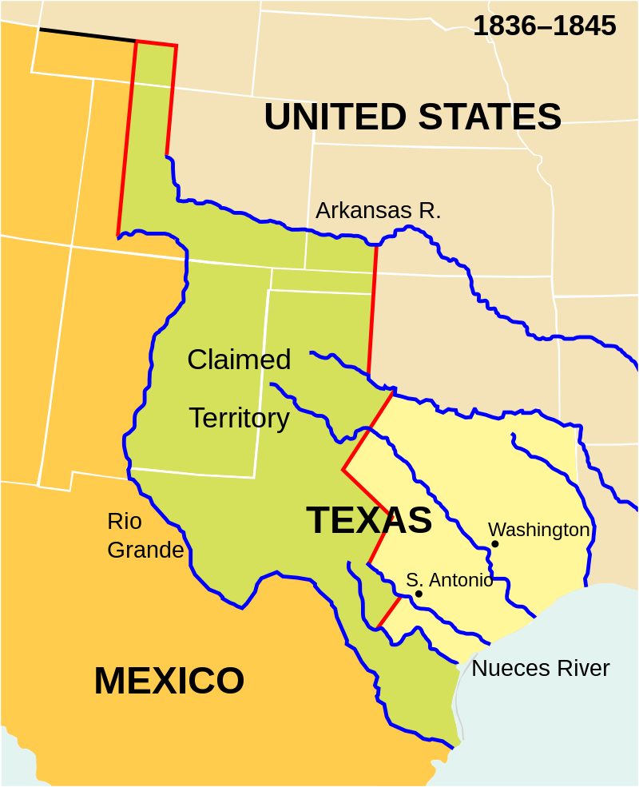
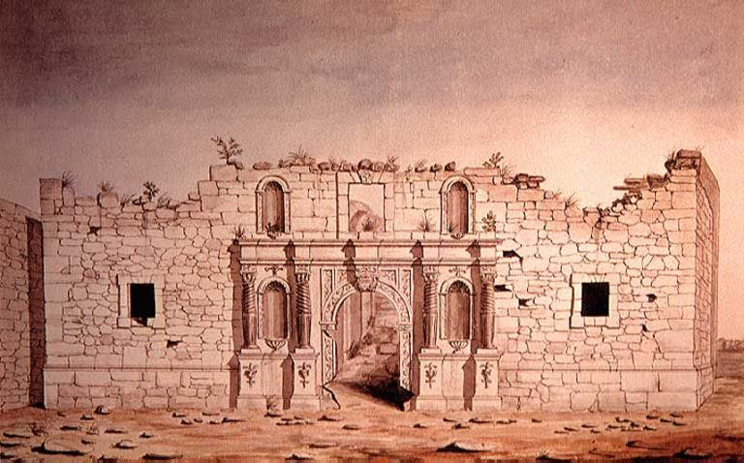
Texas

Slide 26
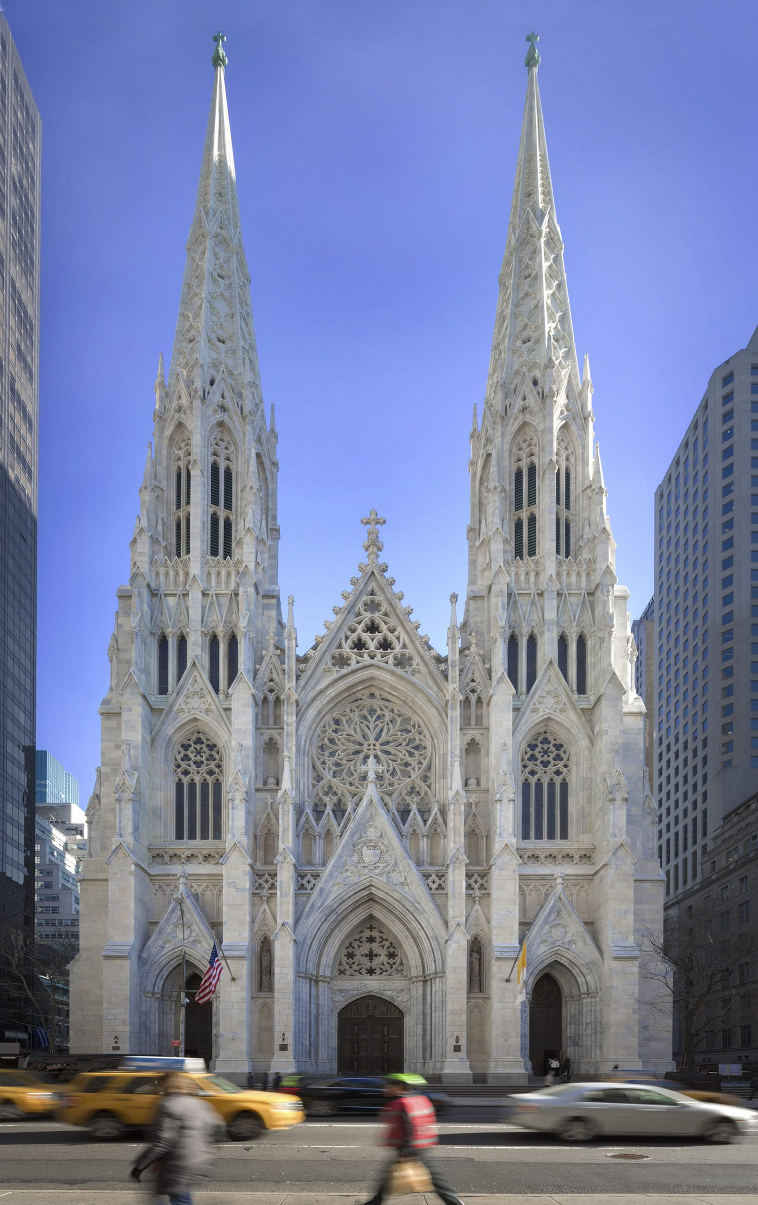
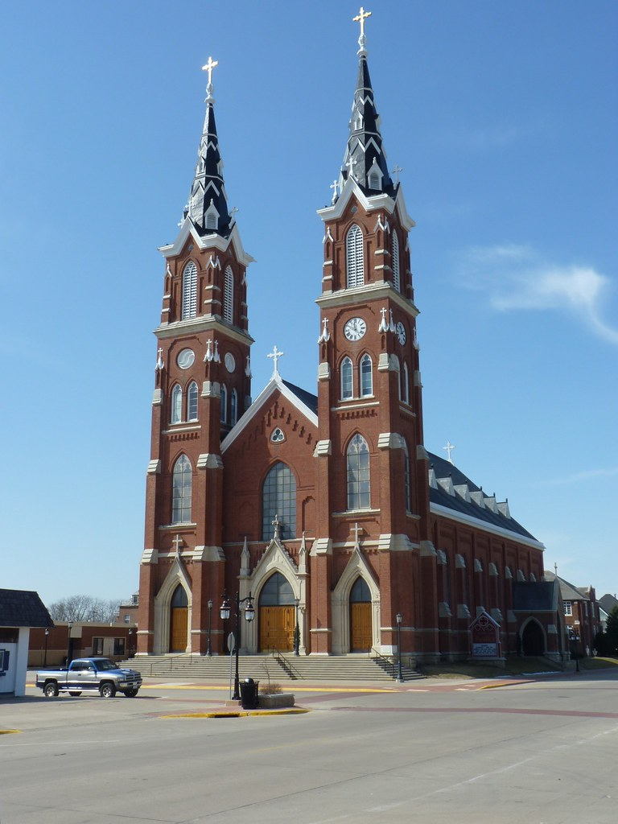
Gothic Revival
St. Patrick’s NYC
Basilica of St. Francis Xavier

Slide 27
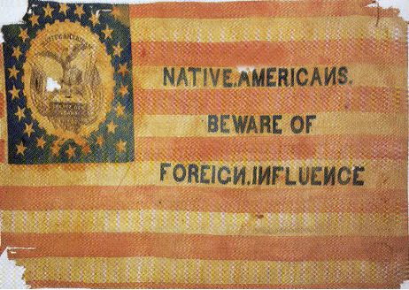
“Know-nothings”

Slide 28
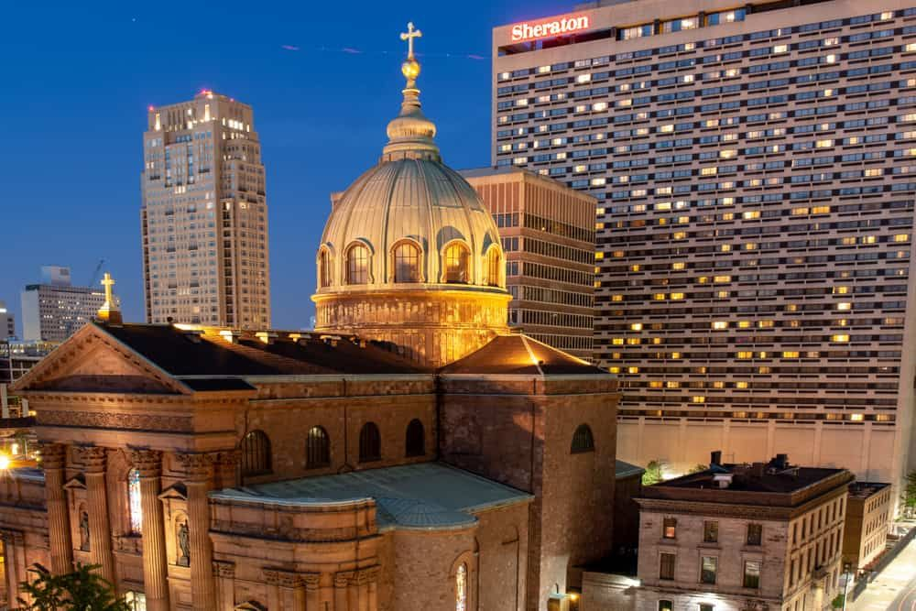
Cathedral of Sts. Peter and Paul, Philadelphia

Slide 29
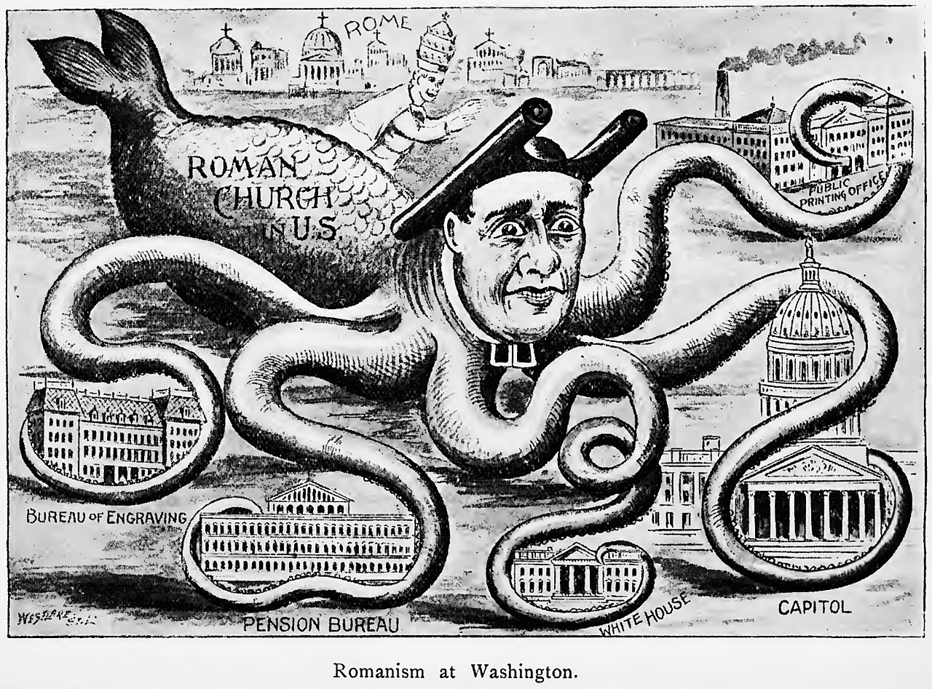

Slide 30
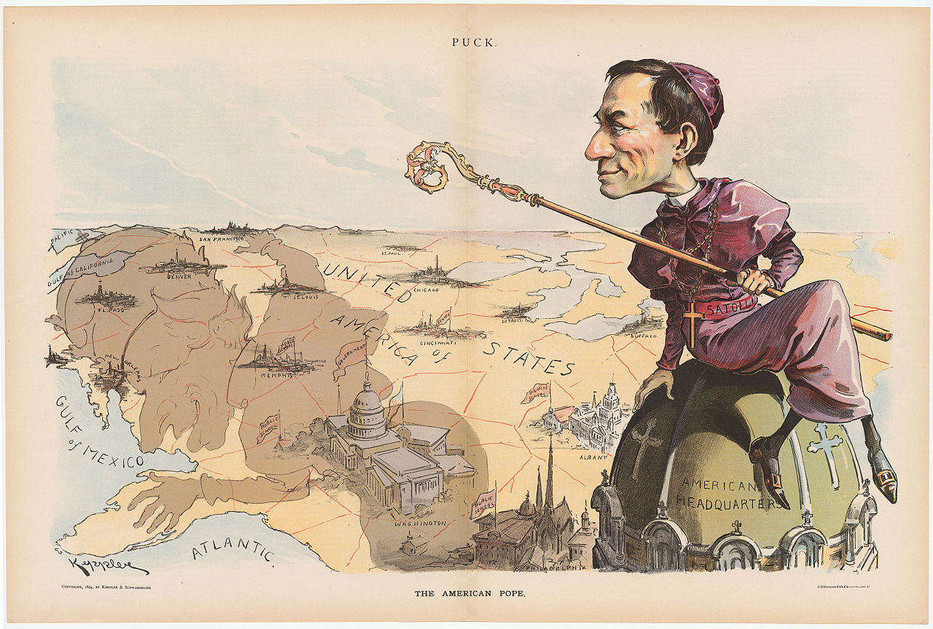

Slide 31
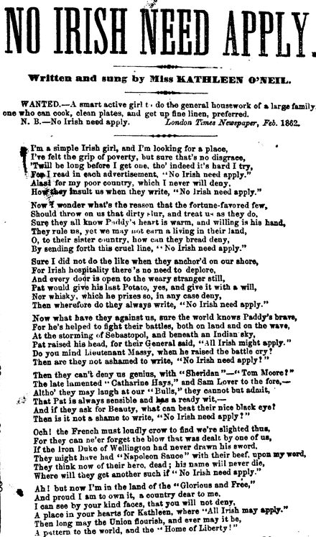
Anti-Irish

Slide 32
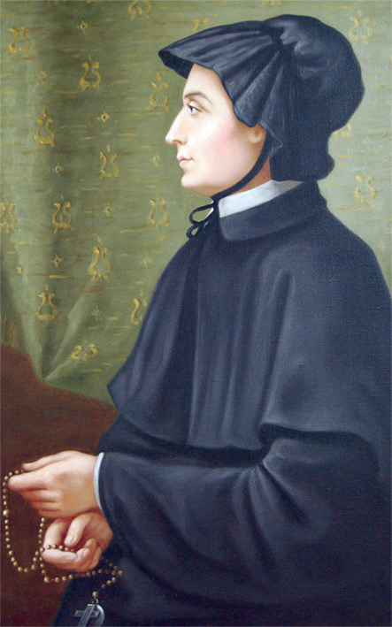
St. Elizabeth Ann Seton (1774-1821)

Slide 33
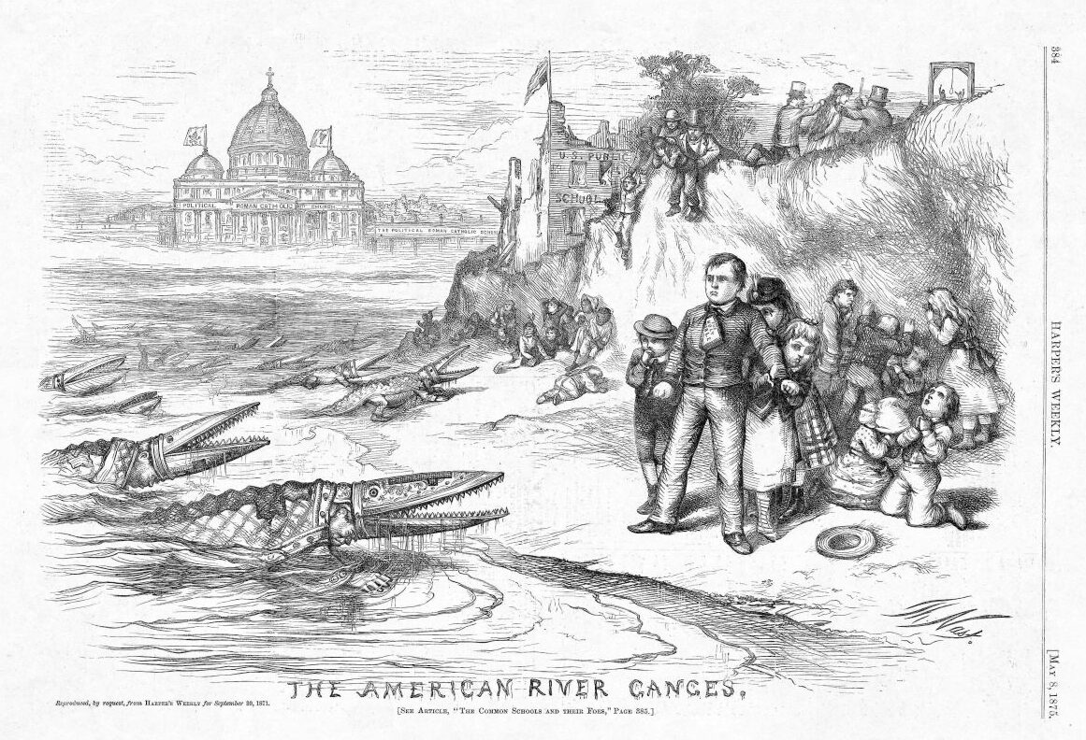

Slide 34
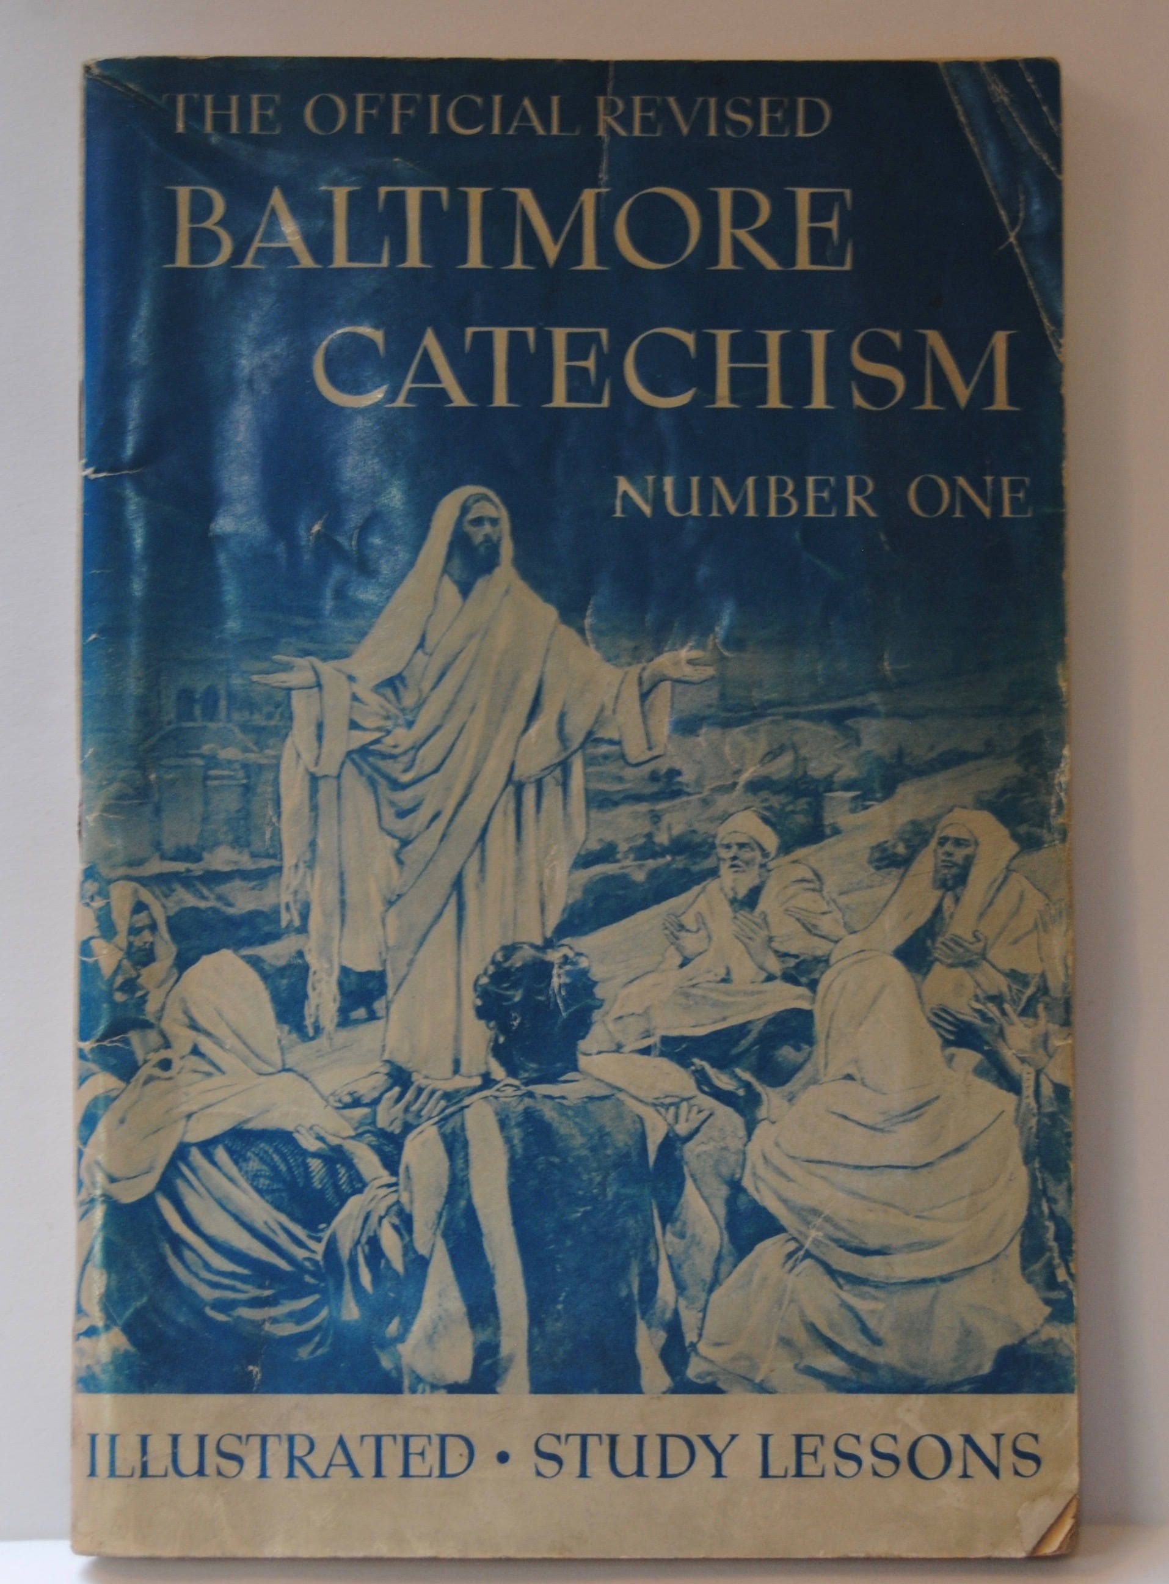
Third Plenary Council of Baltimore 1884

Slide 35
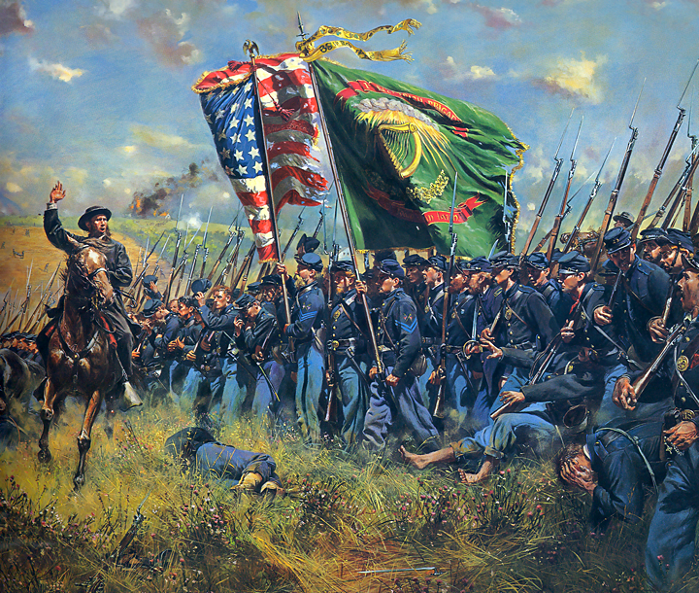
Irish Brigade

Slide 36
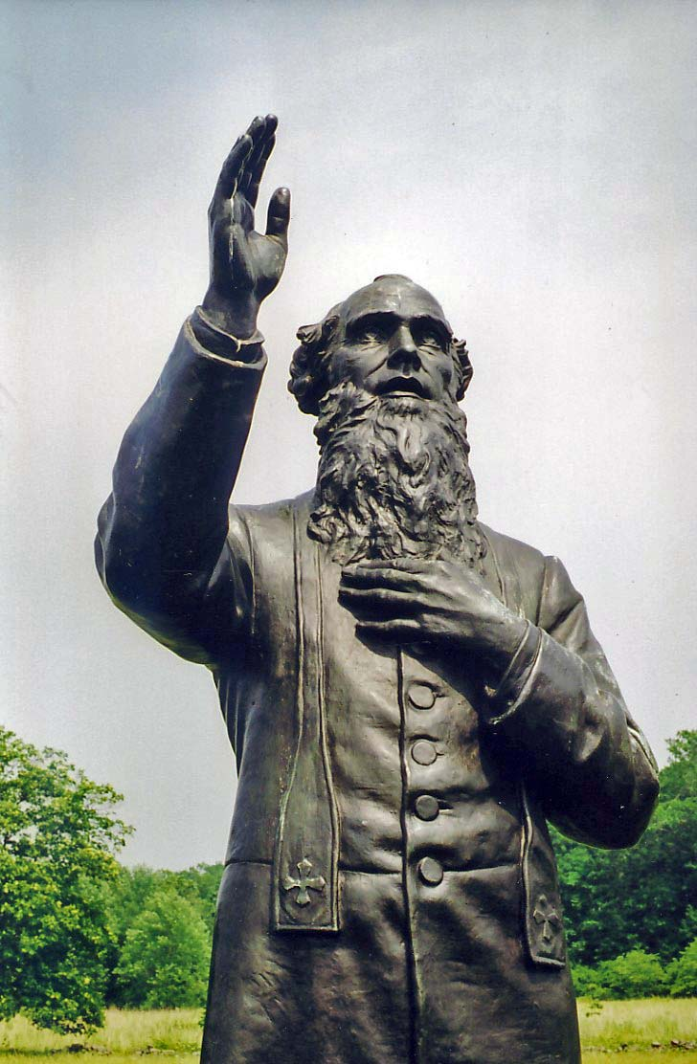
Fr. William Corby (1833-1897)

Slide 37
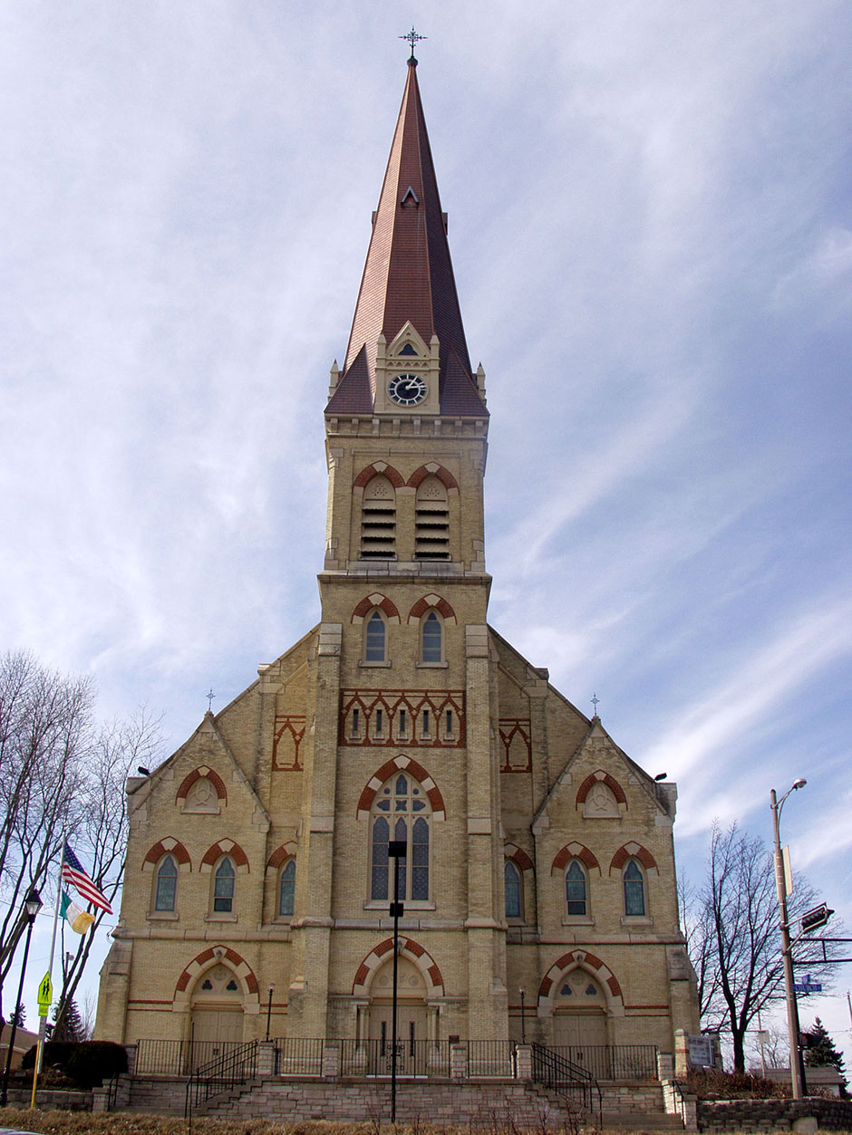
St. Bernard, Watertown

Slide 38
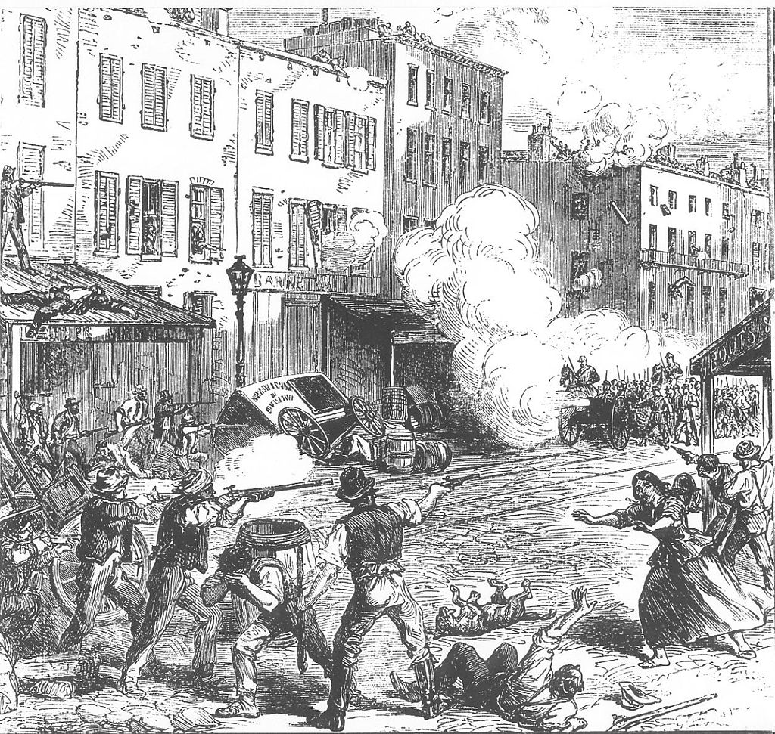
Draft Riots
Enrollment Act
March 3, 1863
“rich man’s war, poor man’s fight”
Detroit March 6
New York City July 13-16

Slide 39
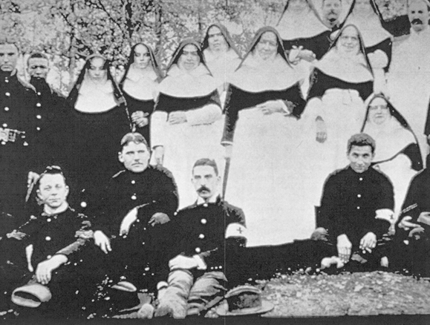
Nuns

Slide 40
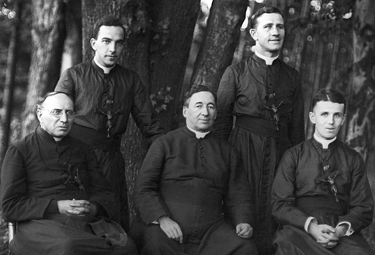
Maryknolls

Slide 41
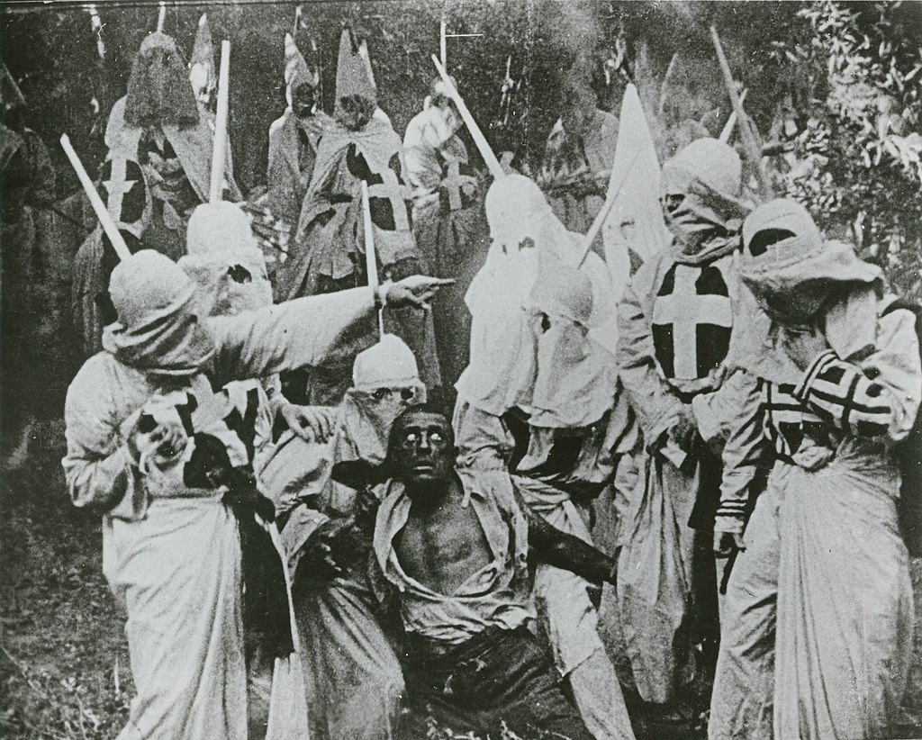
The Birth of a Nation

Slide 42
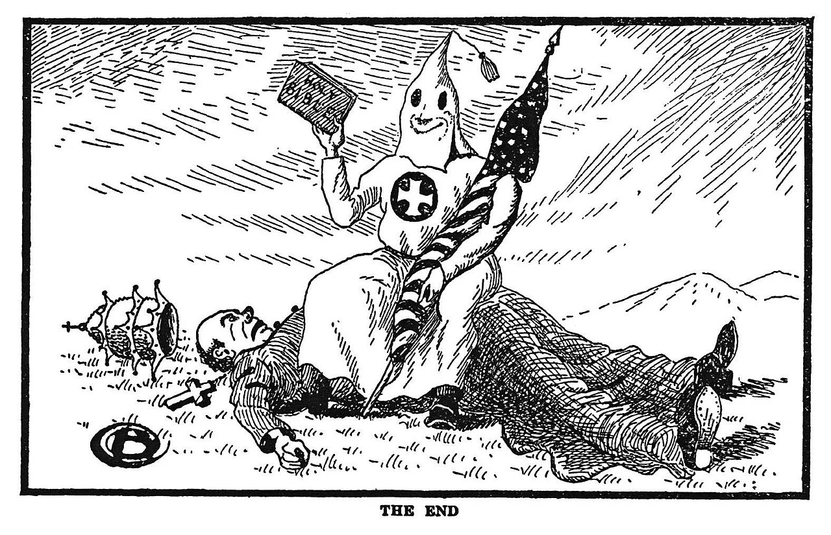
Klan

Slide 43
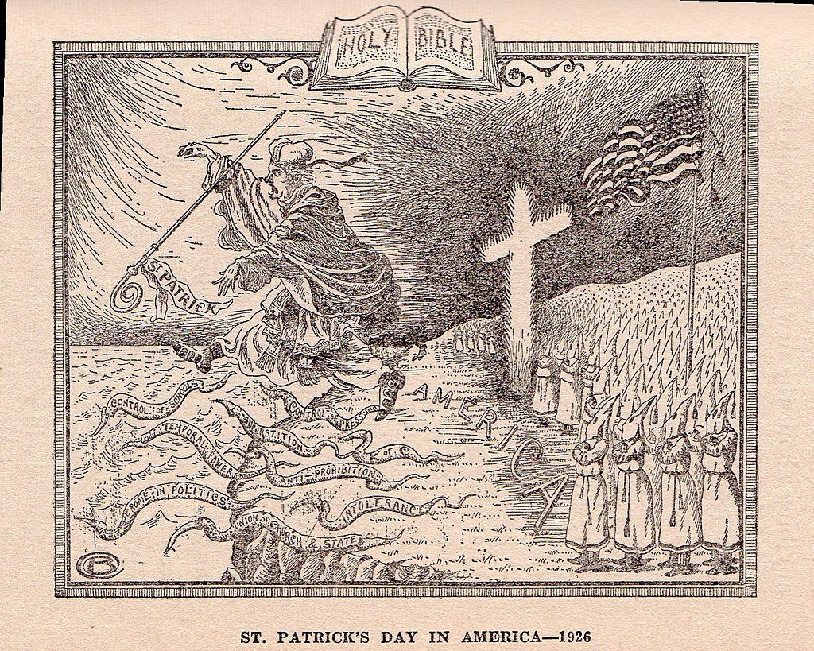
Klan

Slide 44
Immigration
13,000,000 immigrants 1901-1914
14% population foreign born 1910
Emergency Immigration Act of 1921
“Illegal aliens”
“America must be kept American”

Slide 45
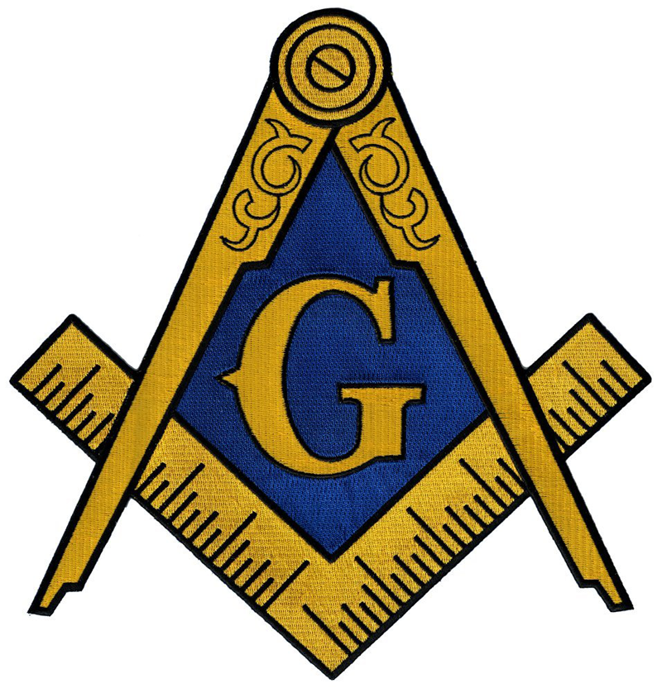
Free Masons
Secret society
Founding Fathers
Catholics prohibited from joining

Slide 46
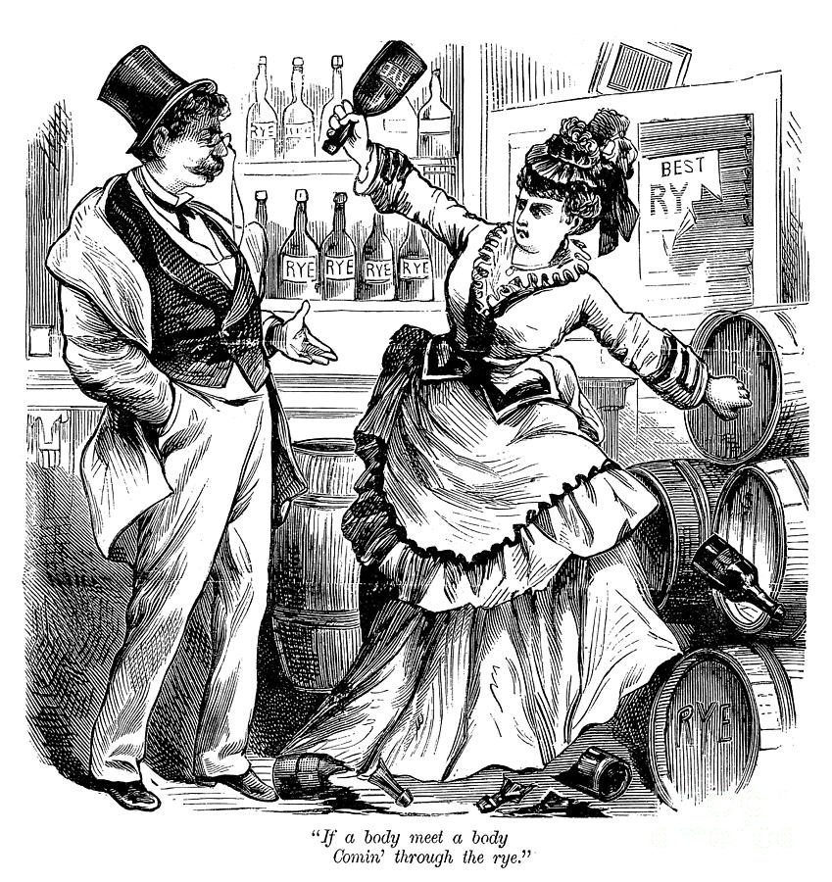
Temperance

Slide 47
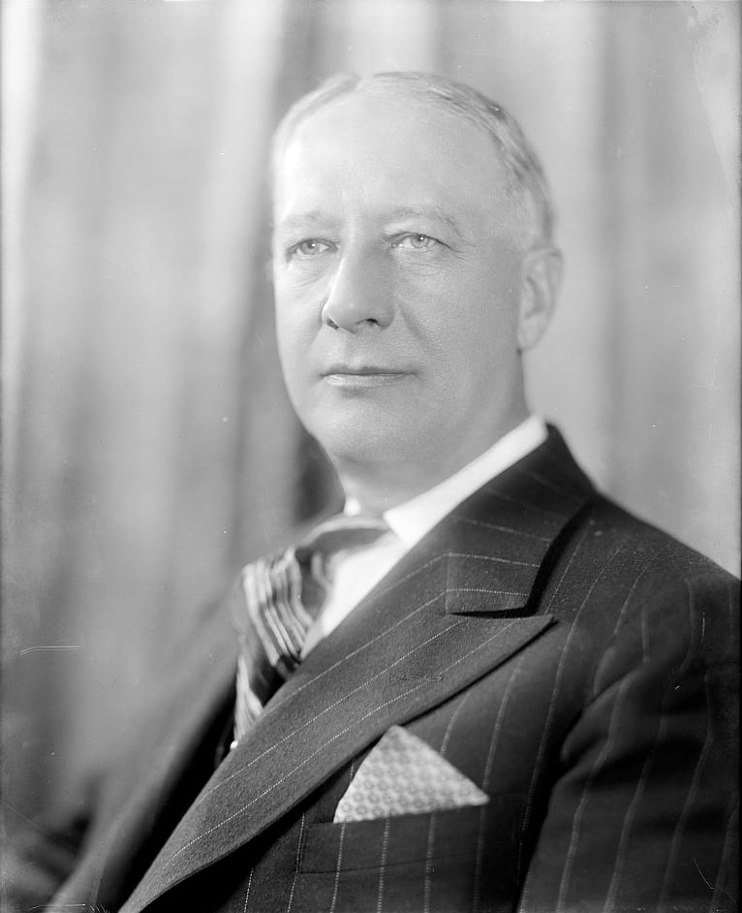
Alfred E. Smith (1873-1944)

Slide 48
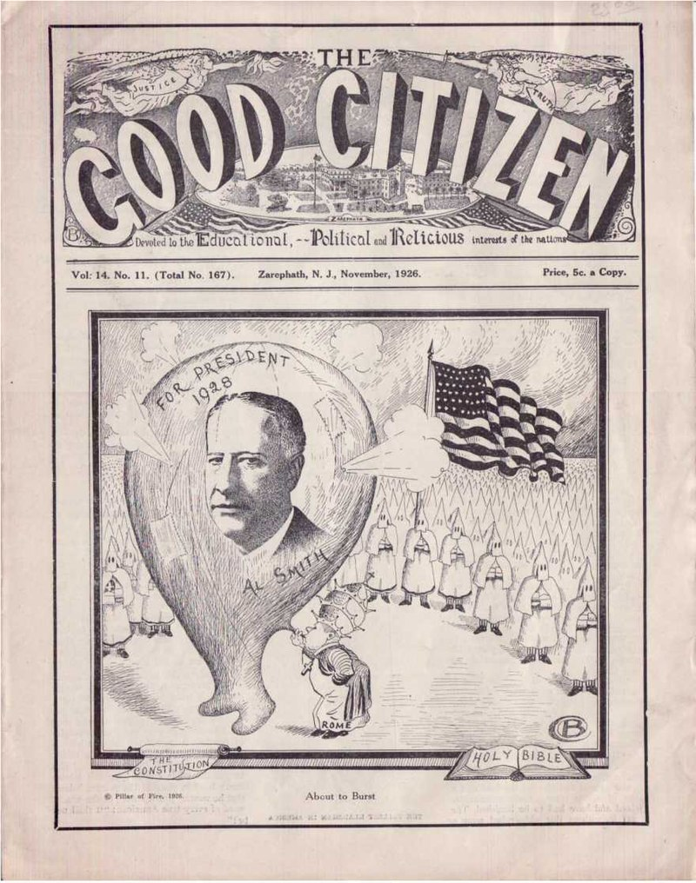

Slide 49
Politics
Catholics mostly Democrats
“Rum, Romanism, and Rebellion”
Labor Unions
“Social Catholicism”
New Deal

Slide 50
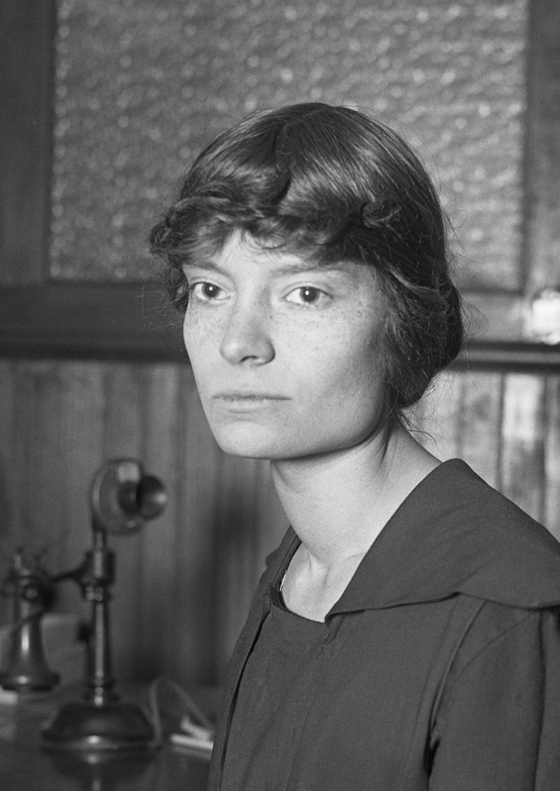
Dorothy Day (1897-1980)

Slide 51


Boys Town

Slide 52

Archbishop Fulton Sheen (1895-1979)

Slide 53

Mother Angelica (1923-2016)

Slide 54

President John F. Kennedy (r1961-1963)

Slide 55

Civil Rights Movement

Slide 56

Fr. James Groppi

Slide 57

Benito Mussolini (r1922-1945)

Slide 58

St. Peter’s

Slide 59


Via della Conciliaione

Slide 60

Pope Pius XI (r.1922-1939)

Slide 61

Adolf Hitler (r.1933-1945)

Slide 62
Pope Pius XI
Absent when Hitler visit
1937 – Mit Brennender Sorge
1938 – syllabus against racism and fascism
Humani generis unitas

Slide 63

Pope Pius XII (r.1939-1958)

Slide 64

St. Maximilian Kolbe (1894-1941)

Slide 65

St. Teresa Benedicta of the Cross (1891-1942)

Slide 66
Key Events
1565 St. Augustine, Florida, founded
1585 Roanoke Island settlers
1606 Virginia Company chartered
1608 Quebec founded
1754-1763 French and Indian War
1769 San Diego founded
1776 Declaration of Independence
1783 Treaty of Paris
1810 St. Elizabeth Ann Seton found St. Joseph’s Academy and Free School
1870s German kulturkampf
1884 Third Plenary Council of Baltimore
1928 Alfred E. Smith first Catholic to run for president
1929 Lateran Treaty
1937 Pope Pius XI writes Mit Brennender Sorge
1930s Catholic Worker Movement established
1960 John F. Kennedy first Catholic elected president

Slide 67
American Saints and Blesseds
St. Isaac Jogues (1607-1646) and Companions
St. Kateri Tekakwitha (1656-1680)
St. Rose Philippine Duchesne (1769-1852)
St. Mother Theodore Guerin (1798-1856)
St. John Neumann (1811-1860)
Blessed Francis Xavier Seelos (1819-1867)
St. Damien de Veuster of Molokai (1840-1889)
St. Marianne Cope (1838-1918)
St. Francis Xavier Cabrini (1850-1917)
Blessed Fr. Michael McGivney (1852-1890)
St. Katharine Drexel (1858-1955)
Blessed Father Solanus Casey (1870-1957)
Blessed Sister Miriam Teresa (1901-1927)
Blessed Father Stanley Rother (1935-1981)
Blessed Fr. James Miller (1944-1982)

Slide 68
For Us Today
Legacy of Anti-Catholicism
Legacy of Great Catholics
Continued need to educate about World War II
Nativism

