Slide 1

Mental Health & Catholic Leaders: A Pastoral Response
Mental Health Ministry for Our Parishes
Deacon Ed Shoener
Diocese of Scranton, PA
President, Association of Catholic Mental Health Ministers

Slide 2
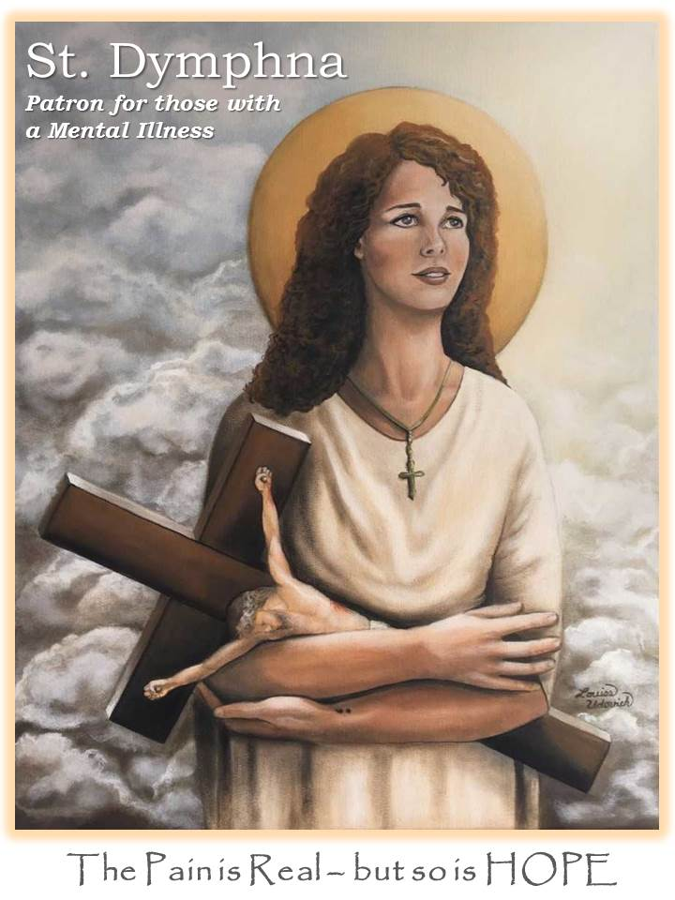
Lord we Pray for those who have a Mental Illness
Help us understand that the way we talk about people with a mental illness affects the people themselves and how we treat the illness.
So often people who have a mental illness are known as their illness; people say that "she is bipolar" or "he is schizophrenic”; when we talk about mental illness, we should not use that phrase. People who have cancer are not cancer; those with heart disease are not heart disease. Let us always remember that people with a mental illness are not the illness – they are beautiful creations of God.
There is so much fear, ignorance and hurtful attitudes that the people who suffer from mental illness needlessly suffer further. Help us to support and be compassionate to those with a mental illness, every bit as much as we support those who suffer from any other illness.
Grant courage to those for whom we pray and fill them with hope. If it is according to Your Divine Will, grant them the recovery and cure they desire. Help them to remember You love them; they are never alone.
Saint Dymphna, Patron of those with a Mental Illness, pray for us

Slide 3
Responding to Mental Illness and Suicide
Why are people reluctant to talk to Church leaders about mental illness and suicide?
THREE DISHEARTENING CONCERNS:
1. Doubt that clergy and other Church leaders understand their experience
2. Fear that the Church will judge them
3. Lack of support in the Church

Slide 4
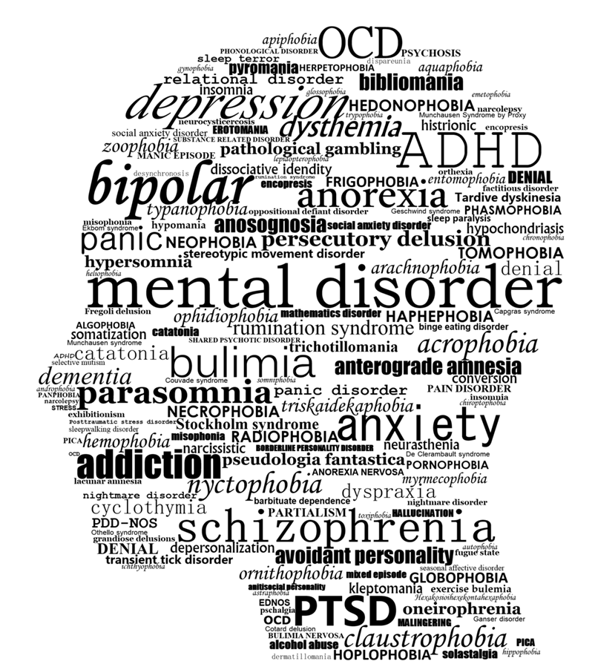
We Need to be able to talk about our Mental Health
It is OK to tell our stories

Slide 5
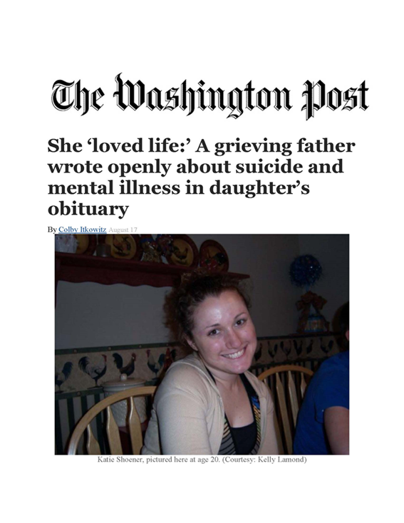
We Need To Tell Our Stories
"We need more people discussing the realities of struggling with a mental illness and, just as you say, that it can be as difficult, painful, and sometimes terminal as any other serious physical illness.”
"People need to read this...in some small way it might begin to chip away at the stigma of mental illness. I have never understood why people treat those with mental illness differently than people with a physical illness.”
"God is using this for a good divine purpose, to educate others to be compassionate... do not be quick to judge because it can happen to you or anyone.”

Slide 6
What is Your Story?
Are you willing to share your story and let God use it for the good?

Slide 7
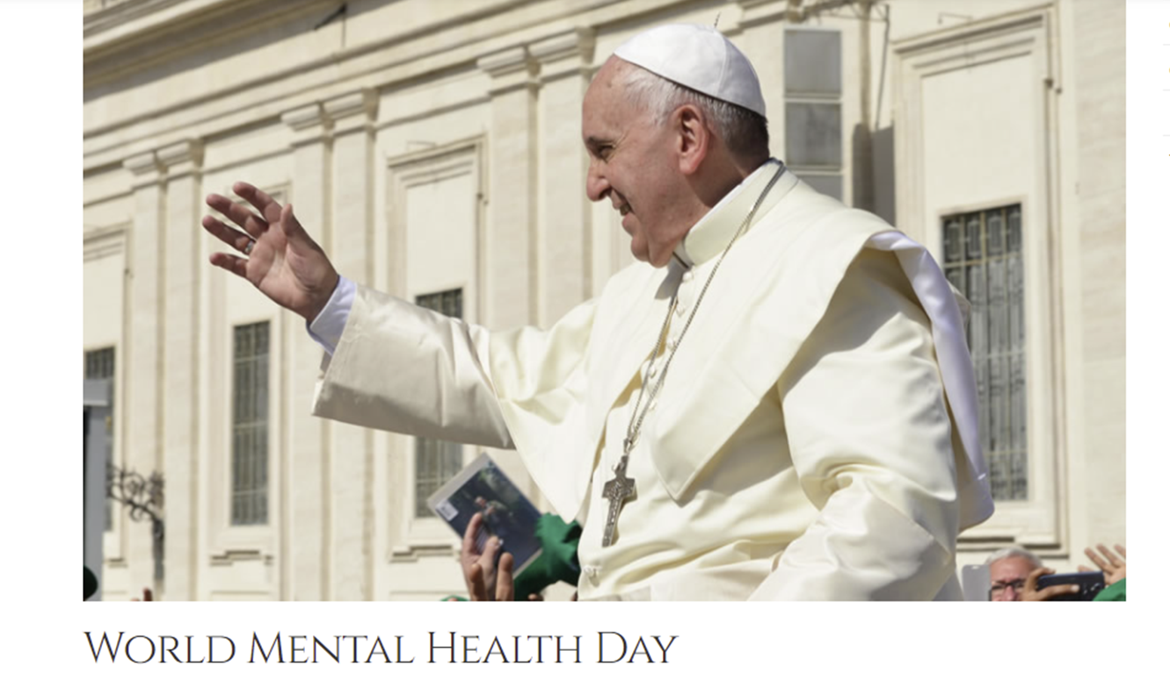
Prayer of Pope Francis on World Mental Health Day:
“I would like, to remember our brothers and sisters affected by mental disorders and also the victims, often young, of suicide. Let us pray for them and for their families, so that they are not left alone or discriminated against but welcomed and supported.”

Slide 8

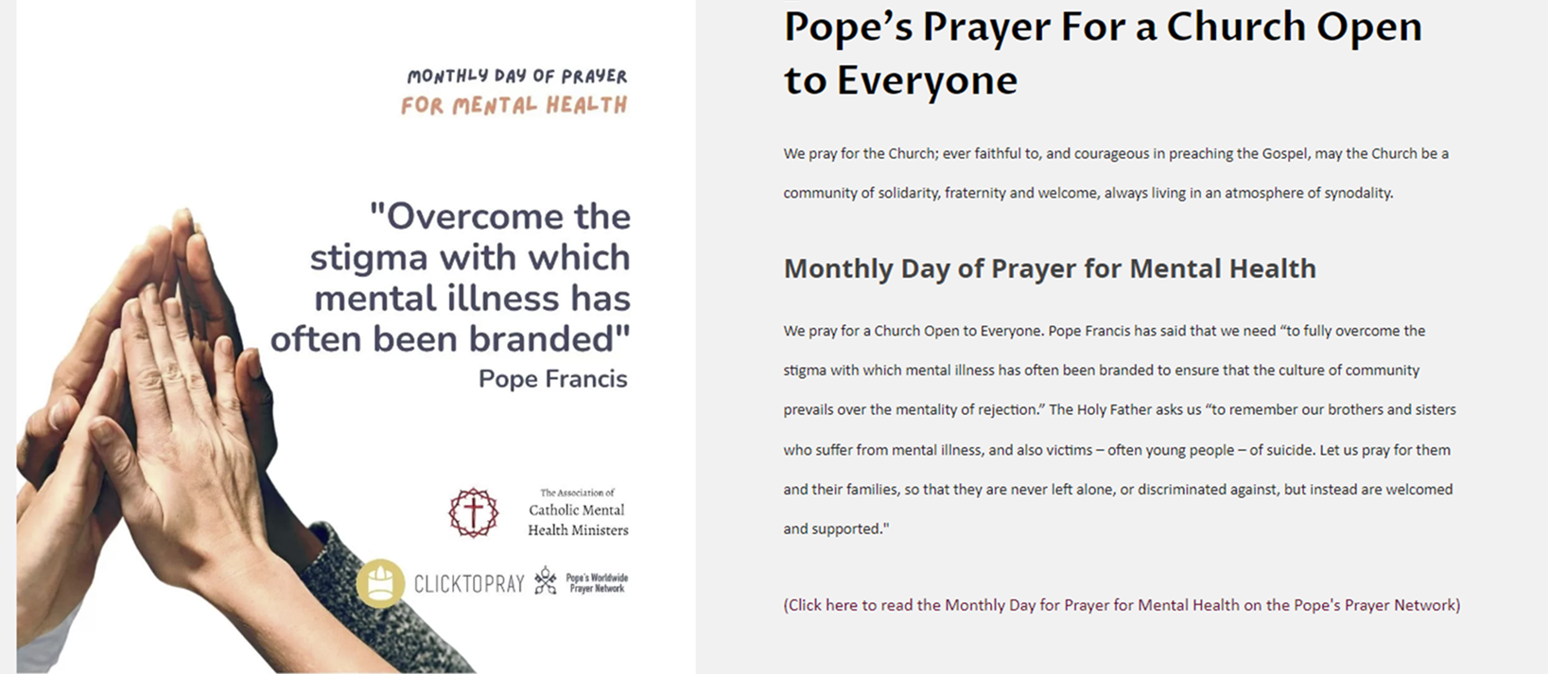
Second Monday of the Month - Day of Prayer for Mental Health

Slide 9


SPIRITUAL SUPPORT
One of the worst things you can do is trivialize their struggles by knowingly or unknowingly implying that everything gets better with prayer (it doesn’t), that it’s as easy as “giving it to God,” (it’s not), that somehow this is the mentally ill person’s fault (it never is). Think before you speak.
Mental illness is as real and as serious as physical illness. Don’t say anything to a mentally ill person that you wouldn’t say to someone with grave injuries or cancer. Because the truth is, mental illness can’t be understood or dealt with in terms of pious-sounding Christianese phrases, or short and sweet quotes from the saints.
If you really want to help a mentally ill person, get to know them, and if necessary, help them seek professional help. Listen to them. Pray with them. Empathize with them. Let them know you will support them with your prayers.
10 Things You Should NEVER Say To A Catholic With Mental Illness
By Brooke Gregory, March 16, 2016
epicpew.com/10-things-never-say-catholic-mental-illness/

Slide 10

Principles of Catholic Mental Health Ministry
“As pastors and bishops, we understand that mental health is a critical component of wellbeing. Therefore, ministering to those who suffer from mental illness is an essential part of the pastoral care of the Church.”

Slide 11
The Church is not called to become a community of psychiatrists; it is called to be become a community of persistent, patient love.¹
Principle 1. Christ calls us to attend to those who suffer from mental illness and provide hope and healing
The Churches’ call is to meet those with mental illness, to learn to love them with the love and the passion of Jesus and to offer them a place of belonging.
The primary task of the Church is to love and heal without the demand for a cure.
To say, “It is good that you exist.”²
¹ Rev. Dr. John Swinton, Chair in Divinity and Religious Studies at the School of Divinity, History, and Philosophy, University of Aberdeen, Scotland.
² Principles of Catholic Theology by Cardinal Joseph Ratzinger (Pope Benedict XVI)

Slide 12
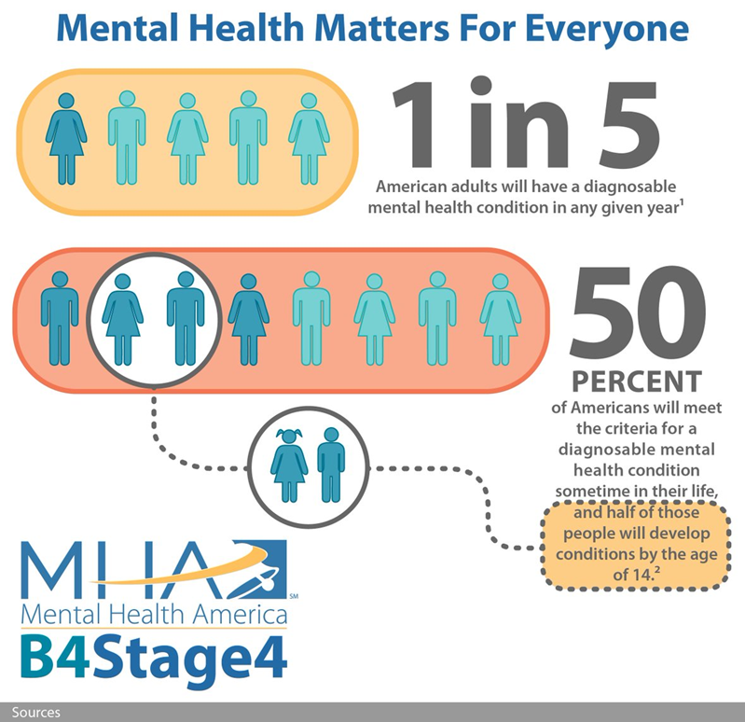
Principle 2
The scope and burden of mental illness in our society is enormous.
We are all affected by mental health concerns.

Slide 13
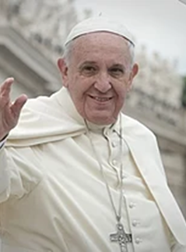

Principle 3. Those suffering from mental illness should not be stigmatized or judged. Mental illness remains poorly understood even by clergy and others in positions of influence.
Mental Health Literacy
We need to “fully overcome the stigma with which mental illness has often been branded and … ensure that the culture of community prevails over the mentality of rejection.”

Slide 14


The Church, health care professionals and scientific researchers should work together to improve mental health care.
Psychiatry and mental health professionals have their place. But their tasks are different (although complementary) from the tasks of the Church.
Mental Health Ministry
Accompaniment - Journey with others as they experience God.
Provide spiritual and social support: a renewed sense of meaning and purpose, feel grounded in faith or other spiritual practice, and increased connection to the faith community.
Faith-based and God-centered. It has to do with the presence of God in a relationship and experiencing His presence.
Mental Health Treatment
A mental health diagnosis that manifests itself in a pervasive manner.
May involve several professionals to guide the treatment and to monitor medication management or any other medical concerns.
The goal of treatment is to reduce the symptoms. Success is defined by the absence of illness, distress or symptoms.
“Hope and Healing”
California Conference of Bishops, 2018

Slide 15
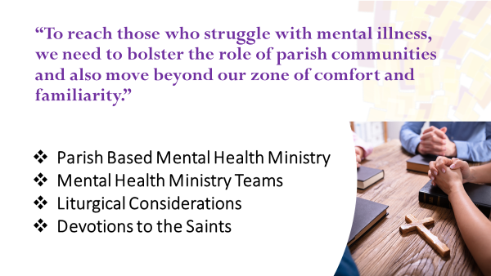
Principle 5. We must meet and attend to those in need where they are.

Slide 16

Mental Health Ministry Teams
Accompaniment
Reducing Stigma and Discrimination
Mental Health Literacy
Clergy and Staff Education
Resources and Referrals
Spiritual Support Groups
Parish Education Events
Support After Suicide

Slide 17
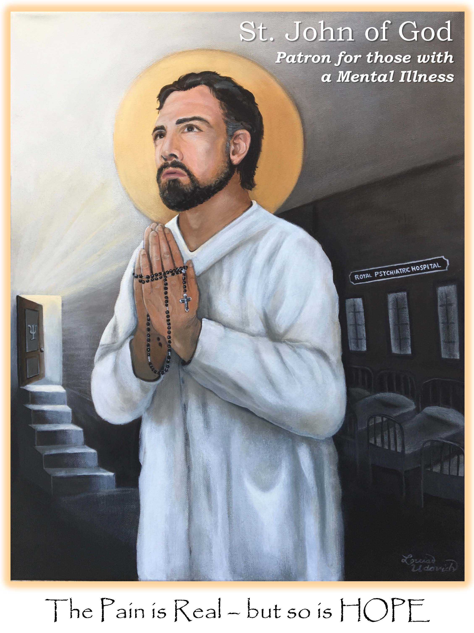
Liturgical Considerations and Devotions to Saints
Homilies
Special Liturgies
Prayers of the Faithful
Devotionals

Slide 18
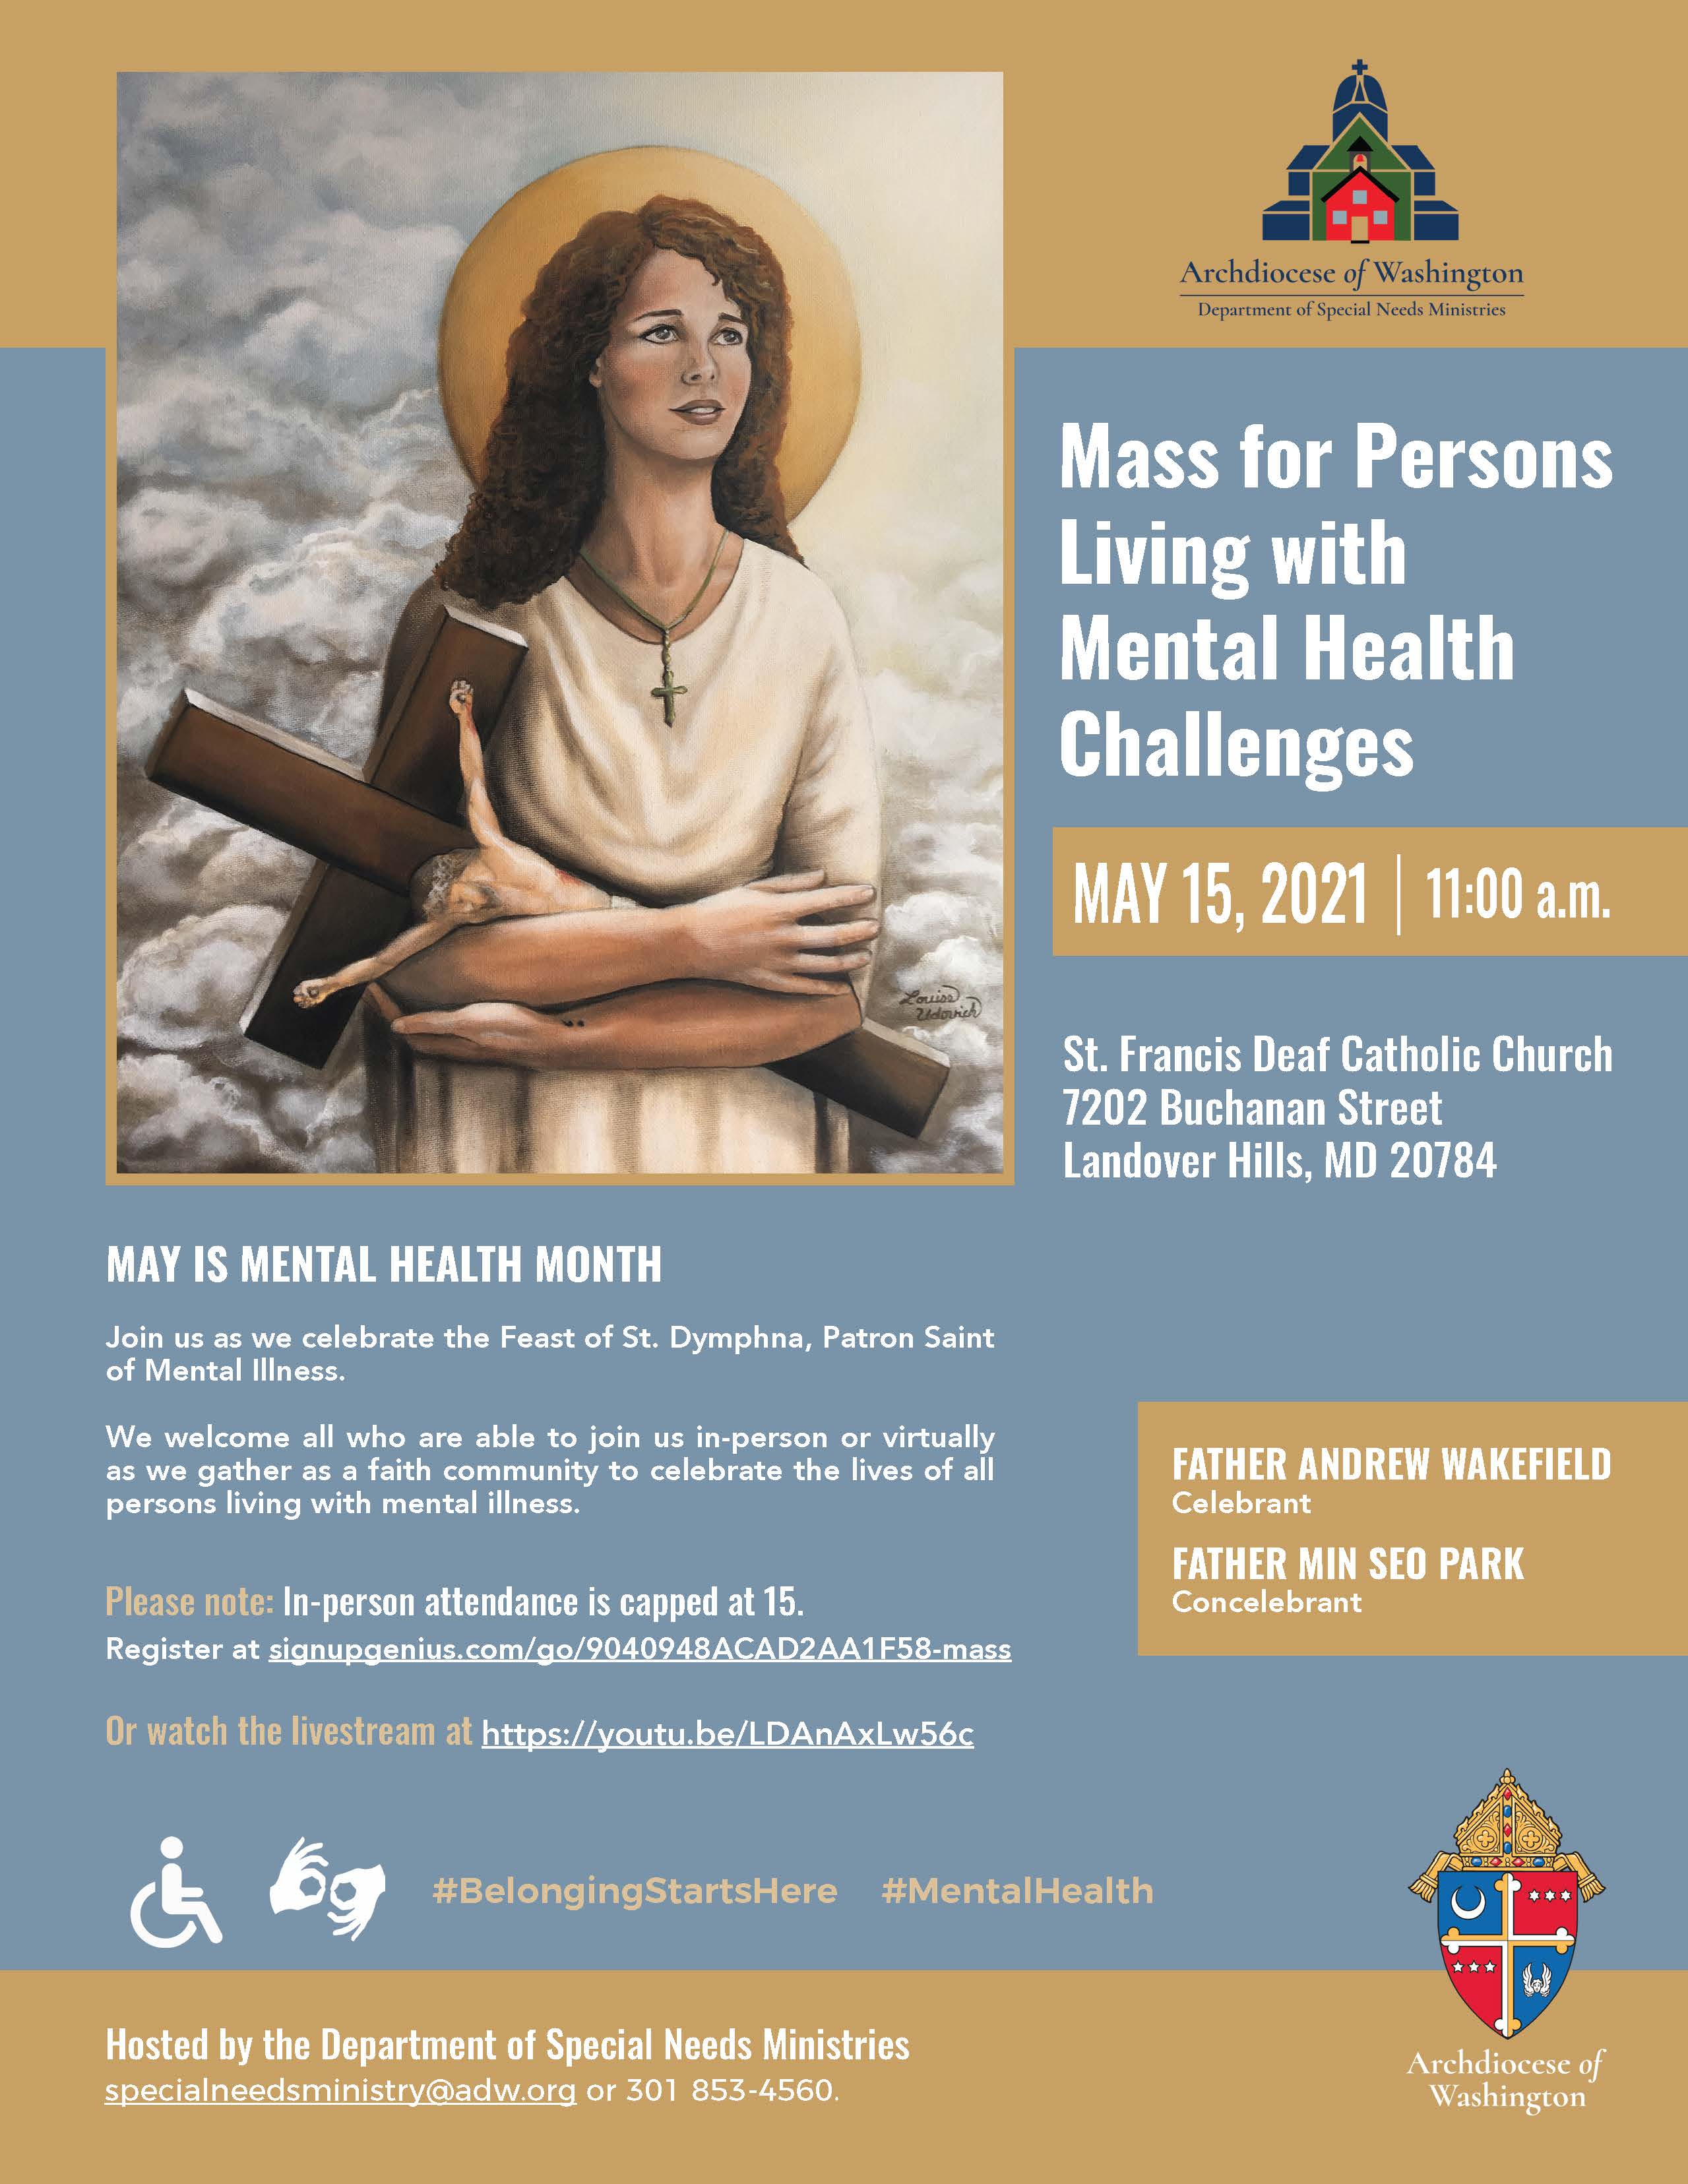
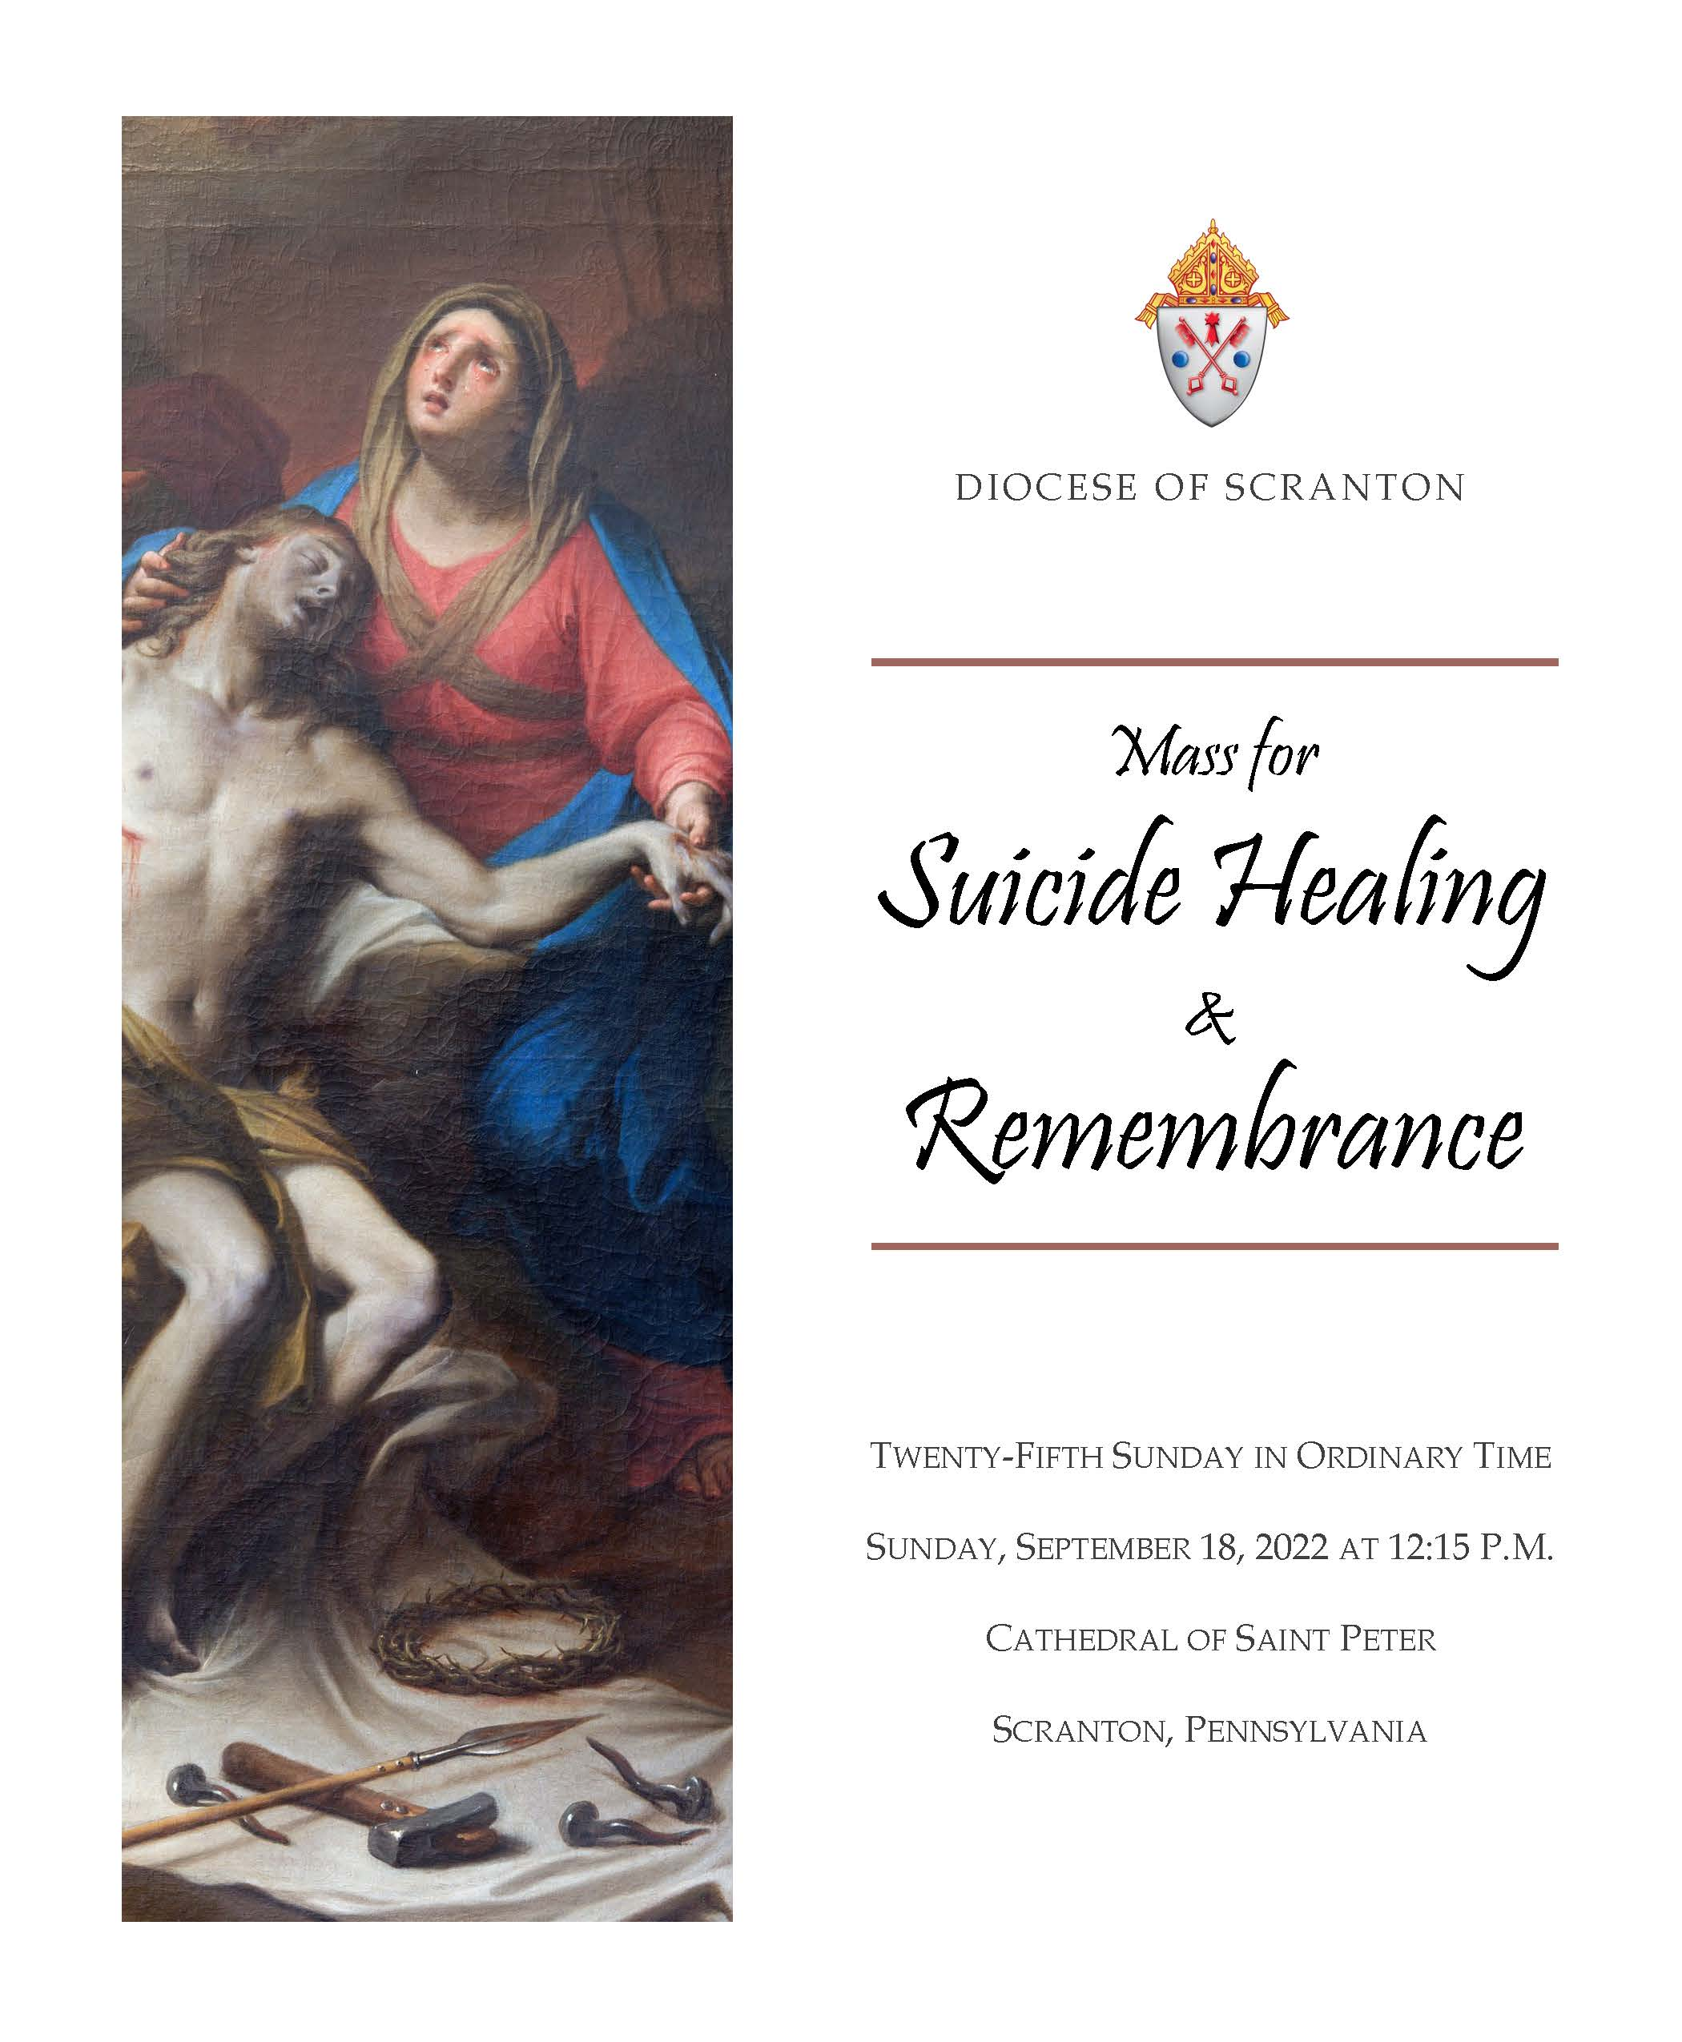

SPECIAL SERVICES
Mental Health Awareness Month – May
Suicide Awareness Month - September
Winter Solstice & Holiday Season

Slide 19
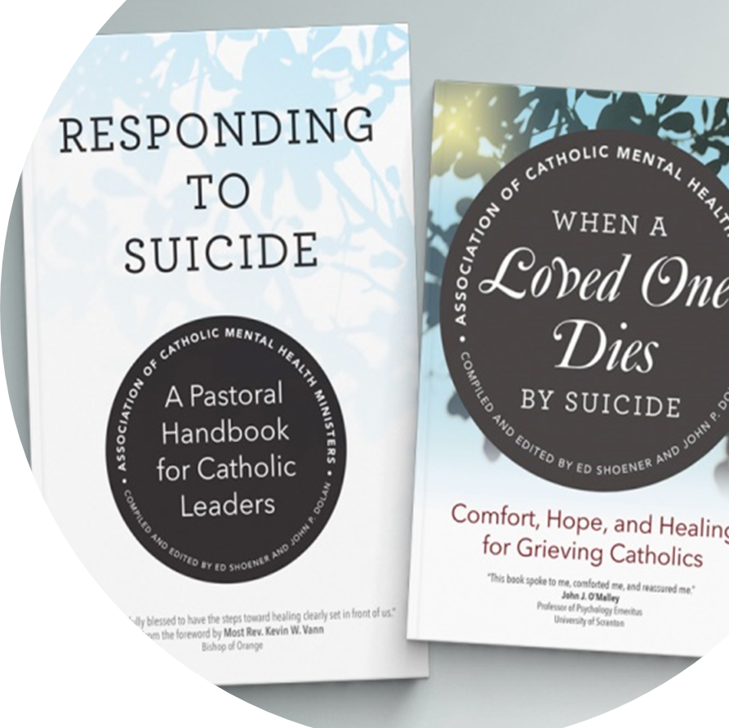
Principle 6. Those impacted by suicide need our compassionate response.
Discussing the hard questions and accompanying the grieving
The funeral for a person who died by suicide
Prayer rite at the location of a suicide
Grief support after a suicide – overcoming isolation and shame
Youth ministry and suicide
Parish mental health ministry

Slide 20
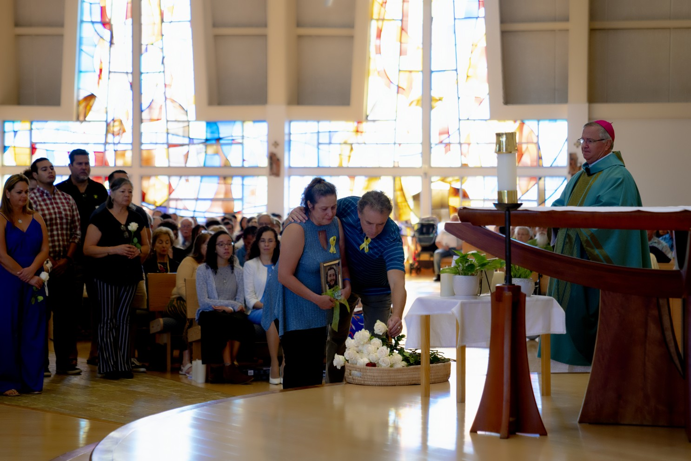
Need for Sensitive Pastoral Response
How can I communicate God's mercy to the families and other loved ones of the person who has died by suicide?
What can my parish do to "walk the long road" with individuals who are grieving a suicide?
What moments of prayer can my parish offer? Are special liturgies or a Mass of Remembrance offered?

Slide 21
Basic “Look” of a Robust Parish Mental Health Ministry
Form a parish mental health ministry team of at least 3 people
Get some basic training for the team, such as Mental Health First Aid and the online "Introduction to Mental Health Ministry" It is important that they understand that this is ministry, not mental health care, and that they have the confidence to offer the ministry.
Prepare a simple ministry plan for approval by the pastor
Introduce the topic to the Parish with either a "Mental Health Illness with Grace - 5 Part Series" and/or the "Sanctuary for Catholics" Program
Work with parish staff to periodically place reflections on mental health and faith in the parish bulletin/website and mention specific mental health conditions and suicide in the intercessions.
Organize special Masses - a May 15 (or thereabouts) St. Dymphna Mass, a Suicide Remembrance Mass and Healing masses.
Facilitate a small faith sharing group for people who live with a mental illness and one for people, usually parents, who support someone with a serious mental illness.
Home visits to people who are homebound because of their illnesses - social anxiety and other debilitating mental illnesses
Visit local psychiatric facilities and psychiatric units at hospitals
Compile a list of mental health resources in the community, such as hospitals and other mental health care providers, that can be provided to families as needed.
Periodically host speakers or events on mental health topics
Support other parish ministries by being the parish resource on mental health issues- for example work with the youth ministry team to periodically discuss mental health issues, work with the prison ministry to support their advocacy for better mental health care in prisons, etc.
Maintain a simple web page with resources, news and posting of events. The Association will provide a web page if needed. See some examples here.

Slide 22
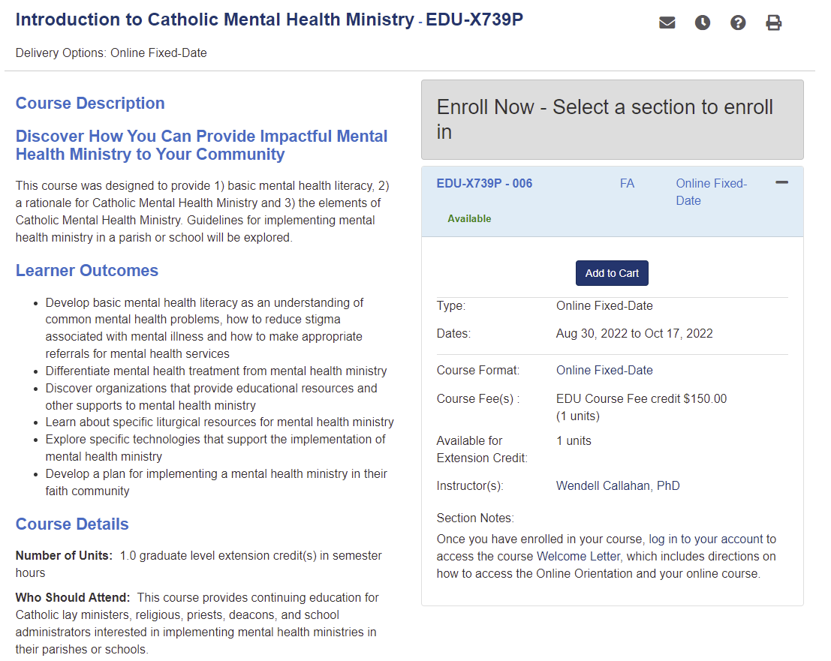

Catholic Institute for Mental Health Ministry

Slide 23


sanctuarymentalhealth.org/catholics/

Slide 24
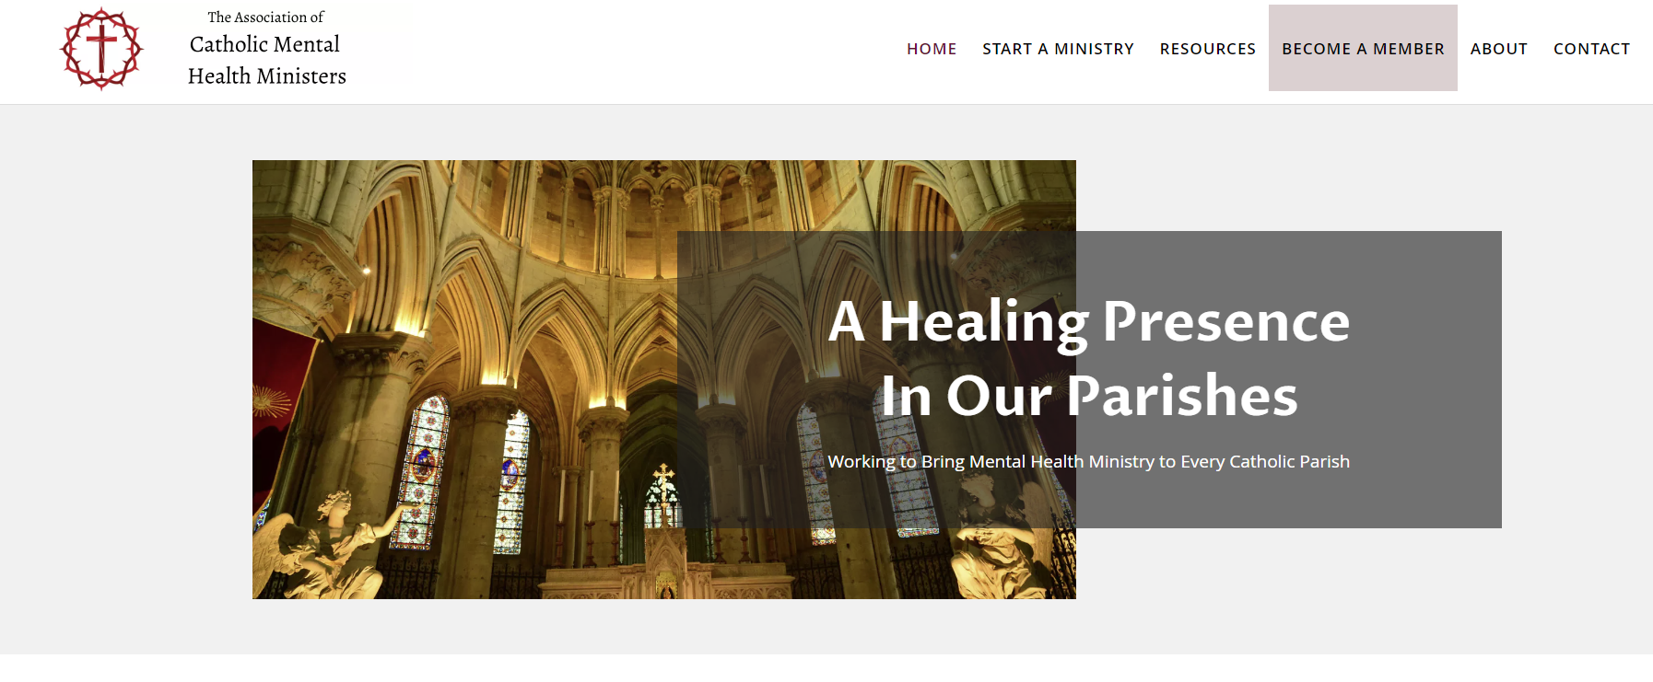
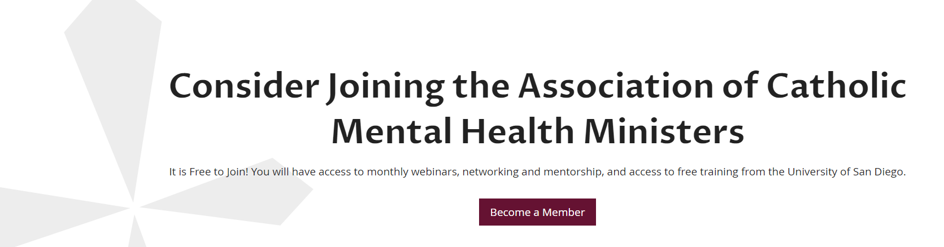
CatholicMHM.org

