Slide 1
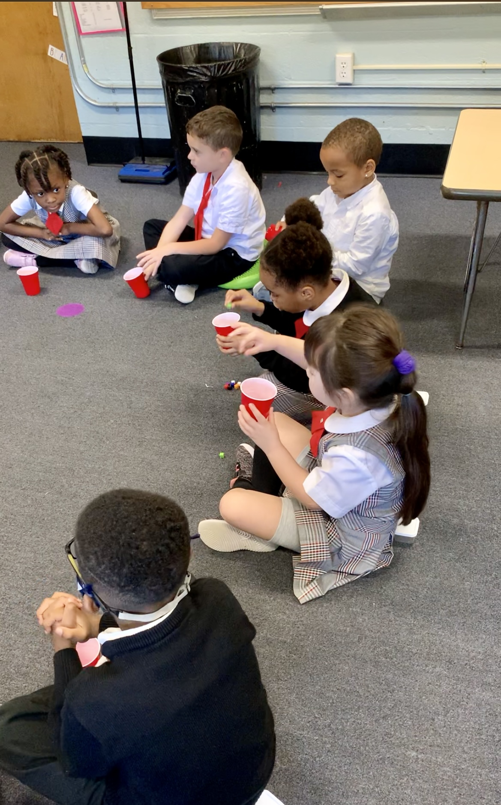
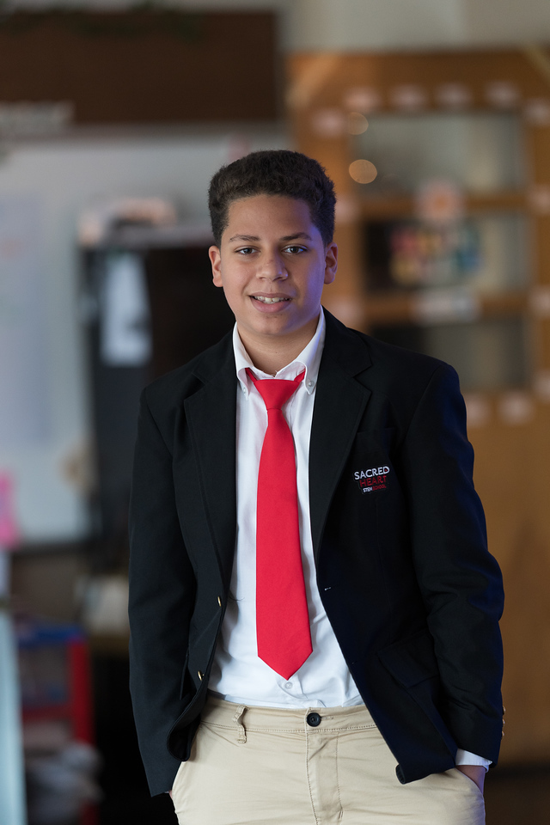
Sacred Heart STEM School Continuous Enrollment
2023-2024
Colleges and private schools nationwide have transitioned to Continuous Enrollment as the most efficient and stress-free way for families to re-enroll year to year. Once your child is enrolled, they will remain enrolled until graduation or until you opt-out.
IMPORTANT DATES:
JANUARY 10
Tuition rates are announced for the upcoming school year
Re-Enrollment begins – packets open on FACTS Family Portal
MARCH 1
Deadline for students who will not be returning for the upcoming school year to complete the opt-out process by contacting Rachael White @ 617-323-2500 or rwhite@sacredheart-boston.org
All returning students must submit the re-enrollment packet by this date (this will not need to be done again after this year!)
Annual Enrollment Deposit charged to all returning families by end of business
STRESS-FREE!
EFFICENT!
Your child’s seat is secure through graduation!

