Slide 1
St. Odilia’s
Brain Health & Dementia Series
Carolyn Klaver, Registered Nurse, Faith Community Nurse
Community Dementia Educator
Notes:
1-2:30 p
1 min 1-1:01

Slide 2
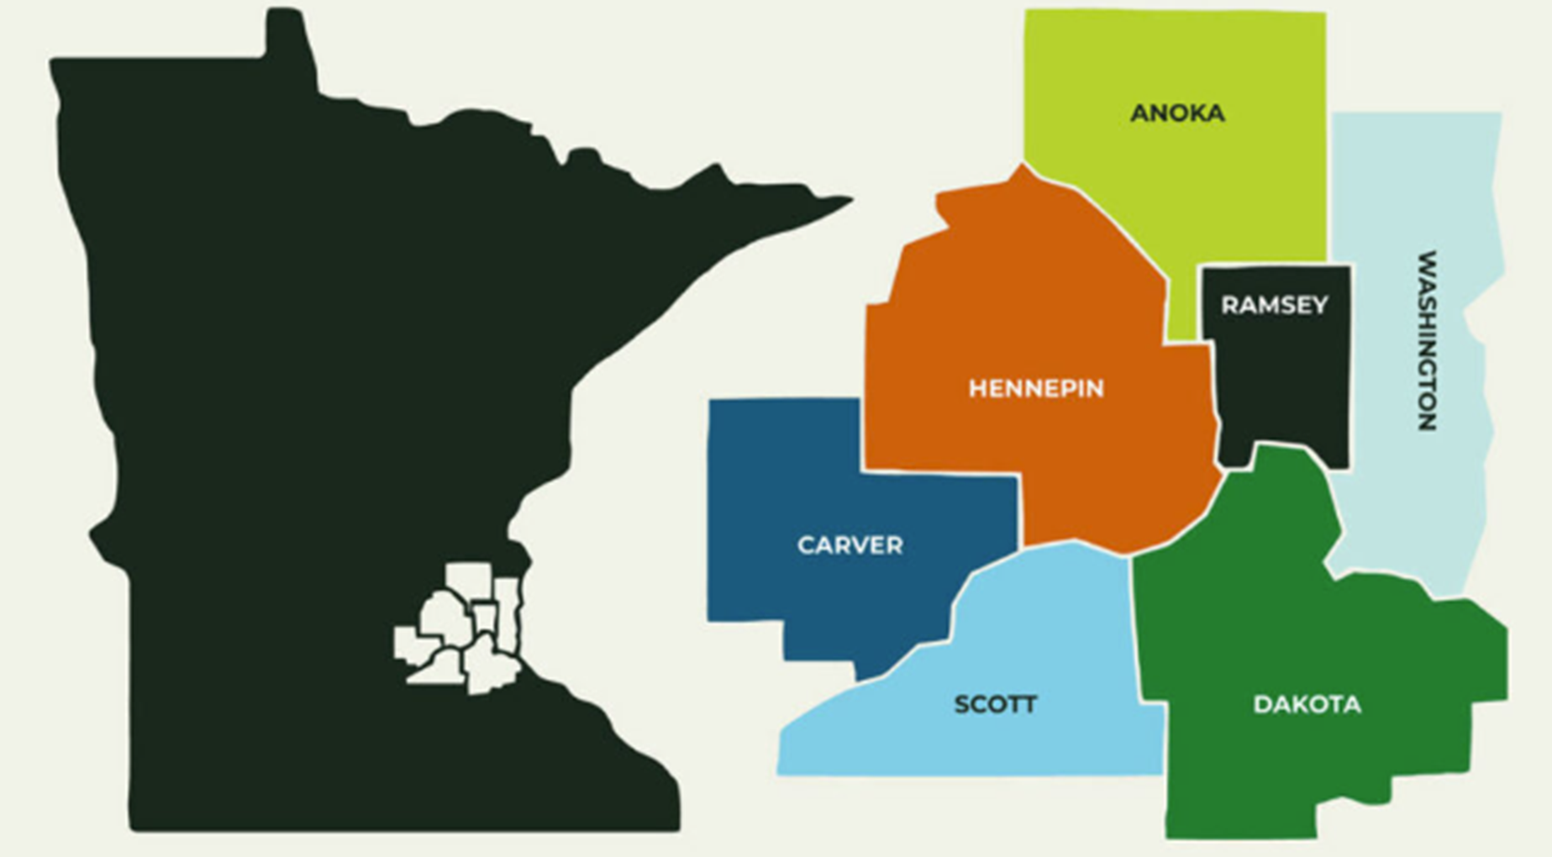
Session Five
Metro Wide Dementia Resources
Notes:
1 min 1:01-1:02

Slide 3

But 1st a Review
2 important items
Notes:
1 min 1:01-1:02

Slide 4
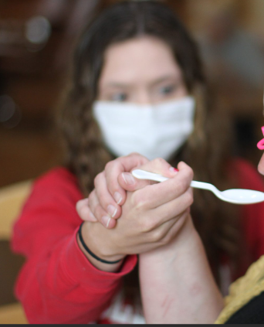
Hand – Under – Hand Position
Watch Teepa Snow demonstrate this technique
https://www.youtube.com/watch?v=vvm2RSFMZeY
A form of
co-active movement.
The person being guided remains an active participant.
To help with cares, i.e. dressing, eating, bathing, zipping, unzipping
Notes:
5 min 1:08-1:13

Slide 5
Reminder:
Get your hearing tested Annually
Hearing loss increases your rate of cognitive decline and dementia
Hearing aids may delay the onset of dementia or slow the progression
With or without a dementia diagnosis – get your hearing tested, wear hearing aids if possible to keep the brain stimulated from social engagement
Hearing is a quality of life issue
When hearing aids are not possible, can a pocket talker or other assistive listening device be used?
Ensure hearing aid batteries are working/changed regularly & aids are cleaned
The same goes for vision – including ensure glasses are clean
Notes:
2 min 1:13-1:15

Slide 6

Who are your resources?
Family members, friends, neighbors
Faith Community Nurse/Pastoral Care, volunteers
Social Work professionals – you will meet one today
Geriatric care managers – assess needs, coordinate care, provide guidance, monitor progress
Health care providers – Primary Care Provider, Neurologist, Neuropsychologist, Psychiatrist
Mental health professionals – Psychiatrist, Psychologist
Notes:
3 min 1:20 – 1:23

Slide 7
Types of Resources – Associations, national non-Profits
Alzheimer’s Association https://www.alz.org/
Lewy Body Dementia Association https://lbda.org/
Association for Frontotemporal Degeneration https://www.theaftd.org/
Vascular Dementia: American Stroke Association https://www.stroke.org/en/about-stroke/effects-of-stroke/cognitive-effects/vascular-dementia
Notes:
2 min 1:18-1:20

Slide 8
Types of Resources -
Local, State Government, Tribal Social Services
Eldercare Locator https://eldercare.acl.gov/home
A public service of the Administration for Community Living
Indian Health Service https://www.ihs.gov/
Federal Health Program for American Indians & Alaska Natives
Notes:
1 min 1:23-1:24

Slide 9
Types of Resources- Respite services
In Home
Group Respite
Provide temporary relief and support to caregivers, allowing them to take a break from their caregiving responsibilities.
Socialization, supervision.
Activities can include reminiscing, music, exercise, art expression
Licensed Adult Day may include personal cares
a paid or volunteer caregiver can visit the care receiver’s home for a short period
companion care from home care agency – less expensive than a home health nurses aid
Volunteer or companion from a social service agency
A facility respite may be available at some Assisted Living or Long-Term Care facilities for stays of a few weeks – for a caregiver’s surgery, health change, vacation.
Notes:
3 min 1:15-1:18

Slide 10

Various levels of care
Day-to-day support
  Adult day centers
  Respite services
  Supervision
  Meals delivered to the home
  Transportation
Residential care
  Assisted Living facilities – maybe in early stage or later with someone living with them
  Memory Care Units
  Nursing Homes/Long term care facilities
  Continuum of care retirement communities
Long-term care in the home
  Unpaid family members & friends
  Paid service providers
    General care
    Medical care
    Home care services – require a doctor’s order, involve licensed medical professionals
Hospice – providing end-of-life care and comfort.
  In home
  At a residential care facility, hospital, hospice facility
Notes:
5 min 1:24-1:29

Slide 11
Home Care Agencies
Consult caregiver professionals who work with caregivers in referring to resources
Ask other caregivers their recommendations from their experiences.
A support group can be an excellent place to get ideas for all types of care based on their personal and recent experiences.
With help, living at home can be safe, familiar and flexible. It is often a more expensive option, depending on services needed, when used in the long term.
Can include companionship, personal care, skilled medical support, and other services tailored to the individual’s specific needs.
Notes:
2 min 1:29-1:31

Slide 12
Hospice Agencies
During the final stages of dementia
I encourage you to remember the tremendous support that hospice can provide.
Focus: comfort and dignity, pain management, emotional and spiritual support, respite care for caregivers, grief support for families
Ensures that patients can live their remaining days with peace and respect
Holistic approach – prioritizes quality of life and the emotional well-being of both patient and their family/friends
Notes:
1 min 1:31-1:32

Slide 13

Resources - Veterans
County Veterans Service Officers (CVSO)
Dedicated professionals in each Minnesota county
Assist veterans, their families, and survivors in accessing benefits and services.
Guidance on applying for veterans benefits, assist with transportation to VA Health Care Systems, and connect veterans with various programs and services available to them.
https://www.macvso.org/find-a-cvso.html
Veterans crisis line 1-800-273-8255
Veteran’s Administration Caregiver Services
888-546-5838 (General service inquiries)
855-260-3274 (Caregiver Support Line) www.caregiver.va.gov/index.asp
Notes:
1 min 1:32-1:33

Slide 14
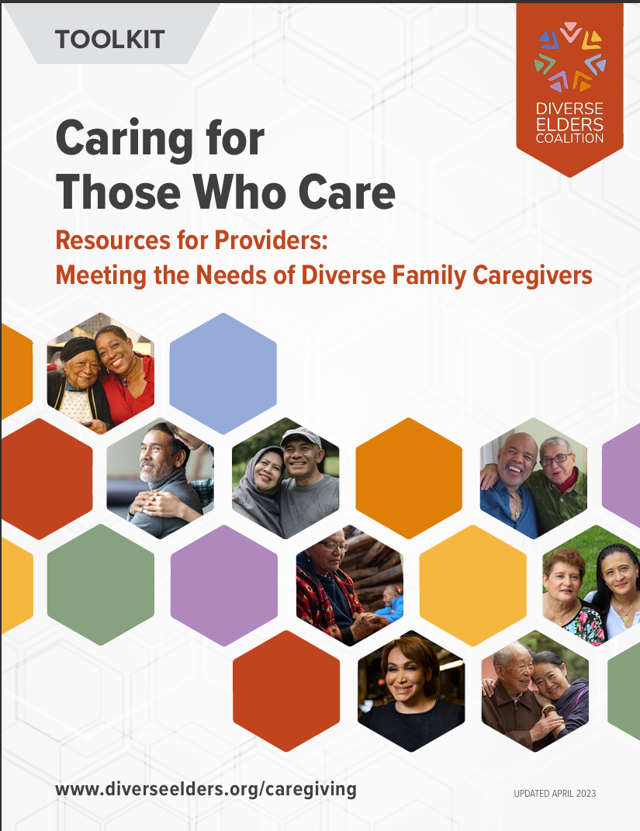
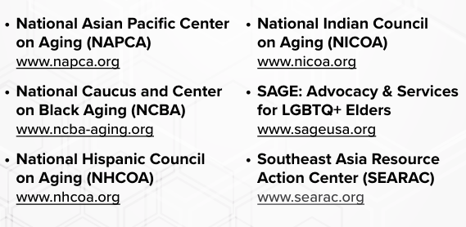
Caregiving for Diverse Adults
https://diverseelders.org/wp-content/uploads/2025/03/DEC-Toolkit-Final-041723-1.pdf
Notes:
1 min 1:33-1:34

Slide 15
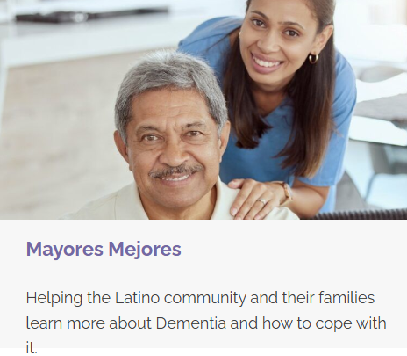

CLUES
https://clues.org/services/elder-programs/
St. Paul 651-379-4200
Minneapolis 612-746-3500
Austin 507-355-2575
Willmar 320-262-5106
Notes:
1 min 1:34-1:35

Slide 16
Resources – Elder Law Attorney
Helps navigate the legal complexities of aging, securing finances, and safeguarding well-being
A specialized legal field
  Address unique legal, financial, and personal needs of older adults and their families.
  Encompasses a broad range of issues affecting seniors as they age
    Focus on planning for the future, protecting assets, ensuring quality of life.
    Legal, financial, healthcare, social services
    Estate planning, asset preservation
    Healthcare and Long-Term Care Planning
    Guardianship and Incapacity Planning
    Protecting against Elder Abuse and Exploitation
    Veterans Benefits, Special Needs Trusts
Notes:
3 min 1:35-1:38

Slide 17
Resources – Paying for care
Support groups – free, some with donation. Learn from other caregivers going through this. What resources have they vetted?
Centers for Medicare & Medicaid Services’ (dually eligible people) – PACE (Program of All-Inclusive Care for the Elderly) https://www.cms.gov/medicare/medicaid-coordination/about/pace
Benefits Check Up – a free services from the National Council on Aging – can assist with finding federal and state benefit programs that may save money & access care and support. https://benefitscheckup.org/
Benefits.gov https://www.usa.gov/benefit-finder?utm_source=usa_benefits-gov&utm_medium=redirect&utm_campaign=redirect_benefits-gov&modal=b-welcome-1899
Long-Term Care Insurance
Notes:
1 min 1:39-1:40

Slide 18
1. Trellis – our designated Area Agency on Aging for the twin Cities metro area
Trellis
https://trellisconnects.org/get-help/family-caregivers/
800-333-2433
Caregiver information or assistance
Information specialists will refer you to resources in your community
See next slide for map
Trellis provides services, connections and innovations to help people thrive as we age.
Counties: Anoka, Carver, Dakota, Hennepin, Ramsey, Scott and Washington
With a broader geographic reach across the state of Minnesota and in some cases across the nation.
***This website will be updated by April 2026
Notes:
1 min 1:40-1:41

Slide 19

1. Trellis – (continued)
Care Ecosystem
free, phone-based program designed to help people living with dementia & their caregivers navigate care and supportive resources.
Local care team navigators, in partnership with a licensed social worker, offer personalized guidance and connections to resources like food delivery, transportation, financial assistance, support groups, and more.
https://trellisconnects.org/dementia-care-navigation/
651-641-8612
Notes:
1 min 1:41-1:42

Slide 20

Trellis – 7 county Metro Area
Notes:
1 min 1:41-1:42

Slide 21
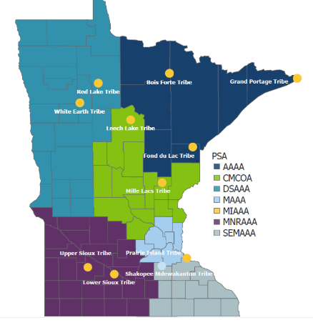
MN Area Agencies on Aging (MN AAA) out state
Duluth: Arrowhead AAA
St. Cloud: Central MN Council on Aging
Warren: Dancing Sky AAA
MN Indian AAA serving 10 MN Reservations
Mankato: MN River AAA
Rochester: Southeastern MN AAA
Notes:
1 min 1:42-1:43

Slide 22

2. Juniper – health promotion classes
Juniper = Health Promotion Classes. A program of Trellis
https://yourjuniper.org/
1-855-215-2174
Email them at info@yourjuniper.org
Go here to schedule evidence-based health promotion classes, such as Powerful Tools for Caregivers
  Or put your name on a waiting list for a class
***This website will be updated by April 2026
Notes:
1 min 1:42-1:43

Slide 23
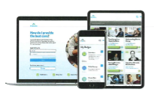

3. Trualta
Online platform to help families build skills to manage care at home for their aging loved ones.
Learn care skills.
Lessons range from 5 minutes to 2 hours.
Fit caregiver training in whenever it works for you.
Request registration through
one of the agencies #4 through # 12
Notes:
1 min 1:42-1:43

Slide 24

4. Family Means
Coaching & Consultation
Support Groups
In-Home and Group Respite
Education
Memory Café
And so much more
  https://www.familymeans.org/help-for-caregivers/
  651-439-4840
  See next slide for map –
  cover entire metro for consultations and online work
  Lynn Amon, MSW, Family Means Caregiving & Aging Social Worker
  Will take you on a presentation tour
Notes:
1 min 1:43-1:44

Slide 25


Family Means –
Stillwater,
St. Paul,
Hudson, Wisconsin
Notes:
1 min 1:43-1:44

Slide 26
FamilyMeans Caregiving & Aging Services
Notes:
1:44-2

Slide 27
FamilyMeans Mission:
Mission
FamilyMeans strengthens communities by helping individuals and families* through challenges in all life stages.
Vision
FamilyMeans envisions vibrant and resilient communities where everyone lives to their fullest potential.
*Definition of Family
A family consists of people, whether living together or apart, related by blood, marriage, adoption, or the commitment to care for or about one another.
Notes:
2 min 1:44-1:46

Slide 28
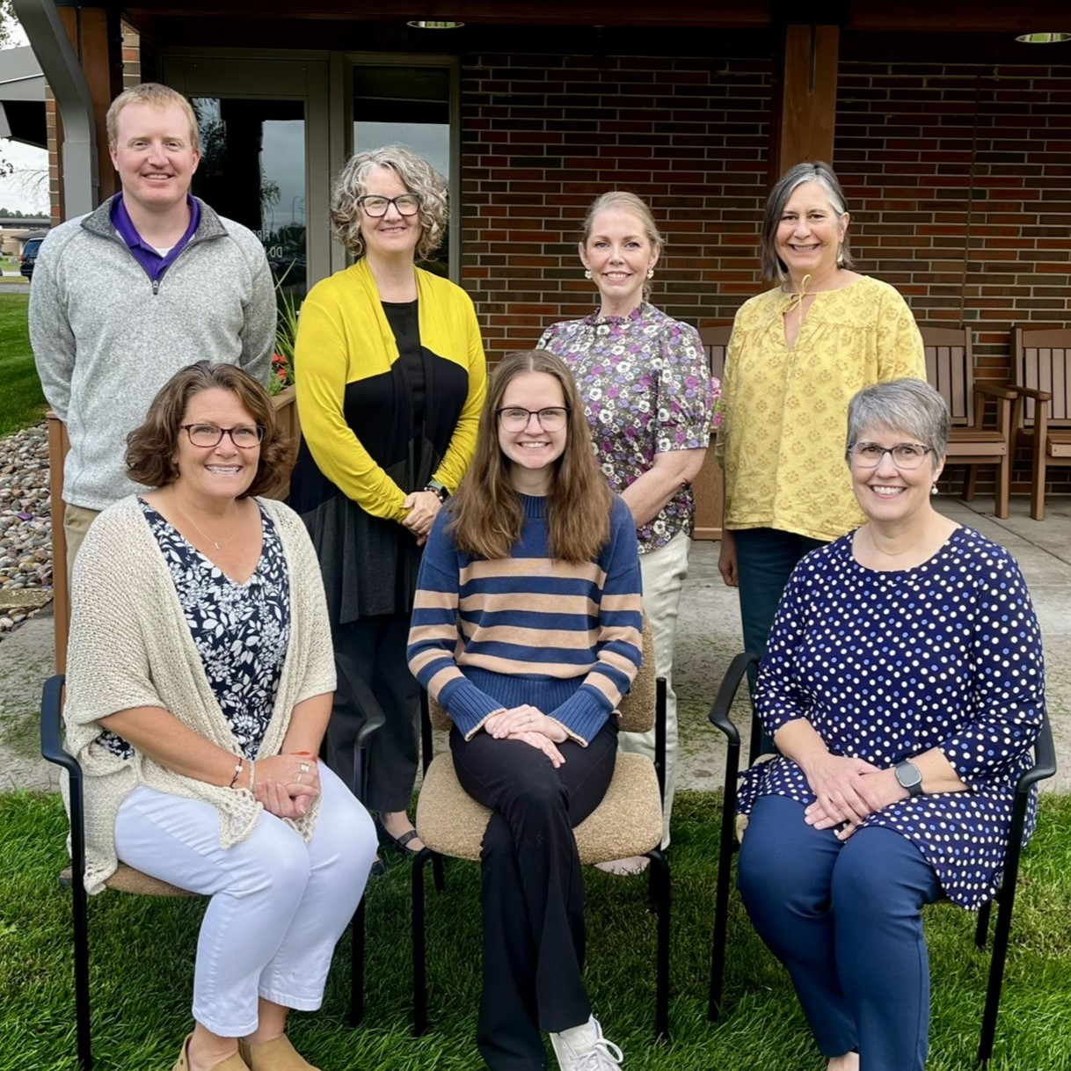
Beth Wiggins
Director of Caregiving & Aging
Lynn Amon
Social Worker
Dan Bohnker
Volunteer & Respite Coordinator
Bre Berwyn
Social Worker
Jocelyn Hayden
Community Engagement and Intake
Heidi Ricks
Dementia Program Coordinator
Jenny West
Community Educator
Notes:
1 min 1:46-1:47

Slide 29
Caregiver Coaching & Consultation
Licensed social workers help caregivers find the best way to care for
someone while keeping balance in their own lives.
The caregiver coach helps families learn about services, cope with daily
challenges, solve problems together, manage family dynamics, and plan ahead.
Options include:
In person * Telephone * Virtually
Notes:
2 min 1:47-1:49

Slide 30
Respite
In-Home
Regularly scheduled 1:1 visits provided at your home by volunteers who are screened, trained and carefully matched and monitored to meet your family's needs. It is typical for the volunteer to come weekly for a maximum of 2-4 hours respite.
Group Respite:
Caregivers of older adults can also have a break while they person they care for spends time with FamilyMeans staff and volunteers in a group setting.
Day Out! Weekly on Fridays, 10am-1pm
Night Out Monthly on the 4th Tuesday, 5:30pm to 7:30pm.
Community Connection
This group is designed for those with early-stage memory loss to explore new places, engage with others, and connect to community
Stillwater Wednesday series, 1pm-4pm
Forest Lake Weekly on Tuesdays, 12noon-4pm
Notes:
1 min 1:49-1:50

Slide 31
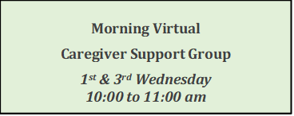
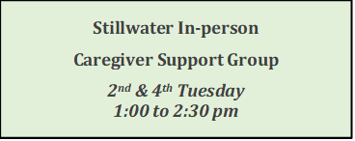
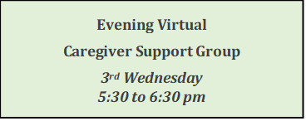
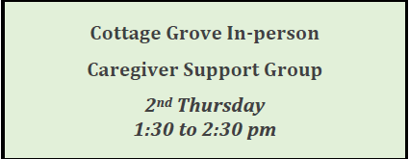
Caregiver Support Groups
Notes:
2 min 1:50-1:52

Slide 32
Education
Offered at FamilyMeans, in workplaces, and at other community sites.
Powerful Tools for Caregivers -
6-week series equips caregivers to take care of themselves while providing care to someone else.
Shaping Your Tomorrow: Dementia and MCI-
10-week series for those with memory loss and a family member/friend, offering a safe setting for learning,
asking questions and sharing experiences.
Finding Meaning and Hope-
10-week series for caregivers to gain hope and build resilience when dealing with the complexities of ongoing ambiguous loss associated with caring for someone with dementia.
Notes:
1 min 1:52-1:53

Slide 33
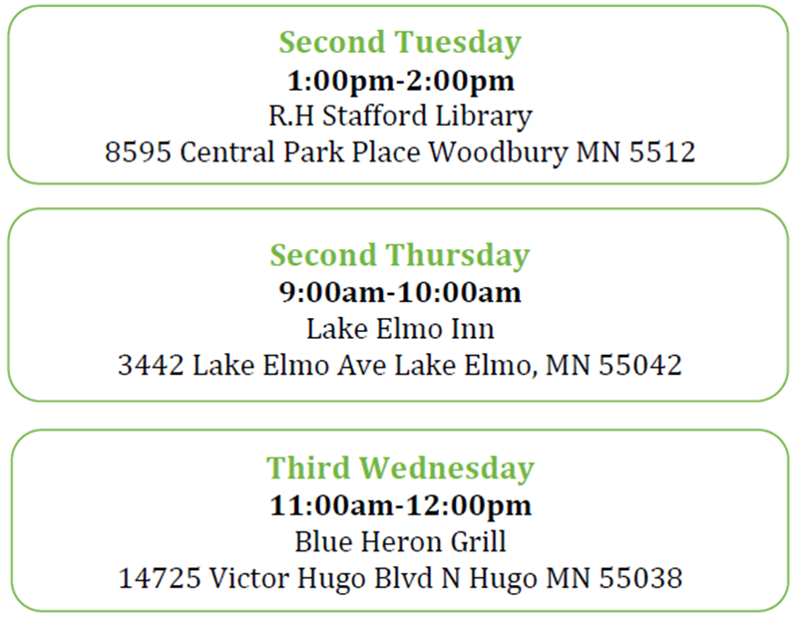
Memory Cafés
A welcoming place for those with memory loss and their caregivers to come together each month to share, support and connect with others in your community.
Notes:
2 min 1:53-1:55

Slide 34
Empowering Persons living with Dementia
Specifically for the person living with dementia or early memory loss
One-to-one Consultations
Provide a listening ear and guidance as you plan your next steps living with dementia.
Each person follows a unique path, and having a guide can be essential to relieving
stress along the way and living your best life.
Journey Together
Virtual social/support group that covers topics important to someone adjusting their
life to living with dementia in order to find joy and purpose.
Community Connection
A group to explore new things in the community and break stigmas about dementia.
Timely themes and special community guests lead us to explore history, art, poetry, nature, community locales and music.
Notes:
1 min 1:55-1:56

Slide 35
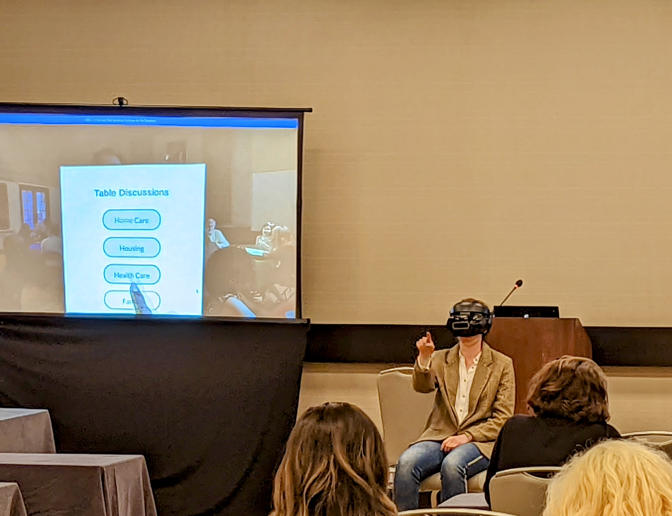

Virtual Reality
Through Virtual Reality, you can experience what it would be like to live with one of these conditions:
Alzheimer’s * Lewy Body Dementia and Parkinson’s * Macular Degeneration
FamilyMeans also offers Virtual Reality for those seeking information about:
Trans Health & LGBT Aging * Effects of Social Isolation
Notes:
2 min 1:56-1:58

Slide 36
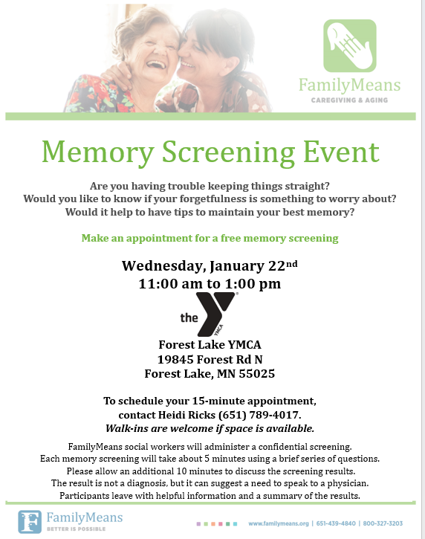
Memory Screenings
Staff offer Memory Screenings out in the community
Brief, confidential assessments with a social worker help people explore memory concerns and learn whether further evaluation is recommended
Notes:
1 min 1:58-1:59

Slide 38
5. Faith Community Nurse Network
FCNNTC.org
To find the next Powerful Tools for Caregivers class, go to https://trellisconnects.org/cc-event/powerful-tools-for-caregivers-10/2025-02-12/ ***This website will be updated by April 2026
Small group workshop with 10-14 participants
1.5 hour sessions, 1 session each week for 6 weeks
Participants with a variety of caregiving experience attend together
Participants receive the Caregivers Helpbook
Led by two trained facilitators
Many social service agencies listed also offer Powerful Tools for Caregivers
Evidence-based educations
Such as Powerful Tools for Caregivers
  For people who help a parent, spouse, partner, child, or friend who lives with a long-term health condition.
  Offers practical strategies and tools for caregivers to reduce stress, improve self-confidence, manage goals, solve problems, self-advocate, make tough decisions, and locate resources. Classes are highly participatory, where mutual support builds participants’ confidence, improve caregiver health and wellbeing.
Notes:
3 min 1:59-2:02

Slide 39
5. Faith Community Nurse Network (continued)
Upcoming schedule:
Summer 2026:
Mid-June to Mid-August on Tuesdays
Fall 2026
Spring 2027
Screening can include: Body metrics, Blood Pressure, Pain Management, Sleep Management, Nutrition, Cognitive Screening, Depression, Loneliness, Hearing Loss, Activity Level, Enhancing Spirituality, Social / Intellectual / Emotional Needs, Financial Wellness
Whole-Person Wellness Screenings
Appointments from 9 a.m. to 3 p.m.
Offered metro wide at various locations with Faith Community R.N.s and University of Minnesota Nursing Students
if interested in hosting for your community & opening to the community, please contact Sam Sleeman, Executive Director, Sam@fcnntc.org or 612-363-8251
Notes:
1 min 2:02-2:03

Slide 40

5. Faith Community Nurse Network (continued)
1. Dementia Friendly Faith Communities
2. Brain Health versus Dementia, including Tips & Typical Aging
3. Dementia: Your Role as Community/ Family/ Friends
4. How to Work with Dementia Care Challenges
5. Dementia Communication Techniques
6. Metro Wide Dementia Resources
7. Dementia and the Significant Role of Faith & Spirituality
8. Navigating Delirium
Dementia Education for Faith Communities
Carolyn Klaver, R.N., Faith Community Nurse, Dementia Specialist
if interested in discussing topic and scheduling for your community plus opening to the community, please contact Carolyn Klaver at carolynklaver@fcnntc.org 952-373-1780
Notes:
1 min 2:02-2:03

Slide 41

6. Amherst H. Wilder Foundation
https://www.wilder.org/services/aging-caregiving/
651-280-2273
See map next slide
Consultation
Information & Assistance
Caregiving Counseling
Caregiver Support Groups
Memory Loss Discussion Group
Adult Children Caregiver Support Group
Notes:
1 min 2:03-2:04

Slide 42
Wilder,
St. Paul
Notes:
1 min 2:03-2:04

Slide 43

7. Anoka County Family Caregiver Connection
2100 3rd Avenue, Anoka, MN 55303
763-324-4000
https://www.anokacountymn.gov/655/Family-Caregiver-Connection
See map next slide
Out of home Group Respite: Coon Rapids, Columbia Heights, Anoka
Support Groups
Memory Café
Caregiver Education
Coaching & Assistance
Notes:
1 min 2:04-2:05

Slide 44
Anoka County
Notes:
1 min 2:04-2:05

Slide 45

8. Lyngblomsten Community Services
651-632-5320. caregiving@lyngblomsten.org https://lyngblomsten.org/community-services/
Respite Care - Lyngblomsten
See map next slide
Specialize in serving those with memory loss and those who care for them.
The Gathering group respite – 3 days per week. Como Park campus, Lino Lakes campus
Caregiver support
Caregiver consultation
Education & Resources
Memory Loss Caregiver Support groups
Lino Lakes temporary care
Notes:
1 min 2:05-2:06

Slide 46
Lyngblomsten
Como Park in St Paul
Lino Lakes
Notes:
1 min 2:05-2:06

Slide 47
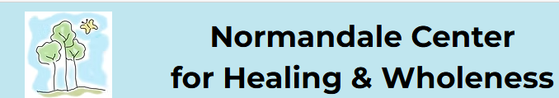
9. Normandale Center for Healing and Wholeness
6100 Normandale Rd., Edina MN 55436 | 952-929-1698 https://www.normandalecenter.org
See map next slide
Caregiver Support
Caregiver Education
Care Consultations
Visiting Volunteers & Respite
Public Education
Medical Equipment Loan Program
Community Workshops (Powerful Tools for Caregivers)
Memory Café
Notes:
1 min 2:06-2:07

Slide 48
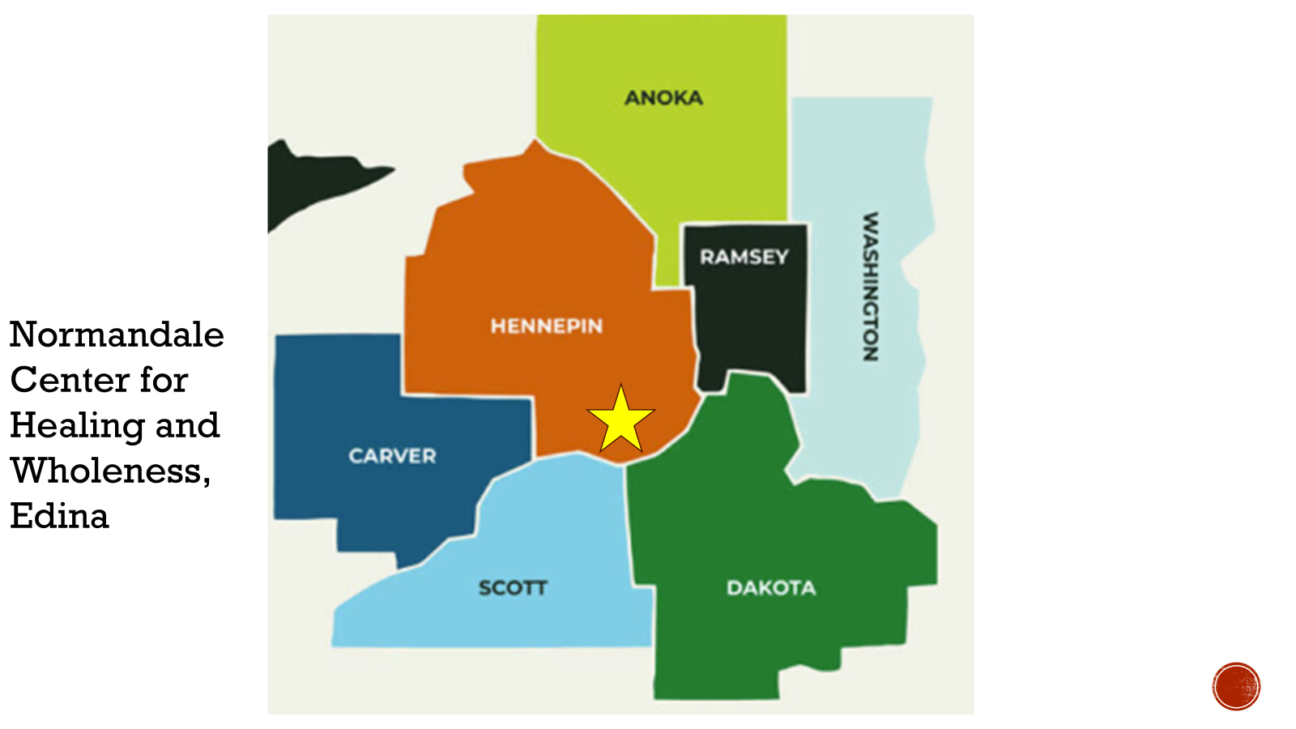
Notes:
1 min 2:06-2:07

Slide 49

10. Senior Community Services
Caregiver Coaching
Caregiver Support Groups
Information & Assistance
Caregiver Consultation
Family Meeting Facilitation
Memory Cafes
7 western metro counties
https://seniorcommunity.org/services/caregiver-support/
952-541-1019
See map on next slide
Notes:
1 min 2:07-2:08

Slide 50
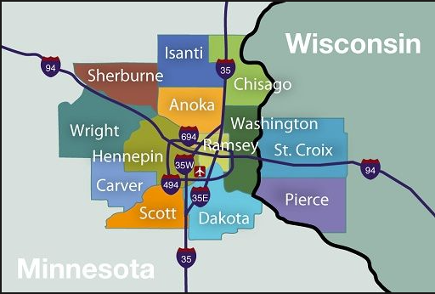
Senior Community Services –
Hennepin
Ramsey
Anoka
Sherburne
Wright
Carver
Scott
Notes:
1 min 2:07-2:08

Slide 51

11. DARTS: Dakota Area Resources, Transportation, Services
https://dartsconnects.org
651-455-1560
info@darts1.org
Map next slide
Caregiver Counseling & Coaching
Family Meetings
Individual Respite
Group Respite: The Breathing Space
  Apple Valley
  West St. Paul
  Eagan
Caregiving Support Groups
Notes:
1 min 2:08-2:09

Slide 52
DARTS
Dakota County
Notes:
1 min 2:08-2:09

Slide 53

12. Karen Organization of MN.
Individual and Family Services for refugee and immigrant communities.
2353 Rice St., Suite 240, Roseville, MN 55113. 651-788-7593 https://mnkaren.org
Counseling
Training
Support groups
Temporary substitute care
Transportation and more
Staff speak Amharic, Burmese, Dari, English, Karen, Oromo, Pashto, Spanish, and Urdu
Supports refugees, asylees, new arrivals under other humanitarian protected statuses who have lived in the U.S. less than 5 years
Home and Community-Based Services Program – to connect people who need support living independently with resources where they need it.
In your home or in your community
Elderly Waiver
Community Alternatives Care (allow family members to be paid caregivers)
Over 60 years old or adults with neurological dysfunction
Notes:
1 min 2:09-2:10

Slide 54

13. East Side Neighborhood Services
1700 Second Street NE, Mpls
(NE Minneapolis)
Vital Living Program — East Side Neighborhood Services
612-787-4086
Caregiver support group
Group Respite – NE Day Spot - Fridays
Notes:
1 min 2:10-2:11

Slide 55
East Side
Neighborhood
Services
Notes:
1 min 2:10-2:11

Slide 56

14. Living at Home Network –
Block Nurse Programs
https://lahnetwork.org/
Helping older adults maintain a safe and healthy life at home.
Many services and support, yet each program may have service(s) that is specific to their community.
Contact Us
(651) 649-0315
info@lahnetwork.org
Notes:
1 min 2:10-2:11

Slide 57
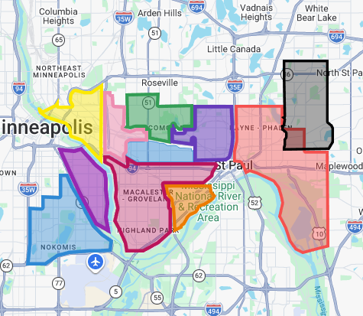
Living at Home Network Metro Programs
Green = Como Park Falcon Heights
Red = East Side Elders
Blue = Hamline Midway
Orange = Keystone Community Services
Maroon= Neighborhood Network for Seniors
Dark Blue = Nokomis Healthy Seniors
Purple/pink = Longfellow/Seward Healthy Seniors
Purple = North End-South Como Block Nurse Program
Pink = St. Anthony Park Area Seniors
Yellow = Southeast Seniors
Black = North East Seniors
Notes:
1 min 2:10-2:11

Slide 58
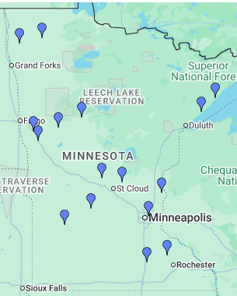
Outstate MN Living at Home Networks
https://lahnetwork.org/find-a-program/#!directory/map
Argyle
Atwater
Barnesville
Foley
Two Harbors
Granite Falls
Grove City
Owatonna
Holdingford
Park Rapids
Middle River
Frazee
Silver Bay
Paynesville
Pelican Rapids
Pine Island
Queermunity in Mpls
Rothsay,
Stephen,
Viking, Holt, Newfolden
Warren, Alvarado, Oslo
Notes:
1 min 2:10-2:11

Slide 59

15. Lutheran Social Service of MN.
Options across the state
Care Coordination Services for those on Medical Assistance
Caregiver Coaching & Counseling
Caregiver Support Groups
Training & Education
Respite – In-Home, Group: East Grand Forks, Spicer, Moorhead, Hutchinson
Services for Veterans
Waiver Services
Emergency Care Planning
https://www.lssmn.org/services/older-adults/caregiver-support-respite
866-787-9802
See map next slide
Notes:
1 min 2:11-2:12

Slide 60

16. Alzheimer’s Association
Free Care Consultations
to provide you with individualized, solution-focused support. You'll speak with a Care Consultant who is a master's-level dementia expert.
An in-depth service for individuals and families who are facing the many decisions and. Challenges associated with Alzheimer’s disease
Notes:
1 min 2:12-2:13

Slide 61
Alzheimer’s Association
24/7 help line
800-272-3900 for immediate assistance (call 9-1-1 if a life threatening emergency)
a free service offering support for people living with all forms of dementia, caregivers, families and the public.
Connect with a live person who can provide information, local resources, crisis assistance and emotional support.
People reach out to the Helpline for many different reasons.
knowledgeable and caring staff can help you navigate a variety of needs and situations.
Notes:
1 min 2:12-2:13

Slide 62

17. Roseville Alzheimer’s & Dementia Community Action Team
https://www.cityofroseville.com/dementiainfo
Since 2013
Monthly updated lists:
Dementia Support Groups & Services https://www.cityofroseville.com/DocumentCenter/View/39047/022026-Dementia-Support-Groups-and-Services
Dementia Friendly Activities https://www.cityofroseville.com/DocumentCenter/View/39046/022026-Dementia-Activities
Past presentations available online https://www.cityofroseville.com/2721/Alzheimers-Dementia
Notes:
1 min 2:13-2:14

Slide 63

18. Twin Cities Support Group for Persons with Lewy Body Dementia
For persons in the early stages of LBD who would benefit from communicating with others about living with this disease, providing mutual support and companionship.
Care partners are also welcome to attend along with the person they are supporting
1st Tuesday of every month 1:30 – 3 p.m. CDT
paula.biever@gmail.com
For additional information and to be placed on the email list for meeting announcements and links: email Paula Rice Biever at paula.biever@gmail.com
Notes:
1 min 2:14-2:15

Slide 64
19. MN Lewy Body Dementia Caregiver Support Group
Serves caregivers, family members, and friends of persons living with Lewy body dementia.
Comfortable and compassionate place to share experiences, support, and resources.
Facilitators: Paula Rice Biever & Erik Biever
paula.biever@gmail.com
Notes:
1 min 2:14-2:15

Slide 65

20. Assistive Technology for People living with dementia Workshop
Wednesday, April 29th 1:00 – 3:00 P.M.
Roseville branch of Ramsey County Library
Occupational Therapists Meghan Hunter & Sue Redepenning
Come try out any of the equipment
Examples: Theora watch https://theoracare.com/theora-connect/ ,
AngelSense trackers https://www.angelsense.com/gps-tracker-for-elderly/?utm_source=bing&utm_medium=cpc&utm_campaign=603303208&utm_content=1298524494846499&utm_term=autism%20tracker&network=o&device=c&matchtype=b&msclkid=0f6014a914451b68b34c7d365802d432 , plus other items such as the FindMy app to locate people, & some communication boards used by individuals living with aphasia.
Notes:
1 min 2:15-2:16

Slide 66


21. Joe Gaugler’s Caring for the Caregiver Conference
Saturday, May 30th, 2026 from 8:30 A.M. to 3:30 P.M.
University of Minnesota
Attend in-person at the McNamara Alumni Center
Or attend online via Zoom
https://www.sph.umn.edu/events-calendar/caring-for-person-with-memory-loss-conference/
Annual conference
Notes:
1 min 2:16-2:17

Slide 67

22. Disability Caregiving
MN Aging and Disability Resources
866-333-2466
https://Mn.gov/adresources
Notes:
1 min 2:17-2:18

Slide 68

23. Online Education
HealthPartners Center for Memory and Aging Life-Long Learning
https://www.healthpartners.com/care/specialty/neuroscience/memory-loss/support/
Alzheimer’s Association Education Center
https://Training.alz.org
Notes:
1 min 2:17-2:18

Slide 69
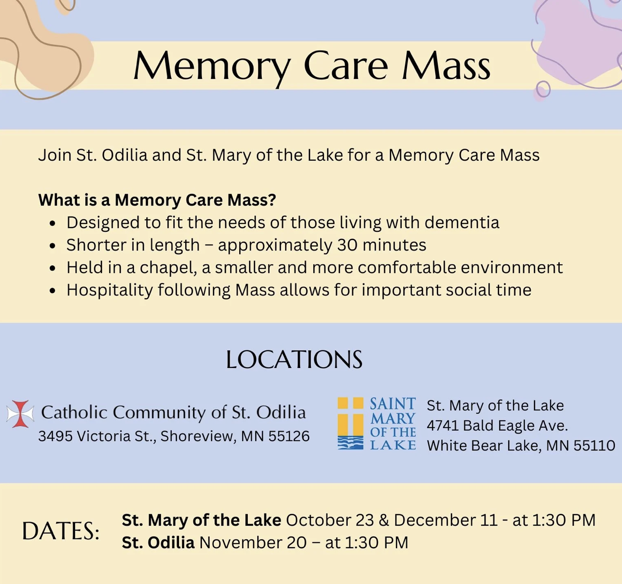
24.
As many as 30 have attended!
Share this with others!
Notes:
1 min 2:18-2:19

Slide 70
Upcoming Sessions
^{April 15 6:30 p.m. to 8 p.m.}
Typical Aging, The Significant Role of Faith & Spirituality – What the Church body can do
Notes:
1 min 2:19-2:20

Slide 71
Online Access to previous sessions
https://www.stodilia.org/dementia-friendly-parish
Notes:
1 min 2:19-2:20

Slide 72
Questions & Answers
Thank you for coming.
I will stay after to answer everyone’s questions.
Notes:
2:20 – 2:30 p

