Slide 1
Fundamentals of Synodality
Welcome!

Slide 2

Today’s Topics
What do I bring to the table?
Fundamentals of PPC synodality.

Slide 3
So many P’s in Parish Pastoral Planning!
# | Good P’s | Bad P’s
1 | Intentional Prayer | Routinary Prayer
2 | Proactive | Passivity (11)
3 | Pastoral | Programmatic
4 | With People (page 36) | For People
5 | Participatory (10) | Prescriptive
6 | Purposeful (32) | Perfunctory
7 | People of God | Personal or group agendas
8 | Practical (34) | Pretentious
9 | Patient (38) | Pessimistic (38)
10 | Pilgrimage (38) | Paper
Source: Elaborated for this presentation,
With elements from Carroll, P. (2022) Becoming a Pastoral Parish Council.

Slide 4

Personal reflection
My Gifts and my Temptations
Review the list of dispositions (P’s) leading to good or bad pastoral planning.
What gifts are natural to me?
So, I can bring them to the conversation.
What temptations affect me?
So, I need to keep in check.
5 minutes

Slide 5
Synodality reveals dialectics to be addressed
 | Pole A | Pole B
A | Unity | Uniformity
B | Preservation | Mission
C | Community | Individual
D | Journeying | Institution
E | …
Source: Elaborated for this presentation,
with elements from Cardinal Ryz’s (2025) Opening Statement at the Jubilee of Diocesan Synodal Teams.

Slide 6

Table conversation
Our Group Dialectics
Dialectic refers to a way of thinking that holds opposing or seemingly contrary truths in creative tension to arrive at a deeper understanding.
  Faith and Reason
  Unity and Uniformity…
Identify some dialectics in your home parish.
How are you actively managing them?
15 minutes

Slide 7
Today’s Topics
What do I bring to the table?
Fundamentals of PPC synodality.

Slide 8
“Pastoral” also means “Content”, not just disposition
Our Risen Lord teaches us how to do “Church business”.
SWWC
Service*
Word
Worship
Community
 | Encounter | Luke | John
A | Mercy | 24:17-24 | 20:11-15
B | Word | 24:25-27 | 20:16
C | Worship | 24:30-31 | 20:17
D | Community | 24:33-36 | 20:18
*Service is not a generic term. It means Works of Mercy and Social Justice.

Slide 9
The ongoing practice and its fruits
7.
We were able to witness the first fruits of the synodal journey that began in 2021, the simplest and most precious of which mature in the life of families, parishes, movements, small Christian communities, schools, and other movements.
This is where the practice of conversation in the Spirit, community discernment, sharing of vocational gifts, and co-responsibility in the mission is growing.
Source: Pope Francis and the Synod of Bishops (2024). For a Synodal Church. Final Document.

Slide 10

Transforming Disposition and Content into a plan
Synodal habits:
Conversations in the Spirit, Community Discernment, Gifts & Talents, Co-Responsibility
Where are we?
Why are we here?
Where do we want to go?
What do we do to get there?
Who will lead which initiatives?
What resources do we need for logical success?
How do we know is working?
Pastoral Content and Personal Dispositions
Α Our Good Shepherd Ω

Slide 11
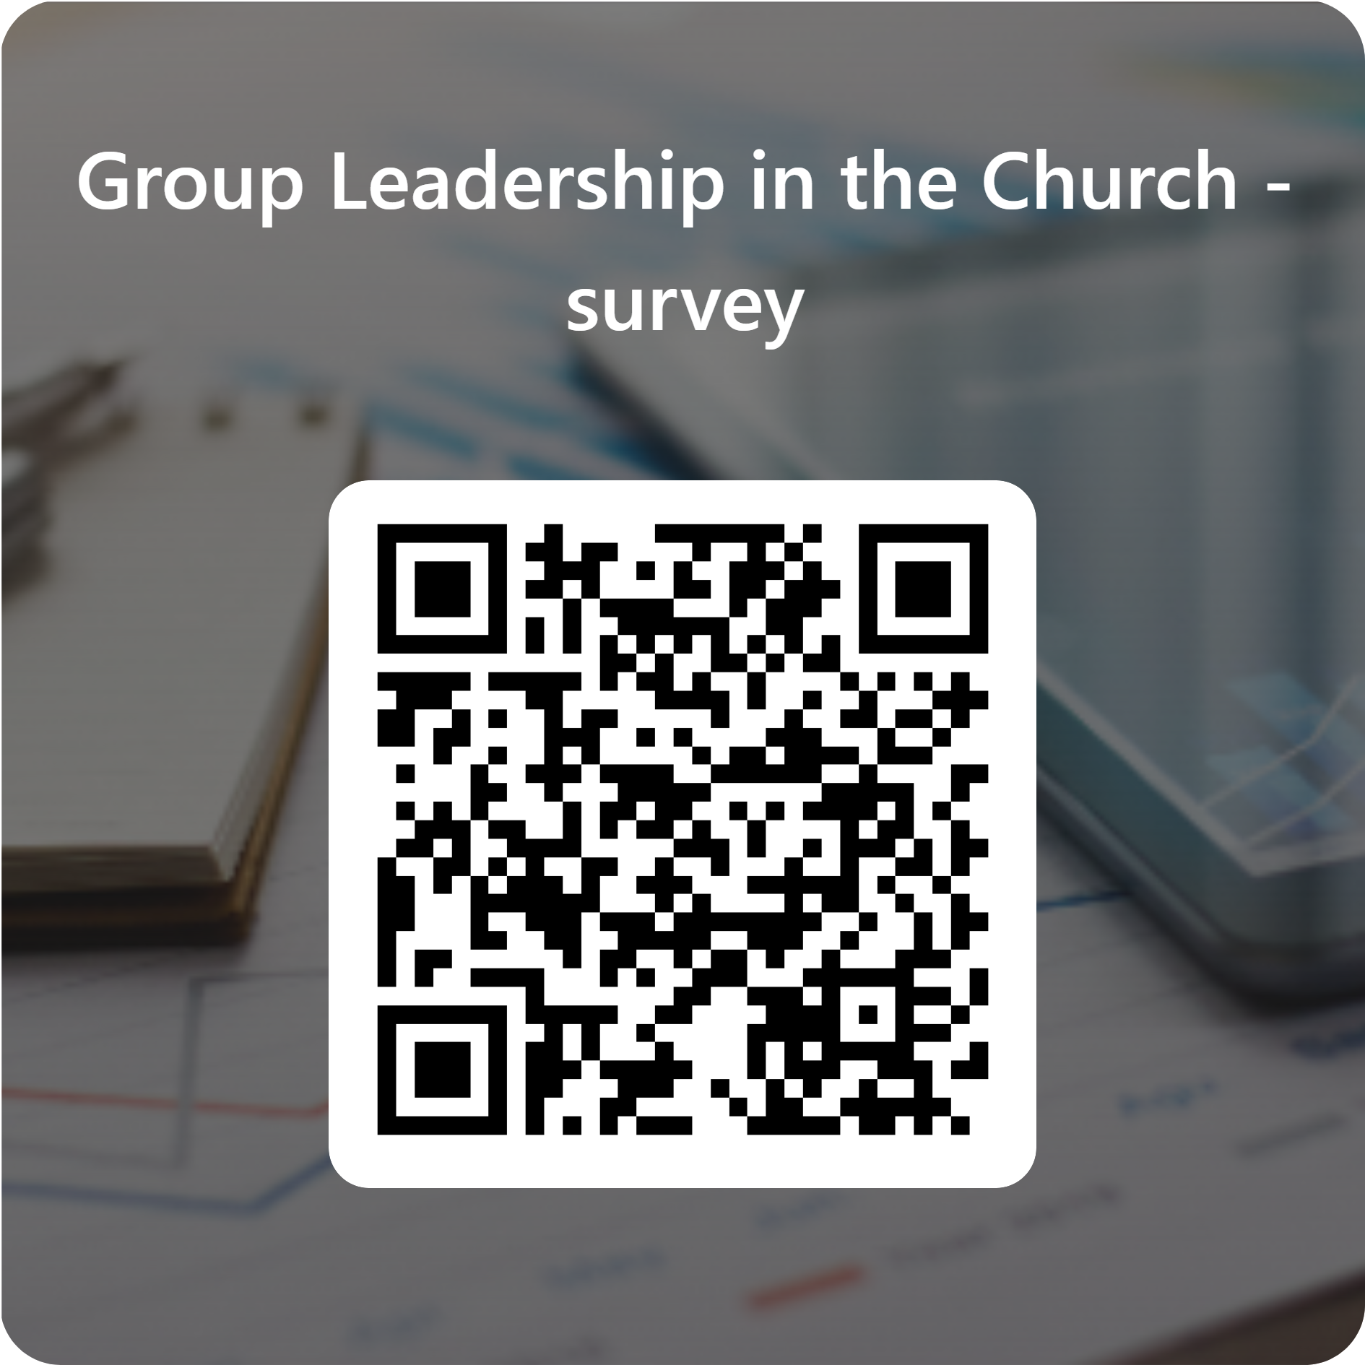
PPC assessment
How Synodal are we?
Go to this website and respond to the survey
As you respond, take notes on the elements more relevant for you.
5 minutes

Slide 12
Table conversation
Our council as a Pastoral Planning body
Discuss your council’s preparedness in terms of
  Synodal habits
  Guiding questions
  Pastoral Content and Disposition
Write down your takeaways
Be ready to share them with the group
20 minutes

Slide 13

Godspeed
May Our Lord, Giver of Life
grant you with all you need
to respond to your individual call
and our shared Mission.
Jim Barrette jbarrette@archgh.org
Ricardo Medina rmedina@archgh.org

Slide 14
- Handouts -
Fundamentals of Synodality
PPC Workshop April 11, 2026
Session 2, presented by Ricardo Medina

Slide 15
So many P’s in Parish Pastoral Planning!
# | Good P’s | Bad P’s
1 | Intentional Prayer | Routinary Prayer
2 | Proactive | Passivity (11)
3 | Pastoral | Programmatic
4 | With People (page 36) | For People
5 | Participatory (10) | Prescriptive
6 | Purposeful (32) | Perfunctory
7 | People of God | Personal or group agendas
8 | Practical (34) | Pretentious
9 | Patient (38) | Pessimistic (38)
10 | Pilgrimage (38) | Paper
Source: Elaborated for this presentation,
With elements from Carroll, P. (2022) Becoming a Pastoral Parish Council.

Slide 16
Synodality reveals dialectics to be addressed
 | Pole A | Pole B
A | Unity | Uniformity
B | Preservation | Mission
C | Community | Individual
D | Journeying | Institution
E | …
Source: Elaborated for this presentation,
with elements from Cardinal Ryz’s (2025) Opening Statement at the Jubilee of Diocesan Synodal Teams.

Slide 17
“Pastoral” also means “Content”, not just disposition
Our Risen Lord teaches us how to do “Church business”.
SWWC
Service*
Word
Worship
Community
 | Encounter | Luke | John
A | Mercy | 24:17-24 | 20:11-15
B | Word | 24:25-27 | 20:16
C | Worship | 24:30-31 | 20:17
D | Community | 24:33-36 | 20:18
*Service is not a generic term. It means Works of Mercy and Social Justice.

Slide 18
Transforming Disposition and Content into a plan
Synodal habits:
Conversations in the Spirit, Community Discernment, Gifts & Talents, Co-Responsibility
Where are we?
Why are we here?
Where do we want to go?
What do we do to get there?
Who will lead which initiatives?
What resources do we need for logical success?
How do we know is working?
Pastoral Content and Personal Dispositions
Α Our Good Shepherd Ω

Slide 19
Detailed Resources
Carroll, P. (2022). Becoming a Pastoral Parish Council.
Francis. (2013) The Common Good and Peace in Society, 217-237.
In Evangelii Gaudium.
Francis and the Synod of Bishops (2024). For a Synodal Church. Final Document.
John Paul II. A spirituality of communion, 43-45.
In Novo Millennio Ineunte. 43
Medina, R. (2025). Loving Others: Mercy and Key Relationships.
In When Love Becomes Whole.

