Slide 1
School Advisory Council
aNd public school board...
How are we different?
Diocese of Crookston Catholic Schools

Slide 2
Problems can result if the role of a Catholic school advisory council is confused with the role of a public school board.

Slide 3
Let’s make this fun!
How much do you know about Catholic School Advisory Councils and public school boards?

Slide 4
Give yourself a point for each correct answer.
Your answer will always be either
“PUBLIC”
or
“CATHOLIC.”
I will ask a question, and give you a moment to think about it.

Slide 5
Let’s begin:
This group hires the administrator (e.g. principal),
but may ask for input from others.

Slide 6
PUBLIC
IN the catholic school,
The PASTOR hires the administrator
And may ask for input from others.

Slide 7
This group recognizes the parent as primarily responsible for educating the child.

Slide 8
CATHOLIC
The public school recognizes the state as primarily responsible for educating the child

Slide 9
This school’s goal is to provide good academics, and develop good citizens.

Slide 10
PUBLIC
The catholic school’s goal is to provide good academics, and develop good disciples of Jesus Christ.

Slide 11
This group evaluates the administrator.

Slide 12
PUBLIC
In the catholic school, the pastor evaluates the administrator(s) but may seek insight from others.

Slide 13
This group is based on Canon law and must follow designated state and federal laws.

Slide 14
CATHOLIC
Public schools are based on state and federal laws.

Slide 15
This group’s decisions are based on consensus.

Slide 16
CATHOLIC
Public school board decisions are based on majority vote.
“consensus” in our councils means that we
Generally agree as a group.

Slide 17
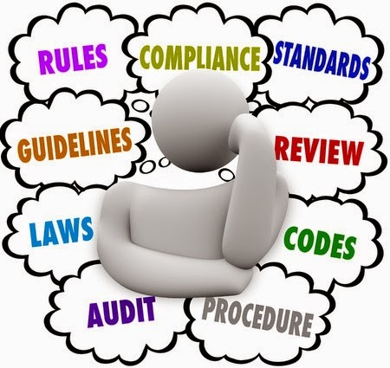
This group makes regulations but may get input from others.

Slide 18
PUBLIC
The catholic school advisory council may be asked to give advice to pastor and principal on regulations.

Slide 19
This group enacts policy (sets it in motion), and may get input from others.

Slide 20
PUBLIC
In catholic school advisory councils,
The pastor enacts policy.
The council formulates policy and may get input from others

Slide 21
This group has the final word in decisions.

Slide 22
PUBLIC
In your school advisory council,
the pastor-superintendent has the final word.

Slide 23
HOW DID YOU DO?

Slide 24
Thank you for being part of our Catholic School Advisory Council. Your work is greatly appreciated!

