Slide 1
Ordinary and
Exempt Income
Assessments
Fr. John Evans
Candice Greenwald
Tiffany Martin
Notes:
Quickly go through the points and then we will open-up for questions.
We can refer back to the slides as needed.

Slide 2
Ordinary & Exempt Income →

Slide 3
Income definitions
Income: All sources of funds that taken in by a Parish.
Ordinary
Exempt
Notes:
CG
Operations or investment in the Parish
For you – all income is either ordinary or exempt
As a rule of thumb, when we review all income sources – we consider them ordinary unless they meet Exemption A Category
Or until identified as exempt
We are improving controls to protect your parish and our entire diocese (allowing for research prior to implementation)

Slide 4
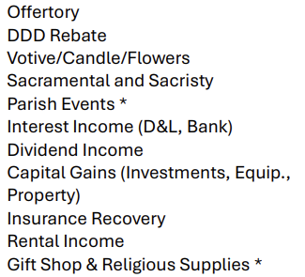
Ordinary income
Notes:
CG

Slide 5
Ordinary income
Net Fundraising
When raising funds in the parish, net fundraising income (revenue less expenses) is considered ordinary income. If you want to apply for a net fundraising exemption, you must:
Advertise how the money is dedicated/used;
The income must be 100% in exempt category;
You must submit your request for exemption before the event along with a copy of the advertising material;
Either exemption A or C could apply with approval.
Notes:
CG
Don’t assume all fundraising is approved
…including any annual fundraising events
An event has to be approved in advance of advertising
Also, all events require a catholic mutual special event form and a check to the diocese $125

Slide 6
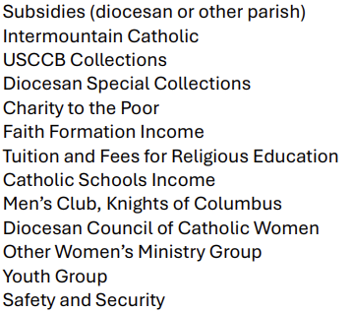
Exemption A: Standard exemption by category
And…
Parish Emergency Fund (until June 30, 2027)
Notes:
TM
These do not need advanced approval
Safety and Security is exempt for setting up processes
…not for maintenance of a system – e.g. elevator
Emergency Fund – this goes into the D&L – into a new D&L account
3-6 months of operating expenses
Withdrawal of these funds must be for catastrophic needs and like all restricted funds/D&L withdrawals
…must be used for donor intent and go through the Vicar General for approval

Slide 7
Exemption B: Annual standard exemption by expenditure limit index
One-Time annual exemption (multiple projects combined for the exemption amount)
Project driven
  Projects must be approved in advance by Vicar General
  Exemption B request listing must be provided with the financial statements at end of fiscal year
  Parishes, Missions, and Stations that are significantly subsidized by the Diocese are fully exempt for property improvements and repairs
  All other Parishes, Missions, and Stations may take a standard income exemption that equals the difference of $100,000 minus twice their expenditure limit
Notes:
TM
Project must be approved
Exemption list does not

Slide 8
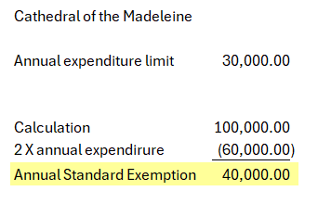
Exemption B: Annual standard exemption by expenditure limit index
Notes:
TM

Slide 9
Exemption C: Additional considerations
Building Projects, Maintenance and Repairs
New construction of buildings are exempt
Maintenance and repair projects are ordinary income
Renovation projects require application for exemption
Notes:
CG

Slide 10
Apply for exemption C
First, if a project is designated/ordered by the diocese, it will be automatically approved for full exemption.
Second, apply your Exemption B to your project. Keeping in mind, Exemption B: “Parishes, Missions, and Stations that are significantly subsidized by the Diocese are fully exempt for property improvements and repairs.”
Third, consider applying for a Capital Fund Drive that could possibly help exempt additional income to the project. Capital Fund Drives demonstrate that you are saving up to pay cash for your project.
Finally, if time is a factor and you need to start your project before you have the cash, then consider a D&L loan. See Unrestricted Gifts (below) for payments on D&L loans.
Capital Fund Drive’s must be approved in advance by Vicar General

Slide 11
Gifts
Restricted Gifts
Solicited restricted gifts are exempt only when applied to an exempt category. When a gift is restricted and non-exempt, the parish is responsible for paying the assessment on the gift. Exemption is about where the money will be allocated and spent, not because it is “restricted.”
Unrestricted Gifts
Unrestricted gifts are normally ordinary income. An unrestricted gift becomes exempt when applied to either a D&L loan, or pre-approved exempt Capital Fund Drive
Notes:
CG

Slide 12
Approvals
All applications for extraordinary exemption are to be submitted to the Vicar General in writing, along with any necessary supporting documentation.
If approved, the pastor or parish administrator must identify the respective income that was approved when submitting financial statements to the Diocesan Finance Office at the end of each fiscal year.
***REQUIRED***
Submit your application before collecting income pertaining to your request.
Notes:
TM

Slide 13
Additional Notes
Funds are exempted or assessed in the year of receipt
Funds that are designated as exempt must be used for that purpose.
If funds are requested from exempt monies for a non-exempt purposes and the request does not break from donor intent – the requests will be assessed at that time. The assessment will be at that year’s current rate.
Catholic Foundation of Utah donations generally follow exemption rules. Funds are assessed on the way in - not on the way out (distributions, withdrawals, growth)
Notes:
CG

Slide 14
Reporting →

Slide 15
Deadline
Annual ordinary income is verified by the Finance office. Please submit in your annual end of year fiscal reporting to the Diocesan Finance Office by August 31st
Once received, the Diocesan Finance Office will review and summarize your parish’s ordinary income calculations and be provided to the Pastor. These calculations must be immediately reviewed by the Pastor and any dispute must be submitted by September 30th
Assessments will begin with the October statement
Notes:
TM

Slide 16
Year-End Reporting Requirements
Statement of Financial Position for June 30th
Statement of Activities for June 30th, to include new FY Budget
Attestation of Financial Accountability
Any Exemption B and Exemption C items that have been previously approved. Identification of all income that applies to these exemptions is required. It is the responsibility of the Pastor and Parish Finance Council to review all required reports and ensure their accuracy. Keep in mind that all approved exempt income qualifies only to the maximum cost of the project.
Internal Control Questionnaire
Segregation of Duties Spreadsheet
Starting Fiscal Year ending June 30, 2026 – Inventory/fixed asset listing (more on this to come)
Notes:
TM

Slide 17
Why Ordinary Income Calculation→

Slide 18
Purpose of Ordinary Income Calculation
Ordinary Income is used in the calculations of the following:
Parish Assessment
School Support Assessment
DDD Quota
Intermountain Catholic Quota
Used in Parish comparisons
Notes:
CG

Slide 19

Thank you!

