Slide 1
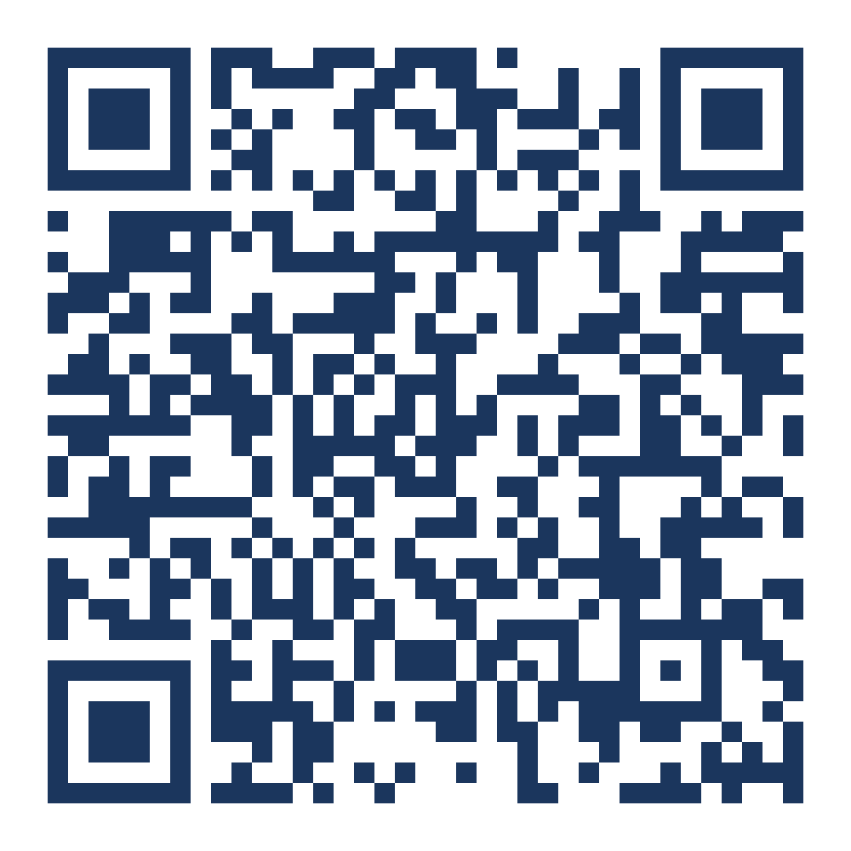

STEWARDSHIP PLEDGE APPEAL
With faith and gratitude, I make the following pledge to support the many ministries and daily operations of Saint Peter Parish beginning in January 2026:
My current gift is $
My new gift is $
If you prefer to complete your pledge online, scan here or visit website.
Weekly
Monthly
Annually
Weekly
Monthly
Annually
I would also like to make the one-time gift of $ for the immediate ministerial needs of the parish.
I want to make my gift through ParishSOFT. Please send me instructions to sign up.
Name(s)
I currently give online and will increase my gift in ParishSOFT
Street Address
I want to give using electronic check from my bank. Please contact your bank.
City, State, Zip
I use/would like to use offertory envelopes.
Phone Number(s)
I want to explore making an IRA distribution, a gift of stock, or remembering the parish in my estate planning. Please contact me.
Email(s)
Use the enclosed envelope to return your pledge card at Mass on December 6 or 7 or by mailing in.
I am new to the parish. Please contact me about registering.
TIME & TALENT PLEDGE
PRAYER INTENTIONS
I would like to share my time and talent through the ministry of this church in the following ways.
YOUR PARISH IS HERE FOR YOU. HOW CAN WE PRAY FOR YOU?
All prayer intentions will be prayed for collectively throughout 2026.
Organize records
Help in the school/office
Greet/usher
Children’s liturgy or PSR
Tend to landscaping
Mass set-up/decorating
Funeral luncheons
Volunteer for outreach meals
Paint
Host donut Sunday
Clean
Light construction work
Music/choir
Church decorating
Other, please specify:
I am available:
I would like to speak to a priest or a member of the parish staff. The best time to reach me is:
Mon
Tue
Wed
Thu
Fri
Sat
Day
Evening
Day / Time

