Slide 1

Training Guide
School Safety
COVID-19 Pandemic
Office of Catholic Education

Slide 2
1. What we know about COVID-19?
The Facts

Slide 3
COVID-19
It is a virus that has spread throughout the world causing illness ranging from no symptoms to mild or severe illness and even death.
The virus is spread through close contact with an infected person (aerosol or physical) or by touching an infected surface.
The virus is found in respiratory droplets, so when a person coughs or sneezes, the virus is easily spread. The highest concentration is found within 6 ft, but the virus can travel up to 20 ft!
A person becomes infected when the virus enters the body via the eyes, nose, or mouth.

Slide 4
2. How can we protect each other?
Our Mission

Slide 5
General Safety
Maintain social distancing-Stay at least 6 ft apart.
Wear a mask covering your nose and mouth.
Wash your hands with soap for 20 seconds and water or use hand sanitizer with at least 60-70% alcohol (wait until hand sanitizer is completely dry before touching surfaces).
Avoid touching your face, mouth, nose with unsanitized hands.
Use a tissue if you must cough or sneeze and immediately throw the tissue into a trash.
Stay home when you’re sick to avoid infecting others and spreading the disease.
Keep frequently touched surfaces clean and sanitized.
Know the symptoms: Fever or chills, cough, shortness of breath, fatigue, muscle/body aches, headache, loss of taste and/or smell, sore throat, congestion/runny nose, nausea/vomiting/diarrhea.

Slide 6
Proper Techniques Ctrl/lClick on each link below
Do's and Dont's of Wearing a Mask and Gloves
General
Safety
Hand Washing Guidelines

Slide 7
3. What if someone at school
contracts the virus?
School Response

Slide 8
What to do...
When coming to school, children and adults will be screened and their temperatures will be taken upon entering the campus. Adults will fill out a questionnaire.
If a child or adult has a temperature above 100.4, he or she will be asked to sit down for 15-20 minutes. If the temperature remains above 100.4 after they rest, they will taken to an isolated area and their parents (adults will be sent home) will be called to pick them up.
School officials will recommend that they be taken immediately for COVID-19 testing.
If a student or adult becomes ill during the day, the same procedure will be followed.
If a parent or guardian notifies the school that a student or someone the student had close contact with tested positive for COVID-19….
The administration will immediately notify local health officials to determine the best course of action for the school.
The administration will notify the OCE and the OCE will determine what communication will be sent out to the school community.
Working with your local agency, the school will determine the next steps to stop the spread of the disease.

Slide 9
4. How do we protect
confidentiality?
Proper Reporting

Slide 10
Confidentiality
Never
Share information or hearsay about students with other parents, staff members, students, etc.
Administrative Handbook-Policy 4620, 8153
Never
Share information or hearsay about colleagues with other.
Administrative Handbook-Policy 3510, 8153
Always
Refer questions about other students and staff members to your administrator.
Administrative Policy-3510, 4410

Slide 11
What if we have to shut down again?
Continued Preparedness

Slide 12
Have a Plan in Place
Online Learning
Be sure to survey parents to determine the families’ online learning capabilities.
Decide as a faculty what platforms sites, apps you will use.
Keep learning focused-less is more, consistency is helpful to parents.
Have a schedule set for face to face sessions.
Practice using all platforms and apps with students so that they know how to use them in the event of a return to online learning.
Parent Communication
Keep parents abreast of any changes.
If there is a return to online learning, have back-to-online learning nights with parents so that they understand how these lessons will work.
Communicate students’ progress to them frequently-email, notes, phone calls.
Listen to their questions, validate their concerns, explain your reasons.
Supplies/Materials/Resources
Plan ahead of time to determine what materials students would need in case of a sudden closure.
Have a list of supplies students might need to work at home in addition to those supplied by the school. Be ready to assist families with these supplies in the case of a hardship.

Slide 13
Remember
Have a plan in place!
Communicate with parents frequently
1st
3rd
2nd
4th
Practice
Work together as a staff to share, collaborate, and pray!

Slide 14
Let’s review some concepts
Prevent the Spread of Virus
Wear a mask.
Maintain Social-Distancing.
Wash your hands and sanitize surfaces frequently.
Be Prepared
Have plans in place for a possible return to online learning.
Communicate
Maintain open lines of communication with your administration and parents.
Maintain Confidentiality
All communications about COVID-19, including information about sick adults or children will be handled through the administration.
Pray
We are not alone in this!
Know the Symptoms
Fever or chills, cough, shortness of breath, fatigue, muscle/body aches, headache, loss of taste and/or smell, sore throat, congestion/runny nose, nausea/vomiting/diarrhea

Slide 15
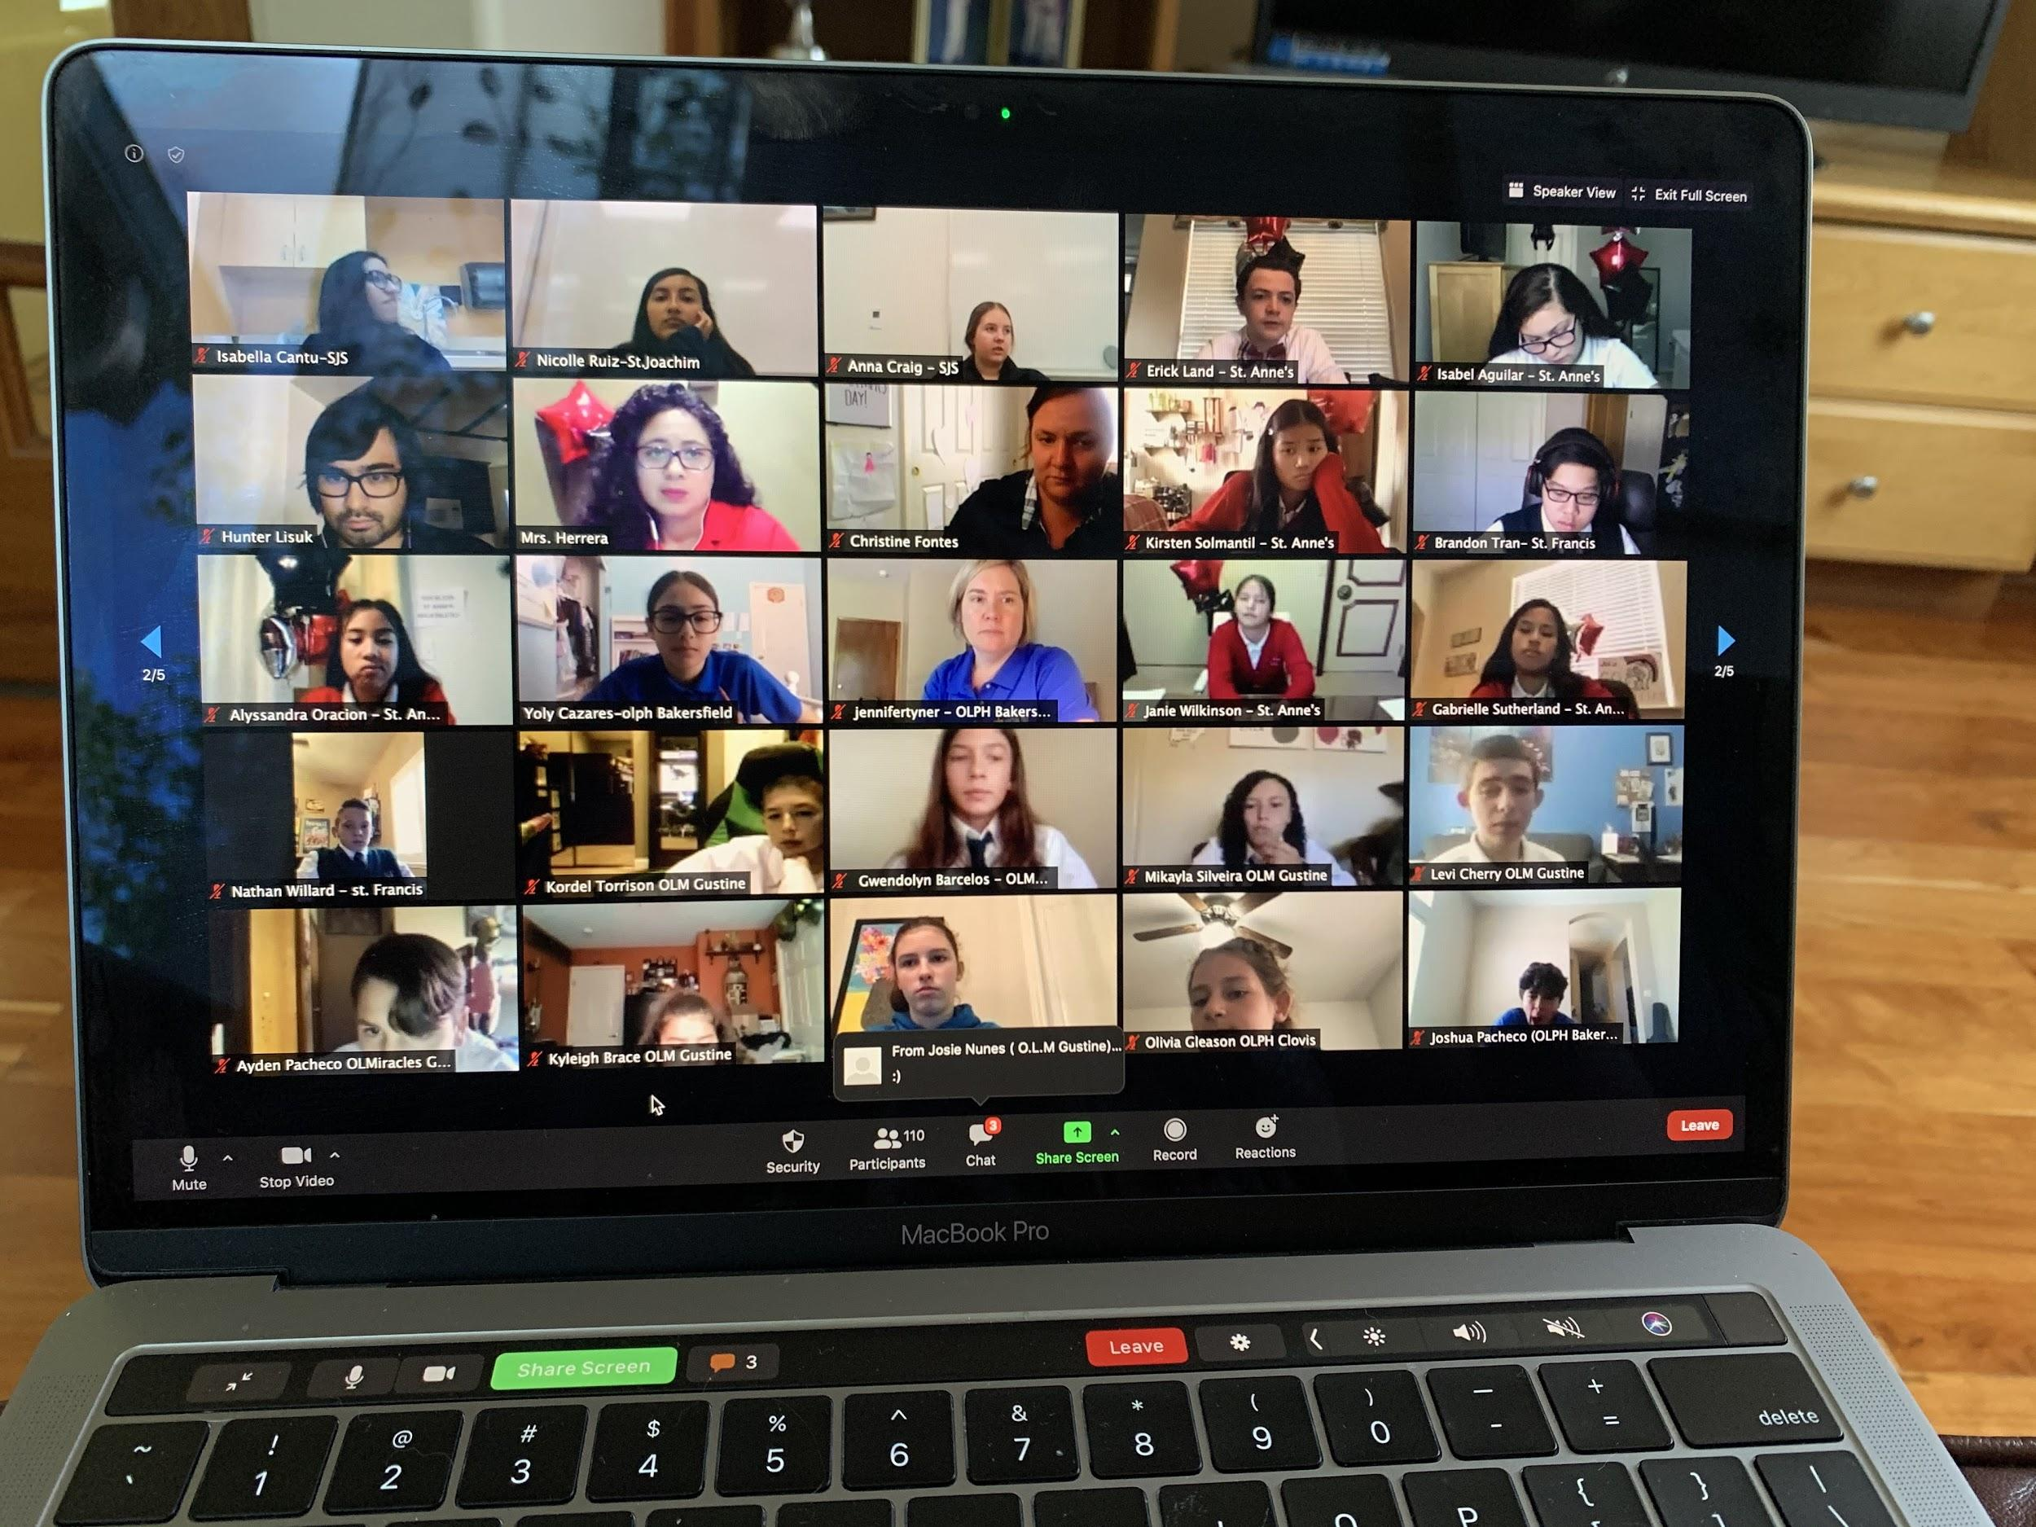
The OCE is here to help and support all of you during this challenging time!
Place your screenshot here

Slide 16
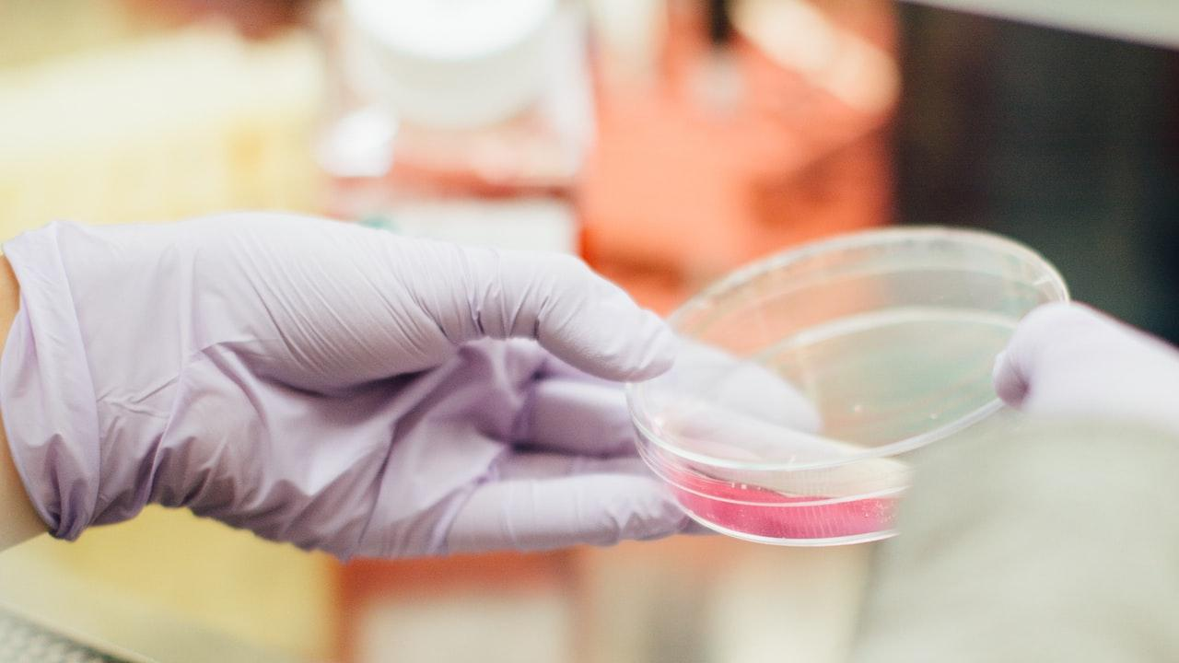
Please take a few minutes
to complete this short survey
https://forms.gle/2PScavkQRnv85G4G7

Slide 17

Thank You for Your Commitment to Catholic Education!

Slide 18
Credits
www.cdc.gov
www.studentprivacy.ed.gov

