Slide 1
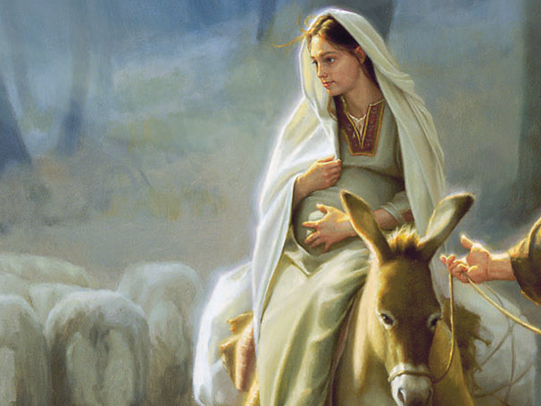

Slide 2
In the sixth month,
the angel Gabriel was sent from God
to a town of Galilee called Nazareth,
to a virgin betrothed to a man named Joseph,
of the house of David,
and the virgin’s name was Mary.

Slide 3
And coming to her, he said,
“Hail, favored one! The Lord is with you.”
But she was greatly troubled at what was said
and pondered what sort of greeting this might be.

Slide 4
Then the angel said to her,
“Do not be afraid, Mary,
for you have found favor with God.
Behold, you will conceive in your womb and bear a son, and you shall name him Jesus.
He will be great and will be called Son of the Most High, and the Lord God will give him
the throne of David his father,
and he will rule over the house of Jacob forever,
and of his kingdom there will be no end.”

Slide 5
But Mary said to the angel,
“How can this be, since I have no relations with a man?”
And the angel said to her in reply,
“The holy Spirit will come upon you,
and the power of the Most High will overshadow you. Therefore the child to be born will be called holy,
the Son of God.”

Slide 6
And behold, Elizabeth, your relative,
has also conceived a son in her old age,
and this is the sixth month for her
who was called barren
for nothing will be impossible for God.”

Slide 7
Mary said,
“Behold, I am the handmaid of the Lord.
May it be done to me according to your word.”
Then the angel departed from her.

Slide 8
Mary said,
“Behold, I am the handmaid of the Lord.
May it be done to me according to your word.”
Then the angel departed from her.

Slide 9
Now this is how the birth of Jesus Christ came about. When his mother Mary was betrothed to Joseph,
but before they lived together,
she was found with child through the holy Spirit.

Slide 10
Joseph her husband, since he was a righteous man,
yet unwilling to expose her to shame,
decided to divorce her quietly.

Slide 11
Such was his intention when, behold,
the angel of the Lord
appeared to him in a dream and said,
“Joseph, son of David,
do not be afraid to take Mary your wife into your home. For it is through the holy Spirit
that this child has been conceived in her.
She will bear a son and you are to name him Jesus, because he will save his people from their sins.”

Slide 12
All this took place to fulfill what the Lord had said through the prophet:
“Behold, the virgin shall be with child and bear a son,
and they shall name him Emmanuel,”
which means “God is with us.”
When Joseph awoke,
he did as the angel of the Lord had commanded him
and took his wife into his home.
He had no relations with her until she bore a son,
and he named him Jesus.

Slide 13
In those days a decree went out from Caesar Augustus
that the whole world should be enrolled.
This was the first enrollment,
when Quirinius was governor of Syria.

Slide 14
So all went to be enrolled, each to his own town.

Slide 15
And Joseph too went up from Galilee
from the town of Nazareth to Judea,
to the city of David that is called Bethlehem,
because he was of the house and family of David,
to be enrolled with Mary, his betrothed,
who was with child.

Slide 16
While they were there,
the time came for her to have her child
and she gave birth to her firstborn son.
She wrapped him in swaddling clothes
and laid him in a manger,
because there was no room for them in the inn.

